Slide 1

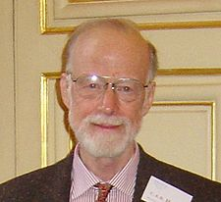

NETWORK VERIFICATION:
WHEN HOARE MEETS CERF
FOR PUBLIC CLOUDS, PRIVATE CLOUDS, ENTERPRISE NETWORKS, ISPs, . . .
TOOLS
Nikolaj Bjørner and George Varghese
Microsoft Research

Slide 2
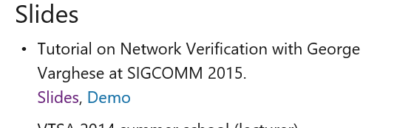
Goals of Tutorial
Motivate: why this may be an important inter-disciplinary field that can have real impact
Expose: SIGCOMM audience to verification ideas and terminology
Survey: describe and put in context existing work in network verification
Inspire: resources available, lessons for you to attempt network verification tasks
Slides and demo: http://research.microsoft.com/~nbjorner

Slide 3
Acknowledgments
Slides borrowed from many sources, including
  Marco Canini, Nate Foster, Brighten Godfrey, Peyman Kazemian, Dejan Kostic, Sharad Malik, Nick McKeown, Mooly Sagiv, Ragunathan, Jennifer Rexford
  Apologies for missing any work related to network verification, please email it to either of us for inclusion in later versions.

Slide 4
Why? Look at Networks today
P1
1001
SQL
10*→ P1
1* → P2
,P2
Drop SQL
P2
Load balancing
Access Control Lists (ACLs)
Multiple Protocols: 6000 RFCs (MPLS, GRE . . .)
Multiple Vendors: Broadcom, Arista, Cisco, . . .
Manual Configurations: Additional arcane programs kept working by “masters of complexity” (Shenker)
Crude tools: SNMP, NetFlow, TraceRoute, . . .
Notes:
But to understand why correct design is hard it is important to see even why just understanding ordinary working networks such as lurk behind your Caltech firewall is hard.

Slide 5
Simple questions hard to answer today
  Which packets from A can reach B?
  Is Group X provably isolated from Group Y?
  Is the network causing poor performance or the server? Are QoS settings to blame?
  Why is my backbone utilization poor?
  Is my load balancer distributing evenly?
  Where are there mysterious packet losses?
Notes:
As a result, even simple questions about a network are hard to answer.

Slide 6
Motivation to do better
Internal: > 1 hr customer visible outage/quarter (P. Patel)
  Azure: 30,000 cores down 3 hrs, L2/L3 configuration bug
  Bing: Entire data center, 8 hours, L2/L3 configuration bug
External: (2012 NANOG Network Operator Survey):
  35% > 25 tickets per month, > 1 hour to resolve
  Amazon, BigDaddy, United Failures (NetCore paper)
  Welsh: vast majority of Google “production failures” due to “bugs in configuration settings”
As we migrate to services ($100B public cloud market), network failure a debilitating cost.

Slide 7
Networks Tomorrow
Online services | → | latency, cost sensitive
Merchant Silicon | → | Build your own router
Rise of Data centers | → | Custom networks
Software defined Networks (SDNs) | → | Program custom design “routing”
P4 (next generation SDN) | → | redefine hardware forwarding at runtime
Opportunity to custom design networks to optimize goal.
Potential simplifications but hard to get right

Slide 8
Digital Hardware Design as Inspiration?
Specification
Specification
Functional Description (RTL)
Testbench & Vectors
Policy Language, Semantics
Testing
Functional Verification
Verification
Logical Synthesis
Synthesis
Static Timing
Performance verification?
Place & Route
Network Topology Design
Design Rule Checking (DRC)
Static checking (local checks)
Layout vs Schematic (LVS)
Wiring Checkers
Parasitic Extraction
Manufacture
& Validate
Dynamic checkers/ debuggers
Interference estimation?
Electronic Design Automation
(McKeown SIGCOMM 2012)
Network Design Automation
(NDA)?
Notes:
Inspired by Nick slide on left but we want to think through to a deeper extent what was a direction pointed to by Nick

Slide 9
This Tutorial’s Slice of NDA
Specification
Policy Language, Semantics
Testing
Verification
Synthesis
Won’t discuss debugging, very little of run-time verification.
Mostly interested in where formal methods can help
Notes:
Inspired by Nick slide on left but we want to think through to a deeper extent what was a direction pointed to by Nick

Slide 10
This Tutorial’s Slice of NDA
Specification
CTL, NoD, Klee Assert
Policy Language, Semantics
Testing
NetKAT, NetCore
NICE, ATPG
Verification
(e.g. reachabilty)
Data Plane: Anteater, VeriFlow, HSA, Atomic Predicates,
First-order + Transitive Closure, local checks
Control Plane: VeriCon, BatFish
Synthesis
(e.g. forwarding)
One big switch, VLAN, NetCore, NetKAT, FlowLog
Won’t discuss debugging, very little of run-time verification.
Mostly interested in where formal methods can help
Notes:
Inspired by Nick slide on left but we want to think through to a deeper extent what was a direction pointed to by Nick

Slide 11
Road Map
Introduction to Formal Methods
Data Plane Verification
  One counterexample
  All counterexamples
  Optimizations
  Adding Functionality
Data Plane Testing
Control Plane Verification
Control Plane Testing
Synthesis, Semantics

Slide 12
INTRODUCTION TO FORMAL METHODS FOR SIGCOMM TYPES
Introduction to Formal Methods
Data Plane Verification
Data Plane Testing
Control Plane Verification
Control Plane Testing
Synthesis, Semantics

Slide 13
Verification: Values and Obstacles
 | Hardware | Software | Networks
 | Chips | Devices (PC, phone) | Service
Bugs are: | Burned into silicone | Exploitable, workarounds | Latent, Exposed
Dealing with bugs: | Costly recalls | Online updates | Live site incidents
Obstacles to eradication: | Design Complexity | Code churn, legacy, false positives | Topology, configuration churn
Value proposition | Cut time to market | Safety/OS critical systems, Quality of code base | Meet SLA, Utilize bandwidth, Enable richer policies

Slide 14
Main Idea: Network as a Program
Model header as point in high dimensional space and all networking boxes as transformers of header space
3
1
Packet
Forwarding
2
Match
Action
+
0xx1..x1
+
11xx..0x
Send to port 3
Rewrite with 1xx011..x1
Send to port 2
Rewrite with 1x01xx..x1
ROUTER ABSTRACTED AS SET OF GUARDED COMMANDS . .
NETWORK BECOMES A PROGRAM →CAN USE PL METHODS
FOR VERIFICATION, TESTING, AND SYNTHESIS

Slide 15
Semantics Based Landscape (partial)
Hoare style proofs (1960s-1980s): axioms, inference rules, invariants : scales poorly, hard for humans
Model checking: search algorithmically over state space to check P. e.g., NuSMV, Impact, IC3
Proof Assistants: Humans help but system can check proofs. E.g., Coq, Isabelle.
Testing: Symbolic execution to maximize coverage and check property failures (e.g., Klee, SAGE)
Notes:
To put some perspective into what we do in Header Space Analysis, I need to give you some background on proof techniques used in computing systems, starting with programs and soon extended to hardware verification. M. Talupur: model checking will replace simulation for 50% of units

Slide 16
Ex: Approaches for Token Passing
Program: Receive & Send Token
Initially: s₀ token is at A
A
Inductive Invariant I: Exactly 1 token at
Node or Link (also correctness spec)
Token
Proof Assistant : Show each action maintains I
Algorithmic Search: Want to show for all states reachable from s₀ that
there is exactly 1 Token in every state.
Testing: Generate executions to exercise every action.

Slide 17
Pros and Cons
Model checking: SMV, nuSMV, Impact, IC3
  Pros: “push-button verification”;
  Cons: finite state systems (e.g., fixed network). Hard to scale (needs abstraction, equivalencing, compression)
Proof Assistants: Coq, Isabelle.
  Pros: Much harder work (must supply invariants)
  Cons: works for infinite state systems (e.g., all networks) and ideally needs methods to suggest invariants
Testing:
  Pros: Can uncover bugs in large code without models
  Cons: Incomplete (state space too large), imprecise
Notes:
To put some perspective into what we do in Header Space Analysis, I need to give you some background on proof techniques used in computing systems, starting with programs and soon extended to hardware verification. M. Talupur: model checking will replace simulation for 50% of units

Slide 18
To apply these techniques
Need to have:
Examples:
a modelling language for networks
a specification language for correctness
a system, data structures to encode program and data and a solver
state machines, Datalog, Propositional Logic
CTL, Modal Logic, Datalog,
NuSMV using BDDs for routers and packets

Slide 19



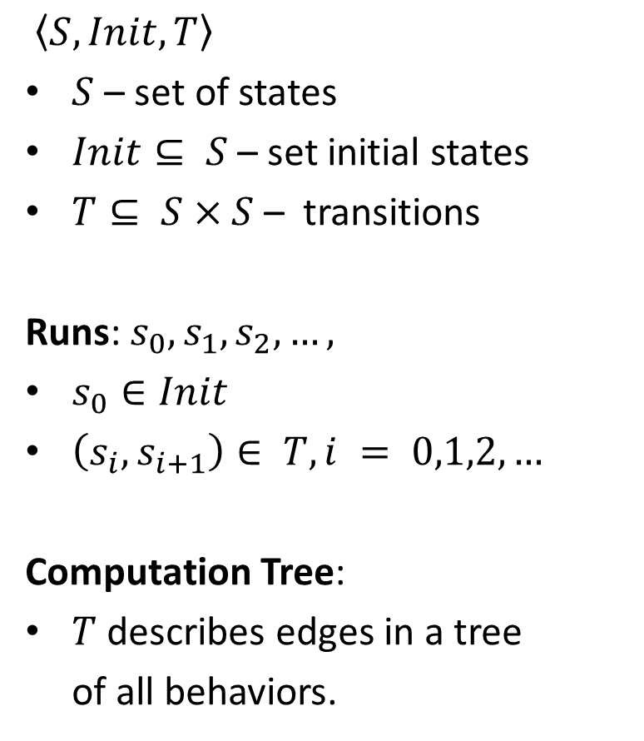












Reactive System/State Machine
$〈S, Init, T〉$
$S$ – set of states
$Init⊆ S$– set initial states
$T⊆ S×S$– transitions
Runs: $s_{0}, s_{1}, s_{2}, …,$
$s_{0}∈Init$
$\left(s_{i}, s_{i+1}\right)∈ T, i = 0,1,2, …$
Computation Tree:
$T$ describes edges in a tree
of all behaviors.
$$s_{3}$$
$$s_{2}$$
$$s_{0}$$
$$s_{1}$$
$$s_{0}$$
$$s_{1}$$
$$s_{2}$$
$$s_{0}$$
$$s_{1}$$
$$s_{3}$$
$$s_{2}$$
$$s_{2}$$
$$s_{0}$$
$$s_{1}$$
$$s_{3}$$

Slide 20

A Sample Network N1
R1
src:10* dst: 01*
R2
src:10* dst:***
A
B
src:1** dst:***
src:1** dst:***; dst[1] := 0
D
R3
src:*** dst:1**
Program: Packets matching source IP 101 or 100,
and destination IP 010 or 011 are forwarded from R1 to R2
States: Headers at Ports : (h, p)
Initially: All possible packets is at Port A
State Transitions: Router forwarding rules move packets between ports

Slide 21
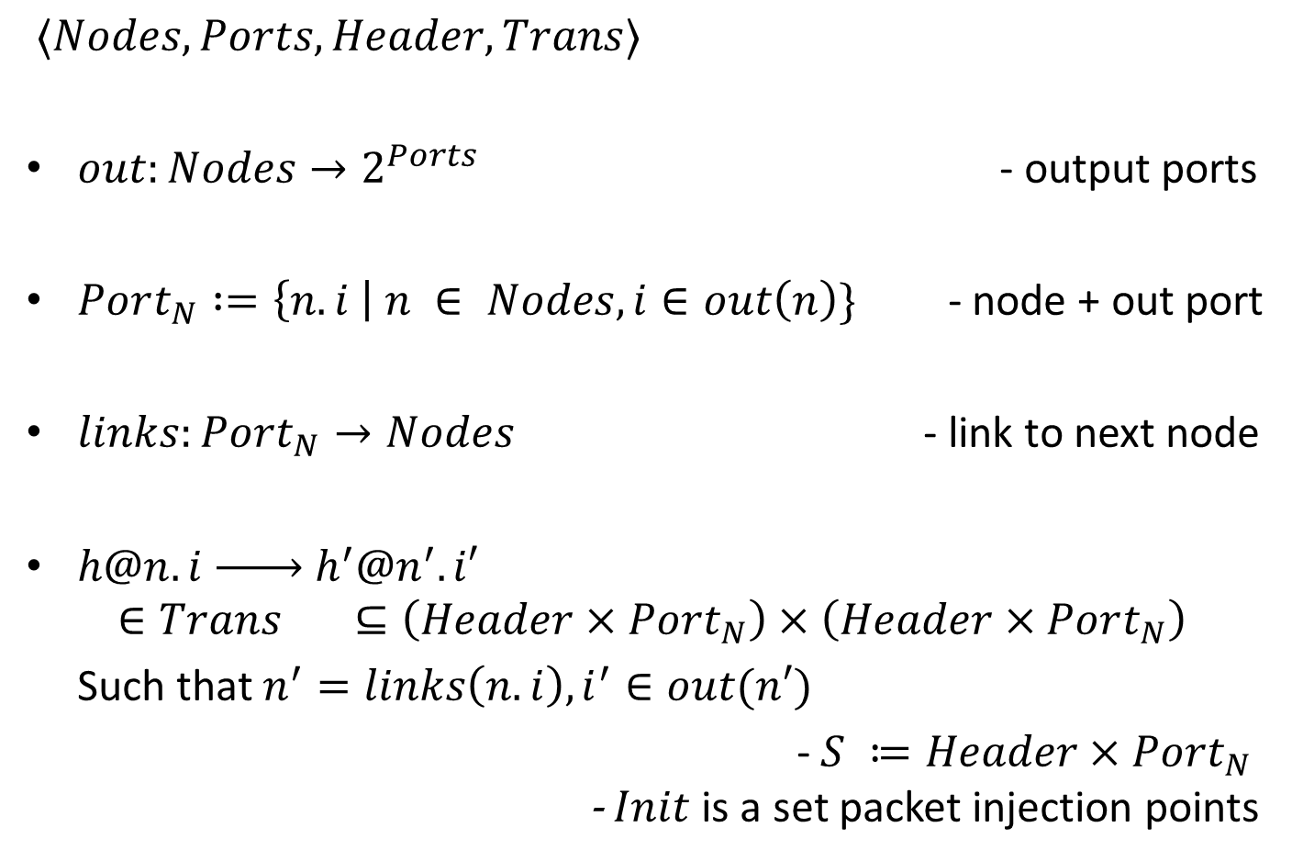
Networks as Reactive Systems
$〈Nodes, Ports, Header, Trans〉$
$out:Nodes→2^{Ports}$ - output ports
$Port_{N} :=\left\{n.i \right| n ∈ Nodes, i∈out\left(n\right)\}$ - node + out port
$links:Port_{N}→Nodes$ - link to next node
$h@n.i \underset{→}{ } h^{′}@n^{′}.i′$
$∈Trans ⊆\left(Header×Port_{N}\right)×\left(Header×Port_{N}\right)$
Such that $n^{′}=links\left(n.i\right), i^{′}∈out(n′)$
- $S ≔Header×Port_{N}$
- $Init$ is a set packet injection points

Slide 22
CTL Specifications
A for all branches, E for some branch.
F if one some state in branch, G for all states in branch
x
E F z
A F y
x
E G x
x,y
x, y, z
y
Example: Al-Sharer 2010: VoIP phones cannot communicate with laptop
$$src = A∧VoIP\left(A\right)∧dst = B∧ Laptop\left(B\right)→¬ EF (src = A∧ dst = B)$$

Slide 23
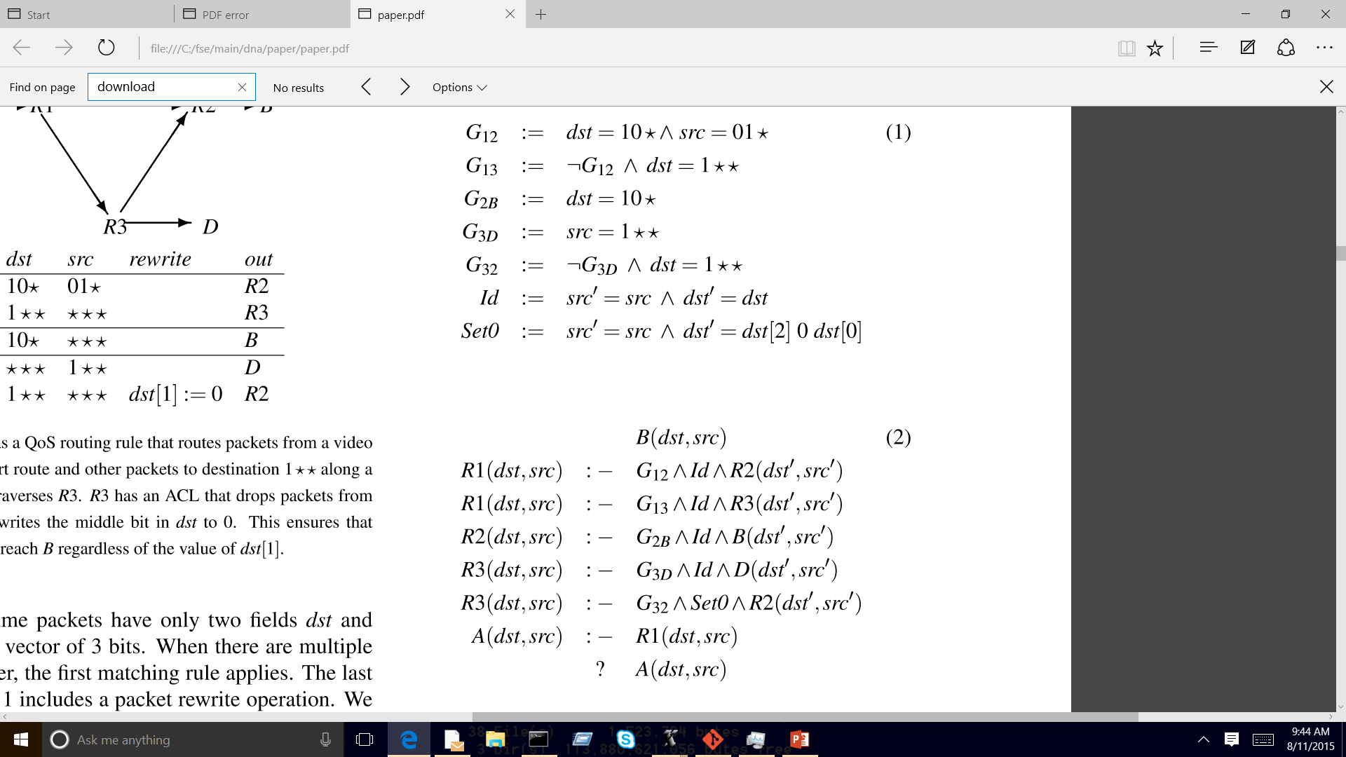
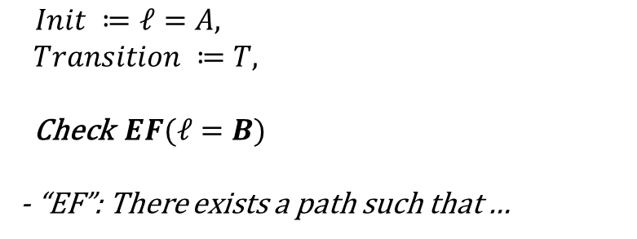
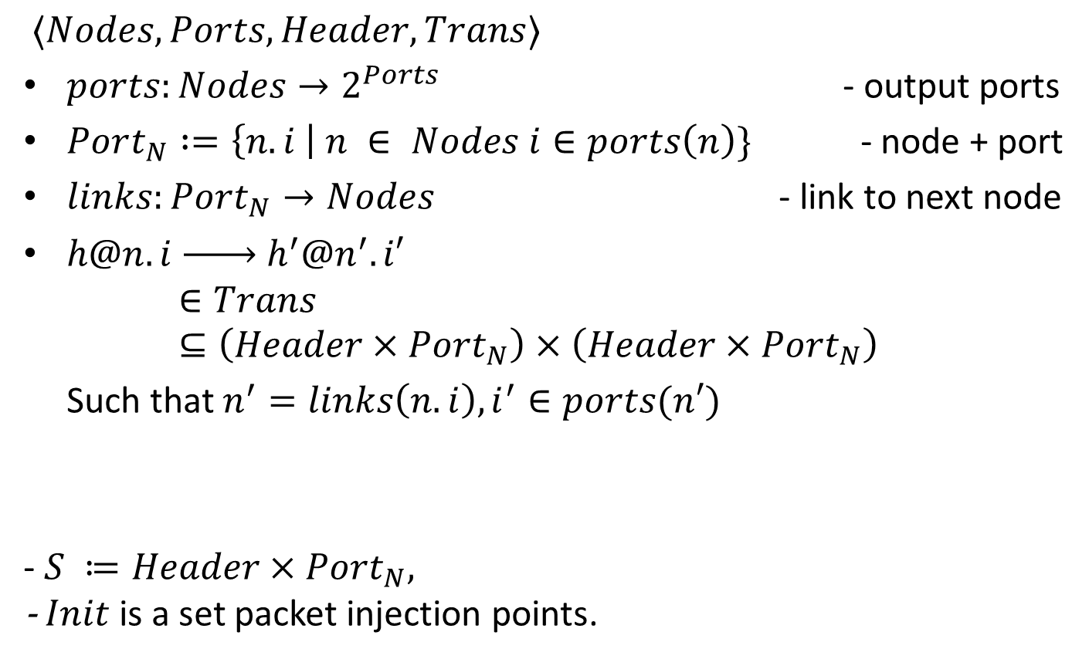
Model Checking Encoding of N1
10* 01*
10* ***
A
B
1** ***
1** *** dst[1] := 0
D
*** 1**
Which packets can reach B from A?
$Init ≔ℓ=A,$
$Transition ≔T,$
Check $EF(ℓ=B)$
- “EF”: There exists a path such that …
$$T\left(src,dst,src^{′},dst^{′}, ℓ,ℓ′\right)≔$$
$∨{ℓ=R1∧G}_{12}∧Id∧ℓ^{′}=R2$
$∨{ℓ=R1∧G}_{13}∧Id∧ℓ^{′}=R3$
$∨ℓ=R3∧G_{3D}∧Id∧ℓ^{′}=D$
$∨ℓ=R3∧G_{32}∧Set0∧ℓ^{′}=R2$
$∨ℓ=R2∧G_{2B}∧Id∧ℓ^{′}=B$

Slide 24
Model Checking Evolution
Explicit Model Checking: Works for protocols, doesn’t scale to many state bits.
Symbolic Model Checking: Works on sets of states encoded compactly with BDDs
Bounded Model Checking: Unrolls state machine k times and uses SAT solver to verify or find counterexample
Impact, IC3 (interpolants, inductive properties): Search for inductive invariants using SAT/SMT solvers

Slide 25
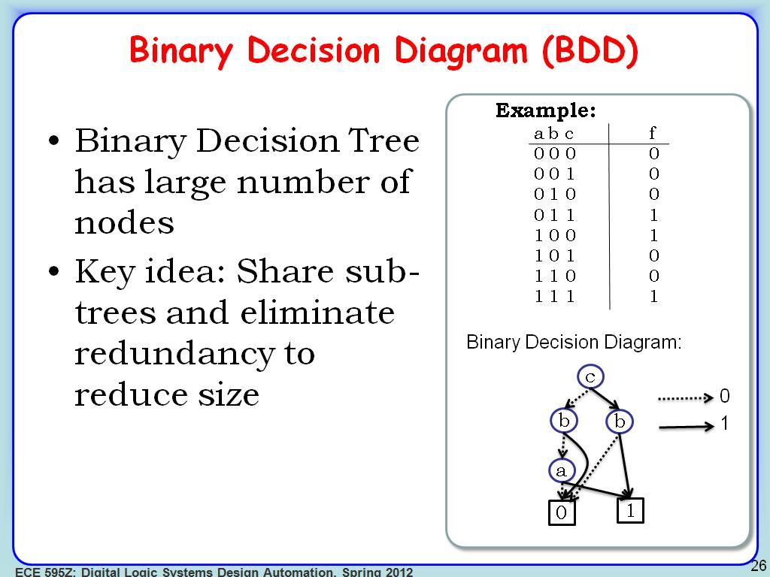
Binary Decision Diagrams
From A. Ragunathan, Purdue University

Slide 26
BDDs for Networking Folks
Compact encoding for Boolean Functions (beyond SMC)
Examples uses:
  [Al-Sharer 10] : model router forwarding state machine
  [Yang 13]: model sets of headers
Pros:
  Compositional: Unions, Intersections, Canonical form
  Works well with some model checkers (NuSMV)
  Code Available: e.g., BuDDy , CUDD Library
  Generalizations to non-Booleans available
Con:
  Sensitive to variable ordering

Slide 27
SAT as another useful subroutine
Used in BMC but of independent interest!
Propositional SAT: Variables, negation, and, or
Example: x₁ ∨ ¬x_{2,} Satisfiable with x₁ = TRUE
Augmented with constraints, functions: SMT
SMT is at least NP hard! But modern heuristic SMT solvers are very fast!
Can reduce network verification tasks to SAT
Many good solvers. Nikolaj promotes Z3!

Slide 28

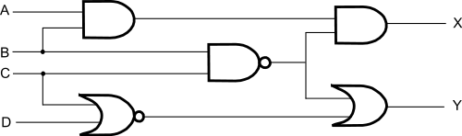

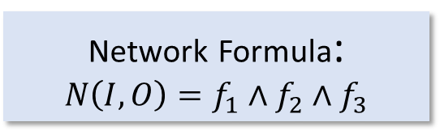








Data Plane as Logic Circuit → SAT [Malik]
Combinational Logic
$$I_{1}$$
$$f_{1}()$$
$$f_{3}()$$
$$O_{3}$$
$$O_{1}$$
$$I_{2}$$
$$f_{2}()$$
$$I_{3}$$
$$O_{2}$$
Network Formula:
$$N\left(I, O\right)=f_{1}∧f_{2}∧f_{3}$$
Model it as a combinational logic circuit?
  Outputs and signals are functions of only the present value of the inputs
If so can use SAT solvers and not (harder) state machine verifiers

Slide 29
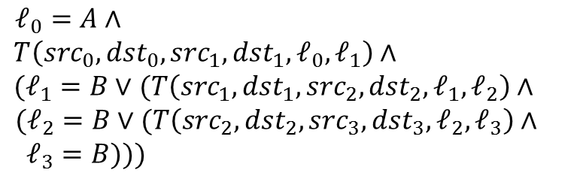
SAT Encoding of N1
10* 01*
10* ***
A
B
1** ***
1** *** dst[1] := 0
D
*** 1**
Which packets can reach B from A?
$ℓ_{0}=A∧$
$T\left(src_{0},dst_{0},src_{1},dst_{1},ℓ_{0},ℓ_{1}\right)∧$
$(ℓ_{1}=B∨$ $(T\left(src_{1},dst_{1},src_{2},dst_{2},ℓ_{1},ℓ_{2}\right)∧$
$(ℓ_{2}=B∨(T\left(src_{2},dst_{2},src_{3},dst_{3},ℓ_{2},ℓ_{3}\right)$ $∧$
$ℓ_{3}=B)))$
$$T\left(src,dst,src^{′},dst^{′}, ℓ,ℓ′\right)≔$$
$∨{ℓ=R1∧G}_{12}∧Id∧ℓ^{′}=R2$
$∨{ℓ=R1∧G}_{13}∧Id∧ℓ^{′}=R3$
$∨ℓ=R3∧G_{3D}∧Id∧ℓ^{′}=D$
$∨ℓ=R3∧G_{32}∧Set0∧ℓ^{′}=R2$
$∨ℓ=R2∧G_{2B}∧Id∧ℓ^{′}=B$

Slide 30
Encoding reachable states with Datalog
Declare facts as predicates: Parent (john, aju), Parent (aju, tim)
Declare inference rules: Head holds if body
  Ancestor (X, Y) :- parent (X, Y)
  Ancestor (X, Y) :- parent (X, Z), ancestor (Z, Y)
State queries ?- Ancestor (john, X)
System runs to a fixed point and returns all variables john is an ancestor of (aju, tim)
Useful if we can state analysis problem recursively and want all solutions not just one. Restrictions → eff. decision procedure

Slide 31
Datalog Encoding of N1
10* 01*
10* ***
A
B
1** ***
1** *** dst[1] := 0
D
*** 1**
Which packets can reach B from A?

Slide 32
Two Simple Demos
N1 encoded into Bounded Model Checking (SAT) and Datalog
using Z3’s Python API

Slide 33
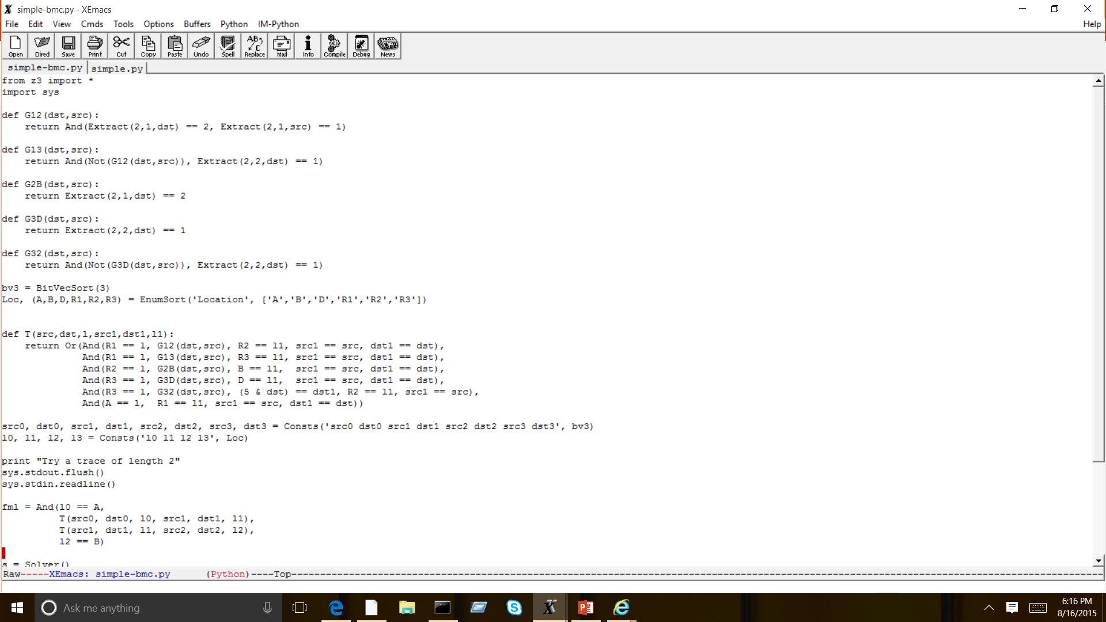
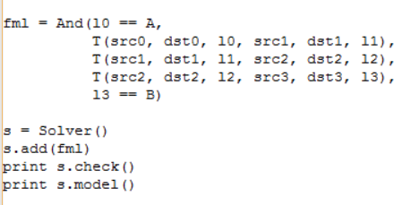
SAT Encoding of N1
10* 01*
10* ***
A
B
1** ***
1** *** dst[1] := 0
D
*** 1**
Which packets can reach B from A?
$ℓ_{0}=A∧$
$T\left(src_{0},dst_{0},src_{1},dst_{1},ℓ_{0},ℓ_{1}\right)∧$
$(ℓ_{1}=B∨$ $(T\left(src_{1},dst_{1},src_{2},dst_{2},ℓ_{1},ℓ_{2}\right)∧$
$(ℓ_{2}=B∨(T\left(src_{2},dst_{2},src_{3},dst_{3},ℓ_{2},ℓ_{3}\right)$ $∧$
$ℓ_{3}=B)))$
$$T\left(src,dst,src^{′},dst^{′}, ℓ,ℓ′\right)≔$$
$∨{ℓ=R1∧G}_{12}∧Id∧ℓ^{′}=R2$
$∨{ℓ=R1∧G}_{13}∧Id∧ℓ^{′}=R3$
$∨ℓ=R3∧G_{3D}∧Id∧ℓ^{′}=D$
$∨ℓ=R3∧G_{32}∧Set0∧ℓ^{′}=R2$
$∨ℓ=R2∧G_{2B}∧Id∧ℓ^{′}=B$

Slide 34
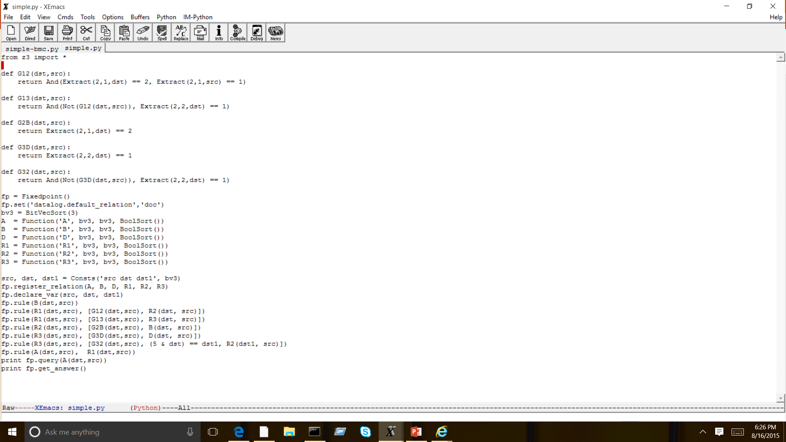
Datalog Encoding of N1
10* 01*
10* ***
A
B
1** ***
1** *** dst[1] := 0
D
*** 1**

Slide 35
First Order Logic (Flowlog ⇒ Alloy)
Flowlog [Nelson 2014] is a top down language for writing controller programs
Specifications in First Order Logic: ∀, ∃
  All packets on Port 1 will be NATed
  Packets from stolen laptop -> Police Notification
Uses Alloy to solve for counterexamples
Useful for higher level properties as in say controllers but
may have difficulty scaling → decision procedure for FOL over finite domains

Slide 36
General SW/HW Verification Toolbox and Networking Examples
Model Checking
Abstract Interpretation
(ex. Al-Shaer via CTL)
( ?)
Symbolic Execution
Runtime Verification
(ex. HSA)
( e.g., ATPG)
Certified Development
Program
Verification
( e.g., Vericon)
(ex. NetCore -> OF)
Model Based Testing
Model Based Development
( ?)
(ex. ATPG, NICE)

Slide 37
Beware the Black Box
Run time in seconds
 | Model Checker | SMT All Solutions | NoD | HSA
Stanford Unreach | 12.2 | 0.1 | 2.1 | 0.1
Stanford Reachable | 13.7 | 1121 | 5.9 | 0.9
Stanford Loop | 11.7 | 290 | 3.9 | 0.2
Cloud | Time out | Time out | 15.7 | -
Cloud 2 | 8.5 | Time out | 4.8 | -
Expressivity-run time tradeoff between hand-crafted code
and leveraging existing code

Slide 38
Data Plane versus Control Plane
1.8.*
Engineering
1.2.*
Accounting
1.8.*
1.8.*
1.8.*
1.8.*
Data Plane (DP): Collection of forwarding tables and logic that forward data packets
Control Plane (CP): Program that takes topology and failed links into account to build forwarding tables for data plane
Existing vs SDN: CP distributed in routers (OSPF, BGP) or centralized (SDN)

Slide 39
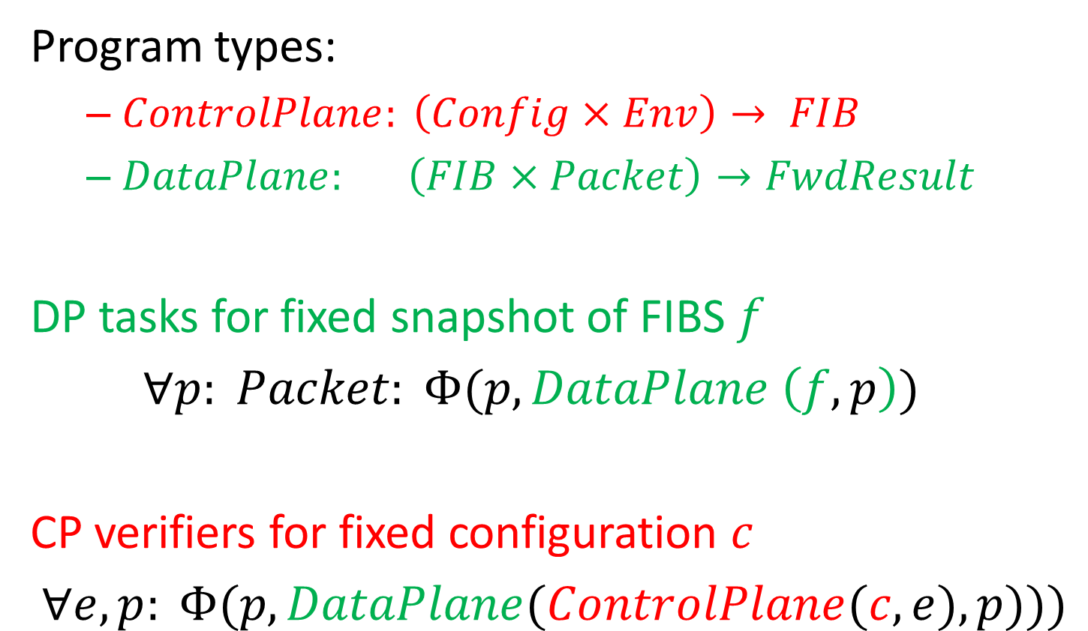
Verification Tasks [Fayazbakhsh 15]
Program types:
  $ControlPlane: \left(Config×Env\right)→ FIB$
  $DataPlane: \left(FIB×Packet\right)→FwdResult$
DP tasks for fixed snapshot of FIBS $f$
$∀p: Packet: Φ(p, DataPlane \left(f, p\right))$
CP verifiers for fixed configuration $c$
$∀e, p: Φ(p, DataPlane(ControlPlane(c, e), p)))$

Slide 40
Examples
Program types:
  Control Plane: RIP, OSPF, BGP
  Data Plane: IP, MPLS, OpenFlow
Data Plane:
  f: IP Fowarding or Openflow Forwarding tables
  Φ: reachability, no loops, waypoint traversal
Control Plane:
  e: Route Announcements, Link Failures
  Latent Bugs: Information flow, backup differences

Slide 41
Plan for tutorial
Data Plane Verification (majority): increasing functionality and scale
Data Plane Testing: Detour via Symbolic Testing
Control Plane Verification:
Control Plane Testing:
Synthesis: Design a Control Plane CP that will ∀p, e satisfy Φ by construction

Slide 42
DATA PLANE VERIFICATION: IF ONE COUNTEREXAMPLE SUFFICES
Introduction to Formal Methods
Data Plane Verification
One counterexample
All counterexamples
Optimizations
Adding Functionality
Data Plane Testing
Control Plane Verification
Control Plane Testing
Synthesis, Semantics

Slide 43
Historically: Encode networks using existing verification engines
[Xie05] Theoretical reachability algorithm
[AlShaer09]: Model checking approach
[Mai11]: SAT Based Anteater
If 1 counterexample + small networks, reusing existing tools works fine. Only clever encoding
SAT Based approach optimized by Malik et al. [Zhang13] whose formulation we describe

Slide 44
FlowChecker [Al-Shaer 10]
Al-Shaer group has been using model checking for firewalls, networks for 10 years!
Flowchecker [Al-Shaer 10] applies ideas to SDN.
Routers as BDDs, specs in CTL, and NuSVM to check end-to-end specs for SDN controllers.
Small scale experiments. May not scale

Slide 45
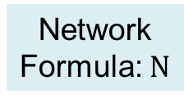
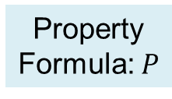

SAT Based Property Verification [Malik]
Property Formula
  Encode negation of the property: finding counter examples
    Example: Check the reachability from A to B
    Property Formula: conditions for non-reachability
Network
Formula: $N$
Satisfiable:
Property violated
Counterexample
Satisfiability
of $N∧P$
Property
Formula: $P$
Unsatisfiable:
Property holds

Slide 46
Adapting Modeling/Analysis
  Limit packet flow to a single path for a single packet through the network
Loop
Multicasting

Slide 47
Modeling/Analysis Challenge
  Even for a single packet entering a network, a link may see multiple packets
Fixed-point computation
IO-relation
Loop
Multicasting
  Switch output not a combinational function of its inputs
Need to store sets of values

Slide 48
Adapting Modeling/Analysis
  Limit packet flow to a single path for a single packet through the network
Loop
Loops implicitly blocked
  Captures only part of the network behavior
  What good is this?

Slide 49
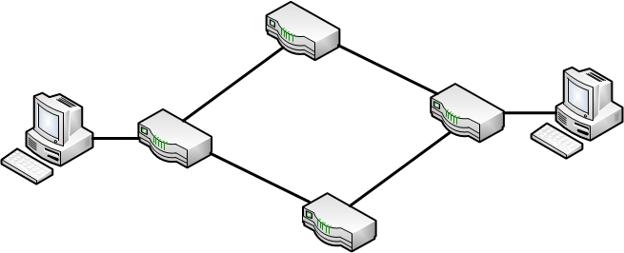
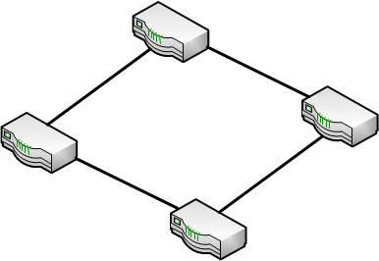
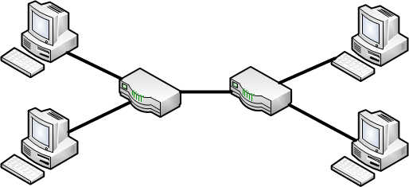
Goal: Counterexamples for Property Failures
Single Path Single Packet Counterexample
Suffices for
Functional Properties:
  Reachability checking
    Waypointing
    Blacklisting
Functional/Performance Properties:
  Forwarding loop
Security Properties:
  Slice isolation
    virtualization context
A
B
Packet
A
Slice 1
B
X
C
D
Slice 2

Slide 50
Adapting Modeling/Analysis
Non-deterministically select one of the paths
  choice variable
Solver explores all possibilities for counterexample
choice
Multicasting

Slide 51
Adapting Modeling/Analysis
Extra tag bit tracks looping
  Packets enter the network with tag 0
  Switch with two incoming packets:
    One of the two packets has looped
    Switch selects packet with tag 0 for forwarding
    The tag of output packet is 1
  Looping packet is blocked
  Minimally unroll to check for k-times-looping
Packet loops iff there exists a switch with two incoming packets
  Easy check for packet looping
Pkt from A: tag 1
Pkt A: tag 0
Pkt B: tag1
Avoid maintaining full path history

Slide 52
Zhang-Malik versus AntEater
Zhang-Malik more modular. Separates network and property formula
More efficient encoding for loops and reachability.
For example, loops are caught in Anteater by making two copies of every switch and checking if each switch can reach its copy.
Both: only 1 counterexample for reachability

Slide 53
DATA PLANE VERIFICATION: IF ALL COUNTEREXAMPLES ARE NEEDED
Introduction to Formal Methods
Data Plane Verification
One counterexample
All counterexamples
Optimizations
Adding Functionality
Data Plane Testing
Control Plane Verification
Control Plane Testing
Synthesis, Semantics

Slide 54
Why all examples?
Easier to see which rule caused counterexample.
Easier to do incremental verification
However, we have now gone from SAT to AllSAT which modern SAT solvers are not optimized for.
Fortunately, we can exploit the domain structure to do quite well.

Slide 55
Towards all Solutions: Header Space
[Kazemian 12]
Step 1 - Model a packet, based on its header bits, as a point in {0,1}^{L} space – the Header Space
Two abstractions: 1. All layers collapsed into a flat sequence of bits 2. Wildcards ignore header bits irrelevant to forwarding
Header
Data
01110011…1
0xxxx0101xxx
L
Notes:
* More time on this – field → bits
The first step is to model a packet based on its header as a point in {0,1}L space, which we call the header space. The idea here is that we look at packet headers a a flat sequence of 0s and 1s, without any protocol specific meaning for those bits. We don’t care whether the 32 bits corresponds to IP source or destination. That’s related to protocols. Then based on value of those bits, we map the packet to a point in the header space. Here we need to choose L large enough to contain all bits in the header. Similarly, a flow that has some wildcard bits in it, will corresponds to a region in the header space. Like Fourier transform in communication systems, the header space representation give us a simple and unified view of all packets.

Slide 56
Header Space Framework
Step 2 – Model all networking boxes as transformers of header space
1101..00
Transfer Function:
3
1
Packet
Forwarding
1110..00
2
Match
Action
+
0xx1..x1
+
11xx..0x
Send to port 3
Rewrite with 1xx011..x1
Send to port 2
Rewrite with 1x01xx..x1
Notes:
The second step is to model all networking boxes as transformer of header space. Here I am showing a simple packet forwarding element consisting of 3 ports, and I also show the header space corresponding to each port. We know that we can represent the forwarding functionality of this box by a set of rules. Each rule consists of a match which tell us which packets match on this rule and an action which tell us how the matching packets are sent to output. The match basically corresponds to a region in the input port header space and the action shows how that region is transformed to output. Similarly if we have more rules, we will have more match regions that is transformed to output header space….

Slide 57
Transfer Function Example
IPv4 Router – forwarding + TTL + MAC rewrite
  172.24.74.x Port1
  172.24.128.x Port2
  171.67.x.x Port3
1
2
3
(rw_mac(dec_ttl(h),next_mac) , 1) if dst_ip(h) = 172.24.74.x
T(h, p) =
(rw_mac(dec_ttl(h),next_mac) , 2) if dst_ip(h) = 172.24.128.x
(rw_mac(dec_ttl(h),next_mac) , 3) if dst_ip(h) = 171.67.x.x

Slide 58
Composition, Inversion
Theorem: Network behavior = composition of router transfer functions (Compositionality)
Theorem: given header h at destination p, we can invert to find (h’,s): headers sent at source s’ to produce (h,p) (Inversion)
R1
R2
R3
T₁(h, p)
Notes:
* Tell them that previously people had to log into boxes, understand different notion, from different protocols and different vendors.
By composing transfer functions, we can find the end to end behavior of networks and the faith of packets as they traverse in the network. Let’s look at one example. Consider this packet arriving at box R1. by applying the transfer function of R1 to the packet, we can see the packet reaches to R2. we then apply the transfer function of R2 to the result, and see the packet reaching R3. repeating the same process, we can see that applying the transfer functions sequentially to the input packet, which is equivalent to composing those transfer functions, will show the faith of the packet after going through the network.
Therefore, for packet between these two ports, we can model the forwarding behavior of the network by a black box, withT3T2T1 transfer function. Remember that without this mechanism, we had to log into every box and comprehend the overall behavior from different tables running different protocols and belonging to multiple vendors.

Slide 59
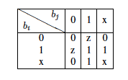
Header Space Algebra- Intersection
Bit by bit intersect using intersection table:
  Example:
  If result has any ‘z’, then intersection is empty:
  Example:
wildcard
empty

Slide 60

Computing Reachability
All Packets that A
can possibly send
All Packets that A can use
to communicate with B
All Packets that A can possibly
send to box 2 through box 1
A
T⁻¹₁
Box 1
Box 2
T⁻¹₂
T₂(T₁(X,A))
T⁻¹₁
T₁(X,A)
T⁻¹₄
T₄(T₁(X,A))
All Packets that A can
possibly send to box 4
through box 1
T⁻¹₃
Box 4
Box 3
B
T⁻¹₃
T₃(T₂(T₁(X,A)) U T₃(T₄(T₁(X,A))
Notes:
The first problem we want to look at, is finding reachability between two hosts in the network. We want to find out whether A can talk to B and if so, what are all packet header that will reach B.
To do that, we start by injecting test packet with wildcard in all bit positions into this simulated network. An all-x test packet is a packet whose bits are all wildcarded, and it represent the set of all possible packet headers that A can generate.
I want to emphasize that we don’t actually send any packet in the actual network, we get a complete snapshot of network and generate transfer function for each box in the network and use it for our analysis.
We apply the all-x packet to the transfer function of box 1, and gets some header space regions passed through the box, so we get the headers at the output of box1. we then apply the result to second transfer function – get the output header space after 2 hops, and finally to the 3rd transfer function giving us the ultimate results….

Slide 61
Reachability via ternary simulation
  Worked terribly till we introduced compression via difference of cubes: ∪ w_{i} − ∪ w_{j}.
  And many optimizations: lazy evaluation (400x), dead space elimination → 10,000x speedup
  We found difference of cubes worked better and faster than BDDs but jury is still out
  Difference of cubes seems to work because router “formulae” have 1 level of negation
  R1: 100*→ P1, R2: 1* → P2, becomes . . .
  Generalizes to path predicates, secure slicing . . .
STRUCTURE IN DOMAIN: LIMITED NEGATION, SMALL SET OF FORWARDING
EQUIVALENCE CLASSES, LIMITED REWRITES, NO LOOPS, SMALL DIAMETER
Notes:
… Now if we want to see if the returned header space region will loop in the next round or not, we should apply the inverse of transfer function to trace the returned header space back to its origin and find out what part of the original all-x test packet could generate the loop. We call this the original header space and the blue region, the returned header space. The idea here is that, from all packet headers, only this orange region can generate loop, and it will come back to injection port in the form of this blue region.

Slide 62

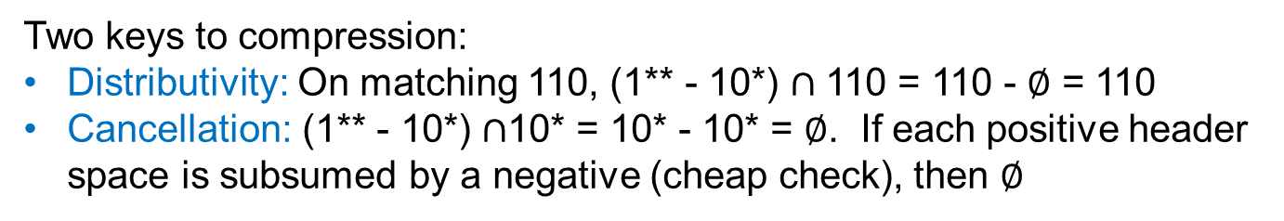
Run Time Compression via Difference of Cubes
10*
1**
$$∅$$
1** - 10*
10*
110*
110
Two keys to compression:
Distributivity: On matching 110, (1** - 10*) $∩$110 = 110 - $∅$ = 110
Cancellation: (1** - 10*) $∩$10* = 10* - 10* = $∅$. If each positive header space is subsumed by a negative (cheap check), then $∅$

Slide 63
Secure Slicing of Networks
Network slice of resources defined by
  A topology consisting of switches and ports.
  A set of predicates on packet headers.
Think Citibank & BOA sharing network.
Generalizes what are known as VLANs today
Notes:
* Slicing is a step to virtualization like bank of america and city want to share the same infrastructure. Like we do it for software. Once you do that, like VMs where we don’t want to interact, we want the same thing here- also there is security.
Next algorithm we discuss is checking isolation of slices, but first we should define what do we mean by a network slice.
A slice is a piece of network resources defined by a topology, consisting of a set of switches and ports the belong to that slice.
And a set of predicates on packet headers that is controlled by that slice. We could have potentially one predicate per switch or port.
As an example, if we want to create a VLAN slice on these switches, then the definition of slice will look like this – on each switch belonging to the slice, we have a header space corresponding to the slice predicate. We call this the header space definition of the slice.

Slide 64

Checking Isolation of Slices
How to check if two slices are isolated?
  Slice definitions don’t intersect.
  Packets don’t leak after forwarding.
Notes:
* The intellectula thing is thatw e don’t need to do it end to end – we do a one hop check.
Now let’s get back to the original question – how to check if two slices are isolated?
Let’s imagine in this example network, we have a red slice defined as shown. The first check, is to make sure that slice definitions don’t intersect. We can use intersection operation of HSA to this check. The red and blue slice pass this check.
The second check is to make sure that packets don’t leak after forwarding. To check for that, we apply the header space definition of each slice to the transfer function of network, to find the image of slice under network transformation, and that image should not intersect with any other slices, because the image shows us how packets in one slice will look like after one hop of forwarding. In this case, they do, and therefore the two slice are not isolated.

Slide 65
DATA PLANE VERIFICATION: OPTIMIZATIONS
Introduction to Formal Methods
Data Plane Verification
One counterexample
All counterexamples
Optimizations
Adding Functionality
Data Plane Testing
Control Plane Verification
Control Plane Testing
Synthesis, Semantics

Slide 66
Scaling to Large Networks
Exploit:
Incrementality [Kazemian 13]
  Only small parts of program change on rule change
Local Checking [Jayaraman 15]
  Suffices in structured data centers
Equivalence Classes [Khurshid 13, Yang 13]
  Number of header equivalence classes is small
Symmetries [Plotkin 15]
  Many rules and boxes are repeated (redundancy)

Slide 67


Exploiting incremantality: NetPlumber [Kazemian 13]
S
.
.
.
.
.
.
.
.
.
.
.
.
?
.
.
.
.
.
.
.
.
.
.
.
.
VERIFYING CHANGES BY SDN CONTROLLERS BEFORE THEY TAKE EFFECT

Slide 68
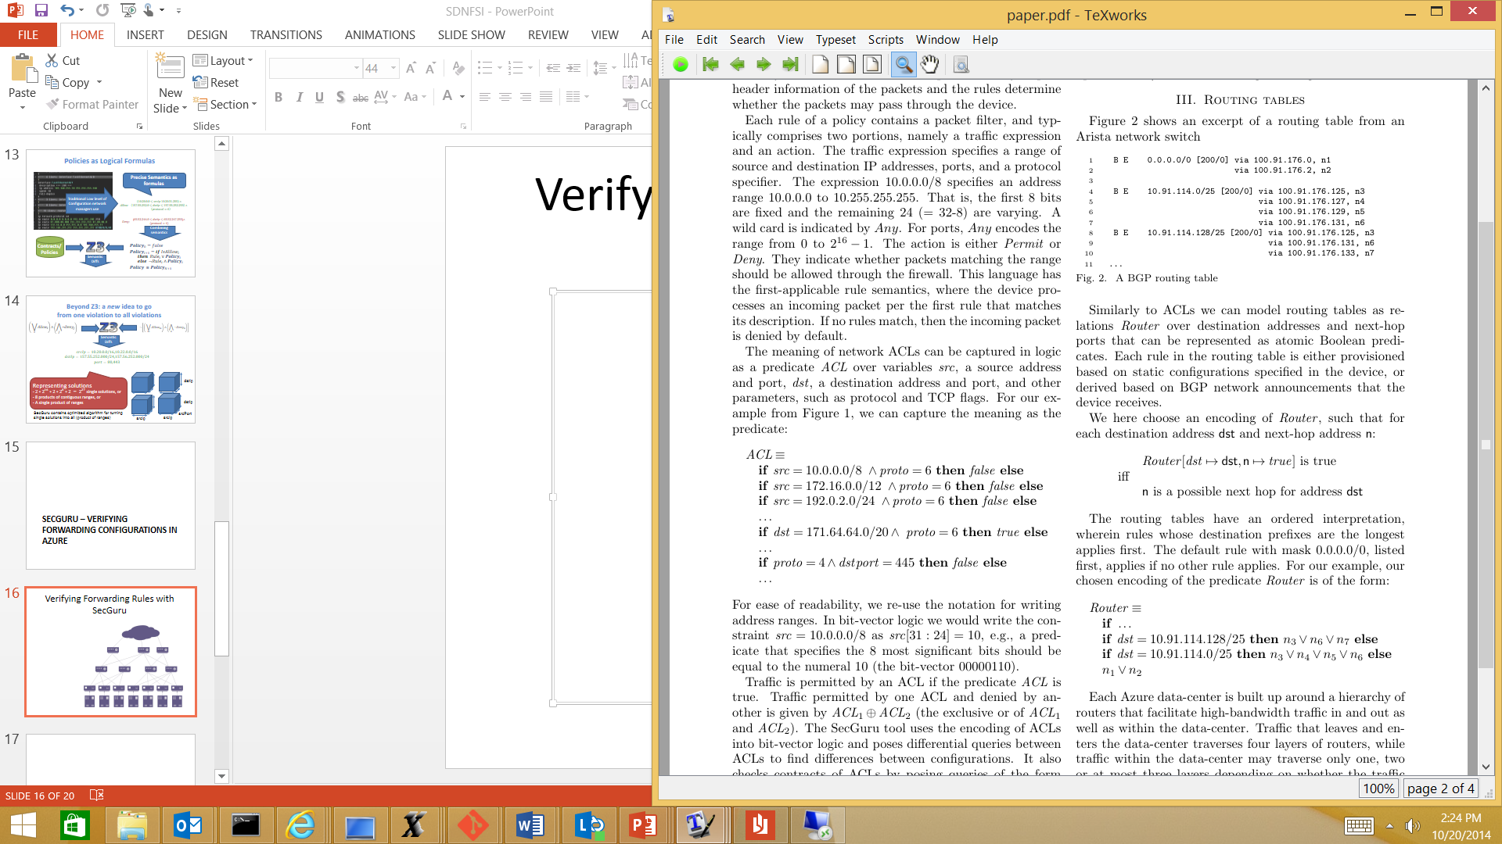
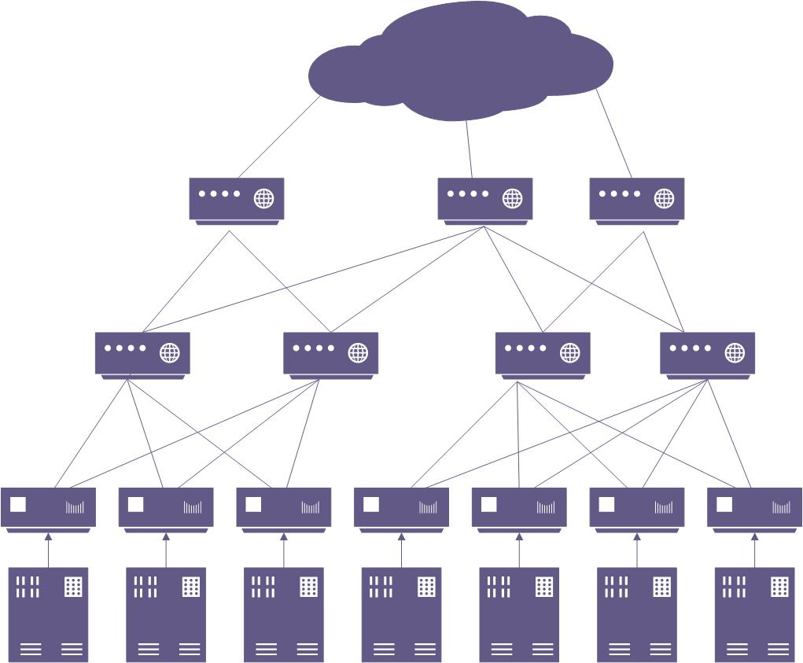
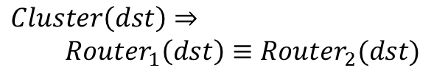
Verifying Local Forwarding Rules with just Z3 (No propagation)
Routes
[Jayaraman 15]
Local check only
Logic
Contract
$Cluster\left(dst\right)⇒$
$Router_{1}\left(dst\right)≡Router_{2}(dst)$

Slide 69
Scaling via Equivalence Classes
Verification complexity proportional to number of headers and rules.
But number of equivalent header classes should be small [Lakshman 98]
Two strategies to discover: Veriflow (heuristic) and Atomic Predicates (optimal)
Similarly, many redundant rules in backup routers (exploit symmetry)

Slide 70
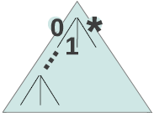

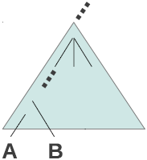
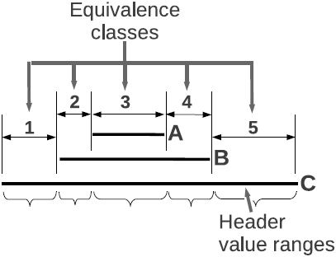

Computing Equivalence Classes in Veriflow [Khurshid 13]
(don’t care/wildcard)
(device, rule) pairs

Slide 71
Atomic Predicates Intuition [Yang 13]
From run-time compression via Difference of cubes to precomputed compression via A_{i}
Computes pairwise intersection of router and ACL guards to generate A_{i} using BDDs
Then rewrites forwarding rules using a simple set of integer labels for each
Symbolic propagation → propagating sets of integers. Fast. No rule matching, less space
Analog to MPLS versus IP forwarding!

Slide 72
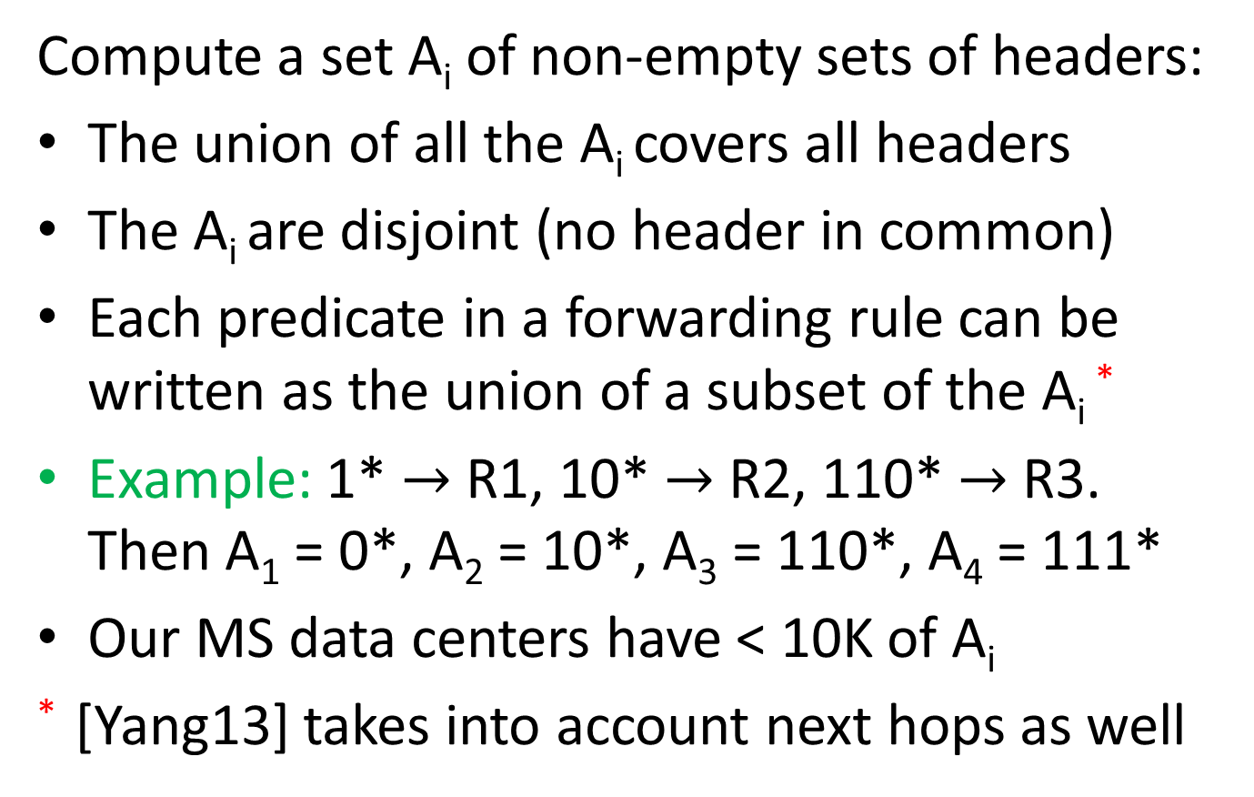
Atomic Predicates
Compute a set A_{i} of non-empty sets of headers:
The union of all the A_{i} covers all headers
The A_{i} are disjoint (no header in common)
Each predicate in a forwarding rule can be written as the union of a subset of the A_{i} *
Example: 1* $→$ R1, 10* $→$ R2, 110* $→$ R3.
Then A₁ = 0*, A₂ = 10*, A₃ = 110*, A₄ = 111*
Our MS data centers have < 10K of A_{i}
* [Yang13] takes into account next hops as well

Slide 73

Compile Time Compression via Atomic Predicates
10* {2}
1** {3,4}
$$∅$$
{3,4}
10*{2}
110 {3}
{3}
Keys to compression:
Labels not prefixes: Every guard and header set → set of integers
Propagation: On match, do intersection. No prefix matches!
Limitation: Original paper assumes no header rewrites by routers

Slide 74
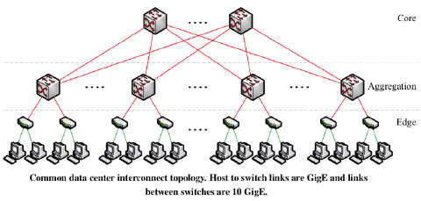
Exploiting Symmetry [Plotkin15]
Symmetry
Modularity
Can exploit regularities in rules and topology (not headers):
Symmetry Theorem: Can reduce fat tree to “thin tree” using a “simulation” and verify reachability cheaply in latter
Modularity Theorem: reuse of parts of switching network

Slide 75
DATA PLANE VERIFICATION: ADDING FUNCTIONALITY
Introduction to Formal Methods
Data Plane Verification
One counterexample
All counterexamples
Optimizations
Adding Functionality
Data Plane Testing
Control Plane Verification
Control Plane Testing
Synthesis, Semantics

Slide 76
Improving Functionality
Support for dynamic networks and imperfect specifications (NOD)
  HSA only static specifications, static routers
Support for Quantities (Sung09)
  HSA only verifies Boolean properties
Support for Stateful boxes
  HSA does not handle stateful boxes like NAT etc.

Slide 77
Dynamic Networks:
Network Optimized Datalog [Lopes15]
Classical model checking provides languages based on temporal logic to specify a variety of properties
  Header Space hard codes some properties
  Classical verification tools compute only 1 solution
  Datalog computes all but was inefficient. Had to redo Datalog engine
Datalog nearly as fast as HSA but much more expressive
Included in Z3. Being used to check Azure configurations

Slide 78
Quantitative Verification [Sung 09]
Extends verification to non Boolean quantities such as Class of Service
Especially important in ISPs: differential treatment of traffic, marking, queues, rates
Finds all class of service treatments for any flow F a user queries for.
Like reachability, accumulate QoS actions in path
Uses BDDs to model QoS ACLs. Finds bugs based on QoS “beliefs”

Slide 79
Recursive ruleset representation of a policy block
VOICE | INTERACTIVE-VIDEO | IP marking | output
permit | * | * | match
* | permit | * | match
* | * | 46 | match
* | * | * | no
REALTIME | CRITICAL-DATA | output
match | * | Q1
* | match | Q2
* | * | Q3
Q
class-map match-any REALTIME
match access-group VOICE
match access-group INTERACTIVE-VIDEO
match ip dscp 46
class-map match-all CRITICAL-DATA
!
policy-map WAN-EGRESS-POLICER-QUEUE
class REALTIME
priority percent 35
class CRITICAL-DATA
bandwidth percent 40
class class-default
bandwidth percent 25
!
interface Serial1/0 ! INTERFACE TO PE1
service-policy output WAN-EGRESS-POLICER-QUEUE
!
ip access-list extended VOICE
permit ip 192.168.1.0 0.0.0.255 any
permit ip any 192.168.1.0 0.0.0.255
ip access-list ...
VOICE
Q1
INTERACTIVE-VIDEO
Q2
Q3
*=Don’t care
srcIP | srcPort | destIP | destPort | proto | output
192.168.1.0/24 | * | * | * | * | permit
* | * | 192.168.1.0/24 | * | * | permit
* | * | * | * | * | deny

Slide 80
Example query
Mx, Px, Qx: marking, policing, queuing rules for class Cx
Tx: transmit the flow without taking any action
Cm: network management class
Data classes: C2, C3, and C4
Pm
Qm
mpls:4
Tx
Q_{(C2,Cm)}
M2
Q2
P2
mpls:4
To CE2
Tx
S
M3
Q3
Q_{(C3)}
P3
Tx
M4
Q4
mpls:3
Q_{(C4)}
P4
CE1
PE1
PE2
CE2
SF
Core

Slide 81

Stateful boxes as transducers [Sagiv 2015]
  $\text{MiddleBox} ≔$
  $\text{S}\text{: }\text{the} \text{set} \text{of} \text{states}$
  $\text{P}\text{: }\text{packets}$
  $\text{s}\text{0}\text{ ∈ }\text{S}\text{:} \text{the} \text{initial} \text{state}$
  $\text{: }\text{S}\text{ × }\text{P}\text{ → 2}\text{P}\text{: }\text{forwarding} \text{behavior}$
  $\text{: }\text{S}\text{ × }\text{P}\text{ → 2}\text{S}\text{:} \text{next} \text{state}$
Stateless: S = {s0}
Increasing: $s^{′}∈δ\left(s):f(s, p)⊆f(s′, p\right)$
Progressing: only $\text{}$ loops are self-loops
Arbitrary
Progressing
EXP-Space Complete
Increasing
co-NP Complete
P
Stateless
IDS
Cache
Load Balancer
Nat
Learning Switch
Firewall

Slide 82
Road Map
Introduction to Formal Methods
Data Plane Verification
Control Plane Verification
Data Plane Testing
Control Plane Testing
Synthesis, Semantics

Slide 83
CONTROL PLANE VERIFICATION
Introduction to Formal Methods
Data Plane Verification
Data Plane Testing
Control Plane Verification
Control Plane Testing
Synthesis, Semantics

Slide 84
Earlier Control Plane Work
BGP Loops Possible
  [Govindan, Griffin-Wilfong]
Sufficient Conditions for Avoiding Loops
  [Gao-Rexford]
Route redistribution can cause loops
  [Le 2008]
But based on human analysis and proofs. We now describe some tools for automated analysis

Slide 85
Static Checking BGP Configs:
RCC [Feamster 05]
Checks BGP configs for path visibility, validity
Example, route reflector configuration bugs
Route r (not visible to all)
Route s (visible to all)

Slide 86

CP Tester: BatFish [Fogel 15]
  Check configuration sanity before applying to the network
    Check safety in the presence of certain routing changes
    Check back-ups are properly implemented
    Abstractions: Datalog model, ignores race conditions
Config files
Parser
Control plane logic
Logic solver
Environment
Query solver
Data plane state
Provenance
Query

Slide 87
VeriCon [Ball 14]
Works for infinite state systems. All networks that meet network invariants
Works only for safety properties
Needs auxiliary invariants for proof
  but system uses weakest preconditions to supply hints

Slide 88
SDN Control Programs Proved
Program | Program and Property
Firewall | Correct forwarding for a basic firewall abstraction
MigFirewall | Correct forwarding for a firewall supporting migration of “safe” hosts
Learning | Topology learning for a simple learning switch
Resonance | Access control for host authentication in enterprises
Stratos (Simplified) | Forwarding traffic through a sequence of middleboxes
Notes:
* The first three are the basic application proposed for SDN, the later two are real and industry accepted applications.
* VeriCon is sometimes comparable to existing verification systems and in others faster
* VeriCon achieves significantly stronger guarantees as it proves the correctness on all possible topologies and network events.

Slide 89
DATA PLANE TESTING
Introduction to Formal Methods
Data Plane Verification
Data Plane Testing
Control Plane Verification
Control Plane Testing
Synthesis, Semantics

Slide 90
Symbolic Execution Methods
Want to push program to as many states as possible: maximize coverage
Random (Fuzz testing) useful but can do better.
Idea: Encode program as a decision tree. Try to cover all paths in decision tree

Slide 91
X = *
int BadAbsoluteValue(int x)
{
if (x < 0)
return – x
if (x == 1234)
return – x
return x
}
TRUE
X < 0?
Return - X
(Test cases:
x = -3, x = MIN_INT)
TRUE
FALSE
X = 1234
Return - X
Return X
(Test case: x = 1234)
(Test case: x = 500)
These three tests have 100% coverage in this case.
A constraint solver supplies concrete values for each path

Slide 92
Scaling Symbolic Execution
General idea: model each path and decision as a conjunction of constraints
Constraint solver: generate concrete values for each explored path that is tested
For large programs with loops, use heuristics to pick branches to maximize line coverage
Abstract OS calls like to File System and Disk. Provide mock framework to abstract OS calls
Some publicly available tools: Klee & Pex

Slide 93
Symbolic Execution
Run Test and Monitor
Execution Path
Path Condition
seed
Test
Inputs
Known
Paths
New input
Constraint System
SMT solver
Solve
Unexplored path
Pex (unlike Klee) starts with a concrete input as seed and then solves constraints to explore other paths.

Slide 94
ATPG vs Klee [Zheng 13]
Monitor the data plane by sending test packets.
  Maximum rule coverage (like Klee: rules→ lines)
  Minimize number of packets required (like Klee: packets→ test cases)
  Constraints on terminal ports and headers of test packets (unlike Klee)
Once error is detected, localize it (unlike Klee more like tomography)

Slide 95

Example
r_{A1}: dst_ip=10.0/16 → Port 0
r_{A2}: dst_ip=10.1/16 → Port 1
r_{A3}: dst_ip=10.2/16 → Port 2
Box A: Router
P_{A}
P_{B}
2
0
2
0
1
1
2
0
r_{B1}: dst_ip=10.2/16 → Port 2
r_{B2}: dst_ip=10.1/16 → Port 1
r_{B3}: dst_ip=10.0/16 → r_{B4}
r_{B4}: tcp=80 → Port 0
Box C: L2 Switch
1
Box B: Router+ACL
r_{C1}: in_port=1 → Port 0,2
r_{C2}: in_port=0,2 → Port 1
P_{C}

Slide 96

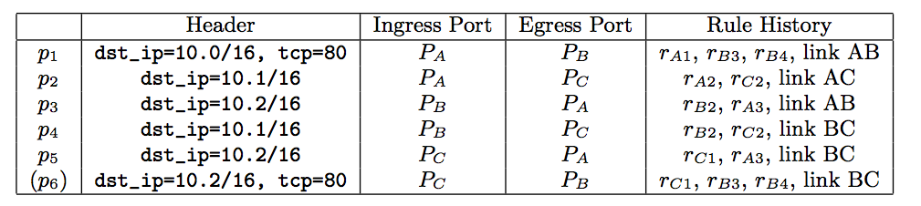
Step 1: Find all-pairs reachability
P_{A}
Box A
P_{B}
Box B
Box C
P_{C}

Slide 97
Step 2: Find minimum covers
P_{A}
Box A
P_{B}
Box B
Box C
P_{C}
Cover All Rules

Slide 98
Step 2: Find minimum covers
P_{A}
Box A
P_{B}
Box B
Box C
P_{C}
Cover All Links

Slide 99
Step 3: Localize fault
P_{A}
Box A
P_{B}
P1
P3
P2
P4
Box B
Box C
P_{C}
Cover All Links

Slide 100
How many packets suffice?
 | Stanford | Internet2
Total Packets | 621,402 | 3,037,335
Regular Packets | 3,871 | 35,462
Min-Set-Cover Reduction | 160x | 85x
Packets/Port (Avg) | 12.99 | 102.8
<1% Link Utilization
when testing 10 times per second!

Slide 101
Using ATPG for Performance Testing
Beyond correctness, ATPG can also be used for detecting and localizing performance problems.
Intuition: generalize results of a test from success/failure to performance (e.g. latency or bandwidth).
Track test packet latency/inferred bandwidth. Raise an error when changed significantly.

Slide 102
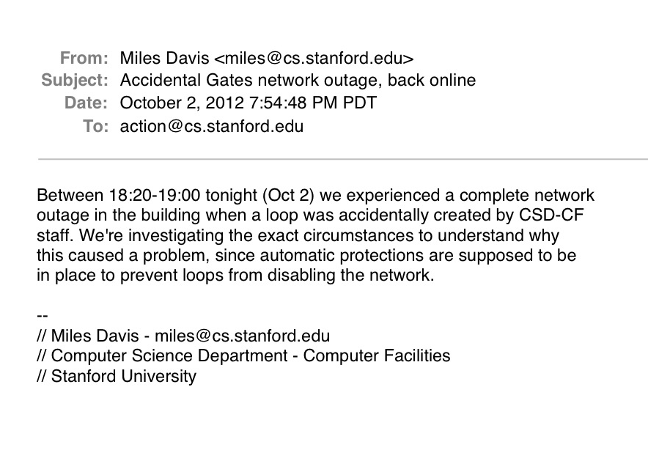
ATPG on Gates/Packard/CIS Network

Slide 103
Huh? Why is ATPG so simple
Because the size of the state space is bounded by network graph so simple set cover suffices
If, however, we have issues with scale (large networks) or imprecision, may need them
We also use ATPG less to find bugs in code than to do performance regression testing

Slide 104
Software Data Plane Verification
[Dobrescu 14]
Verifies actual code of Click software router.
Checks for new physical bugs (e.g., crash freedom, loops) using symbolic testing.
No path explosion: since router is a pipeline only compose potentially buggy path fragments
Use verified data structures (no pointers). Tradeoff verification ease with runtime cost.
Found bugs: e.g., IP option + fragmentation.

Slide 105
Avoiding Path explosion and pointer analysis
Trie
IP Forwarding
ACL
QoS
Safe Table
IP Forwarding
ACL
QoS
m³ paths
3 m + 2 paths

Slide 106
CONTROL PLANE TESTING
Introduction to Formal Methods
Data Plane Verification
Data Plane Testing
Control Plane Verification
Control Plane Testing
Synthesis, Semantics

Slide 107
Control Plane Testing
Ex 1: Can we uncover latent bugs in BGP configurations before they show in dataplane
Ex 2: Can we do the same for OpenFLow controller code?
We will find now that symbolic testing methods are essential unlike in ATPG

Slide 108
Ex 1: Catching an example BGP bug before it happens
Core
BGP peering
0.0.0.0/0
B
1.2.3.0/24
management network
C
A
E
1.2.3.4
D
1. A static rule was already present at B to provide access to the management network:
static route 1.2.3.0/24 0.0.0.0
2. B advertised this route to its BGP peers (including A):
network 1.2.3.0/24
3. A happened to contain a static route of the form:
static route 0.0.0.0/0 1.2.3.4 (Note: E did not have such a rule.)
4. A rejects the default route advertised by B :static default route takes precedence.
5. D does not receive default route from A and hence cannot forward via A when E fails

Slide 109
Symbolic Testing for BGP Backup Router Equivalence [Fayazbakhsh 15]
Core
management network
C
B
A
E
D
Query: Is there any RIBout_{B→neighbor} from B such that:
T_{A→D}(RIBout_{B→neighbor} ) ≠ T_{E→D}(RIBout_{B→neighbor} )
The answer to this will be a RIBin containing 0.0.0.0/0.

Slide 110
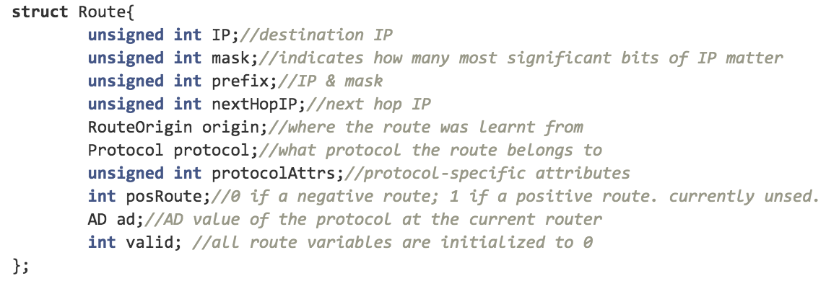
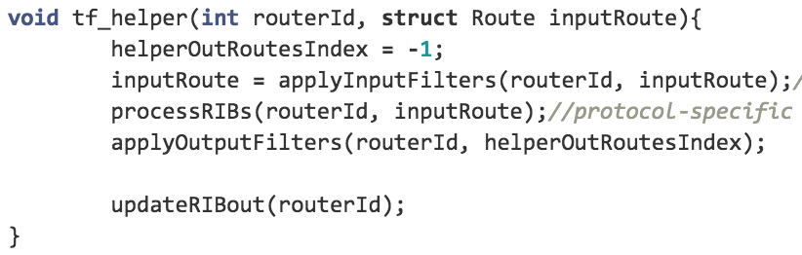
Snippets of router model in C
a route
router transfer function

Slide 111
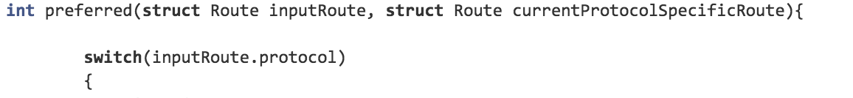
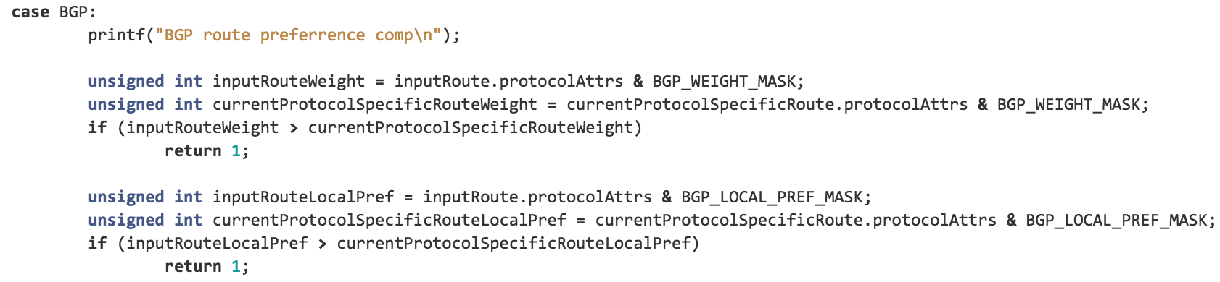
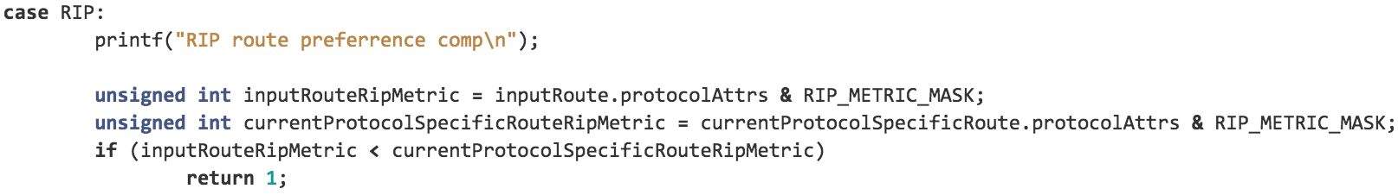
Unifying Routing (BGP, OSPF)
…
…
…
“Route” as the abstract data unit allows control plane unification across protocols.

Slide 112
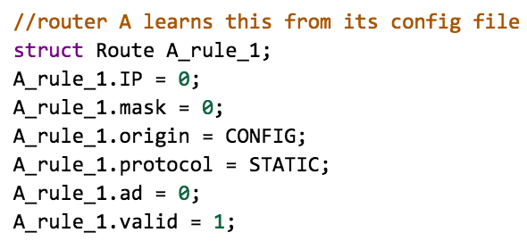


Setting up KLEE
static default route
on router A learned from config. file
invokes the abstract router model
a symbolic route
declaring the prefix field of the symbolic route as symbolic

Slide 113
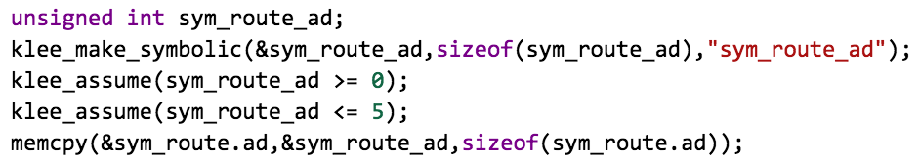
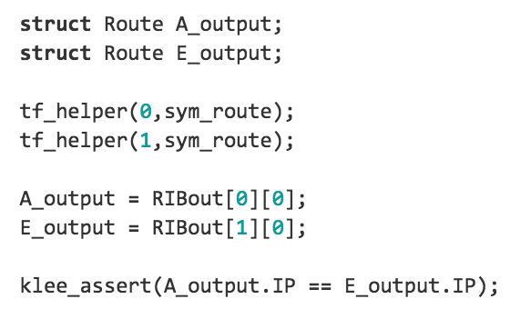
Using Klee to generate latent bug
An example scoping rule: Even though real routing protocols have many possible values for administrative distance (e.g., 256 value on Cisco), all we really need is distinct numerical values to differentiate protocols we use (6 protocols in our model)!
scoping the ad field of the symbolic
router Id
the symbolic route
verification query as a KLEE assertion (i.e., A and E have equivalent outputs)
Given the assertion (i.e., the klee_assert statement), the KLEE engine in this example will find a counter example. sym_route.prefix = 0

Slide 114
Ex 2. NICE: Testing Open Flow Controller Code [Canini 12]
Controller not Data Plane: Harder, many more state transitions, ATPG does not work
SDNs: allow more programmability but also more bugs
Have to model hosts as well as asynchrony (Spec lax about service times of OF messages)
Found 11 bugs in existing NOX applications

Slide 115
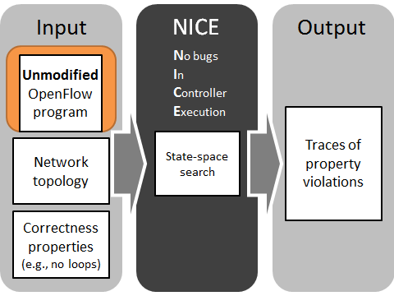
NICE: automated testing of OpenFlow Apps
http://code.google.com/p/nice-of/
Explores state-space efficiently
Tests unmodified NOX applications
Helps to specify correctness
Finds bugs in real applications
SDN: a new role for software tool chains
to make networks more dependable.
NICE is a step in this direction!

Slide 116
Combating Huge Space of Packets
pkt
is dst
broadcast?
Equivalence classes of packets:
Broadcast destination
Unknown unicast destination
Known unicast destination
yes
no
dst in
mactable?
Packet arrival handler
no
yes
Install rule and forward packet
Flood packet
Code itself reveals equivalence classes of packets

Slide 117
Code Analysis: Symbolic Execution (SE)
Symbolic packet
λ
1 path =
1 equivalence class of packets =
1 packet to inject
is λ.dst
broadcast?
Infeasible from initial state
λ .dst ∈ {Broadcast}
λ .dst ∉ {Broadcast}
yes
no
λ.dst in
mactable?
Packet arrival handler
no
λ .dst ∉ {Broadcast}
∧
λ .dst ∉ mactable
yes
λ .dst ∉ {Broadcast}
∧
λ .dst ∈ mactable
Flood packet
Install rule and forward packet

Slide 118
Combining SE with Model Checking
host
send(pkt A)
host
discover_packets
host
send(pkt B)
State
0
State
1
State
2
State
3
host
send(pkt C)
Controller state changes
State
4
discover_packets transition:
Controller state 1
Symbolic
execution
of packet_in
handler
New packets
Enable new transitions:
host / send(pkt B)
host / send(pkt C)

Slide 119
SYNTHESIS AND SEMANTICS
Introduction to Formal Methods
Data Plane Verification
Data Plane Testing
Control Plane Verification
Control Plane Testing
Synthesis, Semantics

Slide 120
Correct by Construction Synthesis
Synthesizing:
Virtual Networks [Rao 09]
Rules: Synthesize ACLs in routers based on network policy [Kang 13]
Tables across routers: NetCore to Featherweight Open Flow [Foster 13]
Tables within P4 router: [Jose15]
Single Firewall: [Zhang 13]

Slide 121
VLAN Synthesis [Rao 09]
Assign contiguous IPs to topologically separated hosts. Done manually today
Constrain broadcast costs
Limit routing inefficiencies
Sales VLAN
Payroll VLAN
Building2
Building1
Network
Core
Data
.
.
.
.
H1
H2
H3
H4

Slide 122
Synthesizing VLANs
Goals:
Determine host membership of each VLAN
For each VLAN, find the best choice of root bridge and designated router
Correctness Constraint: Hosts in distinct logical categories (e.g., sales must belong to different VLANs
Feasibility Constraint: Limit total # of VLANs
Optimization objectives:
Minimize maximum broadcast traffic cost across VLANs
Minimize data traffic costs given traffic matrix
Optimization Technique:
Quadratic Semi-assignment/Facility Location
Heuristics work better on Purdue Network

Slide 123









Rule Synthesis [Kang 13]
Topology
Endpoint policy E
Routing policy R
0.5k
...
1k
1k
0.5k
Automatic Rule Placement
Stay within capacity
Minimize total
...
...
...
...

Slide 124




Three step greedy heuristic
Step 1: Partition global rules by paths
P1
H2
H1
H3
Step 2: Divide rule space across paths
Say Upper Path P1 has R2, R3, R4, R5, R7 and lower path has say R1, R6
Estimate total rules needed by each path, intuition: allocate more total rules to P1
Allocate per router rule budget using LP

Slide 125



Step 3: For each path, Pick rectangle for every switch subject to rule budget
R7
R3
R2
R5
R4
R2, R3, R4’
R5 R3, R4’
R7
5
3
1

Slide 126
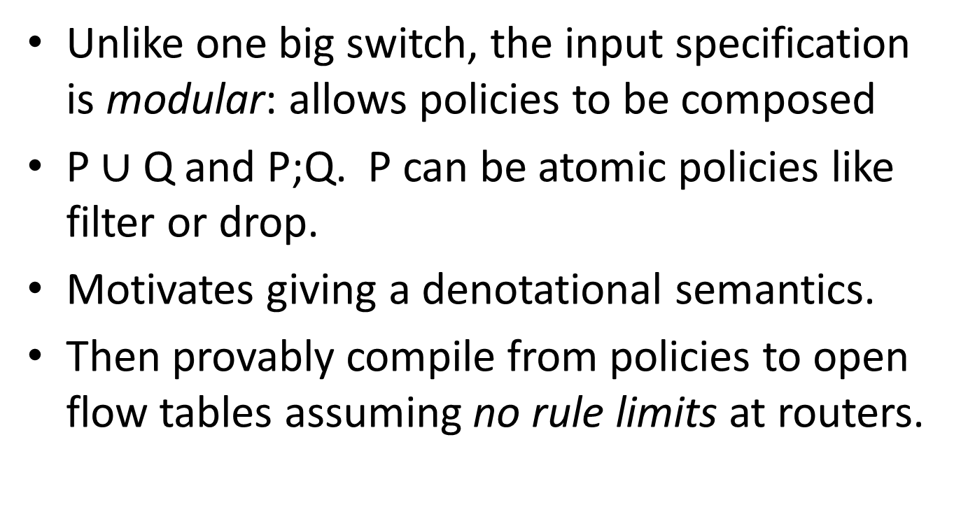
Certified Development in NetCore [Foster 09]
Unlike one big switch, the input specification is modular: allows policies to be composed
P $∪$ Q and P;Q. P can be atomic policies like filter or drop.
Motivates giving a denotational semantics.
Then provably compile from policies to open flow tables assuming no rule limits at routers.

Slide 127
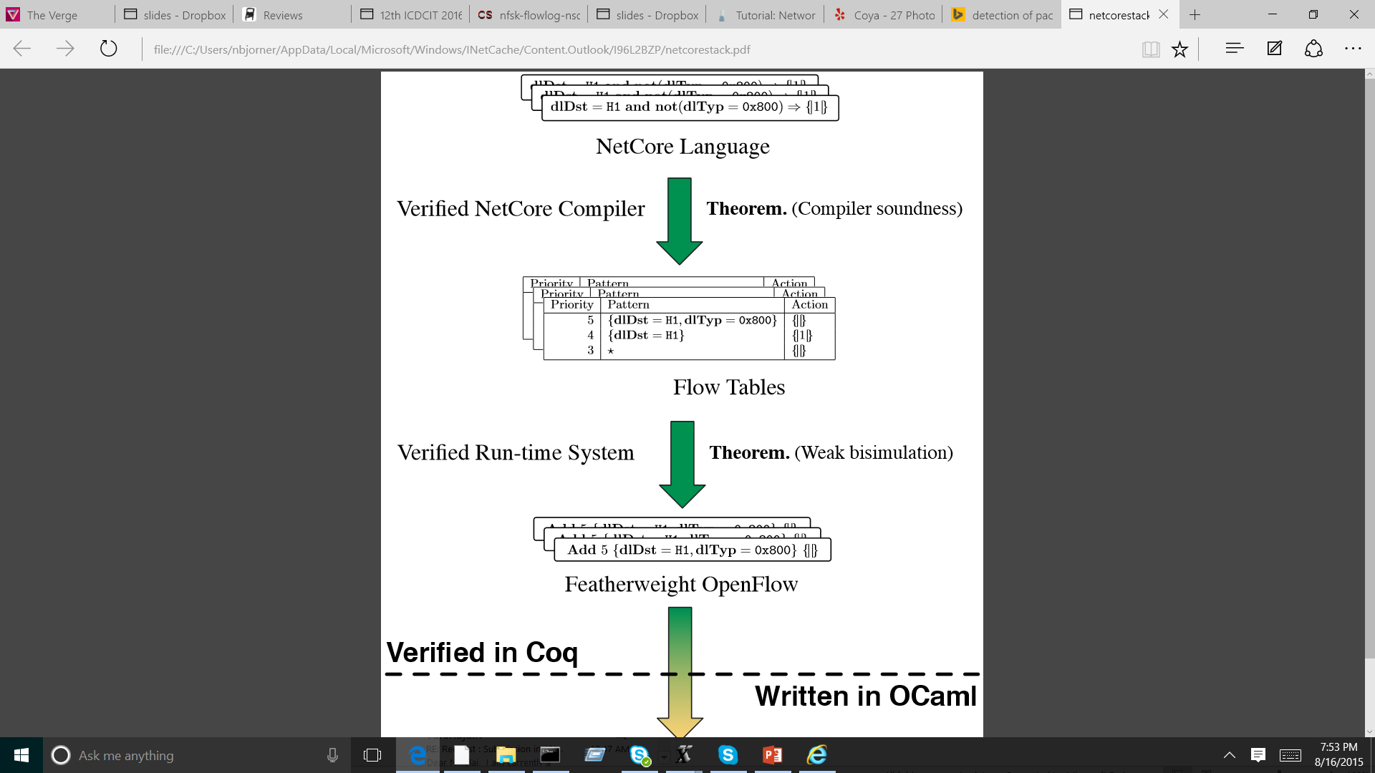


NetCore workflow [Foster 11]
Verified Compiler Theorem: Compiler Soundness
Verified Run-time system
Theorem:
Weak
Bisimulation
Code Extraction

Slide 128
NetKAT: Synthesis + Analysis in 1 package [Anderson 14]
NetKAT allows synthesis of policies and (unlike NetCore) allows automatic analysis of other properties besides policies synthesized.
Unlike Veriflow & HSA which verify a model NetKat allows analysis of code as written.
Denotational semantics and equational theory and shows completeness.
Equational theory used for certified development.

Slide 129
NetKAT - calculus
pol ::= false
| true
| field = val
| pol1 + pol2
| pol1 ; pol2
| !pol
| pol*
| field := val
| S⇒T
Captures modeling SDN Dataplane
Suitable for algebraic toolsets
  Equation solving
  Check equality and inclusion between NetKAT programs using automata theoretic tools

Slide 130
Flowlog [Nelson 14]
Tierless programming for networks
  Compiler inserts controller communication
  Analysis enabled by SQL style language
  Supports stateful switches
Forward to next hop
Forwarding Behavior
FlowLog
Program
Non-forwarding rules
Rules not supported by Switch tables
Forward to controller

Slide 131
Synthesis using Solvers
Example 1: [Zhang12] uses Quantified Boolean Formulations to synthesize firewalls
  Uses binary search to scale
Example 2: [Jose15] uses ILP to synthesize physical tables within router from logical tables
  Uses model restrictions to scale
Either pure heuristics or solvers + heuristics needed as synthesis is hard.

Slide 132
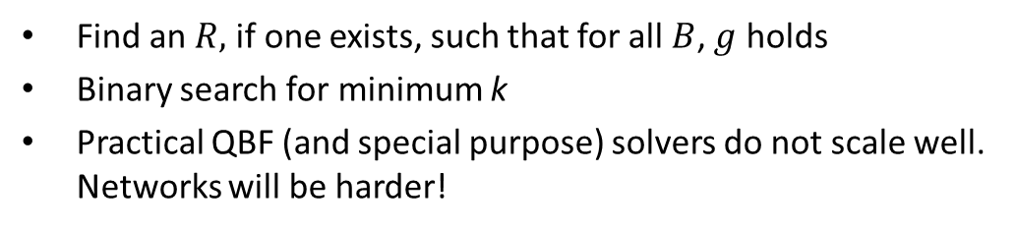
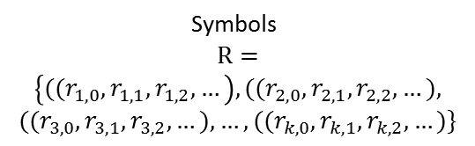
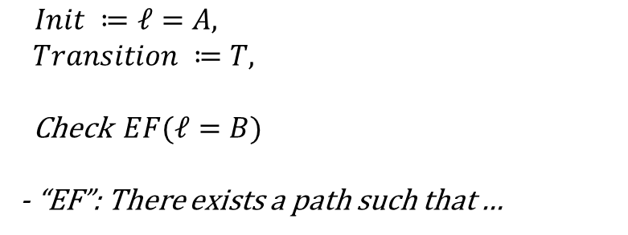
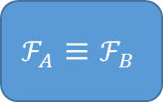

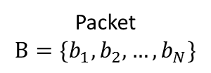
Synthesis via Verification Tools
(don’t scale out of box)
Firewall
Spec
Packet
$$B=\{b_{1}, b_{2}, …,b_{N}\}$$
$$g$$
$$ℱ_{A}≡ℱ_{B}$$
Symbolic
Firewall with
k rules
Symbols
$$R=$$
$$\left\{{({(r}_{1,0},r}_{1,1}, r_{1,2},…\right), {({(r}_{2,0},r}_{2,1}, r_{2,2},…),$$
$${({(r}_{3,0},r}_{3,1}, r_{3,2},…),…,{({(r}_{k,0},r}_{k,1}, r_{k,2},…)\}$$
$∃R ∀B (g)$
Quantified Boolean Formula (QBF)
Find an $R,$ if one exists, such that for all$B$, $g$ holds
Binary search for minimum k
Practical QBF (and special purpose) solvers do not scale well. Networks will be harder!

Slide 133
LESSONS AND LOOKING BACK

Slide 134
Research ideas? → via exemplars from research in real networks
IP Router
10*→ P1
1* → P2
PREFIX MATCH
10010
MAC Bridge
01A1A2→ P1
. . .
EXACT MATCH
01A1A2
MPLS Switch
5→ P1,Pop 5
. . .
INDEXED LOOKUP
5, 6
ESSENTIAL INSIGHT FOR OPENFLOW. USE SAME INSIGHT
IN HSA FOR UNDERSTANDING EXISTING PROTOCOLS.
SIMILARLY MPLS → ATOMIC PREDICATES

Slide 135
Research ideas? → via exemplars from PL and Hardware Verification
Earlier Exemplar | Network Verification
Ternary Simulation, Symbolic Execution (Dill 01, Hardware) | Header Space Analysis (Kazemian 2003)
Certified Development of an OS Sel4 [Klein 09] | Certified Development of a Controller [Guha 13]
Specification Mining for HW [Li 10] | Mining for Enterprise Policy (Benson )
Exploit Symmetry in Model Checking [Sistla] | Exploit Symmetry in Data Center Verification (Plotkin15)
Can choose either analysis of existing (e.g., Veriflow) or clean slate
Approaches based on synthesis. Both have a place

Slide 136
Exemplars: Food for thought?
What are Network Verification analogs of:
Abstract Interpretation (replacing complex state by a simple state)
CEGAR (counterexample driven refinement)
Interpolants
Strong typing in Language Design
Wiring checkers in Chip Design

Slide 137
Scaling? → Exploit Domain Structure
Technique | Structure exploited
Header Space (HSA) | Limited negation, no loops, small equivalence classes
Net Plumber | Network Graph, rule dependencies structure
ATPG (Testing) | Network graph limits size of state space compared to KLEE
Symmetry Exploiting | Known symmetries because of design (vs on logical structures)
Scope for Interdisciplinary work between PL, Hardware CAD, Verification Community and Networking Researchers

Slide 138
No Specifications? → Use Beliefs
Paper | Example Beliefs
Bugs as Deviant Behavior [Engler 01] | Dereferencing Pointer P that could be NULL is a bug
Routing Config Checker (RCC) [Feamster 05] | Routes from a Peer should not be re-advertised to another peer
QoS Verification Tool for ATT [Sung 09] | Marked flows should be placed in corresponding queue
Network Optimized Datalog [Lopes 15] | Customer VMs should not be able to access router ports

Slide 139
Don’t know how → Leverage code
SMT: CVC4, Mathsat, Yices, Z3
BDD packages: (BuDDy, what else?)
Model checking: SPIN, nuSmv/nuXmv
Network Specific verification: Hassel, Veriflow, NoD, Evgeny’s, Atomic Predicates
Datasets: Stanford, Cloud (NoD), Internet2
Symbolic Test Generation: KLEE, DART, SAGE
Proof Assistants: Coq, Isabelle
Known to be available for download

Slide 140
Network Design Automation?→ Lessons from EDA (Malik)
Design discipline for Network Design? (e.g, Fat Trees → Local Checks Only)
Design flows, abstractions and interfaces for Network Design? (SecGuru in Azure)
Effective modeling and analysis to enable NDA evolution? (Veriflow real-time checks)
Maximizing separation of concerns in Network Design? (Control and Data Plane)
Analysis capabilities influencing Network Design/Verification methodology? (Symmetry)

Slide 141
Lessons Summarized
What research? Via exemplars from PL/HW
What research? Via exemplars from networks
Scaling? Exploit domain structure
Lack of specifications? Use Beliefs
Don’t know how? Leverage available code
Network Design Automation? Learn from EDA

Slide 142

Conclusion
Inflection Point: Rise of services, data centers, Software Defined Networks
Ideas: Adapt Verification (analysis) & optimization (synthesis)
Intellectual Opportunity: Rethink existing techniques exploiting domain structure
Systems Opportunity Working chips with billions of gates Why not large operational networks next
Lot more than Verification and Formal Methods (have to add debugging,
run-time checks etc.) but EDA suggests this is an Essential foundation
Notes:
There is a lot more work. For example, we want hardware changes at routers for better monitoring and great debuggers that can do things
Like Step and Walk. But the techniques in this tutorial are a lot more than understanding existing bugs. They may help us lay a foundation
for a systems opportunity: the chance to change the way large networks are operated. The sky’s the limit: Destination Moon

Slide 143
So what can we steal/adapt from the PL Toolbox?
(e.g., NetCore Policies)
Language Based
Language Based
Semantics Based
(e.g., Model routers as
State machines)
Algebraic
Transition Systems
(e.g., Model Checking,
Header Space Analysis
Program Equivalence
Property Checking
State Exploration
(e.g., Lightweight Open Flow)

Slide 144
Data Plane Verification
[Lakshman 98] High-speed policy-based packet forwarding using efficient multidimensional range matching. Lakshman Stiliadis 1998
[Xie 05] On static reachability analysis of IP networks Xie, Zhan, Maltz, Zhang, Greenberg, Hjalmtysson. INFOCOM 2005
[Al-Shaer 09] Network configuration in a box: Towards end-to-end verification of network reachability and security Al-Shaer, Marrero, El-Atawy, Elbadawi. ICNP 2009.
[Sung 09] Modeling and understanding end-to-end class of service policies in operational networks Sung, Lund, Lyn, Rao, Sen, SIGCOMM 2009
[Al-Shaer 10]: FlowChecker: configuration analysis and verification of federated openflow infrastructures, SafeConfig '10
[Nelson 10] The Margrave Tool for Firewall Analysis Nelson, Barratt, Dougherty, Fisler, Krishnamurthi; LISA 2010
[Mai 11]: Debugging the Data Plane with Anteater Mai,Khurshid, Agarwal, Caesar, Godfrey, King. SIGCOMM 2011
[Kazemian 12] Header Space Analysis: Static Checking for Networks. Kazemian, Varghese, McKeown. NSDI 2012
[Kazemian 13] Real Time Network Policy Checking Using Header Space Analysis. Kazemian, Chan, Zeng, Varghese, McKeown, Whyte. NSDI 2013
[Khurshid 13] VeriFlow: Verifying Network-Wide Invariants in Real Time [NSDI 2013, HotSDN 2012]
[Zhang 13]: SAT Based Verification of Network Data Planes, Zhang, Malik. ATVA 2103
[Dobrescu 14] Network Dataplane Verification. Dobrescu, Argyraki. NSDI 2014.
[Chemeritskiy 14] VERMONT - a toolset for checking SDN packet forwarding policies on-line. Altukhov, Chemeritskiy, Podymov, Zakharov SDN&NFV conference 2014.
[Jayaraman 15] Automated Analysis and Debugging of Network Connectivity Policies. Jayaraman, Bjorner, Outhred, Kaufman
[Plotkin 15] Scaling Network Veriﬁcation using Symmetry and Surgery. Plotkin, Bjorner, Lopes, Rybalchenko, Varghese

Slide 145
Control Plane Verification
[Feamster 05] Detecting BGP Configuration Faults with Static Analysis. Feamster, Balakrishnan. NSDI 2005
[Ball 14] VeriCon: Towards Verifying Controller Programs in Software-Defined Networks. Ball, Bjørner, Gember, Itzhaky, Karbyshev, Sagiv, Schapira, Valadarsky. PLDI 2014
[Nelson 14] Tierless Programming and Reasoning for Software-Defined Networks
Nelson, Ferguson, Scheer, Krishnamurthi; NSDI 2014
[Fogel 15] A General Approach to Network Configuration Analysis, Fogel, Fung, Pedrosa, Walraed-Sullivan, Govindan, Mahajan, Millstein. NSDI 15.
[Nelson 15] Static Differential Program Analysis for Software-Defined Networks
Nelson, Ferguson, Krishnamurthi; FM 2015
[Padon 15] Decentralizing SDN Policies Padon Immerman, Karbyshev, Lahav, Sagiv, Shoham. POPL 2015
[Foster 15] A Coalgebraic Decision Procedure for NetKAT Foster, Kozen, Milano, Silva, Thompson. POPL 2015

Slide 146
Synthesis/Compilation
[Sung 08] Towards systematic design of enterprise networks Sung, Rao, Xie, Maltz. CoNEXT 2008
[Foster 11] Frenetic: A Network Programming Language Foster, Harrison, Freedman, Monsanto, Rexford, Story, Walker. ICFP 2011.
[Zhang 12] Verification and synthesis of firewalls using SAT and QBF (ICNP), 2012 Zhang, Mahmoud, Malik, Narain
[Kang 13] “One Big Switch” Abstraction in Software-Defined Networks, Kang, Liu, Rexford, Walker. CoNEXT 2013
[Guha 13] Machine-Verified Network Controllers Guha, Reitblatt, Foster. PLDI 2013.
[Anderson 14] NetKAT: Semantic Foundations for Networks Anderson, Foster, Guha, Jeannin, Kozen, Schlesinger, Walker. POPL 2014.
[Jose 15] Compiling P4 Programs, Jose, Yan, Varghese, McKeown. NSDI 2015
[McClurg 15] Efficient Synthesis of Network Updates. McClurg, Hojjat, Cerny, Foster. PLDI 2015.
[Diekmann 15] Semantics-Preserving Simplification of Real-World Firewall Rule Sets. Diekmann, Hupel, Carle. FM 2015

Slide 147
Testing
[Canini 12] A NICE Way to Test OpenFlow Applications, Canini, Venzano, Perešíni, Kostić, Rexford. NSDI 12.
[Zeng 12] Automatic test packet generation. Zeng, Kazemian, Varghese, McKeown CoNEXT 2012
[Fayaz 15] From Header Space to Control Space: Towards Comprehensive Control Plane Verification, Fayaz, Fogel, Mahajan, Millstein, Sekar, Varghese,
[Brucker 15] Formal firewall conformance testing: an application of test and proof techniques. Brucker, Brügger, Wolff. STVR 2015.

Slide 148
State space exploration tools
Tool | What it does
SMV | Symbolic Model Verifier | McMillan
NuSMV | De facto symbolic model checker today | Cimatti
SPIN | Explicit state model checker (good for protocols) | Holzmann
Impact | Symbolic model checking algorithm based on interpolants and SAT | McMillan
IC3 | Symbolic model checking algorithm based on inductive generalization and SAT | Bradley
Klee | Symbolic state space explorer for C | Engler
SAGE | Dynamic symbolic execution engine | Godefroid
Pex | Dynamic symbolic execution for .NET | Tillmann, Halleux

Slide 149
Logic toolbox
Tool | What it is
CTL | Computational Tree Logic Lets you specify properties of computations
LTL | Linear Time Temporal Logic Lets you specify with fairness assumptions
Datalog | Horn Clauses without function symbols Lets you define sets by induction
FO+TC | First order logic with transitive closure Lets you take transitive closure of binary relation
KAT | Kleene Algebra with Tests Lets you write down programs as a regular expression with conditional statements
Relational Algebra (in Alloy) | Similar to FO+TC but composition of relations is first-class

Slide 150
Proof and specification assistants
Tool | What it does
Coq | Interactive proof assistant | Coquand +
Isabelle | Interactive proof assistant | Nipkow, Paulson
ACL2 | A Computational Logic proof assistant | Boyer, Moore
Alloy | Relational algebra specification environment | Jackson
PVS | Interactive proof assistant | Owre+

Slide 151
Automatic theorem prover toolbox
Tool | What it does
Z3 | SMT solver | de Moura, Bjorner, Wintersteiger
Yices2 | SMT solver | Dutertre
CVC4 | SMT solver | Barrett
MathSAT4 | SMT solver | Griggio
MiniSAT | SAT solver | Een, Soerenson
Lingeling | SAT solver | Biere
BuDDy | BDD package | Lind
CUDD | BDD package | Somenzi

Slide 152
Some Network Verification Tools
Tool | What it does | Based on
Margrave | Specification Environment | Alloy | Nelson, Krishnamurthi
AntEater | Bounded Model Checker | Yices | Godfrey
Hassel | Symbolic Execution, reachability | Ternary bit-vectors | Peymen
NoD/Z3 | Network optimized Datalog, reachability | Datalog + ternary bit-vectors | Lopes
NetKAT | Networks as Kleene Algebra | Automata Theory | Foster
VeriFlow | Incremental verification | Tries | Khurshid
NetPlumber | Path queries using regular expressions, incremental verification | Header Spaces, slicing, regular expressions | Kazemian
SecGuru | Semantic Differences of forwarding tables and firewalls | SMT/Bit-vectors | Jayaraman
VERMONT | Network Reachability, incrementality | FO + Transitive Closure, BDDs | Chemeritskiy

