Slide 1
Program Verification as SMT
SMT workshop 2012
Nikolaj Bjørner, Ken McMillan, Andrey Rybalchenko
Microsoft Research

Slide 2
Takeaways
Program Verification
as Solving Recursive Horn Clauses
as Satisfiability Modulo Theories
SMT-LIB (+ goodies)
a superb basis for Program Verification
benchmark exchange

Slide 3
Program Verification as SMT
mc(x) = x-10 if x > 100
mc(x) = mc(mc(x+11)) if x ≤ 100
assert (mc(x) ≥ 91)

Slide 4
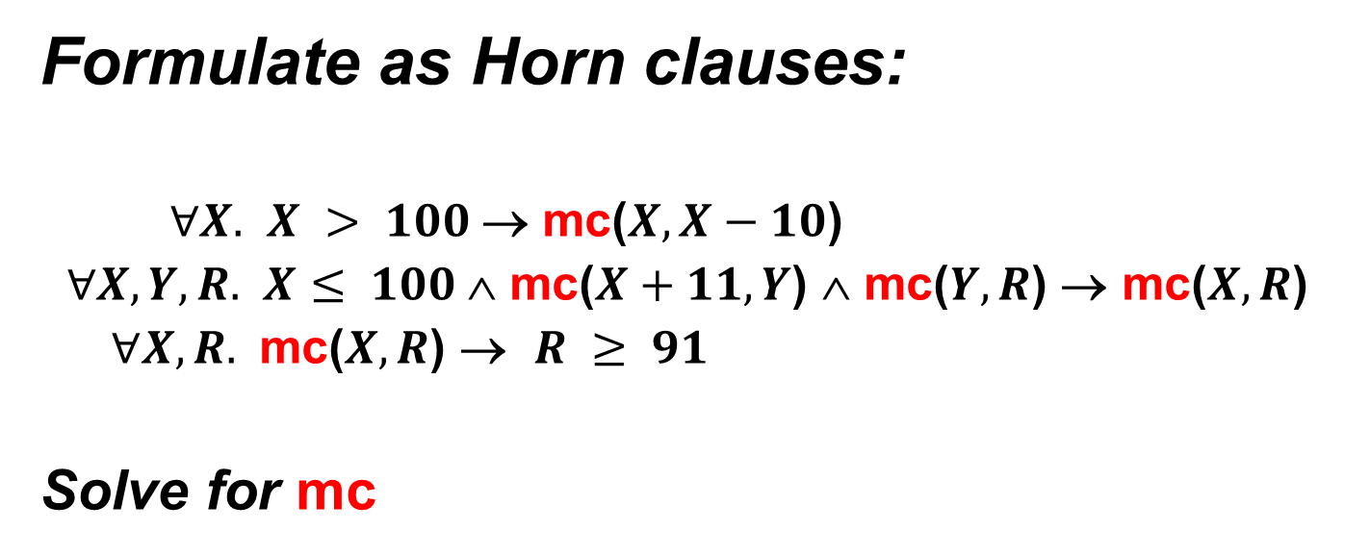
Program Verification as SMT
Formulate as Horn clauses:
$∀X.$ $X > 100$→ mc($X,X−10$)
$∀X,Y,R.$ $X≤ 100$∧ mc($X+11,Y$) ∧ mc($Y,R$) → mc($X,R$)
$∀X,R.$ mc($X,R$) → $R ≥ 91$
Solve for mc

Slide 5
Program Verification as SMT
Program Verification (Safety)
as
Satisfiability of Horn clauses

Slide 6








Verification Tool Workflow
HAVOC
Dafny
Program
Annotated with
Inductive invariants
Verification
condition

Slide 7
Verification Tool Workflow
Inductive variable
selection
Houdini
Slicing
HAVOC
Corral
Dafny
Program
partially
annotated with
Inductive invariants
Verification
condition

Slide 8

Verification Tool Workflow
Verification Condition Generators can already produce Horn Clauses
HAVOC
Corral
Dafny
Program
partially
annotated with
Inductive invariants
Why, LLVM
…
Horn Clauses
Kind
Leon
HSF
Duality
Aligator
Synergy
UFO
MCMTSAFARI
IC3

Slide 9
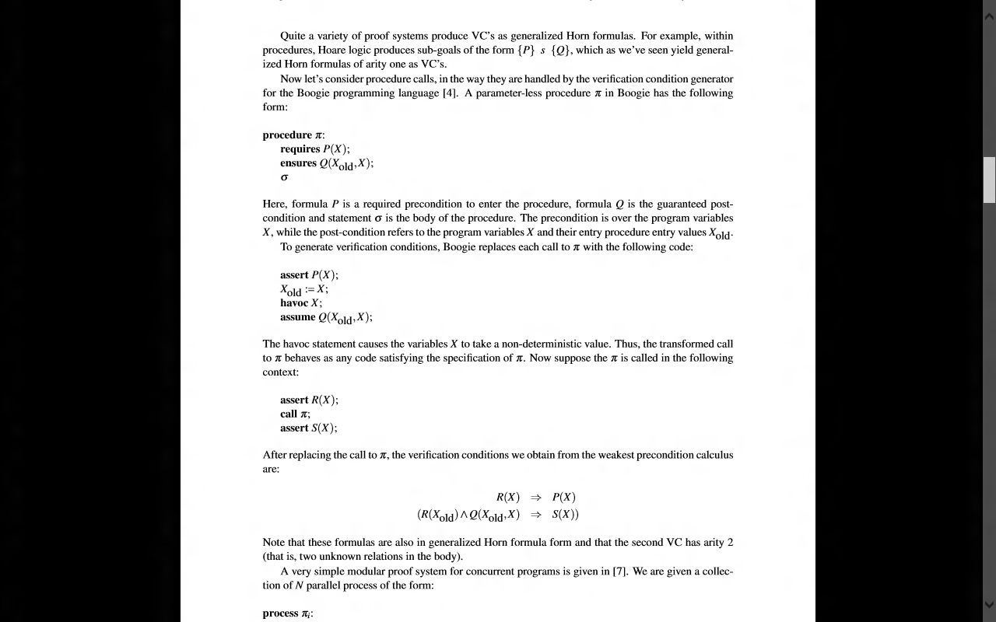
Procedures ⇒ Horn Formulas
Summary as commands
Verifying procedure calls

Slide 10
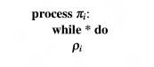
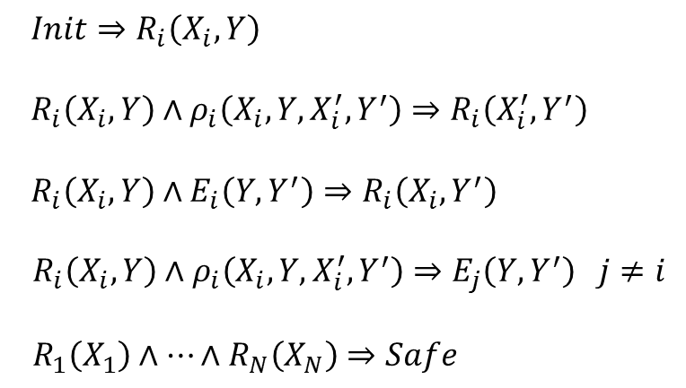
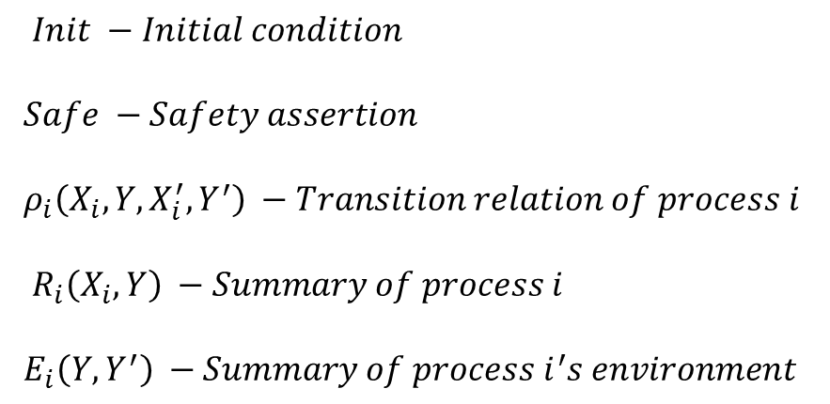

Modular Concurrency ⇒ Horn Clauses
$Init −Initial condition$
$Safe −Safety assertion$
$ρ_{i}\left(X_{i}, Y,X_{i}^{′},Y^{′}\right) −Transition relation of process i$
${ R}_{i}\left(X_{i}, Y\right) −Summary of process i$
$E_{i}\left(Y,Y^{′}\right) −Summary of process i{}_{}^{′}s environment$
$Init⇒R_{i}\left(X_{i}, Y\right)$
${ R}_{i}\left(X_{i},Y\right)∧ρ_{i}\left(X_{i}, Y,X_{i}^{′},Y^{′}\right)⇒R_{i}\left(X_{i}^{′},Y^{′}\right)$
$R_{i}\left(X_{i}, Y\right)∧E_{i}\left(Y,Y^{′}\right)⇒R_{i}\left(X_{i}, Y^{′}\right)$
$R_{i}\left(X_{i},Y\right)∧ρ_{i}\left(X_{i}, Y,X_{i}^{′},Y^{′}\right)⇒E_{j}\left(Y,Y^{′}\right) j≠i$
$R_{1}\left(X_{1}\right)∧…∧R_{N}\left(X_{N}\right)⇒Safe$
[Predicate Abstraction and
Refinement for Verifying
Multi-Threaded Programs
Ashutosh Gupta, Corneliu Popeea,
Andrey Rybalchenko, POPL 2011]

Slide 11
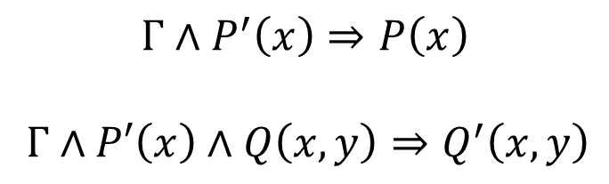
⇒ Horn Clauses
$$Γ⊢\left\{ x:τ \right|P(x)\}→\left\{ y:σ \right| Q(x,y) \}≺\left\{ x:τ \right|P′(x)\}→\left\{ y:σ \right| Q′(x,y) \}$$
Extract sufficient Horn Conditions
$$Γ∧P^{′}\left(x\right)⇒P\left(x\right)$$
$Γ∧P′\left(x\right)∧Q\left(x,y\right)⇒Q^{′}\left(x,y\right)$

Slide 12
Verification Tool Workflow - summary
Many front-ends exist.
Verification Condition Generators:
- used for Checking Inductive Invariants
- re-used for Synthesizing Inductive Invariants

Slide 13
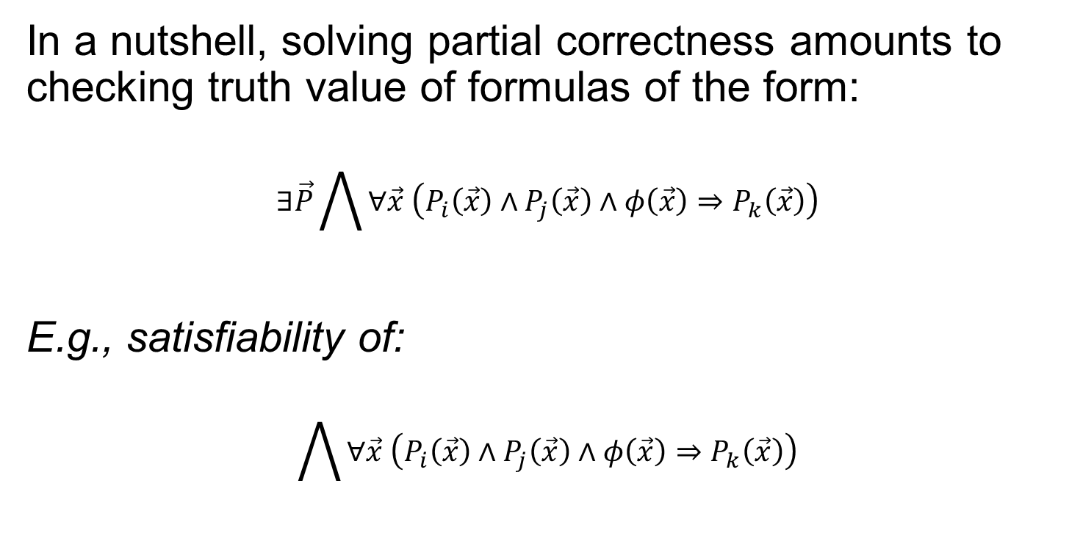
Generalized Horn Formulas
In a nutshell, solving partial correctness amounts to checking truth value of formulas of the form:
$$∃\vec{P}\bigwedge{∀\vec{x} \left(P_{i}\left(\vec{x}\right)∧P_{j}\left(\vec{x}\right)∧φ\left(\vec{x}\right)⇒P_{k}\left(\vec{x}\right)\right)}$$
E.g., satisfiability of:
$$\bigwedge{∀\vec{x} \left(P_{i}\left(\vec{x}\right)∧P_{j}\left(\vec{x}\right)∧φ\left(\vec{x}\right)⇒P_{k}\left(\vec{x}\right)\right)}$$

Slide 14
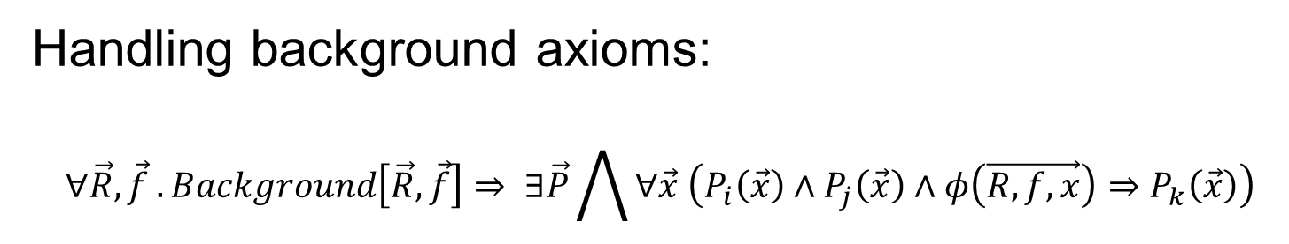
Generalized Horn Formulas
Handling background axioms:
$$∀\vec{R},\vec{f} . Background\left[\vec{R},\vec{f}\right]⇒ ∃\vec{P}\bigwedge{∀\vec{x} \left(P_{i}\left(\vec{x}\right)∧P_{j}\left(\vec{x}\right)∧φ\left(\vec{R, f, x}\right)⇒P_{k}\left(\vec{x}\right)\right)}$$

Slide 15
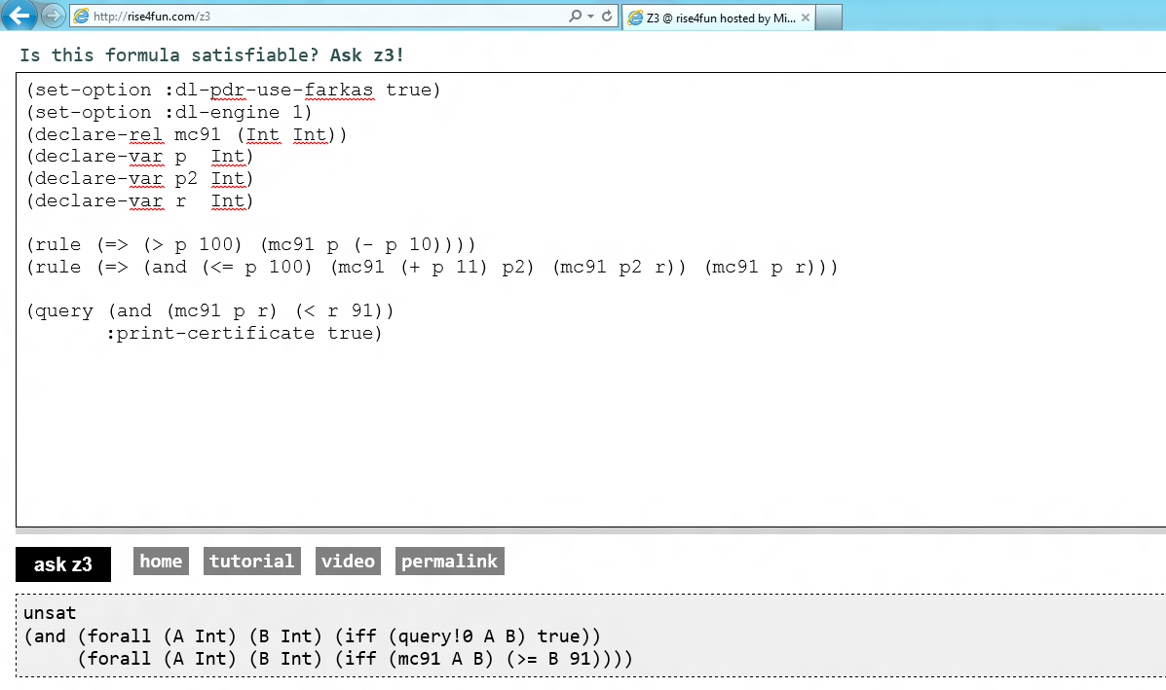
Z3’s SMT format

Slide 16
Takeaways
Program Verification
as Solving Recursive Horn Clauses
as Satisfiability Modulo Theories
SMT-LIB (+ goodies)
a superb basis for Program Verification
benchmark exchange

