Slide 1


An Efficient SMT Solver
Leonardo de Moura and Nikolaj Bjørner
Microsoft Research
FSE &

Slide 2
This Seminar
Applications:
  Dynamic Symbolic Execution
  Bit-precise Scalable Static Analysis
  and several others at Microsoft
Satisfiability Modulo Theories: SMT
  Model-based Theory Combination
Shameless, blatant propaganda for the SMT solver Z3

Slide 3
Satisfiability Modulo Theories (SMT)
Is formula ϕ satisfiable modulo theory T ?
SMT solvers have specialized algorithms for T

Slide 4
The Calculus of Computation
Also the title of
Bradley & Manna’s book
Why Theorem Proving?
At the core of every software analysis engine
is invariably a component using logical
formulas for describing states and
transformations between system states.

Slide 5
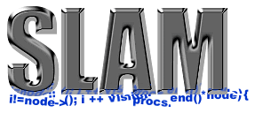
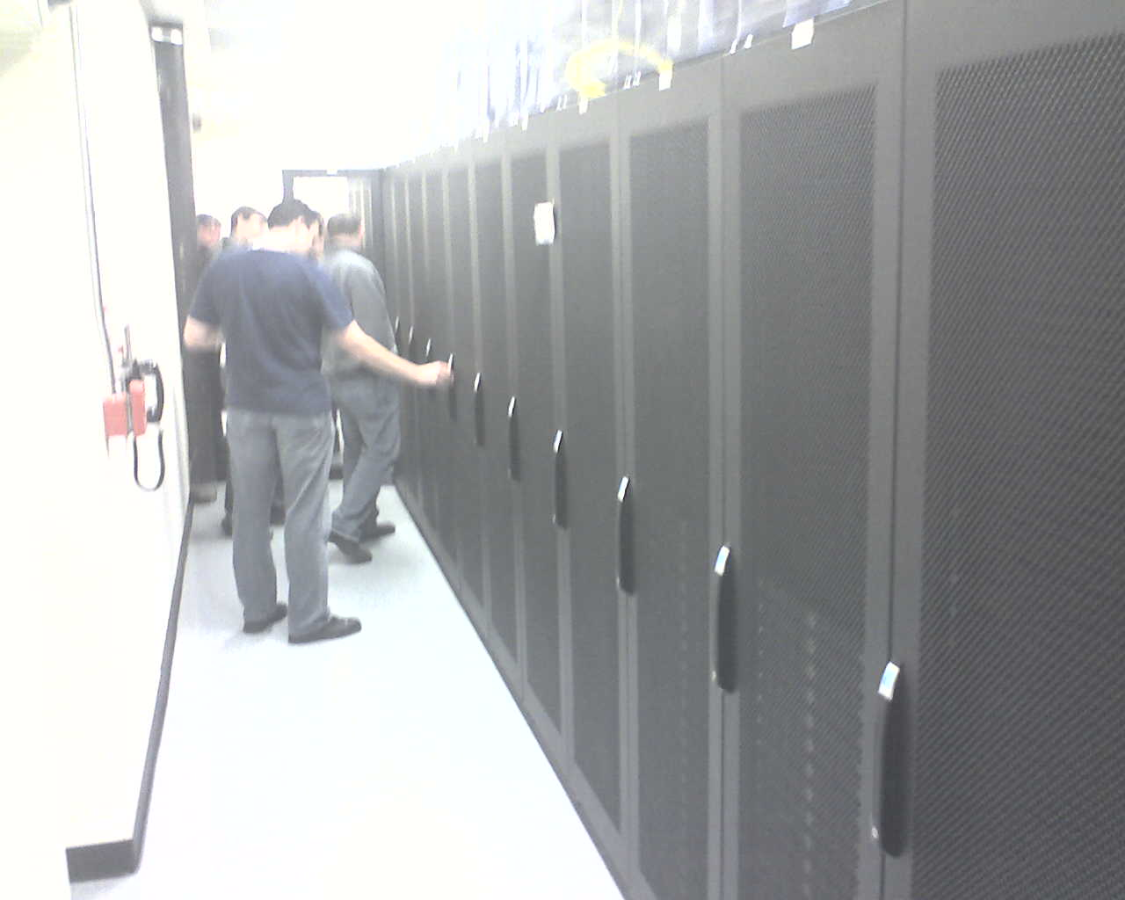



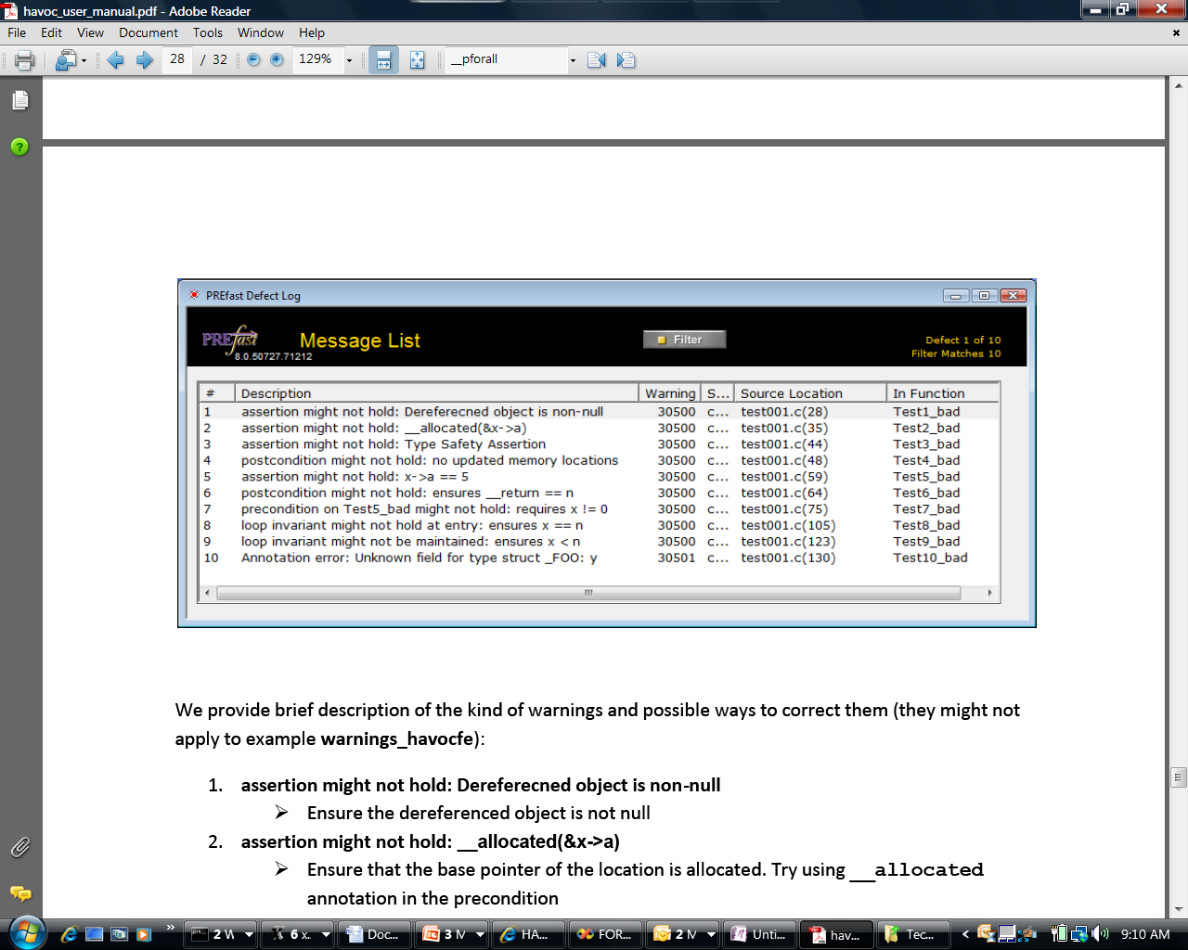

The Calculus of Computation
Some Microsoft engines:
SDV: The Static Driver Verifier
PREfix: The Static Analysis Engine for C/C++.
Pex: Program EXploration for .NET.
SAGE: Scalable Automated Guided Execution
Spec#: C# + contracts
VCC: Verifying C Compiler for the Viridian Hyper-Visor
HAVOC: Heap-Aware Verification of C-code.
SpecExplorer: Model-based testing of protocol specs.
Yogi: Dynamic symbolic execution + abstraction.
FORMULA: Model-based Design
F7: Refinement types for security protocols
M3: Model Program Modeling
VS3: Abstract interpretation and Synthesis
They all use the SMT solver Z3.
Hyper-V

Slide 6
What is Z3?
Simplify
Theories
OCaml
Bit-Vectors
Arrays
SMT-LIB
.NET
Lin-arithmetic
Groebner basis
Native
Recursive Datatypes
Comb. Array Logic
C
Free (uninterpreted) functions
Quantifiers:
E-matching
Model Generation:
Finite Models
Quantifiers:
Super-position
Proof objects
Parallel Z3
Assumption tracking
By Leonardo de Moura & Nikolaj Bjørner http://research.microsoft.com/projects/z3

Slide 7
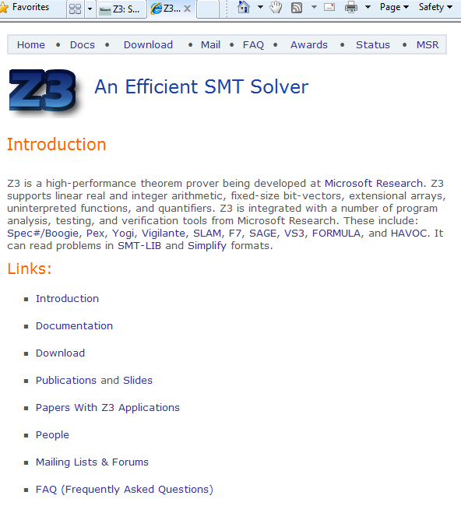
What is Z3?
Leonardo de Moura &
Nikolaj Bjørner
Microsoft Research
Redmond

Slide 8
Z3: Some Microsoft Clients
.NET BCL
Hyper-V
Drivers
PEX
VCC
SLAM/SDV
Is this path feasible?
Hoare
Triples
Finite Program abstraction
Model
Proof

Slide 9
Test case generation
unsigned GCD(x, y) {
requires(y > 0);
while (true) {
unsigned m = x % y;
if (m == 0) return y;
x = y;
y = m;
}
}
(y₀ > 0) and
(m₀ = x₀ % y₀) and
not (m₀ = 0) and
(x₁ = y₀) and
(y₁ = m₀) and
(m₁ = x₁ % y₁) and
(m₁ = 0)
x₀ = 2
y₀ = 4
m₀ = 2
x₁ = 4
y₁ = 2
m₁ = 0
SSA
Solver
We want a trace where the loop is executed twice.

Slide 10


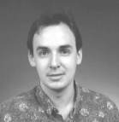


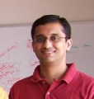


Dynamic Symbolic Execution
Run Test and Monitor
Execution Path
Path Condition
seed
Test
Inputs
Known
Paths
New input
Constraint System
Solve
Unexplored path
Vigilante
SAGE
Nikolai Tillmann Peli de Halleux (Pex), Patrice Godefroid (SAGE)
Aditya Nori, Sriram Rajamani (Yogi), Jean Philippe Martin, Miguel Castro,
Manuel Costa, Lintao Zhang (Vigilante)

Slide 11
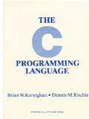
What is wrong here?
-INT_MIN= INT_MIN
(3(INT_MAX-3)/4)+
((INT_MAX-3)/4+4)
= INT_MIN
int binary_search(int[] arr, int low,
int high, int key)
while (low <= high)
{
// Find middle value
int mid = (low + high) / 2;
int val = arr[mid];
if (val == key) return mid;
if (val < key) low = mid+1;
else high = mid-1;
}
return -1;
}
void itoa(int n, char* s) {
if (n < 0) {
*s++ = ‘-’;
n = -n;
}
// Add digits to s
….
Package: java.util.Arrays
Function: binary_search
Book: Kernighan and Ritchie
Function: itoa (integer to ascii)

Slide 12
The PREfix Static Analysis Engine
int init_name(char **outname, uint n)
{
if (n == 0) return 0;
else if (n > UINT16_MAX) exit(1);
else if ((*outname = malloc(n)) == NULL) {
return 0xC0000095; // NT_STATUS_NO_MEM;
}
return 0;
}
int get_name(char* dst, uint size)
{
char* name;
int status = 0;
status = init_name(&name, size);
if (status != 0) {
goto error;
}
strcpy(dst, name);
error:
return status;
}
model for function init_name
outcome init_name_0:
guards: n == 0
results: result == 0
outcome init_name_1:
guards: n > 0; n <= 65535
results: result == 0xC0000095
outcome init_name_2:
guards: n > 0|; n <= 65535
constraints: valid(outname)
results: result == 0; init(*outname)
models
Can
Pre-condition be violated?
path for function get_name
guards: size == 0
constraints:
facts: init(dst); init(size); status == 0
paths
Yes: name is not initialized
pre-condition for function strcpy
init(dst) and valid(name)
C/C++ functions
warnings

Slide 13









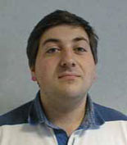


Extended Static Checking and Verification
Hyper-V
VCC
Boogie
Win. Modules
HAVOC
Verification
condition
Bug path
Rustan Leino, Mike Barnet, Michał Moskal, Shaz Qadeer,
Shuvendu Lahiri, Herman Venter,
Wolfram Schulte, Ernie Cohen,
Khatib Braghaven, Cedric Fournet, Andy Gordon, Nikhil Swamy
F7

Slide 14
What is SMT?

Slide 15
Satisfiability Modulo Theories (SMT)
Array Theory
Arithmetic
Uninterpreted Functions

Slide 16
Domains from programs
Bits and bytes
Numbers
Arrays
Records
Heaps
Data-types
Object inheritance

Slide 17
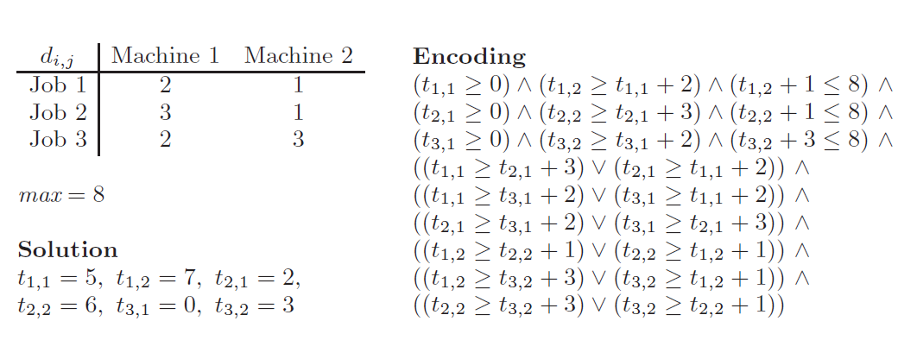
Domains from other areas
Job-shop scheduling and difference arithmetic
Two variables per inequality: x – y ≤ k

Slide 18
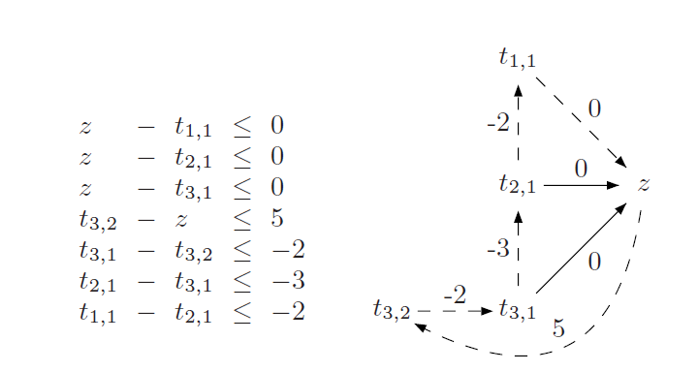
Domains from other areas
Job-shop scheduling and difference arithmetic
Difference arithmetic reduces to a
basic path search problem

Slide 19
Research around Z3
Decision Procedures
Modular Difference Logic is Hard TR 08 B, Blass Gurevich, Muthuvathi.
Linear Functional Fixed-points. CAV 09 B. & Hendrix.
A Priori Reductions to Zero for Strategy-Independent Gröbner Bases SYNASC 09 M& Passmore.
Efficient, Generalized Array Decision Procedures FMCAD 09 M & B
Combining Decision Procedures
Model-based Theory Combination SMT 07 M & B. .
Accelerating Lemma learning using DPLL(U) LPAR 08 B, Dutetre & M
Proofs, Refutations and Z3 IWIL 08 M & B
On Locally Minimal Nullstellensatz Proofs. SMT 09 M & Passmore.
A Concurrent Portfolio Approach to SMT Solving CAV 09 Wintersteiger, Hamadi & M
Quantifiers, quantifiers, quantifiers
Efficient E-matching for SMT Solvers. . CADE 07 M & B.
Relevancy Propagation. TR 07 M & B.
Deciding Effectively Propositional Logic using DPLL and substitution sets IJCAR 08 M & B.
Engineering DPLL(T) + saturation. IJCAR 08 M & B.
Complete instantiation for quantified SMT formulas CAV 09 Ge & M.
On deciding satisfiability by DPLL( Γ+ T) and unsound theorem proving.
CADE 09 Bonachina, M & Lynch. .
.
.
.
Sorry, I can’t cover it all here

Slide 20
Theory Combinations

Slide 21
A Combination History
Foundations
Efficiency using rewriting
1979 Nelson, Oppen - Framework
1996 Tinelli & Harindi. N.O Fix
2000 Barrett et.al N.O + Rewriting
2002 Zarba & Manna. “Nice” Theories
2004 Ghilardi et.al. N.O. Generalized
1984 Shostak. Theory solvers
1996 Cyrluk et.al Shostak Fix #1
1998 B. Shostak with Constraints
2001 Rueß & Shankar Shostak Fix #2
2004 Ranise et.al. N.O + Superposition
2001: Moskewicz et.al. Efficient DPLL made guessing cheap
2006 Bruttomesso et.al. Delayed Theory Combination
2007 de Moura & B. Model-based Theory Combination

Slide 22
The basic combination problem
Examples:
Given:
Σ_{F} = Σ₁ ∪ Σ₂ T₁ , T₂ : Theories over Σ₁, Σ₂
T = DC(T₁ ∪ T₂) – deductive closure
Is T consistent?
Given separate solvers for T₁ and T₂ produce combined solver for T.

Slide 23
Theory combination essentials
Disjoint signatures and Purification
Σ₁ ∩ Σ₂ = ∅
{ +, -, .. } ∩ { read, write} = ∅
Stably-Infinite Theories.
Convex Theories.
Nelson-Oppen combination.
Model-based theory combination.

Slide 24
Main components of modern SMT Solvers
Purification

Slide 25
Main components of modern SMT Solvers
Purification

Slide 26
Main components of modern SMT Solvers
Purification
Arithmetic
Arrays
Functions

Slide 27
Main components of modern SMT Solvers
Propositional Abstraction

Slide 28
Main components of modern SMT Solvers
Propositional Assignment
Using SAT solver

Slide 29
Main components of modern SMT Solvers
Theory Solving
Arithmetic
Arrays
Theories exchange equalities between shared variables. But how?
Free functions
⊥

Slide 30
Patience…
Now to
Stably Infiniteness

Slide 31
Stably-Infinite Theories
Theorem:
  The union of two consistent, disjoint, stably-infinite theories is consistent.

Slide 32
Stably-Infinite Theories
A theory is stably-infinite if every satisfiable QFF is satisfiable in an infinite model.
We can glue together models M₁ and M₂ from stably infinite theories:
  we can extend the size of models M₁ and M₂ to each have |M₁ | + |M₂ | elements.

Slide 33
Why stably infiniteness?
A
B
Equalities align
h(d^{A})
d^{A}
d^{B}
h⁻¹(d^{B})
e^{B}
e^{A}
f^{A} (d,e)
f^{B} (d,e)
Should be able
to add fresh
value in model A
Function interpretations
shared by bottom-up construction
f^{A} (d,e) := h⁻¹(f^{B} (h(d^{A}), h(e^{A})))

Slide 34
Stably-Infinite Theories
A theory is stably-infinite if every satisfiable QFF is satisfiable in an infinite model.
Theories with only finite models are not stably infinite:
T = DC(∀x,y,z. (x = y) ∨ (x = z) ∨ (y = z) )
has only models with at most 2 elements
Is this a problem in practice?
  We want to support finite types found in programming languages.

Slide 35
Stably-Infinite Theories
Are finite domains a problem in practice?
Not really. Add a type predicate, to scope finite sorts.
T’ = DC(∀x,y,z. in₂(x) ∧ in₂(y) ∧ in₂(z) ⇒ (x = y) ∨ (x = z) ∨ (y = z) )
T’ is stably infinite.

Slide 36
Convexity

Slide 37
Convex Theories
Theorem:
  The union of two convex theories can be solved in time O(n⁴ x T₁(n) x T₂(n)).
  The combination of a non-convex theory with another can incur exponential cost.

Slide 38
Convexity
A theory T is convex iff:
for all finite sets L of literals and
for all non-empty disjunctions
L ⊨_{T}
iff L ⊨_{T} for some i ∈ I
Every convex theory T with non-trivial models (i.e., ⊨_{T} ∃x,y . x ≠ y) is stably-infinite
All Horn theories are convex – this includes all (conditional) equational theories.
Linear rational arithmetic is convex

Slide 39
Convexity: Horn theories
Suppose H is a set of horn axioms.
H |= P(t) ∨ Q(t’)
Then there is a resolution proof of [] given:
  H ∧ ¬P(t) ∧ ¬ Q(t’)
Horn resolution maintains invariant:
  Every clause has at most one positive literal.
Either P(t) or Q(t’) consume the only available positive literal.
Notes:
Horn equalities are convex.
Proof: convert the horn equalities into predicate calculus without equality by adding the horn axioms:
E(x,y) :- E(y,x)
E(x,z) :- E(x,y), E(y,z)
E(x,x)
E(f(x),f(y)) :- E(x,y)…. For every f.
The resulting system H is still Horn.
Suppose H |= E(s,t) or E(u,v). Then by FO completeness H & !E(s,t) && !E(u,v) is unsat with a finite resolution derivation.
Now notice that any resolvent with !E(s,t) or !E(u,v) contains no positive literals. Hence, clauses resolved with one cannot be resolved with the other.
The finite resolution derivation must therefore only require one of the equalities.

Slide 40
Convexity: LRA
Suppose A is a matrix, b is a vector, f₁ (x) and f₂ (x) are linear functions and that Ax ≤ b |= f₁ (x) = c₁ or f₂ (x) = c₂ for every x.
Let Ax₁ ≤ b and Ax₂ ≤ b and f₁(x₁) = c₁ and f₂ (x₂) = c₂. We show that either f₁(x₂) = c₁ or f₂(x₁) = c₂.
Proof: let y = (x₁+x₂)/2, then
Ay = A(x₁+x₂)/2 = Ax₁/2 + Ax₂/2 ≤ b/2 + b/2 = b, so either f₁(y) = c₁ or f₂(y) = c2.
Assume wlog f₁ (y) = c₁, then
c₁ = 2*c₁ – c₁ = 2*f₁ (y) – f₁ (x₁) =
f₁ (2y-x₁) = f₁ (2(x₁+x₂)/2 – x₁) = f₁ (x₂) .

Slide 41
Convexity: LRA
Suppose A is a matrix, b is a vector, f(x) and g(x) are linear functions and for every x:
Let
Then either f(z) = c or g(y) = d.
f(y)
g(z)
f(z)
g(y)
Assume wlog f(u) = c:

Slide 42
Many theories are not convex
  Linear integer arithmetic
  1 ≤ x ≤ 2 ⊨ x = 1 ∨ x = 2
  Non-linear arithmetic
  x² = 1, y = 1, z = -1 ⊨ x = y ∨ x = z
  Theory of bit-vectors
  ch : BitVec[8] ⊨ ch = 0 ∨ … ∨ ch = 255
  Theory of arrays
  v = read(write(a,i,w),j) ⊨ v = w ∨ v = read(a,j)

Slide 43
Convexity - combination
Let T = T₁ ∪ T₂ where
  T₁ is E, O(nlog(n)), and
  T₂ is Integer Difference Arithmetic, O(nm).
T₁ is convex, but T₂ is not.
Satisfiability of T is NP-complete:

Slide 44
Nelson-Oppen Combination
Let T₁ and T₂ be consistent, stably infinite theories over disjoint (countable) signatures. Assume satisfiability of conjunction of literals can be decided in time T₁(n), respectively T₂(n). Then,
  The combined theory T is consistent and stably infinite.
  Satisfiability of quantifier-free conjunction of literals in T can be decided in O(2^{n*n} x T₁(n) x T₂(n)).
  If T₁ and T₂ are convex, then so is T. Satisfiability is in O(n⁴ x T₁(n) x T₂(n)).

Slide 45
Nelson-Oppen procedure
Initial state: L is set of literals over Σ₁ ∪ Σ₂
Purify: Preserving satisfiability,
convert L into L’ = L₁ ∪ L₂ such that
L₁ ∈ T(Σ₁,V), L₂ ∈ T(Σ₂,V)
So L₁ ∩ L₂ = V_{shared} ⊆ V
Interaction:
Guess a partition of V_{shared}
Express the partition as a conjunction of equalities.
Example, { x₁ }, { x₂ , x₃ }, { x₄ } is represented as:
ψ: x₁ ≠ x₂ ∧x₁ ≠ x₄ ∧x₂ ≠ x₄ ∧x₂ = x₃
Component Procedures:
Use solver 1 to check satisfiability of L₁ ∧ ψ
Use solver 2 to check satisfiability of L₂ ∧ ψ

Slide 46
NO procedure - soundess
Each step is satisfiability preserving
Say L is satisfiable (in the combination).
  Purification: L₁ ∧ L₂ is satisfiable by M.
  Interaction: M induces a partition ψ
  ψ ∧ L₁ ∧ L₂ is satisfiable
  Component: Each ψ ∧ L₁ and ψ ∧ L₂ are satisfiable.
Therefore, if the procedures return unsatisfiable, then L is unsatisfiable.

Slide 47
NO procedure: correctness
Suppose both procedures return satisfiable:
A ⊨ ψ ∧ L₁
B ⊨ ψ ∧ L₂ A, B are models.
Each theory is stably-infinite. So assume A, B have infinite domains S_{A}, S_{B} (of same cardinality).
Let h be a bijection S_{A} ↔ S_{B} such that h(x^{A}) = x^{B} for each shared variable.
Extend B to B’ to interpret functions in Σ₁ :
f^{B’}(b₁ .. b_{n}) = h(f^{A}(h⁻¹(b₁),…, h⁻¹(b_{n}))
B’ is a model.

Slide 48
NO – reduced guessing
Instead of guessing, we can often deduce the equalities to be shared.
Interaction: T₁ ∧ L₁ ⊨ x = y
then add equality to ψ.
If theories are convex, then we can:
  Deduce all equalities.
  Assume every thing not deduced is distinct.
  Complexity: O(n⁴ x T₁(n) x T₂(n)).

Slide 49
NO – convex case correctness
Assume the theories are convex.
  Suppose L₁ is satisfiable
  Let E be the set of pairs x_{j}, x_{k}, such that
  M₁ ⊨ L₁ ⇒ x_{j} = x_{k}
  By convexity:
    M₁ ⊨ L₁ ⇒ ∨ _{E} x_{j} = x_{k}
  So L₁ ∧ ∧_{E} x_{j} ≠ x_{k} is satisfiable

Slide 50
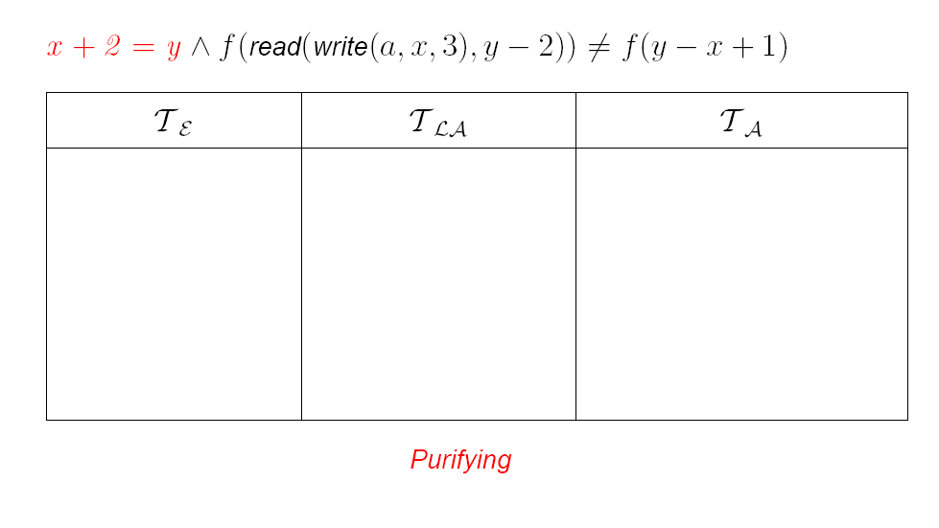
NO procedure - Example

Slide 51
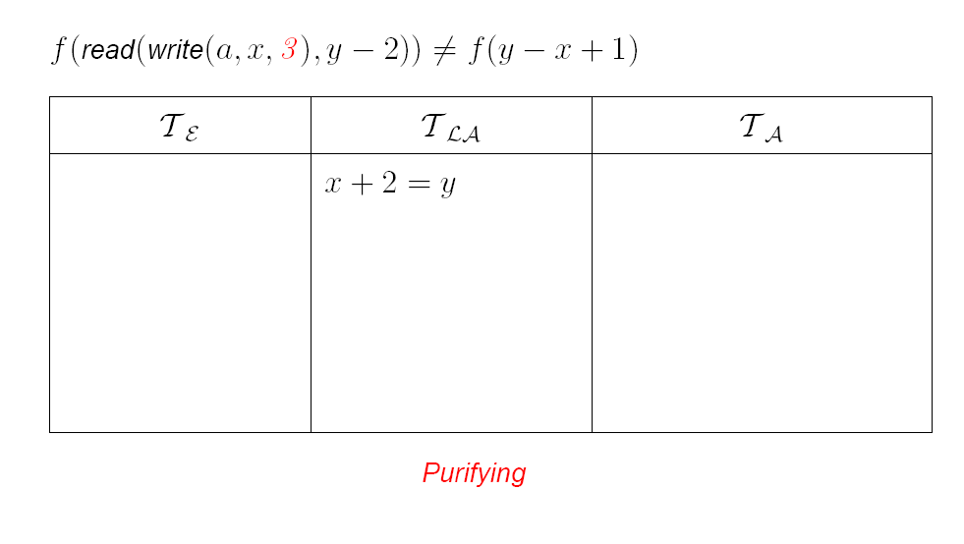
NO procedure - Example

Slide 52
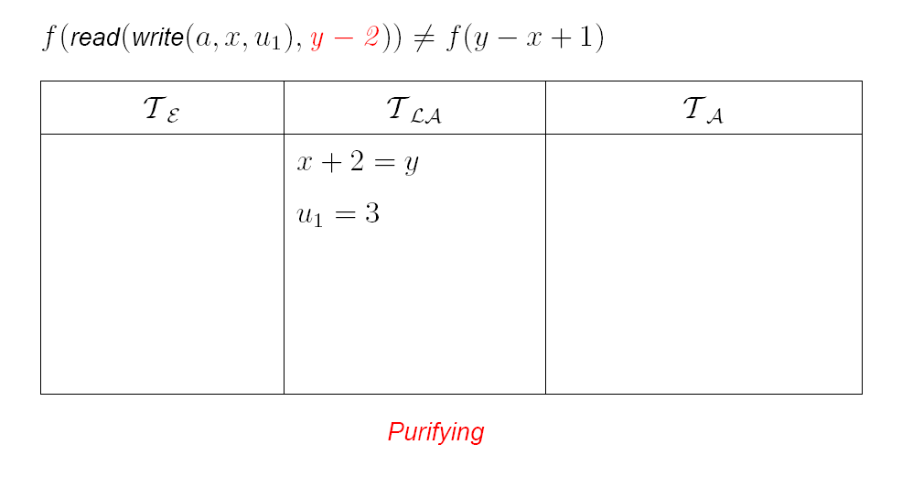
NO procedure - Example

Slide 53

NO procedure - Example

Slide 54
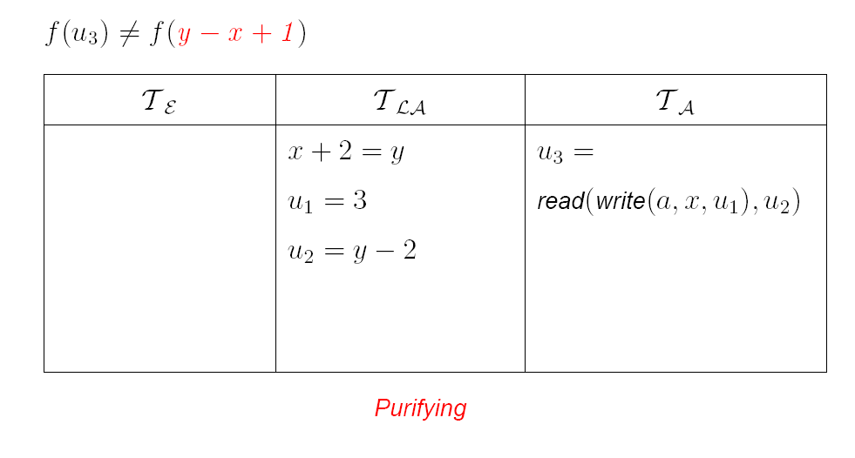
NO procedure - Example

Slide 55

NO procedure - Example

Slide 56

NO procedure - Example

Slide 57

NO procedure - Example

Slide 58
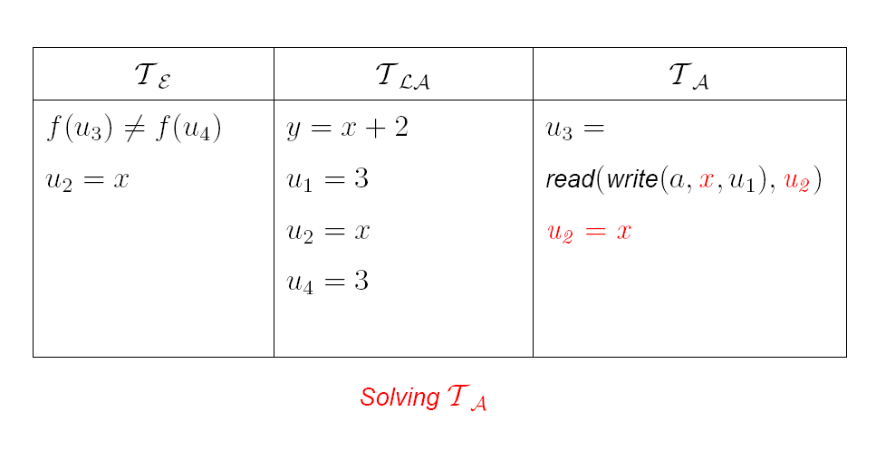
NO procedure - Example

Slide 59
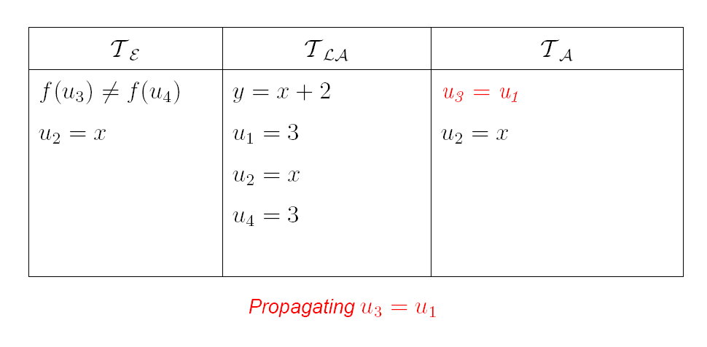
NO procedure - Example

Slide 60
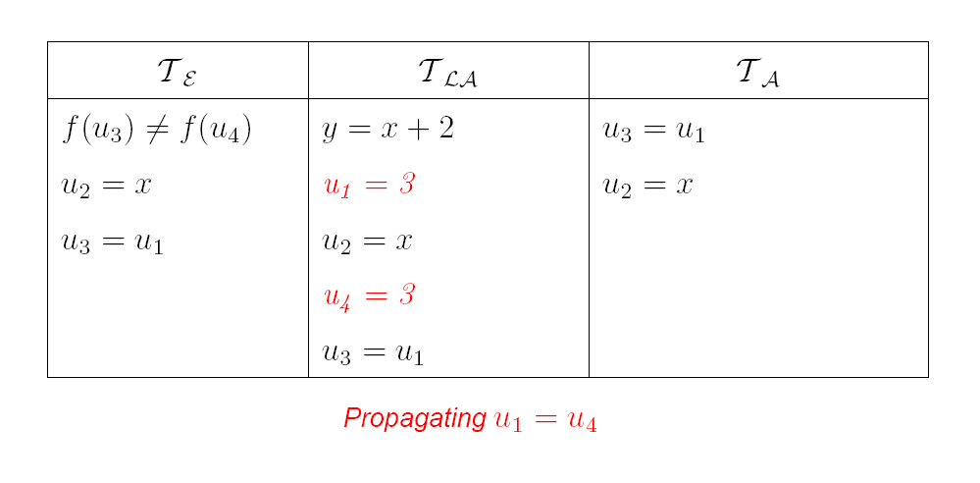
NO procedure - Example

Slide 61
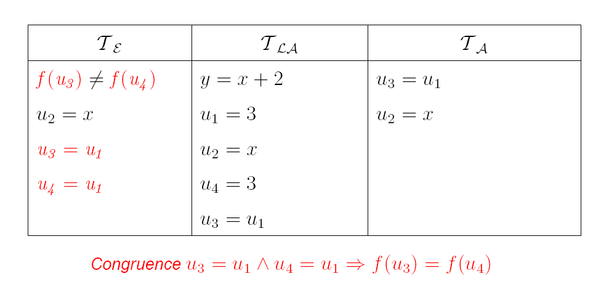
NO procedure - Example

Slide 62

NO procedure - Example

Slide 63
A Combination History
Foundations
Efficiency using rewriting
1979 Nelson, Oppen - Framework
1996 Tinelli & Harindi. N.O. Fix
2000 Barrett et.al N.O + Rewriting
2002 Zarba & Manna. Nice Theories
1984 Shostak. Theory solvers
1996 Cyrluk et.al Shostak Fix #1
1998 B. Shostak with Constraints
2001 Rueß & Shankar Shostak Fix #2
2004 Ranise et.al. N.O + Superposition
2001: Efficient DPLL made guessing cheap
2006 Bruttomesso et.al. Delayed Theory Combination
2007 de Moura & B. Model-based Theory Combination

Slide 64
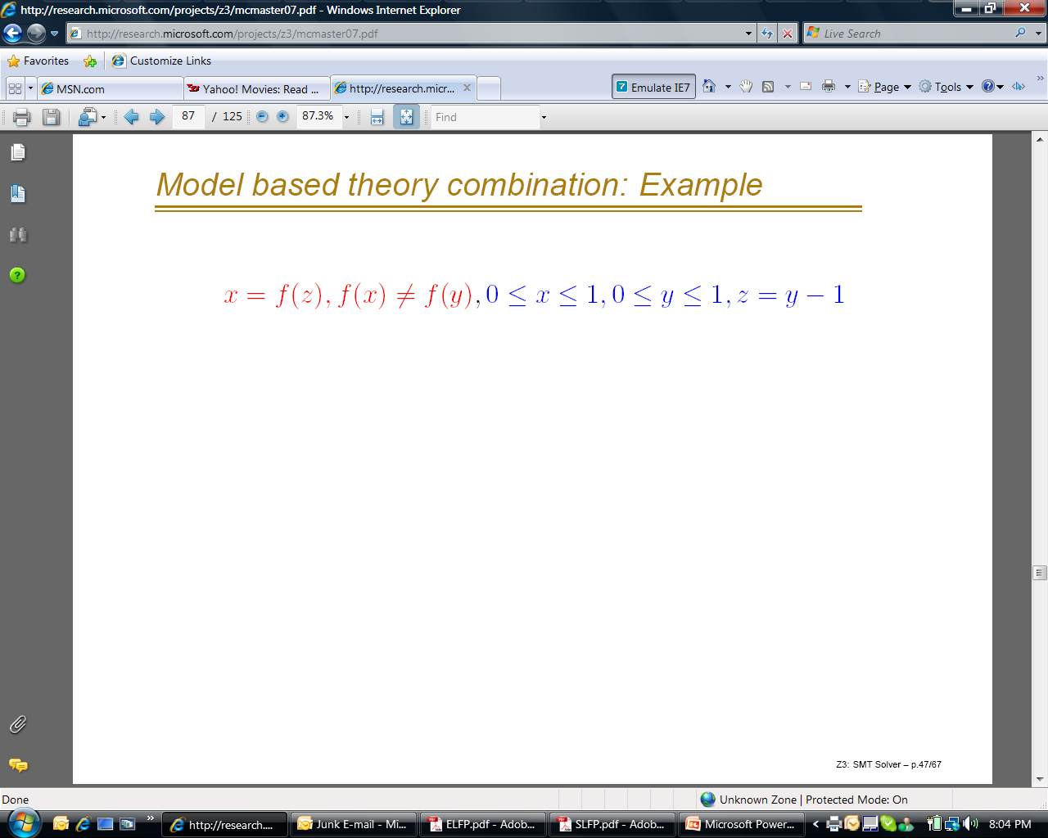
Model-based Combination
The running example was easy.
But what about:
Either x = 0 or x = 1.
y = 0 or y = 1 (when x,y are integers)
Arithmetic module needs to somehow learn
that x≠y. - Integer linear arithmetic is non-convex.

Slide 65
Model-based combination
Delayed Theory Combination solution
[2006 Bruttomesso et.al.]
Add equality literals for every pair of
shared variables:
  ☺: Solvers work completely independently.
  ☺: Works with non-convex theories.
  ☹: O(n²) up-front cost. No use of propagation.

Slide 66
Model-based combination
Idea:
  Have solvers produce models.
  Use models to introduce equalities on demand.
  If M  Γ, M  x = y then guess x = y
☺: No up-front O(n²) cost of adding equalities
☺: Works with non-convex theories
☺: Models are conservative approximations
M  Γ, Γ  x = y implies M  x = y

Slide 67
Model-based - Example

Slide 68
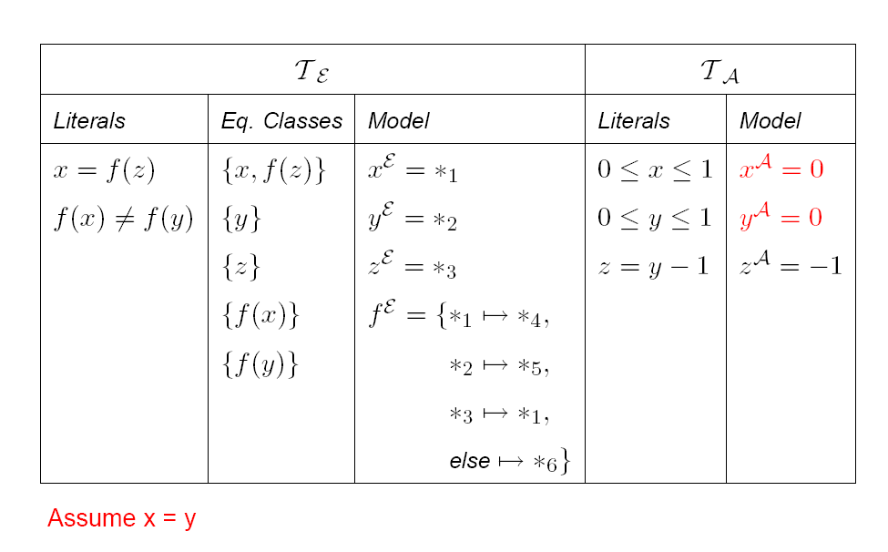
Model-based - Example

Slide 69
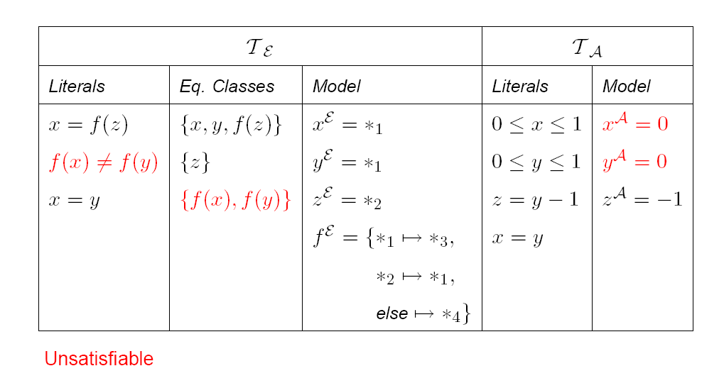
Model-based - Example

Slide 70
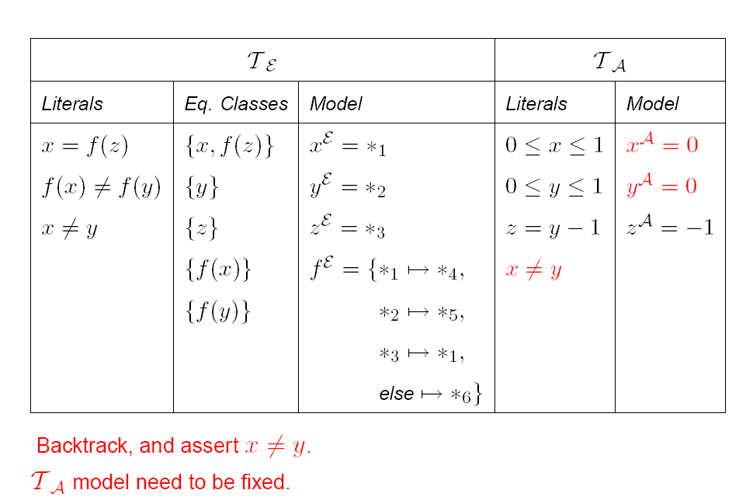
Model-based - Example

Slide 71
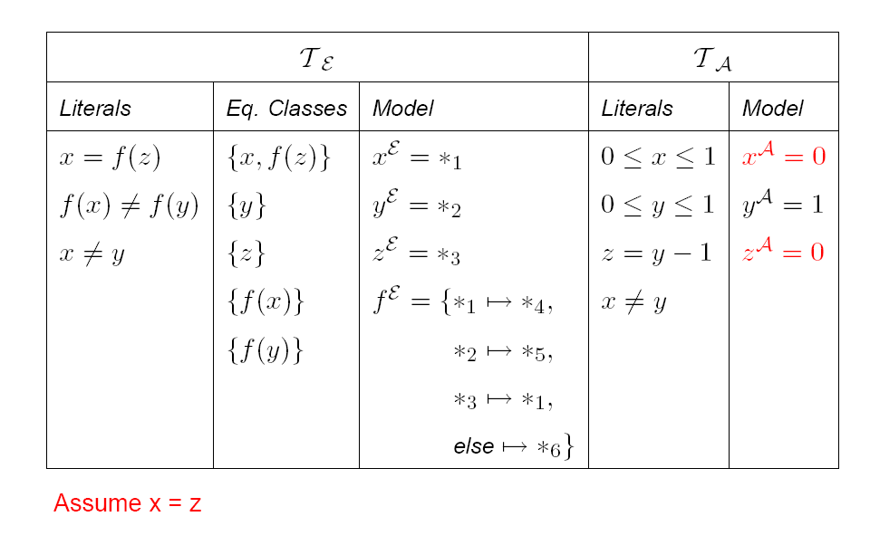
Model-based - Example

Slide 72
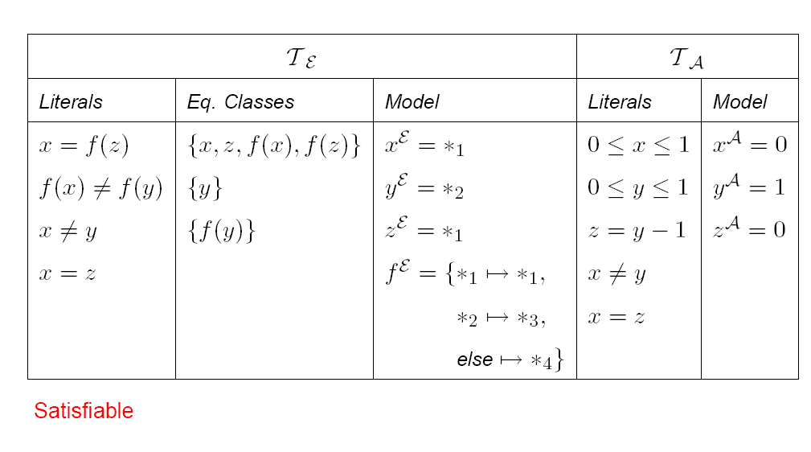
Model-based - Example

Slide 73
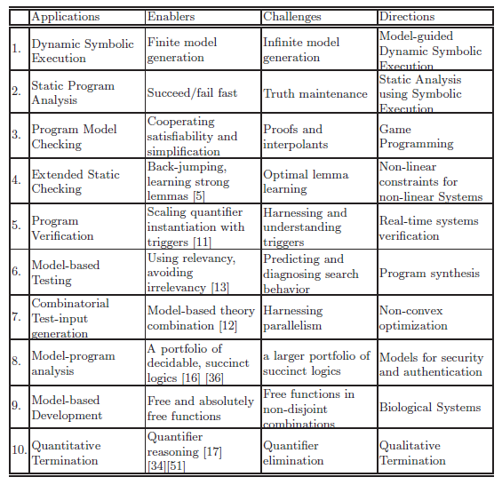

Slide 74
Conclusions
SMT solvers are a great fit for software tools
Current main applications:
  Test-case generation.
  Verifying compilers.
  Model Checking & Predicate Abstraction.
  Model-based testing and development
Future opportunities in SMT research and applications abound

