Slide 1
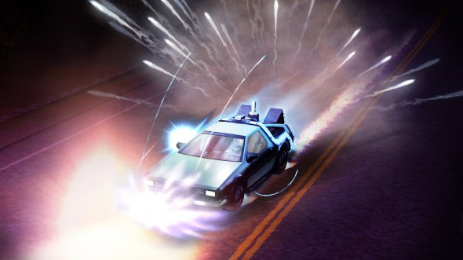


Outatime: Using Speculation to Enable Low-Latency Continuous Interaction for Mobile Cloud Gaming
Kyungmin Lee*, David Chu⁺, Eduardo Cuervo⁺,
Johannes Kopf⁺, Yury Degtyarev^, Sergey Grizan°,
Alec Wolman⁺, and Jason Flinn*
University of Michigan*, Microsoft Research⁺, St. Petersburg Polytechnic University^, Siberian Federal University°
Notes:
Talk about how we can use speculation to mask network latency in cloud gaming environment

Slide 2
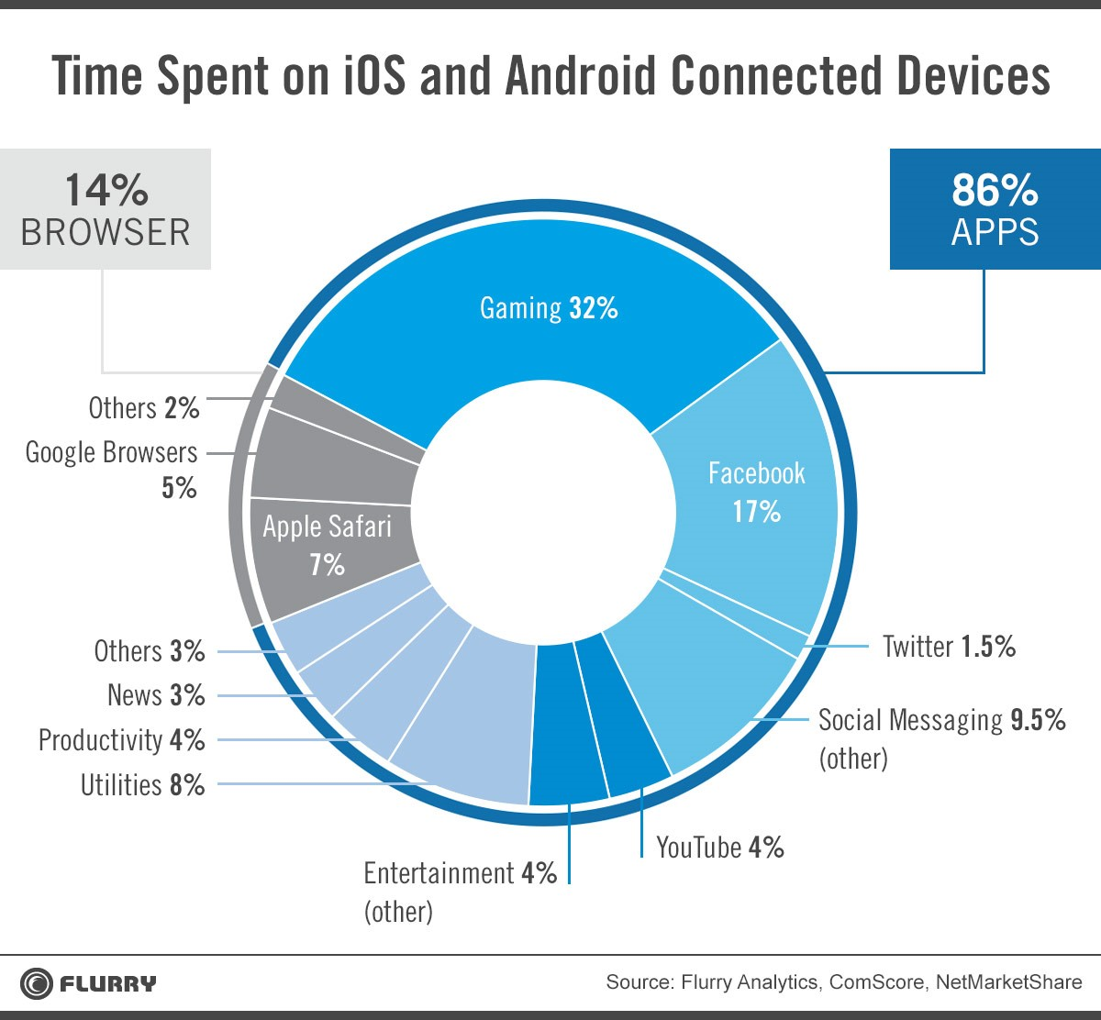
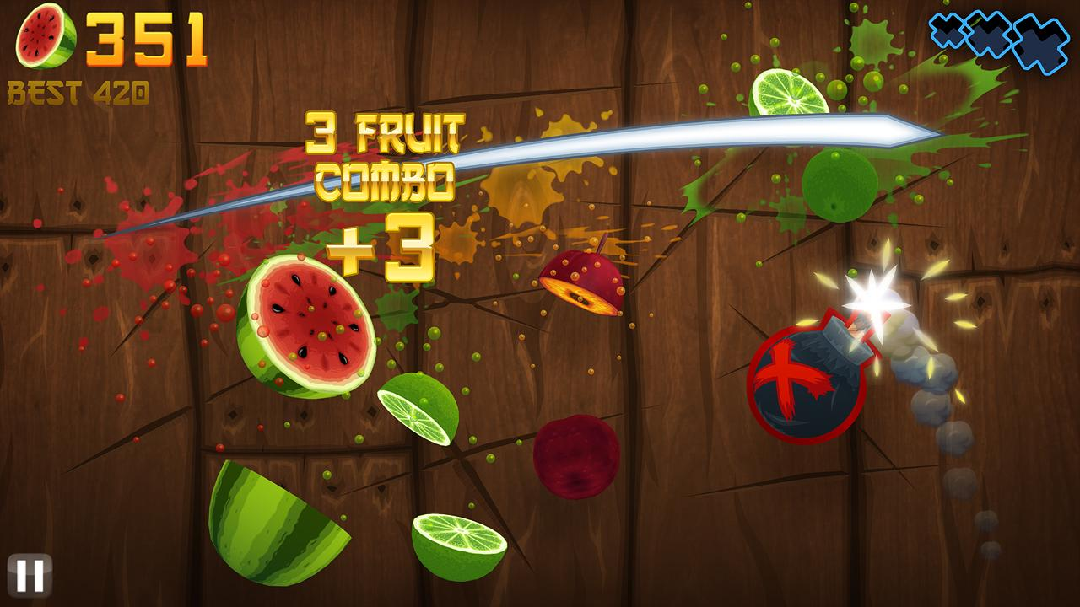
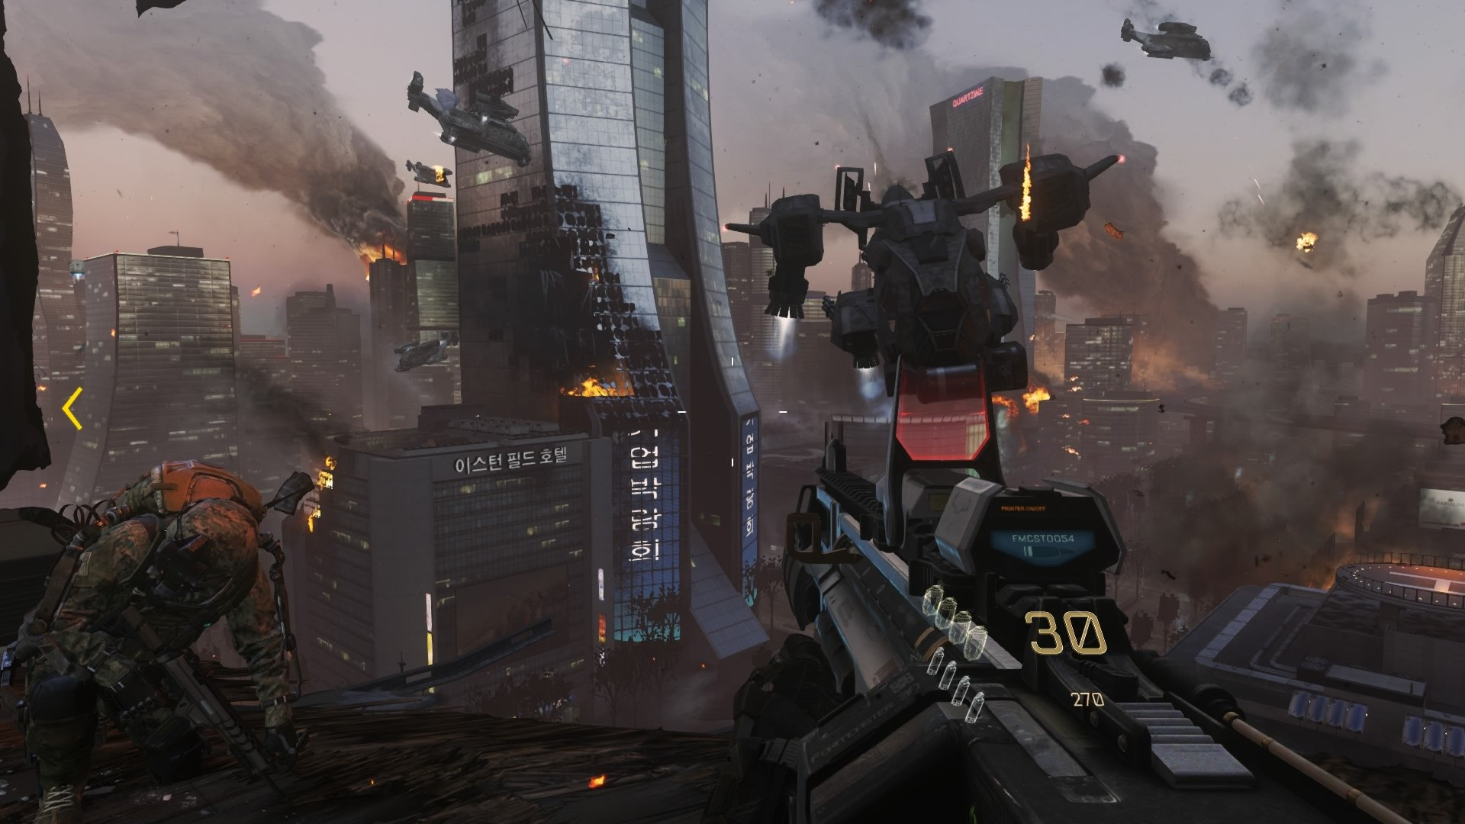
Mobile games are popular
People like games!
People plays:
Gaming 32%
People want:
(Flurry 2014)
Kyungmin Lee
Notes:
Mobile games are very popular. According to statistics from Flurry in 2014, people spent about 32% of their time on games when they use their smartphones.
Furthermore, most of top apps from app stores in both iOS and Android environment are consisted of games.
But, one thing that is very common among these mobile games are they are relatively simple (does not involve much of AI) and have relatively poor graphics.
I admit games like Fruit ninja, angry bird, minecraft are fun and addictive, but they are no way close in terms of graphics and complexity to console games that you can play on PS4 or Xbox one.
Problem is that mobile devices do not have enough computational and graphics power to run these games.
And people actually want to able to play Xbox one and PS4 like games on their mobile devices.
Mobile devices are not currently powerful enough play these games.

Slide 3
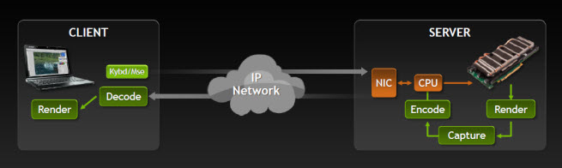
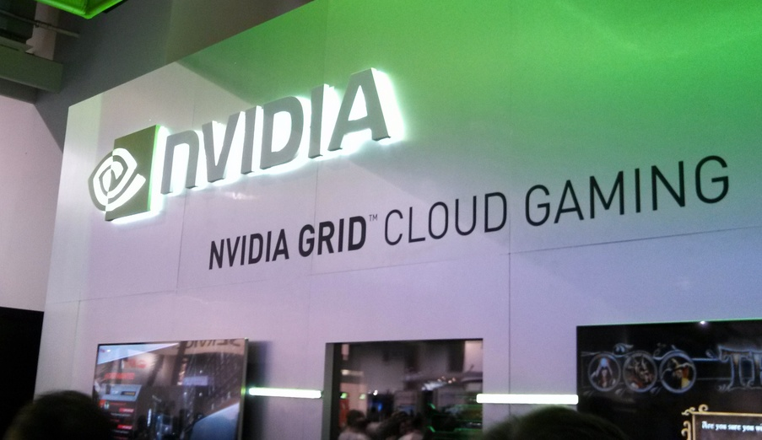
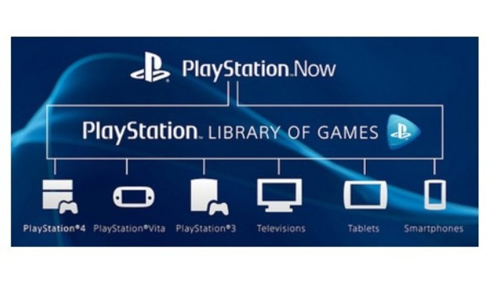
Emerging cloud gaming platform
Kyungmin Lee
Notes:
To remedy this problem, cloud gaming platform has emerged.
In a cloud gaming environment, client (such as mobile devices)’s job is simply capture user input and send that to the server. And later decode the frame that it receives from cloud gaming server and render it. Use h264.

Slide 4
Cloud gaming
+ Powerful servers, more immersive games
(advanced graphics, better AI)
+ Few client dependencies
+ Easy maintenance & upgrades
+ Piracy is much more difficult
+ Instant gratification
- Network latency
- Bandwidth
- Server multi-tenancy
Kyungmin Lee
Notes:
As a side bar, you notice this in generic cloud applications as well. They are magnified in cloud gaming envrionment
Since mobile network usually has high latency, this is especially bad for the cloud gaming environment.
Most feel that network latency — or perceived latency — is the most important since without small latency you cannot get high interactivity necessary for gaming.

Slide 5
Cloud gaming with no RTT
RTT=0ms, FPS=30fps (approx. 32ms per frame)
Server
t₀
t₁
t₂
t₃
t₄
i₀
f₁: generated frame from i₀
Client
t₀
t₁
t₂
t₃
t₄
Display f₁
f₂
f₃
f₄
i₀
input from t₀
Kyungmin Lee

Slide 6
Impact of network RTT
RTT=128ms, FPS=30fps (approx. 32ms/frame)
i₀ => f₁
Server
t₀
t₁
t₂
t₃
t₄
t₅
t₆
t₇
i₀
i₁
f₁
f₂
…. …. ….
Client
t₀
t₁
t₄
t₅
t₆
t₇
t₈
Display f₁
f₂
f₃
f₄
i₀
Kyungmin Lee

Slide 7
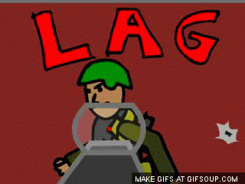

When network RTT is high…
Players are sensitive to as little as 60ms RTT!
Kyungmin Lee
Notes:
Dodge bullet
What can we possible do about this?

Slide 8
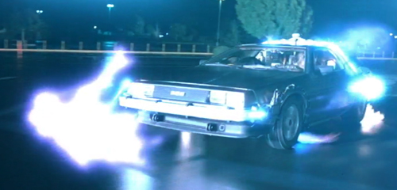
Our solution: Outatime
Predict future inputs and generate future frame
i₀ => i’₁, i’₂, i’₃, i’₄ => f’₅
Server
t₄
t₅
No perceived RTT delay
t₀
t₁
t₂
t₃
t₆
i₀
i₁
f’₅
f’₆
Client
t₀
t₁
t₂
t₃
t₄
t₅
t₆
t₇
t₈
f’₅
f’₆
f’₇
f’₈
i₀
i₄
Display predicted frame
or
Perform misprediction compensation
RTT=128ms, FPS=30fps (approx. 32ms/frame)
Kyungmin Lee
Notes:
Key insight

Slide 9

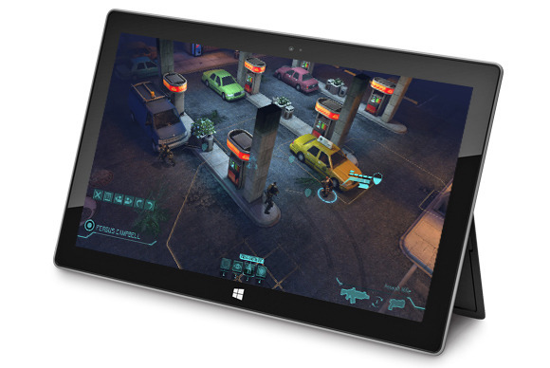

Outatime overview
Outatime client
Decode
Display
Capture/send user input
Outatime server
Receive user input
Run game logic
Render frame
Encode
Kyungmin Lee
Notes:
Color code
Popup animation

Slide 10
Outatime overview
Outatime client
Decode
Display
Capture/send user input
Outatime server
Receive user input
Run game logic
Perform speculation
Render speculated frame
Encode
Kyungmin Lee
Notes:
Color code
Popup animation

Slide 11
Outatime overview
Outatime client
Decode
Handle misprediction
Display
Capture/send user input
Outatime server
Receive user input
Run game logic
Perform speculation
Render speculated frame
Unwind misprediction
Encode
Kyungmin Lee
Notes:
Color code
Popup animation

Slide 12


Outatime overview
Supports up to 128ms RTT!
Outatime client
Decode
Handle misprediction
Display
Capture/send user input
Outatime server
Receive user input
Run game logic
Perform speculation
Render speculated frame
Unwind misprediction
Encode
Kyungmin Lee
Notes:
Color code
Popup animation

Slide 13
Outatime overview
Supports up to 128ms RTT!
Outatime client
Decode
Handle misprediction
Display
Capture/send user input
Outatime server
Receive user input
Run game logic
Perform speculation
Render speculated frame
Unwind misprediction
Encode
Kyungmin Lee
Notes:
Color code
Popup animation
There are so many actions user can perform, how can we deal with wide array of actions that user can perform. How can we cope with this?

Slide 14
Taxonomy of input events
Navigation
  LOOK up/down left/right
  MOVE forward/back left/right jump/duck
Impulse
  FIRE a gun
  SWING a sword
  CAST a spell
Delay tolerant
  Open in-game menu, switch weapons, …
Kyungmin Lee

Slide 15
Speculation for navigation events
Navigation Timeline
RTT = 8 ticks (256ms)
t₀
t₁
t₂
t₃
t₄
t₅
t₆
t₇
t₈
Left
? ? ? ? ? ? ? ?
Look right 2°
? ? ? ? ? ? ? ?
left
right
noop
Markov prediction
Kyungmin Lee
Notes:
Add few wrinkles plus few optimizations.

Slide 16
How accurate is it?
Accuracy
(Doom 3)
Network Latency RTT (ms)
Kyungmin Lee

Slide 17
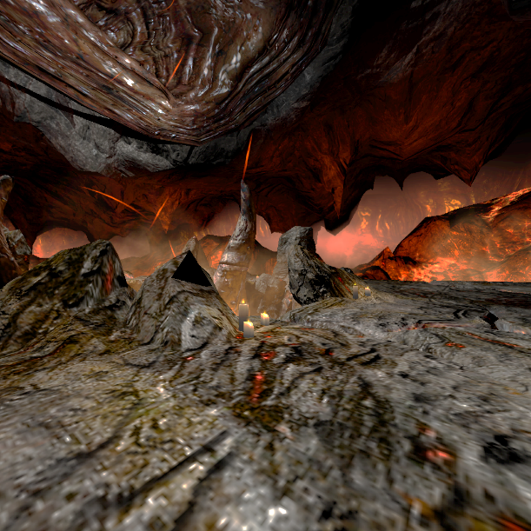

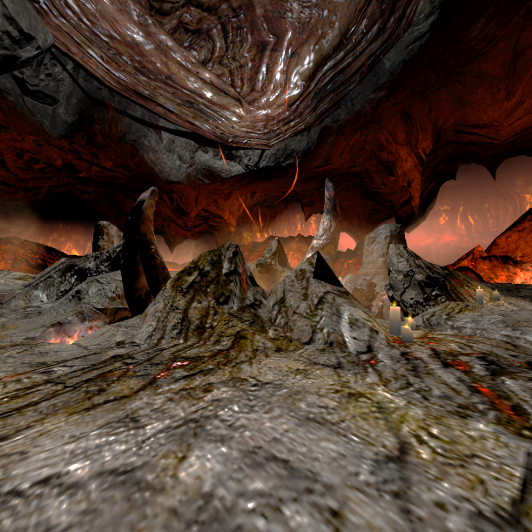
Handling misprediction:
Image based rendering (IBR)
+
Input Image
Input Depth
Output Image
Kyungmin Lee
Notes:
We need to approximate ground truth with our best guess somehow.

Slide 18
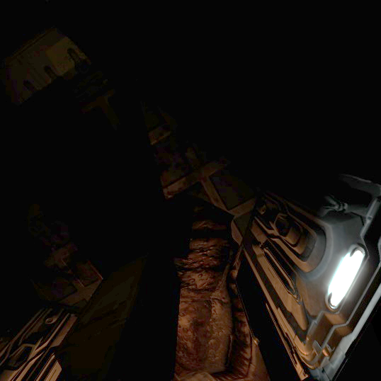
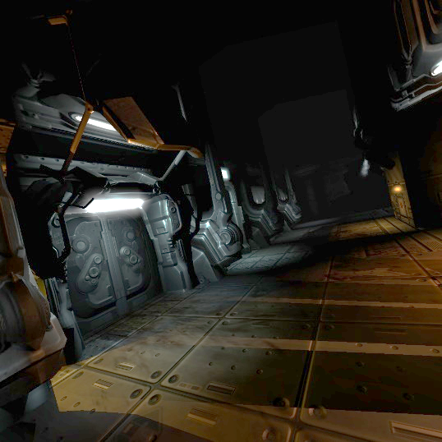
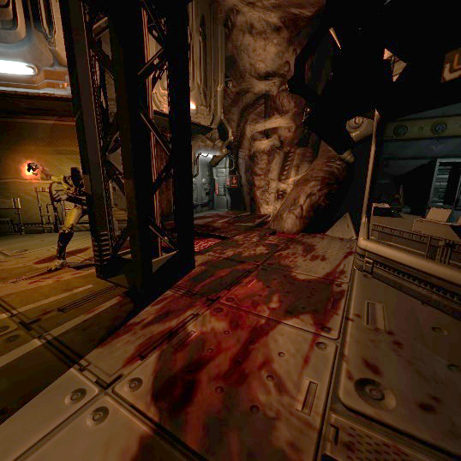
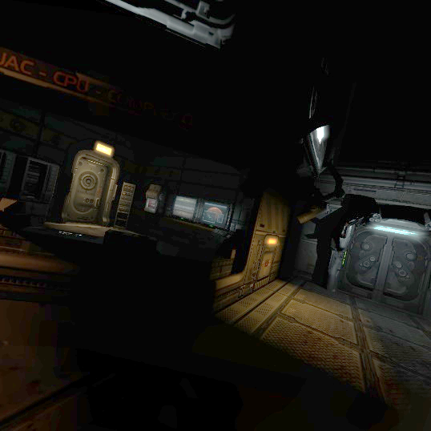
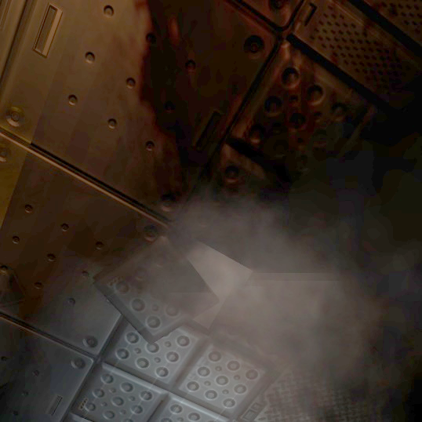
Cube map along with IBR
TOP
FRONT
CLIP
99% error coverage (degrees) as RTT increases
LEFT
RIGHT
(BACK not shown)
BOTTOM
Kyungmin Lee

Slide 19
Speculation for Impulse events
Impulse Timeline
RTT = 8 ticks (256ms)
t₀
t₁
t₂
t₃
t₄
t₅
t₆
t₇
t₈
Speculative Sequences
X
X
~X
X: fire
~X: no fire
X
X
~X
~X
X
X
X
~X
~X
256 choices!
X
………….
~X
X
X
X
X
~X
~X
~X
~X
X
~X
?
X
~X
X
X
~X
~X
~X
X
~X
X
~X
X
~X
~X
Kyungmin Lee
Notes:
Fire twitch-based sensitive action

Slide 20
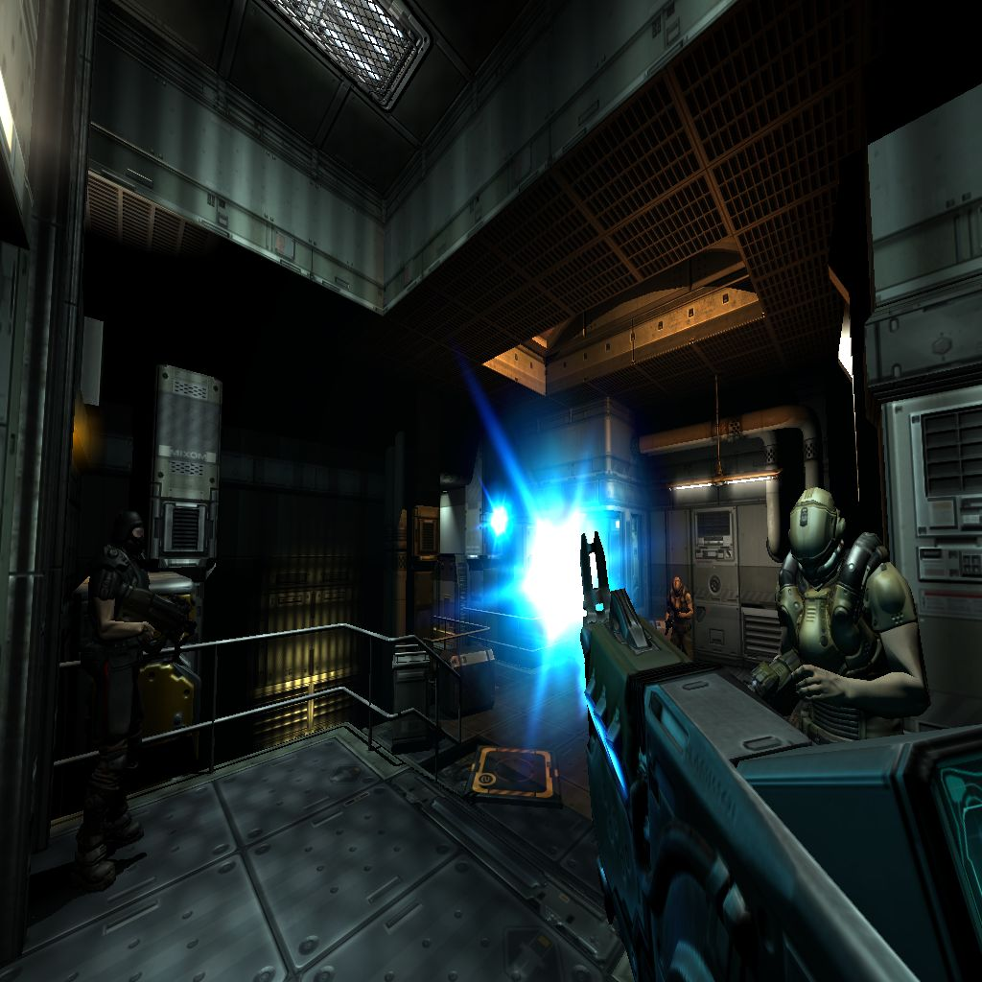
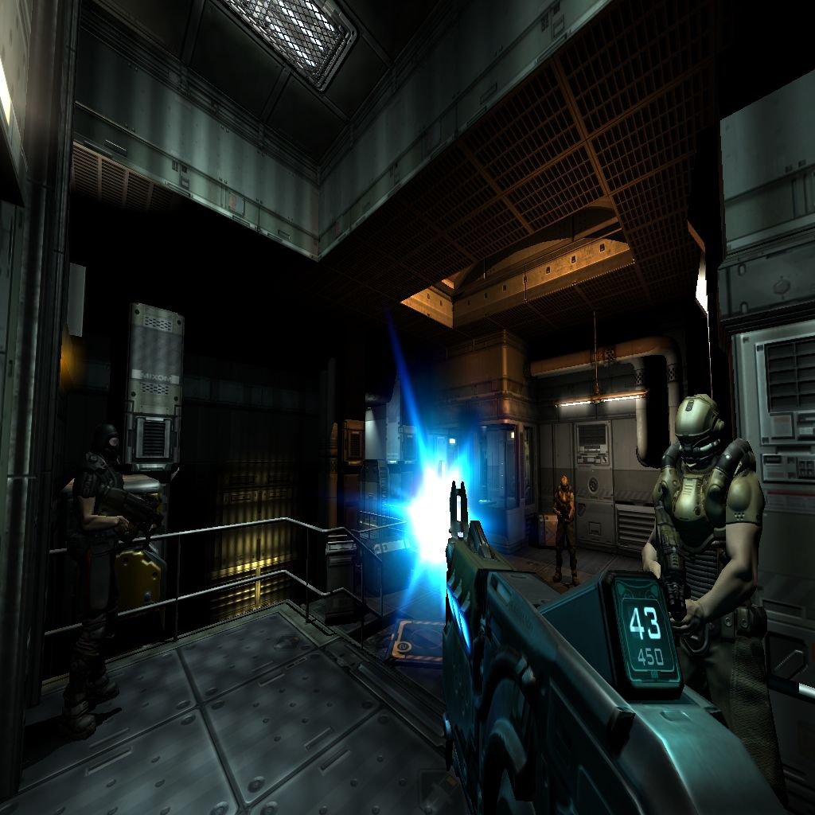
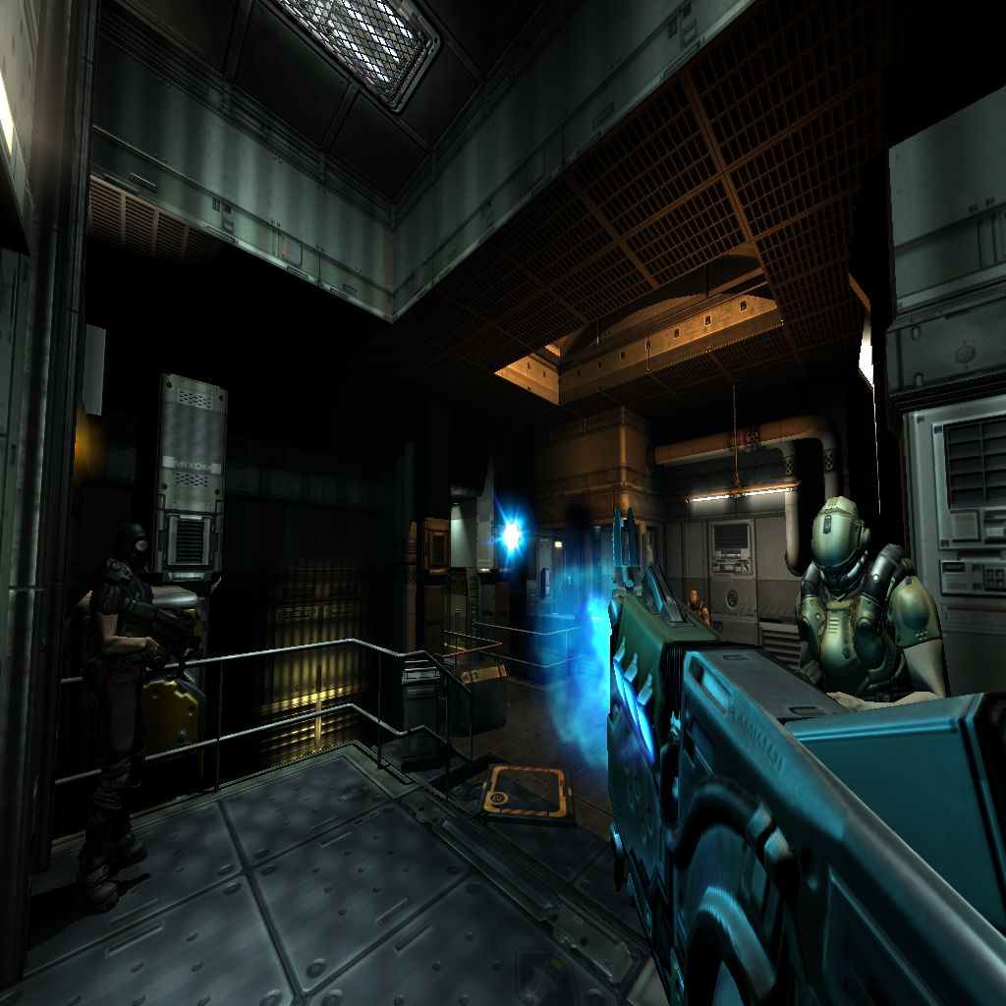
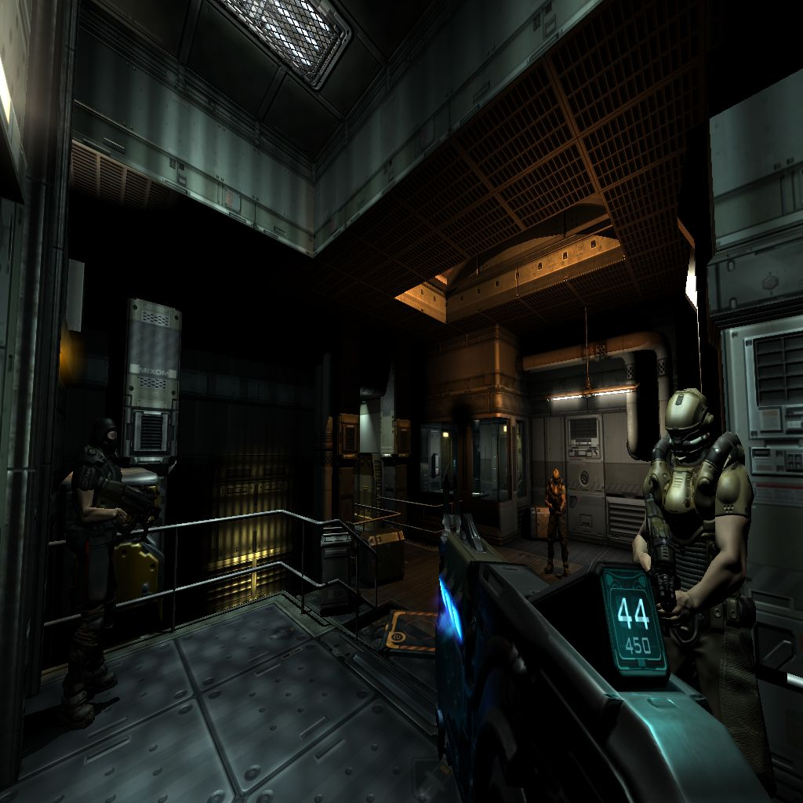
Time-shifting mechanism
Impulse Timeline
RTT = 8 ticks (256ms)
t₀
t₁
t₂
t₃
t₄
t₅
t₆
t₇
t₈
shift forward
shift backward
shift forward
X,X
Speculative Sequences
X,~X
X,?
?,?
~X,X
X: fire
~X: no fire
~X,?
~X,~X
Kyungmin Lee

Slide 21
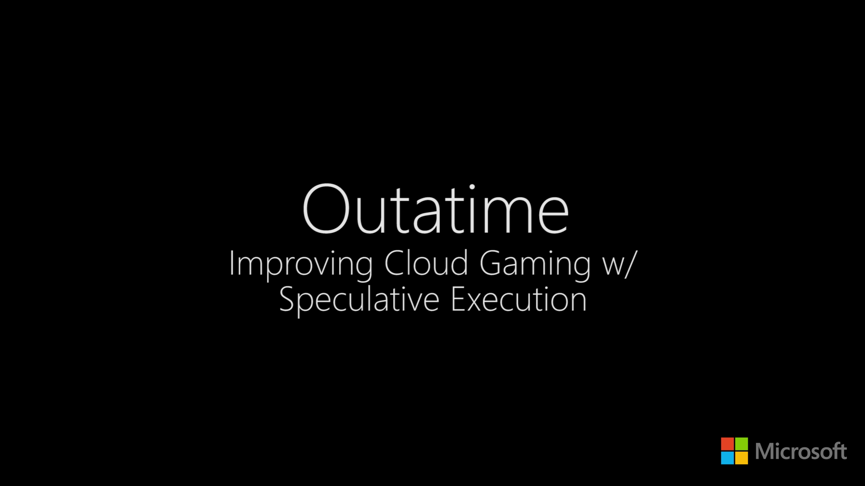
Kyungmin Lee
Notes:
But one thing this video doesn’t show how frustrated suers are

Slide 22
MOS score
Perfect
<Outatime @ 128ms RTT>
“Controls were fluid, animations worked as expected, no rendering issues on movement and no transition issues with textures”
Excellent
Barely acceptable
“Frame rate comfortable; liked the smoothness”
Mean Opinion Score (MOS)
Annoying
<Thin client @ 128ms RTT>
“Felt slow. Needed to guess actions to play”
Would not use
“Controls were extremely delayed”
Network Latency RTT (ms)
41 participants, many self-described“expert gamers”
Kyungmin Lee

Slide 23
Out of time, there is more!
Meeting FPS deadline (e.g., 30 or 60 fps)
  Fast speculation
  Fast checkpoint & restore
  Pack depth-map with frame image
  Fast capture & encode
Better visual experience
  Dealing with IBR artifacts (patching smears)
  Kalman-filtering for shake reduction
Kyungmin Lee

Slide 24
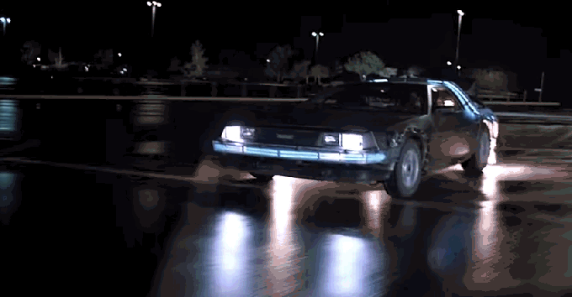
Conclusion
Speculation masks RTT for twitch interactions
Key techniques
  Navigation: Predict future state
  Gracefully handle misprediction
  Impulse: Reduce state space exploration
Outatime can support up to 128ms RTT
  Better game experience than standard thin-client
Kyungmin Lee
Notes:
The goal of this talk has been to show an architecture that allows one to play demanding mobile games on mobile devices.
We can offload, but we need to deal with high network latency in mobile network.

Slide 25
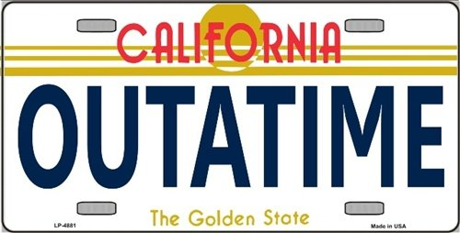
Questions?
Kyungmin Lee

Slide 26
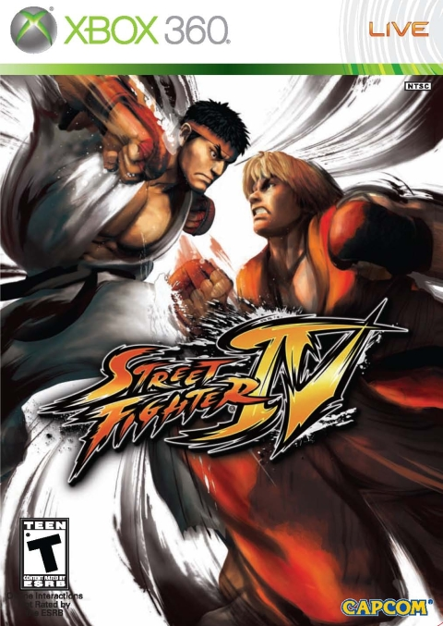


Work with other games?
Depends on impulse speculation’s state space
  Cannot support combo / complex actions
Navigation speculation + IBR -> Any games
✖
✖
✔
Kyungmin Lee

Slide 27
Network latency distribution
95th percentile
RTT to nearest server (ms)
Median
Type of connections
J. Huang et al. SigComm’13
Kyungmin Lee

Slide 28
Multiplayer
Outatime client #1
Outatime multiplayer server
Outatime client #2
S₀
S₁
S₁’
S₁’
S₁
S₀
S₂
S₂’
S₂’
S₂
<- - - -Time
S₁
S₁
S₁
S₃
S₂’
S₂’
S₃
S₁
Kyungmin Lee

Slide 29
Server performance
 | Ckpt & Restore | App Logic | Render | Encode | Total (ms)
Thin Client | N/A | 0.5±0.1 | 1.6±0.3 | 7.3±0.6 | 9.4±1.0
Outatime @64ms | 1.9±0.6 | 4.6±1.9 | 1.9±0.3 | 6.9±1.8 | 15.2±4.6
Outatime @128ms | 2.2±0.8 | 6.7±4.0 | 2.9±2.1 | 20.7±7.4 | 32.4±14.3
Outatime @256ms | 2.3±1.1 | 8.8±5.3 | 3.9±3.2 | 32.5±12.2 | 47.5±21.9
Kyungmin Lee

Slide 30
Client performance
Kyungmin Lee

Slide 31
Bandwidth overhead
4.54X overhead for RTT=256ms
1.97X overhead
For RTT=128ms
Kyungmin Lee

Slide 32
Check point & restore
Save & load is too slow
Hybrid approach
  Page level ckpt&restore for game objects
  Use inverse function calls when available
Method | Time (ms)
Built-in save game | 333000
Baseline object-only | 45.55
Outatime’s hybrid approach | 0.076
Kyungmin Lee

Slide 33
Evaluation setup
Server
  Quad core Intel i7, 16GB memory, Nvidia GTX 680
Client running locally with simulated RTT
User study
  Colleagues + local gaming group
  Play standard Doom 3 for the reference
  Blindly play Outatime or thin client (3~10 times)
  @ randomly selected {0, 64, 128, 256, 384ms} RTT
  Report game-play experience (MOS)
Kyungmin Lee

Slide 34
Outatime developer interface
Checkpoint & restore
“Approximation @ client” events
  Navigation events
  Train model using trace
  May need more complex than Markov model
“Approximation @ server” events
  Impulse events
  Decide how to reduce prediction state space
Kyungmin Lee

Slide 35

Architecture
Client
Server
Sample Input
Restore from Mis-speculation*
Update Simulation
Checkpoint to Updated State
Navigation Speculation
Impulse Speculation
Display Frame
RTT < threshold?
Image-Based Rendering
YES
NO
Kalman Shake Reduction*
Partial Cube Map + Depth Map Rendering*
Decode Bitstream
RX Bitstream
TX Bitstream
Joint Video Encoding
* As needed
Kyungmin Lee
Notes:
remove

