Slide 1
Predicting Replicated Database Scalability
Sameh Elnikety, Microsoft Research
Steven Dropsho, Google Inc.
Emmanuel Cecchet, Univ. of Mass.
Willy Zwaenepoel, EPFL
Notes:
1 = 1280 * 800
2= 1024 * 768
Extend desktop onto this monitor
Presentation mode off, two screens

Slide 2
Motivation
Environment
  E-commerce website
  DB throughput is 500 tps
Is 5000 tps achievable?
  Yes: use 10 replicas
  Yes: use 16 replicas
  No: faster machines needed
How tx workload scales on replicated db?
Single
DBMS
Notes:
How? Two designs.

Slide 3
Multi-Master Single-Master
Replica 1
Master
Replica 2
Slave 1
Replica 3
Slave 2

Slide 4
Background: Multi-Master
Standalone
DBMS
Replica 1
Load
Balancer
Replica 2
Replica 3

Slide 5
Read Tx
Read tx does not change DB state
Replica 1
T
Load
Balancer
Replica 2
Replica 3

Slide 6
Update Tx
Update tx changes
DB state
Replica 1
Load
Balancer
Replica 2
Cert
T
ws
ws
ws
ws
Replica 3

Slide 7
Additional Replica
Replica 1
Load
Balancer
Replica 2
Cert
T
ws
ws
ws
Replica 3
Replica 4
Replica 3
Notes:
Model shows this

Slide 8
Coming Up …
Standalone DBMS
  Service demands
Multi-master system
  Service demands
  Queuing model
Experimental validation

Slide 9
Standalone DBMS
Required
  readonly tx: R
  update tx: W
Transaction load
  readonly tx: R
  update tx: W / (1 - A₁)
Single
DBMS
Abort probability is A₁
Submit W / (1 - A₁) update tx
Commited tx: W
Aborted tx: W ∙ A₁ / (1- A₁)

Slide 10
Standalone DBMS
Required
  readonly tx: R
  update tx: W
Transaction load
  readonly tx: R
  update tx: W / (1 - A₁)
Single
DBMS

Slide 11
Service Demand

Slide 12
Multi-Master with N Replicas
Required (whole system of N replicas)
  Readonly tx: N ∙ R
  Update tx: N ∙ W
Transaction load per replica
  Readonly tx: R
  Update tx: W / (1 - A_{N})
  Writeset: W ∙ (N - 1)

Slide 13
MM Service Demand
Explosive cost!
Notes:
Important

Slide 14
Compare: Standalone vs MM
Standalone:
Multi-Master:
Explosive cost!
Notes:
Than home

Slide 15
Readonly Workload
Standalone:
Multi-Master:
Explosive cost!
Notes:
Than home

Slide 16
Update Workload
Standalone:
Multi-Master:
Explosive cost!
Notes:
Than home

Slide 17
Closed-Loop Queuing Model
Notes:
Assume you know all the values

Slide 18
Mean Value Analysis (MVA)
Standard algorithm
Iterates over the number of clients
Inputs:
  Number of clients
  Service demand at service centers
  Delay time at delay centers
Outputs:
  Response time
  Throughput

Slide 19
Using the Model

Slide 20
Standalone Profiling (Offline)
Copy of database
Log all txs, (Pr : Pw)
Python script replays txs
  Readonly (rc)
  Updates (wc)
Writesets
  Instrument db with triggers
  Play txs to log writesets
  Play writesets (ws)

Slide 21
MM Service Demand
Explosive cost!

Slide 22
Abort Probability
Predicting abort probability is hard
Single-master
  No prediction needed
  Measure offline on master
Multi-master
  Approximate using
  Sensitivity analysis in the paper

Slide 23
Using the Model
1 ms
1.5 ∙ fsync()
# clients, think time

Slide 24
Experimental Validation
Compare
  Measured performance vs model predictions
Environment
  Linux cluster running PostgreSQL
TPC-W workload
  Browsing (5% update txs)
  Shopping (20% update txs)
  Ordering (50% update txs)
RUBiS workload
  Browsing (0% update txs)
  Bidding (20% update txs)

Slide 25
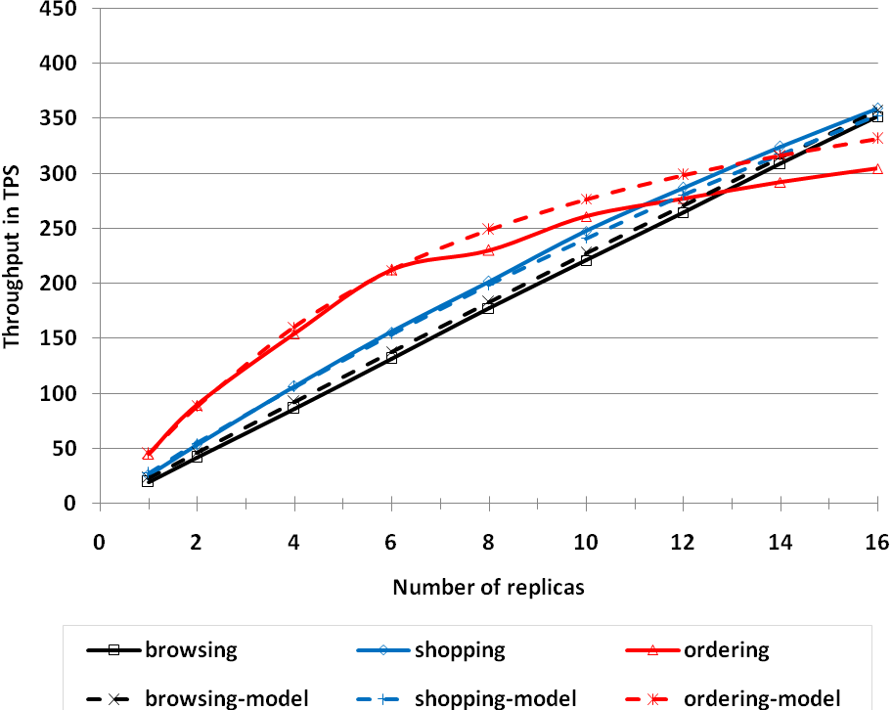
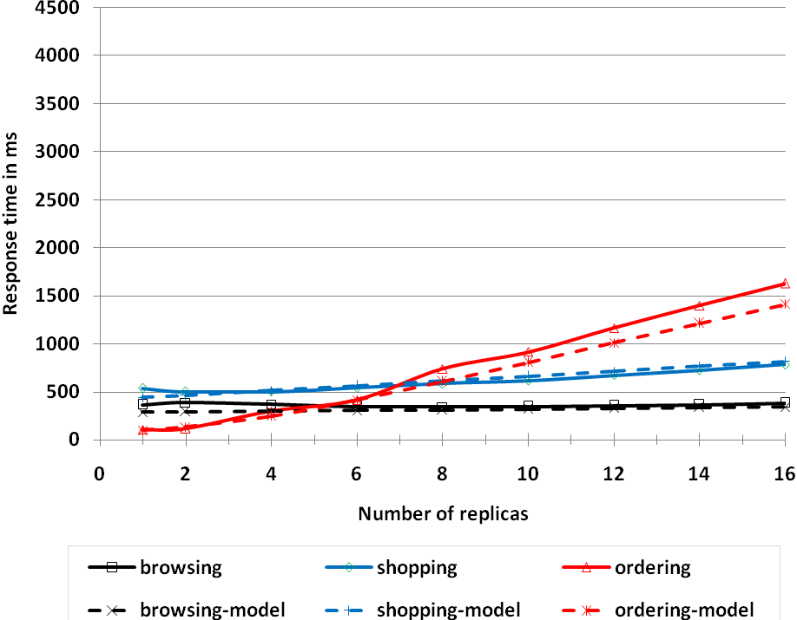
Multi-Master TPC-W Performance
Throughput Response time

Slide 26
15%
6.7 X
Ordering, 50% u
15.7 X
Browsing, 5% u

Slide 27
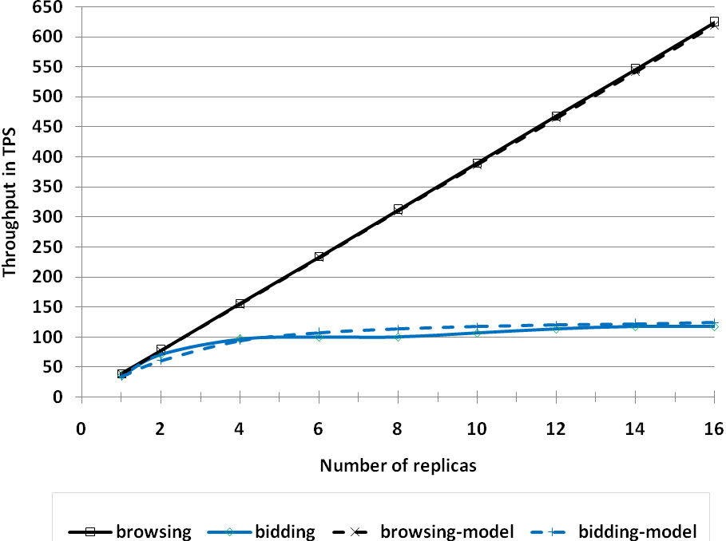
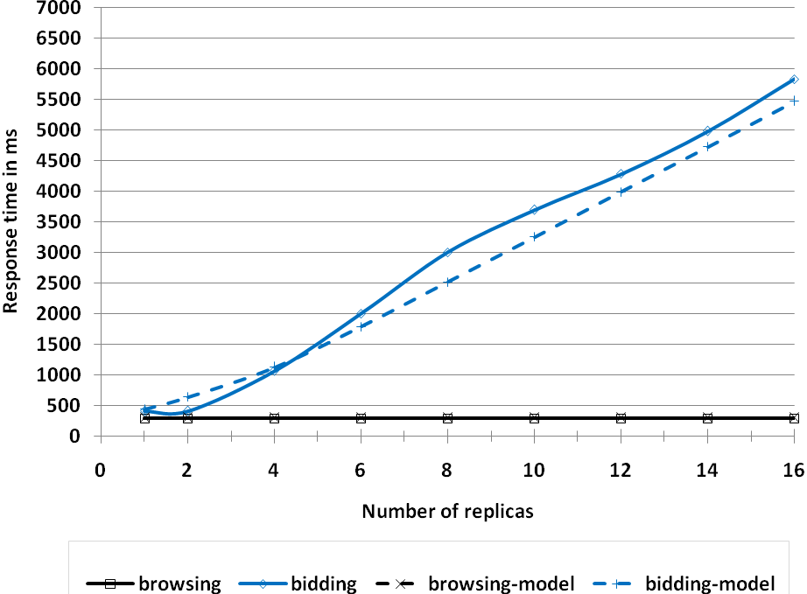
Multi-Master RUBiS Performance
Throughput Response time

Slide 28
16 X
Browsing, 0% u
bidding, 20% u
3.4 X

Slide 29
Model Assumptions
Database system
  Snapshot isolation
  No hotspots
  Low abort rates
Server system
  Scalable server (no thrashing)
Queuing model & MVA
  Exponential distribution for service demands

Slide 30
Checkout the Paper
Models
  Single-Master
  Multi-Master
Experimental results
  TPC-W
  RUBiS
Sensitivity analysis
  Abort rates
  Certifier delay

Slide 31
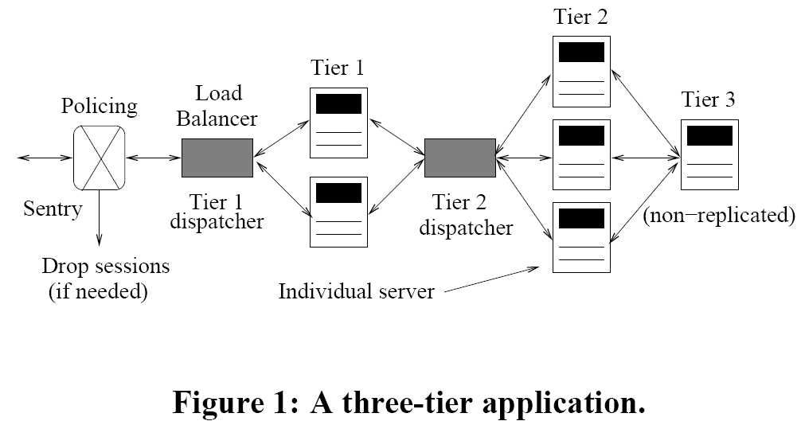
Related Work
Urgaonkar, Pacifici, Shenoy, Spreitzer, Tantawi.
“An analytical model for multi-tier internet services and its applications.” Sigmetrics 2005.

Slide 32
Conclusions
Derived an analytical model
  Predicts workload scalability
Implemented replicated systems
  Multi-master
  Single-master
Experimental validation
  TPC-W
  RUBiS
  Throughput predictions match within 15%

Slide 33
Danke Schön!
Questions?
Predicting Replicated Database Scalability

