Slide 1
Tians Scheduling: Using Partial Processing in Best-Effort Applications
Yuxiong He*, Sameh Elnikety*, Hongyang Sun⁺
*Microsoft Research
⁺ Nanyang Technological University

Slide 2
Background
Interactive services are an important part of data center workload
    Example: web search, web server, VOD server, etc.
    SLA
      Example: web search can require 99% results returned within 150ms.
Server utilization for interactive services is embarrassingly low
    Today high server utilization kills responsiveness and result quality.

Slide 3
Example
FIFO Server:
Norm. arrival rate = 0.3
CPU utilization = 30%
M/M/1 Queue
Mean service time = 15ms
Deadline = 100ms
Quality = 1 if it is fully serviced within deadline; 0 otherwise
Average quality ≥ 0.99
What is max system utilization?

Slide 4
Example
FIFO Server:
Arrival rate = 0.3
CPU utilization = 30%
M/M/1 Queue, FIFO Scheduling
Mean service time = 15ms
Deadline = 100ms
Quality = 1 if it is fully serviced within deadline; 0 otherwise
Average quality ≥ 0.99
What is max system utilization?
?

Slide 5
Motivation
FIFO Server:
Arrival rate = 0.3
CPU utilization = 30%
M/M/1 Queue, FIFO Scheduling
Mean service time = 15ms
Deadline = 100ms
Quality = 1 if it is fully serviced within deadline; 0 otherwise
Average quality ≥ 0.99
What is max system utilization?
Goal
* Sustain higher load while meeting SLA.
* Reduce hardware, energy and operational cost.

Slide 6
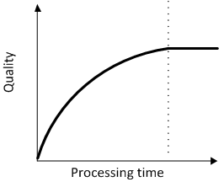
Characteristics of Interactive Services
Deadline with each request
Partial results
    Find the best available result within a predefined response time
Quality function
    Response quality improves with processing time ⬄ progressive
    Exhibits diminishing return ⬄ concave

Slide 7
Traditional System Tians System
Strict request model
flexible model with partial results
A
x
A’x
B’
x
Bx
+
Tians scheduler
Decide processing time of requests
Maximize overall response quality while meeting their deadline

Slide 8
Example
3 Jobs, deadline 100
 | J1 | J2 | J3 | Quality
Service demand | 90 | 20 | 100
FIFO | 90 | 10 | / | 0.98 + 0 + 0 = 0.98
FIFO + partial results | 90 | 10 | / | 0.98 + 0.27 + 0 = 1.25
Tians scheduling + partial results | 40 | 20 | 40 | 0.74 + 0.47 + 0.74 = 1.91
Benefits of partial results
Benefits of scheduling

Slide 9
Contribution
Propose Tians scheduling for interactive services, embracing partial results.
Present three scheduling algorithms
    Tians-Optimal (offline)
      Prove its optimality
    Tians-Clairvoyant (online clairvoyant)
    Tians-NonClairvoyant (online nonclairvoyant)
Evaluate Tians scheduling algorithms using simulation
    Improve response quality

Slide 10
Outline
Introduction
Scheduling model
Optimal offline algorithm
Online algorithms
Simulation results
Concluding Remarks

Slide 11
Scheduling Model
A set of requests
Each request has
    Arrival time
    Deadline
    Service demand
Quality function
    maps the processing time the request receives to a quality value
Scheduler
    assigns request processing time
    maximize total quality of all requests

Slide 12
Optimal Offline Algorithm: Tians-Optimal
Three Intuitions
When SOEP is feasible, SOEP is optimal.
An optimal schedule is composed by SOEP blocks.
Jobs in the busiest interval define a SOEP block.

Slide 13
Intuition 1
When SOEP is feasible, SOEP is optimal.
SOEP (service-oriented equi-partitioning) policy
    Each request gets equal share of processing time unless it requires less.
      Small requests get what they demand
      Large requests share equal processing time
Example: 3 Jobs, deadline 100ms
 | J1 | J2 | J3 | Quality
Service demand | 90 | 20 | 100
SOEP | 40 | 20 | 40 | 1.91

Slide 14
Intuition 2
SOEP is not always feasible because of deadlines
SOEP not feasible ➔ divide into sub-blocks
      Inside each sub-block, SOEP is feasible
An optimal schedule is composed by SOEP blocks.
How to identify the SOEP blocks?
SOEP block1
SOEP block2
SOEP block3

Slide 15
Intuition 3
Jobs in the busiest interval define a SOEP block.
Inside the block, assign processing time using SOEP

Slide 16
Intuition 3
Jobs in the busiest interval define a SOEP block.
Inside the block, assign processing time using SOEP
Remove the block and repeat the process on remaining requests.

Slide 17
Tians-Optimal
Divide and conquer algorithm:
Theorem: Tians-Optimal produces an optimal schedule to maximize the total quality of requests.
  Tians-Optimal([i,j]) {
  find the busiest block [k,h]
  apply SOEP on requests in block [k,h]
  Tians-Optimal ([i,k-1])
  Tians-Optimal ([h+1, j])
  }

Slide 18
Online Algorithms
Tians-Clairvoyant
      Know service demand of released requests
Apply Tians-Optimal on the set of ready requests.
Tians-Nonclairvoyant
      Do not know service demand of any requests
Apply Tians-Clairvoyant using mean service demand of requests
Key features of Tians scheduling:
    Share processing time equally among requests
Prevent long requests from starving short ones
Easy to implement in real systems : FIFO, no preemption

Slide 19
Simulation Results
Application
    Web Search Engine
      Search and rank matching documentss
Implement five algorithms
    Three Tians algorithms
    FIFO : no partial results
    FIFO-Partial : support partial results

Slide 20
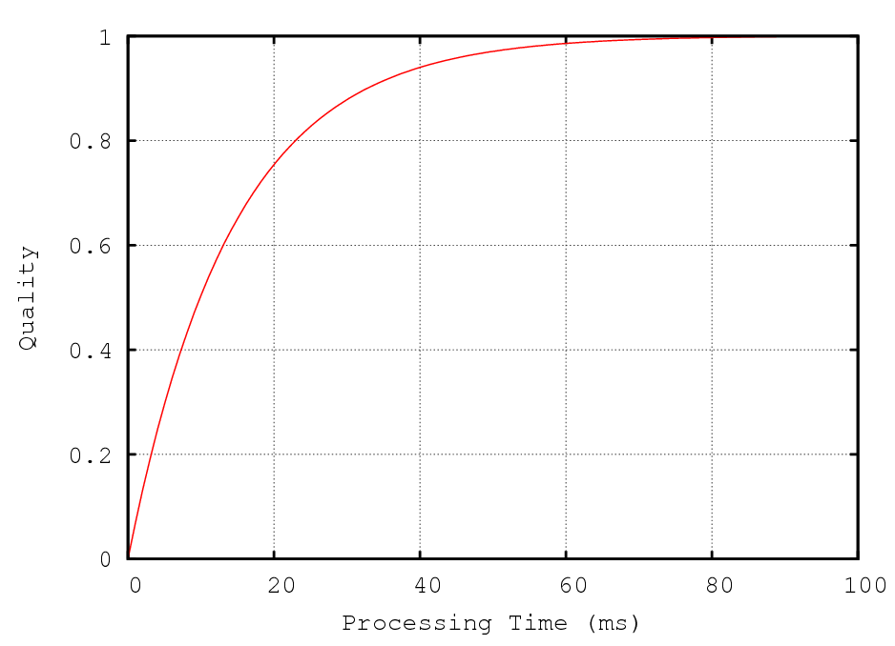
Web Search Engine
Setup
    Service demand exponential distribution with mean = 26ms
    Poisson arrival
    Quality function
    SLA
      Deadline 150ms
      Average quality ≥0.99

Slide 21
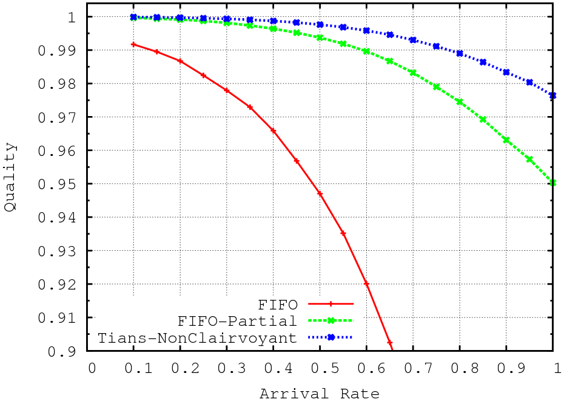
Simulation Result
FIFO
FIFO-Partial
Tians-Noncl
FIFO
Arrival rate 0.15
Utilization 15%
FIFO-Partial
Arrival rate 0.6
Utilization 60%
Tians-Noncl.
Arrival rate 0.78
Utilization 78%

Slide 22
Simulation Result
Gain from partial results
FIFO
FIFO-Partial
Tians-Noncl
FIFO
Arrival rate 0.15
Utilization 15%
FIFO-Partial
Arrival rate 0.6
Utilization 60%
Tians-Noncl.
Arrival rate 0.78
Utilization 78%

Slide 23
Simulation Result
Gain from better scheduling
Tians
FIFO
FIFO-Partial
FIFO
Arrival rate 0.15
Utilization 15%
FIFO-Partial
Arrival rate 0.6
Utilization 60%
Tians-Noncl.
Arrival rate 0.78
Utilization 78%

Slide 24
Simulation Result
420%
Tians-Noncl
Tians sustains more than 400% load.
Save 80% servers.
FIFO
FIFO-Partial
FIFO
Arrival rate 0.15
Utilization 15%
FIFO-Partial
Arrival rate 0.6
Utilization 60%
Tians-Noncl.
Arrival rate 0.78
Utilization 78%

Slide 25
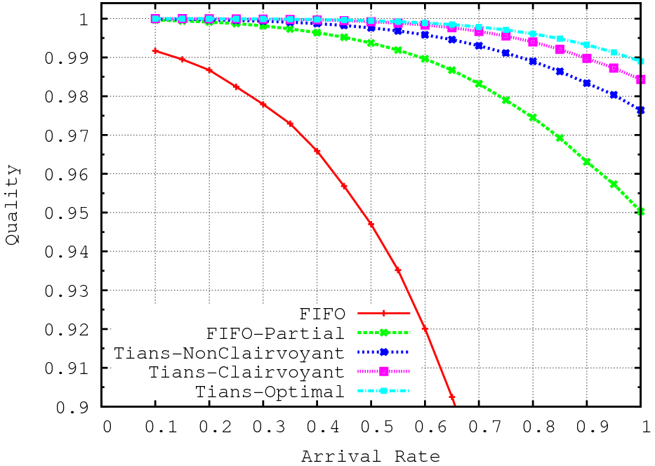
Simulation Result
FIFO
FIFO-Partial
Tians-Noncl
0.15
0.60
0.78
0.90
0.97

Slide 26
Simulation Result
Gain from knowing service demand
0.15
0.60
0.78
0.90
0.97

Slide 27
Simulation Result
Gain from knowing future
0.15
0.60
0.78
0.90
0.97

Slide 28
More Experiments
VOD Server
    Tians manages the upstream bandwidth
    Tians-Clairvoyant streams to 40% more clients than FIFO.
  Variance Reduction
    Partial results that produces smooth quality function
    Share processing time equally among requests

Slide 29
Conclusions
Tians
    Partial results + enhanced scheduling
Scheduling
    Share processing time equally among requests
    Prevent long requests from starving short ones
Simulation results
    Improve response quality
    To achieve the same QoS, Tians supports much higher system utilization than traditional server.

Slide 30

Future Work
Applying Tians in large-scale systems
Notes:
Tians is a new scheduling model. There are many new research problems. We are working on
We are doing this currently in Bing

Slide 31
Thank you!
Questions?

