Slide 1
Graph Data Management Systems for New Application Domains:
Social Networks & the Web of Data
Philippe Cudré-Mauroux | Sameh Elnikety
University of Fribourg Switzerland | Microsoft Research USA
Tutorial at VLDB 2011

Slide 2
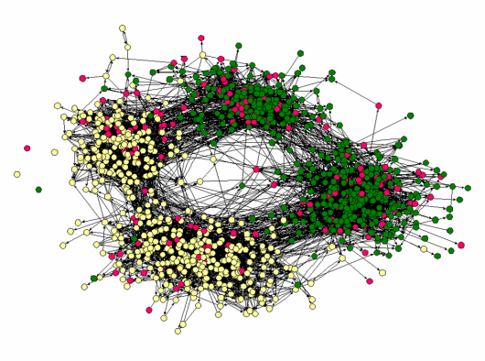
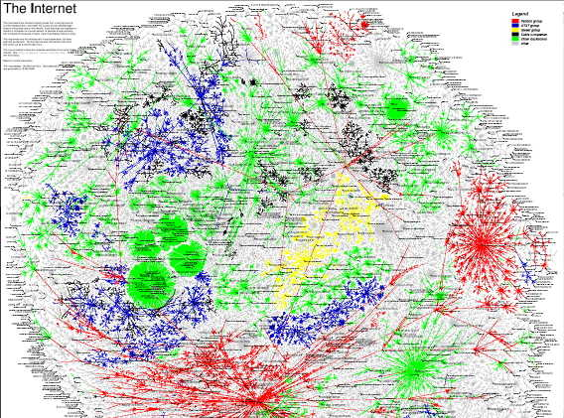
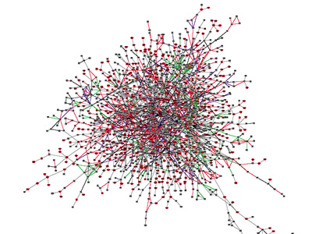
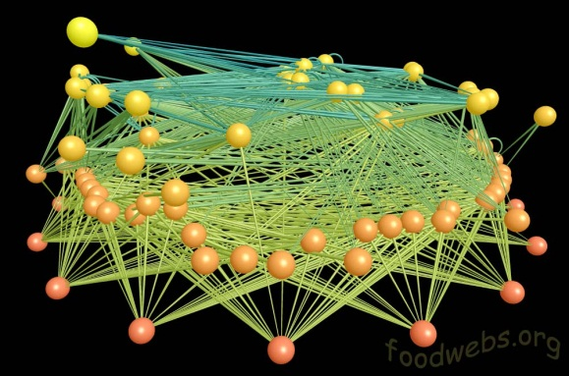
Welcome to Graphs
Friendship Network |  | Internet Map
[Moody’01] |  | [lumeta.com]
Protein Interactions |  | Food Web
[genomebiology.com] |  | [foodwebs.org]
Notes:
A graph represents entities and binary relationships among them

Slide 3
Graphs: Small and Large
Small graphs
  Manage a collection of small graphs
  Bioinformatics and cheminformatics
  Well studied
Large graphs
  One large graph, aka “network”
  Social network, and knowledge representation
  Less studied

Slide 4
Classes of Large Graphs
Random graphs
  Node degree is constrained
  Less common
Scale-free graphs
  Distribution of node degree follows power law
  Most large graphs are scale-free
  Small world phenomena & hubs
  Harder to partition
Notes:
Connected graph with small diameter

Slide 5
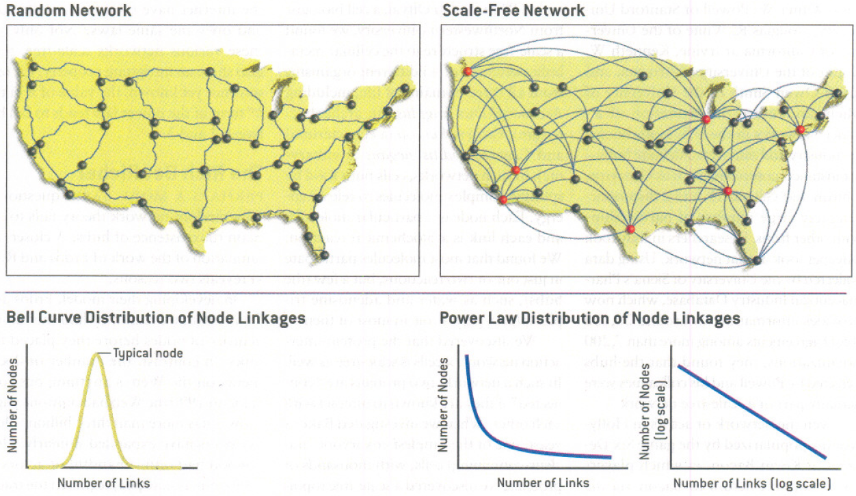
Classes of Large Graphs
Notes:
http://www.nd.edu/~networks/Publication%20Categories/01%20Review%20Articles/ScaleFree_Scientific%20Ameri%20288,%2060-69%20(2003).pdf
Scale-free networks. AL Barabasi, E Bonabeau Scientific American 288:55, 50-9, 5/2003.

Slide 6
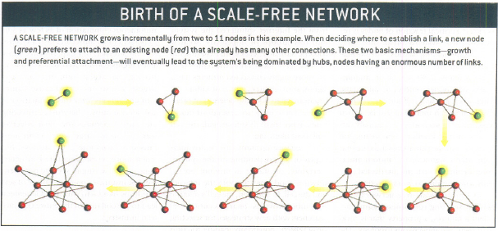
Organic Growth -> Scale Free
Notes:
http://www.nd.edu/~networks/Publication%20Categories/01%20Review%20Articles/ScaleFree_Scientific%20Ameri%20288,%2060-69%20(2003).pdf

Slide 7
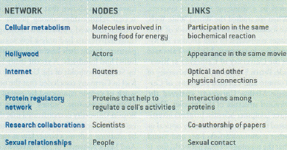
Examples of Organic Growth
Notes:
DBLP citation network
http://www.nd.edu/~networks/Publication%20Categories/01%20Review%20Articles/ScaleFree_Scientific%20Ameri%20288,%2060-69%20(2003).pdf

Slide 8
Generating a Large Graph
Random graph
  Fix the number of nodes (no growth)
  Each edge connects two random nodes
Scale-free graph
  Copy model
    Add new node
      Take percentage of links from another node
  Kronecker graphs
Notes:
http://www.nd.edu/~networks/Publication%20Categories/01%20Review%20Articles/ScaleFree_Scientific%20Ameri%20288,%2060-69%20(2003).pdf

Slide 9
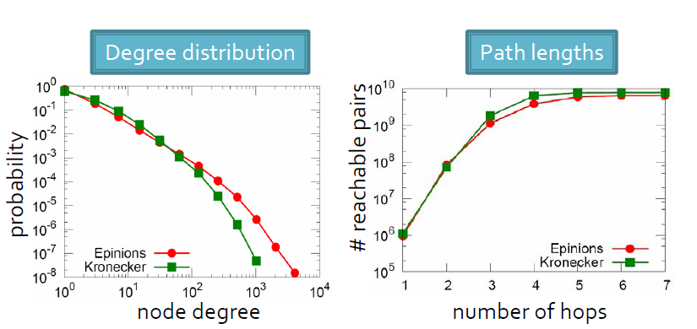
Kronecker Graph Example
Epinions (N=76K, E=510K)
Fitting time = 2 hours
Real and Kronecker graphs are close
Notes:
Kronecker Graphs: An Approach to Modeling Networks
Authors:Jure Leskovec, Deepayan Chakrabarti, Jon Kleinberg, Christos Faloutsos, Zoubin Ghahramani
http://arxiv.org/abs/0812.4905
http://videolectures.net/icml07_leskovec_smrg/

Slide 10
Let’s Go Hyper!
Hyper-edge
  A traditional edge is binary
  A hyper edge relates n nodes
    Order can be important
    Child-of edge versus father, mother, child hyper-edge
Hyper-node
  A traditional node represents one entity
  Hyper node represents a set of nodes
    Person node versus family hyper-node
Notes:
Small world effect
Duality of nodes and edges

Slide 11
Roadmap
Intro to Graphs
Social Networks
  Data Model
  Queries
  Processing
Web of Data
  Data Model
  Queries
  Processing
Systems
Current Research Directions

Slide 12
Social Networks
Scale
  LinkedIn
    70 million users
  Facebook
    500 million users
    65 billion photos
Queries
  Alice’s friends
  Photos with friends
Rich graph
  Types, attributes

Slide 13
Social Networks: Data Model
Node
  ID, type, attributes
Edge
  Connects two nodes
  Direction, type, attributes
App
System
Notes:
Multi graphs

Slide 14
Managing Graph Data
Here we focus on online access
  Rather than offline access
    Network analytics and graph mining
Queries
  Read
Updates
  Data update: change node payload
  Structural update: modify nodes and edges

Slide 15
Updates: API
add-node(node-id, payload)
remove-node(node-id)
update-node(node-id, payload)
add-edge(s-node-id, d-node-id)
remove-edge(s-node-id, d-node-id)
Notes:
Most are short
Automatic updates

Slide 16
Graph Query Languages
Several languages
Trade-off
  Expressiveness
  Execution
Regular language reachability
  Used in Horton
RL
SQL
Notes:
Write a program
declarative

Slide 17
Regular Language
Query is a regular expression
  Sequence of node and edge predicates
Example
  Find Alice’s photos
  Photo, tags, Alice
  Query =
    Node: type=photo,
    Edge: type=tags,
    Node: type=person, name = Alice
  Result: matching paths

Slide 18
Query Language Operators
Projection
  Alice’s photos
  SELECT photo FROM photo, tags, Alice
OR
  (Photo | video), tags, Alice
Kleene star
  Alice’s org chart
  Alice, (manages, person)*

Slide 19
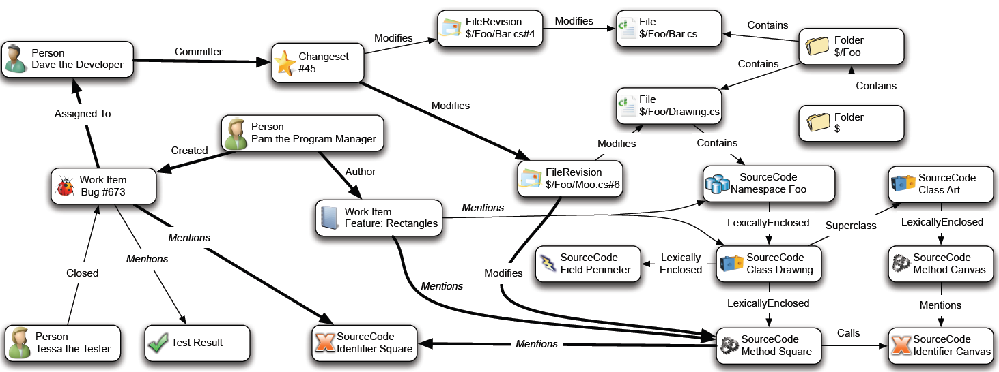
Example: CodeBook - Graph
Notes:
Andrew Begel, Khoo Yit Phang, and Thomas Zimmermann, Codebook: Discovering and Exploiting Relationships in Software Repositories, in Proceedings of the ACM/IEEE 32nd International Conference on Software Engineering, Association for Computing Machinery, Inc., 2 May 2010

Slide 20
Example: CodeBook - Queries
  Person, FileOwner>, File, FileOwner<, Person
  Person, DiscussionOwner>, Discussion, DiscussionOwner<, Person
  Person, WorkItemOwner>, WorkItem, WorkItemOwner< , Person
  Person, Manages<, Person, Manages>, Person
  Person, WorkItemOwner>, WorkItem, Mentions>, File, FileOwner<, Person
  Person, FileOwner>, File, Mentions>, WorkItem, Mentions>, File, FileOwner<, Person
  Who are my colleagues?
  Who is calling my code?
  Who introduced a bug in my code?
Notes:
Andrew Begel, Khoo Yit Phang, and Thomas Zimmermann, Codebook: Discovering and Exploiting Relationships in Software Repositories, in Proceedings of the ACM/IEEE 32nd International Conference on Software Engineering, Association for Computing Machinery, Inc., 2 May 2010
10s of such queries
Who is using my code
Who changes my code

Slide 21
Example Execution Engine
Executing RL query
  Build a FSM
  Optimize FSM
  Execute FSM using distributed graph traversal

Slide 22


Centralized Query Execution
Alice
Tags
Photo
Alice, Tags, Photo
S0
S1
S2
S3
Traversal similar to Breadth First
Answer Paths:
Alice, Tags, Photo1
Alice, Tags, Photo8

Slide 23
Distributed Query Execution
Alice, Tags, Photo, Tags, Hillary
Partition 1
Partition 2
Notes:
Batching messages
Bulk synch
Steps are computation, then communication
Message contents: which state in fsm + partial path so far

Slide 24
Distributed Query Execution
Alice, Tags, Photo, Tags, Hillary
Partition 1
Partition 2
FSM
S0
Partition 1
Step 1
Alice
Alice
S1
Tags
Step 2
S2
Photo1
Photo8
Photo
S3
Tags
S4
Step 3
Hillary
Hillary
Partition 2
S5
Notes:
Steps are computation, then communication
Message contents: which state in fsm + partial path so far
Batching messages
Bulk synch

Slide 25
Sub-graph Matching
  From: path
      Sequence of predicates
  To: sub-graph
      Graph pattern
  Sub-graph isomorphism

Slide 26
Mappings Are Not Rigid
Example
  Edge are entities
    Types, attributes, ids
  Supporting edge entities
  Supporting hyper-nodes and hyper-edges
Notes:
Duality

Slide 27
Roadmap
Intro to Graphs
Social Networks
  Data Model
  Queries
  Processing
Web of Data [WoD]
  Data Model
  Queries
  Processing
Systems
Current Research Directions

Slide 28
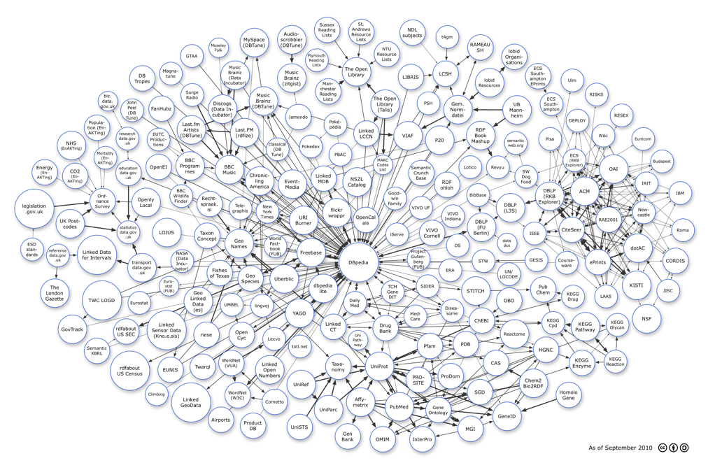
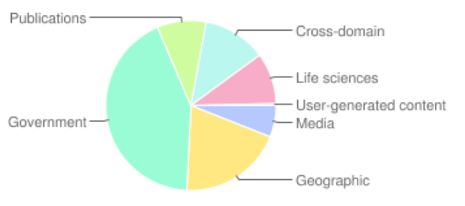
Example: Linked open Data[LoD]
Scale
  Hundreds of data sets
  30B+ tuples
Queries
  SPARQL
Domains
http://www4.wiwiss.fu-berlin.de/lodcloud/state/

Slide 29
Linked Open Data Principles
Four basic principles [Berners-Lee06]
  Use URIs to identify things.
  Use HTTP URIs to dereference URIs
  Provide structured data about URI in RDF
  Include links to related URIs

Slide 30

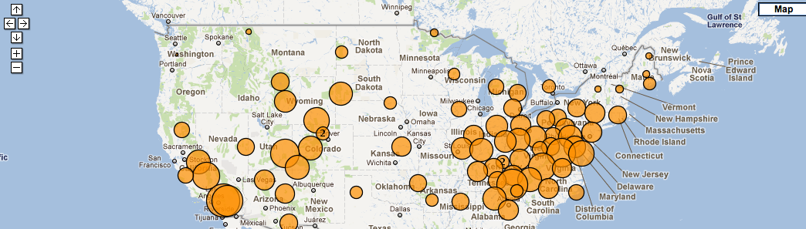
LoD Application Example
ozone level visualization
2 data sets
  clean air status [data.gov]
  Castnet site information [epa.gov]
2 SPARQL queries
data.gov
epa.gov

Slide 31
Web of Data: Data Model (1)
Structured data
  Resource Description Framework (RDF) [Manola04]
Triples!
  1:subject, 2:predicate, 3:object
  ex.: philippe, made, idmesh_paper:
  1: http://data.semanticweb.org/person/philippe-cudre-mauroux
  2: http://xmlns.com/foaf/0.1/made
  3: http://data.semanticweb.org/conference/www/2009/paper/60

Slide 32
Web of Data: Data Model (2)
Naturally forms (distributed) graphs
Nodes
  URIs [subjects]
  URIs / literals [objects]
Edges
  URIs [predicates]
  Directed
Philippe
Idmesh paper
made

Slide 33
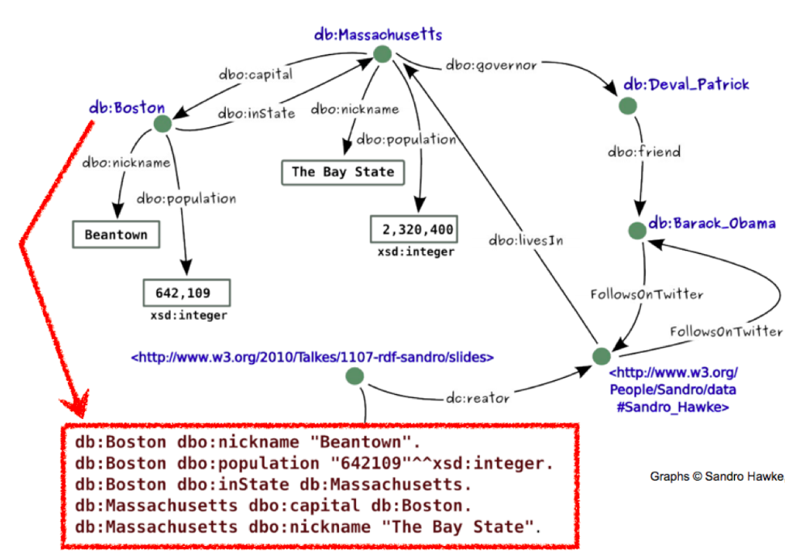
Web of Data: Data Model (3)
Example

Slide 34
RDF Schemas (RDFS) [Brickley04]
Classes, inheritance
  Class, Property, SubClass, SubProperty
Constraints on structure
  Constraints on subjects (Domain)
  Constraints on objects (Range)
Collections
  List, Bag
Reification
Schemas can be reused, mixed

Slide 35
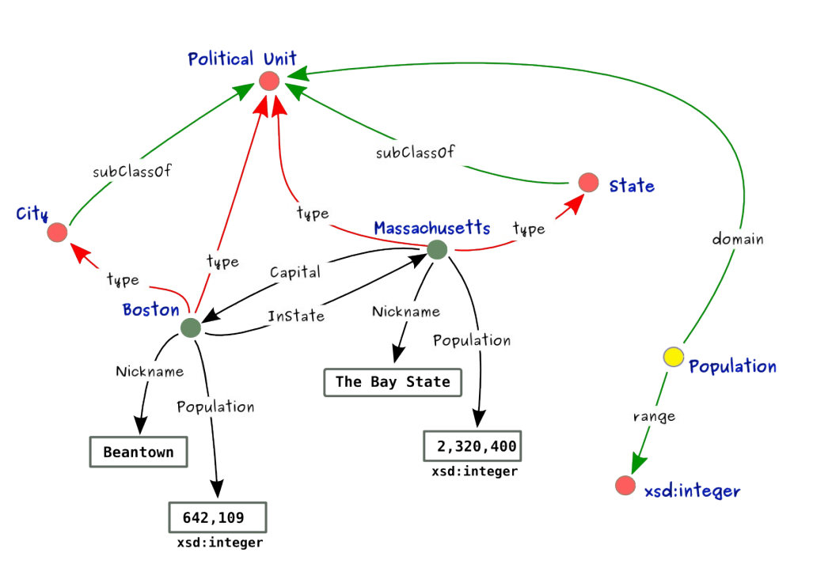
RDFS Example

Slide 36
Ontologies (OWL) [W3COWL09]
  Very expressive schemas (ontologies)
  Based on Description Logics
    Exists in different flavors
  Example: OWL 2 EL axioms:
    class inclusion (SubClassOf)
    class equivalence (EquivalentClasses)
    class disjointness (DisjointClasses)
    object property inclusion (SubObjectPropertyOf) with or without property chains, and data property inclusion (SubDataPropertyOf)
    property equivalence (EquivalentObjectProperties and EquivalentDataProperties),
    transitive object properties (TransitiveObjectProperty)
    reflexive object properties (ReflexiveObjectProperty)
    domain restrictions (ObjectPropertyDomain and DataPropertyDomain)
    range restrictions (ObjectPropertyRange and DataPropertyRange)
    assertions (SameIndividual, DifferentIndividuals, ClassAssertion, ObjectPropertyAssertion, DataPropertyAssertion, NegativeObjectPropertyAssertion, andNegativeDataPropertyAssertion)
    functional data properties (FunctionalDataProperty)
    keys (HasKey)
  Inference! ex.: TransitiveObjectProperty(hasAncestor)
  hasAncestor(x, y) ∧ hasAncestor(y, z) → hasAncestor(x, z)

Slide 37
RDF Storage (1)
XML/JSON Serialization
  Exchange format
    Not meant for humans (ugly)
    Not meant for DBMSs (verbose)
  Example:
<rdf:RDF xmlns:rdf="http://www.w3.org/1999/02/22-rdf-syntax-ns#"
xmlns:db="http://dbpedia.org/resource/">
<rdf:Description rdf:about="http://dbpedia.org/resource/Massachusetts">
<db:Governor>
<rdf:Description rdf:about="http://dbpedia.org/resource/Deval_Patrick" />
</db:Governor>
<db:Nickname>Bay State</db:Nickname>
<db:Capital>
<rdf:Description rdf:about="http://dbpedia.org/resource/Boston">
<db:Nickname>Beantown</db:Nickname>
</rdf:Description>
</db:Capital>
</rdf:Description>
</rdf:RDF>

Slide 38
RDF Storage (2)
RDFa
  Embedding RDF information in HTML pages
  Supported by Google, Yahoo, etc
  Example:
<body>
<div about="http://dbpedia.org/resource/Massachusetts">The Massachusetts governor is
<span rel="db:Governor">
<span about="http://dbpedia.org/resource/Deval_Patrick">Deval Patrick
</span>,
</span>
the nickname is "<span property="db:Nickname">Bay State</span>",
and the capital
<span rel="db:Capital">
<span about="http://dbpedia.org/resource/Boston">
has the nickname "<span property="db:Nickname">Beantown</span>".
</span>
</span>
</div>
</body>

Slide 39
RDF Storage (3)
Various internal formats for DBMSs
  Giant triple table (triple stores)
    |subject|predicate|object|
  Property tables
    |subject|property1|property2|property3|…|
  Sub-graphs

Slide 40
WoD: Workloads
Bulk inserts
Read-mostly
  Node/triple look-ups
  Distributed entity retrieval queries
  Sub-graph queries
  Path queries
  Inference queries
Mostly using SPARQL query language [Prud'hommeaux08]
  Alternatives exist, e.g., “Thread: A Path-Based Query Language” [McDonald11]

Slide 41
SPARQL (1/2)
Declarative query language for SW data
SPJ combinations of triple patterns
  E.g., “Retrieve all students who live in Seattle and take a graduate course”
  Select ?s Where {
  ?s is_a Student
  ?s lives_in Seattle
  ?s takes ?c
  ?c is_a GraduateCourse }

Slide 42
SPARQL Query Execution
Typically start from bound variables and performs self-joins on giant triple table
  Select ?s Where {
  ?s is_a Student
  ?s lives_in Seattle
  ?s takes ?c
  ?c is_a GraduateCourse }
  π_{s} σ_{p=“is_a” ∧ o=“Student”}
  ⨝ π_{s} σ_{p=“lives_in” ∧ o=“Seattle”}
  ⨝ π_{s} (σ_{p=“takes” o}⨝_{s} σ_{p=“is_a” ∧ o=“GraduateCourse”})

Slide 43
SPARQL (2/2)
Beyond conjunctions of triple patterns
  Named graphs
  Disjunctions
    UNION
    OPTIONAL (semi-structured data model)
  Predicate filters
    FILTER (?price < 30)
  Duplicate handling (bag semantics)
    DISTINCT, REDUCED
  Wildcards
  Negation as failure
    WHERE { ?x foaf:givenName ?name .
    OPTIONAL { ?x dc:date ?date } .
    FILTER (!bound(?date)) }

Slide 44
SPARQL 1.1 [Harris11]
Candidate recommendation
Adds a whole new set of beasts
  Aggregates
  Subqueries
  Filters
    EXISTS, NOT EXISTS
  Property paths (? + * ^ / | )
  Inference queries
    Entailment regimes[Glimm11]

Slide 45
Sub-graph Queries (1)
Molecule queries
  Star-shape sub-queries
  Combining properties of a given entity
  E.g., “Retrieve the first name, last name and full address of all students”
12512
student ID
Main st
street
zip
address
Student23
first name
“Bob”
02144
city
takes
Brookline
last name
“Doe”
Course21

Slide 46
Sub-graph Queries (2)
Scope queries
  Retrieve all triples within a certain scope from a given root node (typically for visualization purposes)
  E.g., scope 1 from “Student23”
12512
student ID
Main st
street
zip
address
Student23
first name
“Bob”
02144
city
takes
Brookline
last name
“Doe”
Course21

Slide 47
Path Queries (1)
Property path queries
  Queries on series of predicates
E.g., “find all professors who supervise students following courses”
12512
student ID
Is_a
supervises
takes
Professor
Prof32
Student23
Course21
first name
last name
“Bob”
“Doe”

Slide 48
Path Queries (2)
Various sub-flavors
  Frequent path queries
    For optimization or visualization purposes
    E.g., “Find the most frequent paths of length 2”
  Regular expressions for properties (SPARQL 1.1)
    ? + * ^ / |
    E.g., “find reachable friends through 2 different paths”
      SELECT * WHERE {
      :John (foaf:friendOf|urn:friend)+ ?friend. }

Slide 49
Inference Queries
Additional data can be inferred using various sets of logical rules
Specify which ones to use by entailment regimes [Glimm11]
  RDF Schema has 14 entailment rules
    E.g., (p,rdfs:domain,x) && (u, p, y)
    => (u rdf:type x)
  OWL 2 RL has 70+ entailment rules.
    E.g., (p,rdf:type,owl:FunctionalProperty ) && (x, p, y1) && (x,p,y2)
    => (y1, owl:sameAs, y2)

Slide 50
RDF/OWL Benchmarks
Large choice of benchmarks, e.g., focusing on
  Large knowledge bases (LUBM) [Guo05]
  Library search and visualization (Barton) [Abadi07]
  Linked Open Data (BSBM) [Bizer11]
  RDF Analytics (BowlognaBench) [Demartini11]

Slide 51
Roadmap
Intro to Graphs
Social Networks
  Data Model
  Queries
  Processing
Web of Data [WoD]
  Data Model
  Queries
  Processing
Systems
Current Research Directions

Slide 52
WoD Systems
Many interesting approaches/systems
Only very small sample here

Slide 53
RDF-3X [Neumann08]
Max Planck Institut für Informatik
  Thomas Neumann & Gerhard Weikum
Open-Source
Triple-table storage
No turning knobs
  Workload-independent physical design
Reduced instruction set
  Merge-joins over sorted lists

Slide 54
RDF-3X: Storage and Indexing
Dictionary encoding of all literals
Exhaustive-indexing approach
  Clustered B+-trees on all six SPO permutations (see also Hexastore [Weiss08])
  Also on six binary and three unary projections
    Indexing count aggregates
  Support for versioning by two additional fields for each triple
    Created and deleted timestamps

Slide 55
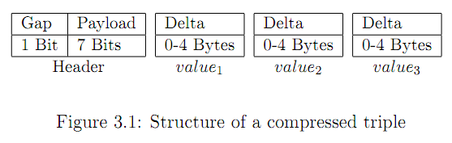
RDF-3X: Compression
  Triples stored at the leaves of the tree
    Value1, Value2, Value3
  Neighboring triples are often very similar
    Value1 and Value2 the same
Leaf pages use byte-wise compression
  Store deltas for each value
Triple often encoded in a single byte

Slide 56
RDF-3X: Query Optimization
Triple pattern
  Single range scan
Multiple triple patterns
  Order-preserving merge-joins
  Join ordering
    Dynamic programming; tradeoff between
      Use literals in triple patterns as index prefix
      Produce interesting orders for subsequent merge-joins
    Plan pruning based on estimated execution costs
    Costs based on selectivity estimates
      Histograms
      Join-path cardinalities

Slide 57
Oracle Semantic Web Technologies
Part of Oracle Database 11g
  http://www.oracle.com/technetwork/database/options/semantic-tech/index.html
RDF data stored in two main tables
  Nodes, edges
Optional B-tree indexing
  add_sem_index(column_list)
Mixing SQL and SPARQL
  SEM_MATCH
Efficient inference

Slide 58
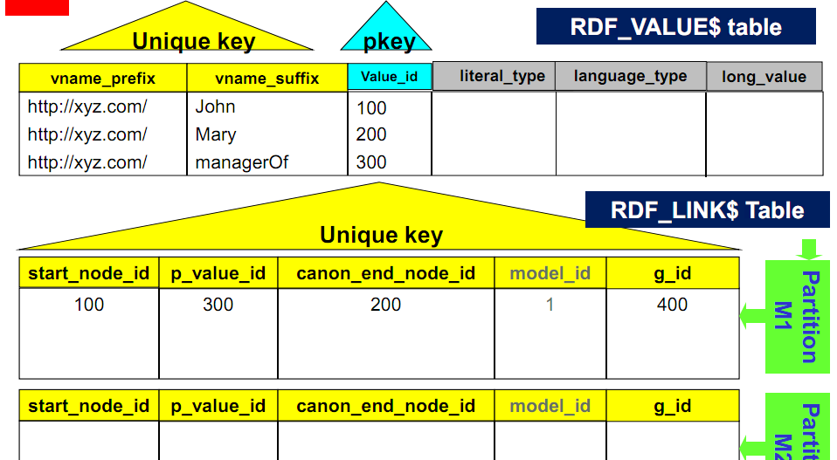
Oracle: Triple Storage

Slide 59
Oracle: Inference
Inference done using forward chaining
  Triples inferred and stored ahead of query time
Various profiles supported
  RDFS, OWL 2 RL, SKOS, subset of OWL 2 EL
Large scale owl:sameAs handling
  Compact materialization of owl:sameAs closure
User-defined SWRL-like rules
Incremental, parallel reasoning

Slide 60
OWLIM [Bishop11]
Commercial, native RDF/OWL DBMS
  Comes in different flavors
    Main-memory
    Disk-based
      Persistency through N-triple files
  Scalable forward-chaining inference
  Several interesting search/ranking features

Slide 61
OWLIM: Searching & Ranking
Full-text search support
  Arbitrary string operations in SPARQL
RDF ranking
  Relevance of entities based on their interconnectedness
RDF “priming”
  Contextualized query processing based on starting nodes
Publish/subscribe mechanisms

Slide 62
dipLODocus[RDF] [Wylot11]
Blazing-fast, hybrid storage system for RDF
  Aggressive compression (lexicographical tree)
  Pre-computed joins (declarative molecule storage)
  Efficient support for aggregate/analytic operations on literals
http://diuf.unifr.ch/xi/diplodocus

Slide 63
Graph Systems
Relational: SQL
Triple store: SPARQL
Custom graph server: API

Slide 64
Graph Servers
Neo4j
InfiniteGraph
Google Pregel
Microsoft Horton & Trinity
DEX
…
Notes:
http://research.microsoft.com/en-us/projects/ldg/
http://research.microsoft.com/en-us/projects/trinity/
http://www.cse.unsw.edu.au/~iwgdm/2011/program.html

Slide 65
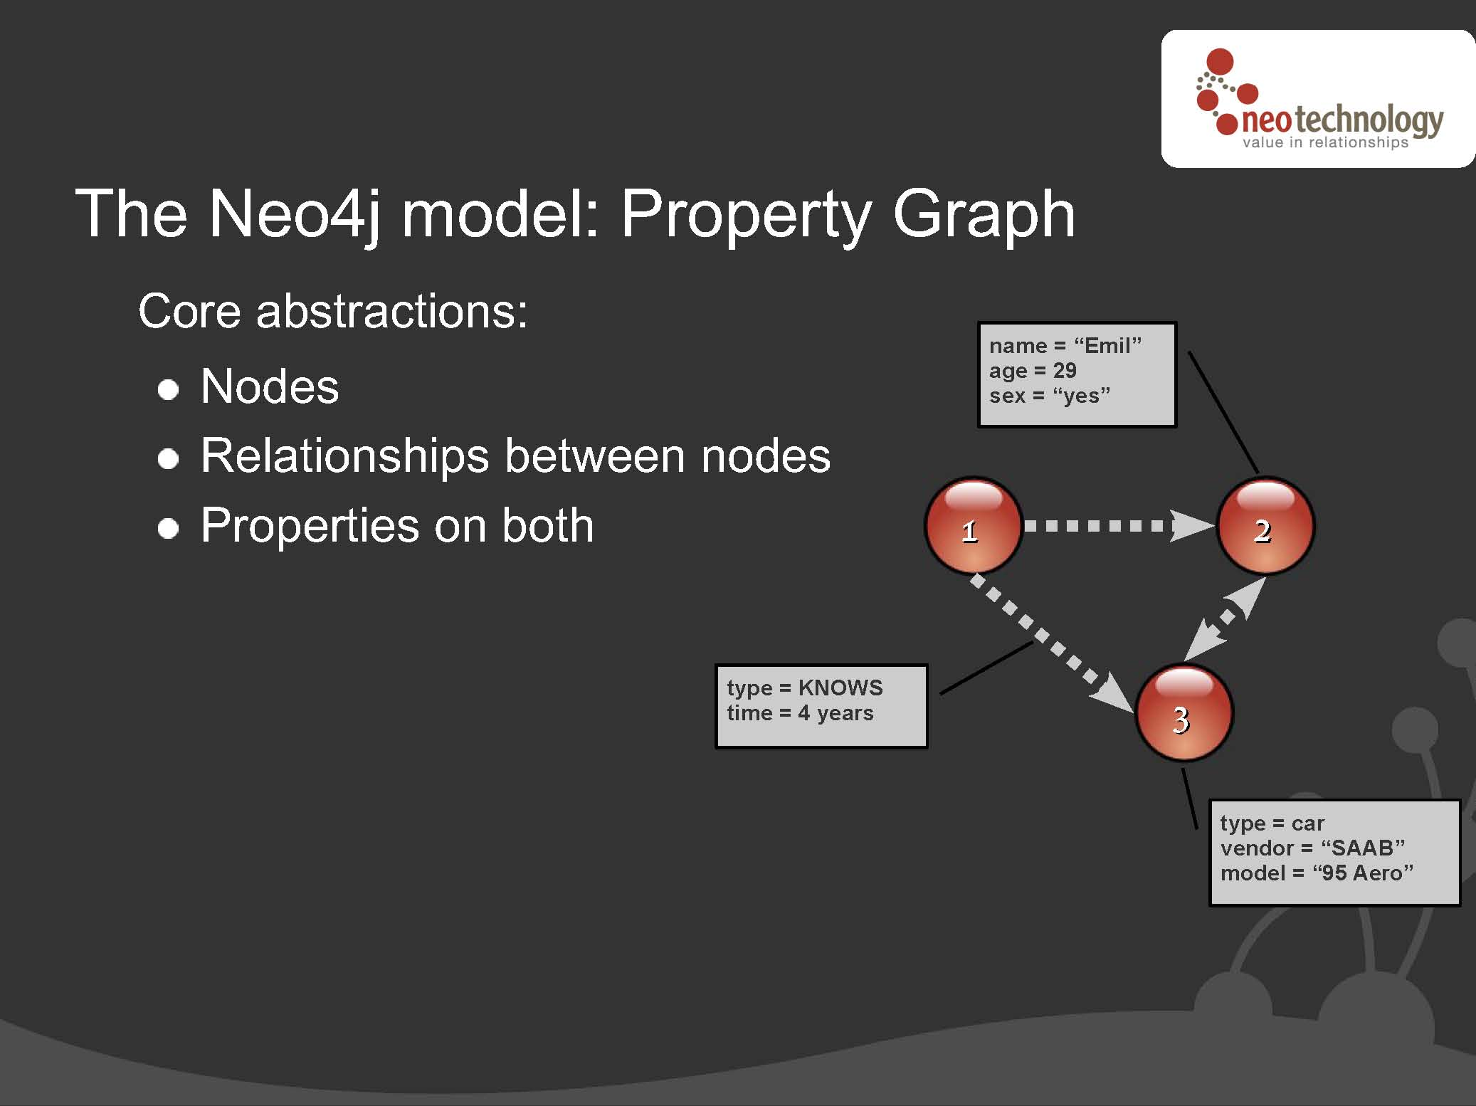
Backup
Notes:
http://www.cse.unsw.edu.au/~iwgdm/2011/Slides/Neo4j.pdf

Slide 66
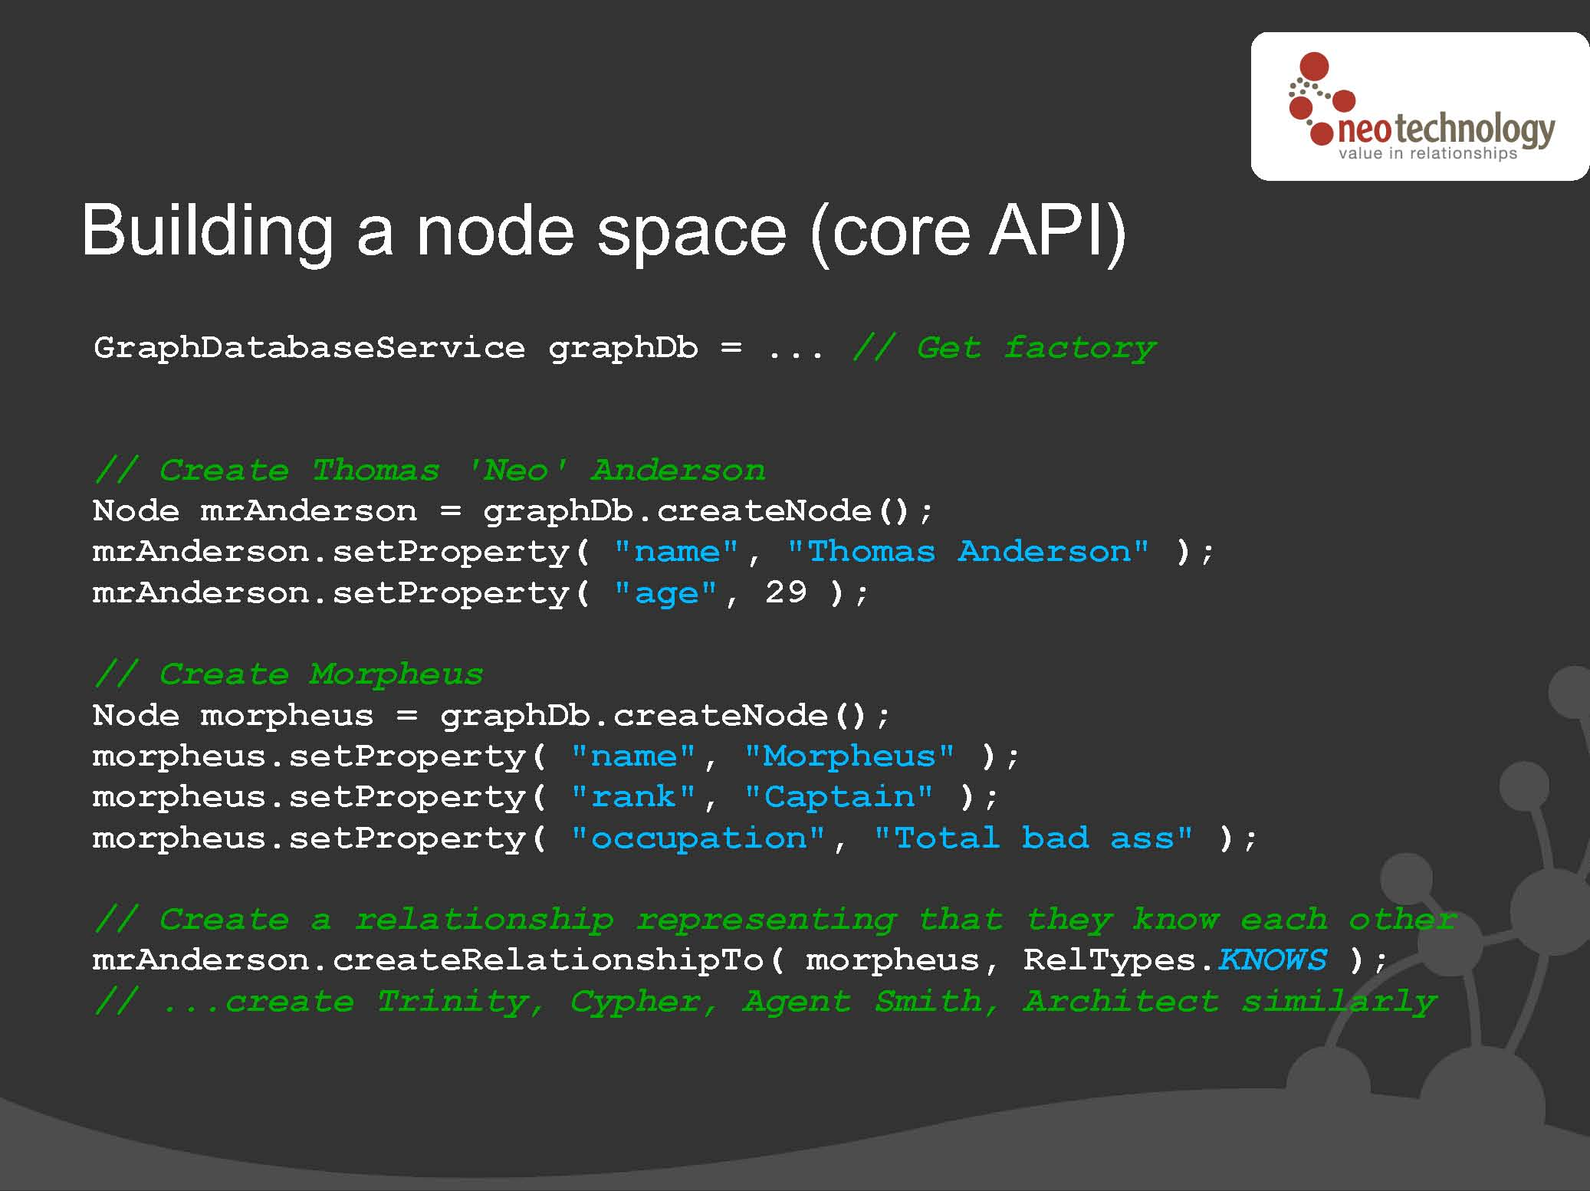
Backup
Notes:
http://www.cse.unsw.edu.au/~iwgdm/2011/Slides/Neo4j.pdf

Slide 67
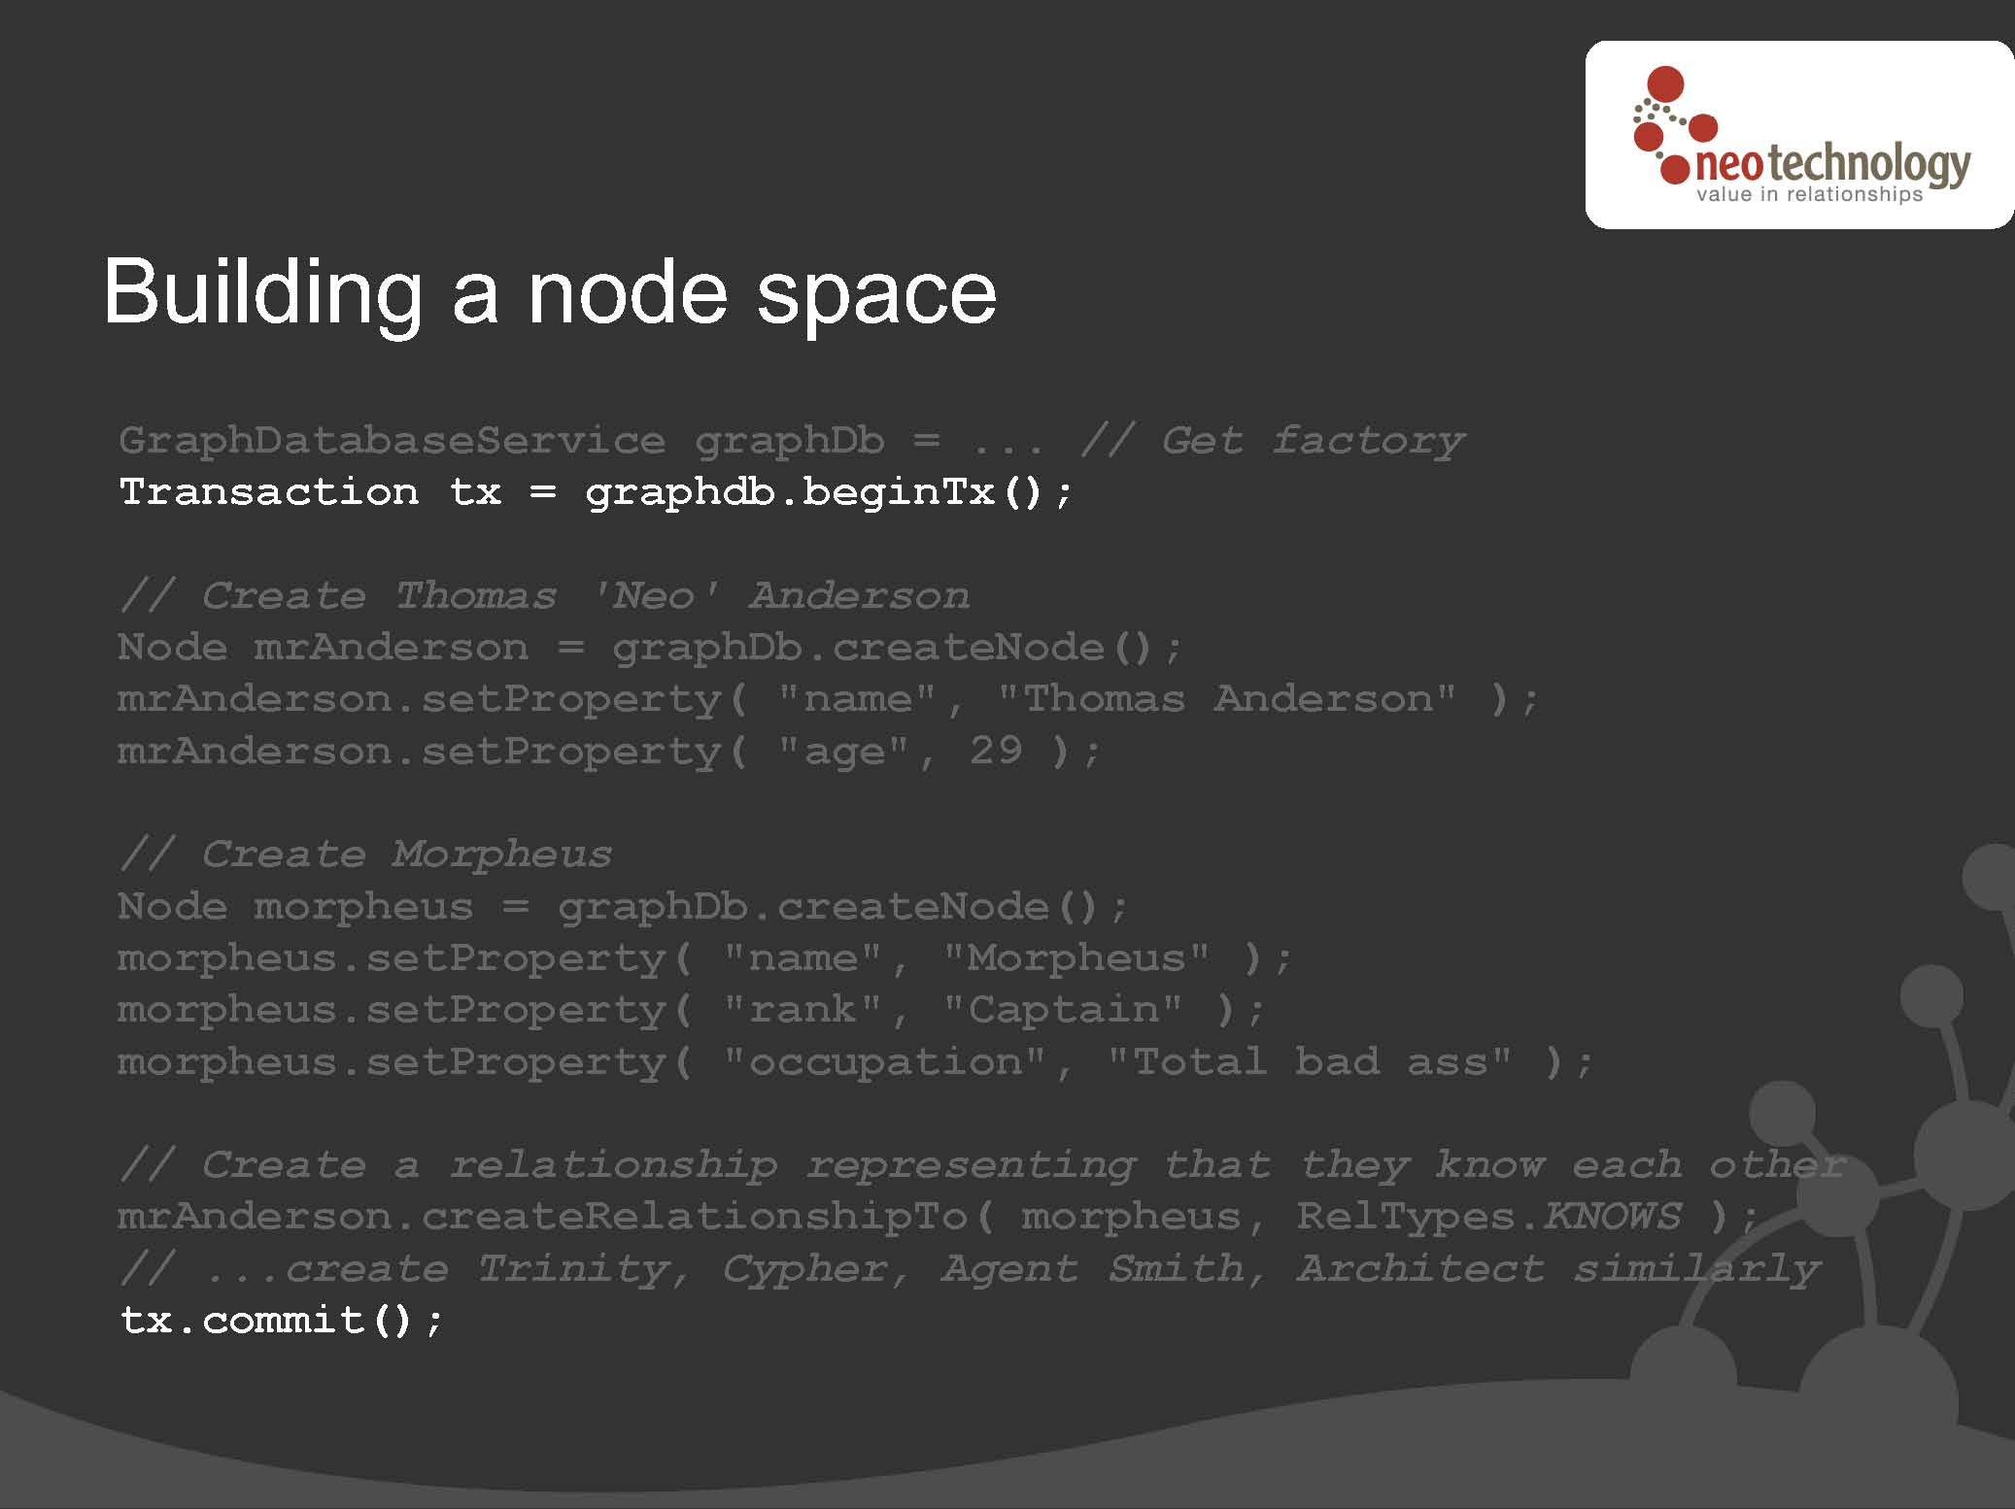
Backup
Notes:
http://www.cse.unsw.edu.au/~iwgdm/2011/Slides/Neo4j.pdf

Slide 68
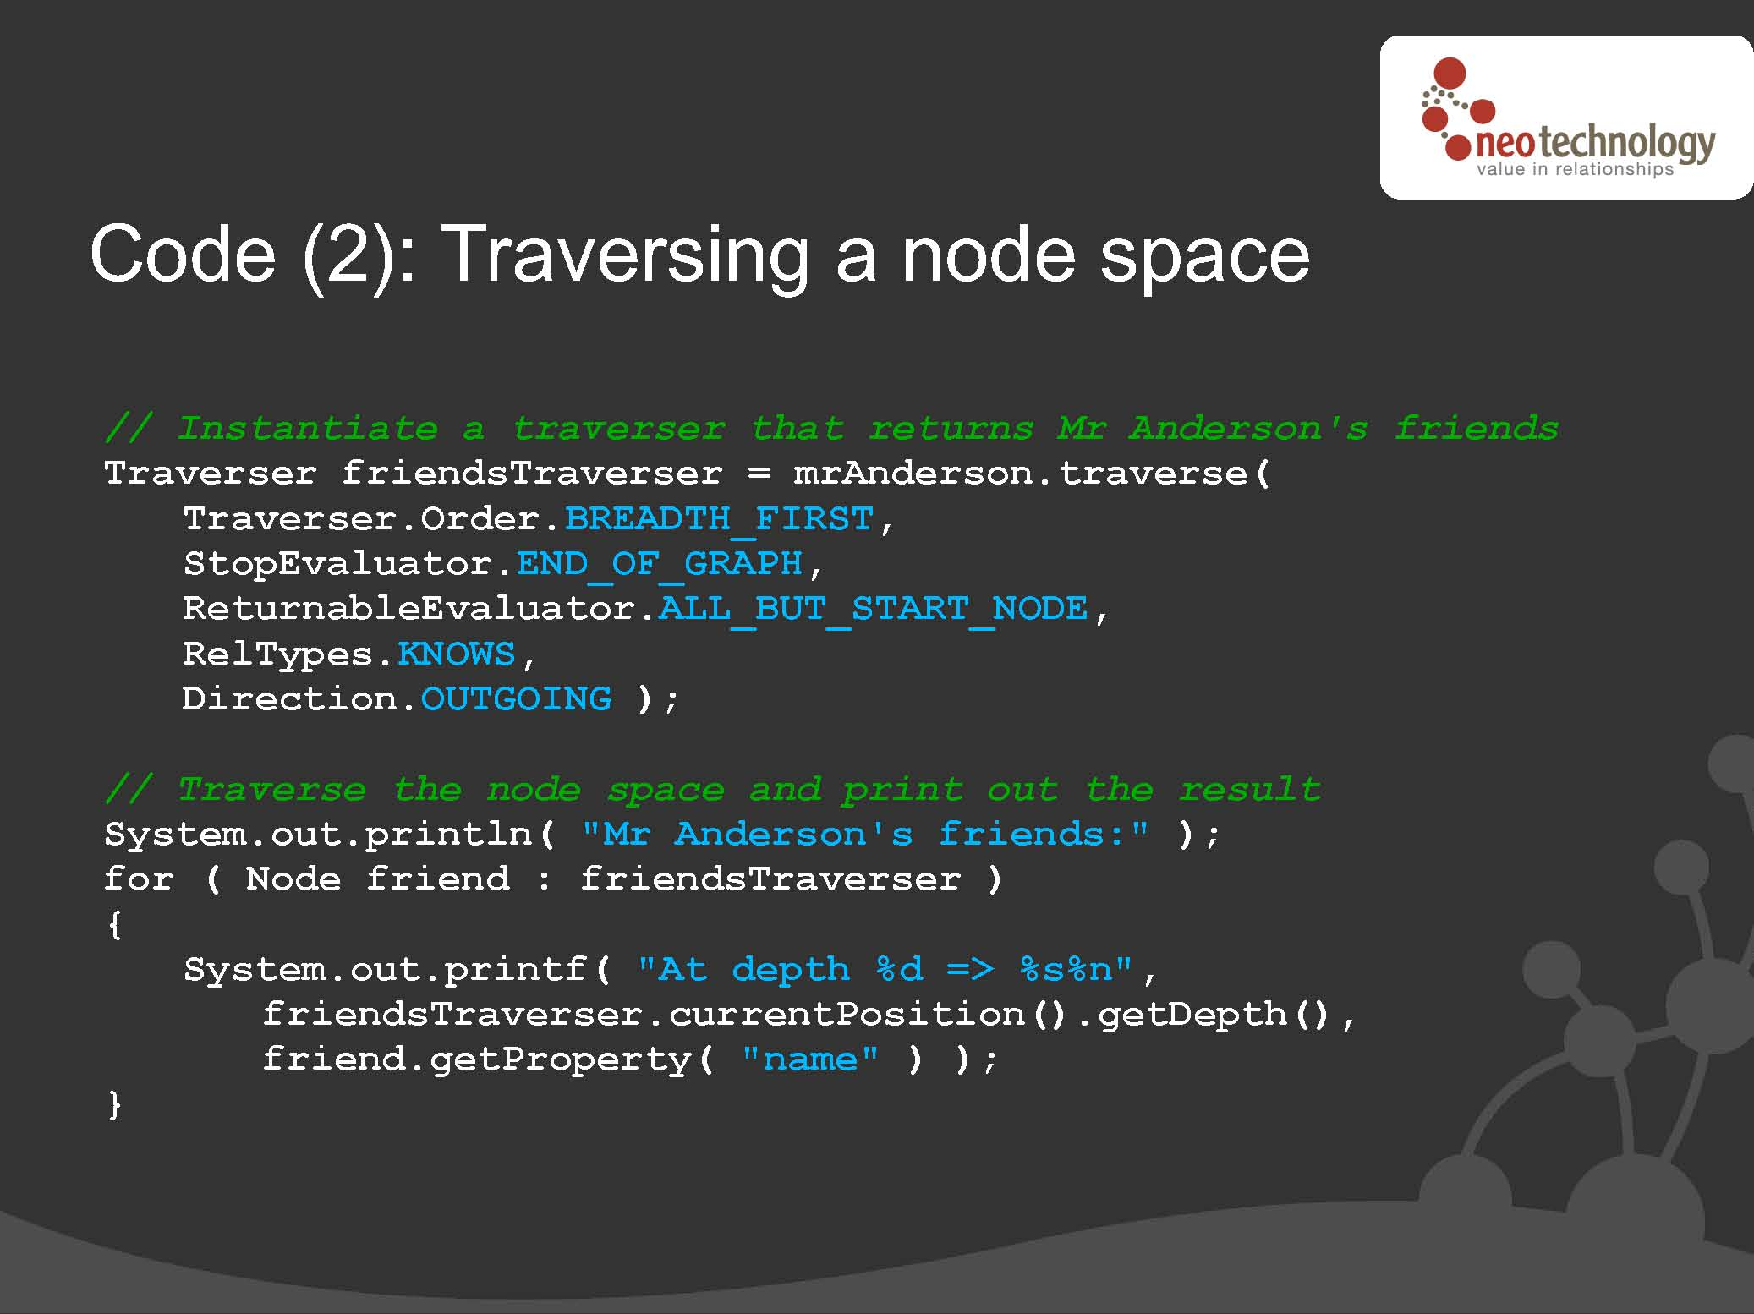
Backup
Notes:
http://www.cse.unsw.edu.au/~iwgdm/2011/Slides/Neo4j.pdf

Slide 69

Infinite Graph
Vertex alice = myGraph.addVertex(new Person(“Alice”));
Vertex bob = myGraph.addVertex(new Person(“Bob”));
Vertex carlos = myGraph.addVertex(new Person(“Carlos”));
Vertex charlie = myGraph.addVertex(new Person(“Charlie”));
alice.addEdge(new Meeting(“Denver”, “5-27-10”), bob);
bob.addEdge(new Call(timestamp), carlos);
carlos.addEdge(new Payment(100000.00), charlie);
bob.addEdge(new Call(timestamp), charlie);
Alice
Bob
Carlos
Charlie
Meets
Calls
Pays
Calls
Notes:
http://www.cse.unsw.edu.au/~iwgdm/2011/Slides/InfiniteGraph-Overview.ppt

Slide 70
Infinite Graph Architecture
User Apps
Blueprints
IG Core/API
Management Extensions
Navigation Execution
Placement
Session / TX Management
Configuration
Objectivity/DB Distributed Database
Notes:
http://www.cse.unsw.edu.au/~iwgdm/2011/Slides/InfiniteGraph-Overview.ppt

Slide 71
Active Research Topics
Transactions
Partitioning
Indexing
Parallel execution

Slide 72
Partitioning A Large Graph
Motivation
  Graph too big for one machine
Solutions
  Hash partition
  METIS
  Local approaches
  Hierarchical approaches

Slide 73
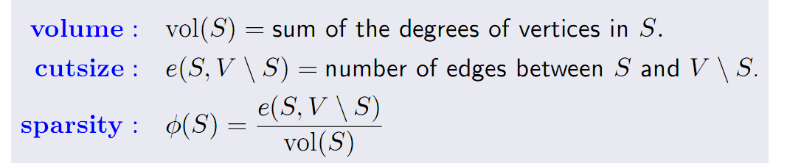
Conductance
Graph G(V,E), search for subset S of V
V = S union V\S
Find S with small conductance
S
V \ S
Notes:
“Finding Sparse Cuts Locally Using Evolving Sets”, Reid Andersen and Yuval Peres
http://arxiv.org/abs/0811.3779

Slide 74
Evolving set partitioning algorithm
Randomized algorithm
Approximation guarantee
Local partitioning
Notes:
“Finding Sparse Cuts Locally Using Evolving Sets”, Reid Andersen and Yuval Peres
http://arxiv.org/abs/0811.3779

Slide 75
Hierarchical Partitioning
Hierarchical communities
Modularity metric
  Each node joins the neighbor that maximizes modularity
Notes:
“Fast unfolding of communities in large networks”, http://arxiv.org/abs/0803.0476

Slide 76
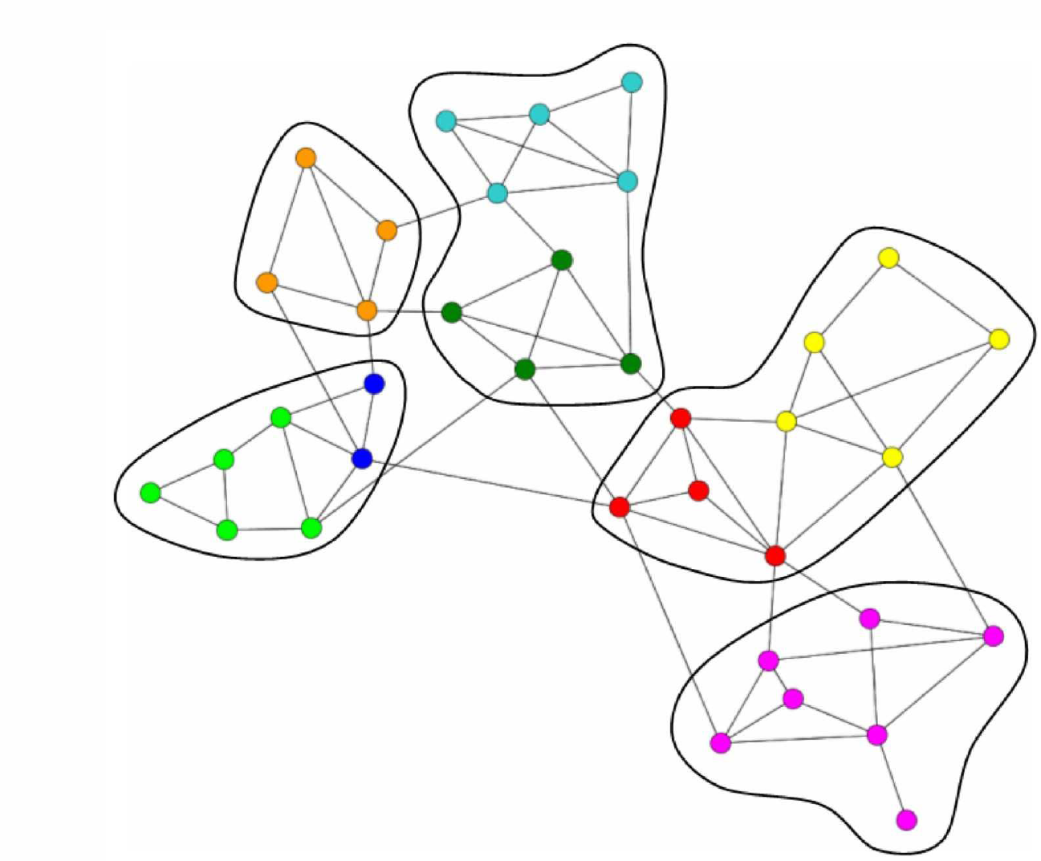
Hierarchical Partitioning
Notes:
“Fast unfolding of communities in large networks”, http://arxiv.org/abs/0803.0476

Slide 77
Transactions
Motivation
  Correctness
    Simplifies applications
Workload characteristics
  Dominated by reads
  Small updates

Slide 78
Centralized Transactions
Solutions
  Locking schemes
  Optimistic concurrency control
    Multi-versioning: snapshot isolation
    Distributed transactions

Slide 79
Distributed Transactions
Motivation
  Graph too large for one machine
  Graph is partitioned
  Replication becomes requirement
    Availability
    Scalability
Notes:
Database Replication Using Generalized Snapshot Isolation.
Sameh Elnikety, Fernando Pedone, and Willy Zwaenepoel.

Slide 80
WoD: Current Research Directions
Read-Write Linked Data
Large-Scale Inference/Query Processing
Publication of Linked Data
Entity Matching

Slide 81
(1) Read-Write Linked Data
How to handle updates / transactions?
Protocols
  HTTP PUT to overwrite file [Berners-Lee10]
  SPARQL update [Gearon11]
Updates & transaction at the back-end
  See for instance x-RDF-3x
Also interesting problems relating to lineage
  Dublin Core, W3C Provenance Group, OPM…

Slide 82
(2) Large-Scale Inference/Query Processing
Large-scale inference
  Old topic, hard
  Inference onlarge A-Boxes (instances)
  Distributed inference on heterogeneous, conflicting data sets
Distributed query processing
  Partitioning/caching triples
  Optimizing queries across N SPARQL end-points

Slide 83
(3) Publication of Linked Data
From websites/text
  Entity extraction, NLP
From relational databases
  Rel2rdf
Knowledge elicitation
  Crowdsourcing

Slide 84
Entity Matching
The great thing about unique identifiers is that there are so many to choose from
  ID jungle!
  Hundreds of identifier for one referent
  Matching URIs at LoD scale

Slide 85
WoD: To Go Further
1-day tutorial on the Semantic Web and WoD
  http://people.csail.mit.edu/pcm/SemWebTutorial.html
International Semantic Web Conf. 2011
  http://iswc2011.semanticweb.org/
List of large triple stores
  http://www.w3.org/wiki/LargeTripleStores
Some benchmarks & results for triple stores
  http://www.w3.org/wiki/RdfStoreBenchmarking

Slide 86
References (1)
[Manola04] Frank Manola and Eric Miller (Eds): RDF Primer. W3C Recommendation (2004). http://www.w3.org/TR/rdf-primer/
[Brickley04] Dan Brickley and R.V. Guha (Eds.): RDF Vocabulary Description Language 1.0: RDF Schema. W3C Recommendation (2004). http://www.w3.org/TR/rdf-schema/
[W3COWL09] W3C OWL Working Group: OWL 2 Web Ontology Language Document Overview. W3C Recommendation (2009). http://www.w3.org/TR/owl2-overview/
[Berners-Lee06] Tim Berners-Lee: Design Issues: Linked Data. http://www.w3.org/DesignIssues/LinkedData
[McDonal11] Glenn McDonald: Thread: A Path-Based Query Language for Graph Databases. SemTech 2011. http://semtech2011.semanticweb.com/uploads/handouts/SemTech2011_Thread_4144_3497.pdf
[Prud'hommeaux08] Eric Prud'hommeaux and Andy Seaborne: SPARQL Query Language for RDF. W3C Recommendation (2008). http://www.w3.org/TR/rdf-sparql-query/
[Glim11] Birte Glimm and Chimezie Ogbuji (Eds): SPARQL 1.1 Entailment Regimes. W3C Working Draft (2011). http://www.w3.org/TR/sparql11-entailment/
[Harris11] Steve Harris and Andy Seaborne: SPARQL 1.1 Query Language. W3C Working Draft (2011). http://www.w3.org/TR/sparql11-query/
[Berners-Lee10] Tim Berners-Lee: Design Issues: Read-Write Linked Data. http://www.w3.org/DesignIssues/ReadWriteLinkedData.html
Notes:
We list all references here (stolen images & slides)

Slide 87
References (2)
[Ogbuji11] Chimezie Ogbuji. SPARQL 1.1 Graph Store HTTP Protocol. W3C Working Draft (2011). http://www.w3.org/TR/sparql11-http-rdf-update/
[Gearon11] Paul Gearon, Alexandre Passant, and Axel Polleres: SPARQL 1.1 Update. W3C Working Draft (2011). http://www.w3.org/TR/2011/WD-sparql11-update-20110512/
[Abadi07] Daniel J. Abadi, Adam Marcus, Samuel R. Madden, and Kate Hollenbach: Using The Barton Libraries Dataset As An RDF benchmark. MIT-CSAIL-TR-2007-036 (2007).
[Guo05] Yuanbo Guo, Zhengxiang Pan and Jeff Heflin. LUBM: A Benchmark for OWL Knowledge Base Systems. Journal of Web Semantics 3(2), 2005.
[Bizer11] Chris Bizer et al.: The Berlin SPARQL Benchmark (BSBM). http://www4.wiwiss.fu-berlin.de/bizer/BerlinSPARQLBenchmark/
[Demartini11] Gianluca Demartini, Iliya Enchev, Joël Gapany, and Philippe Cudré-Mauroux: BowlognaBench—Benchmarking RDF Analytics. SIMPDA 2011.
[Neumann08] Thomas Neumann and Gerhard Weikum: RDF-3X: a RISC-style engine for RDF. PVLDB 1(1), 2008.
[Weiss08] Cathrin Weiss and Panagiotis Karras and Abraham Bernstein:
Hexastore: sextuple indexing for semantic web data management. PVLDB 1(1), 2008.
[Bishop11] Barry Bishop, Atanas Kiryakov, Damyan Ognyanoff, Ivan Peikov, Zdravko Tashev, and Ruslan Velkov: OWLIM: A family of scalable semantic repositories. Semantic Web Journal 2(1), 2011.
[Wylot11] Marcin Wylot, Jige Pont, Mariusz Wisniewski, and Philippe Cudre-Mauroux: dipLODocus[RDF]--Short and Long-Tail RDF Analytics for Massive Webs of Data. ISWC 2011.

Slide 88
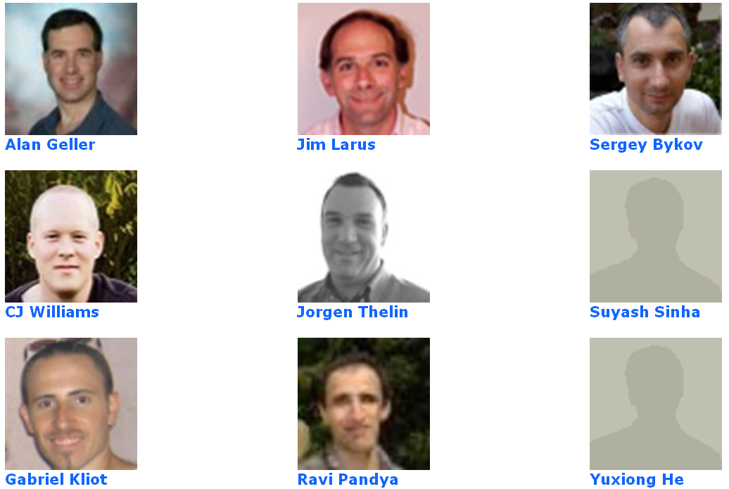
Acknowledgements
Orleans
team (MSR):
Academic collaborators:
  Jiaqing Du (EPFL), Mohamed Fathallah (MSR), Sherif Sakr (NICTA), Mohamed Sarwat (UMN), Willy Zwaenepoel (EPFL)
The whole eXascale Infolab team @ U. Fribourg
  http://diuf.unifr.ch/xi/

Slide 89
Conclusions
New application domains require new systems
  New platforms for Social networks & the WoD
In the future we expect increasing convergence between social networks and the Web of data
  Data Models: SNs models are richer and more diverse
    But as we pointed out they can be mapped onto RDF
  Queries: Nothing standard for SNs, SPARQL++ (i.e., with reachability) might well take over
  Graph Systems are already transactional for SNs
    Systems are increasingly focusing on transactions for WoD

