Slide 1
Collaborative Location and Activity Recommendations with GPS History Data
Vincent W. Zheng†, Yu Zheng‡, Xing Xie‡, Qiang Yang†
†Hong Kong University of Science and Technology
‡Microsoft Research Asia
This work was done when Vincent was doing internship in Microsoft Research Asia.

Slide 2
Introduction and Motivation
Users now sharing GPS trajectories on the Web
Wisdom of crowd: incorporating users’ knowledge
Travel experience:
Some places are more
popular than the others
User activities:
“The food is delicious”
--> dining at that place

Slide 3
Goal: To Answer 2 Typical Questions
Q1: what can I do there if I visit some place?
(Activity recommendation given location query)
Q2: where should I go if I want to do something?
    (Location recommendation given activity query)

Slide 4
Problem Definition
How to well model the location-activity relation
  Encode it into a matrix
Example
An entry denotes how
popular an activity is
performed at a location
5
5
3
2
4
Ranking along the
Columns or rows
1
Tourism
Exhibition
Shopping
5 | 4 | 2
4 | 3 | 1
1 | 2 | 6
Location recommendation
Tourism:
Forbidden City > Bird’s Nest > Zhongguancun
Forbidden City
Bird’s Nest
Activity recommendation
Forbidden City:
Tourism > Exhibition > Shopping
Zhongguancun

Slide 5
Contributions
In practice, it’s sparse!
  User comments are few (in out dataset, <0.6% entries are filled)
Tourism
Exhibition
Shopping
Forbidden City
5 | ? | ?
? | 1 | ?
1 | ? | 6
Bird’s Nest
Zhongguancun
Features
Activities
Activities
Locations
Locations
?
Activities
Location functionalities
Activity correlations

Slide 6
    System Architecture

Slide 7
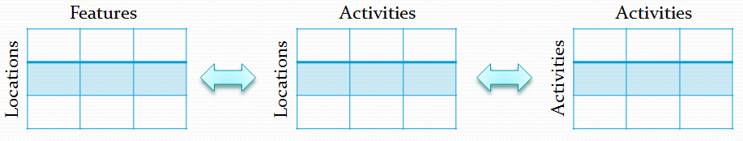
Road Map
?

Slide 8
GPS Log Processing
GPS trajectories*
stay region r
Raw GPS points
Stay points
Stay regions
Stand for a geo-spot where a user
has stayed for a while
Preserve the sequence and vicinity info
Stand for a geo-region that
we may recommend
Discover the meaningful locations
* In GPS logs, we have some user comments associated with the trajectories. Shown later.

Slide 9
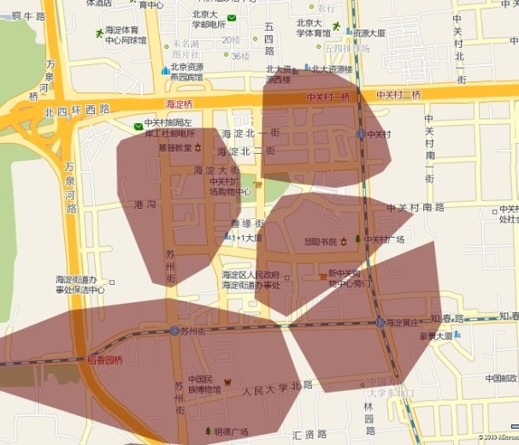
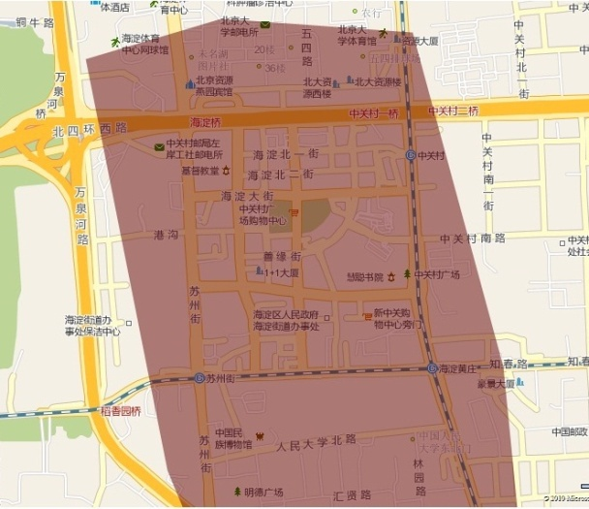
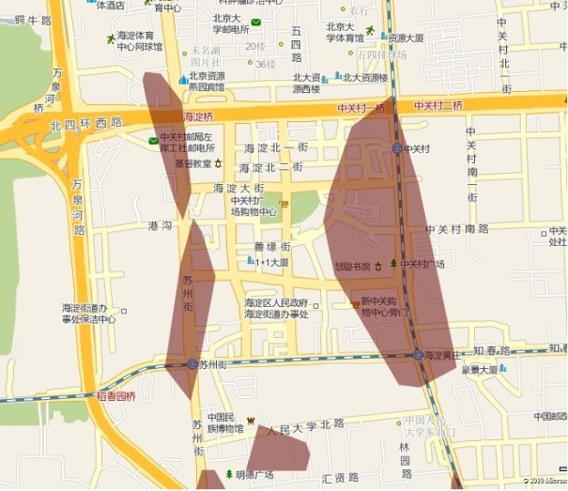
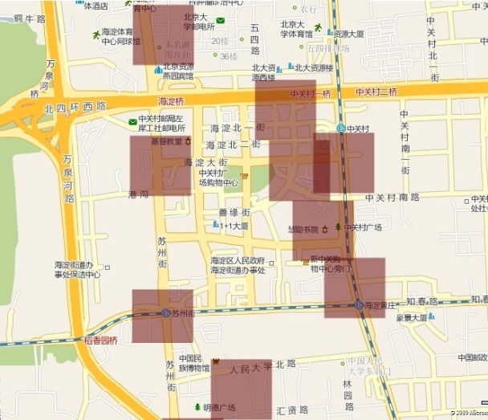
Stay Region Extraction
3 | 10 | 2
5 | 1 |  | 8 | 6
 |  |  | 4
Grid-based clustering
  Greedy algorithm
  Easy, fast and effective
    O(n log n), due to sorting
    Return fixed-size regions
Example
  A big shopping area (“Zhonggancun”) in west Beijing, >6km²
10
8
K-means
[K = 200]
(2) DBSCAN
[ε=0.001, MinPts = 4]
(3) OPTICS
[ε=0.05, MinPts = 4]
(4) Grid clustering
[d=300]

Slide 10
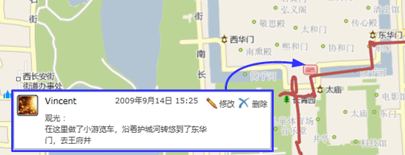
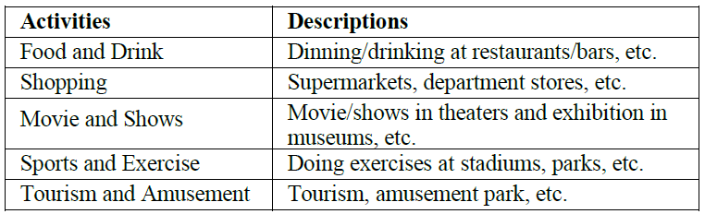
Location-Activity Extraction
Location-activity matrix
GPS: “39.903, 116.391, 14/9/2009 15:25”
Stay Region: “39.910, 116.400 (Forbidden City)”
Tourism
Food
…
“We took a tour bus to see around
along the forbidden city moat …”
Forbidden City
+1
Zhongguancun
Activity: tourism
…
Location-Activity Matrix
User comments are few -> this matrix is sparse!
Our objective: to fill this matrix.

Slide 11
Road Map
?

Slide 12
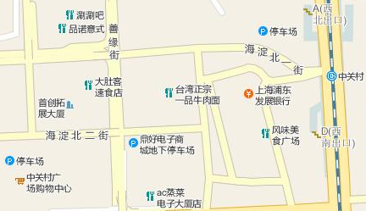
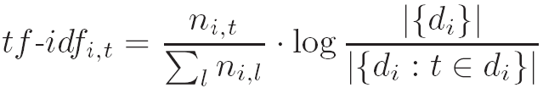
Location Feature Extraction
Location features: Points of Interests (POIs)
restaurant
Stay Region: “39.980, 116.306 (Zhongguancun)”
restaurant
bank
[restaurant, bank, shop] = [3, 1, 1]
shopping mall
TF-IDF style normalization*: feature = [0.13, 0.32, 0.18]
restaurant
restaurant
bank
…
TF-IDF (Term-Frequency Inverse Document Frequency):
Example:
Assume in 10 locations, 8 have restaurants (less
distinguishing), while 2 have banks and 4 have shops:
tf-idf(restaurant) = (3/5)*log(10/8) = 0.13
tf-idf(bank) = (1/5)*log(10/2) = 0.32
tf-idf(shop) = (1/5)*log(10/4) = 0.18
Forbidden City
0.13 | 0.32
Zhongguancun
…
Location-Feature Matrix

Slide 13
Road Map
?

Slide 14

Activity Correlation Extraction
How possible for one activity to happen, if another activity happens?
  Automatically mined from the Web, potentially useful when #(act) is large
“Tourism and Amusement”
and
“Food and Drink”
Correlation = h(1.16M),
where h is a normalization func.
Most mined correlations are reasonable. Example: “Tourism” with other activities.
Tourism-Shopping
more likely to happen
together than
Tourism-Sports
Web search (from Bing)
Human design (average on 8 subjects)

Slide 15
Road Map
√

Slide 16
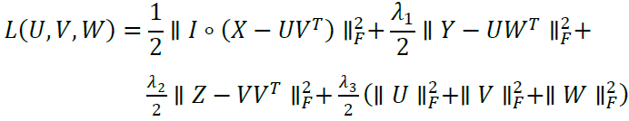
Solution: Collaborative Location and Activity Recommendation (CLAR)
Collaborative filtering, with collective matrix factorization
  Low rank approximation, by minimizing
  After getting U* and V*, reconstruct the incomplete X
  Efficient: complexity is linear to #(loc), can handle large data
  where U, V and W are the low-dimensional representations for the locations, activities and location features, respectively. I is an indicatory matrix.

Slide 17
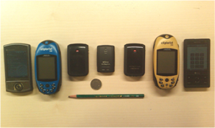
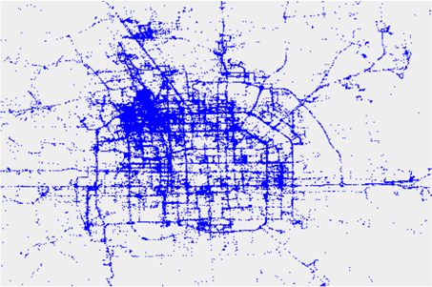
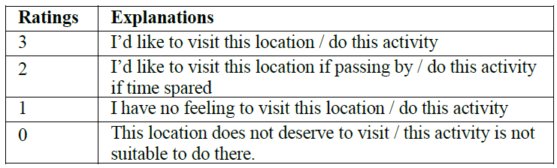


Experiments
Data
  2.5 years (2007.4-2009.10)
  162 users
  13K GPS trajectories, 4M GPS points, 140K kilometers
  530 comments
Evaluation
  Invite 5 subjects to give ratings independently
  Location recommendation
    Measured on top 10 returned locations for each of the 5 activities
  Activity recommendation
    Measured on the 5 activities for top 20 popular locations with most visits
  Normalized discounted cumulative gain (nDCG)
Example: for a rating <1,3,0,2>

Slide 18
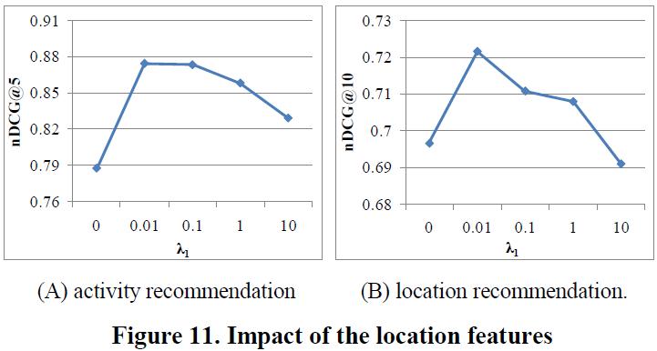
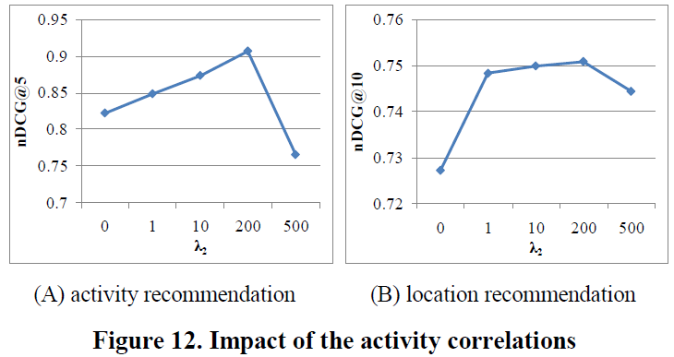
Result 1: System performances
Impact of location feature information (i.e. λ₁ @ Fig.11)
Impact of activity correlation information (i.e. λ₂ @ Fig.12)
Observations
  The weight for each information source should be moderate
  Using both sources outperforms using single source (i.e. λ₁=0, λ₂=0)

Slide 19
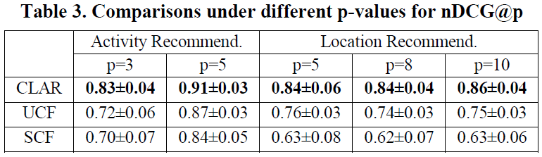
Result 2: Baseline Comparison
Single collaborative filtering (SCF)
  Using only the location-activity matrix
Unifying collaborative filtering (UCF)
  Using all 3 matrices, but in a different way
  For each missing entry, combine the entries belonging to the top N similar locations × top N similar activities in a weighted way
One-tail t-test p₁<0.01, two-tail t-test p₂<0.01

Slide 20
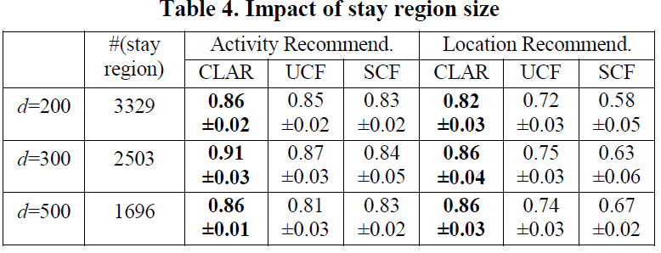
Result 3: Impact of stay region size
Stay region: cluster of stay points, i.e. “locations”
We propose a grid-based clustering algorithm to get stay regions
d=300 implies a size of 300 × 300 m²
Stay region size
  Should not be too small (two regions refer to same place) or too big (hard to find)
One-tail t-test p₁<0.05, two-tail t-test p₂<0.05

Slide 21
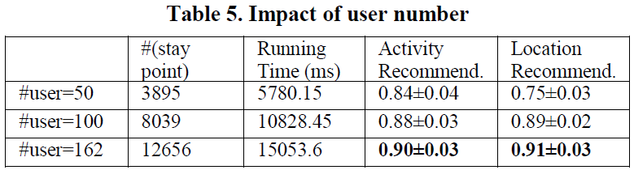
Result 4: Impact of user number
#(user)↑ -> data↑ -> #(loc)↑
  Run on PC with dual core CPU, 2.33GHz, 2G RAM
  Running time is linear to #(loc), converge fast (<300 iterations)
  #(stay point) does not necessary linearly increase w.r.t. #(user)
Expected:
#(stay point)
performance
We are here.
#(user)
#(user)

Slide 22
Discussion 1
Impact of the location types to activity recommendation
  Recommend 5 activities for top 20 locations with most visits
    Aggregate the evaluations and pick top 2 activities as location types
Usually also suitable for food hunting and
sometimes tourism, dominated by them
Fewer comments
Usually more comments for ”tourism”
More often happen
Strong dependency on location features
- More likely to have many restaurant POIs
- “sports” with parks and stadium

Slide 23
Discussion 2
Impact of the activity types to location recommendation
  Recommend top 10 locations for each activity
More often happen
      Popular places with higher scores are
      more likely to be recommended
      Many of them are available for
      shows/movies
Usually more comments
      Popular places are usually not suitable
      for “sports & exercises”
Usually fewer comments

Slide 24
Conclusion
We show how to mine knowledge from the real-world GPS data to answer two typical questions:
  If we want to do something, where shall we go?
  If we visit some place, what can we do there?
We evaluated our system on a large GPS dataset
  >7% improvement on activity recommendation
  >20% improvement on location recommendation
  over the simple baseline without exploiting any additional info
Future Work
  Incorporate user features to provide personalized recommendation
  Establish a comprehensive social network based on user activity and location history

Slide 25
Thanks!
Questions?
Vincent W. Zheng
vincentz@cse.ust.hk
http://www.cse.ust.hk/~vincentz

