Slide 1
Mining Acronym Expansions and Their Meanings Using Query Click Log
Bilyana Taneva, Tao Cheng, Kaushik Chakrabarti, Yeye He
DMX Group, Microsoft Research

Slide 2
The Popularity of Acronyms
Acronym: abbreviations formed from the initial components of words or phrases
  E.g., CMU, MIT, RISC, MBA, …
Acronyms are very commonly used in
  Web search
  Tweets
  Text messages
  …
Even more common on mobile devices

Slide 3
Acronym Characteristics
Ambiguous: one acronym can have many different meanings
  E.g., CMU can refer to “Central Michigan University”, “Carnegie Mellon University”, “Central Methodist University”, and many other meanings
Disambiguated by context: the meaning is often clear when context is available
  E.g., “cmu football” -> “Central Michigan University”
  “cmu computer science” -> “Carnegie Mellon University”

Slide 4
Application Scenario
Web Search
  Acronym Queries
    Suggest the different meanings of the input acronym, or expand to the most likely intended meaning
  Acronym + Context Queries
    Infer the most likely intended meaning given the context and then perform query alteration, e.g., “cmu football” -> “central michigan university football”

Slide 5
Problem Statement
Input: an acronym
Output: the various different meanings of the acronym; each meaning is represented by its canonical expansion, a popularity score and a set of associated context words
Meaning | Popularity | Context Words
central michigan university | 0.615 | michigan, athletics, football, …
carnegie mellon university | 0.312 | pittsburgh, library, computer, …
concrete masonry unit | 0.045 | block, concrete, cement, …
central methodist university | 0.017 | fayette, central, missouri, …
canton municipal utilities | 0.004 | court, docket, case, …
Input
CMU
Notes:
Many variants of the expansion

Slide 6





Insight: Exploiting Query Co-click
$$d_{1}$$
central michigan university
$$d_{2}$$
cmu football
cmu
$$d_{3}$$
central mich univ
$$d_{4}$$
carnegie mellon university
cs carnegie mellon
…

Slide 7








Technical Challenges
Identify co-clicked queries that are expansions
Mined expansions are often noisy, containing variants for the same meaning
Identify context words for each meaning
$$d_{1}$$
central michigan university
Handle tail meanings
$$d_{2}$$
cmu football
cmu
$$d_{3}$$
central mich univ
$$d_{4}$$
carnegie mellon university
…
cs carnegie mellon
Notes:
Bring the figure here to explain

Slide 8
Mining Steps
1
2
3
4
5
Expansion
Identification
Expansion
Clustering
Canonical Expansion
Identification
Popularity
Mining
Context
Mining
central michigan university
0.615
michigan, athletics,
football, …
central mich univ
CMU
central mi university
carnegie mellon university
0.312
pittsburgh, library,
computer, …
caneigie mellon univ
concrete masonry unit
0.045
block, concrete,
cement, …

Slide 9




Acronym Candidate Expansion Identification
$$d_{1}$$
$$d_{2}$$
central michigan university
cmu
central mich univ
$$d_{3}$$
$$d_{4}$$
carnegie mellon university
…
Rely on Acronym-Expansion Checking Function
  Not a trivial task, e.g., “Hypertext Transfer Protocol” for “HTTP”, “Master of Business Administration” is for “MBA”

Slide 10
Mining Steps
2
1
3
4
5
Expansion
Identification
Expansion
Clustering
Canonical Expansion
Identification
Popularity
Mining
Context
Mining
central michigan university
0.615
michigan, athletics,
football, …
central mich univ
CMU
central mi university
carnegie mellon university
0.312
pittsburgh, library,
computer, …
caneigie mellon univ
concrete masonry unit
0.045
block, concrete,
cement, …

Slide 11
Acronym Expansion Clustering
Edit distance is inadequate
  E.g, “central michigan university” and “central mich univ”
Insight: leveraging clicked documents
  Each document typically corresponds to a single meaning
  Expansion of same meaning click on same set of documents, and expansion of different meanings click on different documents
Clicked document based distance
  Set distance (Jaccard distance)
  Distributional distance (Jensen-Shannon Divergence)

Slide 12
Mining Steps
3
1
2
4
5
Expansion
Identification
Expansion
Clustering
Canonical Expansion
Identification
Popularity
Mining
Context
Mining
central michigan university
0.615
michigan, athletics,
football, …
central mich univ
CMU
central mi university
carnegie mellon university
0.312
pittsburgh, library,
computer, …
caneigie mellon univ
concrete masonry unit
0.045
block, concrete,
cement, …

Slide 13


Identifying Canonical Expansion
The probability that a click of acronym query $a$ on document $d$ is intended for expansion $e_{k}$
The probability that acronym query $a$ is intended for expansion $e_{k}$
For each meaning group, canonical expansion is the one with the highest probability

Slide 14
Mining Steps
4
1
2
3
5
Expansion
Identification
Expansion
Clustering
Canonical Expansion
Identification
Popularity
Mining
Context
Mining
central michigan university
0.615
michigan, athletics,
football, …
central mich univ
CMU
central mi university
carnegie mellon university
0.312
pittsburgh, library,
computer, …
caneigie mellon univ
concrete masonry unit
0.045
block, concrete,
cement, …

Slide 15


Measure Meaning Popularity
Remember we mined the probability for an expansion in identifying the canonical expansion
The popularity for a meaning $M_{i}$ for acronym $a$ is the aggregated popularity of all the expansions in its group

Slide 16
Mining Steps
5
1
2
3
4
Expansion
Identification
Expansion
Clustering
Canonical Expansion
Identification
Popularity
Mining
Context
Mining
central michigan university
0.615
michigan, athletics,
football, …
central mich univ
CMU
central mi university
carnegie mellon university
0.312
pittsburgh, library,
computer, …
caneigie mellon univ
concrete masonry unit
0.045
block, concrete,
cement, …

Slide 17


Compute Context Words for Each Meaning
Consider the set of documents clicked by expansions in group $G_{i}$, we treat all the words from queries clicked on these documents as the context words for the meaning group
Let $F(w,G_{i})$ be the aggregated frequency of a word w in group $G_{i}$, the probability of a word given a meaning is:

Slide 18




Enhancement for Tail Meanings
$$d_{1}$$
massachusetts institute of technology
mit
$$d_{2}$$
mit boston
mass institute of tech
mit pune
$$d_{3}$$
maharashtra institute of technology pune
$$d_{4}$$
mit ujjain
mahakal institute of technology ujjain
…
mahakal institute of technology

Slide 19
Expansion Identification (Enhanced)
Consider acronym supersequence queries
  E.g, “mit pune”, “mit ujjain”, etc.
Identify expansions from the co-clicked queries of the acronym supersequence queries
  E.g, “maharashtra institute of technology pune”, “mahakal institute of technology ujjain”, etc.

Slide 20
Expansion Clustering (Enhanced)
Need to aggregate across supersequence queries
  E.g., “mahakal institute of technology ujjain”, “mahakal institute of technology india”, …
Distance aggregation
  For each supersequence pair, compute the distance and then aggregate the distances over all supersequence pairs
Click frequency aggregation
  For each expansion, consider all the documents, including the ones clicked by supersequence queries, and then compute the distributional distance on the aggregated click distribution
Notes:
Give an example, why we need aggregation

Slide 21



Application: Online Meaning Prediction
Given an acronym and context, predict the meaning of the acronym under that context
Given a context word $w$, the probability that the intended meaning is $M_{i}$is calculated as follows:
This can be extended to handle context with multiple words
Notes:
Use example in the formula

Slide 22
Experiments
Data: 100 input acronyms sampled from Wikipedia disambiguation pages
Compared methods
  Edit Distance based Clustering (EDC)
  Jaccard Distance based Clustering (JDC)
  Acronym Expansion Clustering (AEC)
  Enhanced Acronym Expansion Clustering (EAEC)
Ground Truth
  Wikipedia meanings: Wikipedia disambiguation page
  Golden standard meanings: manually captured from co-clicked queries

Slide 23
Evaluation Measures
Standard measures used for evaluating clustering, specifically:
  Purity: how pure are the meaning clusters
  Normalized Mutual Information (NMI): considering both the quality of clusters and the number of clusters
  Recall: number of meanings found with respect to the Golden Standard

Slide 24
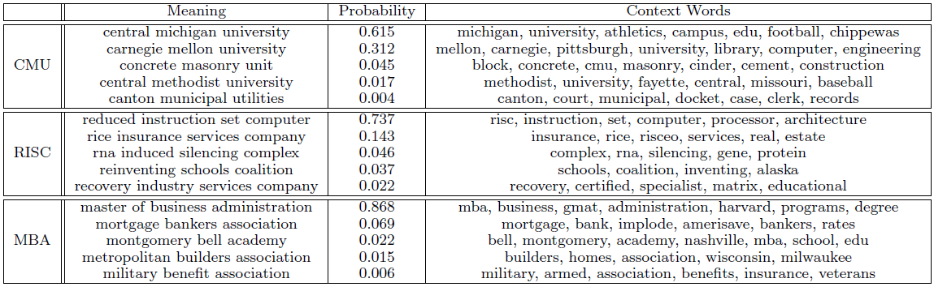
Meanings, Popularity and Context Words

Slide 25
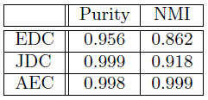

Mining Results
AEC > JDE > EDC: weighting by click frequency helps
EAEC > ACE: exploiting supersequence queries boost recall

Slide 26
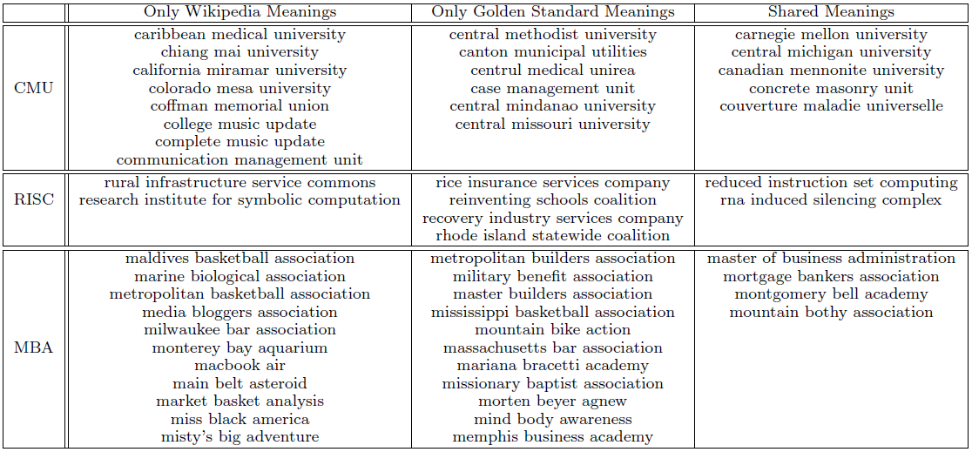
Wikipedia and Golden Standard Meanings

Slide 27
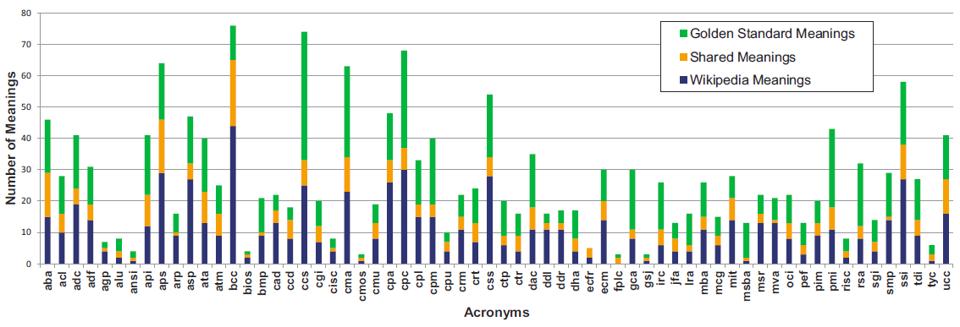
Wikipedia vs. Golden Standard Meanings

Slide 28
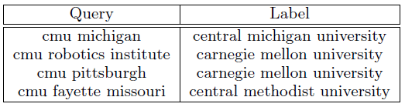
Online Meaning Prediction Results
Data: 7,612 acronym+context queries
Each query is manually labeled to the most probable meaning by judges.
  Examples:
Average Precision: 94.1%

Slide 29
Summary
We introduce the problem of ﬁnding distinct meanings of each acronym, along with the canonical expansion, popularity score and context words
We present a novel, end-to-end solution leveraging query click log
We demonstrate the mined information can be used effectively for online queries in web search

Slide 30
Thanks!

