Slide 1



FlashNormalize:
Programming by Examples for Text Normalization
Dileep Kini | Sumit Gulwani
International Joint Conference on Artificial Intelligence, Buenos Aires

Slide 2
What is Text Normalization?
Real text contains Non-standard words (NSWs) :
numbers, dates, currencies, phone numbers etc. [Sproat, 2010]
Normalization = converting NSWs into contextually appropriate and consistently formatted variants.
Applications like text-to-speech, machine-translation, speech-recognition training require Normalization of such words.

Slide 3
Typical Tasks
Number Translations
Input | English
1234 | One thousand two hundred and thirty four
850 | Eight hundred and fifty
79000 | Seventy nine thousand
French
Mille deux cent trente-quatre
Huit cent cinquatre
Soixante-dix-neuf mille
Dates
Input | Output
Jan 08, 2065 | January eighth twenty sixty five
Apr 23, 2006 | April twenty third two thousand six
Aug 10, 1900 | August tenth nineteen hundred
Input Variation
08/01/2065
23/04/2006
10/08/1900

Slide 4
Challenges
Traditional method: manual programming
  Scalability: large number of domain/format/language combinations
  Requires pairing of programmer and language expert
Recent techniques: Statistical methods
  Requires large number of examples
  Obtained transformation not 100% accurate
Our approach in FlashNormalize: Programming-by-Examples
  Fewer examples
  100% Accurate
  Cannot handle noise in the data

Slide 5
Problem Formulation
Consider certain functions that take an input string and produces a sequence of strings
  For dates we need a function that transforms the input string
  “Jan 08, 2065” into January eighth twenty sixty five
The specification provided by the user is input-output pairs
The goal is to learn a function that is consistent with all the given examples

Slide 6
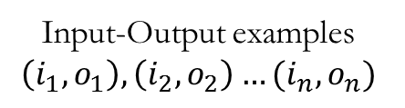
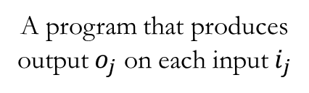
Solution Overview
A Programming-by-Examples technology
Domain Specific Language
The space of possible programs (Concept Class)
Learning
Algorithm
Input-Output examples
$$\left(i_{1},o_{1}\right),\left(i_{2},o_{2}\right)…(i_{n},o_{n})$$
A program that produces
output $o_{j}$ on each input $i_{j}$
Notes:
1 minute

Slide 7
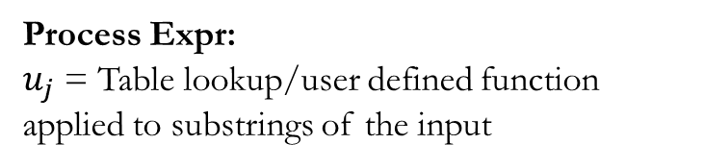
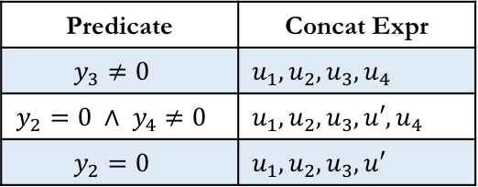
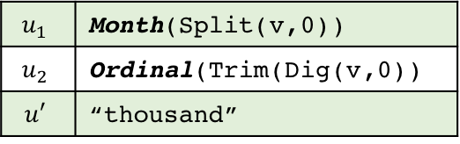







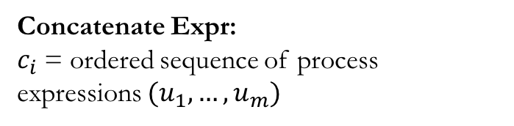
Domain Specific Language (DSL)
Description of the space of possible programs
Decision List: $DL\left(P,C\right) p_{i}∈P,c_{i}∈C$
$$p_{1}$$
$$p_{2}$$
…
$$p_{n}$$
$$c_{1}$$
$$c_{2}$$
$$c_{n}$$
Concatenate Expr:
$c_{i}$ = ordered sequence of process expressions $(u_{1},…, u_{m})$
$$u_{1}$$ | Month(Split(v,0))
$$u_{2}$$ | Ordinal(Trim(Dig(v,0))
$$u′$$ | “thousand”
Process Expr:
$u_{j}$ = Table lookup/user defined function applied to substrings of the input
Predicate | Concat Expr
$$y_{3}≠0$$ | $$u_{1},u_{2},u_{3},u_{4}$$
$$y_{2}=0 ∧ y_{4}≠0$$ | $$u_{1},u_{2},u_{3}, u′,u_{4}$$
$$y_{2}=0$$ | $$u_{1},u_{2},u_{3},u′$$
Notes:
3 min

Slide 8
Synthesis Algorithm
Given a set of input-output example pairs, derive a program from the DSL that is consistent with all the examples.
Our algorithm has 2 logically distinct phases
  A bottom-up learning of process expressions for individual examples
  A top-down search for decision lists and concats for all examples
Notes:
30 sec

Slide 9
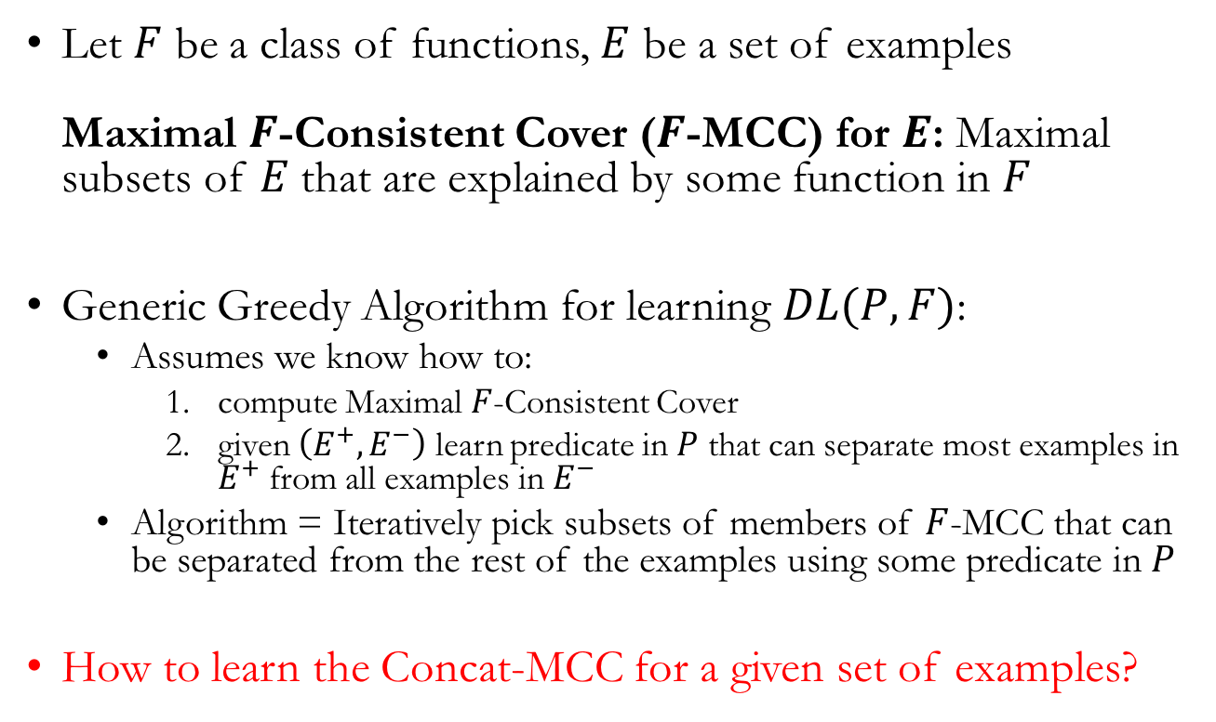
Learning Decision Lists
Let $F$ be a class of functions, $E$ be a set of examples
Maximal $F$-Consistent Cover ($F$-MCC) for $E$: Maximal subsets of $E$that are explained by some function in $F$
Generic Greedy Algorithm for learning $DL(P,F)$:
  Assumes we know how to:
    compute Maximal $F$-Consistent Cover
    given $\left(E^{+},E^{−}\right)$ learn predicate in $P$ that can separate most examples in $E^{+}$ from all examples in $E^{−}$
  Algorithm = Iteratively pick subsets of members of $F$-MCC that can be separated from the rest of the examples using some predicate in $P$
How to learn the Concat-MCC for a given set of examples?
Notes:
Now keep in mind that these are not classical decision lists….

Slide 10









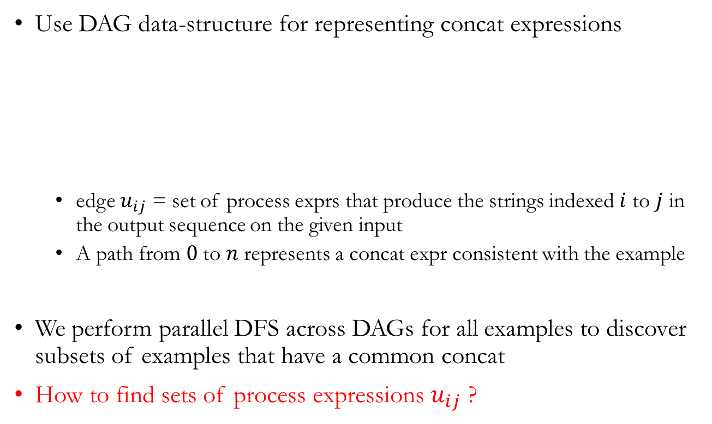
Learning Concat Expressions
Use DAG data-structure for representing concat expressions
  edge $u_{ij}$ = set of process exprs that produce the strings indexed $i$ to $j$ in the output sequence on the given input
  A path from $0$ to $n$ represents a concat expr consistent with the example
We perform parallel DFS across DAGs for all examples to discover subsets of examples that have a common concat
How to find sets of process expressions $u_{ij}$ ?
$$u_{02}$$
$$u_{13}$$
$$u_{01}$$
$$u_{12}$$
$$u_{23}$$
$$0$$
$$1$$
$$2$$
$$3$$

Slide 11
Learning Process Expressions
Process exprs are described using a non-recursive grammar
We use the Version-Space-Algebra [Lau et al. 2000] to represent sets of programs associated with a non-terminal
  bucket programs together that behave similarly on the given input
  use a bottom-up approach to symbolically enumerate these buckets
string S := B | Substr(B,k,k);
string B := v | Split(v,k) | Dig(v,k);
int k := -10 | -9 | … | 10;

Slide 12
Synthesis Strategies
Our learning algorithm requires:
  A set of representative examples
  Descriptions of the tables used in process expressions
Determining either or both can be challenging!
Modularity:
Separation of a program into smaller ones which can be reused
When a program to be learnt is potentially huge we try learning programs that handle
certain parts of the output and use them to learn a complete program
Active Learning:
for assisting the user find the right examples, and synthesizing tables
domain knowledge encoded in the form an algorithm that suggests inputs on which
hypothesis program might be wrong
Queries: a) Membership b) Equivalence c) Test

Slide 13
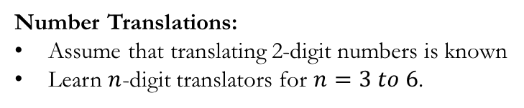
Evaluation
T: #test queries,
M: #membership queries
E: # examples used in synthesis
Tm: time taken in seconds
Dl : length of the decision list
Number Translations:
Assume that translating 2-digit numbers is known
Learn $n$-digit translators for $n=3 to 6$.
 | T | M | E | Tm | Dl
Russian | 27 | 12 | 5 | .13 | 2
 | 50 | 17 | 8 | .16 | 3
 | 90 | 18 | 11 | .23 | 4
 | 183 | 14 | 17 | .31 | 5
Polish | 27 | 12 | 5 | .15 | 2
 | 50 | 15 | 8 | .14 | 3
 | 93 | 20 | 13 | .20 | 4
 | 210 | 34 | 27 | .41 | 5
French | 33 | 20 | 8 | .12 | 4
 | 65 | 42 | 13 | .16 | 6
 | 142 | 57 | 34 | .42 | 6
 | 252 | 112 | 38 | .77 | 10
 | T | M | E | Tm | Dl
Chinese | 30 | 16 | 6 | .14 | 4
 | 68 | 30 | 12 | .19 | 4
 | 124 | 54 | 20 | .43 | 6
 | 195 | 49 | 24 | .73 | 6
German | 26 | 12 | 7 | .13 | 2
 | 43 | 12 | 9 | .13 | 3
 | 89 | 21 | 11 | .16 | 3
 | 188 | 42 | 19 | .31 | 5
Portuguese | 27 | 13 | 6 | .11 | 3
 | 78 | 55 | 18 | .21 | 8
 | 93 | 20 | 14 | .26 | 4
 | 191 | 25 | 18 | .38 | 4
 | T | M | E | Tm | Dl
Spanish | 49 | 41 | 12 | .14 | 4
 | 68 | 44 | 14 | .18 | 6
 | 112 | 43 | 17 | .26 | 4
 | 242 | 72 | 42 | 1.6 | 11
English | 20 | 4 | 4 | .13 | 2
 | 49 | 18 | 8 | .14 | 3
 | 89 | 19 | 10 | .20 | 3
 | 180 | 26 | 14 | .26 | 3
Italian | 27 | 10 | 5 | .10 | 2
 | 48 | 15 | 9 | .13 | 3
 | 85 | 15 | 8 | .15 | 3
 | 174 | 15 | 17 | .28 | 6

Slide 14
Thank You!

Slide 15
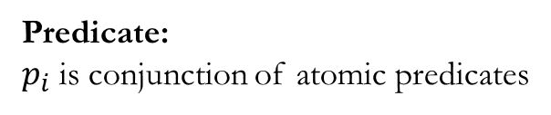
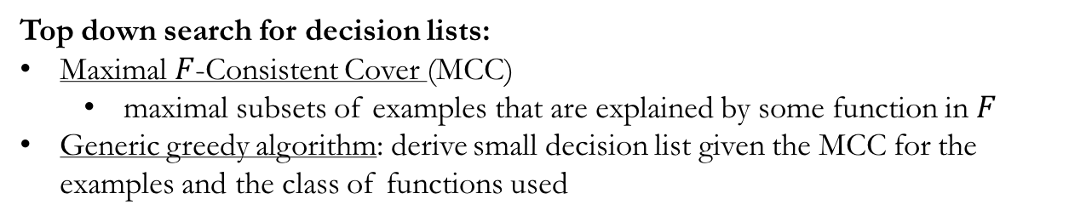
Extras
Synthesis Algorithm
A program in the
DSL consistent with E
Set of examples E
String -> Boolean
Top down search for decision lists:
Maximal $F$-Consistent Cover (MCC)
  maximal subsets of examples that are explained by some function in $F$
Generic greedy algorithm: derive small decision list given the MCC for the examples and the class of functions used
Predicate:
$p_{i}$ is conjunction of atomic predicates
Parse Expr:
functions that extract substring of the input, described by a grammar
String -> String

Slide 16
Bottom up learning of process expressions:
Process expressions are described using a grammar
We perform a symbolic bottom-up enumeration [Menon et al, 13]
of the programs using Version Space Algebra [Lau et al.,00]

Slide 17









$$u_{02}$$
$$u_{13}$$
$$u_{01}$$
$$u_{12}$$
$$u_{23}$$
$$0$$
$$1$$
$$2$$
$$3$$
Learning MCC for concat expressions:
Substrings of the output annotated with process expr that explain the substring
gives rise to a DAG representation of all concats that produce the output for that input
Parallel DFS across all DAGs to obtain subsets explained by common concats

