Slide 1
Compositional Program Synthesis from
Natural Language and Examples
Mohammad Raza, Sumit Gulwani & Natasa Milic-Frayling
Microsoft

Slide 2
Introduction
End-user programming from NL and Examples
  Empowering the 99% of computer users who are non-programmers with the ability to program computers
Important application area:
  text manipulation and string transformations in spreadsheets, word processing tools, etc.
Domain Specific Language (DSL)
formal programming language
Task Specification
Examples, NL, both,….
Program Synthesis Algorithm
DSL-specific or DSL-agnostic
Program

Slide 3

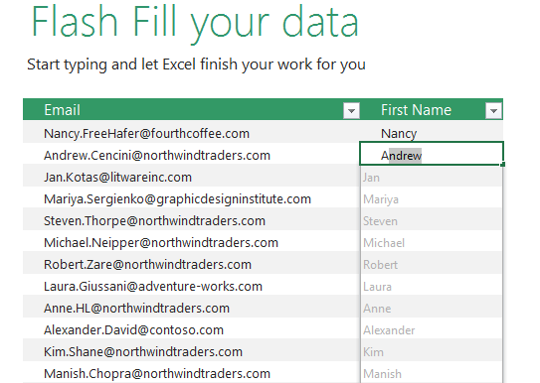

State of the art
Regular Expressions from NL
Kushman & Barzilay, NAACL 2013
Excel Flash Fill
Gulwani, POPL 2011
Synthesis from NL + examples
Manshadi, Gildea & Allen, AAAI 2013

Slide 4
Challenges
Programming by example (PBE):
  expressivity bottleneck: strong language bias to learn effectively from few examples
Programming by Natural Language (PBNL):
  supervision bottleneck: availability of training data for language learning
  Ambiguity and inaccuracy of NL descriptions of tasks
Main challenge: scalability
  Supporting expressive DSLs to allow a wide range of tasks
    e.g. remove “Mr” or “Mrs” or “Miss” from all the names
  Supporting complex tasks
    e.g. find “G” followed by 1-5 numbers or “G” followed by 4 numbers followed by a single letter “A”-“Z”

Slide 5
The Lack of Compositionality
Compositionality is fundamental to achieving scalability in programming
  Expressions, subroutines, classes, libraries, …
  Reasoning with declarative pre/post conditions, unit tests
Compositionality is present in end user interactions with expert programmers
  Iterative descriptions of tasks and elaboration
Compositionality is a challenge in existing PBE and PBNL approaches:
  End users are unaware of the formal DSL

Slide 6
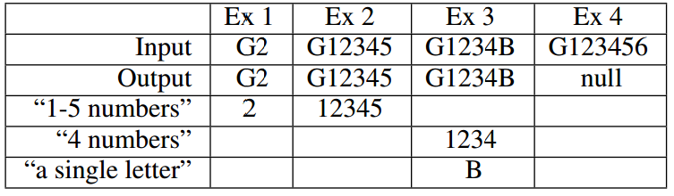
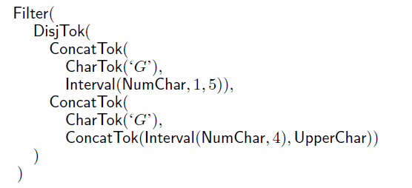
A Compositional Synthesis Paradigm
  Use compositionality in natural language to decompose task into tractable subtasks
User provides:
  NL specification of task
  Input-output examples
  Examples for
  constituent concepts
Program synthesis using constituent examples:
  Aids search and ranking of synthesis
  Not relying on language training
  Not restricting DSL expressivity
“G” followed by 1-5 numbers or “G” followed by 4 numbers followed by a single letter “A”-“Z”
“G” followed by 1-5 numbers or “G” followed by 4 numbers followed by a single letter “A”-“Z”
Synthesized program:

Slide 7
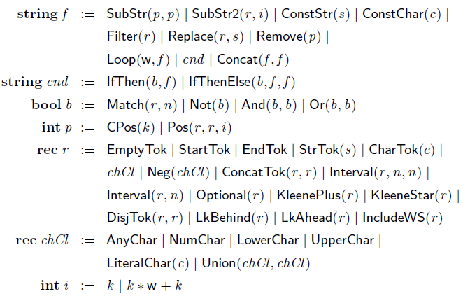
Domain Specific Language (DSL)
Context-free grammar
  Terminal Symbols
  Non-terminal Symbols
  Start symbol
  Rules: (name, head, body)
Semantics
  Each symbol is a type ranging over set of values
  Rule is a function from tuple of body types to head type
  Program is a concrete syntax tree constructed from CFG.
    Complete program
      - root is start symbol
    Program component
      - root is not start symbol
int k, nat n, char c, string s
Example DSL: Flash Fill with no expressivity constraints

Slide 8
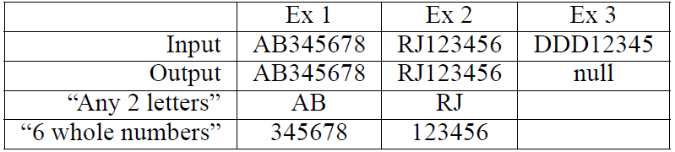
Compositional Task Specifications
Standard input-output examples specification:
Compositional examples specification:
  output is a tree structure including constituent examples
Input
(“AB345678”, “RJ123456”, “DDD12345”)
Output
(“AB345678”, “RJ123456”, null)
Input
(“AB345678”, “RJ123456”, “DDD12345”)
Output
(“AB345678”, “RJ123456”, null)
(“AB”, “RJ”, Ø)
(“345678”, “123456”, Ø)

Slide 9
Program Synthesis Algorithm
“Any 2 letters followed by any combination of 6 whole numbers”
I = (“AB345678”, “RJ123456”, “DDD12345”)
O = (“AB345678”, “RJ123456”, null)
SynthProgs(I, O)
P ← InitializeTerminals()
while (true)
P ← P ᴜ ApplyDSLRules(P)
P’ ← { p ϵ P | p(I) = 0 }
if (P’ ≠ Ø)
return P’
Rank(P)
return smallest p ϵ P
{ … , 2, …, 6, ...}
{ … , 2, …, 6, ..., UpperChar, …, NumChar, … }
{ … , Interval(UpperChar,2), …, Interval(NumChar,6), …. }
{ … , Concat(Interval(UpperChar,2),Interval(NumChar,6)), …. }
{ … , Filter(Concat(Interval(UpperChar,2),Interval(NumChar,6))), …. }
{ … , Filter(Concat(Interval(UpperChar,2),Interval(NumChar,6))), ….
… , Filter(Concat(Interval(UpperChar,2),KleeneStar(NumChar))), …. }
Filter(Concat(Interval(UpperChar,2),KleeneStar(NumChar)))

Slide 10
Program Synthesis Algorithm
“Any 2 letters followed by any combination of 6 whole numbers”
I = (“AB345678”, “RJ123456”, “DDD12345”)
T = O₀ [O₁ , O₂]
O₀ = (“AB345678”, “RJ123456”, null)
SynthesizeProgs(I, T)
let T = O[T₁, …, T_{n}]
P ← InitializeTerminals()
P ← P ᴜ SynthesizeProgs(I, T_{i})
while (true)
P ← P ᴜ ApplyDSLRules(P)
P’ ← { p ϵ P | p(I) O }
if (P’ ≠ Ø)
return P’
Rank(P)
return smallest p ϵ P with the
most CSR-satisfying components
O₁ = (“AB”, “RJ”, Ø)
O₂ = (“345678”, “123456”, Ø)
{ … , 2, …, 6, ...}
ᴜ
SynthesizeProgs(I, O₁) = { … , Interval(UpperChar,2), …}
SynthesizeProgs(I, O₂) = { … , Interval(NumChar,6), …. }
i = 1…n
{ … , Concat(Interval(UpperChar,2),Interval(NumChar,6)), …. }
CSR
͠
{ … , Filter(Concat(Interval(UpperChar,2),Interval(NumChar,6))), …. }
{ … , Filter(Concat(Interval(UpperChar,2),Interval(NumChar,6))), ….
… , Filter(Concat(Interval(UpperChar,2),KleeneStar(NumChar))), …. }
Filter(Concat(Interval(UpperChar,2),Interval(NumChar,6)))

Slide 11



Component Satisfaction Relation (CSR)
Given input I, examples E
and p(I) = V
CSR<Type>(I, E, V)
  determines when values V of type Type are relevant for examples E on inputs I
CSR for types in the string DSL:
  String: if the values are equal to the example strings
  Regex: if the value is a regex that matches the example string in the input string
  Char Class: if the characters in the examples and the values fall under the same minimal character class
  Position: if the value is the start or end position of the example string in the input string
Input
I = (“AB345678”, “RJ123456”, “DDD12345”)
Output
(“AB345678”, “RJ123456”, null)
E = (“AB”, “RJ”, Ø)
(“345678”, “123456”, Ø)
String:
Regex:
Char Class:
Position:

Slide 12
Program synthesis algorithm
Parametric in DSL, CSR and compositional specification
Systematic search
  Soundness and completeness
Specification-guided optimization
  Search with recursive component synthesis using CSR
  Semantic equivalence optimization
  DSL-agnostic rule application patterns
Ranking
  Based on constituent components and size

Slide 13
Evaluation
Problems from online help forums covering range of DSL features
  Excel, StackOverflow and Regex
Used original NL description of the task, detected noun phrases for constituent concepts using Stanford and MSR Splat parsers
  Average number of examples required: 2.73
  Average number of constituent concepts: 1.53
Baselines:
  FF: Flash Fill (8 of 48 tasks expressible, of which 2 inferred correctly)
  B1: Our system without constituent examples
  B2: Our system without ranking based only on size
 | FF | B1 | B2 | CPS
Number of correct results | 2 | 7 | 35 | 42
Number of incorrect results | 46 | 15 | 6 | 0
Number of timeouts | 0 | 26 | 7 | 6
Avg. time (seconds) | < 0.5 | 12.35 | 8.99 | 9.97

Slide 14
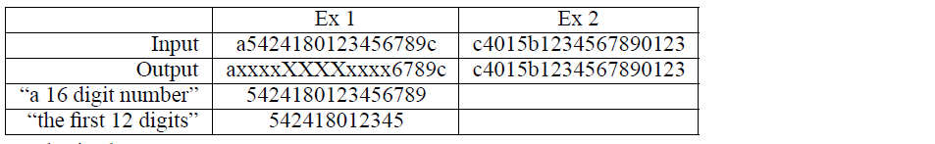
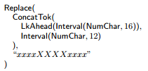
Task: replace within match
  If the cells contain a 16 digit number then Replace the first 12 digits of each string with “xxxxXXXXxxxx”

Slide 15

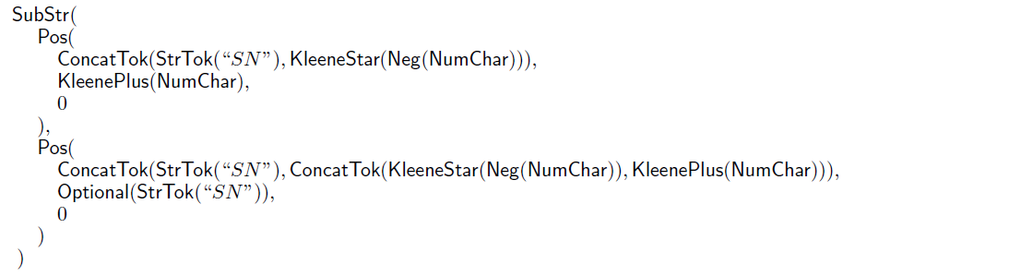
Task: dependent position expressions
  extract any numbers after “SN”. The numbers can be vary in digits. Also, at times there is some other text in between numbers and search word

Slide 16


Task: conditional with disjunction
  If column A contains the words “ear” or “mouth”, then I want to return the value of “face” otherwise I want to return the value of “body”

Slide 17


Task: inaccuracy in NL description
  The string must start with “1” or “2” (only once and mandatory) and then followed by any character between “a” to “z” (only once)

Slide 18
Conclusion
New paradigm with NL, examples and compositionality
Lifting the “expressivity” and “supervision” bottlenecks
Domain-agnostic synthesis approach
Future work
Synthesis technique
  Language learning/probabilistic relevance models from training data (potentially obtained from our system)
  Domain specific optimizations
Interaction
  Dialog-based user interaction model
  Paraphrased NL descriptions of programs shown to user
  Counter-examples, and iterative elaboration
Application domains
  Numerical algorithms, task completion (web, OS), robotics, …

