Slide 1

Automating Grammar Comparison
Ravichandhran Madhavan, EPFL
Joint work with
Mikael Mayër, EPFL
Sumit Gulwani, MSR
Viktor Kuncak, EPFL

Slide 2

Overview
unit -> pkg? imp* type*
field -> method | vard | …
arglist -> exp (, exp)*
…
Proven Equivalent
Context-free grammars
Counter-examples
cu -> pd? impd* classd*
pd -> annot* package qname;
impd -> import static? qname (. '*')? ;
…
final protected interface Id { } ;
public synchronized enum Id { , }
...
Verifier for Grammar Equivalence

Slide 3
Applications
Programming Languages
Compare grammars used by parsers
Unravel incompatibilities / bugs
Catch errors in rewriting
CS Education
Automate grading of grammar exercises
Aid in tutoring grammars
http://grammar.epfl.ch

Slide 4
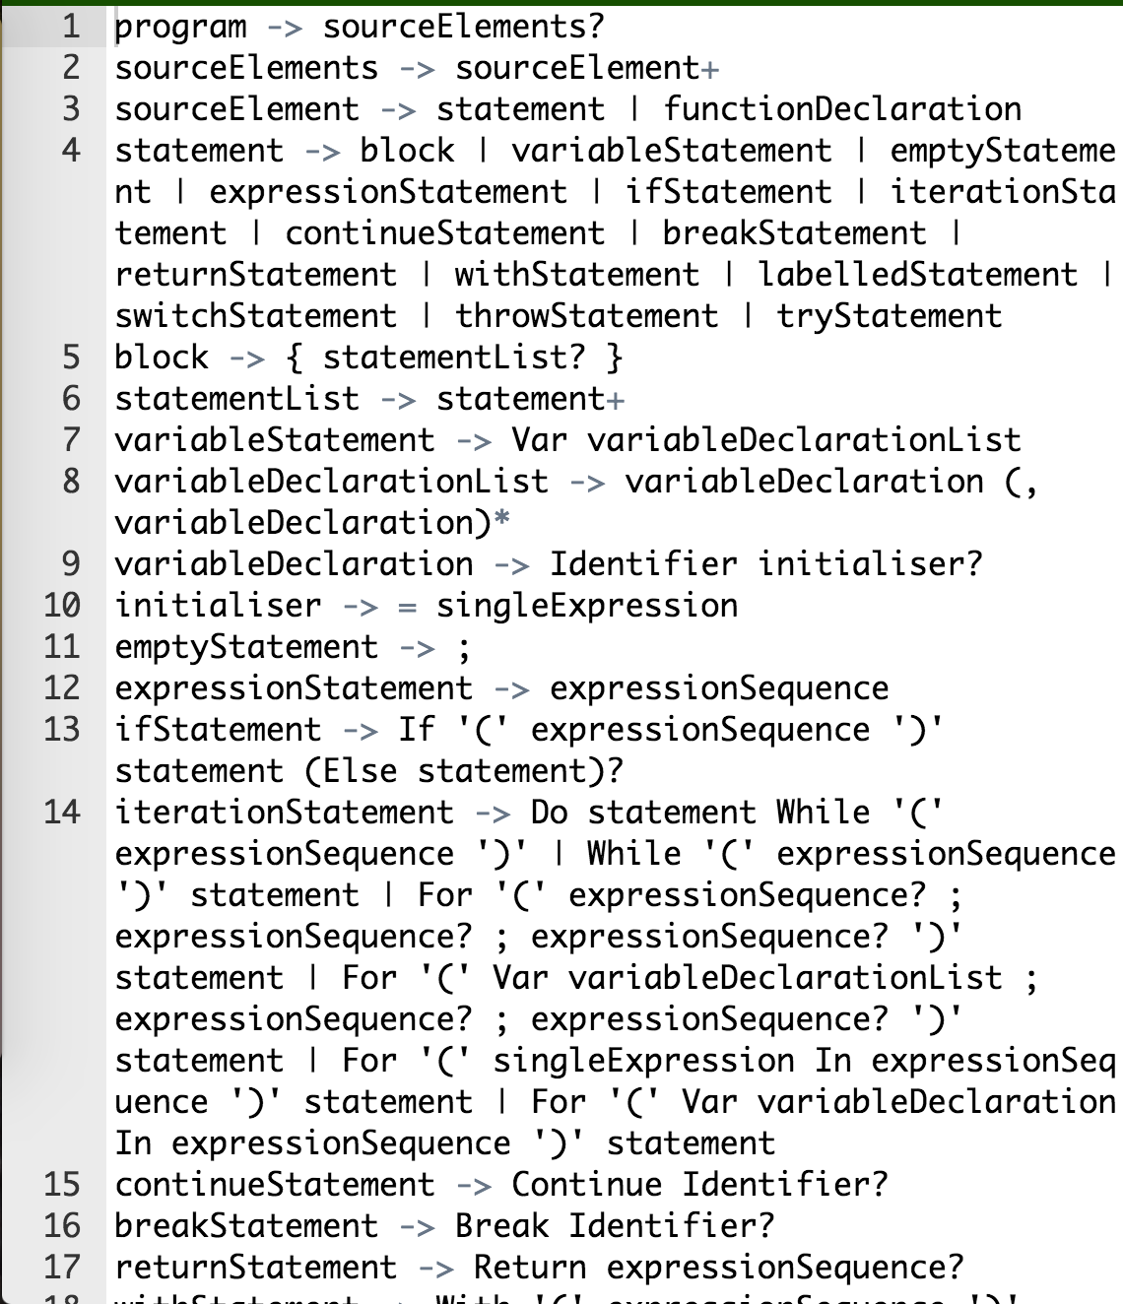
Comparing PL Grammars
Does it accept all syntactically correct programs ?
Does it accept only syntactically correct programs ?
Javascript Grammar

Slide 5
Reality Check
Analyzed grammars of 5 programming languages
Grammars disagree on > 40% of words sampled at random
Oracle JLS vs Antlr Java
private private public public class ID
implements char { }
interface ID { ; short ID = ~ + CharLiteral /= Null -- % IntLiteral == this <<= FloatLiteral ; }
…
Overly Permissive

Slide 6



Incompatibilities
Mozilla JS Grammar vs ECMA Script standard
eval("var k = function() {
}");
++ /a/ − this
Parse Error
Reference
Error
No Error

Slide 7
Grammar Rewrite Tasks
Grammars have to be modified for many reasons
Remove ambiguity
Remove left recursion
Eliminate shift / reduce conflicts (LR)
Enable recursive descent parsing (LL)
…

Slide 8
Our Contribution
Fast and deep counter-example detection
Finds hundreds of counter-examples between real world grammars
Detects incremental modifications
3x more effective and 12x faster than available state of the art

Slide 9
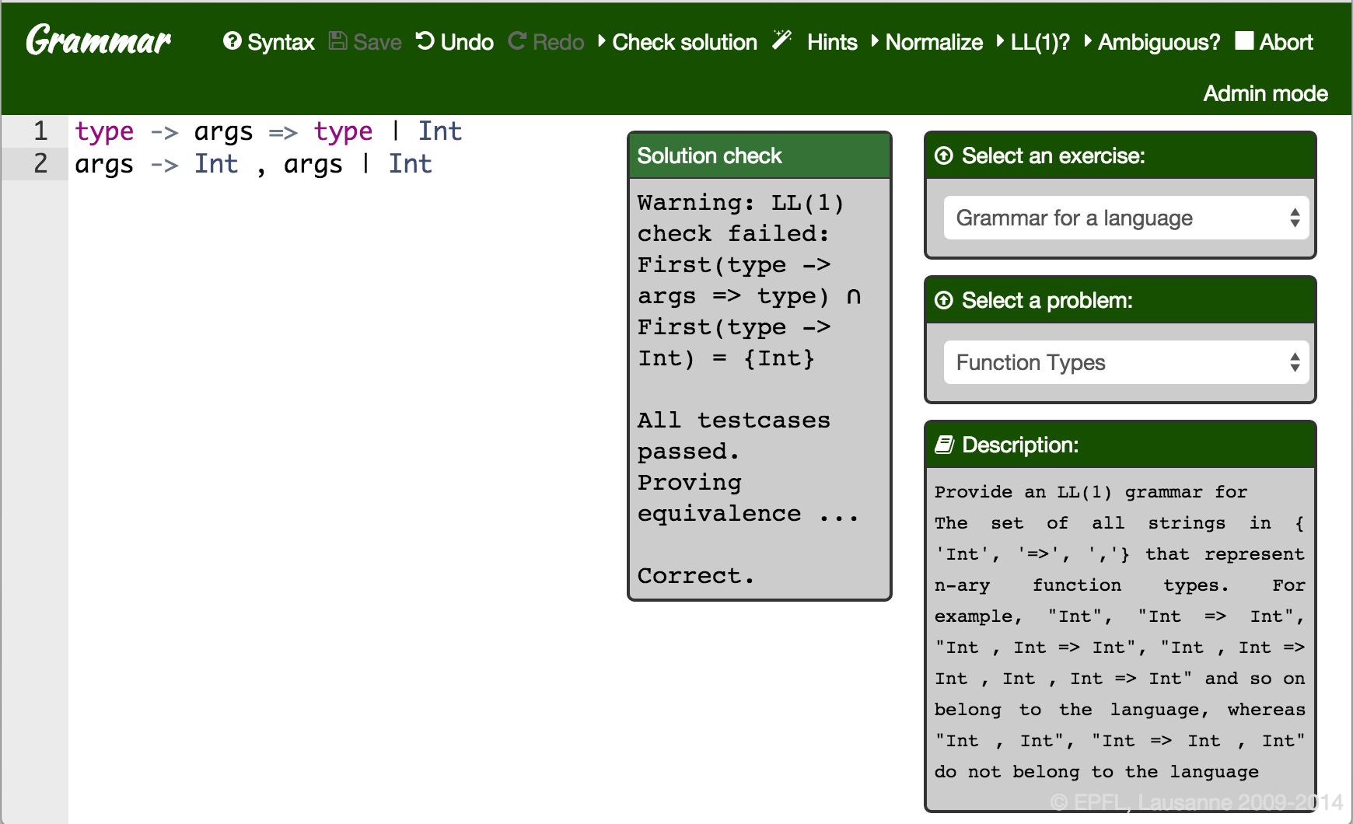
Grammar Tutoring

Slide 10
Grammars from English Descriptions
Construct an LL(1) grammar for function types over Int
Int
Int => Int
Int , Int => Int
Correct but not LL(1)
Solution 1
type → args => type | Int
args → Int , args | Int
Reference
type → Int rest
rest → => type | , Int args | ε
args → , Int args | => type
Solution 2
S → Int U
U → => Int U | , Int U | ε
Incorrect
but LL(1)

Slide 11
Second Contribution
Tutoring system for Context-free grammars
Can find counter-examples as well as prove equivalence
Decided 95.3% of 1395 student queries
Free and open source
http://grammar.epfl.ch

Slide 12
Disproving Equivalence

Slide 13
Counter-Example Discovery
unit -> pkg? imp* type*
field -> method | vard | …
arglist -> exp (, exp)*
…
Enumerate / Sample
Parse
Antlr
LL(1)
cu -> pd? impd* classd*
pd -> annot* package qname;
impd -> import static? qname (. '*')? ;
…
CYK

Slide 14
Enumeration of Words & Parse Trees
We consider enumeration of parse trees
We define the function Enum(S, i) that returns the
i^{th} parse tree rooted at S
0 | 1 | 2 | 3 | 4 | 5 | …

Slide 15
Random Lookup - Illustration
T → P Q | b P
P → a | Q P
Q → b | P Q
T, 100
Choose step 1
P Q, 50
P, 4
Unpair step
Q,5
Choose step 2
Q P, 3
P Q, 4
Q,2
P, 0
P, 1
Q,1
…
…
…
b
a
b
a
b
b
b
b

Slide 16
Advanced Features
Parametrized by word length
Enumerates only parse trees of words of specified length
Uniform random sampling of parse trees
Supports sampling uniformly from parse trees
of words of given length
Fair Enumeration
Fair usage of productions and non-terminals

Slide 17
Proving Equivalence

Slide 18
Theoretical Algorithms for Equivalence
Deterministic Grammars
G. Snizergues
Sub-deterministic grammars
Valiant
Harrison & Havel
LL(k)
Olshansky & Pnueli
Rosenkrantz & Stearns
LL(1)
Korenjak & Hopcroft

Slide 19
Our Algorithm
Combines
Korenjak & Hopcroft
Harrison & Havel
Olshansky & Pnueli
More General
Applies to arbitrary, ambiguous grammars
Complete for LL(2) grammars
Practical
Applied to grading pedagogical exercises

Slide 20

Algorithm Illustration
Two grammars for $a^{n}b^{n}$
Goal: To find a derivation for $S≡P$
S → a T
T → a T U | b
U → b
P → a R
R → a b b | a R b | b
Ambiguous

Slide 21






Proving Equivalence
S → a T
T → a T U | b
U → b
P → a R
R → a b b | a R b | b
$TU⊆Rb$ $bb⊆TU$ $Rb⊆TU$
$$TU⊆\left\{bb∪Rb\right\} \left\{bb∪Rb\right\}⊆TU$$
$$TU≡\left\{bb∪Rb\right\}$$
$$T≡R$$
$$S≡P$$
$$True$$
$$True$$
$$True$$
$$True$$
$T⊆R U⊆b$
$$True$$
$R⊆T b⊆U$

Slide 22
Proving Equivalence
S → a T
T → a T U | b
U → b
P → a R
R → a b b | a R b | b
$TU⊆Rb$ $bb⊆TU$ $Rb⊆TU$
$$TU⊆\left\{bb∪Rb\right\} \left\{bb∪Rb\right\}⊆TU$$
$$TU≡\left\{bb∪Rb\right\}$$
$$T≡R$$
$$S≡P$$
$$True$$
$$True$$
$$True$$
$$True$$
$T⊆R U⊆b$
$$True$$
$R⊆T b⊆U$
Branch Rule

Slide 23

Proving Equivalence
S → a T
T → a T U | b
U → b
P → a R
R → a b b | a R b | b
$TU⊆Rb$ $bb⊆TU$ $Rb⊆TU$
$$TU⊆\left\{bb∪Rb\right\} \left\{bb∪Rb\right\}⊆TU$$
$$TU≡\left\{bb∪Rb\right\}$$
$$T≡R$$
$$S≡P$$
$$True$$
$$True$$
$$True$$
$$True$$
$T⊆R U⊆b$
$$True$$
$R⊆T b⊆U$
Branch Rule

Slide 24
Proving Equivalence
S → a T
T → a T U | b
U → b
P → a R
R → a b b | a R b | b
$TU⊆Rb$ $bb⊆TU$ $Rb⊆TU$
$$TU⊆\left\{bb∪Rb\right\} \left\{bb∪Rb\right\}⊆TU$$
$$TU≡\left\{bb∪Rb\right\}$$
$$T≡R$$
$$S≡P$$
$$True$$
$$True$$
$$True$$
$$True$$
$T⊆R U⊆b$
$$True$$
$R⊆T b⊆U$
Equivalence
to
Inclusion

Slide 25
Proving Equivalence
S → a T
T → a T U | b
U → b
P → a R
R → a b b | a R b | b
$TU⊆Rb$ $bb⊆TU$ $Rb⊆TU$
$$TU⊆\left\{bb∪Rb\right\} \left\{bb∪Rb\right\}⊆TU$$
$$TU≡\left\{bb∪Rb\right\}$$
$$T≡R$$
$$S≡P$$
$$True$$
$$True$$
$$True$$
$$True$$
$T⊆R U⊆b$
$$True$$
$R⊆T b⊆U$
Enumeration
Rule

Slide 26


Proving Equivalence
S → a T
T → a T U | b
U → b
P → a R
R → a b b | a R b | b
$TU⊆Rb$ $bb⊆TU$ $Rb⊆TU$
$$TU⊆\left\{bb∪Rb\right\} \left\{bb∪Rb\right\}⊆TU$$
$$TU≡\left\{bb∪Rb\right\}$$
$$T≡R$$
$$S≡P$$
$$True$$
$$True$$
$$True$$
$$True$$
$T⊆R U⊆b$
$$True$$
$R⊆T b⊆U$
Split Rule
T U
R b
$$⇒$$
$$⇒$$
b
b

Slide 27
Proving Equivalence
S → a T
T → a T U | b
U → b
P → a R
R → a b b | a R b | b
$TU⊆Rb$ $bb⊆TU$ $Rb⊆TU$
$$TU⊆\left\{bb∪Rb\right\} \left\{bb∪Rb\right\}⊆TU$$
$$TU≡\left\{bb∪Rb\right\}$$
$$T≡R$$
$$S≡P$$
$$True$$
$$True$$
$$True$$
$$True$$
$T⊆R U⊆b$
$$True$$
$R⊆T b⊆U$
Inductive
Reasoning

Slide 28
Empirical Evaluation

Slide 29
Benchmarks
Java 7
JavaScript
C 11
Pascal
VHDL
Compared two grammars per benchmark
Average Size: 213 non-terminals & 420 productions

Slide 30
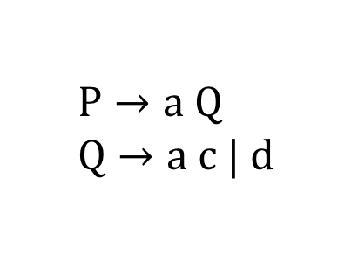
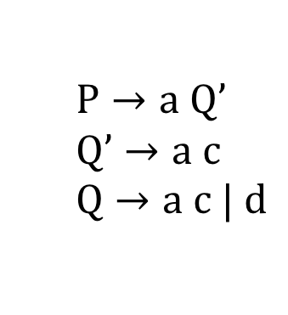
Injecting Fine grained Errors
  Type 1: Removing a production at random
  Type 2: Removing a nonterminal of a production at random
  Type 3: Disabling a production in a specific context at random
$P→a Q$
$Q→a c | d$
$$P→a Q’$$
$$Q’→a c$$
$$Q→a c | d$$

Slide 31
Detecting Fine grained Errors
Mean time / error found
Our tool: 28s
CFG analyzer: 343s
Mean counter-example length
Our tool: 35
CFG analyzer: 12.2

Slide 32
Tutoring System
Evaluations
Queries | Refuted | Proved | Unknown | Time / query
1395 | 1042 74.6% | 289 20.7% | 64 4.6% | 107ms
Evaluated the system on a class of 50 students
The tutoring system has 5 types of exercises & 60 problems

Slide 33
Equivalence Prover
Evaluations
Invocations | Proved | Time / query | LL(2) queries | Ambiguous queries
353 | 289 81.9% | 410ms | 63 18% | 101 28.6%

Slide 34
Conclusion
Tool support for testing compiler grammars
Discovering counter-examples between large programming language grammars
Automating tutoring and evaluation of grammars
Prove or disprove students’ solutions and provide feedback
More useful in the context of MOOCs
http://grammar.epfl.ch

Slide 35
Related Works
Tutoring Systems
Singh et al. [PLDI ’13], Axelsson et al. [ICALP ’08],
Creus & Godoy [RTA-TLCA ’14]
Uniform Random Sampling
Unambiguous – Hickey and Cohen [SIAM J. Comp ’83], Mairson [Inf. Process Lett. ’94]
Ambiguous – Gore et al. [Inf. Comput. ’97]
Data structure Enumeration
Purdom [BIT Numerical Mathematics ’72], Maurer [IEEE Software ’90],
Malloy [Comp. and Inf. science ’01], Lammel & Schulte [TestCom ’06], Majumdar & Xu [ASE ’07], Kuraj & Kuncak [Scala Workshop ‘14]
Decision Procedures for Equivalence
Sénizergues [Theor. Comput. Sci. ‘01] , Valiant [Tech. Report, Univ. of Warwick ‘ 73], Rosenkrantz & Stearns [STOC ‘69], Korenjak & Hopcroft [Switching & Automata Theory ‘66], Olshansky & Pnueli [Theor. Comput. Sci. ‘77], Harisson et al. [Theor. Comput. Sci. ‘79]

