Slide 1
Studies of the Onset & Persistence of Medical Concerns in Search Logs
Ryen White and Eric Horvitz
Microsoft Research, Redmond
{ryenw,horvitz}@microsoft.com

Slide 2
Motivation
People use the Web to diagnose and understand medical conditions
80% of U.S. Web users perform medical search (Pew, 2011)
Studies to date have focused on the impact of the Web on medical search
  Including cyberchondria (White & Horvitz, TOIS 2009) – Escalations in concerns within a single session (e.g., [headache] → [brain tumor])
Search behavior over time reflects in-world events such as professional diagnosis, etc. [Our Focus]

Slide 3
Our Focus: Logs as a Lens on Health
We explore how medical concerns emerge over time and how concerns persist post onset
Long-term needed to understand medical search
  60% of medical sessions start directly with a condition query
    Searchers come to search engines with a condition in mind!
  95% of these sessions had medical query in prior session(s)
Long-term helps us understand medical trajectories
  Predict emerging concerns, personalize search, guide healthcare use
Note: Long-term may be influenced by external events (e.g., diagnosis) – Web not always cause

Slide 4
Contributions
Large-scale log analysis to:
Characterize how health-related concerns emerge in search activity over time
Analyze persistence of concerns post onset, including interruptions to future search tasks
Build models to predict condition onset, escalations in concerns, and future interruptions
Will focus on #1 and #2 in this talk

Slide 5
Data
Anonymized toolbar logs from millions of users
3 month period from Jan – Mar 2011
Extracted search sessions (30 min timeout)
  Included queries from Google, Yahoo!, Bing
Assigned topical labels from ODP to URLs
Content-based classifier
Identify which URLs are medical

Slide 6
Long-Term Profile Generation
Identify searchers with evidence of health seeking intent
Searchers who visited at least one URL in Health category
Removed outlier users
170k users, 25M sessions, 1B+ URLs
150 search sessions / user, spanning avg. of 76 days / user
Automatically labeled queries based on:
  Symptoms: Merck medical dictionary + synonyms from click graph
    E.g., headache
  Benign explanations: ICD10 list + synonyms from click graph
    E.g., caffeine withdrawal
  Serious illnesses: ICD10 list + synonyms from click graph
    E.g., brain tumor

Slide 7
What are some key characteristics of the long-term health-search profiles?

Slide 8
Medical Search Over Time
Statistic (n=169,513) | Mean | SD
# medical queries (based on clicks) | 36.67 | 60.29
% queries medical | 3.4% | 4.3%
# medical sessions | 37.04 | 32.05
# medical queries (wordlist method) | 10.31 | 17.90
# queries with serious illnesses | 4.60 | 8.68
# queries with benign explanations | 1.86 | 5.81
# queries with symptoms | 4.15 | 11.39
3% of queries are medical related
Users search more often for
symptoms and serious illnesses
than benign, common explanations
ODP classes
of SERP clicks
Dictionary lookup

Slide 9
What are characteristics of how health-related concerns emerge in activity over time?

Slide 10
Condition Onset
Explore search behavior before the onset of the first occurrence of a condition – randomly chosen
Pre-onset history can contain other conditions
  83% searched for at most one other condition prior to onset
  61% searched for no conditions pre-onset
Also extracted behavior after the condition onset
Overall: 159K pre-onset histories, one per user
Onset
condition
Pre-onset
Post-onset
Condition
Q
Q
Q
Symptoms
q
q
q
q
q
q
q
Time

Slide 11
Pre-Onset Behavior
Extracted features of search behavior before onset
We computed statistics of search behavior, e.g.,
  20 medical search sessions over 49 days before condition
  3% of user’s time online was spent viewing medical content
Additionally, we wanted to check if onset condition and the symptoms searched previously were related
Extracted symptom-onset pairs, compared with known
  E.g., [headache] → {migraine, caffeine withdrawal, brain tumor}
79.5% of prior symptoms were related to onset
  Emergence of conditions appears to extend back over time

Slide 12
Condition Severity
Study the relationship between pre-onset and severity
Many search / Web usage behaviors are similar, but …
Onset condition is …
Feature | Serious (n=117389) | Benign (n=34424)
% medical queries | 3.0% (4.0%) | 4.0% (4.2%)
# medical queries | 5.30 (12.12) | 7.69 (15.48)
# symptom queries | 1.81 (6.43) | 2.34 (7.58)
# condition queries | 1.74 (5.36) | 2.27 (6.36)
Onset condition = benign, more medical searching
Web may be contributing as a causal influence
  Users may be better informed and less likely to escalate
  Narrow lens of log analysis means that we cannot be sure why

Slide 13
Feature Trends
Benign explanations
Serious illnesses
Number of symptom queries
Compute gradient of line of best fit
of the features over time before the condition onset
Observations:
  Condition acuity increases top-to-bottom
  Benign explanations on bottom are acute
    e.g., food poisoning and panic attacks
  Serious illnesses on top are chronic
    e.g., chronic fatigue syndrome
Line of
best fit
Onset
condition
Time
q
q
q
q
Q
Average best-fit gradient

Slide 14
How do searches for the condition persist following evidence of initial concern onset?

Slide 15
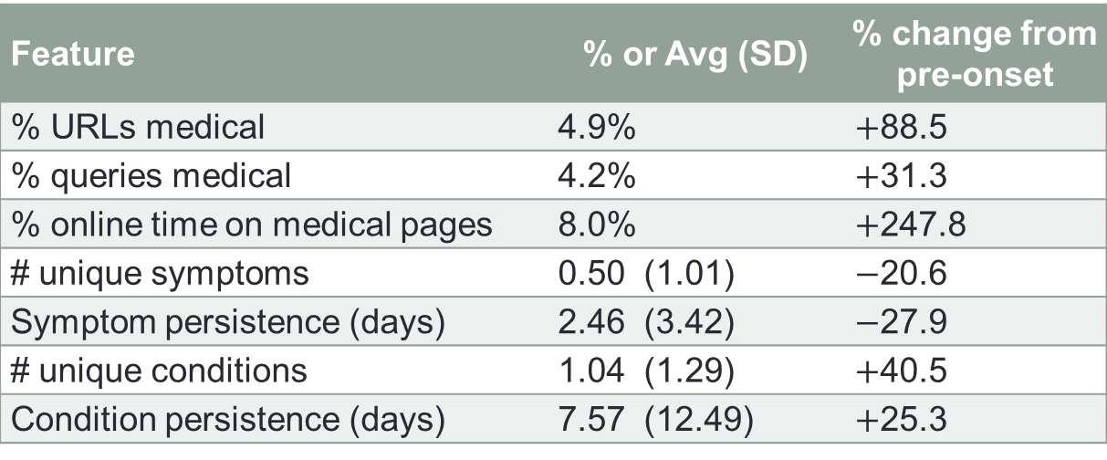
Post-Onset Search Behavior
Computed the same features for search behavior after the onset condition rather than before
Medical search increases, symptom searching decreases, and condition searching increases (more focused)
Feature | % or Avg (SD) | % change from pre-onset
% URLs medical | 4.9% | $+$88.5
% queries medical | 4.2% | $+$31.3
% online time on medical pages | 8.0% | $+$247.8
# unique symptoms | 0.50 (1.01) | $−$20.6
Symptom persistence (days) | 2.46 (3.42) | $−$27.9
# unique conditions | 1.04 (1.29) | $+$40.5
Condition persistence (days) | 7.57 (12.49) | $+$25.3
Most people searched for zero conditions pre-onset

Slide 16
Interruption: Effect of Health Concerns
Suspension of ongoing search activity
Given a search session, an interruption comprises at least one search for the onset condition sandwiched between two series of 1+ non-medical searches, e.g.,
We show that interruption happens often:
  30.3% of users were interrupted in this way
  2.39 interruptions / user, totaling 2 hours and 16 mins. searching
  6% of future search sessions interrupted, on 2.68 total days
Onset
condition
Interruptions
Session
Q
n
Q
n
n
Q
Q
n
n
n
n
n
n
n
Time

Slide 17
Summary and Takeaways

Slide 18
Summary of Presented Findings
80% of pre-onset symptoms relate to onset condition
  True even though the search queries are weeks apart
Medical search increases near to onset
  Related to acuity of condition
Onset type is related to pre-onset behavior
  e.g., Benign explanations follow more medical searching
Medical search behavior post-onset ≠ pre-onset
  e.g., Symptom search drops, condition search increases
Post-onset interruptions occur frequently

Slide 19
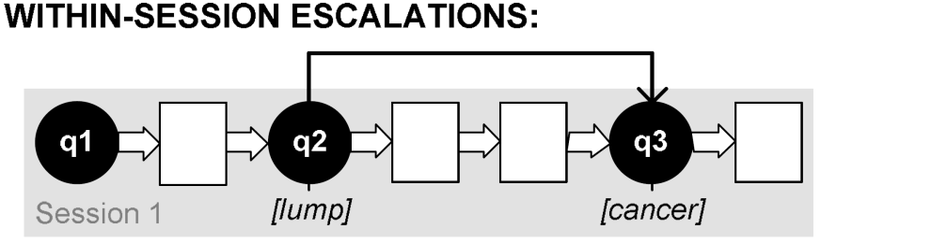

Other Things (see paper for more info)
Between-session escalations in medical concerns
Focus-of-attention
  Users narrow focus over time – focus on particular conditions of interest
Periodicities in medical search
  Medical search behavior is clustered, not spread out over time
Accurate prediction of onset, escalation, interruption
(White & Horvitz, 2009)
(New in this paper)

Slide 20
Implications & Limitations
Onset as cue to use previous clicks for related symptoms
Use combination of symptoms searched over time to estimate the onset condition (early warning signs!)
  Observed over time: [twitching], [twitching eye], [twitch], …
  Unobserved (yet!): [ALS] [Lou Gherig’s Disease]
Given accurate prediction of:
  Onset: Adjust search experience based on severity or prevalence
  Escalation: Provide links to broader content (benign explanations)
  Interruptions: Provide support for more effective task switching
Limitations of log analysis:
  Machines may be shared (not all queries from same user)
  Limited definitions of concepts (e.g., interruptions)

Slide 21
Conclusions
Log-based longitudinal study of online health search
Characterized aspects of that behavior before condition onset – relationship with condition type, escalations
Studied post-onset behavior and found differences in search behavior, and evidence of interruptions
Also built predictive models of onset, escalations, impact
Search engines could mine long-term health seeking behavior to provide better medical-search support

