Slide 1
Cohort Modeling for Enhanced Personalized Search
Jinyun Yan | Wei Chu | Ryen White
Rutgers University | Microsoft Bing | Microsoft Research

Slide 2
Personalized Search
Many queries have multiple intents
  e.g., [H2O] can be a beauty product, wireless, water, movie, band, etc.
Personalized search
  Combines relevance and the searcher’s intent
  Relevant to the user’s interpretation of query

Slide 3
Challenge
Existing personalized search
  Relies on the access to personal history
    Queries, clicked URLs, locations, etc.
Re-finding common, but not common enough
  Approx. 1/3 of queries are repeats from same user [Teevan et al 2007, Dou et al 2007]
  Similar statistics for <user, q, doc> [Shen et al 2012]
2/3 queries new in 2 mo. - ‘cold start’ problem

Slide 4

Motivation for Cohorts
When encountering new query by a user
  Turn to other people who submitted the query
  e.g., Utilize global clicks
Drawback
  No personalization
Cohorts
  A group of users similar along 1+ dimensions, likely to share search interests or intent
  Provide useful cohort search history

Slide 5
Situating Cohorts
Global
Cohort
Individual
Not personalized
Conjoint Analysis
Learning across Users
Collaborative
Grouping/Clustering
Cohorts …
Hard to Handle New Queries
Hard to Handle New Documents
Sparseness (Low Coverage)

Slide 6
Related Work
Explicit groups/cohorts
  Company employees [Smyth 2007]
  Collaborative search tools [Morris & Horvitz 2007]
Implicit cohorts
      Behavior based, k-nearest neighbors [Dou et al. 2007]
  Task-based / trait-based groups [Teevan et al. 2009]
Drawbacks
  Costly to collect or small n
  Uses information unavailable to search engines
  Some offer little relevance gain

Slide 7
Problem
Given search logs with <user, query, clicks>, can we design a cohort model that can improve the relevance of personalized search results?

Slide 8
Concepts
Cohort: A cohort is a group of users with shared characteristics
  E.g., a sports fan
Cohort cohesion: A cohort has cohesive search and click preferences
  E.g., search [fifa] → click fifa.com
Cohort membership: A user may belong to multiple cohorts
  Both a sports fan and a video game fan

Slide 9
Our Solution
Cohort Generation
  Identify particular cohorts of interest
Cohort Membership
  Find people who are part of this cohort
Cohort Behavior
  Mine cohort search behavior (clicks for queries)
Cohort Preference
  Identify cohort click preferences
Cohort Model
  Build models of cohort click preferences
User Preference
  Apply that cohort model to build richer representation
  of searchers’ individual preferences

Slide 10
Cohort Generation
Proxies
  Location (U.S. state)
  Topical interests
  (Top-level categories in Open Directory Project)
  Domain preference
  (Top-level domain, e.g., .edu, .com, .gov)
  Inferred from search engine logs
    Reverse IP address to estimate location
    Queries and clicked URLs to estimate search topic interest and domain preference for each user

Slide 11

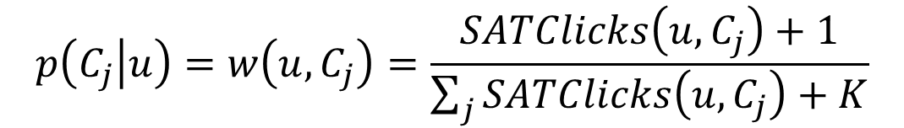
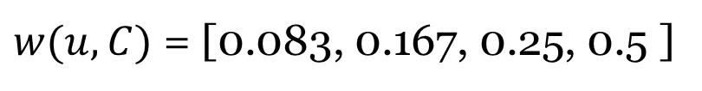
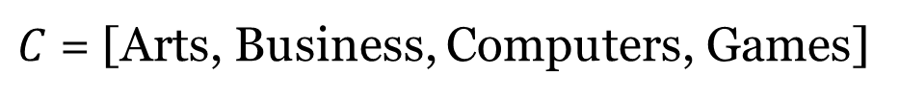
Cohort Membership
Multinomial distribution
  Smoothed
  Example:
$$p\left(C_{j} | u\right)=w\left(u,C_{j}\right)=\frac{SATClicks\left(u,C_{j}\right)+1}{\sum_{j}{SATClicks\left(u,C_{j}\right)+K}}$$
Smoothing
parameter
$C$ = [Arts, Business, Computers, Games]
SATClicks = [0, 1, 2, 5] (clicks w/ dwell ≥ 30s)
$w(u,C)$ = [0.083, 0.167, 0.25, 0.5 ]

Slide 12




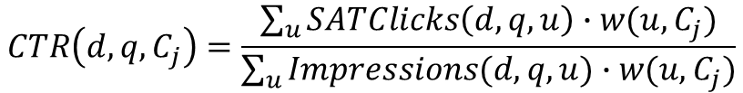
Cohort Preference
Query q
Cohort click preference
  Cohort CTR:
  Global CTR:
  Simplified example:
    Global preference:
      $\left[CTR\left(d1, q\right), CTR\left(d2,q\right)\right]= \left[\frac{4}{100},\frac{3}{100}\right]$
    Cohort preference
      Cohort 1: $\left[{CTR}_{C}\left(c1,d1, q\right),{CTR}_{C}\left(c1,d2, q\right)\right]= \left[\frac{4}{100}, 0\right]$
      Cohort 2: $\left[{CTR}_{C}\left(c2,d1, q\right),{CTR}_{C}\left(c2,d2, q\right)\right]= \left[0,\frac{3}{100}\right]$
d1
$$CTR\left(d,q,C_{j}\right)=\frac{\sum_{u}{SATClicks\left(d,q,u\right)∙w(u,C_{j})}}{\sum_{u}{Impressions(d,q,u)∙w(u,C_{j})}}$$
$$CTR\left(d,q\right)=\frac{\sum_{u}{SATClicks\left(d,q\right)}}{\sum_{u}{Impressions(d,q) }}$$
d2
Notes:
Assume impression for d1 and d2 = 100
Each user belongs to one cohort. W(u, c_1) = 0, then w(u, c_2) = 1

Slide 13
Cohort Model
Estimate individual click preference by cohort preference
$z\left(d,q,u,C_{j}\right)=p\left(d,q,C_{j}\right)∙p\left(C_{j} | u\right)=CTR(d,q,C_{j}$) $∙w(u,C_{j})$
Cohort features
Re-rank
Machine-learned model
Personalized Ranking
Search results
Personal features
Universal rank
Ranked List

Slide 14
Experiments
Setup
  Randomly sampled 3% of users
  2-month search history for cohort profiling: cohort membership, cohort CTR
  1 week for evaluation:
  3 days training, 2 days validation, 2 days testing
  5,352,460 query impressions in testing
Baseline
  Personalized ranker used in production on Bing
  With global CTR, and personal model

Slide 15
Experiments
Evaluation metric:
  Mean Reciprocal Rank of first SAT click (MRR)*
  ΔMRR = MRR(cohort model) – MRR(baseline)
Labels: Implicit, users’ satisfied clicks
  Clicks w/ dwell ≥ 30 secs or last click in session
  1 if SAT click, 0 otherwise
* ΔMAP was also tried. Similar patterns to MRR.

Slide 16
Results
Cohort-enhanced model beats baseline
  Positive MRR gain over personalized baseline
    Average over many queries, with many ΔMRR = 0
    Gains are highly significant (p < 0.001)
  ALL has lower performance, could be noisier:
    Re-ranks more often, Combining different signals
Group Type | ΔMRR ±SEM | Re-Ranked@1
ODP (Topic interest) | 0.0187 ±0.00143 | 0.91%
TLD (Top level domain) | 0.0229 ±0.00145 | 0.96%
Location (State) | 0.0113 ±0.00142 | 0.90%
ALL (ODP + TLD + Location) | 0.0211 ±0.00146 | 0.98%
Notes:
Here we only show MRR results. MAP results are similar, read papers for more details

Slide 17
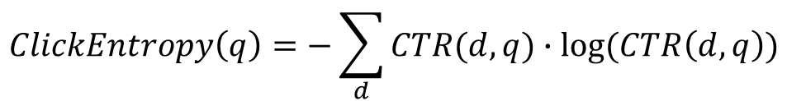
Performance on Query Sets
New queries
  Unseen queries in training/validation
  2× MRR gain vs. all queries
Queries with high click-entropy
  5× MRR gain vs. all queries
Ambiguous queries
  10k acronym queries, all w/ multiple meanings
  10× MRR gain vs. all queries
$$ClickEntropy\left(q\right)=−\sum_{d}{CTR(d,q)∙log⁡(CTR\left(d,q\right))}$$

Slide 18
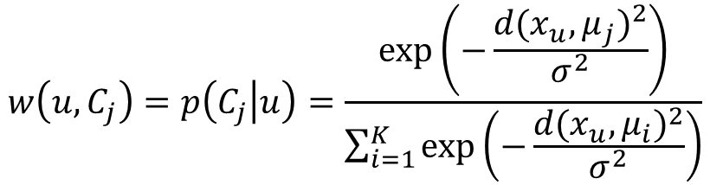
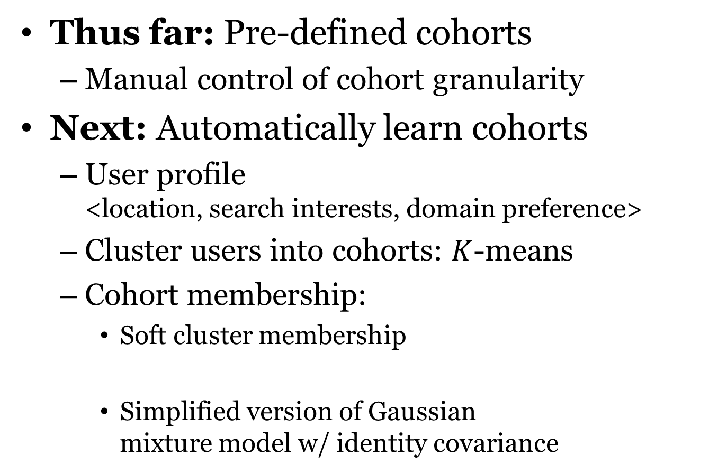
Cohort Generation: Learned Cohorts
Thus far: Pre-defined cohorts
  Manual control of cohort granularity
Next: Automatically learn cohorts
  User profile
  <location, search interests, domain preference>
  Cluster users into cohorts: $K$-means
  Cohort membership:
    Soft cluster membership
    Simplified version of Gaussian
    mixture model w/ identity covariance
Distance between
user vector and
cohort vector
$$w\left(u,C_{j}\right)=p\left(C_{j} | u\right)=\frac{exp⁡\left(−\frac{{d(x_{u},μ_{j})}^{2}}{σ^{2}}\right)}{\sum_{i=1}^{K}{exp⁡\left(−\frac{{d(x_{u},μ_{i})}^{2}}{σ^{2}}\right)}}$$

Slide 19
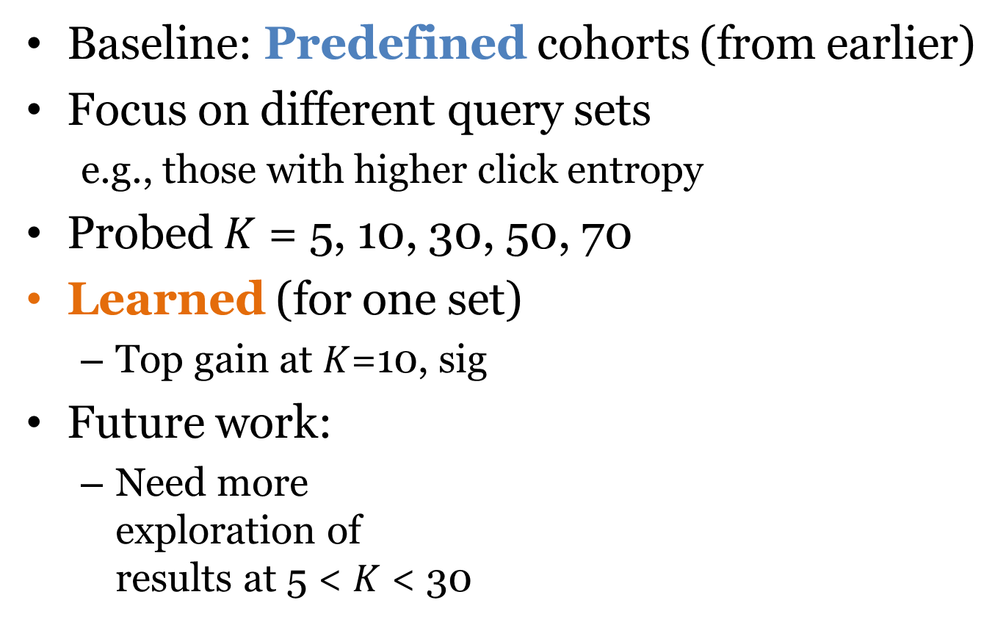
Finding Best K
  Baseline: Predefined cohorts (from earlier)
Focus on different query sets
  e.g., those with higher click entropy
Probed $K$ = 5, 10, 30, 50, 70
Learned (for one set)
  Top gain at $K$=10, sig
Future work:
  Need more
  exploration of
  results at 5 < $K$ < 30

Slide 20
Summary
Cohort model enhanced personalized search
  Enrich models of individual intent using cohorts
  Automatically learn cohorts from user behavior
Future work:
  More experiments, e.g., parameter sweeps
  More cohorts: Age, gender, domain expertise, political affiliation, etc.
  More queries: Long-tail queries, task-based and fuzzy matching rather than exact match

Slide 21
Thanks
Questions?

