Slide 1

Packing Tasks with Dependencies
Srikanth Kandula
Robert Grandl, Sriram Rao, Aditya Akella, Janardhan Kulkarni
University of Wisconsin,
Madison

Slide 2
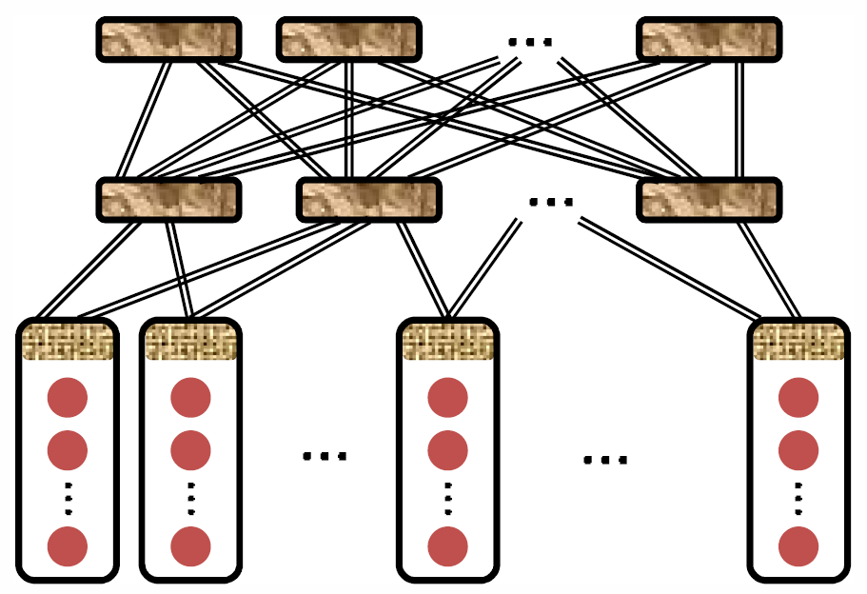
The Cluster Scheduling Problem
Jobs
Goal: match tasks to resources
to achieve
High cluster utilization
Fast job completion
Guarantees (deadlines, fair shares)
Constraints
Scale ⇒ fast twitch
Tasks
Large and high-value deployments
  E.g., Spark, Yarn*, Mesos*, Cosmos
Today, schedulers are simple and (as we show) performance can improve a lot

Slide 3
Jobs have heterogeneous DAGs
Example DAG
User queries → Query optimizer → Job DAG
DAGs have deep and complex structures
Task durations range from <1s to >100s
Tasks use different amounts of resources
(Dryad, Spark-SQL, Hive,…)
Legend
# Tasks
Duration
1
200s
10
60s
100
1000
0s
Edges
need shuffle
can be local

Slide 4
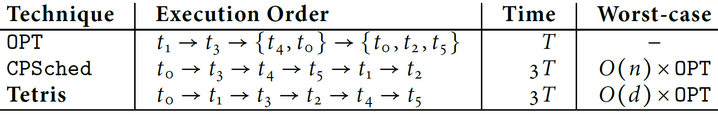
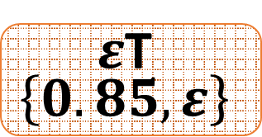
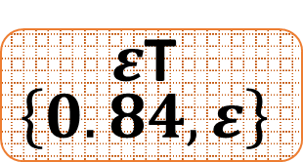



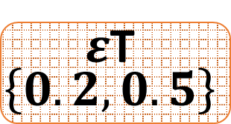
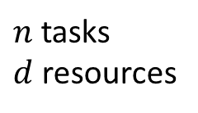
Challenges in scheduling heterogeneous DAGs
$n$ tasks
$d$ resources
Packers¹
CPSched cannot overlap tasks with complementary demands
$ε$T
$$\left\{0.84, ε\right\}$$
3:
Packers do not handle dependencies
$\left(1+5ε\right)$T
$$\left\{0.6, 0.3\right\}$$
$ε$T
$$\left\{0.85, ε\right\}$$
0:
1:
$ε$T
$$\left\{0.2, 0.5\right\}$$
4:
2:
$$T$$
$$\left\{0.2, 0.6\right\}$$
$$\left(1+2ε\right)T$$
$$\left\{0.2,0.1\right\}$$
5:
[1] Tetris: Multi-resource Packing for Cluster Schedulers, SIGCOMM’14

Slide 5
Challenges in scheduling heterogeneous DAGs …
Simple heuristics lead to poor schedules
Production DAGs are roughly 50% slower than lower bounds
Simple variants of “Packing dependent tasks” are NP-hard problems
Prior analytical solutions miss some practical concerns
  Multiple resources
  Complex dependencies
  Machine-level fragmentation
  Scale; Online; …

Slide 6
Given an annotated DAG and available resources, compute a good schedule
+ practical model

Slide 7
Main ideas for one DAG
…
resources
time
Existing schedulers:
A task is schedulable after all its parents have finished
Graphene:
Identifies troublesome tasks and places them first

Slide 8
Main ideas for one DAG
…
…
resources
time
Existing schedulers:
A task is schedulable after all its parents have finished
Graphene:
Identifies troublesome tasks and places them first
Place other tasks around trouble

Slide 9
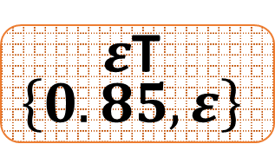
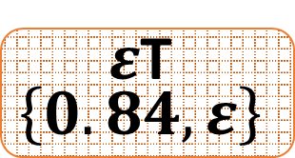



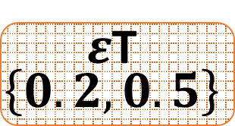
Does placing troublesome tasks first help?
Revisit the example
$ε$T
$$\left\{0.84, ε\right\}$$
3:
2
$\left(1+5ε\right)$T
$$\left\{0.6, 0.3\right\}$$
$ε$T
$$\left\{0.85, ε\right\}$$
0
0:
1:
$ε$T
$$\left\{0.2, 0.5\right\}$$
1
3
4
5
4:
time
2:
$$T$$
$$\left\{0.2, 0.6\right\}$$
$$\left(1+2ε\right)T$$
$$\left\{0.2,0.1\right\}$$
5:
If troublesome tasks ⊇ long-running tasks, Graphene ≡ OPT

Slide 10

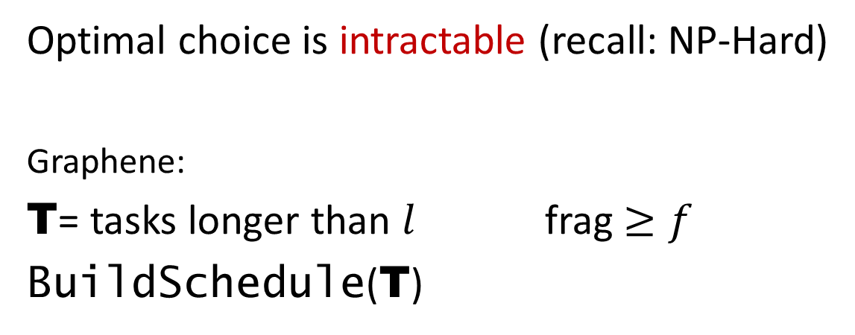
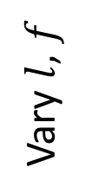

How to choose troublesome tasks T?
Optimal choice is intractable (recall: NP-Hard)
Graphene:
T= tasks longer than $l$ frag $≥f$
BuildSchedule(T)
Stage fragmentation score
$$f$$
and
or
Vary $l$, $f$
$$l$$
Task duration
Pick the most compact schedule
Extensions
  Explore different choices of T in parallel
  Recurse
  Memoize …

Slide 11


Schedule dead-ends
Which of these orders are legit?
T_{fb}P_{b}S_{f}C_{f}
T_{fb}P_{b}C_{f}S_{f}
P
…
…
T_{fb}S_{fb}P_{b}C_{f}
T
resources
Graphene explores all orders and avoids dead-ends
T
C
S
time
Since some parents and children of are already placed with T, may not be able to place
When placing tasks in , P, have to go backwards (place task after all children are placed)
T ← TransitiveClosure (T)

Slide 12
Main ideas for one DAG
P
…
…
P
T
s
resources
resources
T
C
T
C
S
time
time
Identify troublesome tasks and place them first
Systematically place tasks to avoid dead-ends

Slide 13
One DAG Multiple DAGs
Computed offline schedule for
Production clusters have

Slide 14

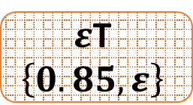
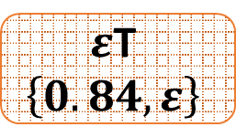
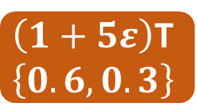
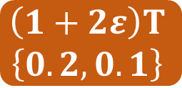

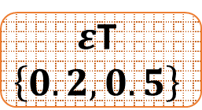
Convert offline schedule to priority order on tasks
$ε$T
$$\left\{0.84, ε\right\}$$
Job1
Job2
$ε$T
$$\left\{0.85, ε\right\}$$
3:
2
2’
1:
0
0’
$\left(1+5ε\right)$T
$$\left\{0.6, 0.3\right\}$$
1
3
4
5
1’
3’
4’
5’
0:
$ε$T
$$\left\{0.2, 0.5\right\}$$
4:
Offline
$$t_{1}→t_{3}→t_{4}→ \left\{t_{0},t_{2},t_{5}\right\}$$
2:
$$T$$
$$\left\{0.2, 0.6\right\}$$
$$\left(1+2ε\right)T$$
$$\left\{0.2,0.1\right\}$$
Runtime
5:
5
5’
4’
2’
2
1
3
3’
4
0
0’
time
1’
2T
4’
5
CPSched
0
0’
3
4
1
3’
5’
1’
2
2’
2
3T
4T

Slide 15
Main ideas for multiple DAGs
Convert offline schedule to priority order on tasks
Online, enforce schedule priority along with heuristics for
  Multi-resource packing
  “SRPT” to lower average job completion time
  Bounded amount of unfairness
  Overbooking …
Schedule priority
best for one DAG; overall?
Job Completion Time
may lose packing efficiency, …
Trade-offs:
We show that:
{best “perf” |bounded unfairness} ~ best “perf”
Packing Efficiency
?
may delay job completion, …
Fairness
may counteract all others

Slide 16
Graphene summary & implementation
Offline, schedule each DAG by placing troublesome tasks first
Online, enforce priority over tasks along with other heuristics

Slide 17
Graphene summary & implementation
Offline, schedule each DAG by placing troublesome tasks first
Online, enforce priority over tasks along with other heuristics
NM
Schedule Constructor
RM
NM
AM
Node heartbeat
+ priority order
+ packing
+ bounded unfairness
+ + overbook
DAG
…
NM
Schedule Constructor
AM
Task assignment
DAG
NM

Slide 18
Implementation details
DAG annotations
Bundling: improve schedule quality w/o killing scheduling latency
Co-existence with (many) other scheduler features

Slide 19
Evaluation
Prototype
  200 server multi-core cluster
  TPC-DS, TPC-H, …, GridMix to replay traces
  Jobs arrive online
Simulations
  Traces from production Microsoft Cosmos and Yarn clusters
  Compare with many alternatives

Slide 20
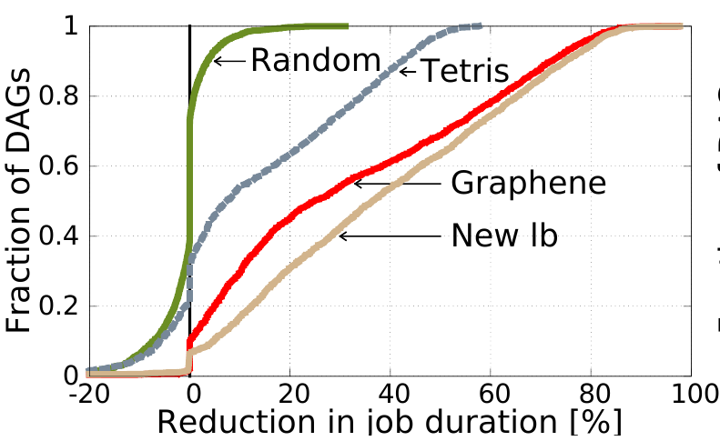
Results - 1
[20K DAGs from Cosmos]
Packing
Packing + Deps.
Lower bound
1.5X
2X

Slide 21
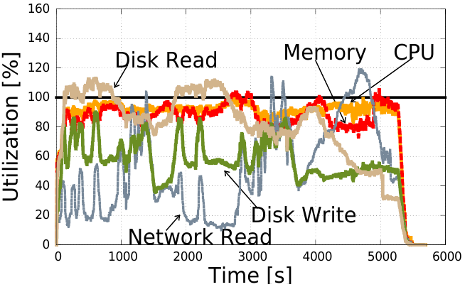
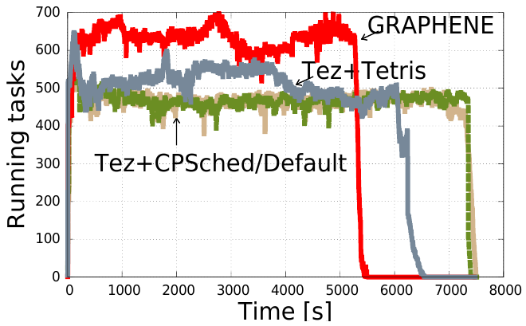
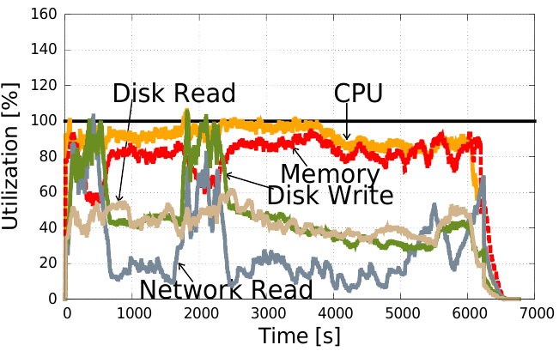
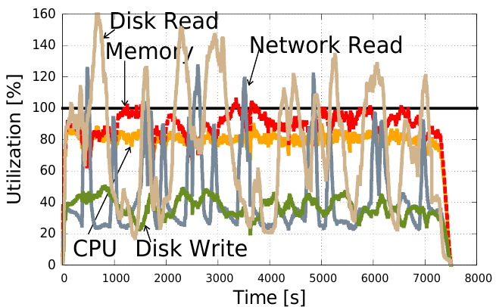
Results - 2
[200 jobs from TPC-DS, 200 server cluster]
Tez + Pack +Deps
Tez + Packing

Slide 22
Scheduling heterogeneous DAGs well requires an online solution that handles multiple resources and dependencies
Conclusions
Graphene
  Offline, construct per-DAG schedule by placing troublesome tasks first
  Online, enforce schedule priority along with other heuristics
  New lower bound shows nearly optimal for half of the DAGs
Experiments show gains in job completion time, makespan, …
Graphene generalizes to DAGs in other settings

Slide 23
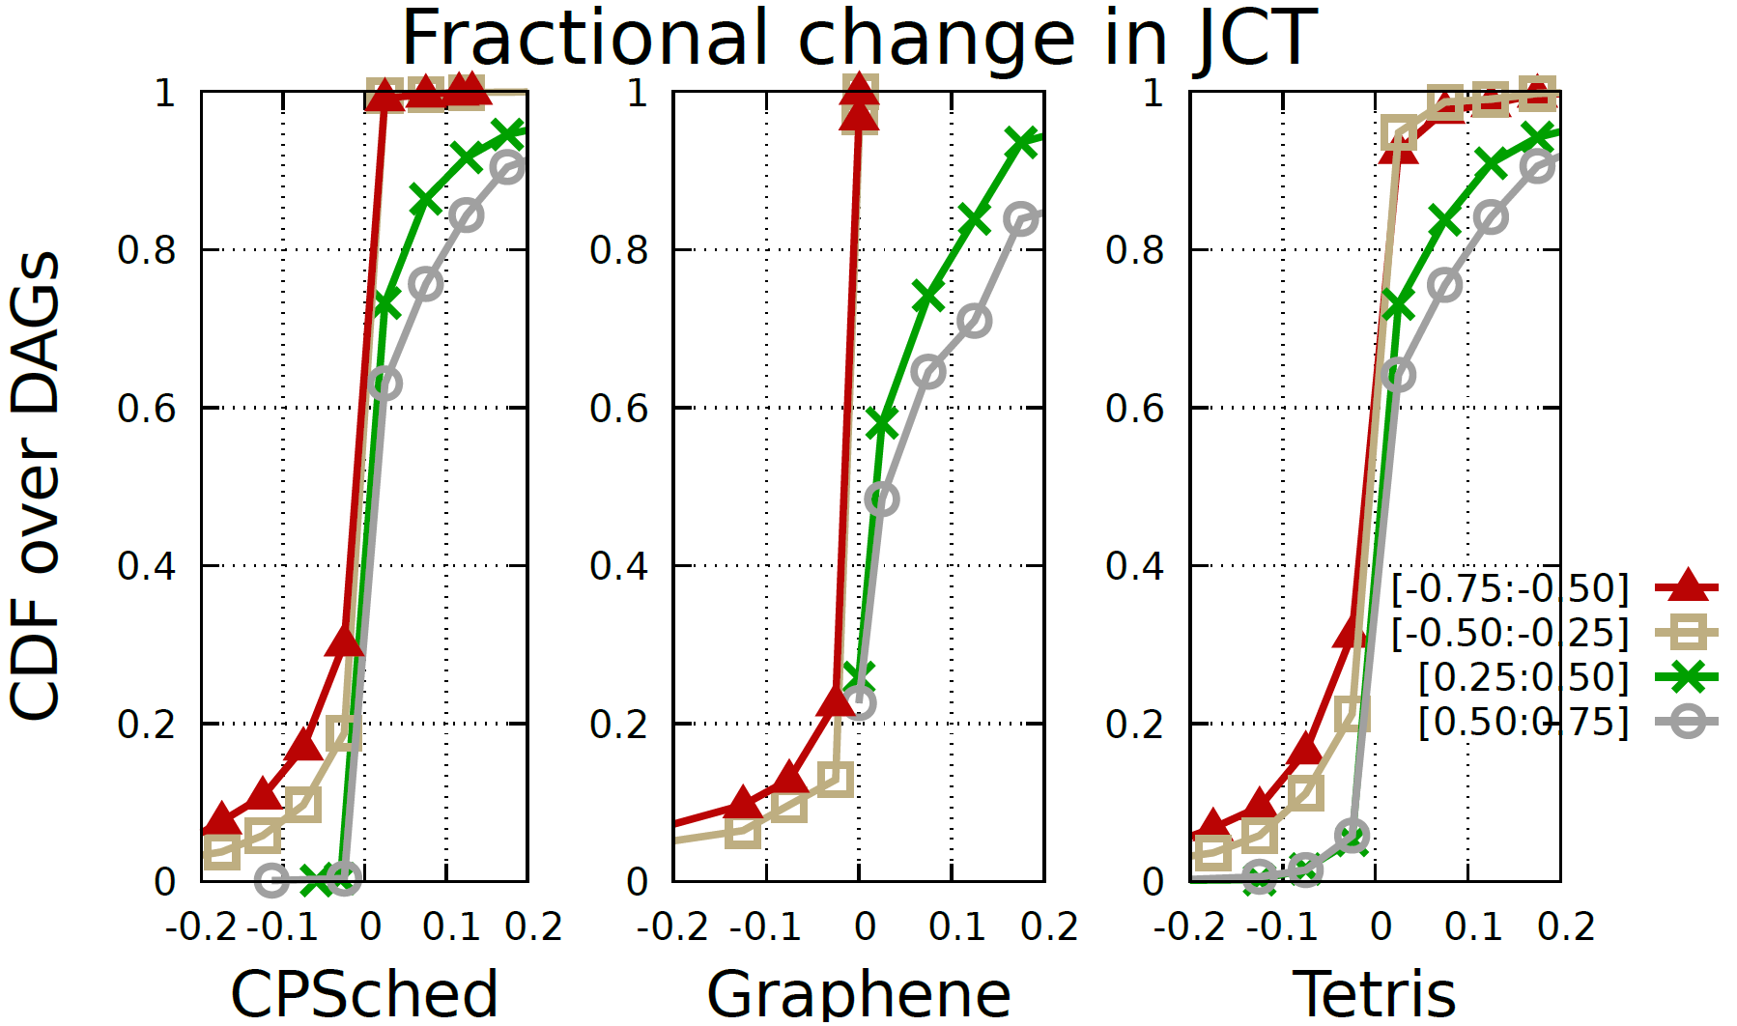

When scheduler works with erroneous task profiles
$$\left[−0.75, −0.50\right]$$
$$\left[−0.50, −0.25\right]$$
$$\left[+0.25, +0.50\right]$$
$$\left[+0.50, +0.75\right]$$
Amount of error
Fractional change in JCT

Slide 24
DAG annotations
G uses per-stage average duration and demands of {cpu, mem, net. disk}
Almost all frameworks have user’s annotate cpu and mem
Recurring jobs¹ have predictable profiles (correcting for input size)
Ongoing work on building profiles for ad-hoc jobs
  Sample and project²
  Program analysis³
[1] RoPE, NSDI’12; …
[2] Perforator, SOCC’16; …
[3] SPEED, POPL’09; …

Slide 25
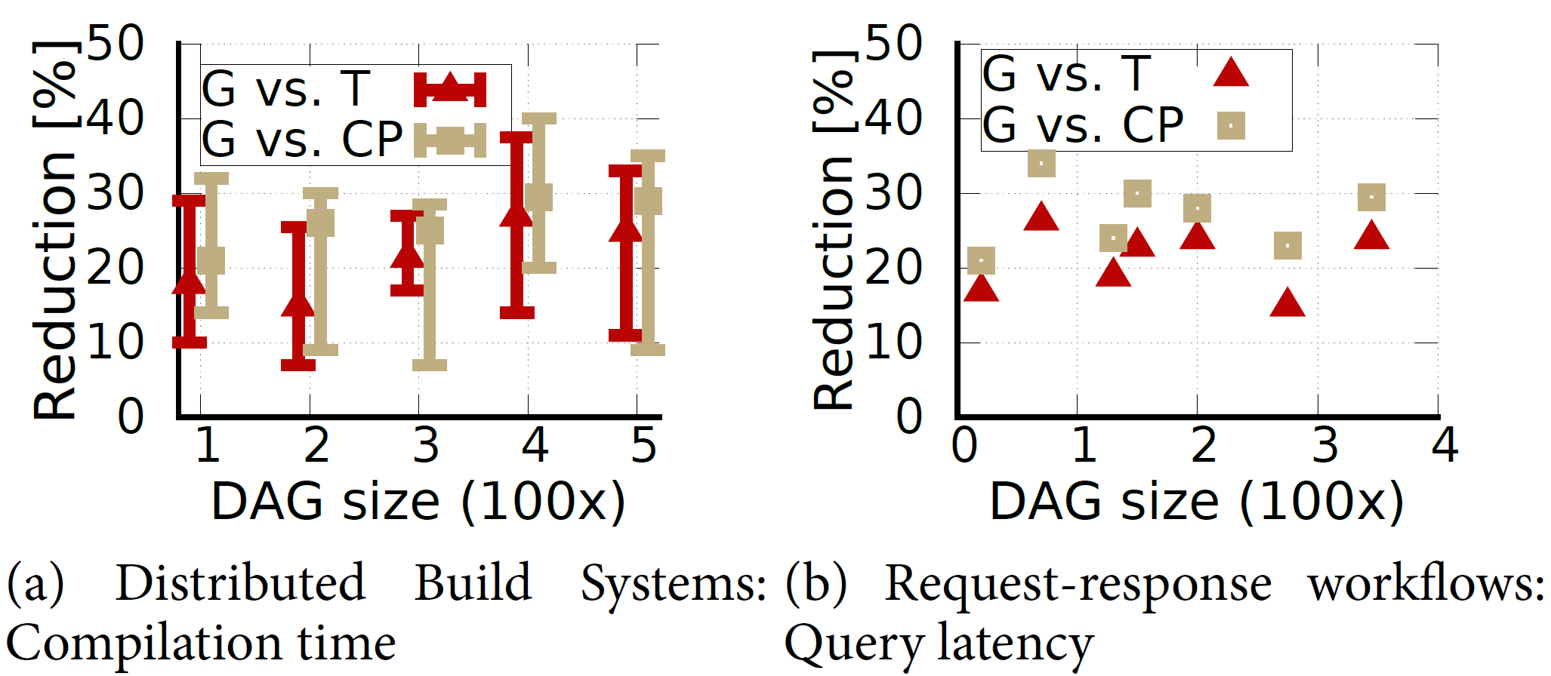
Using Graphene to schedule other DAGs

Slide 26
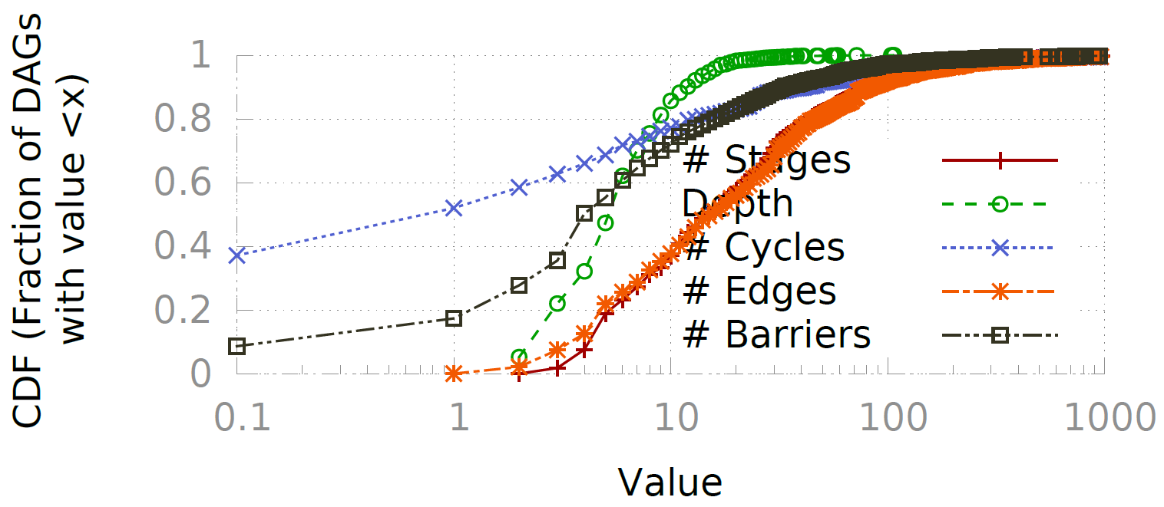
Characterizing DAGs in Cosmos clusters

Slide 27
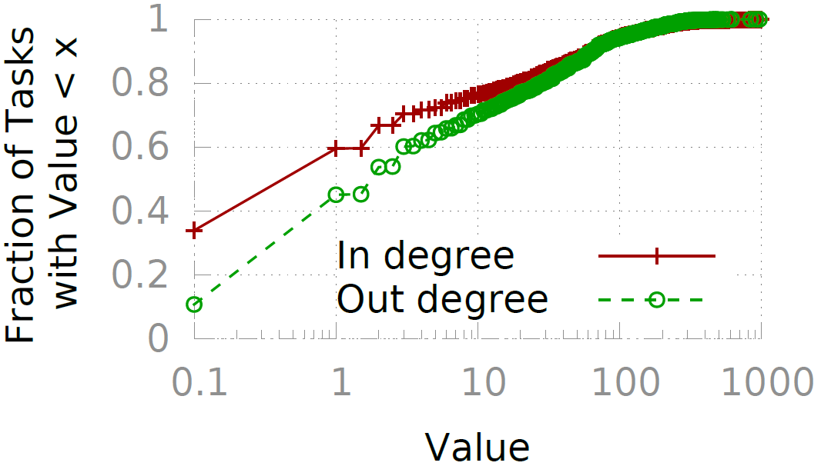
Characterizing DAGs in Cosmos clusters – 2

Slide 28
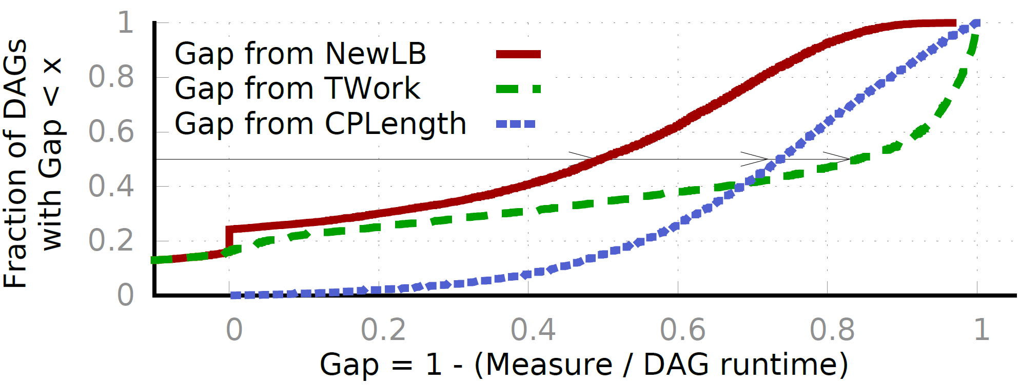
Runtime of production DAGs

Slide 29
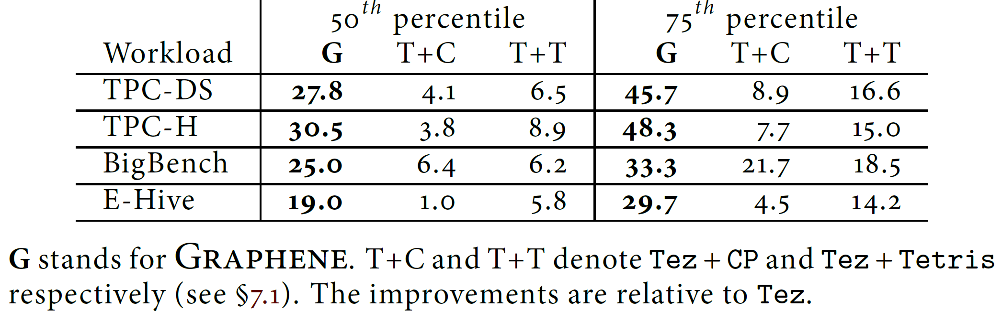
Job completion times on different workloads

Slide 30
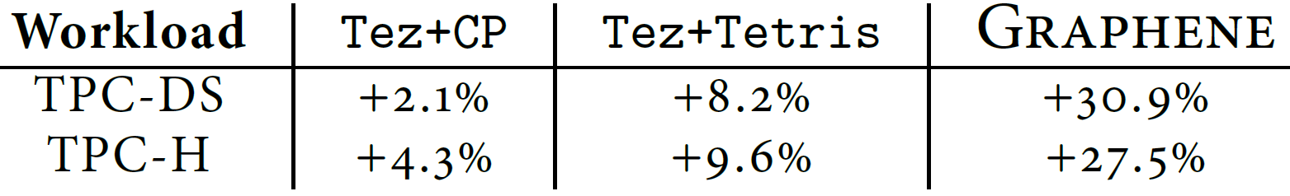
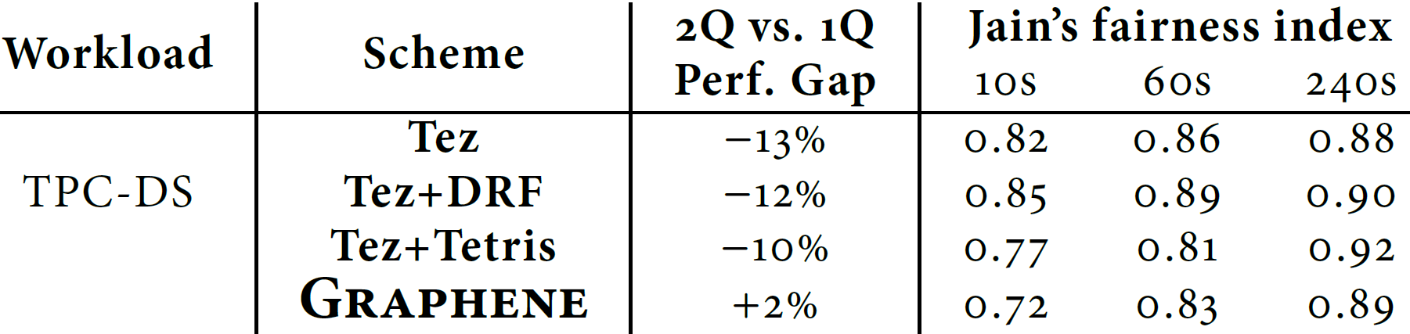
Makespan
Fairness

Slide 31
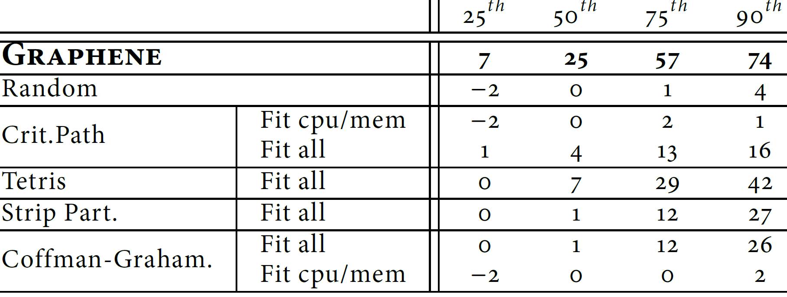
Comparison with other alternatives

Slide 32
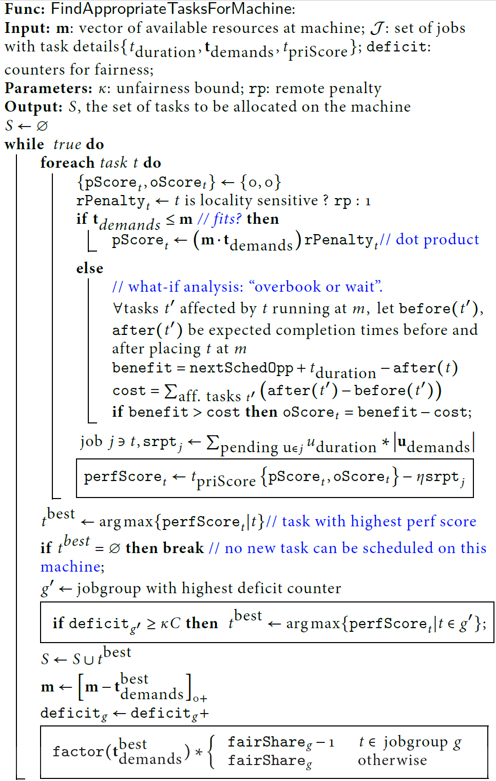
Online Pseudocode

