Slide 1


Data Wrangling
using
Programming by Examples
Sumit Gulwani
Invited Talk @ ECOOP
July 2015

Slide 2





The New Opportunity
2 orders of magnitude more end users
Struggle with simple repetitive tasks
Need domain-specific expert systems
Traditional customer for PL technology
End Users
(non-programmers with access to computers)
Software developer

Slide 3




Excel help forums

Slide 4




Typical help-forum interaction
300_w30_aniSh_c1_b → w30
300_w5_aniSh_c1_b → w5
=MID(B1,5,2)
=MID(B1,5,2)
=MID(B1,FIND(“_”,$B:$B)+1, FIND(“_”,REPLACE($B:$B,1,FIND(“_”,$B:$B),””))-1)

Slide 5
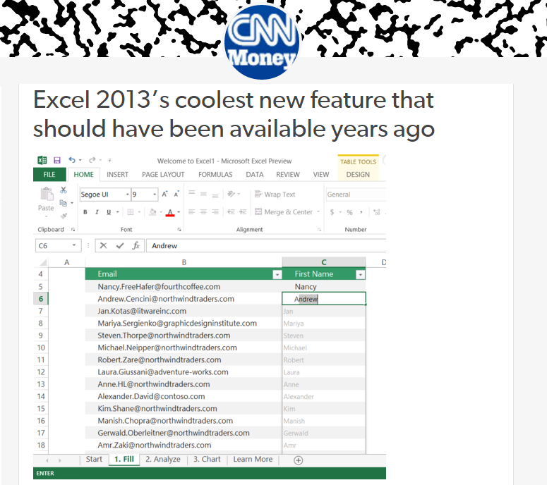
Flash Fill (Excel 2013 feature) demo
“Automating string processing in spreadsheets using input-output examples”; POPL 2011; Sumit Gulwani

Slide 6
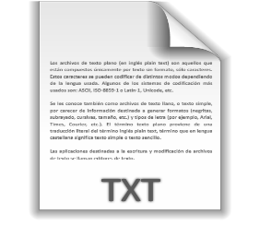





Data Wrangling
Data locked up in silos in various formats
  Great flexibility in organizing (hierarchical) data for viewing but challenging to manipulate and reason about the data.
A typical data wrangling workflow might involve:
  Extraction, Transformation, Querying, Formatting
Data scientists spend 80% of their time wrangling data.
Programming-by-examples (PBE) can provide an easier and faster data wrangling experience.

Slide 7

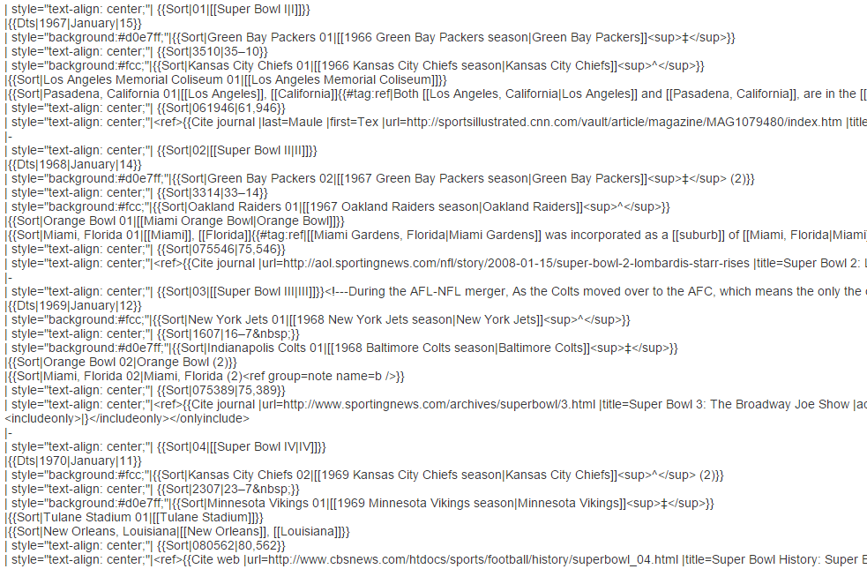
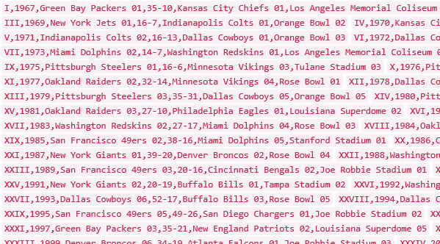
Data Science Class Assignment
To get Started!

Slide 8
FlashExtract Demo
“FlashExtract: A Framework for data extraction by examples”;
PLDI 2014; Vu Le, Sumit Gulwani

Slide 9
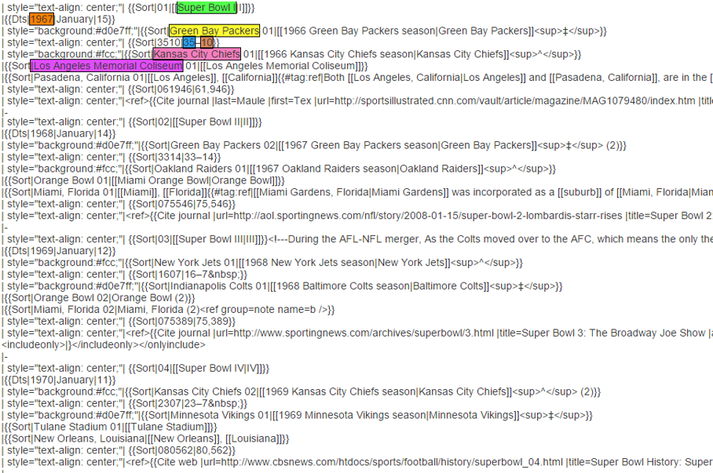
FlashExtract

Slide 10
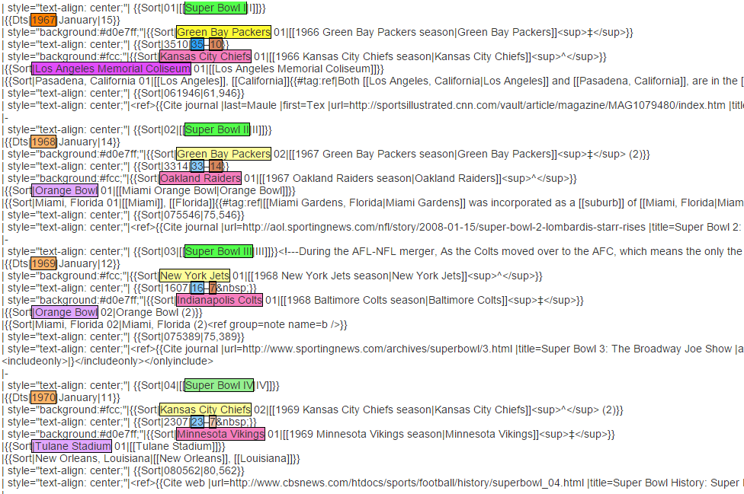
FlashExtract

Slide 11

PBE Architecture
Inductive Spec
Program
(Example based specification)
Search Algorithm

Slide 12
Inductive Specification
Examples: Conjunction of (input state, output value)
Inductive Spec generalizes Examples in 2 ways.
Generalization 1: Conjunction of (input state, output property)
Motivation: Output properties are easier to specify intent.

Slide 13

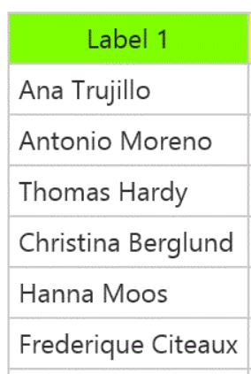

Output properties
Task
Elements belonging to the output list
Elements not belonging to the output list
Contiguous subsequence of the output list
Prefix of the output list

Slide 14

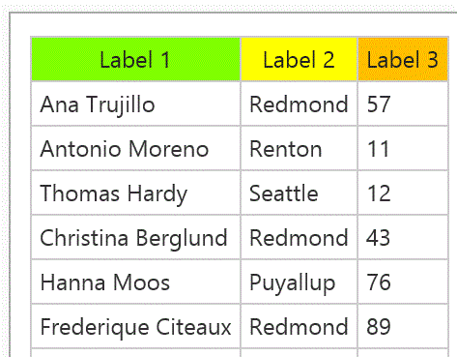
Output properties
Task
Prefix of the output table (seq of records)
We do not require explicit (magenta) record boundaries in which case the spec is:
Prefixes of projections of the output table

Slide 15
Inductive Specification
Examples: Conjunction of (input state, output state)
Inductive Spec generalizes Examples in 2 ways.
Generalization 1: Conjunction of (input state, output property)
Motivation: Output properties are easier to specify intent.
Generalization 2: Boolean comb of (input state, output property)
Motivation: Arises internally as part of problem reduction

Slide 16
PBE Architecture
Inductive Spec
Program
Search Algorithm
DSL
Challenge 1: Designing efficient search algorithm.

Slide 17
Domain-specific Language (DSL)
Balanced Expressiveness
  Expressive enough to cover wide range of tasks
  Restricted enough to enable efficient search
Operators should have a small set of inverses
  To enable efficient problem reduction
Natural computation patterns
  Increased user understanding/confidence
  Enables selection between programs, editing

Slide 18
DSL for Substring Extraction
Consider the tasks:
[String s -> Substring] (arises in FlashFill)
[Long String s ->List of Substrings] (arises in FlashExtract)
Regular expression suffices for both, but is not ideal.
Difficult to synthesize
Difficult to explain to the user
We propose abstractions that involve simpler regexes.

Slide 19
DSL for Substring Extraction
Consider the tasks:
[String s -> Substring] (arises in FlashFill)
[Long String s ->List of Substrings] (arises in FlashExtract)
DSL for Task 1, i.e., [String s -> Substring] :=
let p1 = [s -> index]
in let p2 = [s -> index]
in SubStr(s, p1, p2)
DSL for [String s -> index] := Constant
| Pos(s, regex1, regex2, k)
// k^{th} position in s whose left/right
side matches with regex1/regex2
| let t = Suffix(s,p1) in [t -> index]

Slide 20
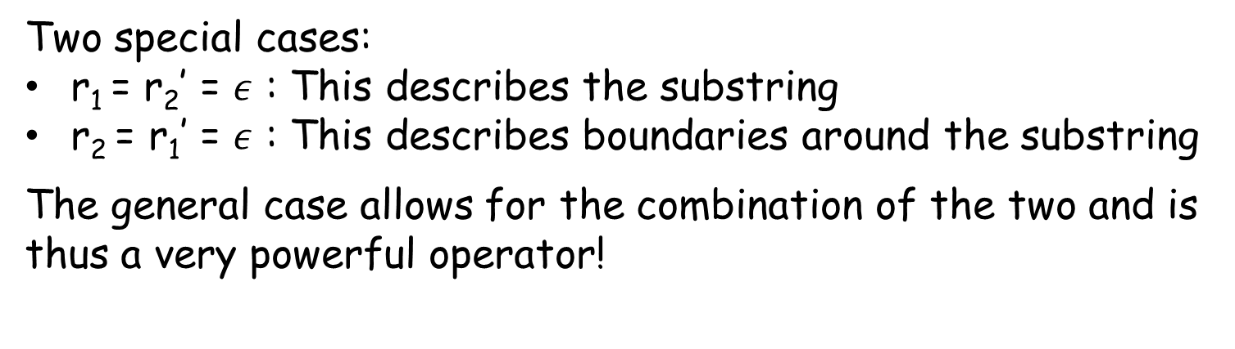
The SubStr Operator
Let w = SubStr(s, p, p’)
where p = Pos(s, r_{1,} r₂, k) and p’ = Pos(s, r₁’, r₂’, k’)
matches r₁
matches r₂
matches r₁’
matches r₂’
p
p’
w
s
Two special cases:
r₁ = r₂’ = $ε$ : This describes the substring
r₂ = r₁’ = $ε$ : This describes boundaries around the substring
The general case allows for the combination of the two and is thus a very powerful operator!

Slide 21
DSL for Substring Extraction
Consider the tasks:
[String s -> Substring] (arises in FlashFill)
[Long String s ->List of Substrings] (arises in FlashExtract)
DSL for Task 2, i.e., [String s -> List of substrings] :=
let L = Filter(Split(s,”\n”), [Line -> Bool]) in
Map(L, [String -> Substring])
DSL for [Line t -> bool] := MatchRegex(t, regex)
| MatchRegex(t.previous, regex)

Slide 22
PBE Architecture
Inductive Spec
Program
Search Algorithm
DSL
Inverse semantics of operators for problem reduction
Challenge 1: Designing efficient search algorithm.

Slide 23
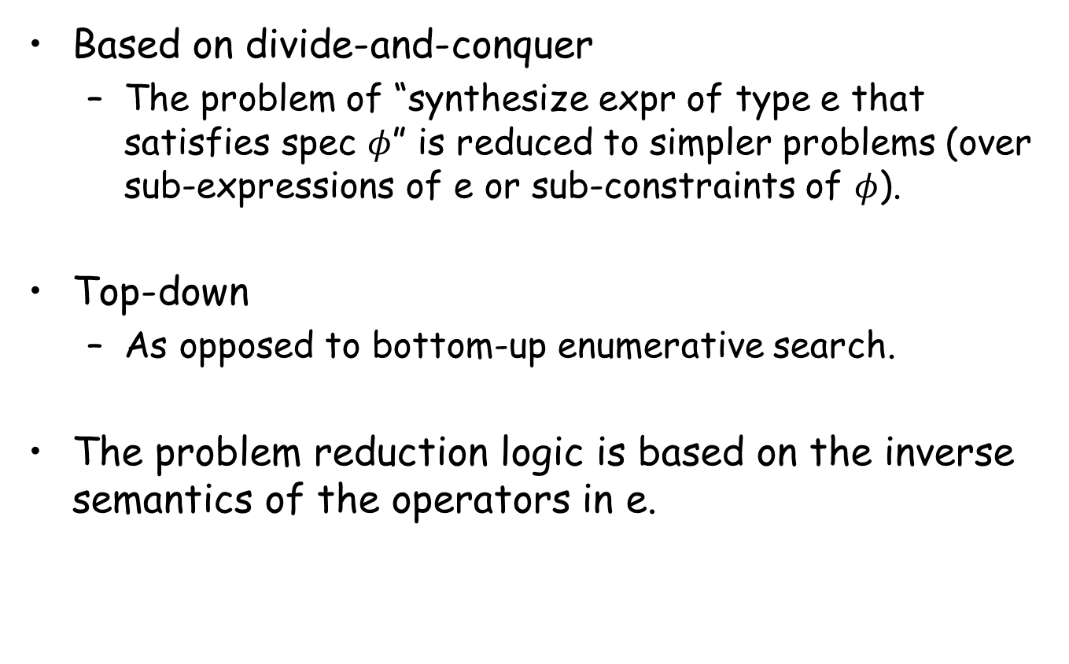
Search Algorithm
Based on divide-and-conquer
  The problem of “synthesize expr of type e that satisfies spec $φ$” is reduced to simpler problems (over sub-expressions of e or sub-constraints of $φ$).
Top-down
  As opposed to bottom-up enumerative search.
The problem reduction logic is based on the inverse semantics of the operators in e.

Slide 24





Problem Reduction
DSL for [String s -> List of substrings] :
let L = Filter(Split(s,”\n”), [Line -> Bool]) in
Map(L, [String -> Substring] )
$$⋈$$
Spec for
[String ->Substring]
Spec for
[String ->List of substrings]
Spec for
[Line ->Bool]
$$∧$$

Slide 25

Problem Reduction
DSL for [String s -> Substring] :=
let p1 = [s -> index] in
let p2 = [s -> index] in
SubStr(s, p1, p2)
Spec for
[String -> Substring]
$$⋈$$
Spec for p1
[String -> Index]
Spec for p2
[String -> Index]
Redmond, WA
Redmond, WA

Slide 26
PBE Architecture
Inductive Spec
Program
Search Algorithm
DSL
Inverse semantics of operators for problem reduction
Challenge 1: Designing efficient search algorithm.
Challenge 2: Ambiguous/under-specified intent may result in unintended programs.

Slide 27

Ranking
Synthesize multiple programs & rank them.
Basic ranking scheme
Define a partial order over program expressions.
  Prefer shorter programs.
  Prefer programs with fewer constants.
Machine-learning based ranking
Score using a weighted combination of program features.
  Weights are learned using training data.
“Predicting a correct program in Programming by Example”; CAV 2015
Rishabh Singh, Sumit Gulwani

Slide 28
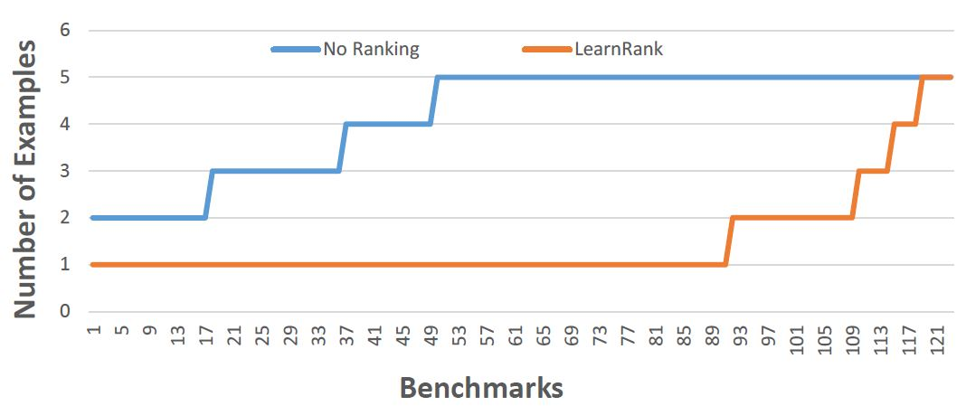
Comparison of Ranking Strategies over FlashFill Benchmarks
Basic
Learning
Strategy | Average # of examples required
Basic | 4.17
Learning | 1.48
“Predicting a correct program in Programming by Example”; CAV 2015
Rishabh Singh, Sumit Gulwani

Slide 29
FlashFill Ranking Demo

Slide 30
PBE Architecture
Top-k
Inductive Spec
Program
s
Ranking
Function
Search Algorithm
Inverse semantics of operators for problem reduction
DSL
Challenge 1: Designing efficient search algorithm.
Challenge 2: Ambiguous/under-specified intent may result in unintended programs.

Slide 31
PBE Architecture
Top-k
Inductive Spec
Programs
Ranking
Function
Search Algorithm
Inverse semantics of operators for problem reduction
DSL
The Inductive Synthesis Problem Definition:
Inductive Spec x DSL x Ranking function -> Top k-Programs
Solution Strategy: Divide-and-conquer based on inverse semantics
“FlashMeta: A Framework for Inductive Program Synthesis”
[Submitted to OOPSLA 2015]; Alex Polozov, Sumit Gulwani

Slide 32
Comparison of FlashMeta with hand-tuned implementations
Lines of Code (K)
Development time (months)
Project
FlashFill
FlashExtractText
FlashRelate
FlashNormalize
FlashExtractWeb
Original | FlashMeta
12 | 3
7 | 4
5 | 2
17 | 2
N/A | 2.5
Original | FlashMeta
9 | 1
8 | 1
8 | 1
7 | 2
N/A | 1.5
Running time of FlashMeta implementations vary between 0.5-3x of the corresponding original implementation.
Faster because of some free optimizations
Slower because of larger feature sets & a generalized framework
“FlashMeta: A Framework for Inductive Program Synthesis”
[Submitted to OOPSLA 2015]; Alex Polozov, Sumit Gulwani

Slide 33
PBE Architecture
Top-k Programs
Inductive Spec
Ranking
Function
Search Algorithm
Inverse semantics of operators for problem reduction
DSL
Challenge 1: Designing efficient search algorithm.
Challenge 2: Ambiguous/under-specified intent may result in unintended programs.

Slide 34


Need for a better User Interaction Model!
“It's a great concept, but it can also lead to lots of bad data. I think many users will look at a few "flash filled" cells, and just assume that it worked. … Be very careful.”
“most of the extracted data will be fine. But there might be exceptions that you don't notice unless you examine the results very carefully.”

Slide 35

User Interaction Models for Ambiguity Resolution
Make it easy to inspect output correctness
  User can accordingly provide more examples
Show programs
  in any desired programming language; in English
  Enable effective navigation between programs
Computer initiated interactivity (Active learning)
  Highlight less confident entries in the output.
  Ask directed questions based on distinguishing inputs.
“User Interaction Models for Disambiguation in Programming by Example”,
[Submitted to UIST 2015] Mayer, Soares, Grechkin, Le, Marron, Polozov, Singh, Zorn, Gulwani

Slide 36
FlashExtract Demo
(User Interaction Models)

Slide 37
PBE tools for Data Manipulation
Extraction
FlashExtract: Extract data from text files, web pages [PLDI 2014; Powershell convertFrom-string cmdlet]
FlashRelate: Extract data from spreadsheets [PLDI 2015]
Transformation
Flash Fill: Excel feature for Syntactic String Transformations [POPL 2011]
Semantic String Transformations [VLDB 2012]
Number Transformations [CAV 2013]
FlashNormalize: Text normalization [IJCAI 2015]
Querying
NLyze: an Excel programming-by-natural-lang add-in [SIGMOD 2014]
Formatting
Table re-formatting [PLDI 2011]
FlashFormat: a Powerpoint add-in [AAAI 2014]

Slide 38
FlashRelate Demo
“FlashRelate: Extracting Relational Data from Semi-Structured Spreadsheets Using Examples”;
PLDI 2015; Barowy, Gulwani, Hart, Zorn

Slide 39










Collaborators
Ted Hart
Dan Barowy
Dileep Kini
Maxim Grechkin
Vu Le
Alex Polozov
Mark Marron
Mikael Mayer
Rishabh Singh
Gustavo Soares
Ben Zorn

Slide 40
Other Directions
Other application domains (E.g., robotics).
Integration with existing programming environments.
Multi-modal intent specification using combination of Examples and NL.

Slide 41
Data Manipulation using Programming-by-Examples
Data manipulation is challenging!
  Data scientists spend 80% time cleaning data.
  99% of end users are non-programmers.
PBE can enable easy and fast data wrangling!
Cross-disciplinary inspiration
  Theory/Logical Reasoning (Search algo)
  Language Design (DSL)
  Machine Learning (Ranking)
  HCI (User interaction models)
We are hiring!

