Slide 1

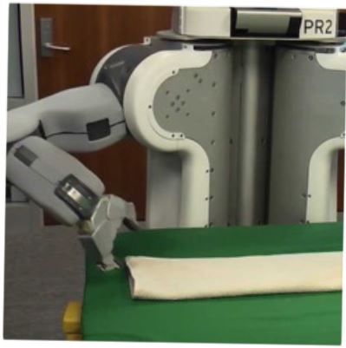

Programming by Examples
Sumit Gulwani
Marktoberdorf Lectures
August 2015

Slide 2
Lecture 3
Search Methodology
Notes:
Union binary
State instead of tuple of states
Cluster [notation, Merge, Leaf informal, LET delete]
Rightsquigarrow
Tactics slide

Slide 3

PBE Architecture
Example-based specification
Ordered set of Programs
Program
Ranking
Function
Search Algorithm
DSL
Challenge 1: Ambiguous/under-specified intent may result in unintended programs.
Challenge 2: Designing efficient search strategy.
“FlashMeta: A Framework for Inductive Program Synthesis”
Alex Polozov, Sumit Gulwani; OOPSLA 2015

Slide 4
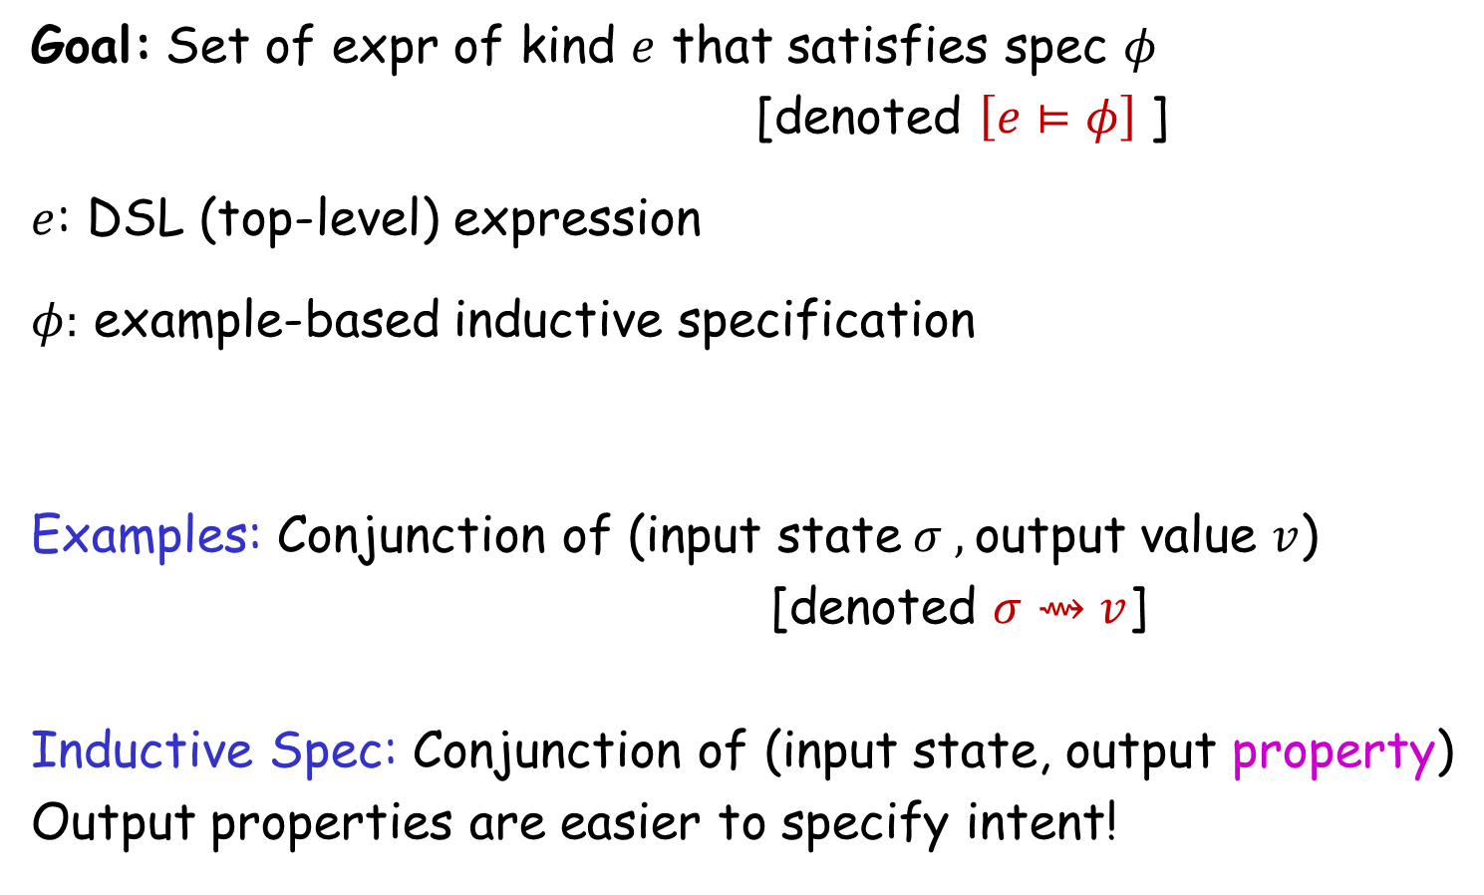
Search Methodology
Goal: Set of expr of kind $e$ that satisfies spec $φ$
[denoted $\left[e⊨φ\right]$]
$e$: DSL (top-level) expression
$φ:$ example-based inductive specification
Examples: Conjunction of (input state$σ ,$output value $v$)
[denoted $σ⇝v$]
Inductive Spec: Conjunction of (input state, output property)
Output properties are easier to specify intent!

Slide 5
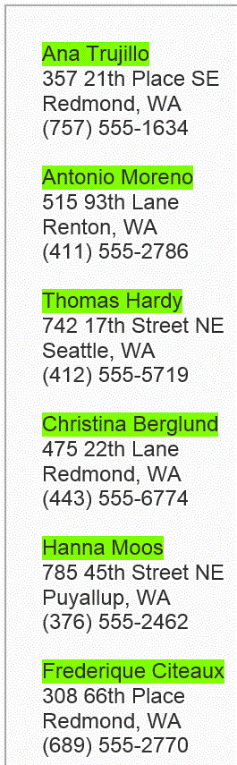
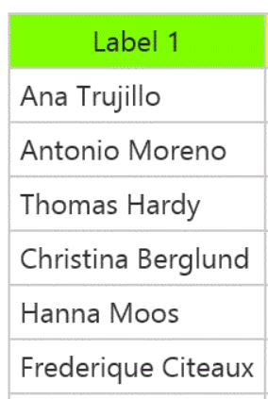

Output properties
Task
Elements belonging to the output list
Elements not belonging to the output list
Contiguous subsequence of the output list
Prefix of the output list

Slide 6
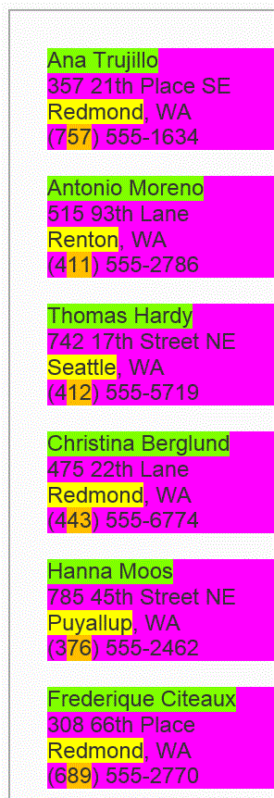
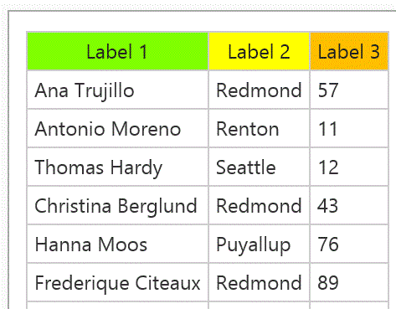
Output properties
Task
Prefix of the output table (seq of records)
We do not require explicit (magenta) record boundaries in which case the spec is:
Prefixes of projections of the output table

Slide 7
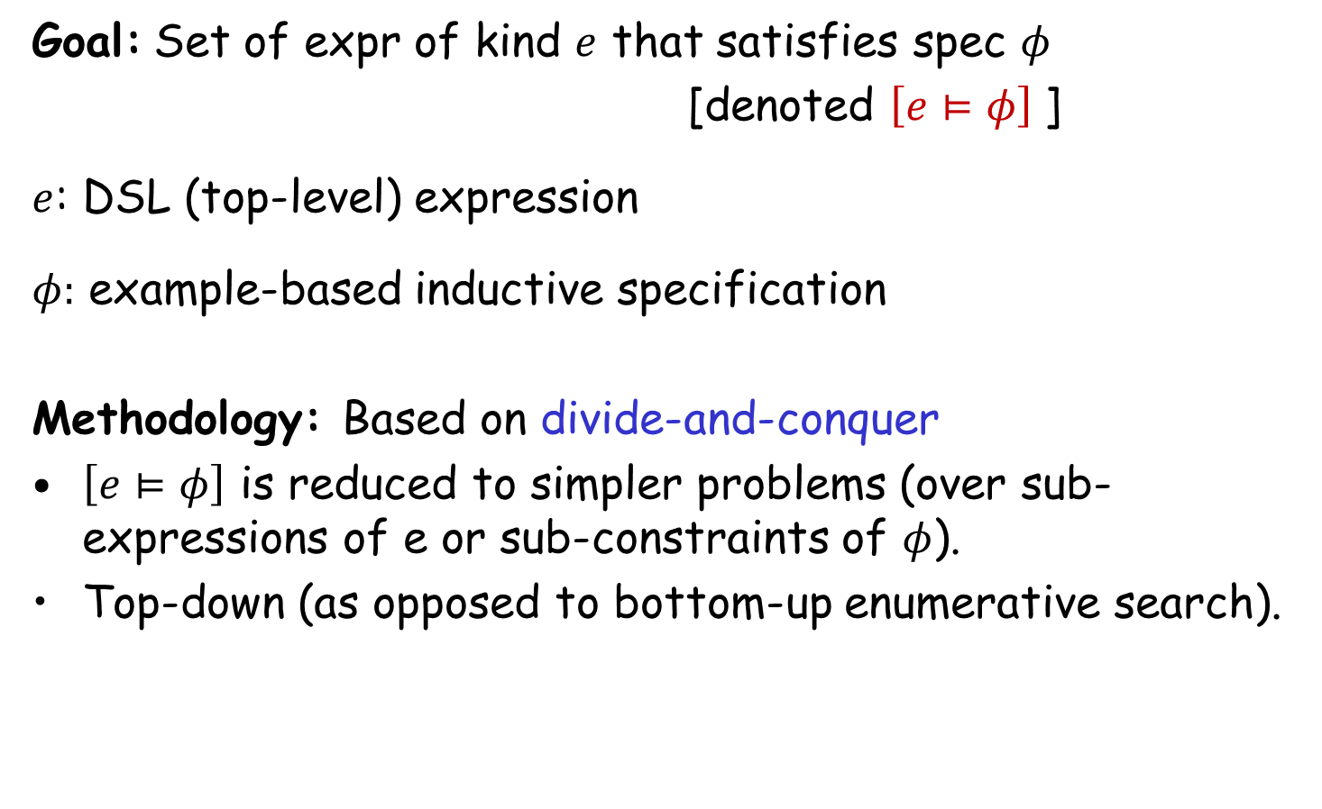
Search Methodology
Goal: Set of expr of kind $e$ that satisfies spec $φ$
[denoted $\left[e⊨φ\right]$]
$e$: DSL (top-level) expression
$φ:$ example-based inductive specification
Methodology: Based on divide-and-conquer
$\left[e⊨φ\right]$ is reduced to simpler problems (over sub-expressions of e or sub-constraints of $φ$).
Top-down (as opposed to bottom-up enumerative search).

Slide 8




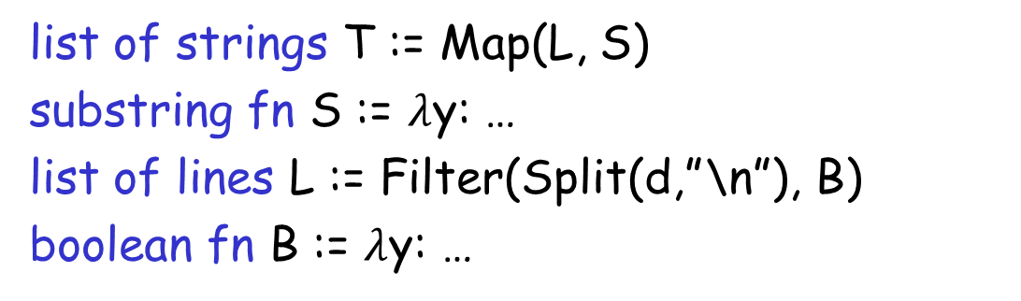

Problem Reduction
list of strings T := Map(L, S)
substring fn S := $λ$y: …
list of lines L := Filter(Split(d,”\n”), B)
boolean fn B := $λ$y: …
FlashExtract DSL
$$⋈$$
Spec for S
Spec for T
Spec for L
$$∧$$

Slide 9

Problem Reduction
substring expr E := SubStr(y, P₁, P₂)
position expr P := K | Pos(y, R₁, R₂, K)
SubStr grammar
$$⋈$$
Spec for E
Spec for P₁
Spec for P₂
Redmond, WA
Redmond, WA

Slide 10
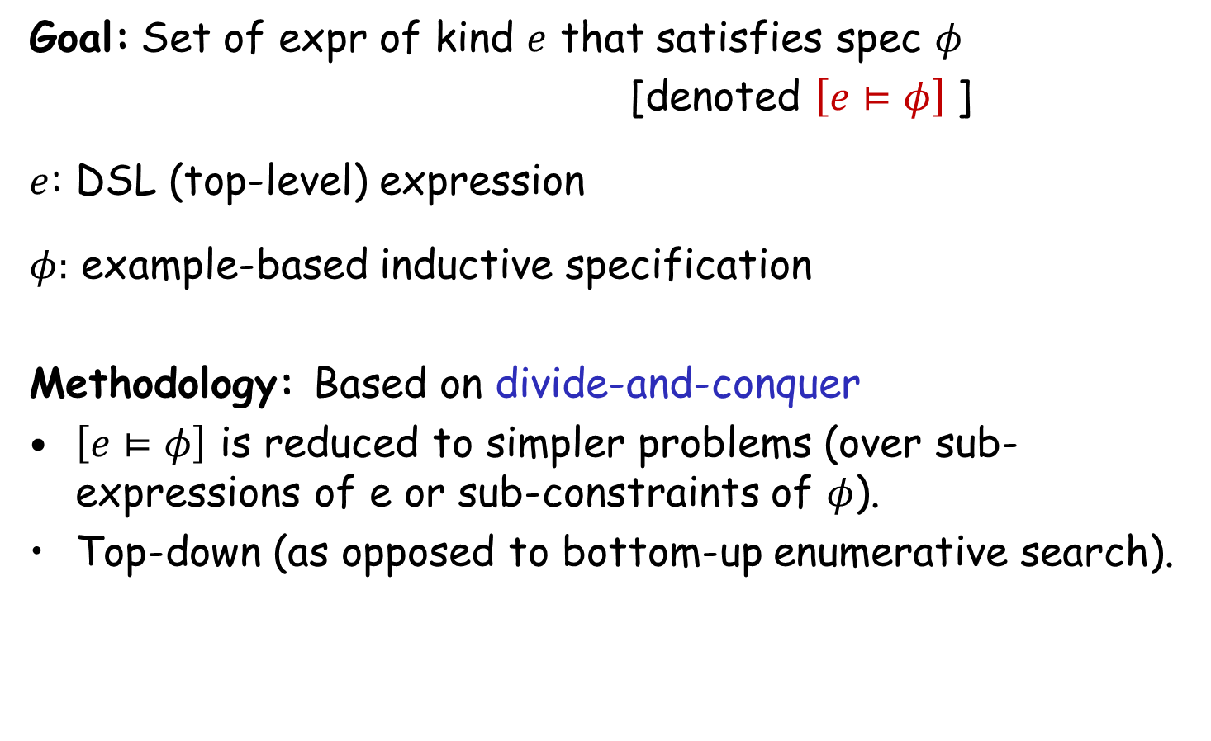
Search Methodology
Goal: Set of expr of kind $e$ that satisfies spec $φ$
[denoted $\left[e⊨φ\right]$]
$e$: DSL (top-level) expression
$φ:$ example-based inductive specification
Methodology: Based on divide-and-conquer
$\left[e⊨φ\right]$ is reduced to simpler problems (over sub-expressions of e or sub-constraints of $φ$).
Top-down (as opposed to bottom-up enumerative search).
Key concepts in problem reduction: VSAs & Witness functions

Slide 11
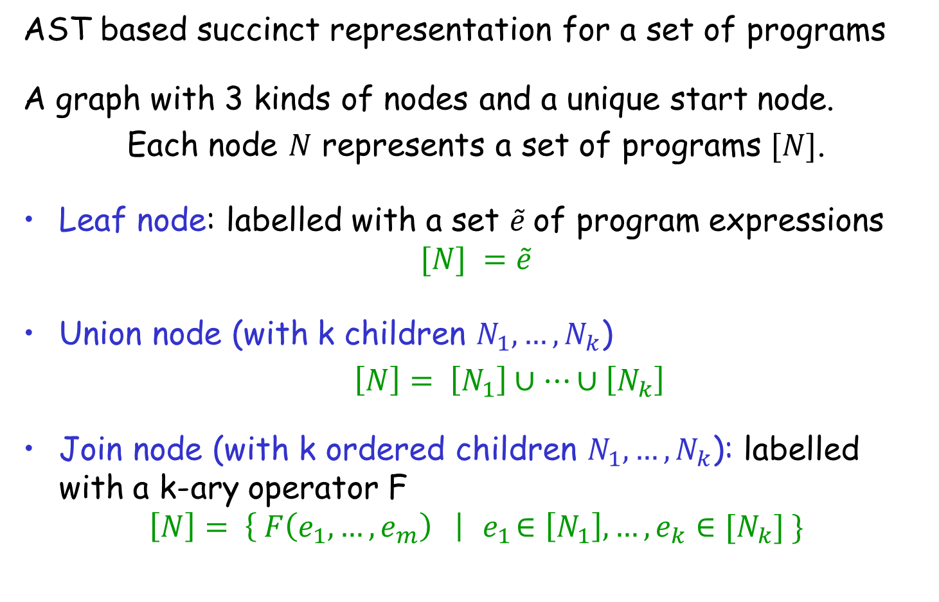
Version Space Algebra (VSA)
AST based succinct representation for a set of programs
A graph with 3 kinds of nodes and a unique start node.
Each node $N$ represents a set of programs $[N]$.
Leaf node: labelled with a set $\tilde{e}$of program expressions
$$[N] =\tilde{e}$$
Union node (with k children $N_{1}, …, N_{k}$)
$\left[N\right]= \left[N_{1}\right]∪…∪\left[N_{k}\right]$
Join node (with k ordered children $N_{1}, …, N_{k}$): labelled with a k-ary operator F
$$\left[N\right]= \left\{ F\left(e_{1}, …, e_{m}\right) \right|{ e}_{1}∈\left[N_{1}\right], …, e_{k}∈[N_{k}] \}$$

Slide 12
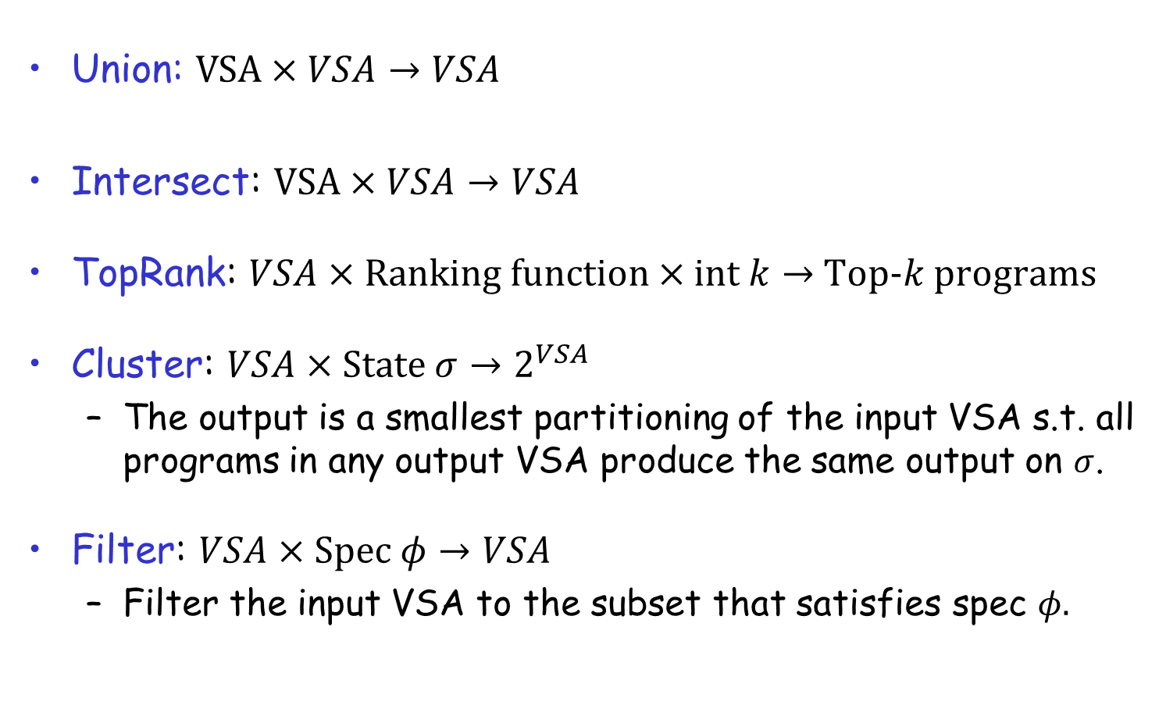
VSA Operations
Union: $VSA×VSA→VSA$
Intersect: $VSA×VSA→VSA$
TopRank: $VSA×Ranking function×int k→$ Top-$k$ programs
Cluster: $VSA×State σ→2^{VSA}$
  The output is a smallest partitioning of the input VSA s.t. all programs in any output VSA produce the same output on $σ$.
Filter: $VSA×Spec φ→VSA$
  Filter the input VSA to the subset that satisfies spec $φ.$

Slide 13



Problem Reduction Rules
$$\left[e⊨φ\right]=$$
where $e$ is a non-terminal defined as $e ≔e_{1} | e_{2}$
$$\left[e⊨φ_{1}∧φ_{2}\right] =$$
$$Union(\left[e_{1}⊨φ\right], \left[e_{2}⊨φ\right])$$
$$Intersect(\left[e⊨φ_{1}\right], \left[e⊨φ_{2}\right])$$

Slide 14
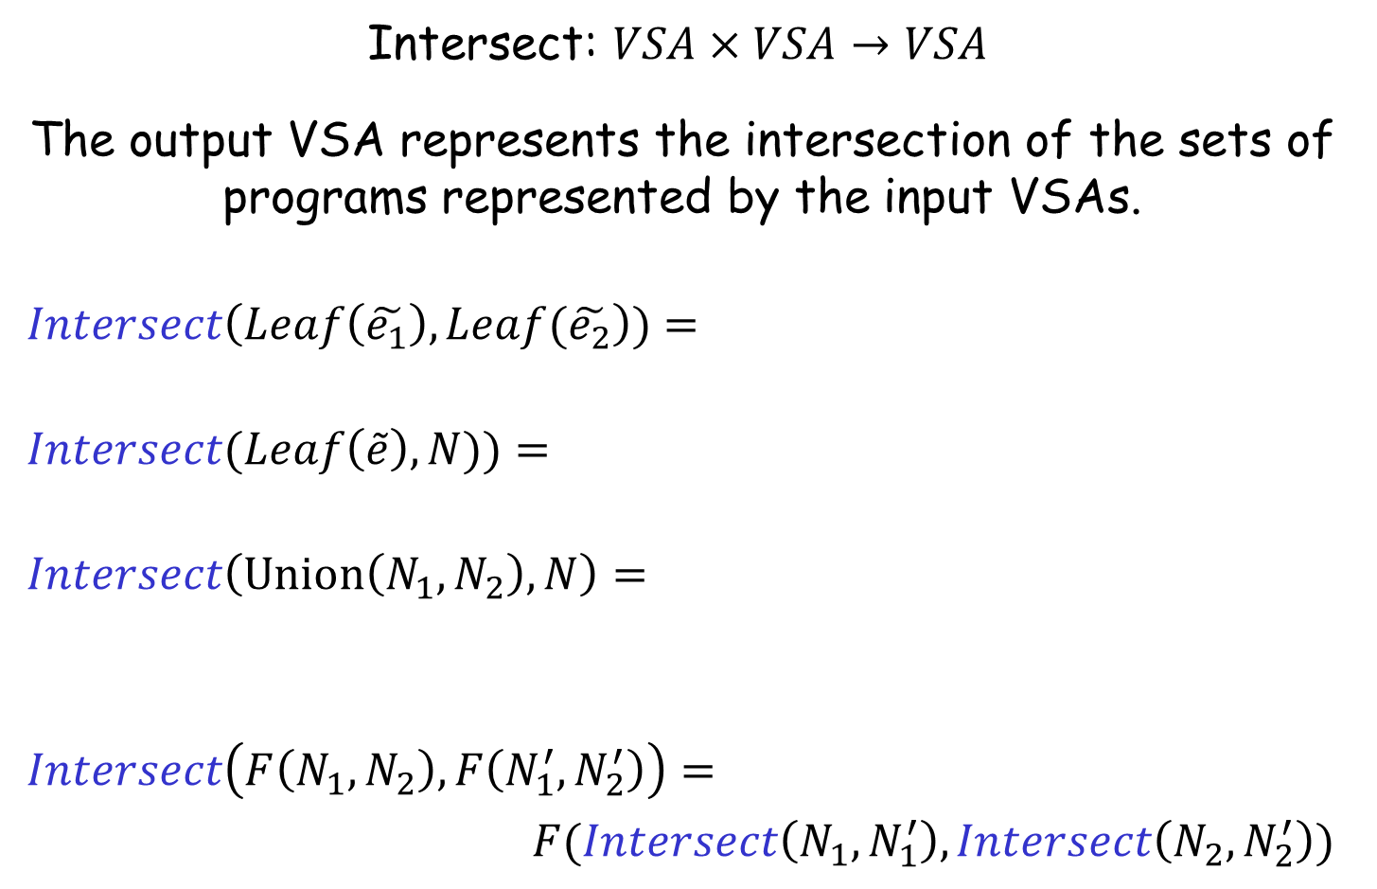


Intersect Operation
Intersect: $VSA×VSA→VSA$
The output VSA represents the intersection of the sets of programs represented by the input VSAs.
$$Intersect\left(Leaf\left(\tilde{e_{1}}\right), Leaf(\tilde{e_{2}}\right))=$$
$$Intersect(Leaf\left(\tilde{e}\right), N))=$$
$$Intersect\left(Union\left(N_{1},N_{2}\right), N\right)=$$
$$Intersect\left(F\left(N_{1},N_{2}\right), F\left(N_{1}^{′}, N_{2}^{′}\right)\right)=$$
$F(Intersect\left(N_{1},N_{1}^{′}\right), Intersect\left(N_{2},N_{2}^{′}\right))$
$$Leaf\left(\tilde{e_{1}}∩\tilde{e_{2}}\right)$$
$$\{ e∈\tilde{e }| e∈\left[N\right] \}$$
$$Union(Intersect\left(N_{1},N\right),Intersect\left(N_{2},N\right))$$

Slide 15


Problem Reduction Rules
$$\left[e⊨φ\right]=$$
where $e$ is a non-terminal defined as $e ≔e_{1} | e_{2}$
$$\left[e⊨φ_{1}∧φ_{2}\right] =$$
$\left[e⊨φ_{1}∧φ_{2}\right] =$
$$Union(\left[e_{1}⊨φ\right], \left[e_{2}⊨φ\right])$$
$$Intersect(\left[e⊨φ_{1}\right], \left[e⊨φ_{2}\right])$$
$$Filter(\left[e⊨φ_{1}\right], φ_{2})$$

Slide 16
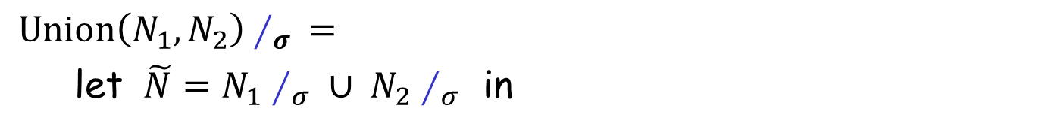


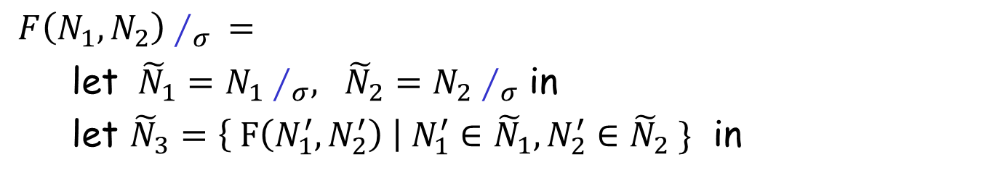

Cluster Operation
Cluster: $VSA×σ→2^{VSA}$
Smallest partitioning of the input VSA s.t. programs in any output VSA are indistinguishable over the input state.
Notation: Let $Cluster(N,σ)$be denoted by $N∕_{σ}$
$Union\left(N_{1},N_{2}\right)∕_{σ} =$
let $\tilde{N}=N_{1}∕_{σ} ∪ N_{2}∕_{σ}$ in
$Merge(\tilde{N},σ)$
$F\left(N_{1},N_{2}\right)∕_{σ} =$
let ${\tilde{N}}_{1}=N_{1}∕_{σ}, {\tilde{N}}_{2}=N_{2}∕_{σ}$ in
let ${\tilde{N}}_{3}=\left\{ F\left(N_{1}^{′},N_{2}^{′}\right) \right| N_{1}^{′}∈{\tilde{N}}_{1}, N_{2}^{′}∈{\tilde{N}}_{2} \}$ in
$Merge({\tilde{N}}_{3},σ)$
$Merge\left(\tilde{N},σ \right)$unites VSAs in $\tilde{N}$that have same behavior on $σ$.

Slide 17

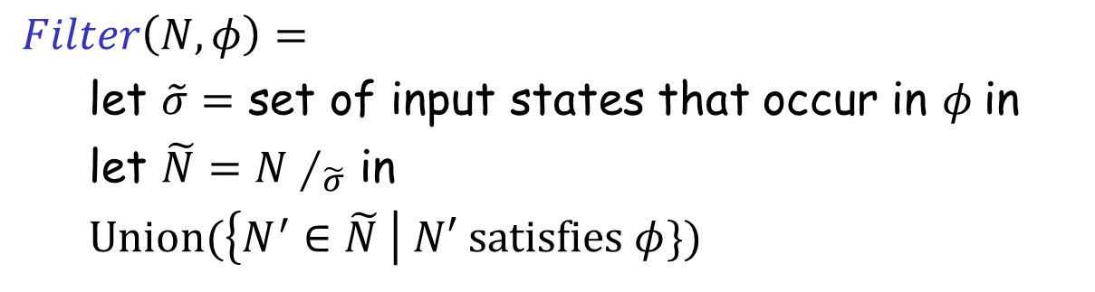
Filter Operation
Filter: $VSA×φ→VSA$
  Filter the input VSA to the subset that satisfies $φ.$
$Filter\left(N,φ\right)=$
let $\tilde{σ}=$ set of input states that occur in $φ$in
let $\tilde{N}=N∕_{\tilde{σ}}$ in
$Union(\left\{N^{′}∈\tilde{N} \right| N′ satisfies φ\})$

Slide 18
Problem Reduction Rules
$$\left[e⊨φ\right]=$$
where $e$ is a non-terminal defined as $e ≔e_{1} | e_{2}$
$$\left[e⊨φ_{1}∧φ_{2}\right] =$$
$\left[e⊨φ_{1}∧φ_{2}\right] =$
$$Union(\left[e_{1}⊨φ\right], \left[e_{2}⊨φ\right])$$
$$Intersect(\left[e⊨φ_{1}\right], \left[e⊨φ_{2}\right])$$
$$Filter(\left[e⊨φ_{1}\right], φ_{2})$$

Slide 19
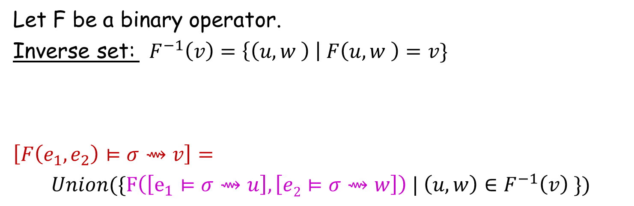
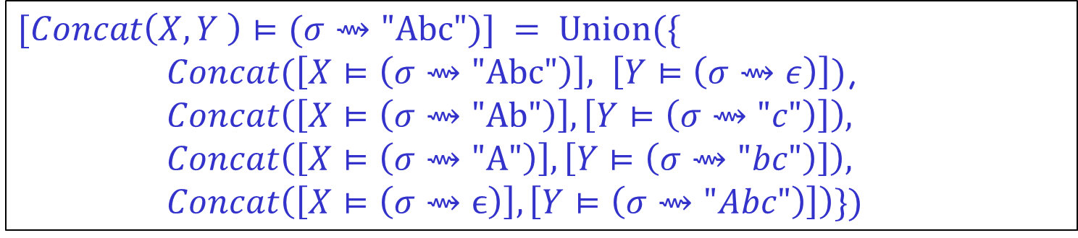
Problem Reduction Rules
Let F be a binary operator.
Inverse set: $F^{−1}\left(v\right)=\left\{\left(u,w \right) \right| F\left(u,w \right)=v\}$
$$\left[F\left(e_{1},e_{2}\right)⊨σ⇝v\right]=$$
$Union(\{F\left(\left[e_{1}⊨σ⇝u\right], \left[e2⊨σ⇝w\right]\right) | \left(u,w\right)∈F^{−1}\left(v\right) \})$
$$\{\left( \text{"}\text{Abc}\text{",}ϵ\right), ("Ab\text{","}\text{c}\text{"), ("}\text{A}\text{","}\text{bc}\text{"), (}ϵ,\text{"}\text{Abc}\text{")\}}$$
$$Concat^{−1}\left(\text{"}\text{Abc}\text{"}\right)=$$
$$[Concat\left(X,Y \right)⊨(σ⇝\text{"}\text{Abc}")] = Union(\{$$
$Concat(\left[X⊨\left(σ⇝\text{"}\text{Abc}\text{"}\right)\right], \left[Y⊨\left(σ⇝ε\right)\right])$,
$$Concat\left(\left[X⊨\left(σ⇝\text{"}\text{Ab}\text{"}\right)\right],\left[Y⊨\left(σ⇝"c"\right)\right]\right),$$
$$Concat\left(\left[X⊨\left(σ⇝\text{"}\text{A}\text{"}\right)\right],\left[Y⊨\left(σ⇝"bc"\right)\right]\right),$$
$$Concat\left(\left[X⊨\left(σ⇝ϵ\right)\right],\left[Y⊨\left(σ⇝"Abc"\right)\right]\right)\})$$

Slide 20
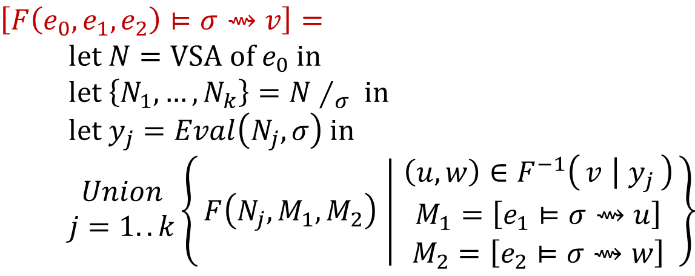
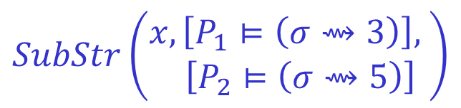

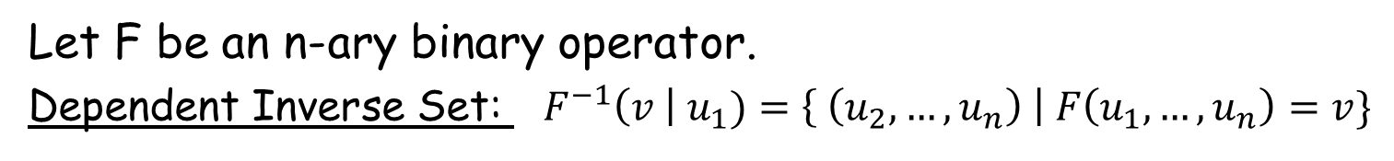
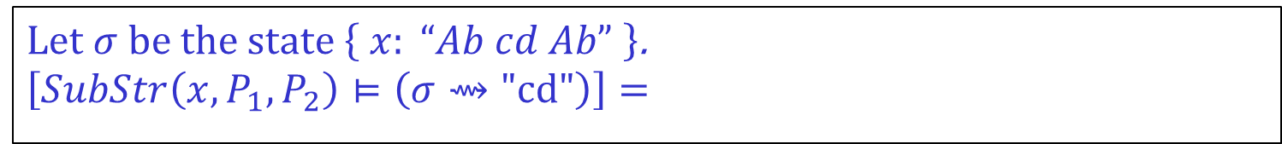
Problem Reduction Rules
Let F be an n-ary binary operator.
Dependent Inverse Set: ${ F}^{−1}\left(v \right| u_{1})=\left\{ \left(u_{2},…, u_{n}\right) \right| F\left(u_{1},…,u_{n}\right)=v\}$
$$\{ \left(0,2\right), (6,8) \}$$
$$SubStr^{−1}\left(\text{"}\text{Ab}\text{"} \right| "Ab cd Ab")=$$
$$\left[F\left(e_{0},e_{1},e_{2}\right)⊨σ⇝v\right]= \\ \text{let} N=\text{VSA} \text{of} e_{0} \text{in} \\ \text{let} \left\{N_{1},…, N_{k}\right\}=N∕_{σ} \text{in} \\ \text{let} y_{j}=Eval\left(N_{j},σ\right) \text{in} \\ \begin{matrix}Union \\ j=1..k\end{matrix}\left\{F\left(N_{j},M_{1},M_{2}\right) ∣ \begin{matrix}\left(u,w\right)∈F^{−1}\left(v ∣ y_{j}\right) \\ M_{1}=\left[e_{1}⊨σ⇝u\right] \\ M_{2}=\left[e_{2}⊨σ⇝w\right]\end{matrix}\right\}$$
Let $σ$be the state $\left\{ x: “Ab cd Ab” \right\}$.
$$\left[SubStr\left(x,P_{1},P_{2}\right)⊨\left(σ⇝\text{"}\text{cd}\text{"}\right)\right]=$$
$$SubStr\left(\begin{aligned}x,\left[P_{1}⊨\left(σ⇝3\right)\right], \\ \left[P_{2}⊨\left(σ⇝5\right)\right]\end{aligned}\right)$$

Slide 21

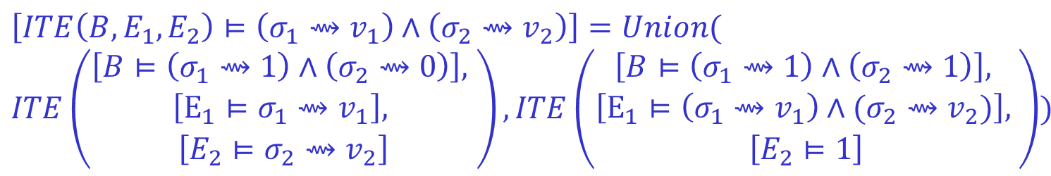
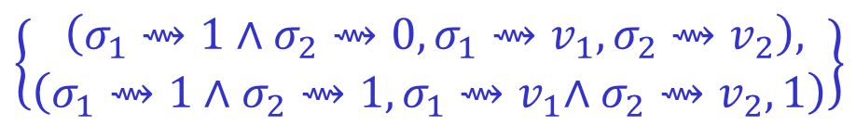
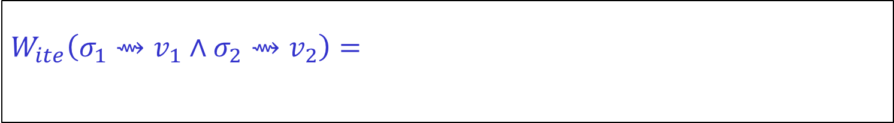
Problem Reduction Rules
Let F be an n-ary operator.
Witness Function: $W_{F}\left(φ\right)=\left\{\left(φ_{1},…,φ_{n}\right) \right| ∀g_{i}⊨φ_{i}: F\left(g_{1},…, g_{n}\right)⊨φ \}$
$$\left[F\left(e_{1},e_{2}\right)⊨φ\right]=$$
$$W_{ite}\left(σ_{1}⇝v_{1}∧σ_{2}⇝v_{2}\right)=$$
$$\left\{\begin{aligned} \left(σ_{1}⇝1∧σ_{2}⇝0,σ_{1}{⇝v}_{1},σ_{2}⇝v_{2}\right), \\ \left(σ_{1}⇝1∧σ_{2}⇝1,σ_{1}{⇝v}_{1}∧σ_{2}⇝v_{2}, 1\right)\end{aligned}\right\}$$
$$Union(\left\{F\left(\left[e_{1}⊨φ_{1}\right], \left[e2⊨φ_{2}\right]\right) \right| \left(φ_{1},φ_{2}\right)∈W_{F}\left(φ\right)\})$$
$$\left[ITE\left(B,E_{1},E_{2}\right)⊨\left(σ_{1}⇝v_{1}\right)∧\left(σ_{2}⇝v_{2}\right)\right]=Union($$
$$ITE\left(\begin{aligned}\left[B⊨\left(σ_{1}⇝1\right)∧\left(σ_{2}⇝0\right)\right], \\ \begin{aligned}\left[E_{1}⊨σ_{1}⇝v_{1}\right], \\ \left[E_{2}⊨σ_{2}⇝v_{2}\right]\end{aligned}\end{aligned}\right), ITE\left(\begin{aligned}\begin{aligned}\left[B⊨\left(σ_{1}⇝1\right)∧\left(σ_{2}⇝1\right)\right], \\ \left[E_{1}⊨\left(σ_{1}⇝v_{1}\right)∧(σ_{2}⇝v_{2})\right], \end{aligned} \\ \left[E_{2}⊨1\right]\end{aligned}\right))$$

Slide 22
FlashMeta Framework
Provides efficient implementations of VSA operations
Provides a library of witness functions
Role of synthesis designer
Can add new operators and witness functions.
Can provide ranking strategies.
Can specify tactics to resolve non-determinism in search
  Which witness function to use?
  How to order search branches?

Slide 23
Comparison of FlashMeta with hand-tuned implementations
Lines of Code (K)
Development time (months)
Project
FlashFill
FlashExtractText
FlashRelate
FlashNormalize
FlashExtractWeb
Original | FlashMeta
12 | 3
7 | 4
5 | 2
17 | 2
N/A | 2.5
Original | FlashMeta
9 | 1
8 | 1
8 | 1
7 | 2
N/A | 1.5
Running time of FlashMeta implementations vary between 0.5-3x of the corresponding original implementation.
Faster because of some free optimizations
Slower because of larger feature sets & a generalized framework

