Slide 1




PA Man
Coordinated Memory Caching for Parallel Jobs
Ganesh Ananthanarayanan, Ali Ghodsi, Andrew Wang, Dhruba Borthakur, Srikanth Kandula, Scott Shenker, Ion Stoica

Slide 2
Data Analytics Clusters
Data analytics frameworks are an important driver for modern Internet services
  E.g., MapReduce, Dryad, Hadoop
  Jobs are parallel and data-intensive
Jobs sizes follow the power-law [HotOS’11]
  92% of jobs at FB’s Hadoop cluster can fit all their data in memory

Slide 3
Cache the data to speed up jobs
Falling memory prices
  64GB/machine at FB in Aug 2011, 192GB/machine not uncommon now
Memory utilization often low
  Analyzed Hadoop jobs in Facebook’s production cluster
  19% median memory utilization (95th-tile 42%)

Slide 4
We built a memory cache…
File cache in memory on top of HDFS
  Cache input data of jobs (accessed by map tasks)
Schedule map tasks for memory locality
Simple cache replacement policies
  Least Recently Used (LRU) and Least Frequently Used (LFU)

Slide 5
We built a memory cache…
Replayed the Facebook trace of Hadoop jobs
Jobs sped up by only 10%, hit-ratio of 47% (for LFU) ☹
Optimal hit-ratio (Belady’s MIN Oracle)
  Hit-ratio 63%
  Completion time speedup 13%
How can we make caching significantly speedup jobs?

Slide 6
Parallel jobs require a new class of caching algorithms

Slide 7
Parallel Jobs
  Tasks of small jobs run simultaneously in a wave
Task duration
(uncached input)
Task duration
(cached input)
slot₁
slot₁
slot₁
slot₂
slot₂
slot₂
time
time
time
completion
time
completion
time
completion
time
All-or-nothing: Unless all inputs are cached, there is no benefit

Slide 8
All-or-nothing for multi-waved jobs
  Large jobs run tasks in multiple waves
  Number of tasks is larger than number of slots
  Wave-width: Number of parallel tasks of a job
slot₁
slot₂
slot₃
slot₄
slot₅
time
completion time

Slide 9
All-or-nothing for multi-waved jobs
  Large jobs run tasks in multiple waves
  Number of tasks is larger than number of slots
  Wave-width: Number of parallel tasks of a job
slot₁
slot₂
slot₃
slot₄
slot₅
time
completion time

Slide 10
All-or-nothing for multi-waved jobs
  Large jobs run tasks in multiple waves
  Number of tasks is larger than number of slots
  Wave-width: Number of parallel tasks of a job
slot₁
slot₂
Cache at the wave-width granularity
slot₃
slot₄
slot₅
completion time
time

Slide 11
How to evict from cache?
  View at the granularity of a job’s input (file)
  Focus evictions on incompletely cached waves– Sticky Policy
Task duration
(uncached input)
Task duration
(cached input)
slot₁
slot₂
slot₃
slot₄
slot₅
slot₆
a
slot₇
slot₈
slot₁
slot₂
slot₃
slot₄
slot₅
slot₆
slot₇
slot₈
Without Sticky Policy
Job 1
Job 1
With Sticky Policy
Job 2
Job 2
completion
completion
Hit-ratio: 75%
No speed-up of jobs
Hit-ratio: 75%
Job 1 speeds up

Slide 12
Which file should be evicted?
Depends on metric to optimize:
User centric metric
  Completion time of jobs
System centric metric
  Utilization of the cluster
What are the eviction policies for these metrics?

Slide 13
Reduction in Completion Time
D
Idealized model for job:
  Wave-width for job: W
  Frequency predicts future access: F
  Data read is proportional to task length: D
  Speedup factor for cached tasks: µ
W
Cost of caching: W D
Benefit of caching: µD F
Benefit/cost: µF/W
time
Completion Time of Job: frequency/wave-width

Slide 14
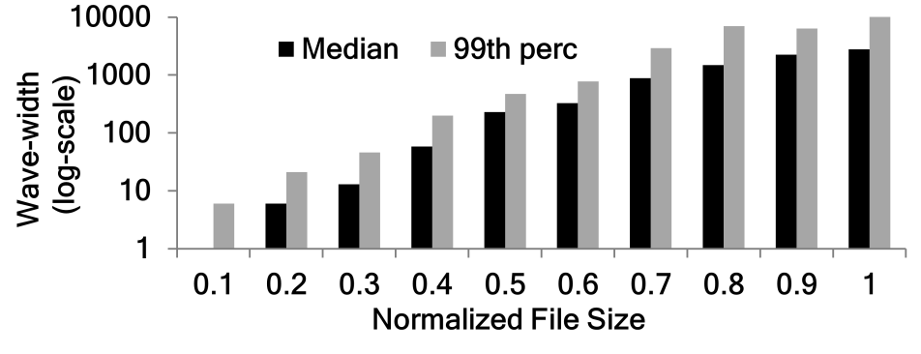
How to estimate W for a job?
Wave-width (slots)
Job size
Use the size of a file as a proxy for wave-width
  Paper uses a more sophisticated approximation

Slide 15
Improvement in Utilization
D
Idealized model for job:
  Wave-width for job: W
  Frequency predicts future access: F
  Data read is proportional to task length: D
  Speedup factor for cached tasks: µ
W
Cost of caching: W D
Benefit of caching: W µD F
Benefit/cost: µF
time
Utilization of job: frequency

Slide 16
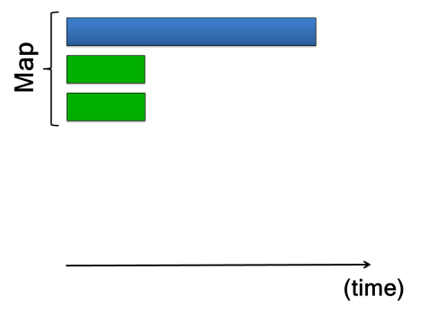
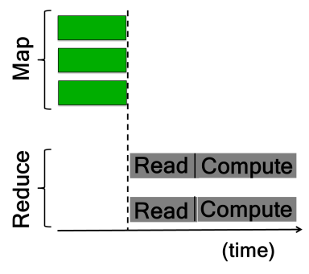

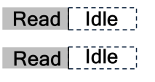
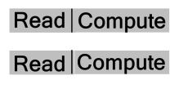

Isn’t this just Least Frequently Used?
All-or-nothing property matters for utilization
Tasks of different phases overlap
  Reduce tasks start before all map tasks finish (to overlap communication)
All-or-nothing →
No wastage!

Slide 17
Cache Eviction Policies
Completion time policy:
  Evict from file with highest (frequency/wave-width)
  Sticky: fully evict file before going to next (all-or-nothing)
Utilization policy:
  Evict from file with the lowest frequency
  Sticky: fully evict file before going to next (all-or-nothing)
LIFE
LFU-F

Slide 18
How do we achieve the sticky policy?
Caches are distributed
Blocks of files are spread across different machines
Coordination
  Global view of all the caches
  …which blocks to evict (sticky policy)
  …where to schedule tasks (memory locality)

Slide 19
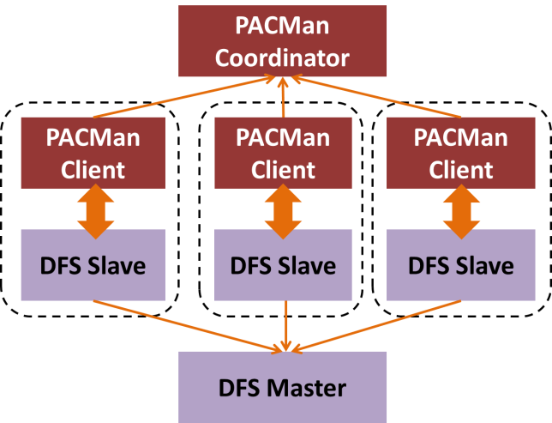
PA Man: Centralized Coordination
Global view

Slide 20
Evaluation Setup
Workload derived from Facebook & Bing traces
  FB: 3500 node Hadoop cluster, 375K jobs, 1 month
  Bing: 1000’s of nodes Dryad cluster, 200K jobs, 6 weeks
Prototype in conjunction with HDFS
Experiments on 100-node EC2 cluster
  Cache of 20GB per machine
Simulations
  Replay of entire traces

Slide 21
Reduction in Completion Time
Replacement Policy | Reduction in average completion time (%) | Hit-Ratio (%)
MIN | 13% | 59%
LRU | 9% | 33%
LFU | 10% | 48%
LIFE | 53% | 45%
Sticky Policy

Slide 22
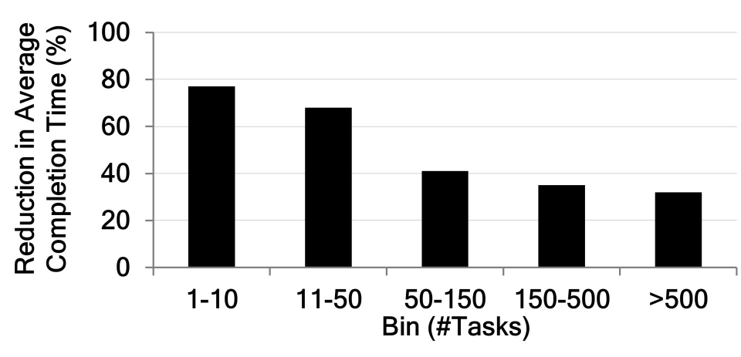
Which jobs are sped up?
small jobs: largest improvement under LIFE
Small jobs have lower wave-width
Power law in job sizes → there is space for large jobs too

Slide 23
Improvement in Utilization
Replacement Policy | Improvement in utilization (%)
LRU | 13%
LFU | 46%
MIN | 51%
LFU-F | 54%
Sticky Policy

Slide 24
Related Work
In-memory computation frameworks [e.g., Spark, Piccolo, Twister]
  Mediates cache access across jobs
Memory Storage Systems [e.g., RAMCloud]
  Data-intensive clusters cannot fit all data in memory; 200x more storage on disk than available memory
Global Memory Systems [e.g., GMS, NOW]
  Does not replace based on job-level granularity

Slide 25
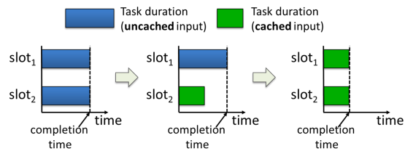
onclusions
All-or-nothing property of parallel jobs
  Cache all of the inputs of a job
PA Man: Coordinated Cache Management
  Sticky policy: Evict from incomplete inputs
  LIFE for completion time, LFU-F for utilization
  Jobs are 53% faster, cluster utilization improves by 54%

