Slide 1




Scarlett : Coping with Skewed Content Popularity in MapReduce Clusters
Ganesh Ananthanarayanan, Sameer Agarwal, Srikanth Kandula, Albert Greenberg, Ion Stoica, Duke Harlan, Ed Harris

Slide 2
Data Locality
Frameworks: MapReduce, Hadoop, Dryad …
  Job → {Phase} → {Task}
Map phases constitute 59% of lifetime, 68% of resources [Microsoft Bing]
Co-locate map task with its input
  Network capacity is limited
  Data blocks are replicated three times

Slide 3





Problem: Slot Contention
Task Queue
Contention Resolution
Run remotely
Evict and run
Dryad
→Slow Read
→Wasted Work

Slide 4
Slot contention is a big deal
In Dryad [Microsoft Bing]:
  21% of tasks get evicted and re-run
  One-fifth of the cluster practically wasted!
  Valuable resource for outlier speculation etc.
In Hadoop [Facebook]:
  Node-locality for only 57% of map tasks; small jobs achieve only 5% node-locality
  Increases load on (already) under-provisioned network

Slide 5
Replication is a natural solution…
Task Queue
Contention Resolution
Contention Avoidance

Slide 6
Storage space is a crunch
Storage is more than 50% total cost
  Non-linear increase for new datacenter
Facebook and Microsoft datacenters
  MS: 3 replicas to 2
  FB: 3 replicas →(1 replica + reed-solomon code)
How do we replicate data while not wasting scarce storage space?

Slide 7
Production Logs
Logs from Bing cluster with thousands of machines, sampled over six months
200K jobs, 400K phases, 300PB of data, 10PB network transfers
  Task-level details
  Production and experimental jobs

Slide 8
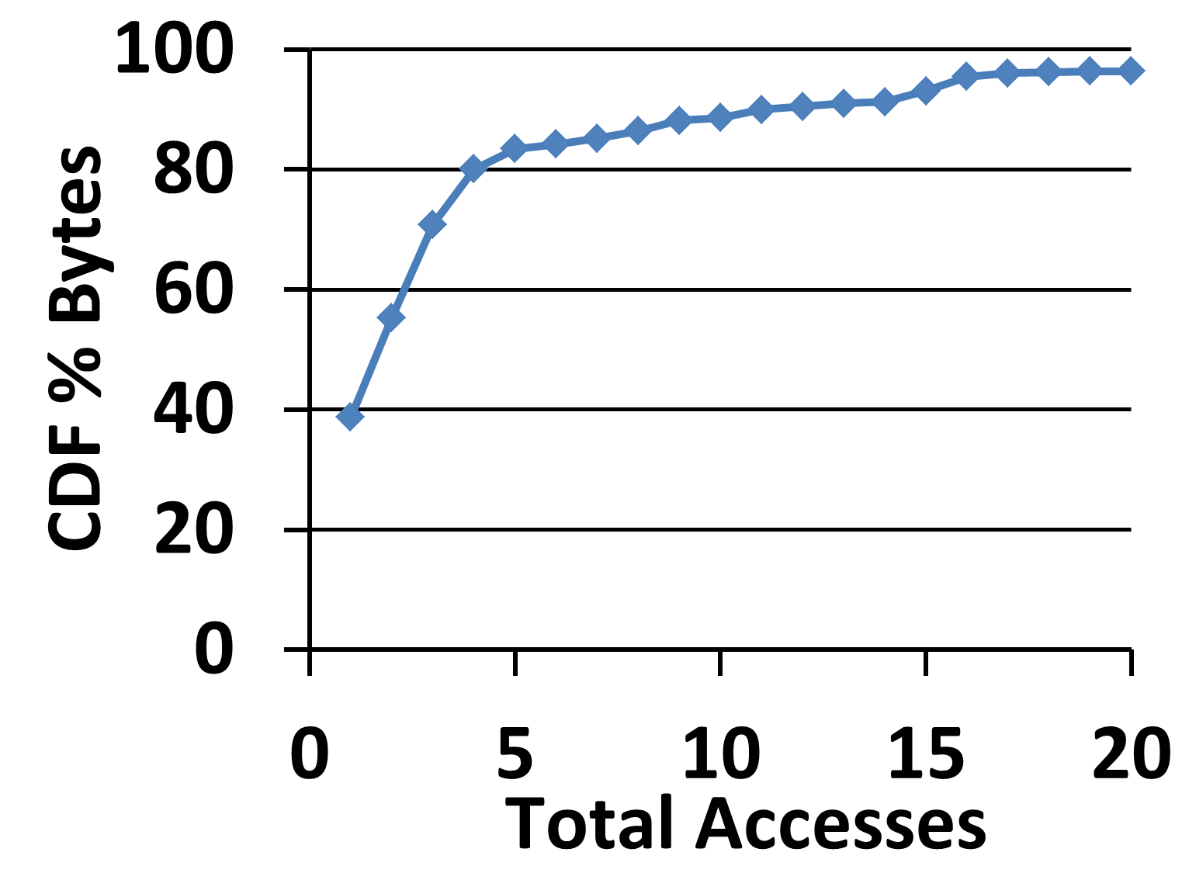
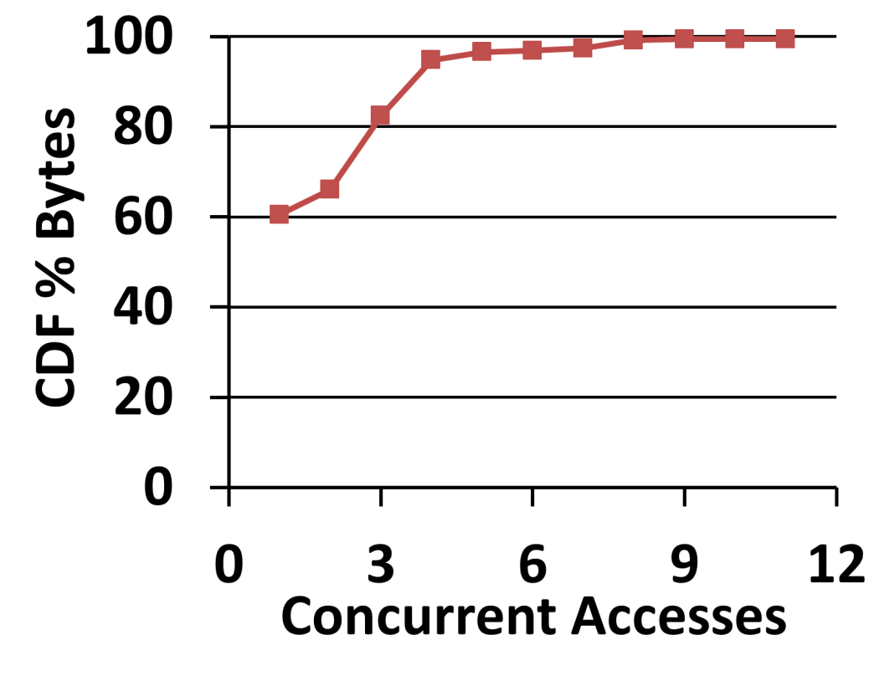
Popularity Skew
Total Accesses: #Jobs accessing a file
Concurrent Accesses: #Simultaneous Jobs accessing a file
Top 12% is 10x more popular than bottom third
18% data is accessed ≥ three times concurrently

Slide 9
Skew → Contentions
Top 1% of contention-causing files
  …account for 60% of contentions
  …have 9x more total accesses
  …have 2.5x more concurrent accesses
Access counts correlates with contention
Gain by replicating popular files

Slide 10
Scarlett replicates data to predicted popularity, using budgeted storage

Slide 11
Design Choices
file
Replication granularity: file vs. block
  All or none of a file is accessed – outliers
  Simple to implement
Proactive vs. Reactive
  Ability to deal with evictions
Proactive

Slide 12
Scarlett: System Design
Increase replication for files
Avoid hotspots of popularity
Efficient Replica Creation

Slide 13
Calculate replication factor
Calculate every rearrangement window T_{R}
Use learning window of T_{L}
f₁
Concurrent Access in T_{L}
f₂
(J_{a,} f₁)
(J_{b,} f₁)
T_{R}
(J_{d,} f₂)
2T_{R}
(J_{c,} f₂)
(J_{e,} f₂)
time
T_{L}

Slide 14
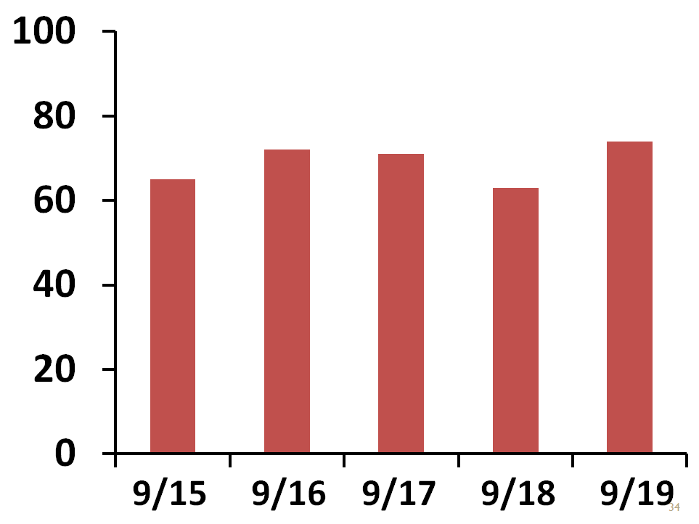
Overlap in data access
Data accessed on day n+1
Predictability_{n} =
Data accessed on day n
Predictability (%)

Slide 15
Replication Budget
Storage budget limits overhead
How to distribute the budget?
Priority
Round-robin
File A
(3)
File B
(3)
(Total Access x Size)
File C
(2)
File D
(2)
Budget
Budget

Slide 16
Scarlett: System Design
Increase replication for popular files
Avoid hotspots of popularity
Efficient Replica Creation

Slide 17
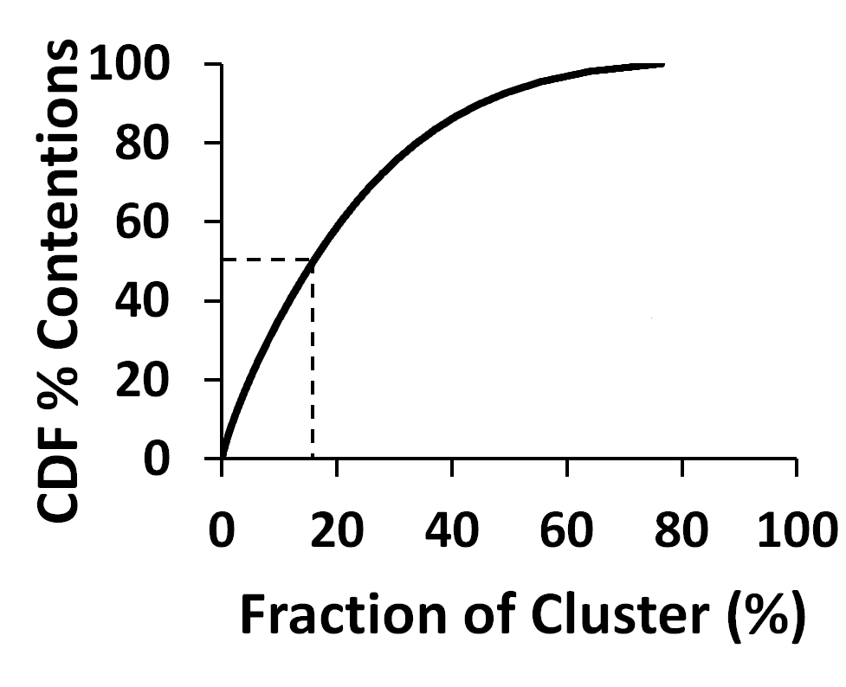
Hotspots
50% of the contentions happen in 16% of the cluster

Slide 18
Smooth placement of replicas
One replica per rack
  Rack-local bandwidth ~ Disk bandwidth
Load-factor of machine/rack is ratio of desired to achieved replication factors
Balance load on machines and racks
  Files in desc. order of (Total Access x Size)
  Place new block in least loaded rack/machine

Slide 19
Scarlett: System Design
Increase replication for popular files
Avoid hotspots of popularity
Efficient Replica Creation

Slide 20

Spread Replication Traffic
Each old replica is a source for (r^{new} – r^{old})/ r^{old} new replicas
Replicas increase, at most, in steps of 2
  Data flowing per link remains constant
r^{old} = 1 → r^{new} = 4
Rack
Data
1 → 2
→ 4

Slide 21
Compress Replication Traffic
Cross-rack bandwidth is over-subscribed
Lenient latency constraints to finish replica creation
Text data yields high compression ratios
  Spare cores available for compression

Slide 22
1. Does Scarlett’s replication increase locality and reduce evictions?
Evaluation
2. How much extra resources does Scarlett’s replication consume?

Slide 23
Setup
Hadoop deployment
  100-node cluster
  10 hour workload, 502 jobs
Dryad simulator
  Detailed replay of the entire trace
  Jobs and cluster characteristics

Slide 24
Does locality improve in Hadoop?
Baseline is vanilla HDFS, 3 replicas per block
T_{R} = 5 hours, Budget = 10%, Priority distribution
Locality | 57 → 92%
Job Speed-up (Median) | 20.2%
Job Speed-up (75th percentile) | 44.6%

Slide 25
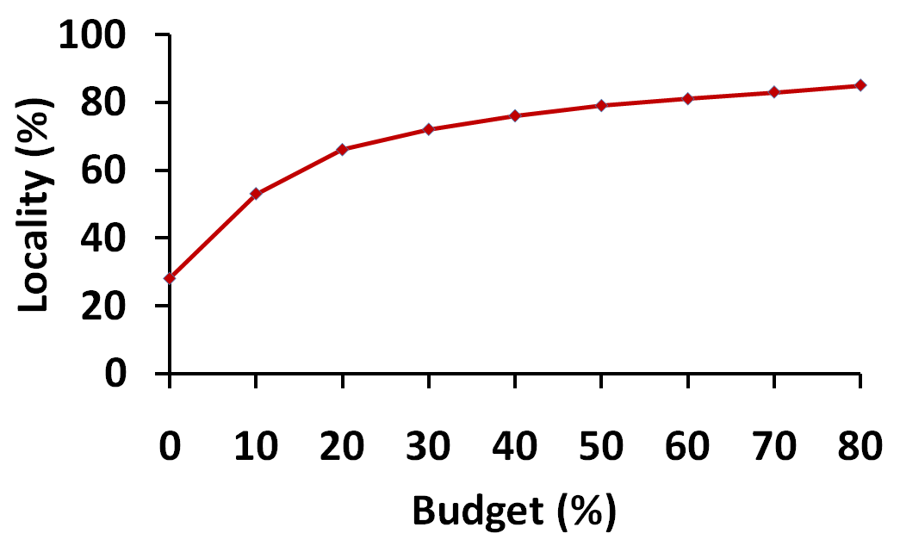
What if one replica per block?
Locality with (1 replica per block +13% budget) is equivalent to 3 replicas per block
(Asymptotic)
(Sharp gain)
(Base Replication: 3)
Scarlett helps future datacenters deal with storage crunch
25

Slide 26
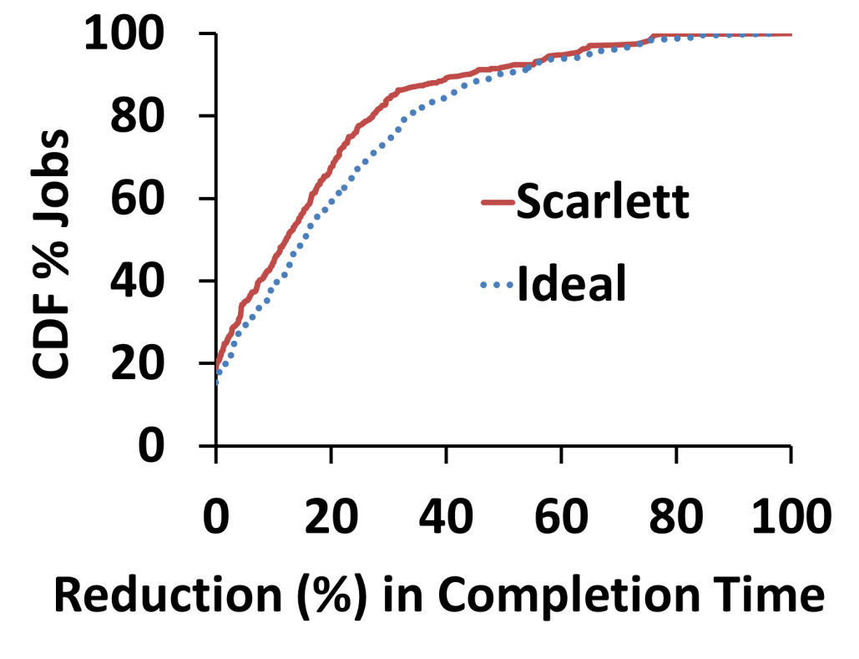
Are evictions avoided in Dryad?
Evictions down by 83%
  For top 100 popular files, by 93%
Scarlett is within 16% of an ideal scheme that has perfect knowledge of #replicas

Slide 27
Replication Overhead
Budget:
  Using 10% extra storage achieves near-optimality
  Priority is 52% better than round-robin
Sufficient to rearrange once in T_{R}=12 hours
Less than 1% increase in network traffic

Slide 28
Summary
Data popularity skew →contention for slots
Scarlett: Contention-Avoidance system
  Popularity-based proactive replication of files
  Limited storage and network overhead
Near-ideal elimination of contentions using under 10% extra storage
Increased value under storage crunch
  (1 replica + 13% budget ≈ 3 replicas)

