Slide 1


Spreadsheet Table Transformations
from Examples
William Harris
Sumit Gulwani
Notes:
Thanks for the introduction. This was work done with Sumit Gulwani during an internship at Microsoft Research, Redmond.

Slide 2
General Problem
End-users have large-scale, repetitive tasks, and don’t have the right tools to do them automatically.
Transform strings [POPL ‘11]
Transform layout of tables
Notes:
+transform strings: add example
-The work that I’ll cover today aims to address one instance of the following general problem: [read text in slide].
-In previous work, Sumit gave a technique that allows users to automatically transform large collections of strings.
-In this work, we give a technique that allows users to automatically transform large tables. In particular, we focus on allowing users to automatically transform the layout of a table. This is to say that we focus on allowing users to rearrange how cells are grouped together, without actually changing the content of individual cells. This may sound like a limited problem, but it actually describes a huge set of the practical transformations that users need to perform.

Slide 3
A Running Example: “Quals”
 | Qual 1 | Qual 2 | Qual 3
Andrew | 01.02.2003 | 27.06.2008 | 06.04.2007
Ben | 31.08.2001 |  | 05.07.2004
Carl |  | 18.04.2003 | 09.12.2009
Example
input
table
Andrew | Qual 1 | 01.02.2003
Andrew | Qual 2 | 27.06.2008
Andrew | Qual 3 | 06.04.2007
Ben | Qual 1 | 31.08.2001
Ben | Qual 3 | 05.07.2004
Carl | Qual 2 | 18.04.2003
Carl | Qual 3 | 09.12.2009
Example
output
table
Notes:
-As an example of the kind of layout transformation I’m talking about, consider the following example, which I’ll call Quals.
-This example is taken from an actual Excel help forum thread, and in the example, a novice Excel user has a table storing if and when each of their students took each of a set of tests, or quals. The user wants to output a new table, where each row contains the name of the student who took the qual, the name of the qual taken, and the date on which the qual was taken.
-This was the actual example that the novice wrote up and posted on the help forum, but by writing up this example, the novice definitely hasn’t already done the hardest part of their job, because although the example illustrates the transformation that the novice needs to perform…

Slide 4
 | Qual 1 | Qual 2 | Qual 3
Andrew | 01.02.2003 | 27.06.2008 | 06.04.2007
Ben | 31.08.2001 |  | 05.07.2004
Carl |  | 18.04.2003 | 09.12.2009
Dennis | 02.03.2004 | 28.07.2009 | 10.01.2010
Emma | 03.05.2005 |  | 11.02.2010
Fred |  | 29.08.2010
Garry | 04.06.2006 | 30.08.2010 | 12.03.2010
Howard |  | 31.08.2010 | 13.04.2010
Isolde | 05.07.2007 |  | 14.05.2010
Janice | 06.08.2008 | 01.09.2009
Kathy | 07.09.2009 | 02.09.2009 | 15.06.2010
Larry | 08.10.2010 |  | 16.06.2010
Mario |  | 03.09.2009
Neville | 08.11.2010 |  | 17.07.2010
Oscar | 08.12.2010 | 04.09.2009 | 18.08.2010
Andrew | 01.02.2003 | 27.06.2008 | 06.04.2007
Ben | 31.08.2001 |  | 05.07.2004
Carl |  | 18.04.2003 | 09.12.2009
Dennis | 02.03.2004 | 28.07.2009 | 10.01.2010
Emma | 03.05.2005 |  | 11.02.2010
Fred |  | 29.08.2010
Garry | 04.06.2006 | 30.08.2010 | 12.03.2010
Howard |  | 31.08.2010 | 13.04.2010
Isolde | 05.07.2007 |  | 14.05.2010
Janice | 06.08.2008 | 01.09.2009
Kathy | 07.09.2009 | 02.09.2009 | 15.06.2010
Larry | 08.10.2010 |  | 16.06.2010
Mario |  | 03.09.2009
Neville | 08.11.2010 |  | 17.07.2010
Oscar | 08.12.2010 | 04.09.2009 | 18.08.2010
Andrew | 01.02.2003 | 27.06.2008 | 06.04.2007
Ben | 31.08.2001 |  | 05.07.2004
Carl |  | 18.04.2003 | 09.12.2009
Dennis | 02.03.2004 | 28.07.2009 | 10.01.2010
Emma | 03.05.2005 |  | 11.02.2010
Fred |  | 29.08.2010
Garry | 04.06.2006 | 30.08.2010 | 12.03.2010
Notes:
-…what they really need to do is transform some large table, like this one, that might have dozens or hundreds or maybe thousands of rows.

Slide 5
Solution Space
GUI tools
programs from
examples
Ease
of
Use
traditional programming
Expressiveness
Notes:
-So how can we allow a user to automatically transform a large table of data? The conventional route is to extend a GUI program that edits spreadsheets with some set of GUI tools, but experience has shown that it’s very hard to capture most of the needs of users with a fixed set of tools, and once these tools get too complex, users ignore them.
-Another option is to allow users to use fully-general programming languages like Excel macros or VBA scripts, but these languages may take more time for users to learn then they’re prepared to give, and the languages can also get very complicated very quickly.
-A third option, and one that we pursue in this work, is to only require users to give examples of a transformation that they want to perform. We’ll then automatically infer the general transformation that the user has in mind from the examples.

Slide 6
A Running Example: “Quals”
 | Qual 1 | Qual 2 | Qual 3
Andrew | 01.02.2003 | 27.06.2008 | 06.04.2007
Ben | 31.08.2001 |  | 05.07.2004
Carl |  | 18.04.2003 | 09.12.2009
Input
table
Andrew | Qual 1 | 01.02.2003
Andrew | Qual 2 | 27.06.2008
Andrew | Qual 3 | 06.04.2007
Ben | Qual 1 | 31.08.2001
Ben | Qual 3 | 05.07.2004
Carl | Qual 2 | 18.04.2003
Carl | Qual 3 | 09.12.2009
Output
table
Notes:
-To justify this approach, let’s look deeper into the Quals help thread.
-Now it’s important to note that the practice of providing small examples in help threads is hardly isolated to this thread. In fact, the practice is really a convention: a lot of the time, experts will refuse to help novices until the novice gives an example, and novices will often decide on their own that their English description of a transformation is unclear, and so they’ll volunteer on their own an example as the best way to communicate their transformation.
-In the Quals help thread, an expert used the example posted by the novice to guess the general transformation that the novice had in mind. The expert then wrote a visual basic script that implements the transformation, and sent it to the novice, in a matter of about an hour.
-Our goal is to automate this process so that it takes a few seconds.

Slide 7
Demo on Quals
Notes:
-Our technique takes a small, representative example input and resulting output of a transformation, and infers a general transformation, represented as a program.
-The inferred program will be “correct” in the sense that if the user applies the program to the example input, they get back the example output.
-But more importantly, the user can take the program and apply it to other larger inputs to get the appropriate outputs, and then even store the program in a library, or share it with others, or do whatever they like.

Slide 8
Methodology
Study a large corpus of practical transformations
Identify common patterns in transformations
Design a language:
  expressive enough for most transformations
  amenable to inference
Notes:
-The problem of inferring programs from examples is clearly intractable in general: we can’t expect to infer a program for every transformation that a user may have in mind. But we found that we could still help users out with a significant set of practical transformations using the following methodology, which at a high-level is similar to the methodology that we used for allowing users to transform strings.
-First, we surveyed online help forums for spreadsheet programs like Excel, and studied a large set of transformations that users actually require.
-Second, from the survey, we found a pattern to the transformations. We found that many table transformations, which may apparently look different at first glance, could all be described as carrying out two phases, which I’ll discuss later.
-Finally, using this pattern that we observed, we designed a language expressive enough to describe the transformations that users want, while still allowing for an efficient algorithm that can infer programs from examples.

Slide 9
Outline
Give a language of transformations
Give an inference algorithm for the language
Demonstrate inference algorithm
Usage and Experiments
Notes:
-In the rest of this talk, I’ll use the Quals example to describe how we carried out our methodology for table transformations. In particular, I’ll use the Quals example to:
Introduce our language of table transformations, and
sketch an algorithm for inferring programs in the language from examples.
demo a prototype of our inference algorithm on a set of real-world examples, and
discuss some of the more interesting high-level issues with using the tool, and some experimental results
-But first, let’s discuss the semantics of the language of transformations.

Slide 10
Layout Program
=
(Filter Programs,
Associative Programs)
Notes:
-When studying real-world transformations, we observed that the transformations can usually be described as carrying out two steps, which we call filtering and association.
-So accordingly, we introduce into our language “filter programs” that carry out the filter step, …
-…and “associative Programs” that carry out the association step.
-Then we say that a layout program just builds an output table by running a set of filter programs, and then running a set of associative programs. So once we understand how filter programs and associative programs execute, we’ll understand how layout programs execute.

Slide 11
Transformation Step 1: Filtering
Filter cells from input table to output column
Notes:
-So let’s now take a closer look at the filter step. The idea here is that each transformation first selects, or filters, some cells in the input table, and from these cells, constructs a column of the output table.

Slide 12
Filtering Cells to Quals Column 3
 | Qual 1 | Qual 2 | Qual 3
Andrew | 01.02.2003 | 27.06.2008 | 06.04.2007
Ben | 31.08.2001 |  | 05.07.2004
Carl |  | 18.04.2003 | 09.12.2009
not in row 1
not in column 1
not empty
01.02.2003
Andrew | Qual 1 | 01.02.2003
Andrew | Qual 2 | 27.06.2008
Andrew | Qual 3 | 06.04.2007
Ben | Qual 1 | 31.08.2001
Ben | Qual 3 | 05.07.2004
Carl | Qual 2 | 18.04.2003
Carl | Qual 3 | 09.12.2009
27.06.2008
06.04.2007
31.08.2001
05.07.2004
18.04.2003
09.12.2009
Notes:
-We see this step in the Quals example. For this talk, I’ve colored the example tables here as a visual aid, but keep in mind that the cells in the original example tables provided by the user aren’t actually marked in different colors. Observe that we can build column 3 of the example output table by scanning the input table in row-major order, and whenever we reach any of the input cells that I’ve colored blue, so any cells that are […], we add the input cell on as the next cell in column 3 of the output table.
-Now as long as we’re just considering filter programs, we can think of the filter program as taking cells in the input table and adding them to an output column, but instead I’ll describe the filter program as mapping cells from the input table to coordinates of cells in the output table. This seems like a meaningless distinction now, but it’ll help us later when discussing associative programs.

Slide 13
Filter Program: Quals Column 3
Filter Programs: General Form
while (in_cell = get_next_row_major_cell()) {
if (row(in_cell) != 1
&& col(in_cell) != 1
&& text(in_cell) != “”) {
map_next_row(in_cell, );
}
}
if (guard(in_cell)) {
Col3
OutColumn
Notes:
-So if we re-imagine this filter program in some kind of procedural pseudo-code, it might look something like the following. The filter program loops through every cell in the input table in row-major order. If the features of the cell satisfy some condition, then the filter program maps the cell to the next unmapped cell coordinates in column 3.
-From this particular filter program, we can get a pretty good idea of the general form of a filter program. Every filter program is the same for the code in black, and only differ for the code in blue. That is, a filter program is defined by what condition it uses to select cells, and what output column it maps the cell to.

Slide 14
Transformation Step 2: Association
Filter cells from input table to output column
Map spatially associated output cells from spatially associated input cells
Notes:
-Filter programs are one of the major constructs in our language, but in practice, they can’t describe most practical table transformations on their own. In the Qual example, they can only be used to produce column 3 of the output table. So let’s go back to our claim that many practical transformations carry out two steps. The first step is filtering, which we’ve just discussed.
-The second step can be described as follows: [read 2]. To see what I mean by this, let’s go back to the Quals example.

Slide 15
Associative Program for Col 1
 | Qual 1 | Qual 2 | Qual 3
Andrew | 01.02.2003 | 27.06.2008 | 06.04.2007
Ben | 31.08.2001 |  | 05.07.2004
Carl |  | 18.04.2003 | 09.12.2009
Col. 1
Carl
18.04.2003
Andrew | Qual 1 | 01.02.2003
Andrew | Qual 2 | 27.06.2008
Andrew | Qual 3 | 06.04.2007
Ben | Qual 1 | 31.08.2001
Ben | Qual 3 | 05.07.2004
Carl | Qual 2 | 18.04.2003
Carl | Qual 3 | 09.12.2009
Lookup input
Carl
18.04.2003
Col. 3
Notes:
-Let’s consider a procedure for filling in all of the cells in columns 1 of the Quals output table. No filter program will produce this column, but let’s suppose that we have the filter program from earlier that maps column 3 of the output.
-Supposing that we have this map in hand, let’s consider how we might fill column 1 of the output. In particular how we might fill in the marked output cell coordinate. We could do the following.
-First, from the marked cell, we lookup the neighbor output cell in the same row, but in column 3, the one with date 18.04.2003.
-Then, we lookup the pre-image of the neighbor under the map built by the filter program.
-Then, from the pre-image cell, we lookup the neighboring input cell in the same row, but in column 1.
-Finally, we map the resulting input cell to the marked cell. We can follow the same sequence of lookups to fill in every cell in column 1 of the output table.

Slide 16
Associative Program: Quals Column 1
Associative Programs: General Form
outNbor := ( );
pre := preImage( , outNbor);
inCell := (pre);
map(inCell, X);
AssocFuncOut
EqRowCol3
X
col3Filter
filter
AssocFuncIn
EqRowCol1
Notes:
-And the psuedocode for this example gives a pretty good idea of what associative programs look like in general. All associative programs are the same for the code in black, and so what defines an associative program are the associative functions that it applies (the code in red) and the filter map that it uses (the code in blue).

Slide 17
Outline
A language of transformations
An inference algorithm for the language
Demonstration of inference algorithm
Usage and Experiments
Notes:
-We’ve now covered the basic constructs of our language of transformations, so I’ll now say a little bit about how we infer programs built from these constructs from examples.

Slide 18
Inferring Layout Programs
Inferring Filter Programs
Inferring Associative Programs
Notes:
+flash slide Filter program slide as a reminder (?)
-Recall that a layout program is just a set of filter programs and associative programs, each of which map cells in the input table to cells in the output table. To infer a layout program from an example, we iteratively infer more and more filter and associative programs that are consistent with an example until we find enough subprograms to map to every cell in the example output table. So then the only question is how we infer filter programs and associative programs.
-For filter programs, remember that a filter program is defined by a column in the output to which the program adds cells, and a guard used to select input cells, so inferring a filter program amounts to inferring an output column and inferring an input guard.

Slide 19
Filter Programs: General Form
while (in_cell = get_next_row_major_cell()) {
if (guard(in_cell)){
map_next_row(in_cell, OutColumn);
}
}

Slide 20
Filter Predicates
Cell Features
row
column
text
Constants
1, …, COL_MAX
“”
Predicates
FEATURE(cell) = CONST
FEATURE(cell) != CONST
Notes:
-We assume that all guards are conjunctions of literals built from some set of predicates.
-To define a suitable set of predicates, we observed in our study of transformations that many layout transformations only refer to whether or not an input cell is empty, whether or not its in the first row, or what column its in.
-So we fix sets of cell features (e.g. …) and constants (e.g. …), and then take the set of predicates that we’re interested in to be the set of all equalities or inequalities over these features and constants.
-These features include the row number, column number, and text of a cell, and the constants include all of the columns in an example, and special text values like the empty string.
-The predicates are then all equality and inequalities over the chosen cell features and constants.

Slide 21
Filtering Cells to Quals Column 3
 | Qual 1 | Qual 2 | Qual 3
Andrew | 01.02.2003 | 27.06.2008 | 06.04.2007
Ben | 31.08.2001 |  | 05.07.2004
Carl |  | 18.04.2003 | 09.12.2009
01.02.2003
Andrew | Qual 1 | 01.02.2003
Andrew | Qual 2 | 27.06.2008
Andrew | Qual 3 | 06.04.2007
Ben | Qual 1 | 31.08.2001
Ben | Qual 3 | 05.07.2004
Carl | Qual 2 | 18.04.2003
Carl | Qual 3 | 09.12.2009
cell.row != COL_1
&& cell.col != ROW_1
&& cell.text != “”
27.06.2008
06.04.2007
31.08.2001
05.07.2004
18.04.2003
09.12.2009
Notes:
-So to infer the set of all filter programs, we consider each column in the example output table.
-For each column, we try to infer a conjunction of literals over the set of predicates that is satisfied by exactly a set of cells in the example input table that, when read in row-major order, have the same text as the cells in the chosen example output column. For details on how we infer this conjunction, please see the paper.

Slide 22
Inference Algorithm
Inferring Filter Programs
Inferring Associative Programs
Notes:
-This is roughly how we infer filter programs. As for associative programs…

Slide 23
Associative Programs: General Form
outNbor := AssocFuncOut(X);
pre := preImage(filter, outNbor);
inCell := AssocFuncIn(pre);
map(inCell, X);
Notes:
-And the psuedocode for this example gives a pretty good idea of what associative programs look like in general. All associative programs are the same for the code in black, and so what defines an associative program are the associative functions that it applies (the code in red) and the filter map that it uses (the code in blue).

Slide 24
Associative Functions
RowEqCol1
RowEqCol2
…
RowEqColN
Row1ColEq
Notes:
-Recall that each associative programs is defined by a filter program and a pair of associative functions. So to infer associative programs, we first fix a set of associative functions to some small set that captures how most practical programs need to associate cells.
-[read through all of the associative functions in the list]

Slide 25
Inferring an Associative Program for Col 1
 | Qual 1 | Qual 2 | Qual 3
Andrew | 01.02.2003 | 27.06.2008 | 06.04.2007
Ben | 31.08.2001 |  | 05.07.2004
Carl |  | 18.04.2003 | 09.12.2009
Col. 1
Col. 2
Carl
18.04.2003
Andrew | Qual 1 | 01.02.2003
Andrew | Qual 2 | 27.06.2008
Andrew | Qual 3 | 06.04.2007
Ben | Qual 1 | 31.08.2001
Ben | Qual 3 | 05.07.2004
Carl | Qual 2 | 18.04.2003
Carl | Qual 3 | 09.12.2009
Lookup input
Carl
18.04.2003
Col. 3
Notes:
-To infer associative programs from an example, we enumerate over the space of associative functions and maps from filter programs that we have in hand, and see which can be combined to build associative programs that are consistent with the example.
-As we enumerate over the space of all associative functions, we observe what we saw earlier: that by applying the equal-row-column-3 associative function, looking up the preimage under the column 3 filter map, and applying the equal-row-column-1 associative function, we get an associative program that works.
-In contrast, if we build an associative program that applies the equal-row-column-3 function, looks up the preimage of the filter map, and then applies the equal-row-column-2 associative program, then the resulting associative program doesn’t build any of the example output columns, so we discard the associative program.

Slide 26
Outline
A language of transformations
An inference algorithm for the language
Demonstration of inference algorithm
Usage and Experiments

Slide 27
Experiments
Examples from 50+ real-world help threads
From example, inferred program
Checked program against informal description
If program was good: done
else: extend example, repeat
Notes:
We validated empirically that our language and inference algorithm are practical by using them to infer transformation programs for transformations requested in over 50 real-world Excel help-forum threads. For each help thread, we
First, we took the example provided by the user and inferred a program that was consistent with the example.
Then, we used the informal description in the thread to manually build larger examples, fed them to our inferred program, and checked the output produced by the program.
If the program behaved as expected, then we considered it a success. Otherwise, we used the larger example to infer a new program, and then repeat.

Slide 28
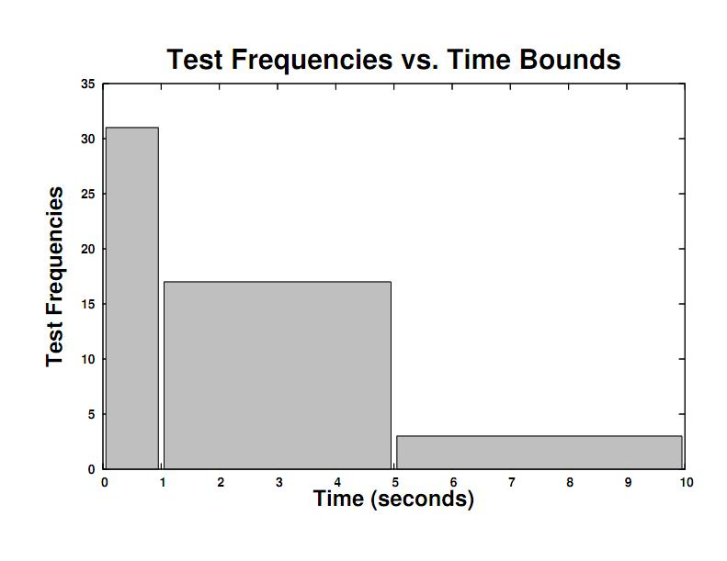
Notes:
-First, we found that our algorithm infers real-world programs quickly. This plot shows that the algorithm inferred programs from most examples in 1 second or less, and inferred program for almost all examples in 5 seconds or less.

Slide 29
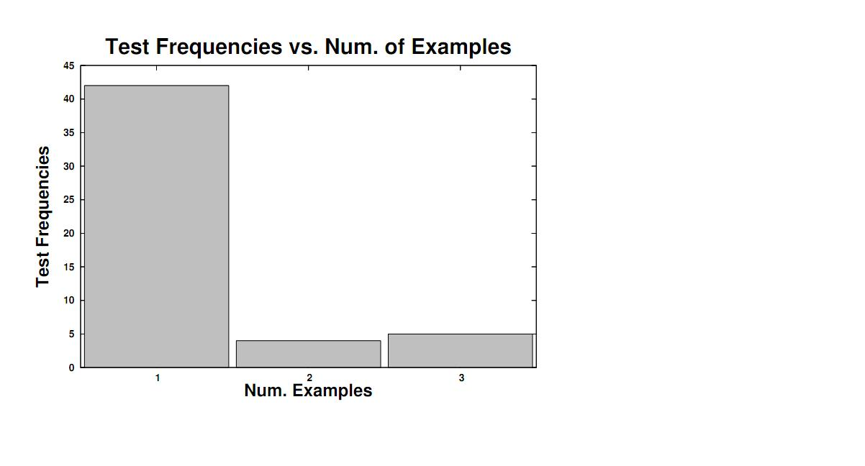
Notes:
-Second, we found that our language seems to be the “right fit” for practical transformations. This plot shows that the algorithm inferred what we determined to be a correct program from the original example in a help thread, and it inferred a correct program for all help threads after in 3 examples (two refinements) or less.

Slide 30
Conclusion
Motivated the problem of inferring table-layout transformations
Sketched a language that describes practical transformations over table layouts
Sketched an algorithm that infers programs in the language
Notes:
-read the slide

Slide 31
Layout Program
=
(Filter Programs, Associative Programs)
Questions?

Slide 32
Extra Slides

Slide 33
Spreadsheet Table Transformations from Examples
William Harris
Sumit Gulwani
Notes:
Thanks for the introduction. This was work done with Sumit Gulwani during an internship at Microsoft Research, Redmond.
-cool picture of Excel and tables

Slide 34
Our Approach
Input
Output
P
P
Notes:
-TODO: replace this slide with a demo
-So given that users are already comfortable with specifying transformations as examples, we propose the following approach for helping them transform the layout of large tables.
-Our technique takes a small, representative example input and resulting output of a transformation, and infers a general transformation, represented as a program.
-The inferred program will be “correct” in the sense that if the user applies the program to the example input, they get back the example output.
-But more importantly, the user can take the program and apply it to other larger inputs to get the appropriate outputs, and then even store the program in a library, or share it with others, or do whatever they like.

