Slide 1
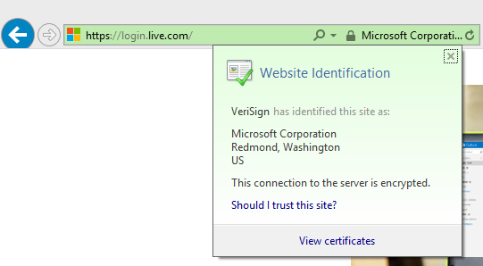




Towards a Verified Drop-in
Replacement of HTTPS
Everest*
*the Everest VERified End-to-end Secure Transport
Notes:
MSR Cambridge Technical Advisory Board, May 24.
miTLS: our main verified-cryptograph project since 2013; papers, research prototypes, etc.
Everest: a new, more ambitious 5-year research project, just starting.

Slide 2
The HTTPS Ecosystem is critical
Services & Applications
Edge
cURL
WebKit
Skype
IIS
Apache
Nginx
Clients
Servers
HTTPS Ecosystem
Most widely deployed security?
½ Internet traffic (+40%/year)
Web, cloud, email, VoIP, 802.1x, VPNs, …
Notes:
HTTPS foundation of Internet Security, from mobile users to cloud services.
Encryption will be mandatory with HTTP/2.
Critical infrastructure for Microsoft (and many others).
Security best practices say don’t invent your own, so everyone uses tools like HTTPS.

Slide 3
The HTTPS Ecosystem is complex
Services & Applications
Edge
cURL
WebKit
Skype
IIS
Apache
Nginx
Clients
Servers
HTTPS
Certification Authority
X.509
ASN.1
TLS
***
RSA
SHA
ECDH
4Q
Crypto Algorithms
Network buffers
Untrusted network (TCP, UDP, …)
Notes:
Distributed system, networking, cryptography.
Complex, but not necessarily large.
Smaller than a browser or an OS, for example.
Amenable to formal verification.

Slide 4


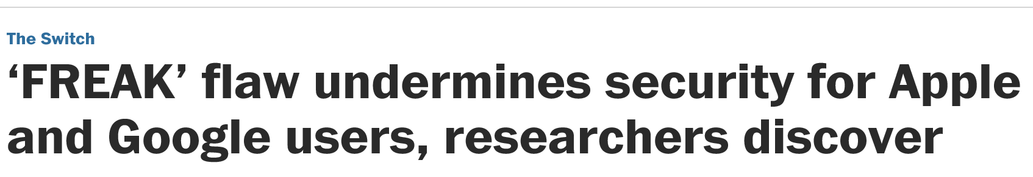
The HTTPS Ecosystem is broken
20 years of attacks & fixes
Buffer overflows
Incorrect state machines
Lax certificate parsing
Weak or poorly implemented crypto
Side channels
Informal security goals
Dangerous APIs
Flawed standards
Mainstream implementations
OpenSSL, SChannel, NSS, …
Still patched every month!
Services & Applications
Edge
cURL
WebKit
Skype
IIS
Apache
Nginx
Clients
Servers
HTTPS
Certification Authority
X.509
ASN.1
TLS
***
RSA
SHA
ECDH
4Q
Crypto Algorithms
Network buffers
Untrusted network (TCP, UDP, …)
Notes:
Many attacks and fixes.
More fundamental problems.
For example, the security goals are informal, revised after some attacks.
The APIs are hard to use securely—many misconfigured clients and servers.
And we found flaws in the standards too, not just their implementations.

Slide 5




Everest Goals
Strong verified security
Widespread deployment
Trustworthy usable tools
Services & Applications
Edge
cURL
WebKit
Skype
IIS
Apache
Nginx
Clients
Servers
HTTPS
Certification Authority
X.509
ASN.1
TLS
***
RSA
SHA
ECDH
4Q
Crypto Algorithms
Network buffers
Untrusted network (TCP, UDP, …)
Notes:
Fully-verified standards-compliant replacement
- We will prove cryptographic security, not just eliminate bugs.
- As a result, we rule out both past attacks, and attacks we haven’t even thought of yet
Many academically successful verification projects. Few deployments. Challenging research goal.

Slide 6
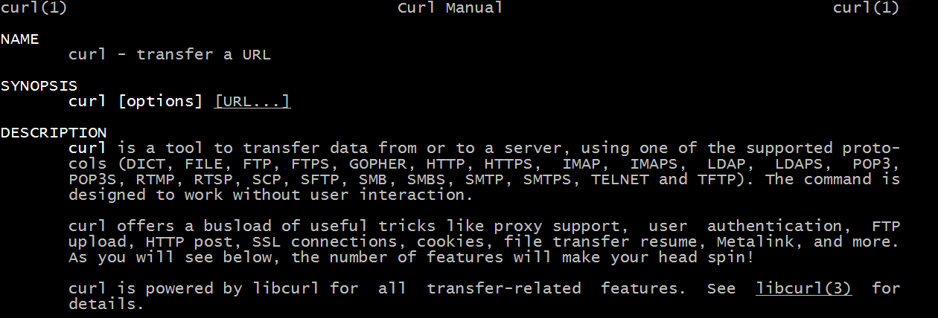

Where we are today
Everest in cURL client
cURL is a popular https client
Pervasive (500M+ users?) on Linux, Android, OS X, iOS, powershell, TVs, git, IoTs…
Running a fully verified TLS record layer
Several verified, performant ciphersuites in C and assembly
A partially verified TLS handshake

Slide 7
















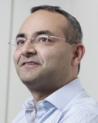

Team Members
Security
Systems
and Engineering
Cambridge
Antoine
Delignat-Lavaud
Paris (INRIA)
Aseem Rastogi
Redmond
Chris
Hawblitzel
Bangalore
Barry Bond
Kenji Maillard
Nik Swamy
Pittsburgh (CMU)
Bryan Parno
Catalin Hritcu
+ interns
+ academic collaborators
+ you?
Karthik
Bhargavan
Cédric
Fournet
Jonathan Protzenko
Tahina
Ramanandro
Markulf
Kohlweiss
Santiago
Zanella-Beguelin
Cryptology
Samin Ishtiaq
Leonardo de Moura
Jean Karim Zinzindohoue
Nadim
Kobeissi
PL/Verification
Notes:
A great team of researchers from 3 labs, soon 4.
All these people are excited, they think it’s valuable, and they want to be heavily involved.
Gold mine of expertise.
Diversity: Programming languages, verification, systems, security
Coordination required
TODO: Fold in the previous slide with this one

Slide 8

https://ecosystem
HTTPS
X.509
ASN.1
TLS
***
RSA
SHA
ECDH
4Q
Crypto Algorithms
Network buffers
Notes:
Overview of the HTTPS ecosystem, focusing on prior results on TLS.
A few words on X.509, HTTPS, and crypto algorithms.

Slide 9
Cryptographic protocol: TLS
Internet Standard
  1994 Netscape’s Secure Sockets Layer
  1995 SSL3
  1999 TLS 1.0 (≈SSL3)
  2006 TLS 1.1
  2008 TLS 1.2
  2017? TLS 1.3
Implementations:
OpenSSL SChannel NSS SecureTransport PolarSSL JSSE GnuTLS miTLS
  Large C++ codebase (400K LOC), many forks https://github.com/openssl/openssl
  Optimized cryptography for 50 platforms
  Terrible API
  Frequent critical patches https://openssl.org/news/vulnerabilities.html
  Never secure so far
Notes:
Stats for OpenSSL
34 CVEs just in 2015
60 kLOC for the protocol
55 kLOC for ASN.1 and X.509
200 kLOC for crypto algorithms (150 sym, 20 asym, 80 curves)

Slide 10
High-Profile TLS Attacks
Crypto
failures
MD5
RC4
RSA 512 bit
SHA1
SLOTH
DROWN
Renegotiation
Attack
CRIME
Triple Handshake
Protocol
weaknesses
ECDHE Cross-protocol Attack
BEAST
(Rogaway 02)
Logjam
Lucky13
POODLE
FREAK
OpenSSL entropy
EarlyCCS
Implementation
bugs
Heartbleed
SKIP
2007 2008 2009 2010 2011 2012 2013 2014 2015 2016
Notes:
3 classes; overlapping. More scrutiny (Snowden); leading to more attacks being uncovered.
Yellow = attacks
Orange = practical attacks
Red = attacks we found and helped fixed.

Slide 11
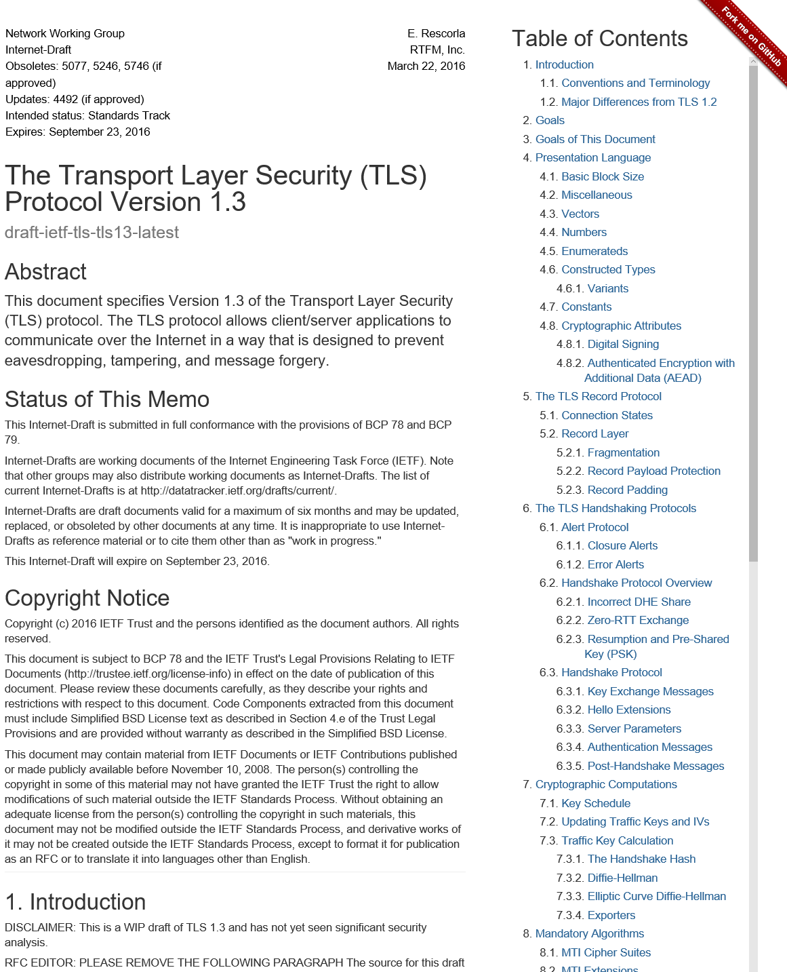
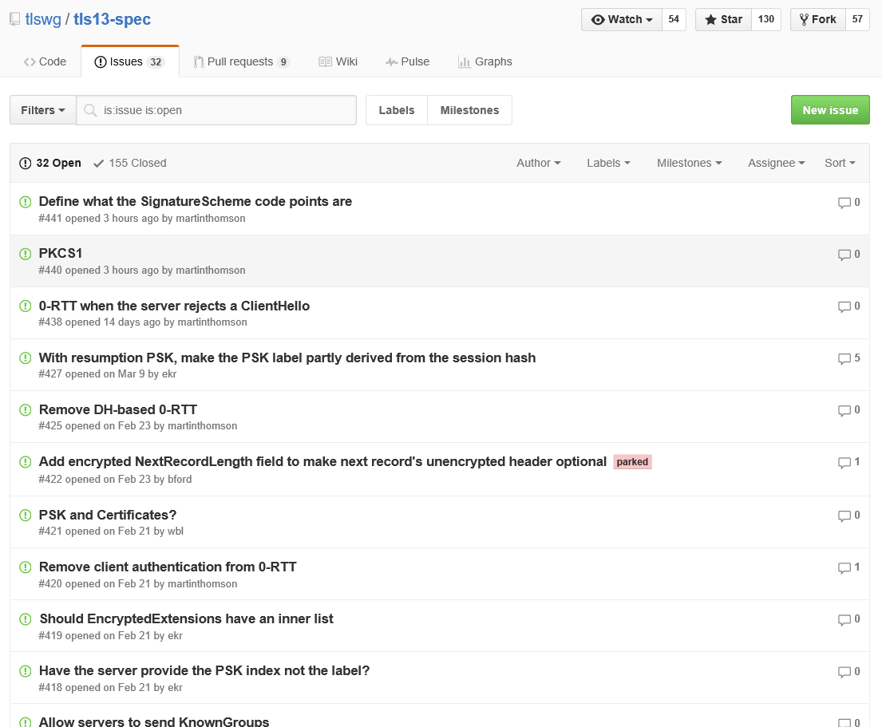
TLS 1.3: a new hope
Much discussions
  IETF, Google, Mozilla, Microsoft, CDNs,
  cryptographers, network engineers, …
Much improvements
  Modern design
  Fewer roundtrips
  Stronger security
New implementations
required for all
  An early implementer and verified too!
  Find & fix flaws before it’s too late
20th draft including
many of our proposals
  #4 log-based key separation
  extended session hashes
  (fixing attacks we found on 1.2)
  #11 stream terminators
  (eventually fixing an attack)
  #14 downgrade resilience
  #15 session ticket format
  #17 simplified key schedule
  pre-shared-key 0RTT
  #18 PSK binding (fixing an attack)
And our verified reference implementation of the
record layer
Notes:
IETF drafting the new standard.

Slide 12
Building
Performant
Verified
Code
Notes:
A brief overview of our method.

Slide 13
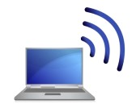
TLS Verification Goal: Secure Channel
Public Key
Infrastructure
client credential
server credential
connect(server,port);
send “GET…”;
data = recv();
send “POST…”;
…
accept(port);
request = recv();
send “<html>…”;
order = recv();
…
client
server
adversary
Security Goal: As long as the adversary does not control
the long-term credentials of the client and server, it cannot
Inject forged data into the stream (authenticity)
Distinguish the data stream from random bytes (confidentiality)
Threat model: Adversary fully controls the network, e.g.
it can redirect traffic to its own server (DNS rebinding)
it can passively read all data (IP monitoring)
it can play an active man-in-the-middle (TCP hijacking)
Notes:
The first research question is: how do we decide whether https:// is secure?
This is not part of the standards.
Especially when interoperating in a dangerous ecosystem.
We want to express clear, strong security guarantees at the HTTPS API (hiding all cryptographic details).

Slide 14

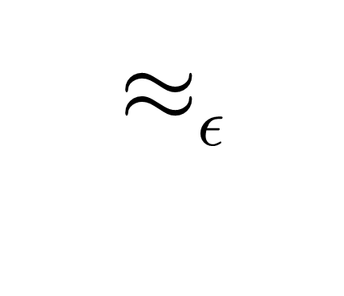
Modelling
Cryptographic
Security
Bytes, Network
lib.fs
Cryptographic Provider
cryptographic assumptions
Main crypto theorem:
concrete TLS & ideal TLS
are computationally
indistinguishable
We then verify that ideal TLS is secure
TLS implementation
TLS ideal implementation
miTLS typed API
miTLS typed API
any program
representing the adversary
Safe, except for a
negligible probability
Safe by typing
(info-theoretically)
Notes:
Except with negligible probability our implementation behaves like an ideal functionality that never sends secrets over the network, instead reading messages from the writer state.
This involves cryptographic reductions, relating the probability of breaking the secure channel to the probability of breaking some core cryptographic algorithms.
We are the first to do this kind of proof at this scale. Moreover, we verify for the ideal functionality that it satisfies a typed interface, which allows to continue verification for applications, without having to worry about the TLS implementation.

Slide 15
Modelling Secure Data Streams
Stream authentication as a distributed state invariant
Data Stream
state shared between
a reader and a writer
HTTPS Connection
i:id
connection info
reader
writer
duplex
streams when the
connection is secure
Data i #0
Data i #2
Data i #3
data
data
data
Data i #1
Warning i
Error i
Data i #0
data
data
warning
close
Data i #3
Data i #1
reader
i:id
connection info
(how we got here)
writer
writer
reader
Peer HTTPS Connection
Notes:
To model stream authentication, we relate the state of the sender and the state of the receiver using global ghost variables (aka an idealized functionality with shared logs)
Technically, this is a distributed state invariant.
Message fragments must be received in order.

Slide 16
A key technical problem
Separation and monotonicity
let c1 : Connection = …
let c2 : Connection = …
{ Inv c1 /\ Inv c2 }
TLS.write c1 “message”
{ Inv c1 /\ Inv c2 }
TLS Connection
i:id
connection info
receiver
sender
Data i #0
Data i #2
duplex
streams when the
connection is secure
Data i #3
Data i #1
Warning i
Data i #3
Data i #0
Data i #1
i:id
connection info
(how we got here)
sender
receiver
Peer TLS Connection
Notes:
To model stream authentication, we relate the state of the sender and the state of the receiver.
Message fragments must be received in order.
Technically, this is a distributed state invariant.

Slide 17
A key technical problem
Separation and monotonicity
let c1 : Connection = …
let c2 : Connection = …
{ Inv c1 * Inv c2 }
TLS.write c1 “message”
{ Inv c1 * Inv c2 }
TLS Connection
i:id
connection info
receiver
sender
Data i #0
Data i #2
duplex
streams when the
connection is secure
Data i #3
Data i #1
Warning i
Data i #3
Data i #0
Data i #1
Would like to use separation
Except, their states are not separate!
The log is written by the sender
And read by the receiver
i:id
connection info
(how we got here)
sender
receiver
Peer TLS Connection
Notes:
To model stream authentication, we relate the state of the sender and the state of the receiver.
Message fragments must be received in order.
Technically, this is a distributed state invariant.

Slide 18
A key technical problem
Separation and monotonicity
let c1 : Connection = …
let c2 : Connection = …
{ Inv c1 * Inv c2 }
TLS.write c1 “message”
{ Inv c1 * Inv c2 }
let c1:Connection rgn1 = …
let c2:Connection rgn2 = …
{ Inv c1 /\ Inv c2 }
TLS.write c1 “message”
{ Inv c1 /\ Inv c2 }
Each connection owns a distinct region of memory
TLS Connection
i:id
connection info
receiver
sender
Data i #0
Data i #2
Only rely on
monotone
properties
across
regions
Data i #3
Data i #1
Warning i
Data i #3
Data i #0
Monotone properties are stable
with respect to arbitrary modifications
in another region
Data i #1
i:id
connection info
(how we got here)
sender
receiver
Peer TLS Connection
Notes:
To model stream authentication, we relate the state of the sender and the state of the receiver.
Message fragments must be received in order.
Technically, this is a distributed state invariant.

Slide 19
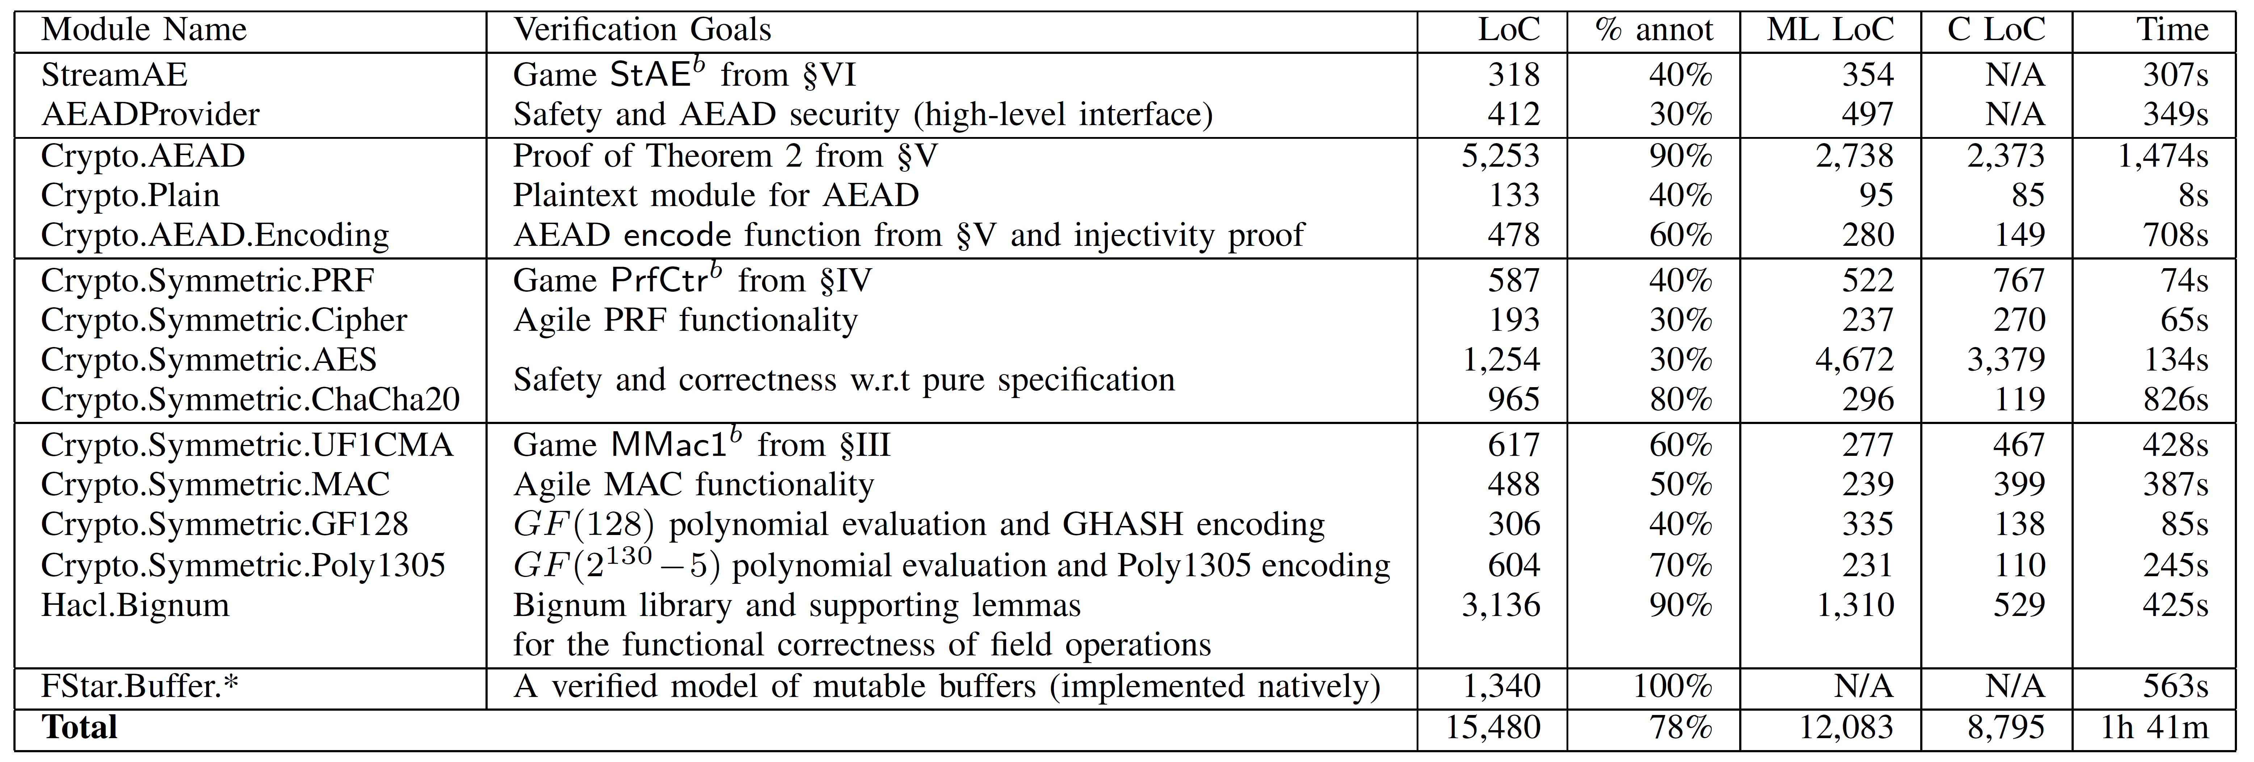
Authenticated Encryption with Additional Data (AEAD)
Crypto algorithms & constructions (performance critical)
~15K lines of code and proofs in F*
Compiled to ~9K lines of C

Slide 20
Low*, a subset of F* for verified C-style programming
And to support compilation to C, in nearly 1-1 correspondence, for auditability of our generated code
Designed to allow manipulating a C-like view of memory
Low*
C
COMPILED
Erased
specification
Stack allocation
Pointer arithmetic

Slide 21
From Low* to C in several stages, using KreMLin
Proved KreMLin semantics preserving from Low* to CompCert Clight
And, KreMLin does not introduce side channels due to timing or cache behavior
Compile C using mainstream commercial compilers
Or, CompCert
Notes:
Explain what CompCert is and that we don’t plan to go beyond C for verification

Slide 22
Verified Low* code at least as fast as
best handwritten C implementations
But, still slower than best
assembly implementations

Slide 23

Vale: extensible, assembly language verification
machine model (Dafny/F*/Lean)
Vale code
instructions
Trusted
Computing
Base
machine interface
type reg = r0 | r1 | ...
type ins =
Mov(dst:reg, src:reg)
| Add(dst:reg, src:reg)
| Neg(dst:reg)
…
procedure mov(…)
requires …
ensures …
{ … }
procedure add(…)
…
Vale
semantics
crypto spec
code
proof
eval(Mov(dst, src), …) = …
eval(Add(dst, src), …) = …
eval(Neg(dst), …) = …
…
mem[eax] ==
SHA(mem[ebx])
[Mov(r1, r0),
Add(r1, r0),
Add(r1, r1)]
lemma_mov(…);
lemma_add(…);
lemma_add(…);
program
procedure quadruple(…)
requires 0 <= r0 < 2³⁰;
ensures r1 == r0 * 4;
{
mov(r1, r0);
add(r1, r0);
add(r1, r1);
}
code generation
print(Mov(dst, src), …) =
“mov “ + (…dst) + (…src)
print(Add(dst, src), …) = …
…
Notes:
TODO: Show the spec
TODO: finesse the Mindy point later

Slide 24
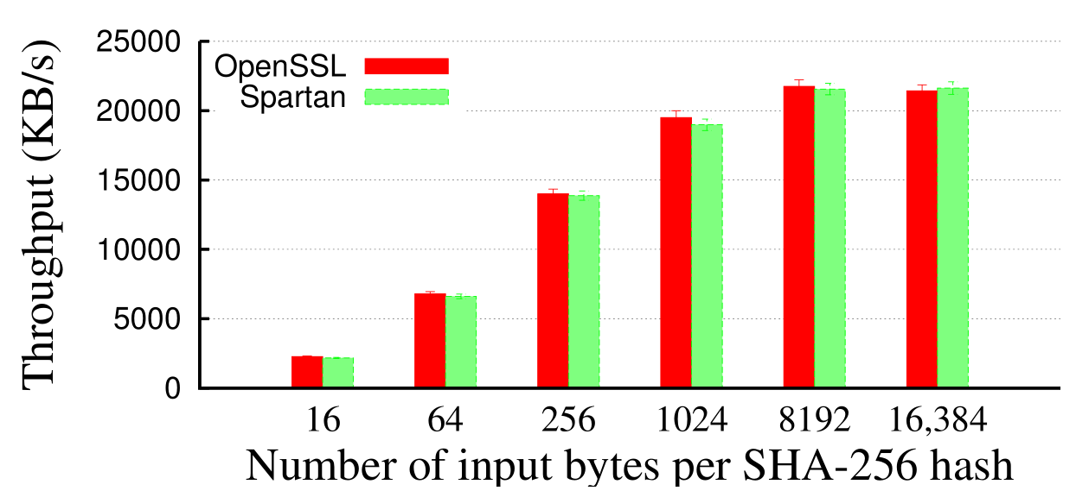
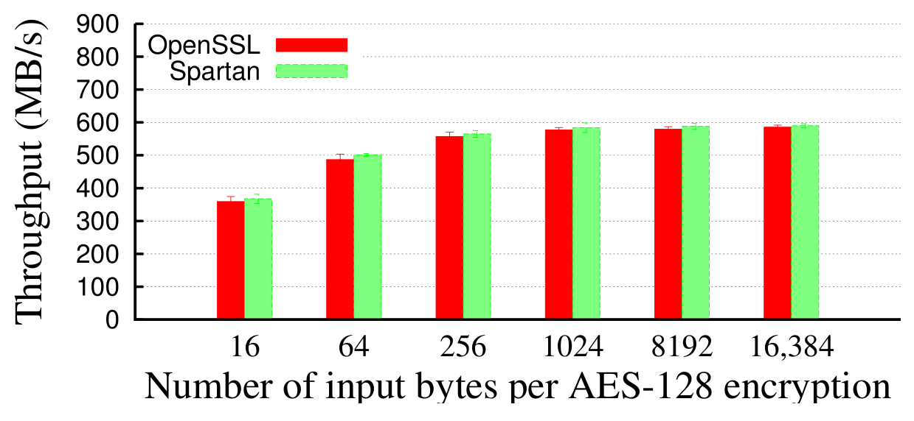
Vale Perf
At parity with OpenSSL assembly
Caveats
  Specific platforms
  Missing OpenSSL’s advanced modes

Slide 25
Everest Goals
Strong verified security
Widespread deployment
Trustworthy usable tools
Services & Applications
Edge
cURL
WebKit
Skype
IIS
Apache
Nginx
Clients
Servers
HTTPS
Certification Authority
X.509
ASN.1
TLS
***
RSA
SHA
ECDH
4Q
Crypto Algorithms
Network buffers
Untrusted network (TCP, UDP, …)
Notes:
Fully-verified standards-compliant replacement
- We will prove cryptographic security, not just eliminate bugs.
- As a result, we rule out both past attacks, and attacks we haven’t even thought of yet
Many academically successful verification projects. Few deployments. Challenging research goal.

Slide 26
Open
Questions
Notes:
A brief overview of our method.

Slide 27
Research questions
Game-based cryptography on efficient implementations
Proofs of side-channel resistance
  Current approach based on parametricity for constant time crypto
  But, we need more subtle techniques higher up the protocol stack
  Relational reasoning in F*
Automated, Expressive, Controllable verification tools
  Balancing SMT + Tactic-based interactive proofs in F* + Lean + Z3
Certification
  Proving our tools trustworthy, independently checkable

Slide 28
Developer acceptance and maintenance
Why will people risk deploying unfamiliar verified code?
Why choose Everest over OpenSSL?
Who will patch Everest overnight?
Who will maintain Everest 10 years from now?
How do we keep deployed C/C++ code
from diverging from high-level verified code?
Notes:
Even certification isn’t enough. Why will people really trust us?
No-one ever gets blamed for deploying OpenSSL – as long as patches are regularly applied.

Slide 29
Developer acceptance approach
Open-source standard-compliant transparent development
    Early reference implementation of TLS 1.3
    IETF endorsement + interop and performance testing
Compile to clean readable commented C++ code
    Allows developers to
      Ignore verification machinery, if desired
      Apply code reviews, auditing, or any other reasoning approaches
Drop-in replacements in popular software (API compatibility)
    Also: interop & security testing tools for specialists (flexTLS)
    Also: lightweight deployment with minimal TCB (SGX)
Resilience to ongoing CVEs in other implementations
Time…

Slide 30
Maintenance approach
Improve usability of verification tools to the point where outsiders can adapt, improve, recompile our code
Build a thriving open-source community
Buy-in from Microsoft and others? See OpenSSL

