Slide 1

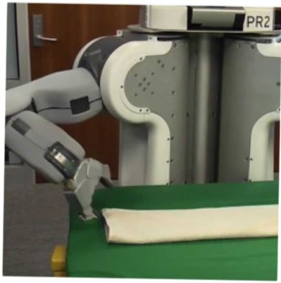

Programming by Examples
Applications, Algorithms & Ambiguity Resolution
Sumit Gulwani
UPMARC Lectures
June 2017

Slide 2

Programming by Examples
Program synthesis: Generate a program in an underlying language from user specification using a search algorithm.
Programming by Examples is a subfield of Program Synthesis where the specification is in the form of examples.
An old problem but enabled today by
better algorithms & faster machines.
The new programming revolution
Enables 10-100x productivity for programmers.
The new computer user experience
99% users can’t program and struggle with repetitive tasks.
Non-programmers can now create scripts & achieve more.

Slide 3
Outline
Applications
  Data transformations
  Code transformations
Algorithms
  Domain-specific language
  Top-down/backward propagation based search
Ambiguity Resolution
  Ranking
  Interactivity

Slide 4


Killer Applications
Transformation
Extraction
Formatting
Data scientists spend 80% time wrangling data from raw form to a structured form.
Old
SELECT foo, bar FROM dbo.splunge ORDER BY 1, 2 DESC;
RAISERROR @err @message RAISERROR ('RAISERROR TEST',16,1)
On-prem to cloud
Company 1 to company 2
Old to new
New
SELECT foo, bar FROM dbo.splunge ORDER BY foo, bar DESC;
Throw @err, @message, 1 Throw 99999, 'RAISERROR TEST', 1
Developers spend 40% time in code refactoring in migration

Slide 5




Excel help forums

Slide 6




Typical help-forum interaction
300_w30_aniSh_c1_b → w30
300_w5_aniSh_c1_b → w5
=MID(B1,5,2)
=MID(B1,5,2)
=MID(B1,FIND(“_”,$B:$B)+1, FIND(“_”,REPLACE($B:$B,1,FIND(“_”,$B:$B),””))-1)

Slide 7
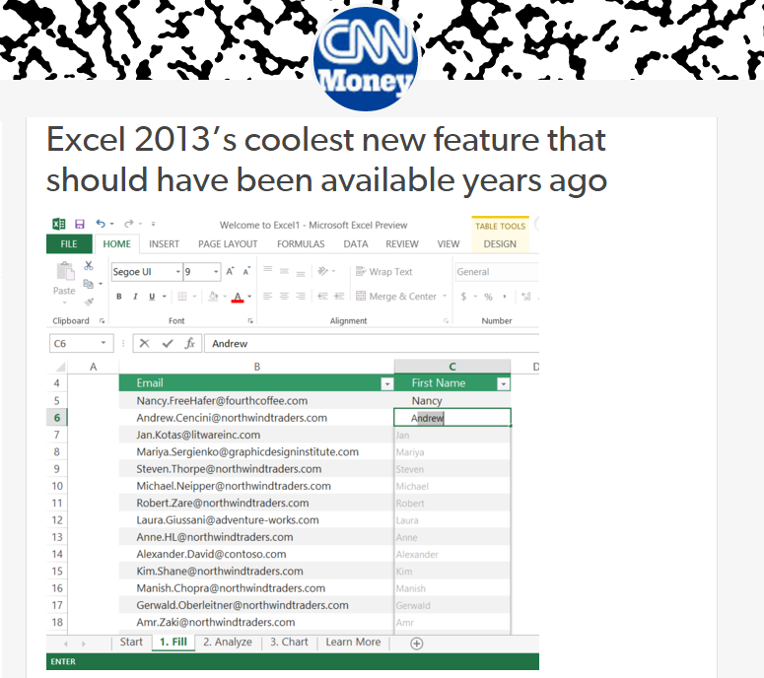
Flash Fill (Excel 2013 feature) demo
“Automating string processing in spreadsheets using input-output examples”;
POPL 2011; Sumit Gulwani

Slide 8
Number and DateTime Transformations
Input | Output (Round to 2 decimal places)
123.4567 | 123.46
123.4 | 123.40
78.234 | 78.23
Excel/C#:
Python/C:
Java:
#.00
.2f
#.##
Input | Output (Half hour bucket)
0d 5h 26m | 5:00-5:30
0d 4h 57m | 4:30-5:00
0d 4h 27m | 4:00-4:30
0d 3h 57m | 3:30-4:00
Synthesizing Number Transformations from Input-Output Examples;
CAV 2012; Singh, Gulwani

Slide 9
Lookup Transformations
Id | Name | Markup
S33 | Stroller | 30%
B56 | Bib | 45%
D32 | Diapers | 35%
W98 | Wipes | 40%
A46 | Aspirator | 30%
... | .... | ...
Id | Date | Price
S33 | 12/2010 | $145.67
S33 | 11/2010 | $142.38
B56 | 12/2010 | $3.56
D32 | 1/2011 | $21.45
W98 | 4/2009 | $5.12
... | ... | ...
MarkupRec
Table
CostRec
Table
Input v1 (Name) | Input v2 (Date) | Output (Price+ Markup*Price)
Stroller | 10/12/2010 | $145.67+0.30*145.67
Bib | 23/12/2010 | $3.56+0.45*3.56
Diapers | 21/1/2011
Wipes | 2/4/2009
Aspirator | 23/2/2010
Learning Semantic String Transformations from Examples; VLDB 2012; Singh, Gulwani

Slide 10

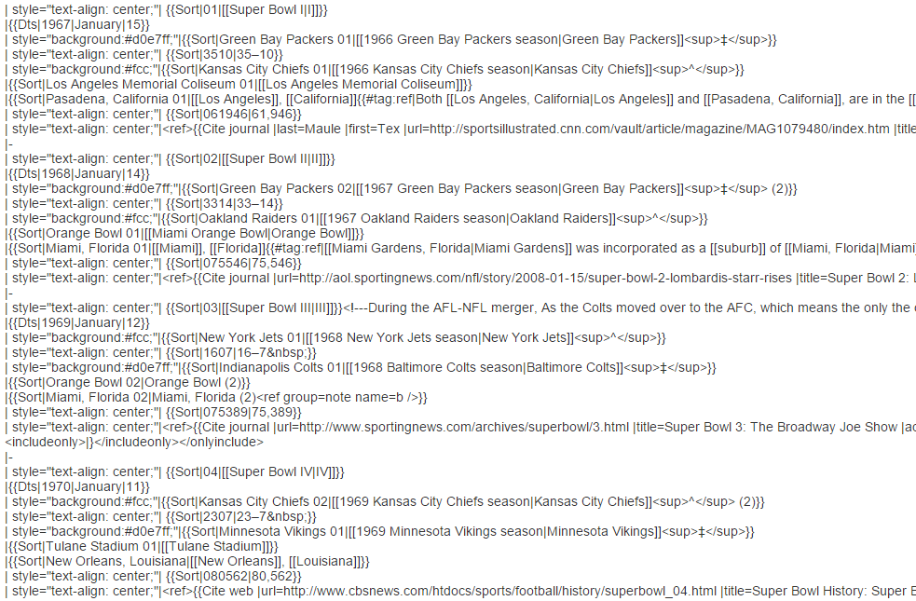
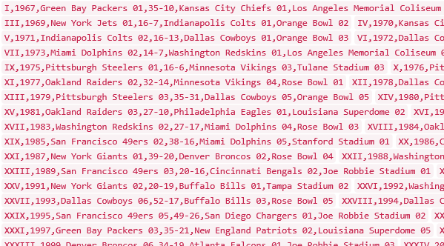
Data Science Class Assignment
To get Started!

Slide 11
FlashExtract Demo
“FlashExtract: A Framework for data extraction by examples”;
PLDI 2014; Vu Le, Sumit Gulwani

Slide 12
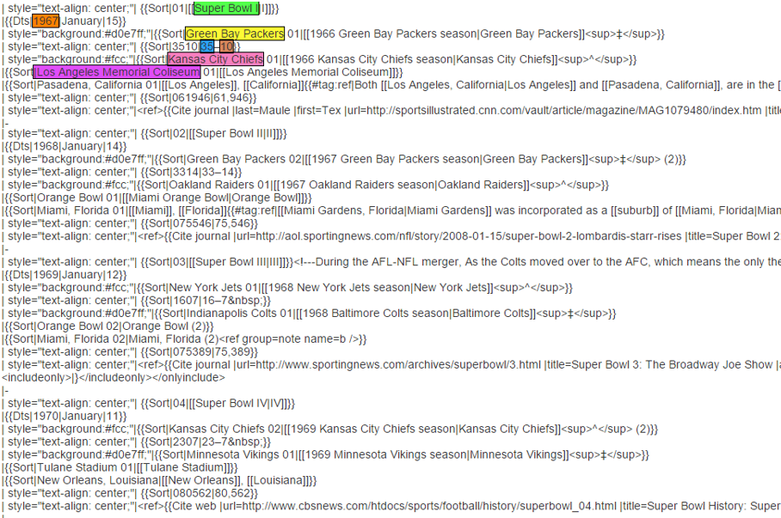
FlashExtract

Slide 13
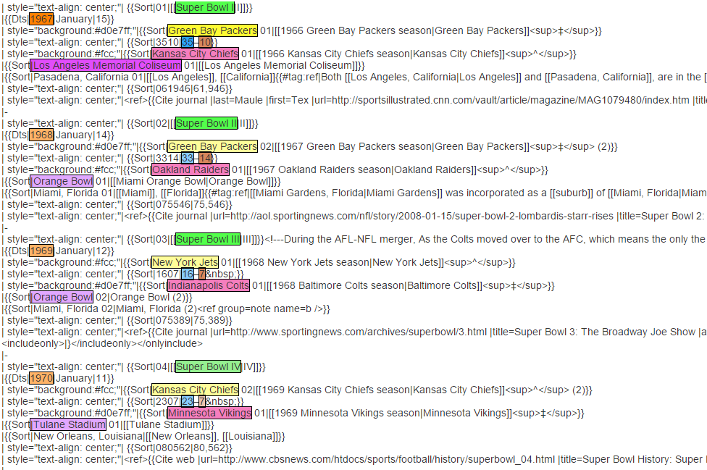
FlashExtract

Slide 14
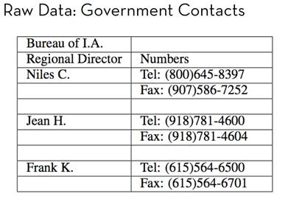
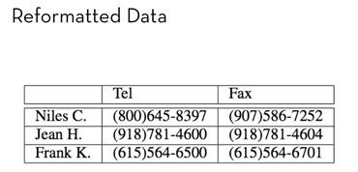
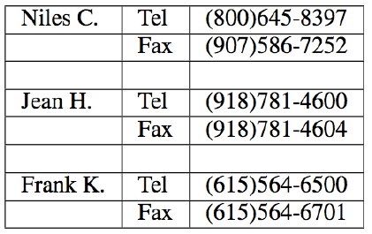
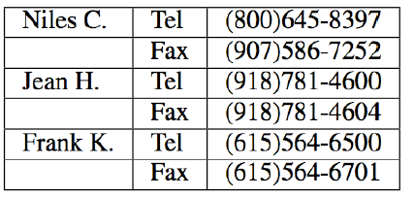
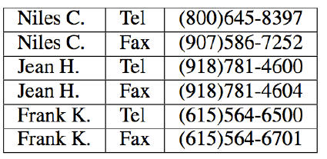
FlashRelate: Table Reshaping by Examples
Start with:
End goal:
FlashRelate
(from few examples of records in output table)
4. Pivot Number on Type
Trifacta facilitates the transformation through a series of recommended steps
1. Split on “:” Delimiter
2. Delete Empty Rows
3. Fill Values Down
50% Excel spreadsheets (e.g., financial reports) are semi-structured.
The need to canonicalize similar information across varying formats is huge.
  Companies like KPMG, Deloitte can budget millions of dollars each to solve this.

Slide 15
FlashRelate Demo
“FlashRelate: Extracting Relational Data from Semi-Structured Spreadsheets Using Examples”;
PLDI 2015; Barowy, Gulwani, Hart, Zorn

Slide 16
PBE tools for Data Manipulation
Extraction
FlashExtract: Extract data from text files, web pages [PLDI 2014; Powershell convertFrom-string cmdlet
Transformation
Flash Fill: Excel feature for Syntactic String Transformations [POPL 2011]
Semantic String Transformations [VLDB 2012]
Number Transformations [CAV 2013]
FlashNormalize: Text normalization [IJCAI 2015]
Formatting
FlashRelate: Extract data from spreadsheets [PLDI 2015, PLDI 2011]
FlashFormat: a Powerpoint add-in [AAAI 2014]

Slide 17
Repetitive Code Transformations
Migration
  old version to new version
  Company 1 to company 2
  On prem to cloud
API changes
Corrections in student assignments
Notes:
Many IDEs and Static Analysis tools automate these transformations. For instance, Visual Studio and Resharper automate programming refactorings and bug fixes for software developers in general and also Auto Grader proposed in PLDI thirteen automates common bug fixes in programming assignments. These tools rely on pre-defined classes of transformations. Thus, it is hard to extend them to allow other types of transformations that are not included in this set. Developers have to identify the other transformations that should be implemented, and also developers need to have very specific skills to implement these transformations.

Slide 18
Repetitive Code Migration
Old
SELECT foo, bar FROM dbo.splunge ORDER BY 1, 2 DESC;
RAISERROR @err @message RAISERROR ('RAISERROR TEST',16,1)
New
SELECT foo, bar FROM dbo.splunge ORDER BY foo, bar DESC;
throw @err, @message, 1 Throw 99999, 'RAISERROR TEST', 1
  Old version to new version
  Company 1 to company 2
  On-prem to cloud

Slide 19
Repetitive API Changes
- while (receiver.CSharpKind() == SyntaxKind.ParenthesizedExpression)
+ while (receiver.IsKind(SyntaxKind.ParenthesizedExpression))
foreach (var m in modifiers)
{ if (m.CSharpKind() == modifier) return true; };
+ foreach (var m in modifiers)
{ if (m.IsKind(modifier)) return true; };
receiver.CSharpKind() == SyntaxKind.ParenthesizedExpression
receiver.IsKind(SyntaxKind.ParenthesizedExpression)
m.CSharpKind() == modifier
m.IsKind(modifier)
<name>.CSharpKind() == <exp>
<name>.IsKind(<exp>)
Learning Syntactic Program Transformations from Examples
ICSE 2017; Rolim, Soares, Antoni, Polozov, Gulwani, Gheyi, Suzuki, Hartmann
Notes:
Many code edits have already been performed in the past. Sometimes, by the same developer. For instance, here, the same developer performed these edits into the Roslyn project, replacing the equals expressions that uses the CSharp Kind method to the new invocation for the Is Kind method. In other scenarios, different developers may perform similar edits to different programs. In this case, for instance, more than one hundred students at UC Berkeley performed the same bug fix to their program code. Here, to fix a bug, they just add a call to the term function.

Slide 20
Repetitive Corrections in Student Assignments
def product(n, term):
total, k = 1, 1
while k<=n:
- total = total * k
+ total = total * term(k)
k = k + 1
return total
def product(n, term):
if(n == 1):
return 1
- return product(n-1, term)*n
+ return product(n-1, term)*term(n)
k
term(k)
n
term(n)
<name>
term(<name>)
Learning Syntactic Program Transformations from Examples
ICSE 2017; Rolim, Soares, Antoni, Polozov, Gulwani, Gheyi, Suzuki, Hartmann
Notes:
These edits have the same structure. For instance, if we represent them as tree edit in the abstract syntax tree of the program. On the left-hand side, we replace the node k to term k. On the right-hand side, we replace the node n to term n. So, they share the same structure but have different expressions. In this case, different variable names.

Slide 21
Outline
Applications
  Data transformations
  Code transformations
Algorithms
  Domain-specific language
  Top-down/backward propagation based search
Ambiguity Resolution
  Ranking
  Interactivity

Slide 22

Programming-by-Examples Architecture
Example-based Intent
Program set
(a sub-DSL of D)
Program
Synthesizer
DSL D
21

Slide 23
Domain-specific Language (DSL)
Balanced Expressiveness
  Expressive enough to cover wide range of tasks
  Restricted enough to enable efficient search
    Restricted set of operators
      those with small inverse sets
    Restricted syntactic composition of those operators
Natural computation patterns
  Increased user understanding/confidence
  Enables selection between programs, editing

Slide 24
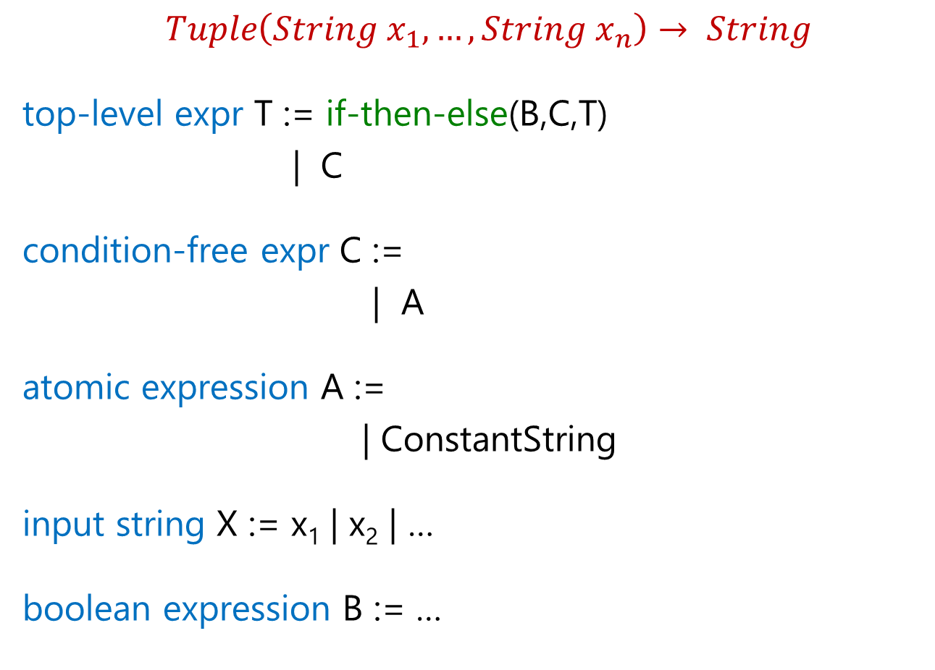
FlashFill DSL
$Tuple\left(String x_{1},…,String x_{n}\right)→ String$
top-level expr T := if-then-else(B,C,T)
| C
condition-free expr C :=
| A
atomic expression A :=
| ConstantString
input string X := x₁ | x₂ | …
boolean expression B := …
Concatenate(A, C)
SubStr(X, …)

Slide 25
Substring Operator
What is a good choice for … in SubStr(X, …) ?
Regular expression
  Not very expressive. Does not take context into account.
  For instance: content within parenthesis, second word
Extended regular expression
  Too sophisticated for learning and readability.
Desired computational pattern:
Should involve simple regexes.
Take context into account.
Notes:
Composition: First do this, then do that (relative position extraction, FlashExtract filter and map)

Slide 26
Substring Operator
position expr P :=
SubStr(X, P, P’)
Pos(X, R₁, R₂, K)
K^{th} position in X whose left/right side matches with R₁/R₂.

Slide 27
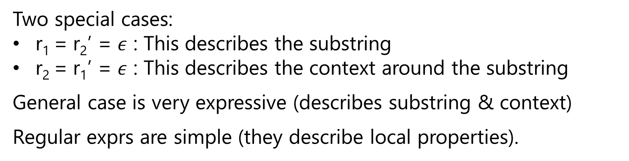
Substring Operator
Evaluation of Expr SubStr(x,p,p’) , where p=Pos(x,r_{1,}r₂,k) &
p’=Pos(x,r₁’,r₂’,k’)
matches r₁
matches r₂
matches r₁’
matches r₂’
p
p’
w
x
Two special cases:
r₁ = r₂’ = $ε$ : This describes the substring
r₂ = r₁’ = $ε$ : This describes the context around the substring
General case is very expressive (describes substring & context)
Regular exprs are simple (they describe local properties).

Slide 28
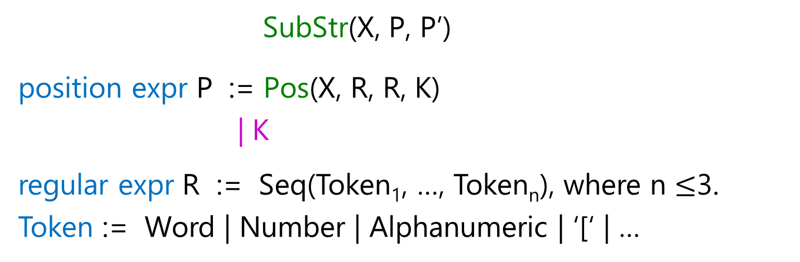
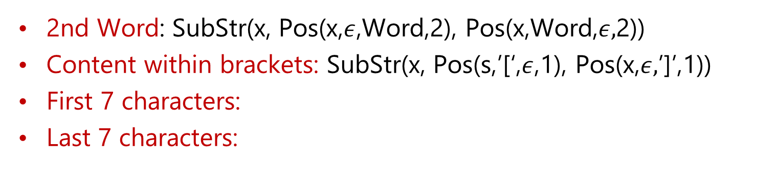
Substring Operator
SubStr(X, P, P’)
position expr P := Pos(X, R, R, K)
| K
regular expr R := Seq(Token₁, …, Token_{n}), where n $≤$3.
Token := Word | Number | Alphanumeric | ‘[‘ | …
2nd Word: SubStr(x, Pos(x,$ε$,Word,2), Pos(x,Word,$ε,$2))
Content within brackets: SubStr(x, Pos(s,’[‘,$ε$,1), Pos(x,$ε,$’]’,1))
First 7 characters:
Last 7 characters:
SubStr(x, 0, 7)
SubStr(x, -8, -1)

Slide 29
Substring Operator
SubStr(X, P, P)
position expr P := Pos(X, R, R, K) | K
Restriction
let x = X in
SubStr(x, P, P)
position expr P := Pos(x, R, R, K) | K
Elegance
let x = X in
let p₁ = P[x] in
let p₂ = P[x] in
SubStr(x, p₁, p₂)
position expr P[y] := Pos(y, R, R, K) | K

Slide 30


Substring Operator
let x = X in
let p₁ = P[x] in
let p₂ = P[x] in
SubStr(x, p₁, p₂)
position expr P[y] := Pos(y, R, R, K) | K
Increased Expressiveness
let x = X in
let p₁ = P[x] in
let p₂ = P[x] | p₁ + P[Suffix(x,p₁)] in
SubStr(x, p₁, p₂)
position expr P[y] := Pos(y, R, R, K) | K
First 7 chars in 2nd Word:
SubStr(x, p₁=Pos(x,$ε$,Word,2), p₁+7)
Suffix(x,p) $≡$SubStr(x,p,-1)

Slide 31

Substring Operator
let x = X in
let p₁ = P[x] in
let p₂ = P[x] | p₁ + P[Suffix(x,p₁)] in
SubStr(x, p₁, p₂)
position expr P[y] := Pos(y, R, R, K) | K
Increased Expressiveness
let x = X in
let p₁ = P[x] | let p₀ = P[x] in (p₀ + P[Suffix(s, p₀)]) in
let p₂ = P[x] | p₁ + P[Suffix(x,p₁)] in
SubStr(x, p₁, p₂)
position expr P[y] := Pos(y, R, R, K) | K
2nd word within brackets:
let p₀ = Pos(x,’[‘,$ε$,1) in
SubStr(x, p₁ = p₀+Pos(Suffix(x,p₀), $ε$, Word, 2),
p₁+Pos(Suffix(x,p₁), Word, $ε$, 2))

Slide 32


FlashExtract DSL
$String d→List(PosPair)$
all lines L := Split(d,”\n”)
some lines N := Filter(L, $λ$z: F[z])
| FilterByPosition(L, init, iter)
line filter function F[y] := Contains(y,r,K) | startsWith(y,r)
| Filter(L, $λ$z: F[prevLine(z)])
[X]
substr expr S :=
let x = X in
let p₁=P[x] | let p₀=P[x] in (p₀+P[Suffix(s,p₀)]) in
let p₂ = P[x] | p₁ + P[Suffix(x,p₁)] in
SubStr(x, p₁, p₂)
position expr P[y] := Pos(y, R, R, K) | K

Slide 33


FlashExtract DSL
$String d→List(PosPair)$
Seq expr E := Map($λ$z: PP[z], N)
| Map($λ$z: PP[Suffix(d,z)], Pos(d,R,R))
| Merge(T_{1,} T₂)
all lines L := Split(d,”\n”)
some lines N := Filter(L, $λ$z: F[z])
| FilterByPosition(L, init, iter)
line filter function F[y] := Contains(y,r,K) | startsWith(y,r)
| Filter(L, $λ$z: F[prevLine(z)])
[X]
substr expr S :=
let x = X in SubStr(x, PP[x])
position pair PP[x] := let p₁=P[x] | let p₀=P[x] in (p₀+P[Suffix(s,p₀)]) in
let p₂ = P[x] | p₁ + P[Suffix(x,p₁)] in
(p₁,p₂)
position expr P[y] := Pos(y, R, R, K) | K

Slide 34
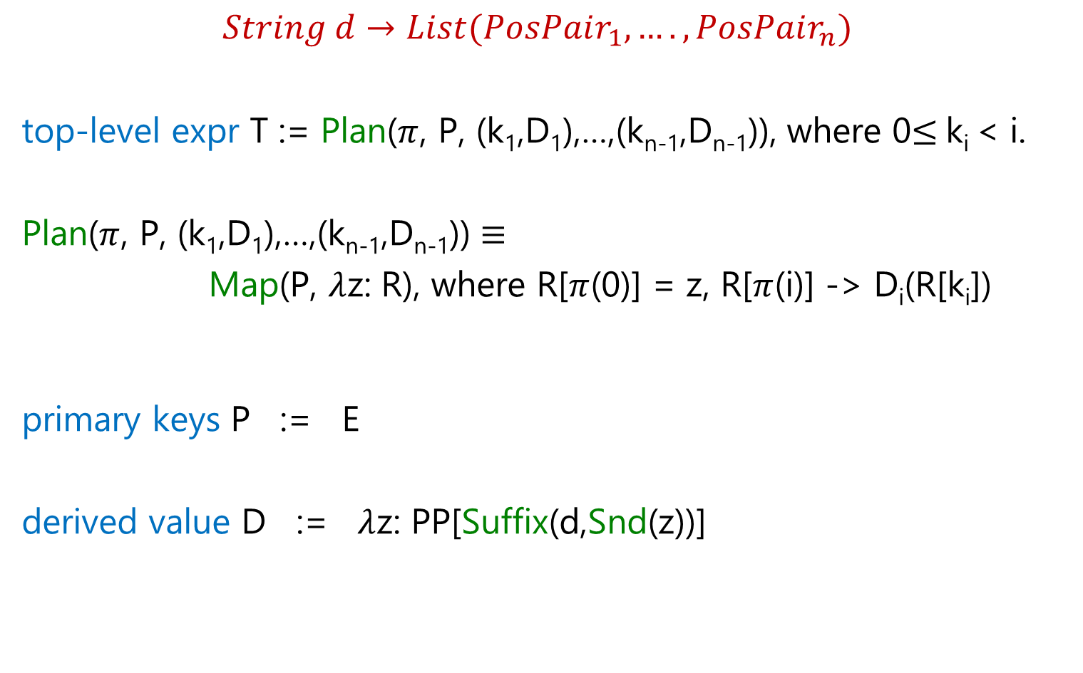
FlashExtract DSL
$String d→List(PosPair_{1},….,PosPair_{n})$
top-level expr T := Plan($π$, P, (k₁,D₁),…,(k_{n-1},D_{n-1})), where 0$≤$k_{i} < i.
Plan($π$, P, (k₁,D₁),…,(k_{n-1},D_{n-1})) $≡$
Map(P, $λ$z: R), where R[$π$(0)] = z, R[$π$(i)] -> D_{i}(R[k_{i}])
primary keys P := E
derived value D := $λ$z: PP[Suffix(d,Snd(z))]

Slide 35
FlashRelate DSL

Slide 36
Table Re-formatting
Input: Semi-structured spreadsheet
Output: Relational table

Slide 37
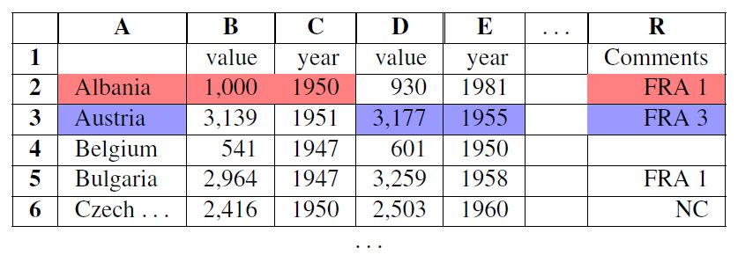
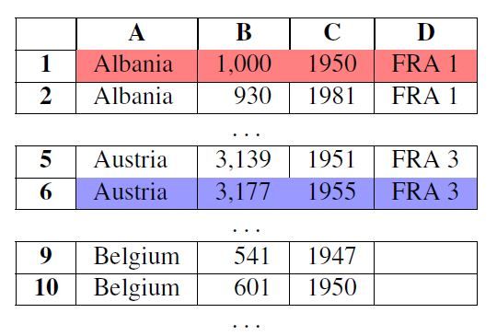
Table Re-formatting
Input: Semi-structured spreadsheet
Output: Relational table

Slide 38
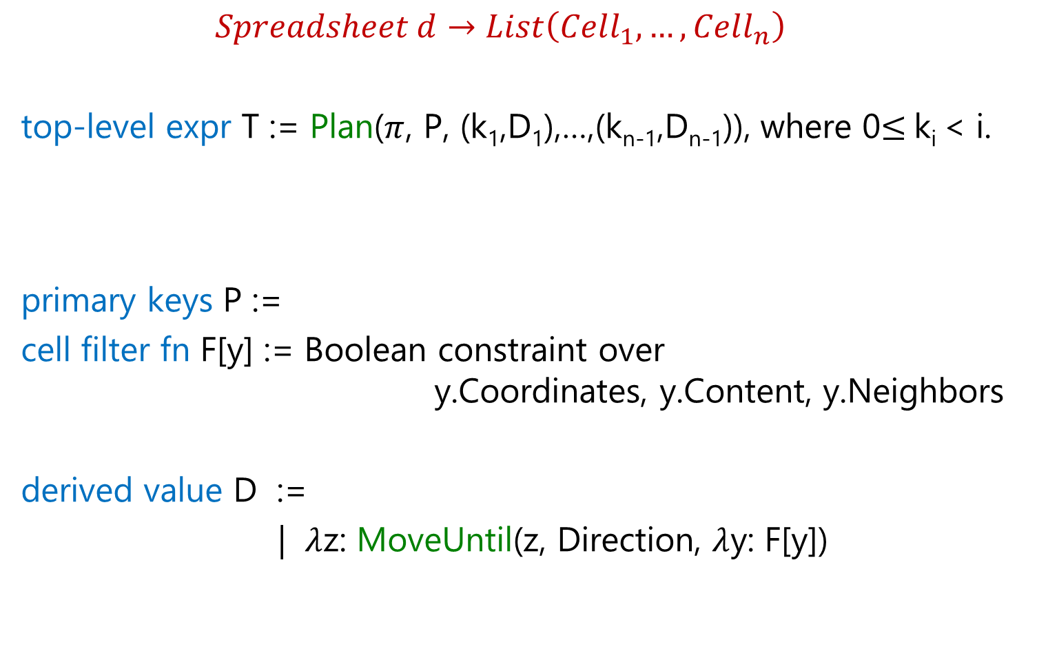
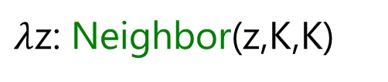

FlashRelate DSL
$Spreadsheet d→List\left(Cell_{1},…, Cell_{n}\right)$
top-level expr T := Plan($π$, P, (k₁,D₁),…,(k_{n-1},D_{n-1})), where 0$≤$k_{i} < i.
primary keys P :=
cell filter fn F[y] := Boolean constraint over
y.Coordinates, y.Content, y.Neighbors
derived value D :=
| $λ$z: MoveUntil(z, Direction, $λ$y: F[y])
Filter(d.Cells, $λ$z: F[z])
$λ$z: Neighbor(z,K,K)

Slide 39
Summary: Design of DSLs for Synthesis
Balanced Expressiveness
  Expressive enough to cover wide range of tasks
    Build out iteratively from a simple core.
  Restricted enough to enable efficient search
    Use “let” construct for syntactic restrictions.
Natural computation patterns
  Use function definitions for reusability.

Slide 40
Outline
Applications
  Data transformations
  Code transformations
Algorithms
  Domain-specific language
  Top-down/backward propagation based search
Ambiguity Resolution
  Ranking
  Interactivity

Slide 41
Programming-by-Examples Architecture
Example-based Intent
Program set
(a sub-DSL of D)
Program
Synthesizer
DSL D
40

Slide 42
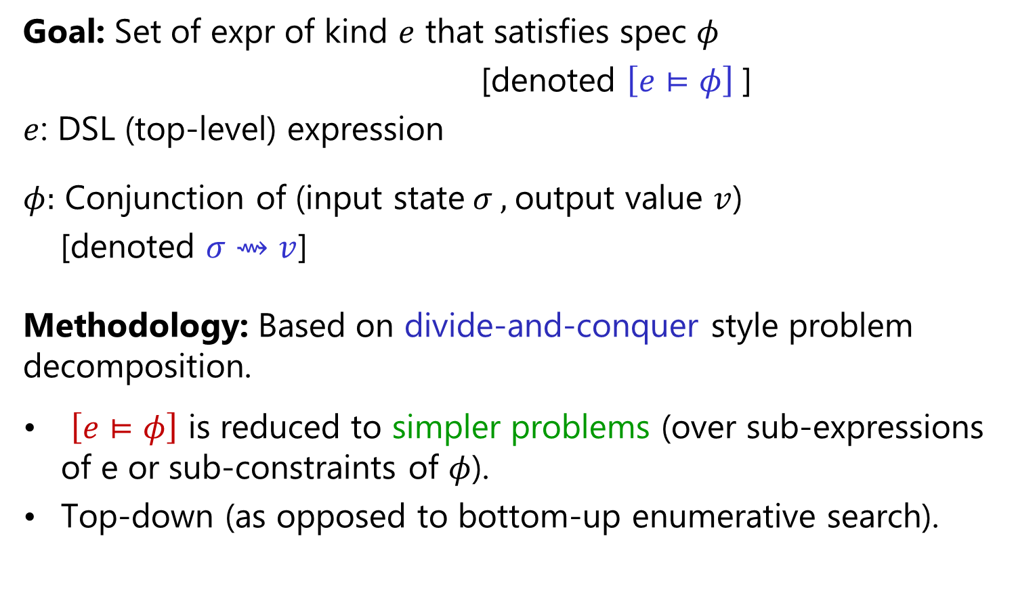
Search Methodology
Goal: Set of expr of kind $e$ that satisfies spec $φ$
[denoted $\left[e⊨φ\right]$]
$e$: DSL (top-level) expression
$φ:$ Conjunction of (input state$σ ,$output value $v$)
[denoted $σ⇝v$]
Methodology: Based on divide-and-conquer style problem decomposition.
$\left[e⊨φ\right]$ is reduced to simpler problems (over sub-expressions of e or sub-constraints of $φ$).
Top-down (as opposed to bottom-up enumerative search).
“FlashMeta: A Framework for Inductive Program Synthesis”;
[OOPSLA 2015] Alex Polozov, Sumit Gulwani

Slide 43
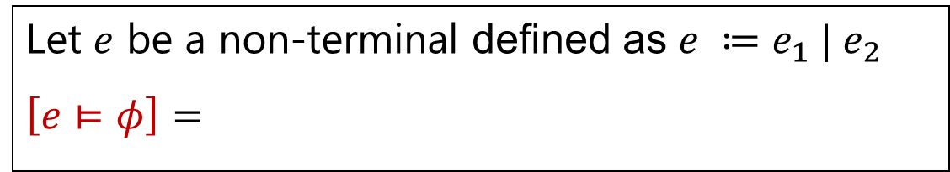
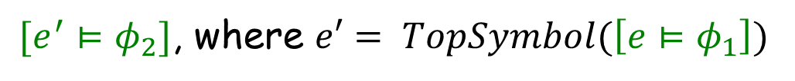



Problem Reduction Rules
$$\left[e⊨φ_{1}∨φ_{2}\right] =$$
$$Union(\left[e⊨φ_{1}\right], \left[e⊨φ_{2}\right])$$
$$\left[e⊨φ_{1}∧φ_{2}\right] =$$
$$Intersect(\left[e⊨φ_{1}\right], \left[e⊨φ_{2}\right])$$
An alternative strategy:
$[e^{′}⊨φ_{2}]$, where $e′= TopSymbol(\left[e⊨φ_{1}\right])$
$$\left[e⊨φ_{1}∧φ_{2}\right] =$$
Let $e$ be a non-terminal defined as $e ≔e_{1} | e_{2}$
$$\left[e⊨φ\right]=$$
$$Union(\left[e_{1}⊨φ\right], \left[e_{2}⊨φ\right])$$

Slide 44

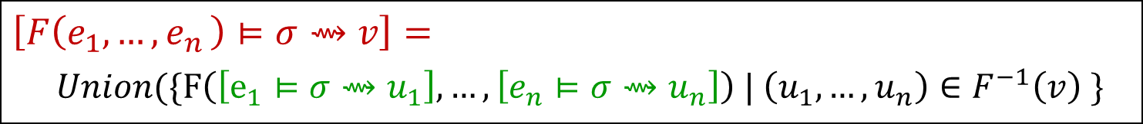
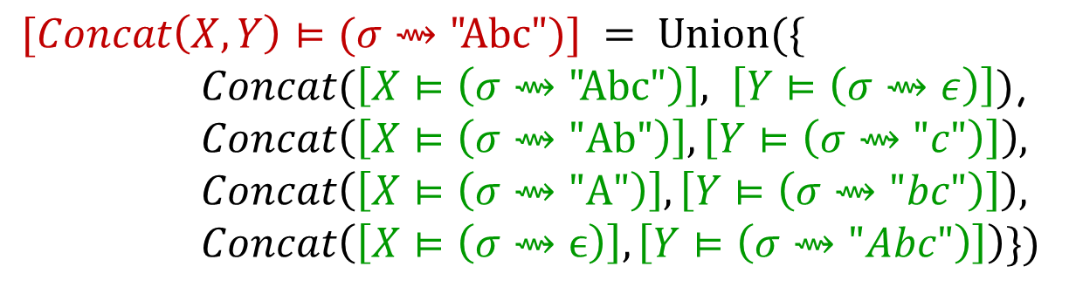
Problem Reduction Rules
Inverse Set: Let F be an n-ary operator.
$$F^{−1}\left(v\right)=\left\{\left(u_{1},…,u_{n} \right) \right| F\left(u_{1},…,u_{n}\right)=v\}$$
$$Concat^{−1}\left(\text{"}\text{Abc}\text{"}\right)=$$
$$\{\left( \text{"}\text{Abc}\text{",}ϵ\right), ("Ab\text{","}\text{c}\text{"), ("}\text{A}\text{","}\text{bc}\text{"), (}ϵ,\text{"}\text{Abc}\text{")\}}$$
$$\left[F\left(e_{1},{…,e}_{n}\right)⊨σ⇝v\right]=$$
$Union(\{F\left(\left[e_{1}⊨σ⇝u_{1}\right], …,\left[e_{n}⊨σ⇝u_{n}\right]\right) | \left(u_{1},…,u_{n}\right)∈F^{−1}\left(v\right) \}$
$$[Concat\left(X,Y\right)⊨(σ⇝\text{"}\text{Abc}")] = Union(\{$$
$Concat(\left[X⊨\left(σ⇝\text{"}\text{Abc}\text{"}\right)\right], \left[Y⊨\left(σ⇝ε\right)\right])$,
$$Concat\left(\left[X⊨\left(σ⇝\text{"}\text{Ab}\text{"}\right)\right],\left[Y⊨\left(σ⇝"c"\right)\right]\right),$$
$$Concat\left(\left[X⊨\left(σ⇝\text{"}\text{A}\text{"}\right)\right],\left[Y⊨\left(σ⇝"bc"\right)\right]\right),$$
$$Concat\left(\left[X⊨\left(σ⇝ϵ\right)\right],\left[Y⊨\left(σ⇝"Abc"\right)\right]\right)\})$$

Slide 45


Problem Reduction Rules
Inverse Set: Let F be an n-ary operator.
$$F^{−1}\left(v\right)=\left\{\left(u_{1},…,u_{n} \right) \right| F\left(u_{1},…,u_{n}\right)=v\}$$
$$Concat^{−1}\left(\text{"}\text{Abc}\text{"}\right)=$$
$$\{\left( \text{"}\text{Abc}\text{",}ϵ\right), ("Ab\text{","}\text{c}\text{"), ("}\text{A}\text{","}\text{bc}\text{"), (}ϵ,\text{"}\text{Abc}\text{")\}}$$
$$\{\left(true, v, ⊤\right), (false, ⊤, v)\}$$
$$IfThenElse^{−1}\left(v\right)=$$
Consider the SubStr(x,i,j) operator
$$\{ \left(0,2\right), (6,8) \}$$
$$SubStr^{−1}\left(\text{"}\text{Ab}\text{"} \right| x="Ab cd Ab")=$$
$$SubStr^{−1} \left(\text{"}\text{Ab}\text{"}\right)= …$$
The notion of inverse sets (and corresponding reduction rules) can be generalized to the conditional setting.

Slide 46
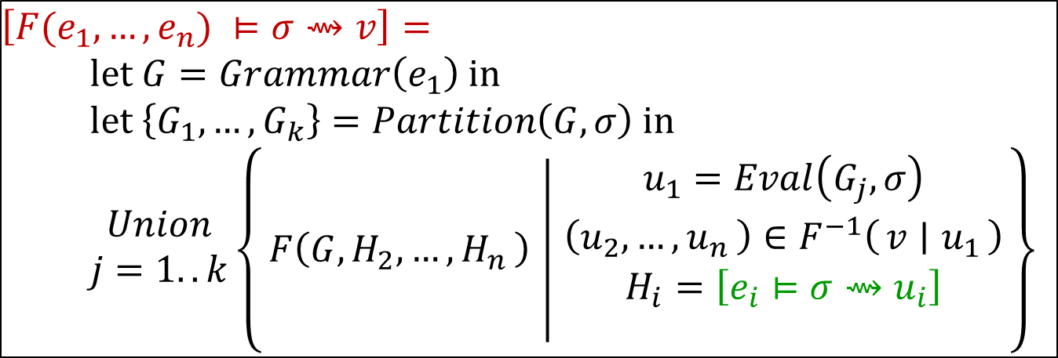
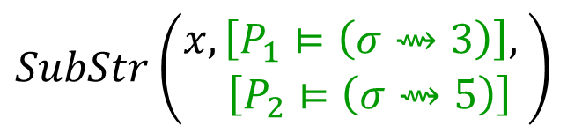


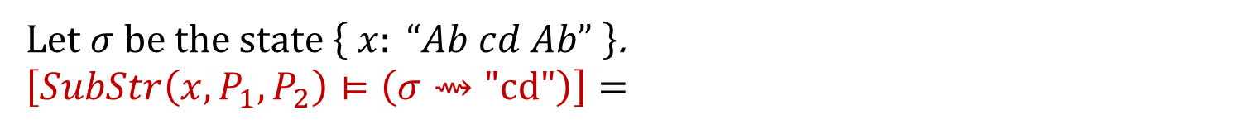
Problem Reduction Rules
Conditional Inverse Set: Let F be an n-ary operator.
$${ F}^{−1}\left(v \right| u_{1})=\left\{ \left(u_{2},…, u_{n}\right) \right| F\left(u_{1},…,u_{n}\right)=v\}$$
$$\{ \left(0,2\right), (6,8) \}$$
$$SubStr^{−1}\left(\text{"}\text{Ab}\text{"} \right| "Ab cd Ab")=$$
$$\left[F{(e}_{1},…, e_{n}) ⊨σ⇝v\right]= \\ \text{let} G=Grammar\left(e_{1}\right) \text{in} \\ \text{let} \left\{G_{1},…, G_{k}\right\}=Partition\left(G,σ\right) \text{in}$$
$$\begin{matrix}Union \\ j=1..k\end{matrix}\left\{F\left(G,H_{2},{…, H}_{n}\right) ∣ \begin{matrix}\begin{aligned}u_{1}=Eval\left(G_{j},σ\right) \\ \left(u_{2},{…, u}_{n}\right)∈F^{−1}\left(v ∣ u_{1}\right)\end{aligned} \\ H_{i}=\left[e_{i}⊨σ⇝u_{i}\right] \\ \end{matrix}\right\}$$
Let $σ$be the state $\left\{ x: “Ab cd Ab” \right\}$.
$$\left[SubStr\left(x,P_{1},P_{2}\right)⊨\left(σ⇝\text{"}\text{cd}\text{"}\right)\right]=$$
$$SubStr\left(\begin{aligned}x,\left[P_{1}⊨\left(σ⇝3\right)\right], \\ \left[P_{2}⊨\left(σ⇝5\right)\right]\end{aligned}\right)$$

Slide 47
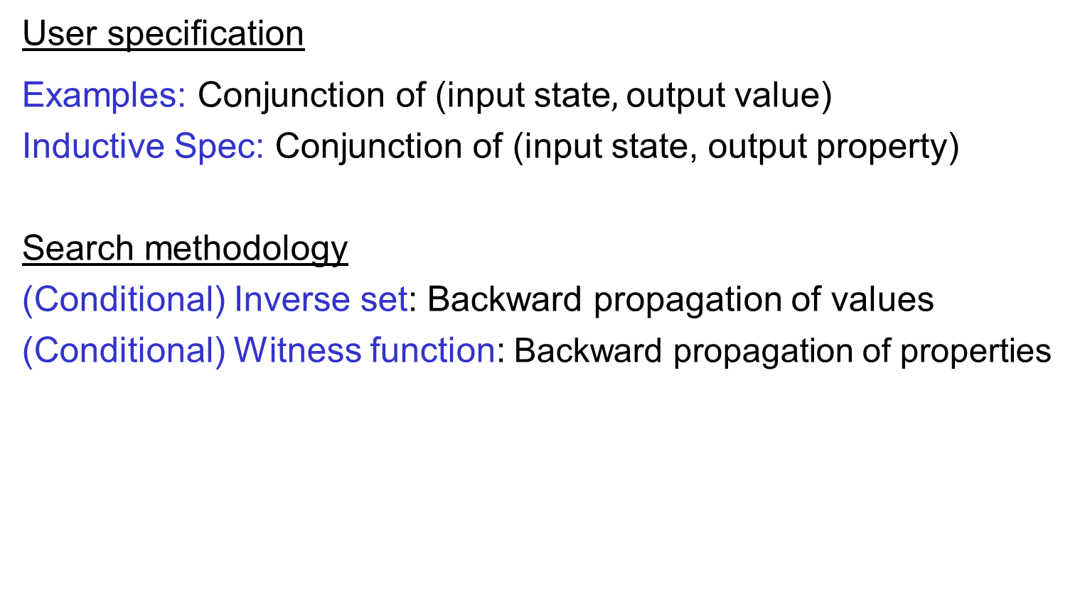
Generalizing output values to output properties
User specification
Examples: Conjunction of (input state$,$output value)
Inductive Spec: Conjunction of (input state, output property)
Search methodology
(Conditional) Inverse set: Backward propagation of values
(Conditional) Witness function: Backward propagation of properties

Slide 48
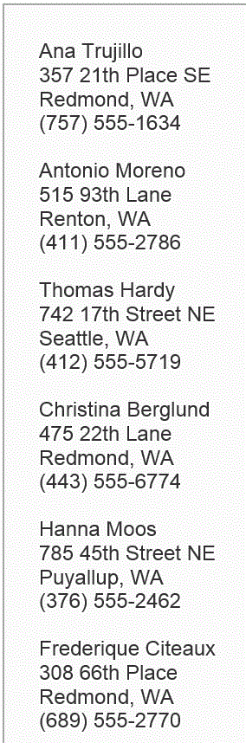


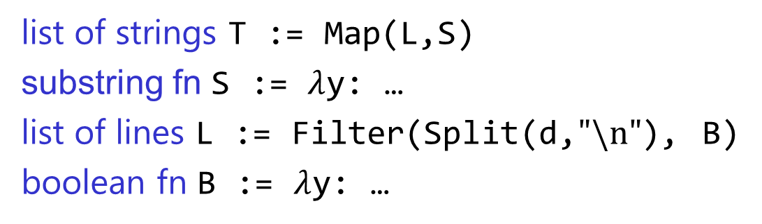


Problem Reduction
list of strings T := Map(L,S)
substring fn S := $λ$y: …
list of lines L := Filter(Split(d,$"\text{\backslash }\text{n}\text{"}$), B)
boolean fn B := $λ$y: …
FlashExtract DSL
$$⋈$$
Spec for S
Spec for T
Spec for L
$$∧$$

Slide 49

Problem Reduction
substring expr E := SubStr(y,P₁,P₂)
position expr P := K | Pos(y,R₁,R₂,K)
SubStr grammar
$$⋈$$
Spec for E
Spec for P₁
Spec for P₂
Redmond, WA
Redmond, WA

Slide 50
Outline
Applications
  Data transformations
  Code transformations
Algorithms
  Domain-specific language
  Top-down/backward propagation based search
Ambiguity Resolution
  Ranking
  Interactivity

Slide 51
Programming-by-Examples Architecture
Example-based Intent
Ranked Program set
(a sub-DSL of D)
Program set
(a sub-DSL of D)
Program
Synthesizer
Ranking fn
DSL D
50

Slide 52

Basic ranking scheme
Prefer programs with simpler Kolmogorov complexity
Prefer fewer constants.
Prefer smaller constants.
Input | Output
Justin Gottschlich | Justin
Faouzi Atig | Faouzi
1st Word
If (input = “Justin Gottschlich”) then “Justin” else “Faouzi”
“Justin”

Slide 53
Challenges with Basic ranking scheme
Prefer programs with simpler Kolmogorov complexity
Prefer fewer constants.
Prefer smaller constants.
Input | Output
Justin Gottschlich | Gottschlich, Justin
Faouzi Atig | Atig, Faouzi
2nd Word + “, ‘’ + 1st Word
“Gottschlich, Justin”
How to select between
Fewer larger constants vs. More smaller constants?
  Idea: Associate numeric weights with constants.
Predicting a correct program in Programming by Example; CAV 2015; Singh, Gulwani

Slide 54
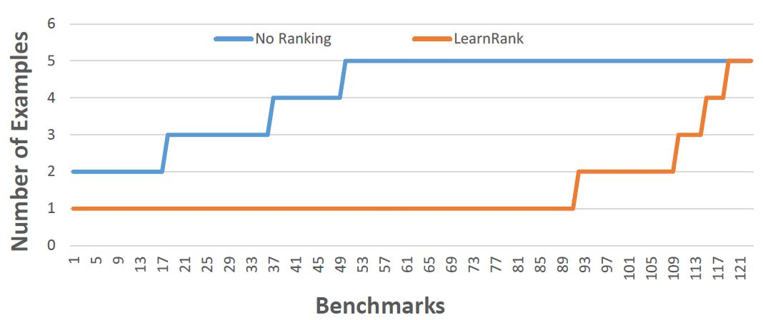
Comparison of Ranking Strategies over FlashFill Benchmarks
Basic
Learning
Strategy | Average # of examples required
Basic | 4.17
Learning | 1.48
Predicting a correct program in Programming by Example; CAV 2015; Singh, Gulwani

Slide 55
FlashFill Ranking Demo

Slide 56
Challenges with Basic ranking scheme
Prefer programs with simpler Kolmogorov complexity
Prefer fewer constants.
Prefer smaller constants.
Input | Output
Missing page numbers, 1993 | 1993
64-67, 1995 | 1995
1st Number from the left
1st Number from the right
How to select between
Same number of same-sized constants?
Learning to Learn Programs from Examples: Going Beyond Program Structure ;
IJCAI 2017; Ellis, Gulwani

Slide 57
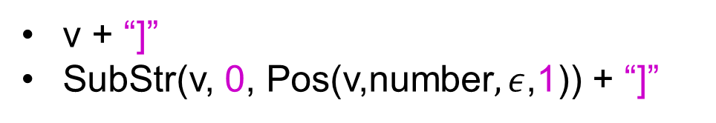
Challenges with Basic ranking scheme
Prefer programs with simpler Kolmogorov complexity
Prefer fewer constants.
Prefer smaller constants.
Input v | Output
[CPT-0123 | [CPT-0123]
[CPT-456] | [CPT-456]
v + “]”
SubStr(v, 0, Pos(v,number$,ε$,1)) + “]”
What if the correct program has larger Kolmogorov complexity?
Idea: Examine data/trace features (in addition to program features)
Learning to Learn Programs from Examples: Going Beyond Program Structure ;
IJCAI 2017; Ellis, Gulwani

Slide 58
Machine learning based ranking scheme
Rank score of a program: Weighted combination of various features.
Weights are learned using machine learning.
Program features
Number of constants
Size of constants
Features over user data: Similarity of generated output (or even intermediate values) over various user inputs
IsYear, Numeric Deviation, Number of characters
IsPersonName

Slide 59
Outline
Applications
  Data transformations
  Code transformations
Algorithms
  Domain-specific language
  Top-down/backward propagation based search
Ambiguity Resolution
  Ranking
  Interactivity

Slide 60


Need for a fall-back mechanism
“It's a great concept, but it can also lead to lots of bad data. I think many users will look at a few "flash filled" cells, and just assume that it worked. … Be very careful.”
“most of the extracted data will be fine. But there might be exceptions that you don't notice unless you examine the results very carefully.”

Slide 61

User Interaction Models for Ambiguity Resolution
Make it easy to inspect output correctness
  User can accordingly provide more examples
Show programs
  in any desired programming language; in English
  Enable effective navigation between programs
Computer initiated interactivity (Active learning)
  Cluster inputs/outputs based on syntactic patterns.
  Highlight less confident entries in the output based on distinguishing inputs.
“User Interaction Models for Disambiguation in Programming by Example”,
[UIST 2015] Mayer, Soares, Grechkin, Le, Marron, Polozov, Singh, Zorn, Gulwani
“FlashProfile: Interactive Synthesis of Syntactic Profiles”,
[Under submission] Padhi, Jain, Perelman, Polozov, Gulwani, Millstein

Slide 62
FlashExtract Demo
(User Interaction Models)

Slide 63

Programming-by-Examples Architecture
Refined Intent
Example based Intent
Ranked Program set
(a sub-DSL of D)
Intended Program in D
Program
Synthesizer
Debugging
Incrementality
Translator
Test inputs
Ranking fn
DSL D
Intended Program in R/Python/C#/C++/…
62

Slide 64

Predictive Program Synthesis
Intended programs can sometimes be synthesized from just the input.
  Tabular data extraction, Sort, Join
Can save large amount of user effort.
  User need not provide examples for each of tens of columns.
“Automated Data Extraction using Predictive Program Synthesis”,
[AAAI 2017], Raza, Gulwani

Slide 65

Adaptive Program Synthesis
Learn from past interactions
  of the same user (personalized experience).
  of other users in the enterprise/cloud.
The synthesis sessions now require less interaction.

Slide 66
Programming-by-Examples Architecture
Refined Intent
Example based Intent
Ranked Program set
(a sub-DSL of D)
Intended Program in D
Program
Synthesizer
Debugging
Incrementality
Translator
Test inputs
Ranking fn
DSL D
Intended Program in R/Python/C#/C++/…
Learner
Interaction history
65

Slide 67
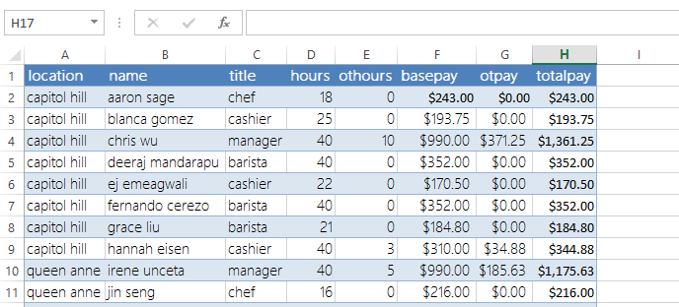
Spreadsheet Programming using Natural Language
    Challenge: Handle variability in English description
    “sum the hours for the capitol hill location chefs”
    “total hours capitol hill chefs”
    “get the hours where title = chef that work at capitol hill & sum them up”
    “sum column D where column C is chef and A is capitol hill”
NLyze: Interactive Programming by Natural Language for SpreadSheet Data Analysis and Manipulation; SIGMOD 2014; Gulwani, Marron

Slide 68
SmartPhone Programming using Natural Language
  “When I receive a new SMS, if the phone is connected to my car’s bluetooth, read the message content and reply to the sender ‘I am driving’.“
Synthesis Methodology
Similar to PBE, there is an underlying DSL & ranking fn.
Candidate set of programs is produced using:
  Rule based NLP engine identifies operators and likely relationships between them.
  Type-based synthesis is used to complete partial programs.
SmartSynth: Synthesizing Smartphone Automation Scripts from Natural Language, MobiSys 2013, Le, Gulwani, Su

Slide 69
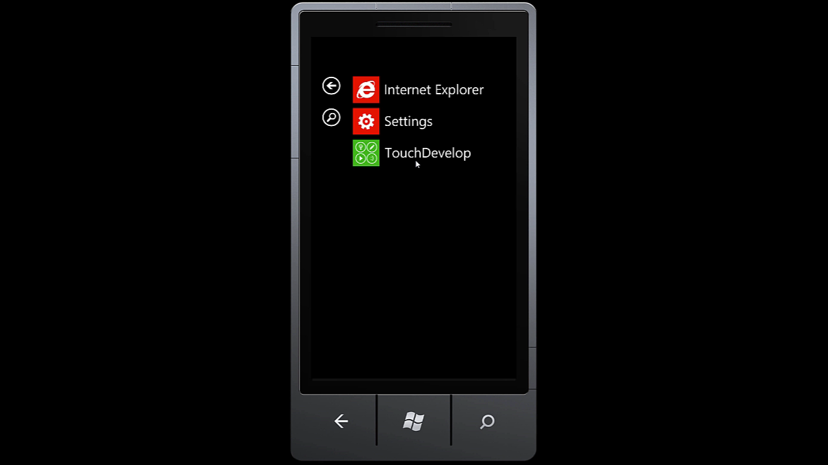
SmartSynth (TouchDevelop) Demo

Slide 70
Future Directions
Application to robotics
Combining statistical and formal reasoning techniques
Probabilistic noise handling
Programming using multi-modal intent involving examples and natural language

Slide 71
PROSE Framework
https://microsoft.github.io/prose
Efficient implementation of the generic search methodology.
Provides a library of reduction rules.
Role of synthesizer developer
Implement a DSL with executable semantics for new operators.
Implement reduction rules (inverse semantics) for some operators.
Implement ranking strategy.
Can also specify tactics to resolve non-determinism in search.

Slide 72

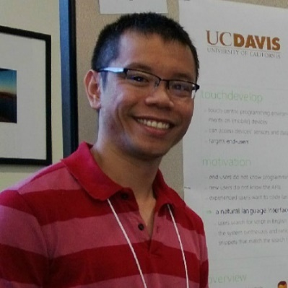





The PROSE Team
Sumit Gulwani
Ranvijay Kumar
Vu Le
Daniel Perelman
Mark Plesko
Please apply for intern/full-time positions!
Arjun Radhakrishna
Mohammad Raza
Danny Simmons
Abhishek
Udupa
Gustavo Soares

Slide 73

Conclusion
Killer applications: Data wrangling & Code Refactoring
99% of end users are non-programmers.
Data scientists spend 80% time cleaning data.
Developers spend 40% time refactoring code during migration.
Algorithmic search
Domain-specific language
Divide-and-conquer methodology based on inverse functions
Ambiguity resolution
Ranking
Interactivity
Reference: “Programming by Examples (and its applications in Data Wrangling)”,
In Verification and Synthesis of Correct and Secure Systems; IOS Press; 2016
[based on Marktoberdorf Summer School 2015 Lecture Notes]

