Slide 1

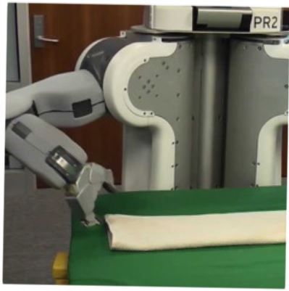

Programming by Examples:
PL meets ML
MAPL Keynote
June 2017
Sumit Gulwani
Joint work with PROSE team and others

Slide 2

Programming by Examples (PBE)
The task of synthesizing a program in an underlying language from example-based specification using a search algorithm.
An old problem but enabled today by
better algorithms & faster machines.
The new programming revolution
Enables 10-100x productivity for programmers.
The new computer user experience
99% users can’t program and struggle with repetitive tasks.
Non-programmers can now create scripts & achieve more.

Slide 3





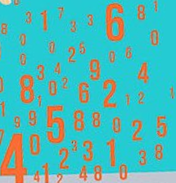

A perspective on “PL meets ML”
PBE/Intelligent software
Logical strategies
Creative heuristics
Features
Model
Can be learned and maintained by ML-backed runtime
Written by developers
Advantages
Better models
Less time to author
Online adaptation, personalization

Slide 4


Killer Applications
Transformation
Extraction
Formatting
Data scientists spend 80% time wrangling data from raw form to a structured form.
Old
SELECT foo, bar FROM dbo.splunge ORDER BY 1, 2 DESC;
RAISERROR @err @message RAISERROR ('RAISERROR TEST',16,1)
On-prem to cloud
Company 1 to company 2
Old to new
New
SELECT foo, bar FROM dbo.splunge ORDER BY foo, bar DESC;
Throw @err, @message, 1 Throw 99999, 'RAISERROR TEST', 1
Developers spend 40% time in code refactoring in migration

Slide 5




Excel help forums

Slide 6




Typical help-forum interaction
300_w30_aniSh_c1_b → w30
300_w5_aniSh_c1_b → w5
=MID(B1,5,2)
=MID(B1,5,2)
=MID(B1,FIND(“_”,$B:$B)+1, FIND(“_”,REPLACE($B:$B,1,FIND(“_”,$B:$B),””))-1)

Slide 7
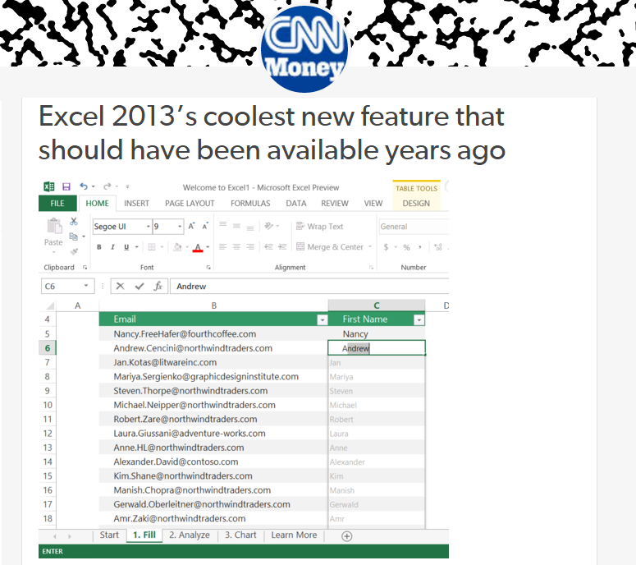
Flash Fill (Excel 2013 feature) demo
“Automating string processing in spreadsheets using input-output examples”;
POPL 2011; Sumit Gulwani

Slide 8
Number and DateTime Transformations
Input | Output (Round to 2 decimal places)
123.4567 | 123.46
123.4 | 123.40
78.234 | 78.23
Excel/C#:
Python/C:
Java:
#.00
.2f
#.##
Input | Output (Half hour bucket)
0d 5h 26m | 5:00-5:30
0d 4h 57m | 4:30-5:00
0d 4h 27m | 4:00-4:30
0d 3h 57m | 3:30-4:00
Synthesizing Number Transformations from Input-Output Examples;
CAV 2012; Singh, Gulwani

Slide 9
Lookup Transformations
Id | Name | Markup
S33 | Stroller | 30%
B56 | Bib | 45%
D32 | Diapers | 35%
W98 | Wipes | 40%
A46 | Aspirator | 30%
... | .... | ...
Id | Date | Price
S33 | 12/2010 | $145.67
S33 | 11/2010 | $142.38
B56 | 12/2010 | $3.56
D32 | 1/2011 | $21.45
W98 | 4/2009 | $5.12
... | ... | ...
MarkupRec
Table
CostRec
Table
Input v1 (Name) | Input v2 (Date) | Output (Price+ Markup*Price)
Stroller | 10/12/2010 | $145.67+0.30*145.67
Bib | 23/12/2010 | $3.56+0.45*3.56
Diapers | 21/1/2011
Wipes | 2/4/2009
Aspirator | 23/2/2010
Learning Semantic String Transformations from Examples; VLDB 2012; Singh, Gulwani

Slide 10

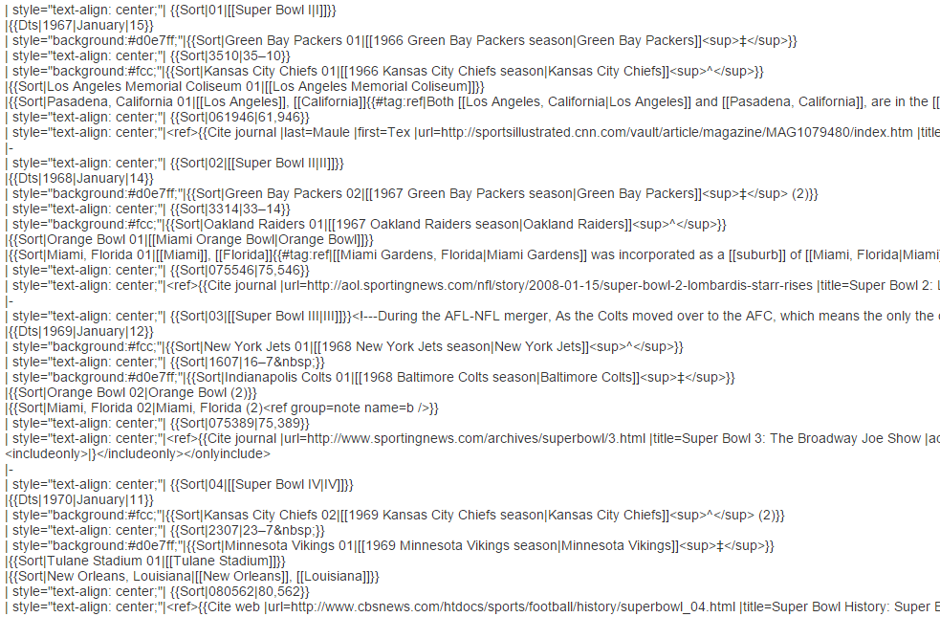
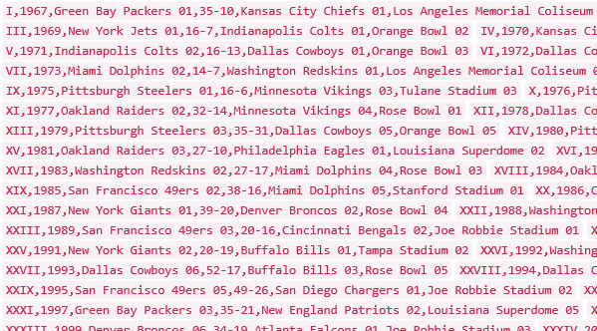
Data Science Class Assignment
To get Started!

Slide 11
FlashExtract Demo
“FlashExtract: A Framework for data extraction by examples”;
PLDI 2014; Vu Le, Sumit Gulwani

Slide 12
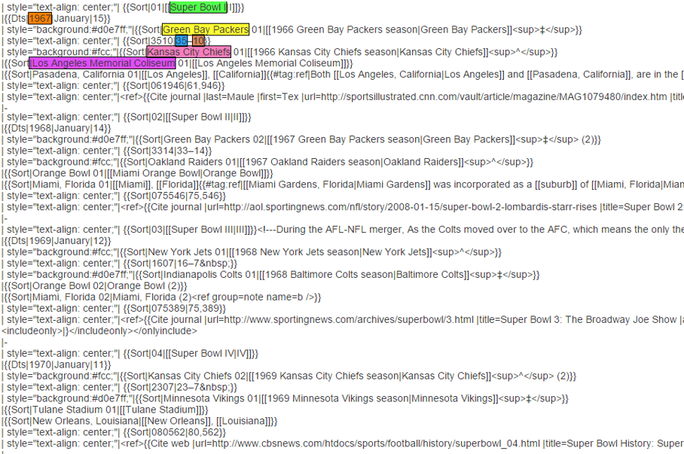
FlashExtract

Slide 13
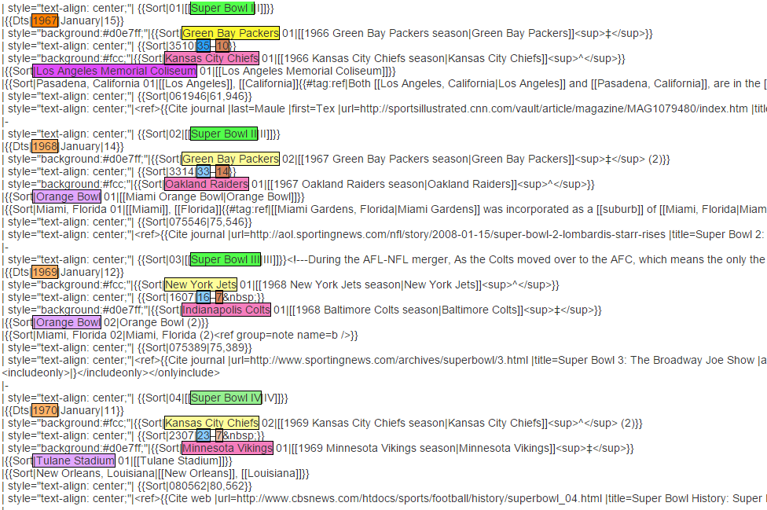
FlashExtract

Slide 14
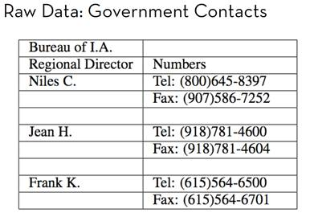
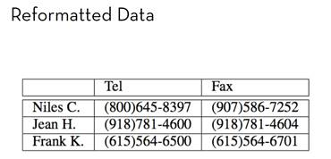
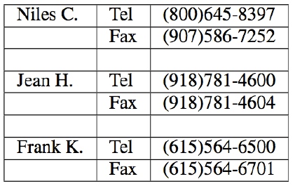
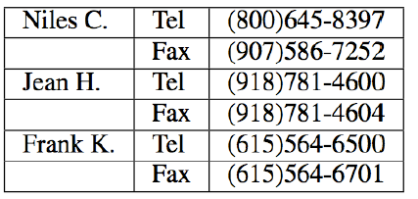
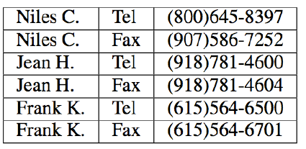
FlashRelate: Table Reshaping by Examples
Start with:
End goal:
FlashRelate
(from few examples of records in output table)
4. Pivot Number on Type
Trifacta facilitates the transformation through a series of recommended steps
1. Split on “:” Delimiter
2. Delete Empty Rows
3. Fill Values Down
50% Excel spreadsheets (e.g., financial reports) are semi-structured.
The need to canonicalize similar information across varying formats is huge.
  Companies like KPMG, Deloitte can budget millions of dollars each to solve this.

Slide 15
FlashRelate Demo
“FlashRelate: Extracting Relational Data from Semi-Structured Spreadsheets Using Examples”;
PLDI 2015; Barowy, Gulwani, Hart, Zorn

Slide 16
PBE tools for Data Manipulation
Extraction
FlashExtract: Extract data from text files, web pages [PLDI 2014; Powershell convertFrom-string cmdlet
Transformation
Flash Fill: Excel feature for Syntactic String Transformations [POPL 2011]
Semantic String Transformations [VLDB 2012]
Number Transformations [CAV 2013]
FlashNormalize: Text normalization [IJCAI 2015]
Formatting
FlashRelate: Extract data from spreadsheets [PLDI 2015, PLDI 2011]
FlashFormat: a Powerpoint add-in [AAAI 2014]

Slide 17
Repetitive Code Transformations
API changes
Migration
  old version to new version
  Company 1 to company 2
  On prem to cloud
Corrections in student assignments
Notes:
Many IDEs and Static Analysis tools automate these transformations. For instance, Visual Studio and Resharper automate programming refactorings and bug fixes for software developers in general and also Auto Grader proposed in PLDI thirteen automates common bug fixes in programming assignments. These tools rely on pre-defined classes of transformations. Thus, it is hard to extend them to allow other types of transformations that are not included in this set. Developers have to identify the other transformations that should be implemented, and also developers need to have very specific skills to implement these transformations.

Slide 18
Repetitive Code Migration
Old
SELECT foo, bar FROM dbo.splunge ORDER BY 1, 2 DESC;
RAISERROR @err @message RAISERROR ('RAISERROR TEST',16,1)
New
SELECT foo, bar FROM dbo.splunge ORDER BY foo, bar DESC;
throw @err, @message, 1 Throw 99999, 'RAISERROR TEST', 1
  Old version to new version
  Company 1 to company 2
  On-prem to cloud

Slide 19
Repetitive API Changes
- while (receiver.CSharpKind() == SyntaxKind.ParenthesizedExpression)
+ while (receiver.IsKind(SyntaxKind.ParenthesizedExpression))
foreach (var m in modifiers)
{ if (m.CSharpKind() == modifier) return true; };
+ foreach (var m in modifiers)
{ if (m.IsKind(modifier)) return true; };
receiver.CSharpKind() == SyntaxKind.ParenthesizedExpression
receiver.IsKind(SyntaxKind.ParenthesizedExpression)
m.CSharpKind() == modifier
m.IsKind(modifier)
<name>.CSharpKind() == <exp>
<name>.IsKind(<exp>)
Learning Syntactic Program Transformations from Examples
ICSE 2017; Rolim, Soares, Antoni, Polozov, Gulwani, Gheyi, Suzuki, Hartmann
Notes:
Many code edits have already been performed in the past. Sometimes, by the same developer. For instance, here, the same developer performed these edits into the Roslyn project, replacing the equals expressions that uses the CSharp Kind method to the new invocation for the Is Kind method. In other scenarios, different developers may perform similar edits to different programs. In this case, for instance, more than one hundred students at UC Berkeley performed the same bug fix to their program code. Here, to fix a bug, they just add a call to the term function.

Slide 20
Repetitive Corrections in Student Assignments
def product(n, term):
total, k = 1, 1
while k<=n:
- total = total * k
+ total = total * term(k)
k = k + 1
return total
def product(n, term):
if(n == 1):
return 1
- return product(n-1, term)*n
+ return product(n-1, term)*term(n)
k
term(k)
n
term(n)
<name>
term(<name>)
Learning Syntactic Program Transformations from Examples
ICSE 2017; Rolim, Soares, Antoni, Polozov, Gulwani, Gheyi, Suzuki, Hartmann
Notes:
These edits have the same structure. For instance, if we represent them as tree edit in the abstract syntax tree of the program. On the left-hand side, we replace the node k to term k. On the right-hand side, we replace the node n to term n. So, they share the same structure but have different expressions. In this case, different variable names.

Slide 21
PBE vs ML
Traditional PBE | Traditional ML
Requires few examples. | Requires too many examples.
Generates human readable and editable models. | Generates black-box models.
Models are deterministic & intended to work correctly. | Models are probabilistic & aimed for high precision.
Deals with simple structured tasks. | Can deal with complicated fuzzy tasks.
Opportunity: Use ML to improve a PBE system (not replace it).

Slide 22
A perspective on “PL meets ML”
Intelligent software
Logical strategies
Creative heuristics
Features
Model
Can be learned and maintained by ML-backed runtime
Written by developers
Advantages
Better models
Less time to author
Online adaptation, personalization

Slide 23



Programming-by-Examples Architecture
Example based Intent
Intended Program in R/Python/C#/Java/…
Refined Intent
DSL D
Search
Algorithm
Intended Program in D
Program set
Translator
Disambiguator
Ranked Program set
Test inputs
Program Ranker
“Programming by Examples (and its applications in Data Wrangling)”;
In Verification and Synthesis of Correct and Secure Systems; IOS Press; 2016
[based on Marktoberdorf Summer School 2015 Lecture Notes]
22

Slide 24
Domain-specific Language (DSL)
Balanced Expressiveness
  Expressive enough to cover wide range of tasks
  Restricted enough to enable efficient search
    Restricted set of operators
      those with small inverse sets
    Restricted syntactic composition of those operators
Natural computation patterns
  Increased user understanding/confidence
  Enables selection between programs, editing

Slide 25
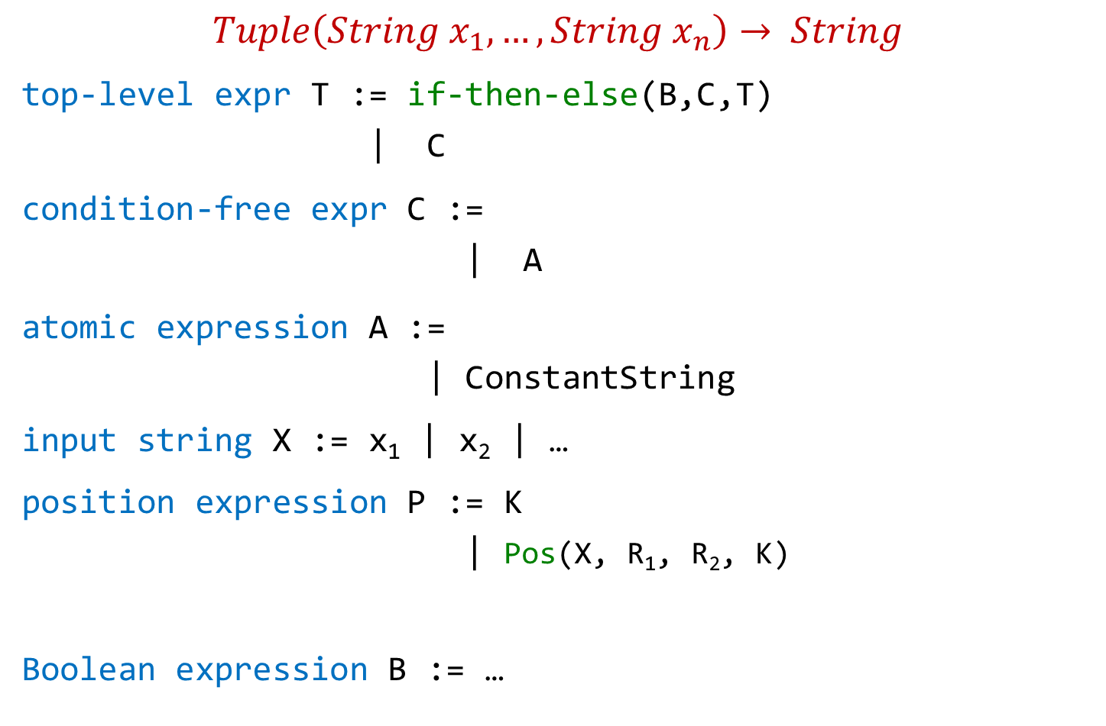
Flash Fill DSL (String Transformations)
$$Tuple\left(String x_{1},…,String x_{n}\right)→ String$$
top-level expr T := if-then-else(B,C,T)
| C
condition-free expr C :=
| A
atomic expression A :=
| ConstantString
input string X := x₁ | x₂ | …
position expression P := K
| Pos(X, R₁, R₂, K)
Boolean expression B := …
Concatenate(A,C)
SubStr(X,P,P)
K^{th} position in X whose left/right side matches with R₁/R₂.

Slide 26
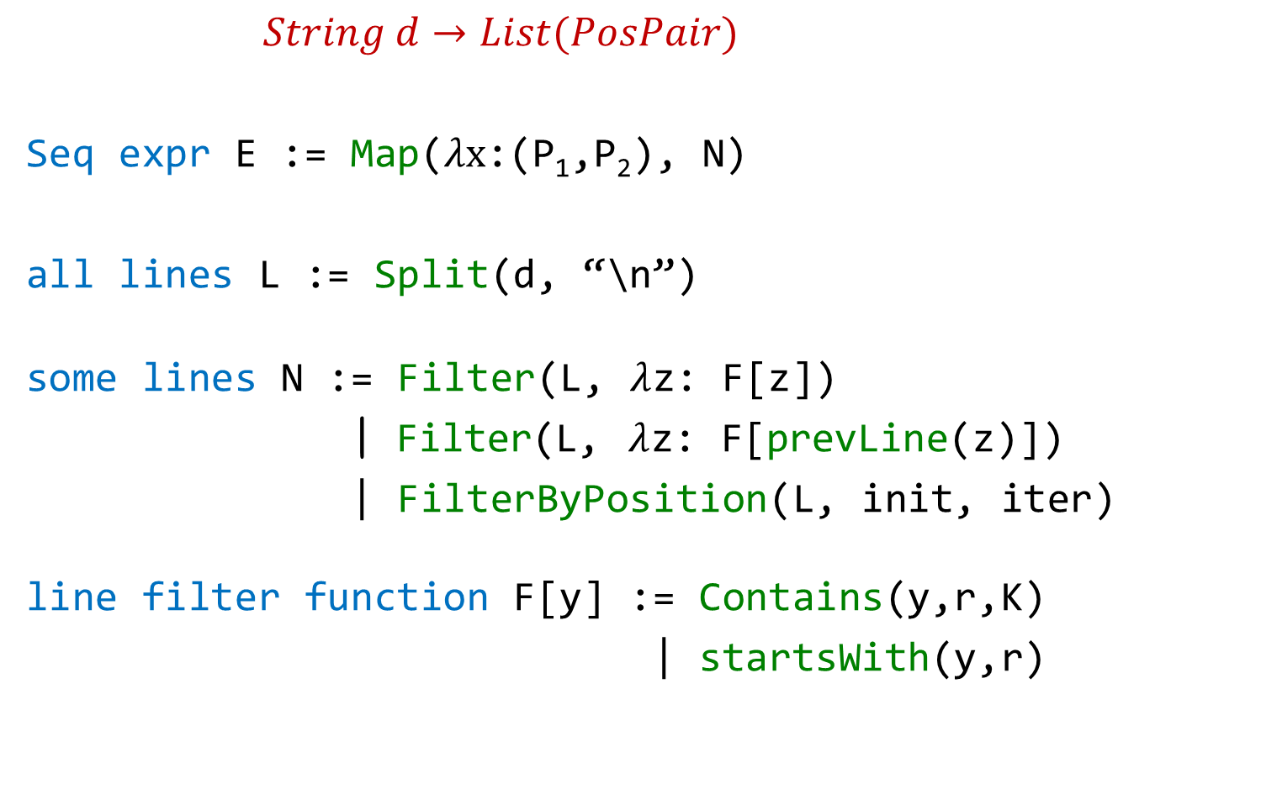
FlashExtract DSL
$String d→List(PosPair)$
Seq expr E := Map($λx$:(P₁,P₂), N)
all lines L := Split(d, “\n”)
some lines N := Filter(L, $λ$z: F[z])
| Filter(L, $λ$z: F[prevLine(z)])
| FilterByPosition(L, init, iter)
line filter function F[y] := Contains(y,r,K)
| startsWith(y,r)
position expression P := K | Pos(x, R₁, R₂, K)

Slide 27
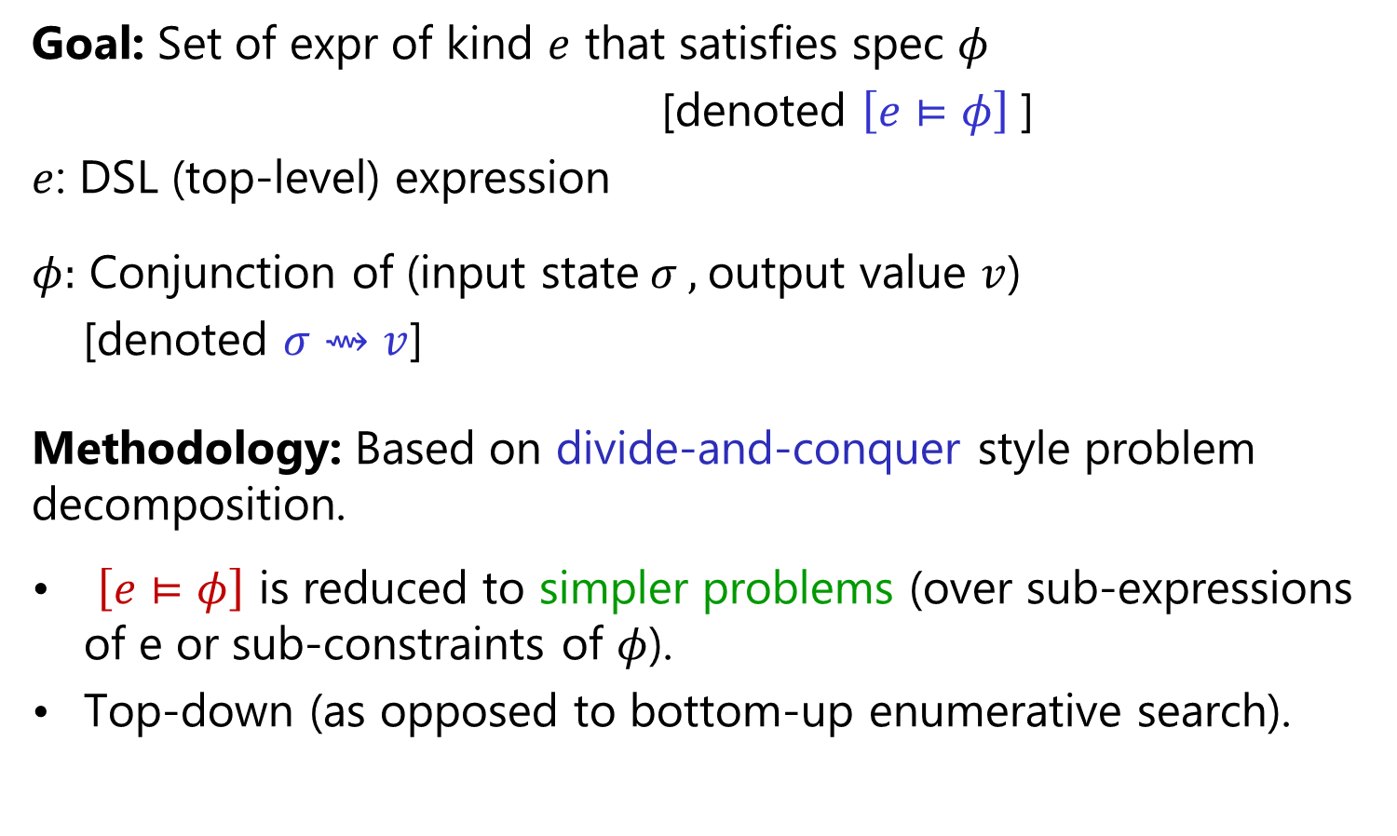
Search Methodology
Goal: Set of expr of kind $e$ that satisfies spec $φ$
[denoted $\left[e⊨φ\right]$]
$e$: DSL (top-level) expression
$φ:$ Conjunction of (input state$σ ,$output value $v$)
[denoted $σ⇝v$]
Methodology: Based on divide-and-conquer style problem decomposition.
$\left[e⊨φ\right]$ is reduced to simpler problems (over sub-expressions of e or sub-constraints of $φ$).
Top-down (as opposed to bottom-up enumerative search).
“FlashMeta: A Framework for Inductive Program Synthesis”;
[OOPSLA 2015] Alex Polozov, Sumit Gulwani

Slide 28
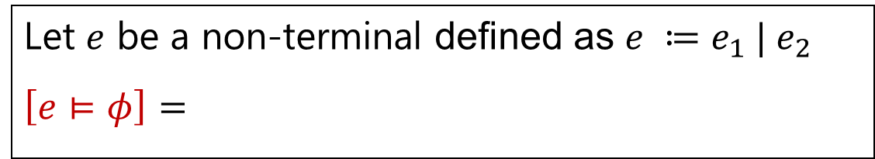
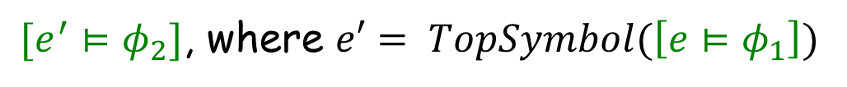



Problem Reduction Rules
$$\left[e⊨φ_{1}∨φ_{2}\right] =$$
$$Union(\left[e⊨φ_{1}\right], \left[e⊨φ_{2}\right])$$
$$\left[e⊨φ_{1}∧φ_{2}\right] =$$
$$Intersect(\left[e⊨φ_{1}\right], \left[e⊨φ_{2}\right])$$
An alternative strategy:
$[e^{′}⊨φ_{2}]$, where $e′= TopSymbol(\left[e⊨φ_{1}\right])$
$$\left[e⊨φ_{1}∧φ_{2}\right] =$$
Let $e$ be a non-terminal defined as $e ≔e_{1} | e_{2}$
$$\left[e⊨φ\right]=$$
$$Union(\left[e_{1}⊨φ\right], \left[e_{2}⊨φ\right])$$

Slide 29

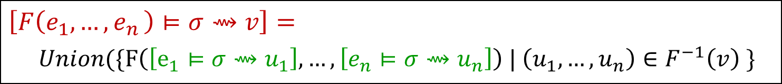
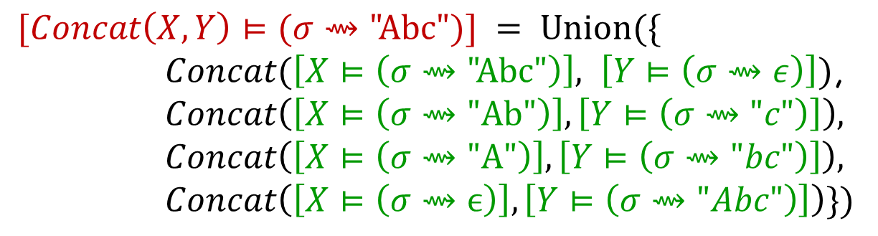
Problem Reduction Rules
Inverse Set: Let F be an n-ary operator.
$$F^{−1}\left(v\right)=\left\{\left(u_{1},…,u_{n} \right) \right| F\left(u_{1},…,u_{n}\right)=v\}$$
$$Concat^{−1}\left(\text{"}\text{Abc}\text{"}\right)=$$
$$\{\left( \text{"}\text{Abc}\text{",}ϵ\right), ("Ab\text{","}\text{c}\text{"), ("}\text{A}\text{","}\text{bc}\text{"), (}ϵ,\text{"}\text{Abc}\text{")\}}$$
$$\left[F\left(e_{1},{…,e}_{n}\right)⊨σ⇝v\right]=$$
$Union(\{F\left(\left[e_{1}⊨σ⇝u_{1}\right], …,\left[e_{n}⊨σ⇝u_{n}\right]\right) | \left(u_{1},…,u_{n}\right)∈F^{−1}\left(v\right) \}$
$$[Concat\left(X,Y\right)⊨(σ⇝\text{"}\text{Abc}")] = Union(\{$$
$Concat(\left[X⊨\left(σ⇝\text{"}\text{Abc}\text{"}\right)\right], \left[Y⊨\left(σ⇝ε\right)\right])$,
$$Concat\left(\left[X⊨\left(σ⇝\text{"}\text{Ab}\text{"}\right)\right],\left[Y⊨\left(σ⇝"c"\right)\right]\right),$$
$$Concat\left(\left[X⊨\left(σ⇝\text{"}\text{A}\text{"}\right)\right],\left[Y⊨\left(σ⇝"bc"\right)\right]\right),$$
$$Concat\left(\left[X⊨\left(σ⇝ϵ\right)\right],\left[Y⊨\left(σ⇝"Abc"\right)\right]\right)\})$$

Slide 30


Problem Reduction Rules
Inverse Set: Let F be an n-ary operator.
$$F^{−1}\left(v\right)=\left\{\left(u_{1},…,u_{n} \right) \right| F\left(u_{1},…,u_{n}\right)=v\}$$
$$Concat^{−1}\left(\text{"}\text{Abc}\text{"}\right)=$$
$$\{\left( \text{"}\text{Abc}\text{",}ϵ\right), ("Ab\text{","}\text{c}\text{"), ("}\text{A}\text{","}\text{bc}\text{"), (}ϵ,\text{"}\text{Abc}\text{")\}}$$
$$\{\left(true, v, ⊤\right), (false, ⊤, v)\}$$
$$IfThenElse^{−1}\left(v\right)=$$
Consider the SubStr(x,i,j) operator
$$\{ \left(0,2\right), (6,8) \}$$
$$SubStr^{−1}\left(\text{"}\text{Ab}\text{"} \right| x="Ab cd Ab")=$$
$$SubStr^{−1} \left(\text{"}\text{Ab}\text{"}\right)= …$$
The notion of inverse sets (and corresponding reduction rules) can be generalized to the conditional setting.

Slide 31
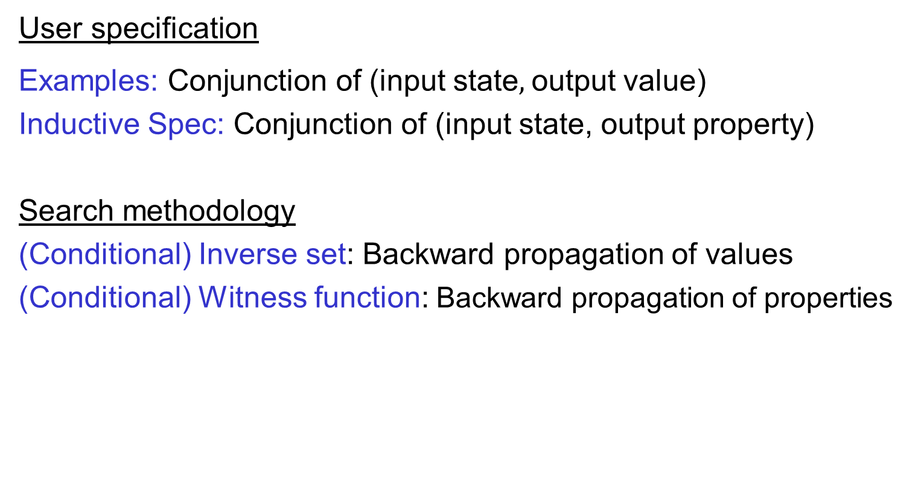
Generalizing output values to output properties
User specification
Examples: Conjunction of (input state$,$output value)
Inductive Spec: Conjunction of (input state, output property)
Search methodology
(Conditional) Inverse set: Backward propagation of values
(Conditional) Witness function: Backward propagation of properties

Slide 32



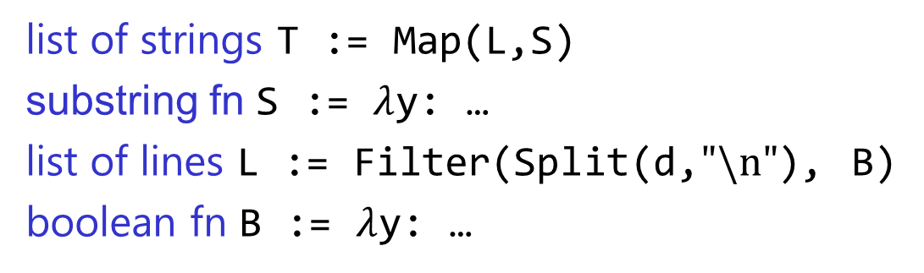


Problem Reduction
list of strings T := Map(L,S)
substring fn S := $λ$y: …
list of lines L := Filter(Split(d,$"\text{\backslash }\text{n}\text{"}$), B)
boolean fn B := $λ$y: …
FlashExtract DSL
$$⋈$$
Spec for S
Spec for T
Spec for L
$$∧$$

Slide 33

Problem Reduction
substring expr E := SubStr(y,P₁,P₂)
position expr P := K | Pos(y,R₁,R₂,K)
SubStr grammar
$$⋈$$
Spec for E
Spec for P₁
Spec for P₂
Redmond, WA
Redmond, WA

Slide 34
“PL meets ML” opportunity 1: Search Algorithm
PL aspects
Domain-specific language specified as grammar rules.
Top-down/goal-directed search using Inverse semantics.
Heuristics that can be machine learned
Which grammar production to try first?
Which sub-goal resulting from application of inverse semantics to try first?

Slide 35
Programming-by-Examples Architecture
Example based Intent
Intended Program in R/Python/C#/Java/…
Refined Intent
DSL D
Search
Algorithm
Intended Program in D
Program set
Translator
Disambiguator
Ranked Program set
Test inputs
Program Ranker
“Programming by Examples (and its applications in Data Wrangling)”;
In Verification and Synthesis of Correct and Secure Systems; IOS Press; 2016
[based on Marktoberdorf Summer School 2015 Lecture Notes]
34

Slide 36

Basic ranking scheme
Prefer programs with simpler Kolmogorov complexity
Prefer fewer constants.
Prefer smaller constants.
Input | Output
Justin Gottschlich | Justin
Faouzi Atig | Faouzi
1st Word
If (input = “Justin Gottschlich”) then “Justin” else “Faouzi”
“Justin”

Slide 37
Challenges with Basic ranking scheme
Prefer programs with simpler Kolmogorov complexity
Prefer fewer constants.
Prefer smaller constants.
Input | Output
Justin Gottschlich | Gottschlich, Justin
Faouzi Atig | Atig, Faouzi
2nd Word + “, ‘’ + 1st Word
“Gottschlich, Justin”
How to select between
Fewer larger constants vs. More smaller constants?
  Idea: Associate numeric weights with constants.
Predicting a correct program in Programming by Example; CAV 2015; Singh, Gulwani

Slide 38
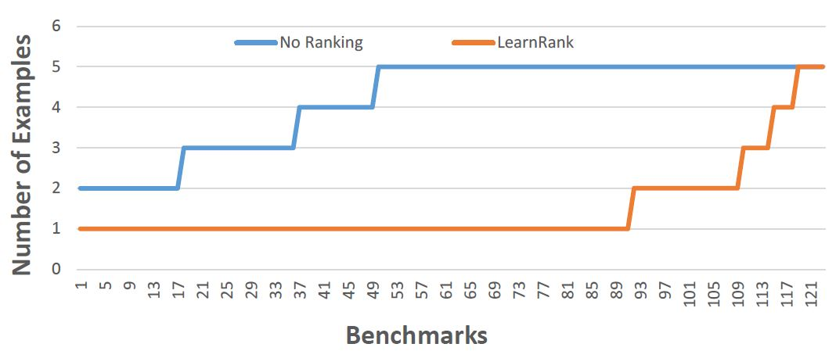
Comparison of Ranking Strategies over FlashFill Benchmarks
Basic
Learning
Strategy | Average # of examples required
Basic | 4.17
Learning | 1.48
Predicting a correct program in Programming by Example; CAV 2015; Singh, Gulwani

Slide 39
FlashFill Ranking Demo

Slide 40
Challenges with Basic ranking scheme
Prefer programs with simpler Kolmogorov complexity
Prefer fewer constants.
Prefer smaller constants.
Input | Output
Missing page numbers, 1993 | 1993
64-67, 1995 | 1995
1st Number from the left
1st Number from the right
How to select between
Same number of same-sized constants?
Learning to Learn Programs from Examples: Going Beyond Program Structure ;
IJCAI 2017; Ellis, Gulwani

Slide 41
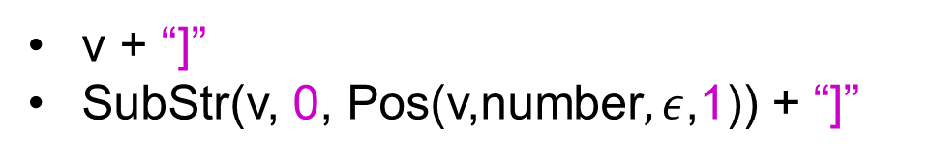
Challenges with Basic ranking scheme
Prefer programs with simpler Kolmogorov complexity
Prefer fewer constants.
Prefer smaller constants.
Input v | Output
[CPT-0123 | [CPT-0123]
[CPT-456] | [CPT-456]
v + “]”
SubStr(v, 0, Pos(v,number$,ε$,1)) + “]”
What if the correct program has larger Kolmogorov complexity?
Idea: Examine data/trace features (in addition to program features)
Learning to Learn Programs from Examples: Going Beyond Program Structure ;
IJCAI 2017; Ellis, Gulwani

Slide 42
“PL-meets-ML” opportunity 2: Program Ranking
PL aspects
Syntactic features of a program
  Number of constants, size of constants
Features of outputs/execution traces of a program on extra inputs.
  IsYear, Numeric Deviation, Number of characters
Heuristics that can be machine learned
Weights over various features
Non-syntactic features
  isPersonName.

Slide 43
Programming-by-Examples Architecture
Example based Intent
Intended Program in R/Python/C#/Java/…
Refined Intent
DSL D
Search
Algorithm
Intended Program in D
Program set
Translator
Disambiguator
Ranked Program set
Test inputs
Program Ranker
“Programming by Examples (and its applications in Data Wrangling)”;
In Verification and Synthesis of Correct and Secure Systems; IOS Press; 2016
[based on Marktoberdorf Summer School 2015 Lecture Notes]
42

Slide 44


Need for a fall-back mechanism
“It's a great concept, but it can also lead to lots of bad data. I think many users will look at a few "flash filled" cells, and just assume that it worked. … Be very careful.”
“most of the extracted data will be fine. But there might be exceptions that you don't notice unless you examine the results very carefully.”

Slide 45

“PL meets ML” opportunity 3: Disambiguation
Communicate actionable information back to user.
PL aspects
Generate multiple top-ranked programs
  Enable effective navigation between those programs.
Highlight ambiguity based on distinguishing inputs.
  An input where different programs generate different outputs.
Heuristics that can be machine learned
Highlight ambiguity based on clustering of inputs/outputs
  based on their syntactic and other features.
When to stop highlighting ambiguity?
“User Interaction Models for Disambiguation in Programming by Example”,
[UIST 2015] Mayer, Soares, Grechkin, Le, Marron, Polozov, Singh, Zorn, Gulwani
“FlashProfile: Interactive Synthesis of Syntactic Profiles”,
[Technical Report] Padhi, Jain, Perelman, Polozov, Gulwani, Millstein

Slide 46
FlashExtract Demo
(User Interaction Models)

Slide 47
Future Directions
Application to robotics
Programming using multi-modal intent involving examples and natural language
Predictive synthesis
Adaptive synthesis

Slide 48

Predictive Program Synthesis
Intended programs can sometimes be synthesized from just the input.
  Tabular data extraction, Sort, Join
Can save large amount of user effort.
  User need not provide examples for each of tens of columns.
“Automated Data Extraction using Predictive Program Synthesis”,
[AAAI 2017], Raza, Gulwani

Slide 49

Adaptive Program Synthesis
Learn from past interactions
  of the same user (personalized experience).
  of other users in the enterprise/cloud.
The synthesis sessions now require less interaction.

Slide 50
PROSE Framework
https://microsoft.github.io/prose
Efficient implementation of the generic search methodology.
Provides a library of reduction rules.
Role of synthesizer developer
Implement a DSL with executable semantics for new operators.
Implement reduction rules (inverse semantics) for some operators.
Implement ranking strategy.
Can also specify tactics to resolve non-determinism in search.

Slide 51


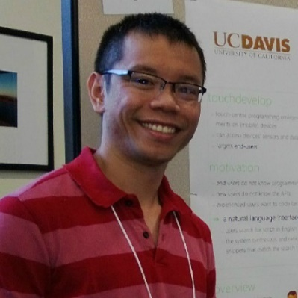



The PROSE Team
Sumit Gulwani
Prateek Jain
Ranvijay Kumar
Vu Le
Daniel Perelman
Please apply for intern/full-time positions!
Mohammad Raza
Danny Simmons
Abhishek
Udupa
Mark Plesko

Slide 52
Conclusion
“PL meets ML” in AI software creation
ML can synthesize code heuristics: better, efficient, adaptable
PBE is a revolutionary new frontier in AI.
99% of end users are non-programmers.
Data scientists spend 80% time cleaning data.
Developers spend 40% time refactoring code during migration.
PBE component | PL aspect | Heuristics that can be machine learned
Search Algorithm | DSL, Inverse functions | Non-deterministic choices
Program Ranking | Features | Weights
Disambiguation | Program navigation, Distinguishing inputs | Clustering, When/what to ask?

