Slide 1
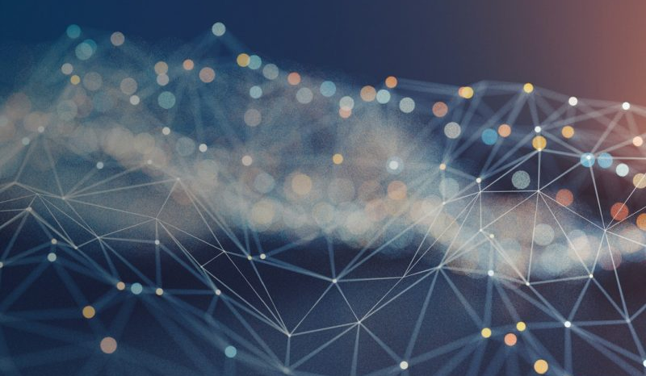
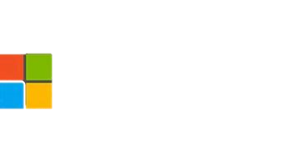
Fast Distributed Deep Learning over RDMA
Jilong Xue, Youshan Miao,
Cheng Chen, Ming Wu,
Lintao Zhang, Lidong Zhou
Microsoft Research

Slide 2
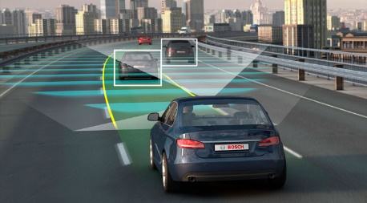
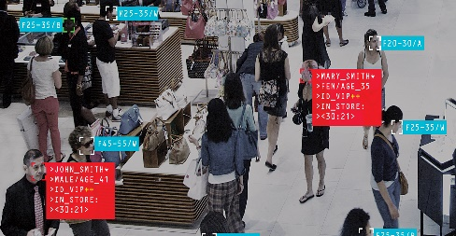

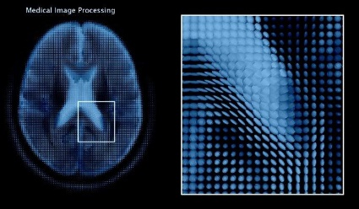
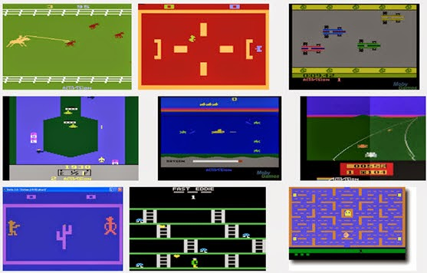
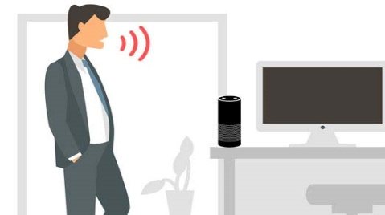
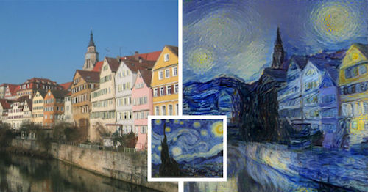
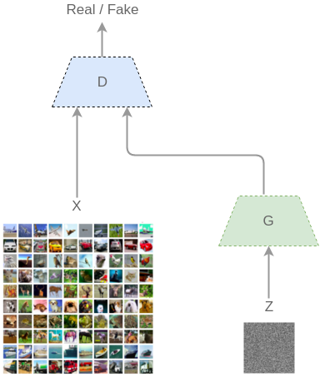

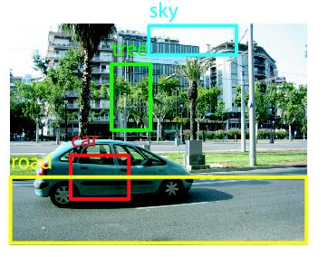
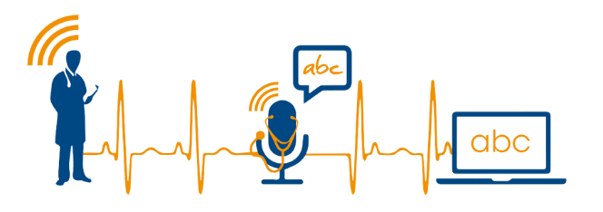
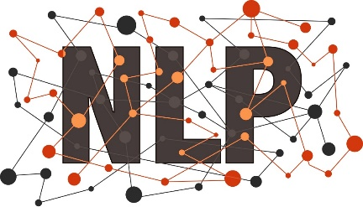
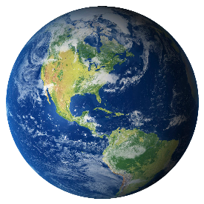
It is the Age of Deep Learning
Self-driving
Surveillance detection
Translation
Medical diagnostics
Game
Personal assistant
Art
Image recognition
Speech recognition
Natural language
Generative model
Reinforcement learning

Slide 3
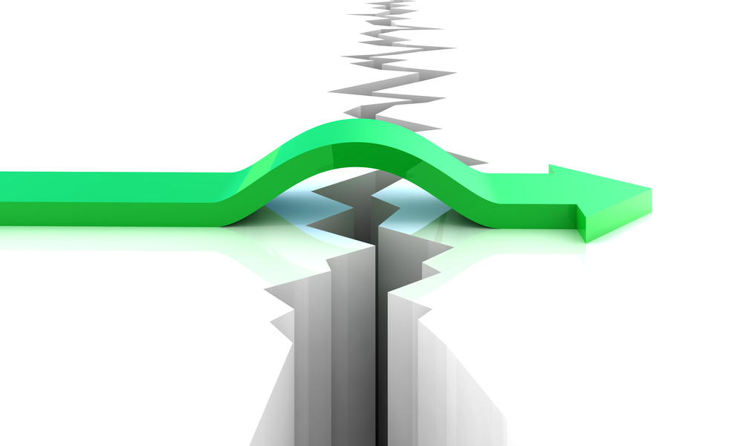
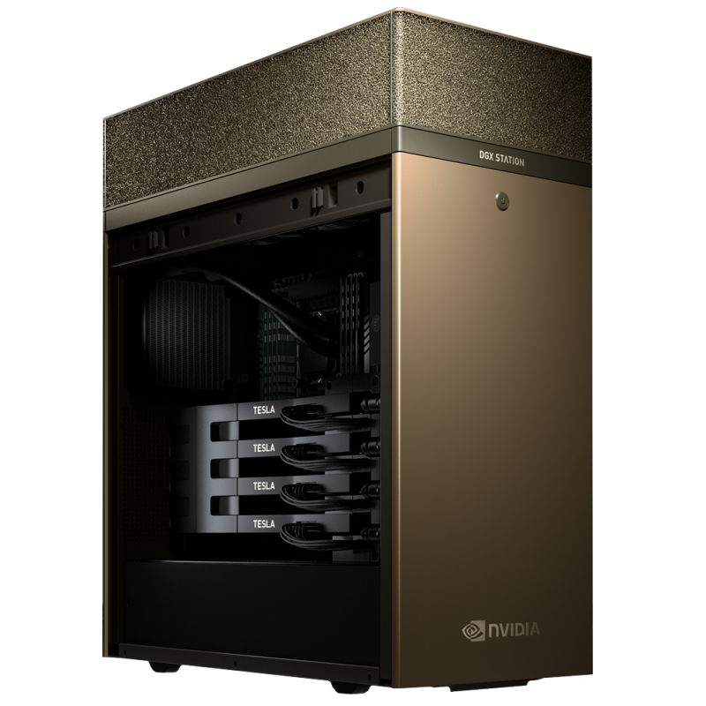
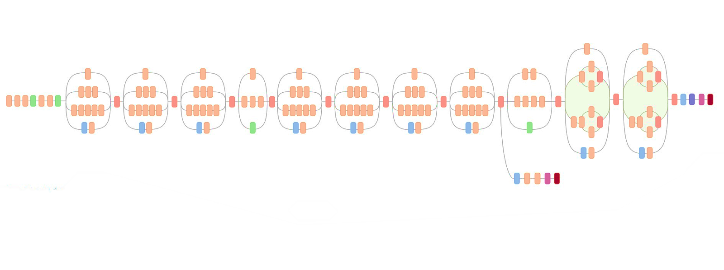
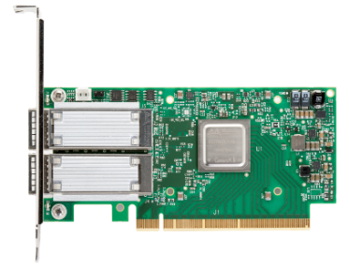
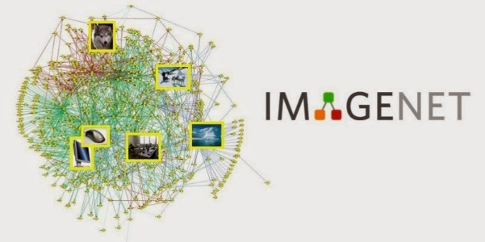
What Makes Deep Learning Succeed?
Massive computing power
Complex model
RDMA
14M images
Fast communication
Massive labeled datasets

Slide 4
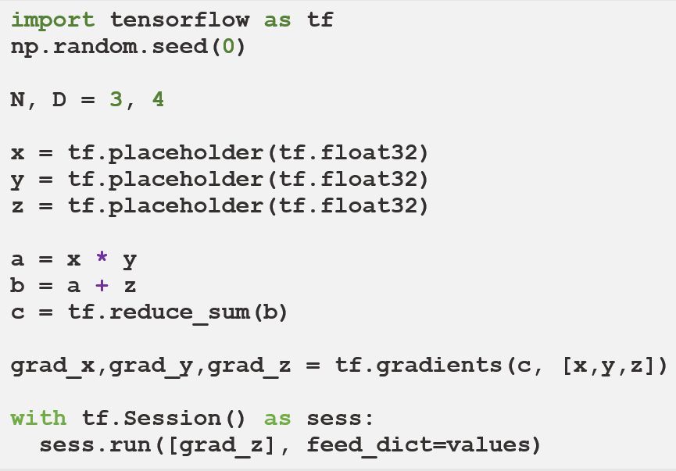








Representation of Deep Learning Computation
TensorFlow
x
y
z
$$∇x$$
$$∇y$$
*
*$g$
$$∇z$$
Data-Flow Graph (DFG)
as
Intermediate Representation
a
$$∇a$$
+
+$g$
b
$$∇b$$
Σ
Σ$g$
c

Slide 5

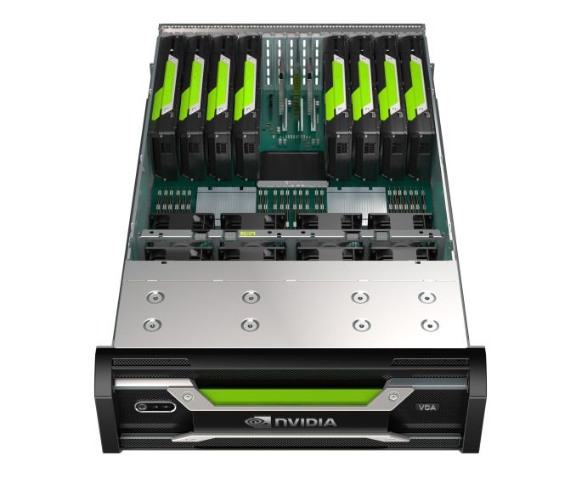
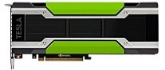
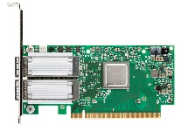

Modern GPU Cluster Architecture
How to execute a data-flow graph in a distributed GPU-cluster?
Server 0
QPI bus
Server 1
QPI bus
PCI-Express Switch
PCI-Express Switch
PCI-Express Switch
PCI-Express Switch
PCI-Express Switch
PCI-Express Switch
PCI-Express Switch
PCI-Express Switch
RDMA

Slide 6
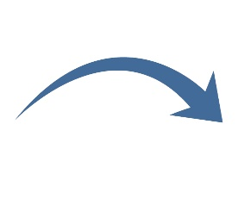
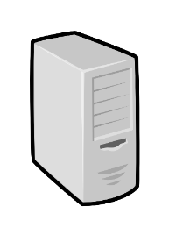











Distributed Deep Learning
Partition DFG to servers
Dispatch
partitions
Partition graph
$$Y$$
*
Send
$$H$$
$$H$$
$$Y$$
$$σ$$
$$W_{2}$$
$$σ$$
*
*
*
Recv
$$W_{2}$$
Server₁
$$W_{1}$$
$$X$$
$$W_{1}$$
$$X$$
Server₀
Server₀
Server₁
6

Slide 7






Model Parallelism and Data Parallelism
Communicate once per mini-batch
Parameter Server
ApplyGrad
ApplyGrad
$$Weight$$
Send
$$H$$
$$Y$$
GenGrad
GenGrad
$$σ$$
*
$$Y$$
$$Y$$
$$σ$$
$$σ$$
*
Recv
$$W_{2}$$
*
*
$$W_{1}$$
$$X$$
$$X_{1}$$
$$X_{2}$$
Worker₀
Worker₁
Server₀
Server₁
Data Parallelism
Model Parallelism
7

Slide 8
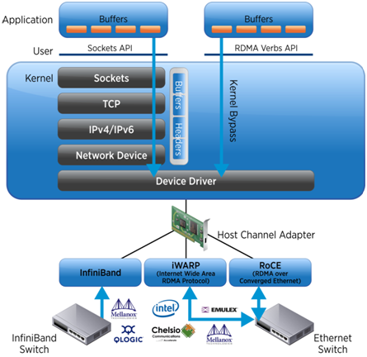
RDMA (Remote Direct Memory Access)
High throughput: 40-100 Gbps
Low latency: 1-3 µs
Communication related computation overhead can be significant
Zero-copy communication for extreme efficiency
8

Slide 9


RPC in Deep Learning Frameworks
Issues of general message passing library (e.g., RPC)
  Designed for dynamic data structure
  Unaware of data placement and size
  Extra memory copy comes from data serialization and packet split/merge
$$H$$
Send
$$Y$$
$$σ$$
*
*
Recv
$$W_{2}$$
$$W_{1}$$
$$X$$
Application memory
Application memory
t
t
RPC managed buffer
RPC managed buffer
10x
t
t
t
Server₀
Server₁
* gRPC using RDMA transfer

Slide 10
Opportunities when deep-learning meets RDMA
One-side RDMA R/W; GPU-Direct RDMA
  Efficient memory copy between host and device memory across servers
  Enables to manage global memory similar to local one
Many data operated and transferred are dense tensors
  Do NOT require variant data serialization/deserialization
  Do NOT require extra batching since access pattern is already sequential
Many runtime information can be decided statically
  Workload patterns are repeated across mini-batches in iterative way
  Shape and placement of tensors can be known beforehand

Slide 11


Combine Dataflow Graph with RDMA
Coupled with RDMA directly
  Remove RPC overhead
  No extra memory-copy
  No (de)serialization
Challenges
  Tensor place tracking
  Handle dynamic changed tensors
$$H$$
Send
$$Y$$
$$σ$$
*
*
Recv
$$W_{2}$$
$$W_{1}$$
$$X$$
Application memory
Application memory
t
t
RPC managed buffer
RPC managed buffer
t
t
t
Server₀
Server₁

Slide 12




Transfer statically placed tensor through one-side RDMA write
Phase I: graph analyzing
Phase II: graph execution
RDMA-based zero-copy communication
RDMA lib:
Conduct remote memory copy
Send
$$H$$
$$Y$$
$$σ$$
One-sided RDMA write
(Polling flag byte)
*
......
......
1
*
1
0
Recv
$$W_{2}$$
$$W_{1}$$
$$X$$
Source Tensor
Dest Tensor
Addr.
Tensor Manager:
Detect the source tensor place
Re-allocate as RDMA memory
Tensor Manager:
Pre-allocate RDMA compatible receive tensor
Server₀
Server₁
12

Slide 13


Transfer dynamically allocated tensor through RDMA write/read
Phase I: graph analyzing
Phase II: graph execution
Supports GPUDirect RDMA as well
Send
$$H$$
One-sided RDMA write
Tensor meta data
$$Y$$
$$σ$$
Tensor meta data
*
0
1
1
*
Recv
$$W_{2}$$
$$W_{1}$$
$$X$$
One-sided RDMA read
Allocate
Addr.
......
......
Source Tensor
Dest Tensor
Server₀
Addr.
Server₁
13

Slide 14
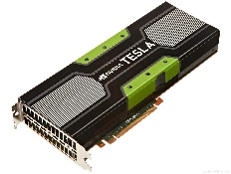
Implementation
Our technique is implemented in TensorFlow in 4,000 lines of C++ code
Major components:
  Graph analyzer
    Decide whether we should use static or dynamic transmission mechanisms
  Graph Rewriter
    Replace Send/Recv ops with RDMASend/RDMARecv ops
  Operator library
    RDMA specific ops: E.g., RDMASend, RDMARecv
  Tensor Tracker
    Tracking physical tensor allocation site
  RDMA device abstraction
    Conduct cross-server direct memory copy
Transparent to users
Computational Dataflow Graph
x
*
+
y
w
b
Graph Partitioning
Graph Analyzer and Rewriter
Op library
Tensor Tracker
RDMA device abstraction
Runtime
Runtime
$ ENABLE_RDMA_OPT=TRUE python3 model.py --args …
14

Slide 15
Evaluation
Testbed: 8x servers
  CPU: Dual 2.6 GHz Intel Xeon E5-2690v4 (14-core),
  RAM: 512 GB memory,
  GPU: NVIDIA Tesla P100 GPU,
  Network: 100 Gbps Mellanox RDMA-enabled InfiniBand
Deep Learning Applications
  Convolutional Neural Network (CNN)
    AlexNet, Inception-v3, VGGNet-16
  Recurrent Neural Network (RNN)
    LSTM, GRU
  Fully Connected Neural Network (FCN)
    FCN-5

Slide 16
Throughput
Comparisons with RPC-based solutions
~2x Throughput
over RPC+RDMA
up to 21x Throughput
over RPC+TCP
Avg. worker throughput; worker# = 8, batchsize=32
16

Slide 17
Convergence
Convergence of real applications with different communication mechanisms
1.5 ~ 3.3x speed up
1.2 ~ 2.6x speed up
CIFAR
Seq2Seq
worker# = 8
17

Slide 18
Scalability
Comparisons with RPC-based solutions
2.5x ~ 3x
speed up
~ 2x speed up
VGGNet-16
LSTM
batch-size = 32
18

Slide 19
Conclusion
Deep learning workloads and network technologies (RDMA)
=> rethink the RPC abstraction for network communication.
We designed: a “device”-like interface, with static analysis and dynamic tracing, enables cross-stack optimizations for deep neural network training:
=> take full advantage of the underlying RDMA capabilities

Slide 20
Q&A
Thank you!

