Slide 1


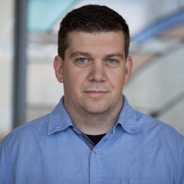





Armada: Low-Effort Verification of
High-Performance Concurrent Programs
Library of theorems for reasoning about state machines
stdlib
Generate state machines and Dafny proofs
✓
P.dfy
Dafny
P.arm
Armada compiler
P.c
CompCert
TSO
Generate code
Jacob R. Lorch
Microsoft Research
Yixuan Chen
Univ. of Michigan
and Yale Univ.
Manos Kapritsos
Univ. of Michigan
Bryan Parno
Carnegie Mellon Univ.
Shaz Qadeer
Calibra
Upamanyu Sharma
Univ. of Michigan
James R. Wilcox
Certora
Xueyuan Zhao
Carnegie Mellon
Univ.

Slide 2
Armada goals
benign race
(read of global variable without holding lock)
Give developers flexibility in code writing
Allows proofs about any code structure
Supports arbitrary synchronization mechanisms, as in lock-free data-structure libraries
if (my_guess < best_guess)
{
lock(&mutex);
if (my_guess < best_guess)
{
best_guess := my_guess;
best_sol := my_sol;
}
unlock(&mutex);
}
enables high-performance code
Our tool generates most of the proof automatically, using developer guidance
Use realistic weak-consistency memory model
(x86’s total store order, i.e., x86-TSO)
Reduce developer proof burden with automation
Ensure soundness of correctness proofs
Notes:
Remember to say that you’re looking for the shortest route among those you explore, and that best_guess is a global variable.

Slide 3
Overview of Armada usage
Implementation
Specification
method worker()
{
...
if (my_guess < best_guess) {
lock(&mutex);
if (my_guess < best_guess) {
best_guess := my_guess;
best_sol := my_sol;
}
unlock(&mutex);
}
}
method main()
{
... create_thread worker(); ...
}
method main()
{
var s:Solution;
somehow modifies s
ensures valid_sol(s);
print_sol(s);
}
For human appraisal
To be compiled and executed
Notes:
Don’t talk about refinement yet.

Slide 4
Overview of Armada usage
Implementation
Specification
method worker()
{
...
if (my_guess < best_guess) {
lock(&mutex);
if (my_guess < best_guess) {
best_guess := my_guess;
best_sol := my_sol;
}
unlock(&mutex);
}
}
method main()
{
... create_thread worker(); ...
}
method main()
{
var s:Solution;
somehow modifies s
ensures valid_sol(s);
print_sol(s);
}
Language has features useful for high-performance, concurrent code
var p:ptr<int32>;
struct S1 {
var x:int32[4];
var y:uint32[8];
var s:S2;
}
tid := create_thread worker();
Notes:
Pause after the set of features, to give people time to digest.

Slide 5
Overview of Armada usage
Non-compilable features are usable in specs
Implementation
Specification
method worker()
{
...
if (my_guess < best_guess) {
lock(&mutex);
if (my_guess < best_guess) {
best_guess := my_guess;
best_sol := my_sol;
}
unlock(&mutex);
}
}
method main()
{
... create_thread worker(); ...
}
method main()
{
var s:Solution;
somehow modifies s
ensures valid_sol(s);
print_sol(s);
}
Unbounded-size integers and infinite sets, even though they can’t be compiled
var s:iset<int> :=
iset n | true :: n * n;
Blocks of code that can’t be interrupted by other threads, which hardware can’t enforce
atomic { x := 3; y := 4; }
Sequentially-consistent memory accesses, even though CPU uses x86-TSO
x ::= 3; /* immediately
visible to all */
Notes:
Pause after the set of features, to give time to digest

Slide 6
Overview of Armada usage
Implementation
Specification
method worker()
{
...
if (my_guess < best_guess) {
lock(&mutex);
if (my_guess < best_guess) {
best_guess := my_guess;
best_sol := my_sol;
}
unlock(&mutex);
}
}
method main()
{
... create_thread worker(); ...
}
method main()
{
var s:Solution;
somehow modifies s
ensures valid_sol(s);
print_sol(s);
}
prove refinement
i.e., that all external behaviors of implementation are behaviors of spec

Slide 7
Proofs take the form of refinement levels
level Spec
{
var s:Solution;
somehow modifies s
ensures valid_sol(s);
print_sol(s);
}
level AtomicUpdate
{
...
atomic {
if (*) {
if (my_guess < best_guess) {
best_guess := my_guess;
best_sol := my_sol;
}
}
}
...
}
level HiddenMutex
{
...
if (*) {
atomic {
if (my_guess < best_guess) {
best_guess := my_guess;
best_sol := my_sol;
}
}
}
...
}
prove refinement
i.e., that all external behaviors of one level are behaviors of next level
level AtomicCriticalSection
{
...
if (*) {
atomic {
lock(&mutex);
if (my_guess < best_guess) {
best_guess := my_guess;
best_sol := my_sol;
}
unlock(&mutex);
}
}
...
}
level ArbitraryGuard
{
...
if (*) {
lock(&mutex);
if (my_guess < best_guess) {
best_guess := my_guess;
best_sol := my_sol;
}
unlock(&mutex);
}
...
}
level Implementation
{
...
if (my_guess < best_guess) {
lock(&mutex);
if (my_guess < best_guess) {
best_guess := my_guess;
best_sol := my_sol;
}
unlock(&mutex);
}
...
}
The proofs are generated mostly automatically.
But, the developer needs to write the levels and provide other guidance like invariants.
Intermediate levels can use the full specification language, since they’re not compiled
Notes:
The use of levels provides the flexibility needed to support high performance. The implementation can be structured however you like because we’re going to transform it, in levels, to the specification.

Slide 8
Each pair of levels represents a program transformation
level n+1
{
...
}
Transformation should be simple enough to automatically generate a proof
must prove refinement
level n
{
...
}

Slide 9
Example of program transformation: weakening
level A {
method worker()
{
if (my_guess < best_guess)
{
lock(&mutex);
if (my_guess < best_guess)
{
best_guess := my_guess;
best_sol := my_sol;
}
unlock(&mutex);
}
}
}
level B {
method worker()
{
if (*)
{
lock(&mutex);
if (my_guess < best_guess)
{
best_guess := my_guess;
best_sol := my_sol;
}
unlock(&mutex);
}
}
}
proof AB {
refinement A B
starweakening
}

Slide 10
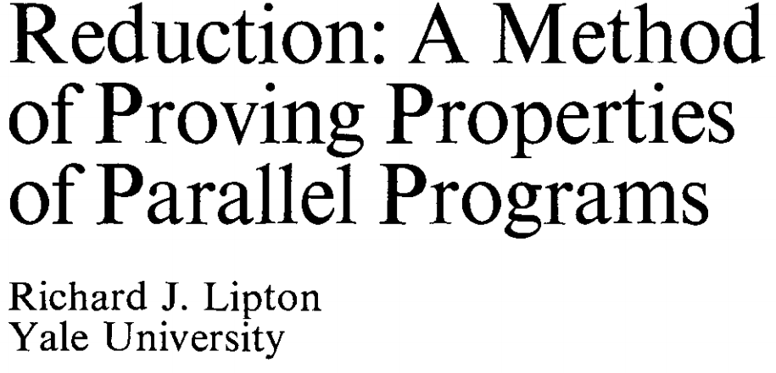
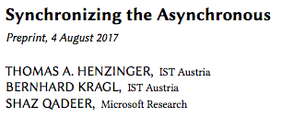

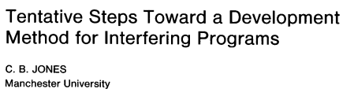
Armada supports a variety of transformations
weakening
variable introduction
variable hiding
TSO elimination
reduction
rely-guarantee
…and more to come!
MakeXThree();
x := 3;
y := 4;
if (my_guess <
best_guess)
var x:int32;
var ghost_x:int;
var x:int32;
x := 3;
var x:int32;
var ghost_x:int;
x ::= 3;
var ghost_x:int;
if (*)
atomic { x := 3;
y := 4; }
MakeXThree();
assume x == 3;

Slide 11
Armada’s semantic extensibility is sound
Generated proofs are checked by verifier
So, generation tools aren’t part of the TCB
Can incorporate new proof-generation techniques without worrying if they’re valid
For instance, if our rely-guarantee approach were unsound, proofs it generated would fail
Levels and other developer guidance
Proof generator
Proof
Verifier
✓

Slide 12
Proof customization
A failing proof gives developer feedback on what’s wrong with their reasoning
…or about what proof-specific arguments they need to make
level A {
method cos2sin2(r:real)
{
label lb1:
g := cos(r) * cos(r) +
sin(r) * sin(r);
}
}
level B {
method cos2sin2(r:real)
{
g := 1;
}
}
Notes:
Helps with flexibility: you can prove things even if the proof generators don’t have a case for it.

Slide 13
Compilation
Armada language close enough to C that translation is straightforward
Translation to ClightTSO subset of C, and subsequent compilation with CompCertTSO, preserves assumed TSO semantics
To estimate performance with a future,
better-optimized verified compiler, we can unsoundly compile with gcc

Slide 14
Examples demonstrate Armada’s utility
Barrier
Supports programs not amenable to ownership-based proofs
Pointers
Can generate proof using automatic alias analysis
Mellor-Crummey and Scott (MCS) lock
Supports high-performance custom synchronization code
Automation reduces developer-written proof by ~90% compared to CertiKOS
Queue from liblfds
Lock-free
Allows port of high-performance data-structure library
Notes:
Don’t say “book”.
Armada lets us prove the correctness of complex implementations, like a lock-free queue, without compromising on the application's performance.

Slide 15
Performance of queue implementations
Using % 0x10000 instead of & 0xFFFF reduces performance
(not a fundamental limitation)
Porting to Armada loses virtually no performance
High performance even when using CompCertTSO compiler for soundness

Slide 16
Future work
Reduce trusted computing base
Support memory models besides x86-TSO
Use layers for modularity
Model infinite behaviors to prove liveness properties
Watch and contribute! https://github.com/microsoft/armada
Notes:
Don’t say “remaining limitations”

Slide 17
Conclusions
Armada methodology proves correctness of concurrent programs and permits whatever developer wants for high performance
Developer writes proof outline as succession of program abstractions
Extensible tool uses developer hints to generate refinement proofs
If proof succeeds, compiled code will satisfy spec
If proof fails, developer can see how to fix it
Code @ https://github.com/microsoft/armada

