Slide 1

Autonomous Index Tuning
Bailu Ding
Microsoft Research
AIDB@VLDB 2020

Slide 2
Index Tuning
Building the right indexes is critical for database performance
  Example: select * from R, S where R.a = S.a
Index tuning: Recommend the best set of indexes for a database given a workload
  Workload: A set of query instances and their importance
Total cost: 750
Total cost: 410
Hash Join
300
Nested Loop Join
200
250
200
200
10
Table Scan
Table Scan
Table Scan
Index Seek
R
S
S
Index on R

Slide 3
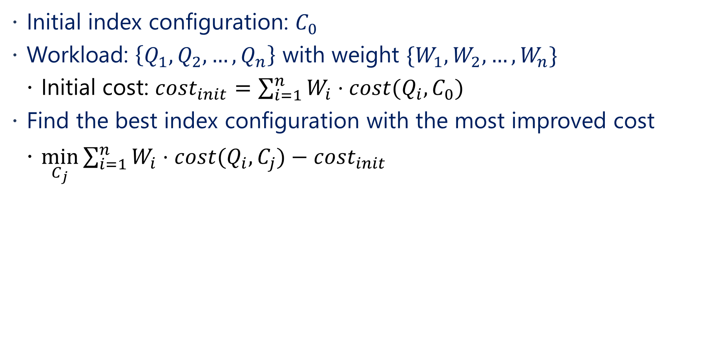
Problem Formulation
Initial index configuration: $C_{0}$
Workload: $\left\{Q_{1},Q_{2},…, Q_{n}\right\}$ with weight $\{W_{1},W_{2},…, W_{n}\}$
  Initial cost: ${cost}_{init}=\sum_{i=1}^{n}{W_{i}⋅cost(Q_{i}, C_{0})}$
Find the best index configuration with the most improved cost
  $\min_{C_{j}}{\sum_{i=1}^{n}{W_{i}⋅cost(Q_{i}, C_{j}})−cost_{init}}$

Slide 4
Prior Work
Database tuning advisor (DTA) [1]
  Identify the set of candidate indexes given the workload
  Search different combinations of candidate indexes to find the best index configuration
  Use ‘what-if’ API to estimate query plan cost under a set of indexes w/o creating the indexes using the optimizer’s cost model
  Support additional constraints, such as storage constraint
DTA has been shipped with Microsoft SQL Server
  Widely used in other commercial databases
[1] Agrawal, S., Chaudhuri, S., et al, Database tuning advisor for Microsoft SQL Server 2005.
SIGMOD 2005

Slide 5


Scenario: Index Tuning
W
Index Tuning
Tool
R
R’
Analyze workload
Analyze recommendations
Observe and diagnose
Implement R’
DBA plays a central role in index tuning

Slide 6
Autonomous Index Tuning in the Cloud
Goal: Continuously recommend and implement indexes over time for a database in the cloud
A closed-loop index tuning solution with minimal human intervention [2]
  Not every database has a DBA
  Reduce overhead of manual investigation
[2] Das, S., Grbic, M., et al. Automatically indexing millions of databases in Microsoft Azure SQL
database. SIGMOD 2019

Slide 7

Scenario: Autonomous Index Tuning
Recommendations (R)
Index tuning
Reports
Server feedback
Implement R
When to tune, what to tune, tuning parameters and constraints
Validation
Exec stats
A/B Tests
Revert R’
Exec stats, query store, other telemetry
Continuous monitoring, alerting, invocation
Constraints
Results

Slide 8
Query Regressions Are Real
Estimated to be cheaper,
but turns out to be 10x slower!
Execute TPC-DS queries under different index configurations
Compare plan pairs of the same query
TPC-DS: ~20% plan regresses with improved estimated cost

Slide 9
Challenges and Opportunities
Query regressions create disruptions for database performance and often require manual investigation
  The major roadblock for autonomous index tuning
Research challenge
  How to recommend indexes to improve query execution cost without causing query regressions?
Opportunities in the cloud
  Observe aggregated query execution statistics
  Collect additional execution statistics with extra resources

Slide 10
Overview: Autonomous Index Tuning
How to improve index recommendation quality without causing query regressions with execution statistics?
  Ding, B., Das, S., et al. AI meets AI: Leveraging query executions to improve index recommendations. SIGMOD 2019
How to cope with the case where execution statistics is scarce?
  Ma, L., Ding, B., et al. Active Learning for ML Enhanced Database Systems. SIGMOD 2020

Slide 11
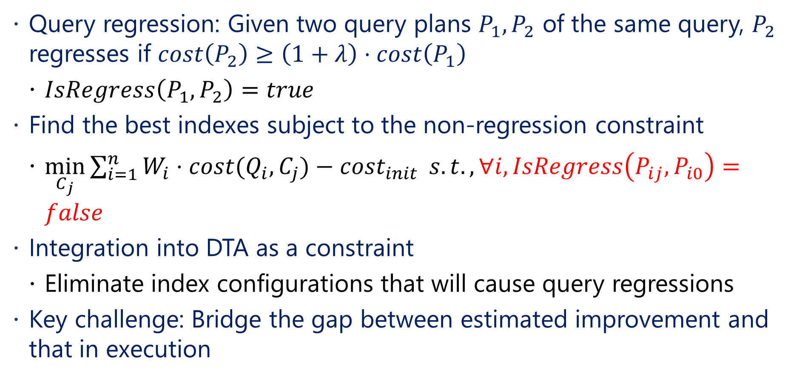
Problem Formulation
Query regression: Given two query plans $P_{1},P_{2}$ of the same query, $P_{2}$ regresses if $cost\left(P_{2}\right)≥\left(1+λ\right)⋅cost\left(P_{1}\right)$
  $IsRegress\left(P_{1},P_{2}\right)=true$
Find the best indexes subject to the non-regression constraint
  $\min_{C_{j}}{\sum_{i=1}^{n}{W_{i}⋅cost(Q_{i}, C_{j}})−cost_{init}} s.t., ∀i, IsRegress\left(P_{ij}, P_{i0}\right)=false$
Integration into DTA as a constraint
  Eliminate index configurations that will cause query regressions
Key challenge: Bridge the gap between estimated improvement and that in execution

Slide 12
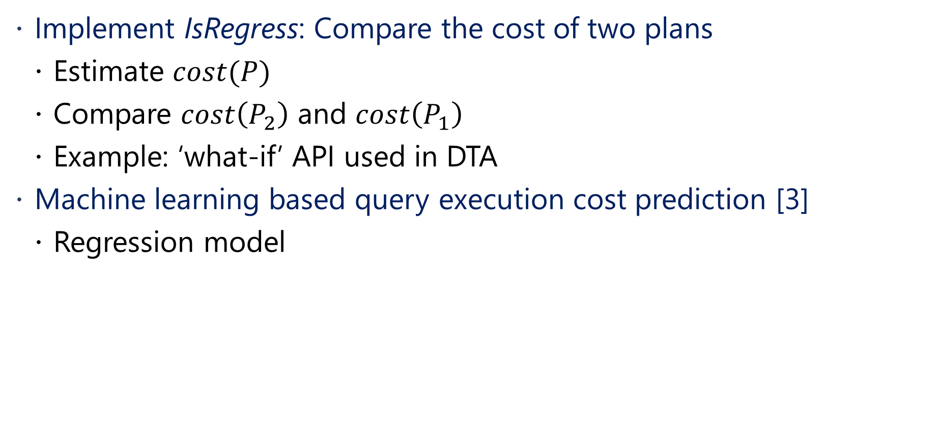
Prior Work: Query Plan Cost Estimation
Implement IsRegress: Compare the cost of two plans
  Estimate $cost(P)$
  Compare $cost\left(P_{2}\right)$ and $cost\left(P_{1}\right)$
  Example: ‘what-if’ API used in DTA
Machine learning based query execution cost prediction [3]
  Regression model
[3] Li, Jiexing, et al. "Robust estimation of resource consumption for SQL queries using statistical
techniques." VLDB 2012

Slide 13
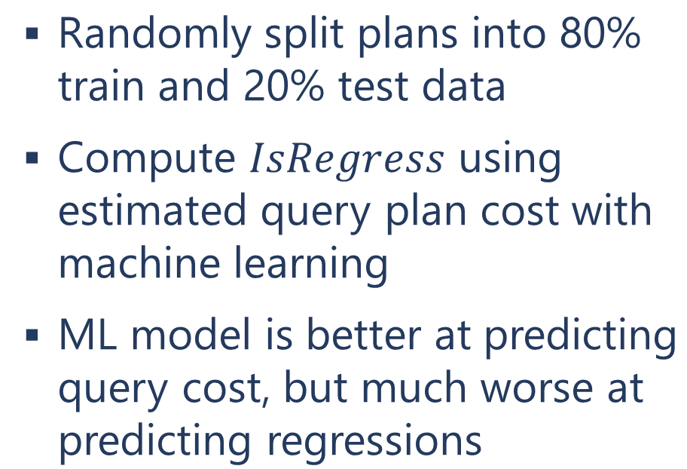
IsRegress Using Query Estimated Cost
Randomly split plans into 80% train and 20% test data
Compute $IsRegress$ using estimated query plan cost with machine learning
ML model is better at predicting query cost, but much worse at predicting regressions

Slide 14
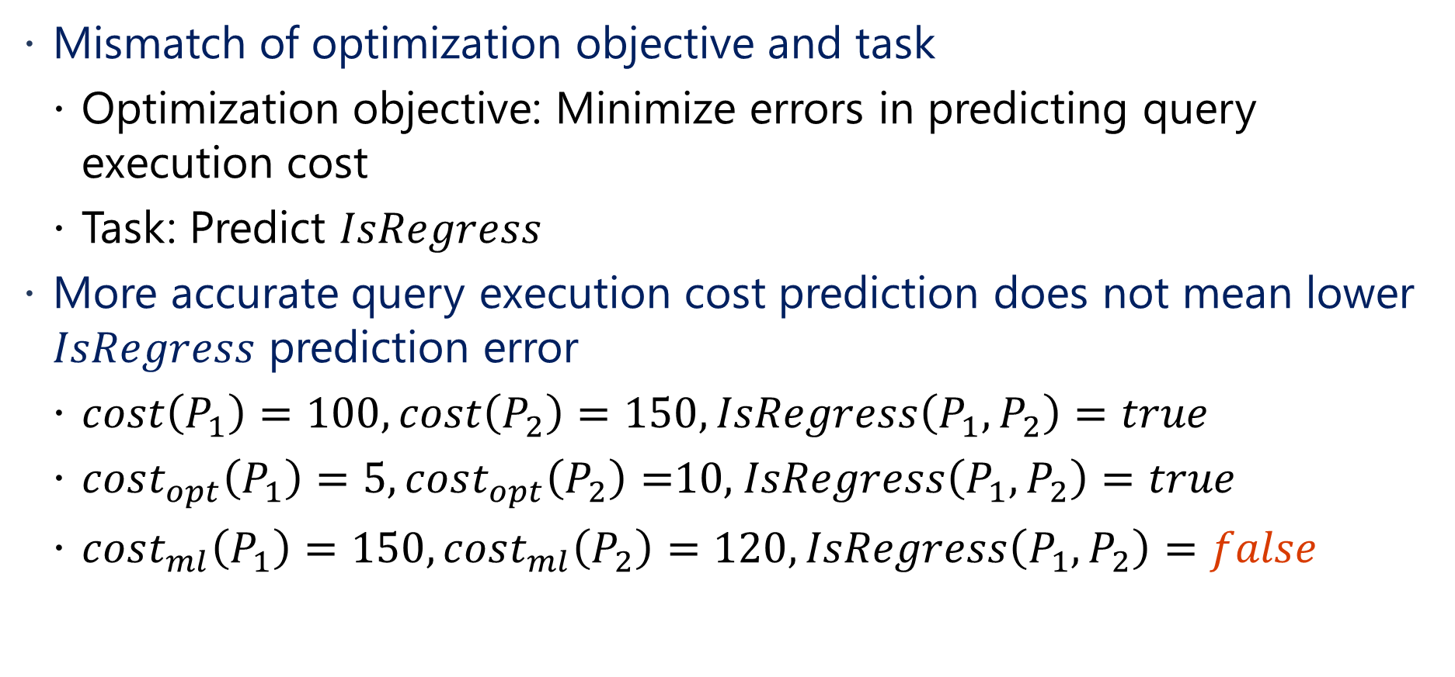
Why is ML-based Cost Estimate Bad
Mismatch of optimization objective and task
  Optimization objective: Minimize errors in predicting query execution cost
  Task: Predict $IsRegress$
More accurate query execution cost prediction does not mean lower $IsRegress$ prediction error
  $cost\left(P_{1}\right)=100, cost\left(P_{2}\right)=150, IsRegress\left(P_{1},P_{2}\right)=true$
  $cost_{opt}\left(P_{1}\right)=5, cost_{opt}\left(P_{2}\right)=$10, $IsRegress\left(P_{1},P_{2}\right)=true$
  $cost_{ml}\left(P_{1}\right)=150, cost_{ml}\left(P_{2}\right)=120,IsRegress\left(P_{1},P_{2}\right)=false$

Slide 15
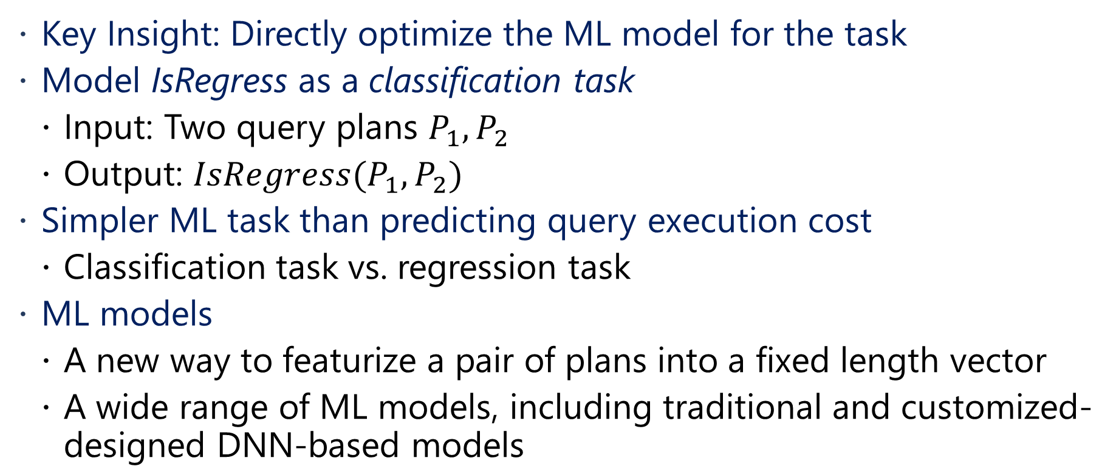
AI meets AI: Leveraging Query Executions to Improve Index Recommendations
Key Insight: Directly optimize the ML model for the task
Model IsRegress as a classification task
  Input: Two query plans $P_{1},P_{2}$
  Output: $IsRegress(P_{1},P_{2})$
Simpler ML task than predicting query execution cost
  Classification task vs. regression task
ML models
  A new way to featurize a pair of plans into a fixed length vector
  A wide range of ML models, including traditional and customized-designed DNN-based models

Slide 16
Predict IsRegress Over 15 Workloads
Reduce up to 12x errors in F1 score

Slide 17
End-to-end Index Recommendation on TPC-DS
More improvement with less regressions

Slide 18
When ML Model Meets New Data
Randomly split data by plan pairs, queries, and databases
Prediction performance degrades as the training and test data becomes more mismatched

Slide 19
Need for Adaptation
New data distribution is unavoidable in the cloud
  New queries executed on existing databases
  New applications and databases deployed
ML models need to adapt to the new data distribution

Slide 20
Adapt Models to New Data
Passive data collection: Observe execution statistics on the target database
  No additional overhead for acquiring data
  Subject to the queries executed on the database
  Skew towards the optimizer’s biases, i.e., optimizer’s ‘best’ plans
Actively collect data for the target database
  Acquire labels on a replica without impacting the normal operation
Challenge: How to choose the data to acquire labels that best improve the model’s performance with a given resource budget?

Slide 21
Active Data Collection Platform
Production
Database
Index tuning component
ML Model
Make Prediction
Model
New Labels
Replica
ADCP
User
Selected Unlabeled Data
Budget
New Labels

Slide 22
Active Data Collection Platform
Collecting data to improve the model’s performance for all unknown data is infeasible
Key insight: The target test data set can be derived for index tuning
  Sets of indexes and the corresponding plans explored during index tuning

Slide 23
Holistic Active Learning
Goal: Select the best set of training data from a pool of unlabeled data to improve ML models’ prediction performance
Prior work: Active learning
  Data with more uncertainty is more valuable to label
New challenges
  Robust: Noisy uncertainty signal under significant distribution shift
  Cost-sensitive: Drastically different labelling costs, especially with index creations
  Batch-friendly: Collecting a batch of data before retraining the model

Slide 24
Holistic Active Learner (HAL)
Biased sampling to compensate noisy signals
Cost weighting: Combine the cost of labeling and the value of the data
Reduce redundancy when sampling a batch of data
w(x)
0.9 | 0.8 | 0.7 | 0.6 | 0.5 | 0.4 | 0.3 | 0.2 | 0.1
x1 | x2 | x3 | x4 | x5 | x6 | x7 | x8 | x9

Slide 25
Results: IsRegress Prediction
0.32
75%
~100 Queries
Less than 5% of the unlabeled data
Budget: 50x average
query cost per iteration

Slide 26
Takeaways
Indexing tuning is crucial for database performance
Query regression is a big challenge for autonomous index tuning
Recommend indexes without causing query regressions using ML
  AI Meets AI: Prevent recommending indexes that can cause query regressions with ML-based classifiers
  Active Data Collection Platform: Adapt ML models to new data distributions by actively acquiring additional training data
Other related work
  Ding, B., Das, S., et al. Plan stitch: harnessing the best of many plans. VLDB 2018
Bailu Ding
badin@microsoft.com

