Slide 1
Perspectives on Security
Butler Lampson
Microsoft Research
Symposium on Operating Systems Principles
October 4, 2015

Slide 2
How did we get here?
In the beginning, security was by physical isolation (1950-1963)
  Easy: You bring your data, control the machine, take everything away
  Still do this today with VMs and crypto (+ enclaves if VM host is untrusted)
Timesharing brought the basic dilemma of security: (1963-1982)
Isolation vs. sharing
  Hard: Each user wants a private machine, isolated from others
  but users want to share data, programs and resources
Since then, things have steadily gotten worse (1982-2015)
  Less isolation, more sharing, no central management
  More valuable stuff in the computers
  Continued misguided search for perfection (following the NSA’s lead)

Slide 3
Wisdom
If you want security, you must be prepared for inconvenience.
    —General B.W. Chidlaw, 12 December 1954
When it comes to security, a change is unlikely to be an improvement.
    —Doug McIlroy, ~1988
The price of reliability is the pursuit of the utmost simplicity.
It is a price which the very rich find most hard to pay.
    —Tony Hoare, 1980 (cf. Matthew 19:24)
But who will watch the watchers? She’ll begin with them and buy their silence.
    —Juvenal, sixth satire, ~100

Slide 4
What we know how to do
Secure something simple very well
Protect complexity by isolation and sanitization
Stage security theatre
What we don’t know how to do
Make something complex secure
Make something big secure if it’s not isolated
Keep something secure when it changes
Get users to make judgments about security
Understand privacy—fortunately not an SOSP topic

Slide 5
Themes
Goals: Secrecy (confidentiality), integrity, availability (CIA: Ware 1970)
Gold standard: Authentication, authorization, auditing (S&S 1975)
Principals: People, machines, programs, … (Dennis 1966, DEC 1991)
Groups/roles: make policy manageable (Multics 1968, NIST 1992)
Oppositions
Winner |  | Loser
Convenience | vs. | Security
Sharing | vs. | Isolation
Bug fixes | vs. | Correctness
Policy/mechanisms | vs. | Assurance
Access control | vs. | Information flow
(in deployment, not good vs. bad)

Slide 6
Timeline

 | Themes | Systems
1960s | Timesharing; ACLs; access control matrix; VMs; passwords; capabilities; domains; gates | CTSS; Multics; CP/CMS; Cal TSS; Adept-50; Plessey 250
1970s | TS; LANs/Internet (e/e security); public key; multi-level sec.; ADTs/objects; least privilege; Trojans; isolation by crypto; amplification; undecidability | Unix; VMS; VM/370; IBM RACF; Clu; Hydra; Cambridge CAP
1980s | Workstations; client/server; Orange Book; global authentication; Clark and Wilson | A1 VMS; SecureID; Morris worm; IX
1990s | PCs; Web; sandboxes; Java security; crypto export; decentralized information flow; Common Criteria; biometrics; RBAC; BAN; SFI; SET | Browsers; SSL; NT; Linux; PGP; Taos
2000s | Web; JavaScript; buffer overflows; DDoS | TPM; LSM; SELinux; seL4; HiStar
2010s | Web; big data; enclaves; homomorphic crypto | Singularity; CryptDB; Ironclad ...

Slide 7
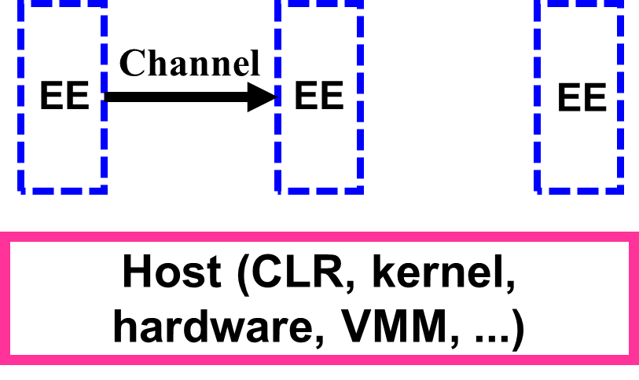
Foundation: Isolation

A host isolates an execution environment
  The basis for any security. Must trust the host
Many ways to do it (and many bugs):
Mechanism | Host
Java/JavaScript sandboxing | JVM/JS engine | Java 1995
Modules/objects | language/runtime | Clu 1974
Software fault isolation | process | Wahbe et al 1993
Processes | OS | CTSS 1961
Virtual machines | hypervisor | CP/40 1966
Limited comm (wires or crypto) | network | DESNC 1985
Air gaps: physical separation | physics | 1950; Tempest ~1955

Slide 8
Safe Sharing: Access Control
Isolation boundary limits attacks to channels (no bugs)
Access Control for channel traffic
Policy sets the rules
Authentication
Authorization
Guard /
Reference monitor
Subject / Principal
Object /
Resource
Request
Anderson report 1972
1. Isolation boundary
Policy
Audit log
2. Access control
3. Policy
Host (CLR, kernel, hardware, VMM, ...)

Slide 9
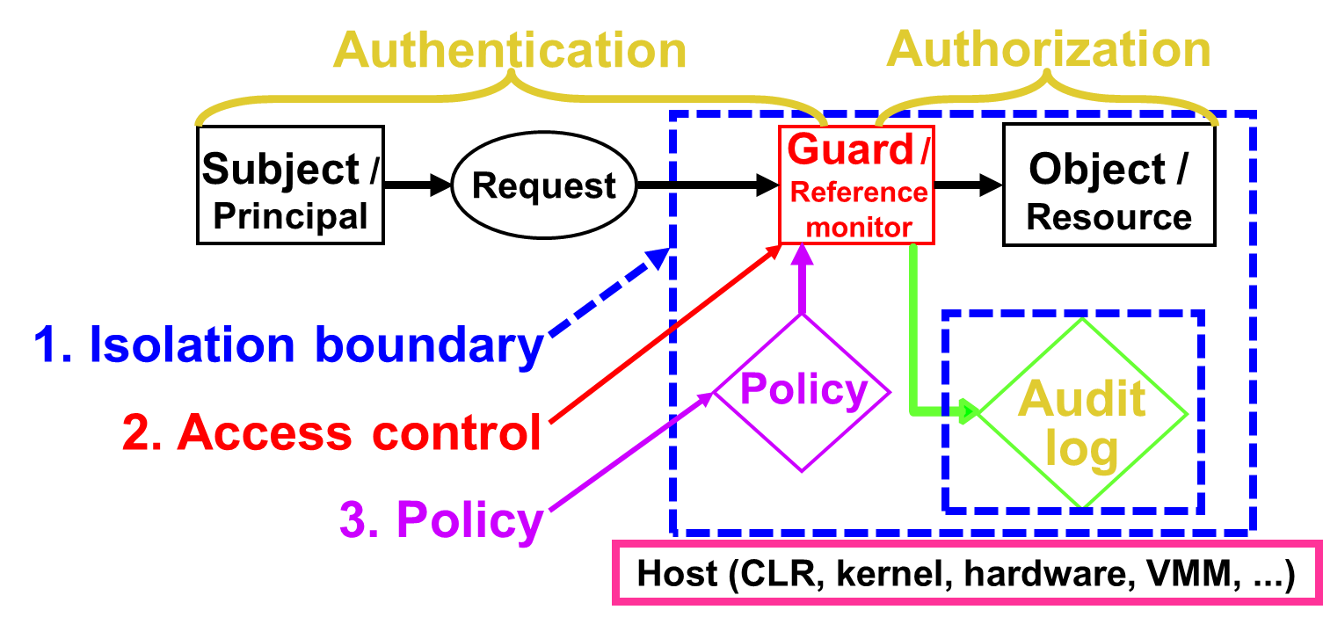
Access Control: The Gold Standard
Authenticate principals: Who made a request?
  People, but also channels, servers, programs
    (encryption implements channels, so the key is a principal)
Authorize access: Who is trusted with a resource?
  Group principals or resources, to simplify management
    Can define a group by a property,
    e.g. “type-safe” or “safe for scripting”
Audit requests: Who did what when?

Slide 10
Policy: What sharing is allowed?
The guard evaluates a function: permissions = policy(subject, object)
  If functions are too mathematical, call it an access matrix (Lampson 1971)
Permissions kept at the object are ACLs; at the subject, capabilities
  Capabilities work for short term policy
    File descriptors/handles in OS; objects in languages (Unix/Windows; Java, C#)
  ACLs work for long-term policy; tell you who can access the resource
    Groups of subjects and objects keep this manageable (Multics 1968)
Subject/principal | Object/resource
 | File foo | Database payroll
Alice | read, write | write paychecks
Bob | read | -

Slide 11
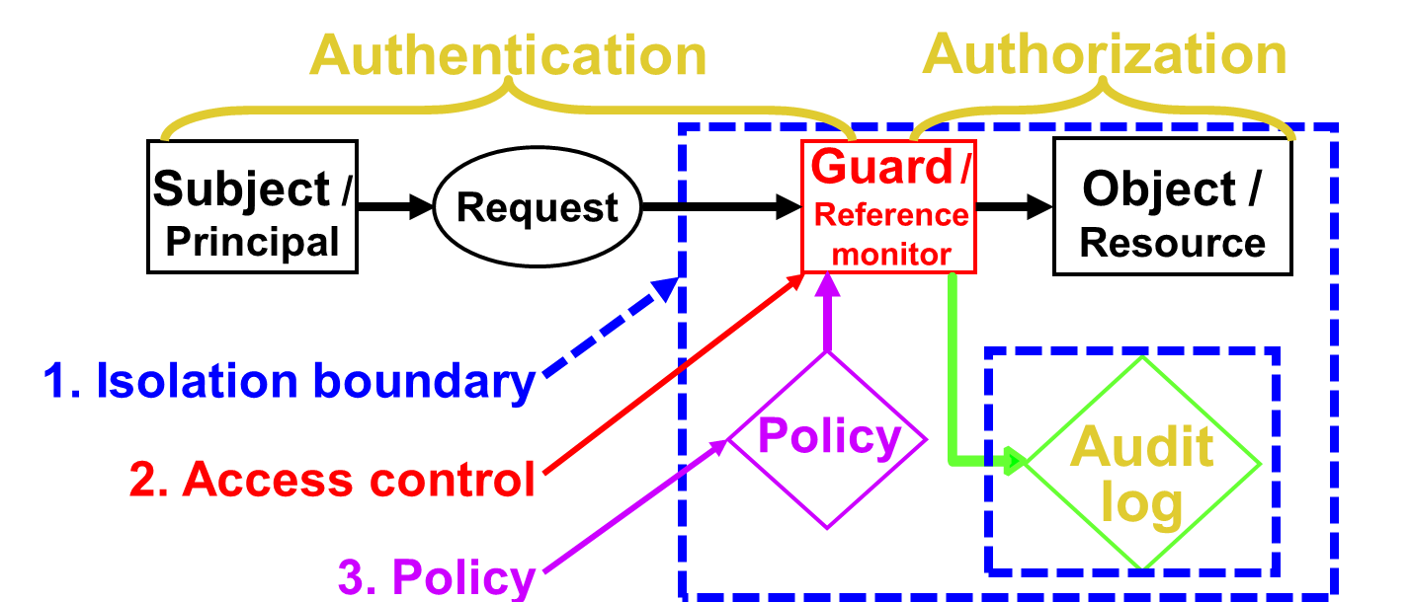
Keeping Secrets: Information Flow Control
0. Labels on information
1. Isolation boundary limits flows to channels
2. Flow control based on labels
3. Policy says what flows are allowed
Adept-50 1969
Orange Book 1985
Authorization
Authentication
Data
+ Label
Guard /
Ref mon
Subject / Principal
Send
0. Labels
Compare access control
1. Isolation boundary
Policy
Audit log
2. Flow control
3. Policy

Slide 12
Information Flow Control
Invented to model military classification (Adept-50 1969)
  Label every datum: top secret/nuclear ≥ top secret ≥ secret
    Labels form a lattice, and propagate: If d₁ is input to d₂, then d₂’s label is ≥ d₁’s
  Enforce with access control: label subjects, containers (Bell/LaPadula 1973)
    No read up, write down; can be dynamic or static (Adept-50; Denning 1976)
Decentralized flow control (Myers and Liskov 1998)
  Anyone can invent labels. If you own a label, you can declassify it
    Can do this in a language or in an OS (Jflow 1999; HiStar 2006)
So far, none of this has been practical
And then there are covert (side) channels: timing, radiation, power ...
  Abstractions don’t keep secrets (Tempest 1955, Lampson 1972)

Slide 13
Who controls policy? DAC, MAC, RBAC
How to decide:
  Is the user or the program malicious? Insiders, Trojan horses
  Is the user competent? Policy can be tricky
  Is the user motivated? Security gets in the way of work and play
Discretionary access control (DAC) : the object’s owner (CTSS 1963)
Mandatory access control (MAC) : an administrator (1969; 1985)
  MAC ≠ flow control
Role based access control (RBAC): the app designer (NIST 1992)
  Administrator just populates the roles

Slide 14
Distributed Systems: Cryptography
  Systems communicate, so need secure channels
  Host, secure wire, …, but usually cryptography: it’s general, end-to-end
Basic crypto functionality: mathematical magic that implements:
  Sign with K⁻¹/ verify with K : integrity
  Seal with K / unseal with K⁻¹: secrecy
  This gives you an end-to-end secure channel
Public key crypto: K ≠ K⁻¹; I can sign, anyone can verify (RSA 1977)
Homomorphic crypto: compute on encrypted data (Gentry 2009)
  This is too slow, but you can simulate it (CryptDB 2011)
Zero knowledge and verifiable computation (Pinocchio 2013)
  You can only do it
  if you know the key

Slide 15
Distributed Systems: Understanding Trust
Systems are decentralized, so we must reason about trust
  We need proofs to justify such reasoning
Principals: people, machines, programs, services, protocols, …
Accountability: principal says statement
  Alice says read from file Foo
Trust: principal A speaks for principal B
    Alice says Bob@microsoft speaks for Alice
    Microsoft says Key63129 speaks for Bob@microsoft
    Key63129 says read from file Foo
  Extending this to authorization yields an end-to-end argument
    file Foo says Alice speaks for file Foo ACL entry
    So Foo says read from file Foo
DEC 1989, 1991

Slide 16
Does it actually work? Assurance (Correctness)
Keep it simple—Trusted Computing Base (TCB) (Rushby 1981)
  One way: a security kernel—apps out of the TCB. This works for sharing hardware
Ideally, you verify: prove that a system satisfies its security spec
  This means that every behavior of the system is allowed by the spec
    Not the same as proving that it does everything in the manual
  Today in seL4, Ironclad, … First tried in Gypsy (late 1970s)
  What if the spec is wrong? Keep it simple
Usually verifying is too hard, so you certify instead
  Through some “independent” agency. Alas, process trumps substance
    First by DoD for Orange Book, later international Common Criteria (1985, 1999)
Or you can verify some properties: isolation, memory/type safety
Or you can apply bandaids

Slide 17
Bandaids for Bugs (Defense in Depth)
No guarantees, but at least the bad guy has to work harder
  Firewalls to keep intruders out, look for suspicious traffic (DEC 1988)
  Signature hacks to detect malware (~1990)
  Memory safety hacks to catch writes outside array bounds (Phrack 1996)
  Intrusion detection hacks to look for anomalous behavior (SRI 1986)
  Control Flow Integrity to block jumps not in the normal flow (MSR 2005)
  Taint tracking to keep unsanitized input away from execution (CMU 2005)
  Process to enforce use of the tools (MS SDL 2004)
“I don’t have to outrun the bear; I just have to outrun you.”
  These are not bad things, but they are hacks

Slide 18
What about my system? Configuration (Policy)
If the code is correct, the configuration may still be wrong
  You write the code once, but every system has its own configuration
  It’s boring, and it changes. So either it’s small, or it’s wrong.
    But it’s not small; there’s always another feature, another plausible scenario
      There are 12 levels of indirection in Windows printing, each with its own security
And configuration is usually done by amateurs
  With MAC and RBAC at least it’s done by pros
Conflict: want fine grained policy, but can only manage coarse grain
  Not much work on this, and it remains unsolved
    Solution (never adopted): Lower aspirations, budget for complexity


Slide 19
What has worked? What hasn’t?
Worked ~ gotten wide adoption
Worked
VMs
SSL
Passwords—universal
Safe languages
Firewalls
Process—SDL
Failed
“Secure systems”
Capabilities (except short term)
Metrics for security
MLS/Orange book
User education
Intrusion detection

Slide 20
Why don’t we have “real” security?
A. People don’t buy it
  Danger is small, so it’s OK to buy features instead
  Security is expensive
    Configuring security is a lot of work
    Secure systems do less because they’re older
  Security is a pain
    It stops you from doing things
    Users have to authenticate themselves
  Goals are unrealistic, ignoring technical feasibility and user behavior
B. Systems are complicated, so they have bugs
  Especially the configuration

Slide 21
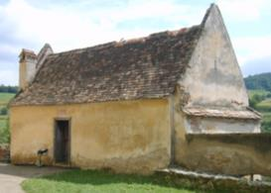
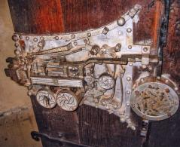
What next?
Lower aspirations. In the real world, good security is a bank vault
    Hardly any computer systems have anything like this
    At best we can only make simple things secure
Access control doesn’t work—40 years of experience says so
  Basic problem: its job is to say “No”
    This stops people from doing their work, and then they relax the access control
    usually too much, but no one notices until there’s a disaster
Retroactive security: focus on things that actually happened
  rather than all the many things that might happen
  Real world security is retroactive
    Burglars are stopped by fear of jail, not by locks
    The financial system’s security depends on undo, not on vaults
Biertan fortified church, Romania
Jail
Lock

