Slide 1
DSB: A Decision Support Benchmark for Workload-Driven and Traditional Database Systems
Bailu Ding, Surajit Chaudhuri, Johannes Gehrke, Vivek Narasayya
Microsoft Research

Slide 2
Why Yet Another Decision Support Benchmark?
Industrial-standard decision support benchmark: TPC-DS
Model the data warehouse of a retail product supplier
Realistic database schema
Real-world data distribution
Semantically meaningful queries
Scalable database and parameterized query templates

Slide 3
New Trends In Decision Support Workloads
More complex data distribution
  Skews on individual columns
  Correlations between columns in the same table
  Correlations of columns across multiple tables
More varieties in queries
  More join patterns, including non-equi joins, cyclic join graphs, non PKFK joins
More fine-grained data slicing
  More joins and more predicate filters on table columns

Slide 4
New Requirements From Workload-driven DBMSs
Make database systems more workload-driven, especially with machine learning (ML) techniques
Several efforts that attempt to re-architect database system components by leveraging the workload and its execution feedback
  Index tuning, query processing, query optimization
Workload-driven DBMSs have different performance dimensions compared to traditional DBMSs

Slide 5
New Requirements From Workload-driven DBMSs
More distinct query instances
  Can require a significant number of distinct query instances for training and test
Dynamic workloads
  Can require workloads with different parameter distributions to assess the adaptability
More dimensions of performance metrics
  Can introduce overhead from training and inference

Slide 6
DSB: A Decision Support Benchmark for Workload-Driven and Traditional Database Systems
Adapted from TPC-DS
More complex data distribution
New query templates w/ more join patterns
More distinct query instances with fine-grained data slicing
Configurable and dynamic query workloads
Guidelines on evaluating workload-driven and traditional DBMSs

Slide 7
Data Generation: Skewed Distribution
Single column: Exponential distribution
  Categorical and numerical values

Slide 8
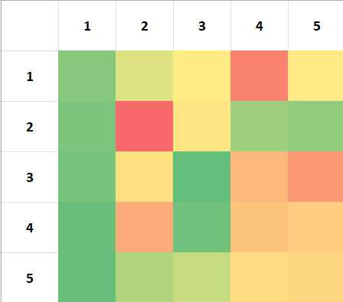
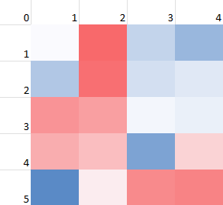
Data Generation: Correlated Data Distribution
Multiple columns within a table
  i_item_sk and i_manager_id on item table
Multiple columns across tables
  People from CA buy more shorts than people from AK
  item, store_sales, customer, customer_address

Slide 9
Query Generation: New Query Templates
Non-equi join
Non PKFK join: self joins, cyclic joins
Query 100
Query 102

Slide 10
Query Generation: Fine-grained Data Slicing
Exploratory data science tries to find more insight from the data
Join more tables with more predicate filters
Combined with complex data distribution: More variety in cardinality
Combined with query generation: More distinct query instances
Items sold in Q1
select count(*)
from store_sales, item, date
where ss_item_sk = i_item_sk
and d_date_sk = ss_date_sk
and d_quarter_seq = 1
Items sold in Q1, sliced by category, customer info, …
select count(*)
from store_sales, item, date, customer, customer_address, …
where ss_item_sk = i_item_sk
and d_date_sk = ss_date_sk
and …
and d_quarter_seq = 1
and i_category = ‘Music’ and i_manager_id = 1
and ca_state = ‘WA’
and …

Slide 11




Configurable and Dynamic Workload
Configurable to generate a sequence of workloads
For each workload
  Query templates used
  Number of instances per query template
  Distribution of parameters
Query parameter distribution
  Uniform
  Gaussian (center, variance)

Slide 12
Evaluation Guidelines
Data and query generation
  Training query workload
  Test query workload
  Duplicate ratio of the workload
Preparation stage
  Time and resources
Test stage
  Average CPU and elapsed time of end-to-end query execution, including overhead of query optimization, model inference, and any adaptation if applicable
  Recommended: Percentiles of CPU and elapsed time

Slide 13
Evaluation

Slide 14
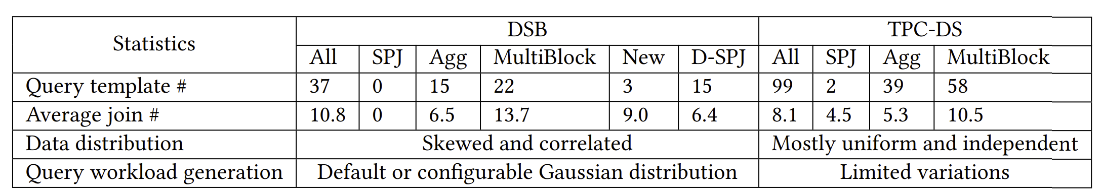
DSB vs. TPC-DS: Overview

Slide 15
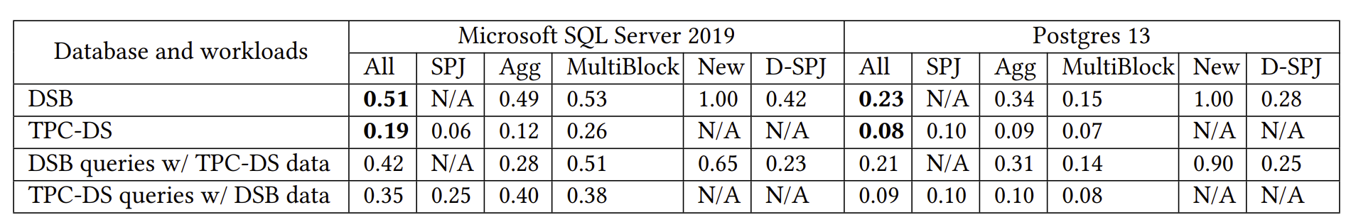
DSB vs. TPC-DS: Complexity of Query Optimization
Average normalized query optimization time
  Data generation x query generation

Slide 16
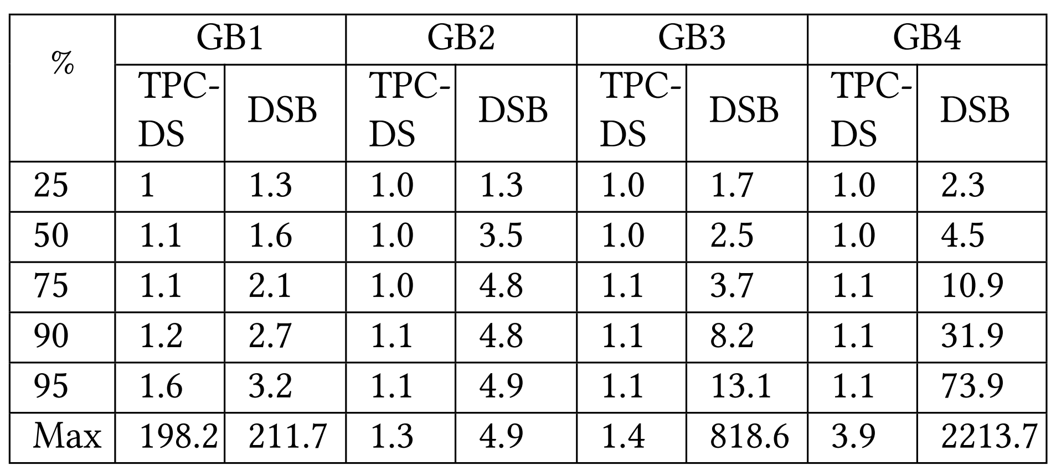
DSB vs. TPC-DS: Difficulty in Cardinality Estimation
Q errors w.r.t. independence assumption
  GB1: item grouped by i_category and i_manager_id
  GB4: The join result of catalog_sales, item, customer, customer_address, and customer_demographics grouped by i_category, cd_education_status, and ca_state.

Slide 17
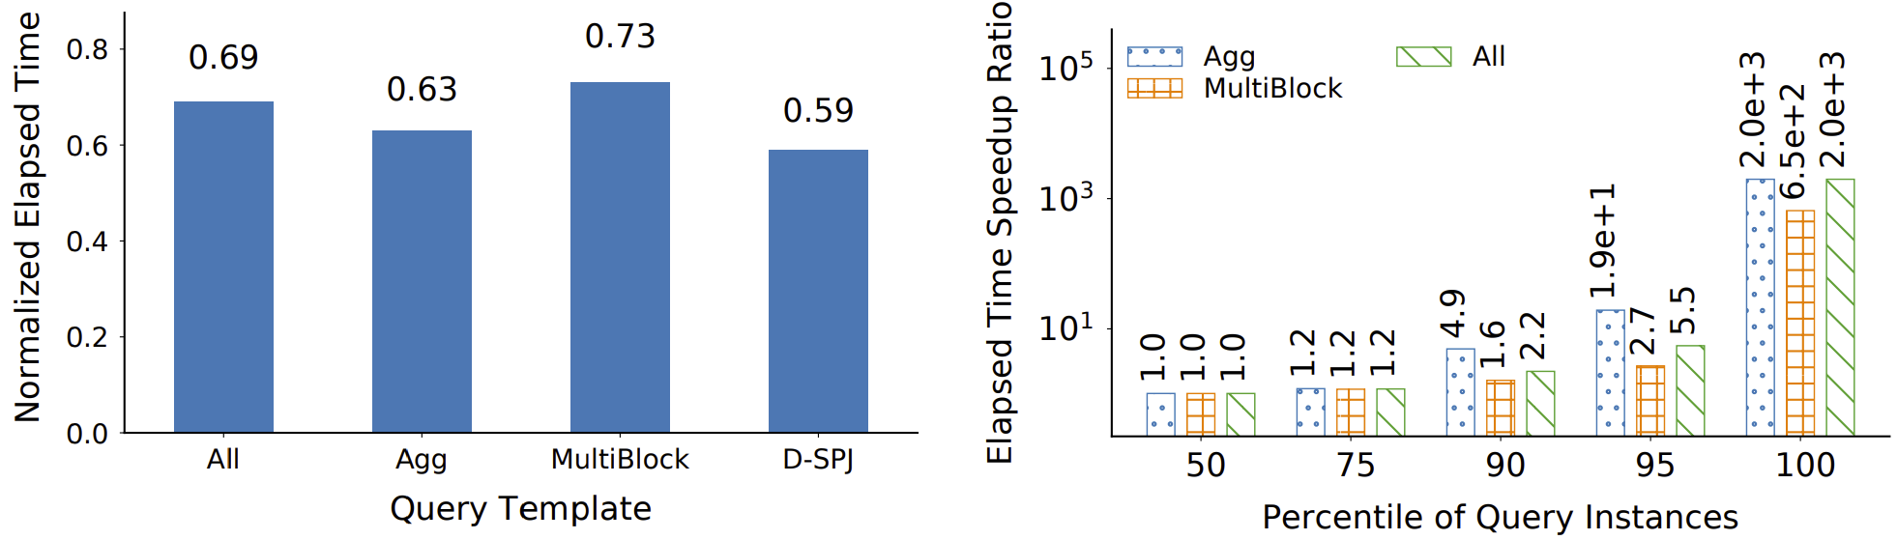
DSB: Room for Improvement in Plan Quality
Normalized elapsed time using ‘best’ plans
Distribution of elapsed time speedup ratio using ‘best’ plans

Slide 18
Case Study: Evaluating Traditional and ML-based DBMSs w/ DSB
Original
NoPartAgg: Disable advanced rules for group-bys
Three variants of a ML-based cardinality estimator
  MLData: Training query instances are automatically generated based on the database content
  MLSame: Training and test query instances are generated based on similar parameter distribution
  MLDiff: Training and test query instances are generated based on different parameter distributions

Slide 19
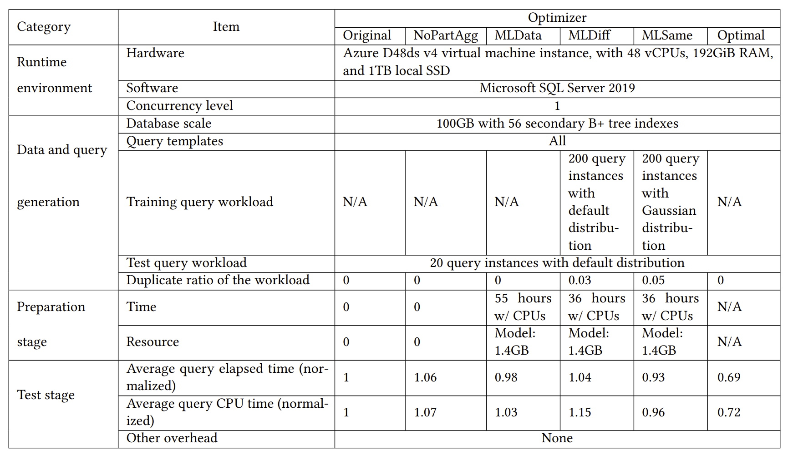
Case Study: Evaluating Traditional and ML-based DBMSs w/ DSB

Slide 20
Conclusion
We propose, DSB, a new decision support benchmark for evaluating both workload-driven and traditional database systems
DSB provides complex data distributions, challenging query templates, dynamic workloads, and evaluation guidelines to assess different performance aspects
DSB is open sourced at GitHub (aka.ms/dsb)
Bailu Ding
badin@microsoft.com

Slide 21
Thanks and Q&A
Bailu Ding
badin@microsoft.com

Slide 22
Backup

Slide 23
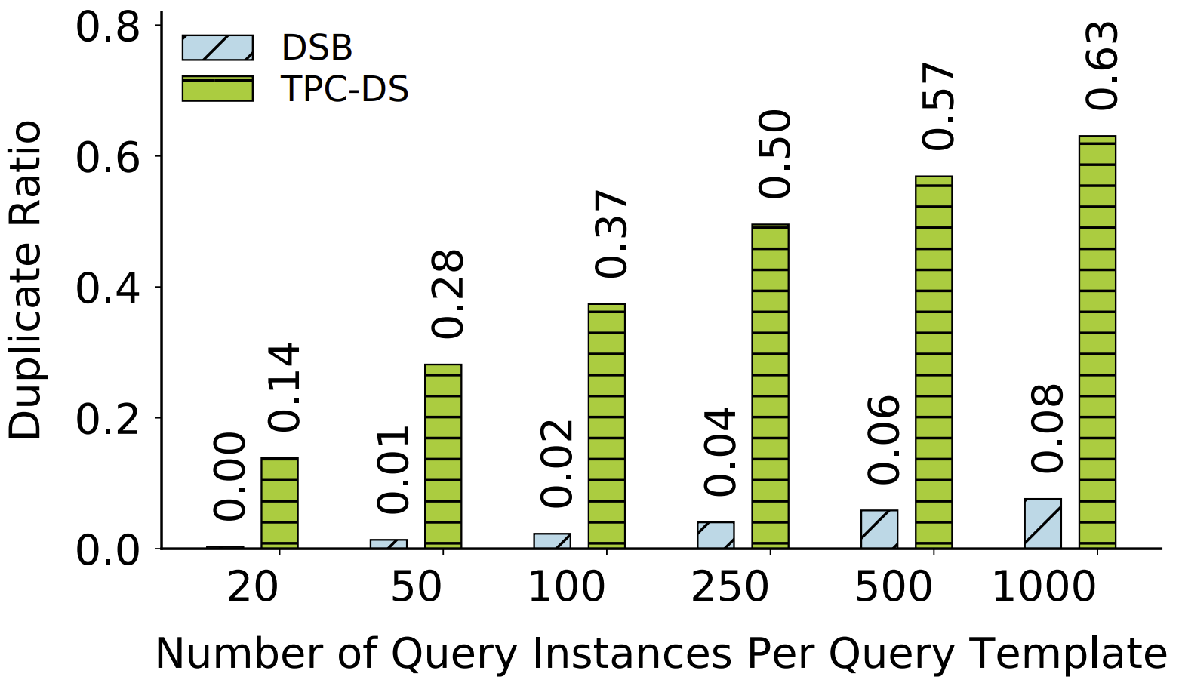
DSB vs. TPC-DS: Duplicate Ratio

