Slide 1
Reshaping Deep Models to Embed Explainability and Grow Trust
Xiting Wang
Social Computing Group
Microsoft Research Asia

Slide 2

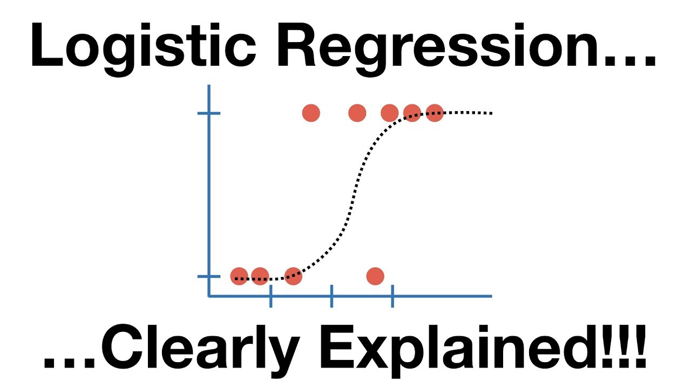



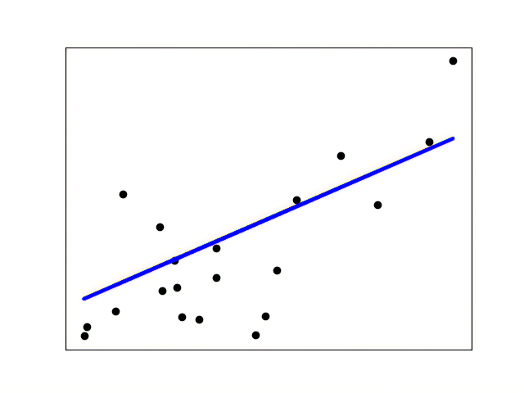
Trust Issues with Deep Models
What is the working mechanism?
Any serious unknown issues?
Performance aligns with real user satisfaction?
Fully transparent model
How to integrate user feedback?
Customer
Model developer
Deep model

Slide 3



Trust Issues with Deep Models
Any legal risks?
Will anyone feel dissatisfied?
…
Fully transparent model
Manager
Lawyers
Mutual understanding between models and humans?
Value others’ influence and voice
Open to criticisms
Model developer
Deep model
What is the working mechanism?
Any serious unknown issues?
Performance aligns with real user satisfaction?
Product manager
Customer
How to integrate user feedback?

Slide 4

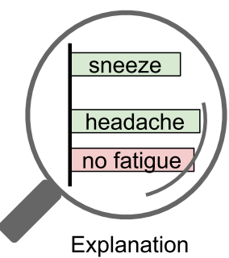



Limitation of Post-Hoc Explanations
The communication capability is inherently limited by their black-box nature
To ensure close collaboration, both human and the model should change
Sometimes
Understanding the model through post-hoc explanations
Can we trust the explanations?
Post-hoc explanations
$$≈$$
Trust?
Frequency
Always an approximation [1]
“General uneasiness” of practitioners [2]
Phase II:
Occasionally One-Way Communication
Practitioner 9 in [2]
Low
Feedback?
How to integrate user feedback?
No systematic method for direct control
Requires model retraining
No guarantee for satisfying user needs
Interpret a black-box model after it has been trained
Computational cost: test the complex black-box model thousands of times to obtain a complete and faithful understanding
“... it’s an attempt to make an estimate. So, it’s making a marginal claim in most cases.”
Can be easily applied to explain any trained model
Both humans and models should make effort to improve
[1] Stop Explaining Black Box Machine Learning Models for High Stakes Decisions and Use Interpretable Models Instead, Nature Machine Intelligence, 2019
[2] Human Factors in Model Interpretability: Industry Practices, Challenges, and Needs, ACM HCI 2020
Credible
Understandable
Relevant
Useful
Bi-
Quality
Direction
Seldom
Medium

Slide 5




Our Method: SELOR
  Upgrade a given deep model to a self-explaining version
Trust
Self-
Explaining
with
LOgic rule
Reasoning
  Upgrade
No trust issues: the model explains itself
Steerable: we can easily control the model by treating the explanations as handles
Human understandable: predict according to human logic, ensure that the humans are on the same page with the model
  Lays the foundation for close collaboration
  Upgrade a given deep model to a self-explaining version
  Trust: explanations faithful to the model
Control
  Feedback: explanations as handle for control
  Familiar
  Robust to noise
  Logic rules possess the …
  Advantages in terms of communication
  Once the model is upgraded, the bi-direction communication highway is built, and we can leverage it freely
  Automatically achieve high human precision
Self-explaining deep models with logic rule reasoning, Arxiv, 2022

Slide 6
Our Method: SELOR
Explain from the model’s perspective
Do not map to decisions that are reasonable for humans
is, an => positive sentiment
Self-
Explaining
with
LOgic rule
Reasoning
Low Human Precision
Definition: Whether the explanation naturally leads to the prediction according to human perception
Low Human Precision:
User Study of SENN [1]
>30% explanation: humans cannot correctly guess model prediction
(Yelp dataset)
is, an => positive sentiment
awesome => positive sentiment
[1] Towards Robust Interpretability with Self-Explaining Neural Networks, NeurIPS 2018
High Human Precision:

Slide 7



Our Method: SELOR
Logic rules
not BEFORE good => negative sentiment
awesome AND tasty => positive sentiment
Close to human decision logic
Widely applied for making predictions
Explanations reasonable to humans?
  Upgrade a given deep model to a self-explaining version
Self-
Explaining
with
LOgic rule
Reasoning
  Human precision?
No trust issues: the model explains itself
Steerable: we can easily control the model by treating the explanations as handles
Human understandable: predict according to human logic, ensure that the humans are on the same page with the model
  Select rules automatically
  Select rules that lead to accurate prediction and high human precision
  Minimum human effort
  Define the form of the rule
Whether humans find the explanations reasonable and naturally leads to the prediction
e.g., basic unit: word
logical connectives = {AND, OR}
max rule length = 4
Explanations reasonable to humans?
  Prediction performance?
  Familiar
  Robust to noise
  Logic rules possess the …
  Advantages in terms of communication
  Once the model is upgraded, the bi-direction communication highway is built, and we can leverage it freely
  Automatically achieve high human precision
The usefulness are inherently limited because most existing self-explaining models are not on the same page with humans
The usefulness are inherently limited because most existing self-explaining models are not on the same page with humans
Is expla, the models will mostly explain from the
LIME Anchor SENN RCN Ours
Cannot derive useful and actionable insights
+48%
SENN
RCN
Ours
LIME
Anchor

Slide 8
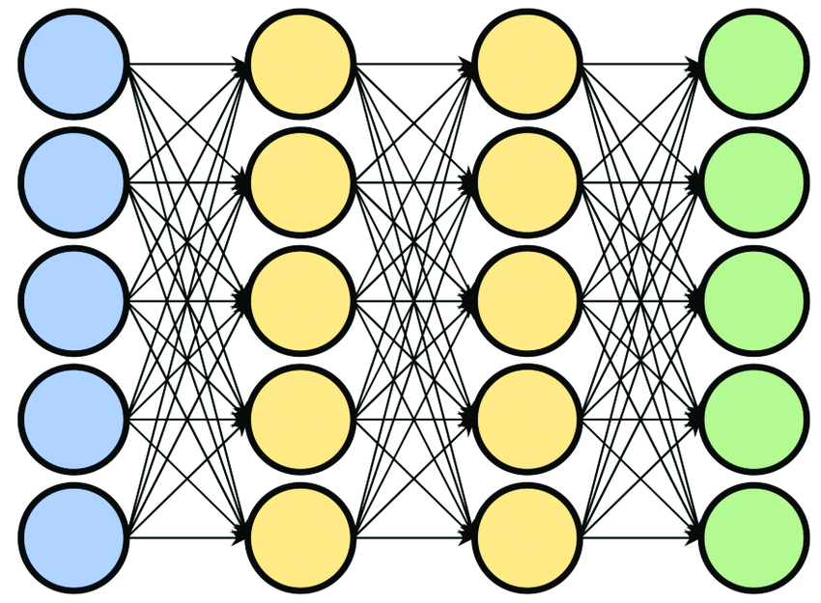

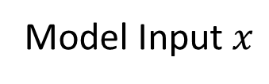
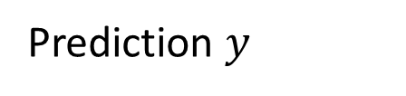
Framework
Input embedding $e$
Model Input $x$
Prediction $y$
The food is awesome, and the service is good
E.g., Softmax + Linear
Positive sentiment
…
Prediction layer
Encoder Network

Slide 9
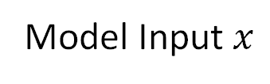
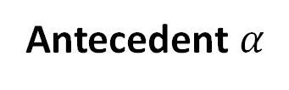
Framework
awesome AND tasty => positive sentiment
Antecedent
Consequent
(condition for applying the rule)
Antecedent $α$
the
the AND food
service AND food
……
the AND is AND good
and AND the AND is
……
Input embedding $e$
Model Input $x$
The food is awesome, and the service is good
RNN
awesome AND good
…
Antecedent generator
Selects the first part of the rule from all candidates
Candidate: antecedent that satisfies the human given form

Slide 10
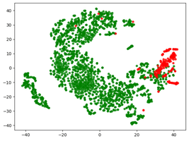
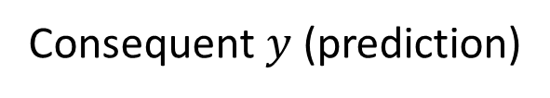
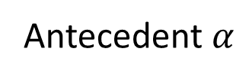
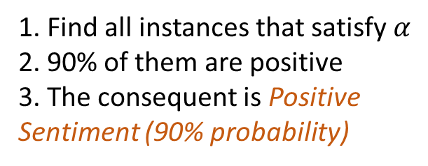
Framework
awesome AND tasty => positive sentiment
Antecedent
Consequent
(model prediction)
Input embedding $e$
Model Input $x$
Antecedent $α$
The food is awesome, and the service is good
RNN
awesome AND good
…
Rule
Consequent estimator
Consequent $y$ (prediction)
1. Find all instances that satisfy $α$
2. 90% of them are positive
3. The consequent is Positive Sentiment (90% probability)
Positive sentiment
(90% probability)

Slide 11
Framework
Optimize the cross-entropy loss
Automatically find rules that can well distinguish positive and negative samples
High Human Precision
awesome AND good => pos (90% prob)
Small loss
is AND an => positive sentiment (50% prob)
Large loss
Input embedding $e$
Model Input $x$
Antecedent $α$
The food is awesome, and the service is good
RNN
awesome AND good
…
Rule
Consequent estimator
Consequent $y$ (prediction)
1. Find all instances that satisfy $α$
2. 90% of them are positive
3. The consequent is Positive Sentiment (90% probability)
Positive sentiment
(90% probability)

Slide 12
Framework
Optimize the cross-entropy loss
Automatically find rules that can well distinguish positive and negative samples
awesome AND good => pos (90% prob)
Small loss
is AND an => positive sentiment (50% prob)
Large loss
High Human Precision
Input embedding $e$
Model Input $x$
User study
Percentage of best
Antecedent $α$
The food is awesome, and the service is good
RNN
awesome AND good
+500%
…
(Adult dataset)
Rule
Consequent estimator
Consequent $y$ (prediction)
1. Find all instances that satisfy $α$
2. 90% of them are positive
3. The consequent is Positive Sentiment (90% probability)
Positive sentiment
(90% probability)

Slide 13

Framework
Optimize the cross-entropy loss
Automatically find rules that can well distinguish positive and negative samples
awesome AND good => pos (90% prob)
Small loss
is AND an => positive sentiment (50% prob)
Large loss
High Human Precision
Input embedding $e$
Model Input $x$
User study
Percentage of best
Antecedent $α$
The food is awesome, and the service is good
RNN
awesome AND good
+500%
…
(Adult dataset)
Rule
Consequent estimator
Consequent $y$ (prediction)
Good Prediction Performance
1. Find all instances that satisfy $α$
2. 90% of them are positive
3. The consequent is Positive Sentiment (90% probability)
Positive sentiment
(90% probability)
SELOR
$$≈$$

Slide 14
Framework
Optimize the cross-entropy loss
Automatically find rules that can well distinguish positive and negative samples
awesome AND good => pos (90% prob)
Small loss
is AND an => positive sentiment (50% prob)
Large loss
Training cost
High Human Precision
Input embedding $e$
Model Input $x$
User study
Percentage of best
Antecedent $α$
  Trained efficiently in a differentiable way with widely-used deep learning modules
The food is awesome, and the service is good
RNN
awesome AND good
+500%
…
(Adult dataset)
Rule
Consequent estimator
SELOR
slightly slower than
+16% training time
(BERT base, Yelp)
Consequent $y$ (prediction)
Good Prediction Performance
1. Find all instances that satisfy $α$
2. 90% of them are positive
3. The consequent is Positive Sentiment (90% probability)
Positive sentiment
(90% probability)
SELOR
$$≈$$

Slide 15


Additional Advantages
  Generate explanations efficiently
  Robust to noisy labels
SELOR vs LIME: 1,000x speed-up
SELOR vs Anchor: >50,000x speed-up
(BERT base, Yelp)
>10% F1 increase when 20% labels are randomly flipped
(BERT base, Yelp)
vs
SELOR
$$>$$
  Can be steered without retraining
vegas => positive sentiment
tasteless => negative sentiment

Slide 16

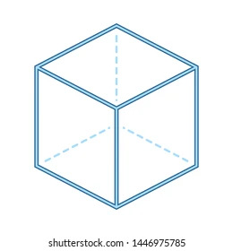


Explainable Machine Reasoning
Initial attempts for achieving close human-close relation
There is so much we should learn from interdisciplinary studies
We need to find better ways to evaluate the reasoning processes
Logic rule: SELOR [Arxiv 2022]
Knowledge graph: ReMR [WWW 2022], AnchorKG [KDD 2021], ADAC [SIGIR 2020], ECR [IJCAI 2020], DEAML [AAAI 2019]
Social network: SureFact [KDD 2022], FinerFact [AAAI 2021]
Symbolic System
Substructure
Input
Output Prediction
…
Plan II
Interdisciplinary Collaboration
Plan I
Explanation Benchmark Dataset
Psychologists’ view
  System 1 Thinking Intuition
Logical Reasoning
  System 2 Thinking: Reasoning
① Model design
Neuroscientists’ view
Human Knowledge
② Desirable reasons

Slide 17


Thanks
Xiting Wang
Social Computing Group
Microsoft Research Asia

