Slide 1
Machine Learning Assisted Hyper-heuristics for Online Combinatorial Optimization
2022 MSRA Data-Driven Optimization Workshop, 26 Nov. 2022
Ruibin Bai
Digital Port Technologies Lab
School of Computer Science
University of Nottingham Ningbo China

Slide 2
Contents
Combinatorial Optimization and Hyper-heuristics
Container Port Truck Online Dispatching Optimization
A Double-layer Genetic Programming Hyper-heuristics
Deep Reinforcement Learning Hyper-heuristic

Slide 3

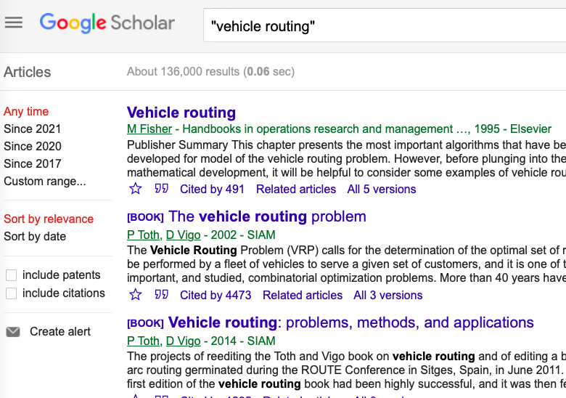
机器学习与运筹优化结合的车辆调度问题
Background and Motivation
136,000 publications
28,900 publications
a hugely popular topic but …
  limited pratical applications
  mostly focusing on analytical results.
  complex mathematical models for uncertainty handling
  unrealistic computational time
An emerging VRP research directions
  Analytical Methods + Machine learning (ML)
  Two different (often isolated) communities: Operations Research vs Computer Science/AI

Slide 4

组合优化问题 - Challenges
Combinatorial Optimization Problems (COP)
COP is the problem of finding the optimal assignments, sequencing, grouping, scheduling of discrete events under various conditions/constraints.
Example Problems
VRP
Timetabling
Scheduling
Challenges
Large scale
NP-Hard
Constraints
MOO
Non-linear
Uncertainty
Drawbacks of the current methods
Data
OR, CI
DNN
$$∑$$
Neglect uncertainty of data source
Model not flexible
computation time
Robustness
Poor Interpretability
Poor reusability
Low data efficiency

Slide 5
ML Guided COP with Uncertainties
Offline training + online optimization
Offline solution+ sliding time window
Offline Problem Solving
Execution
Offline Training
Execution
Problem Params. Estimation
Uncertainties realisation & Mornitoring
Problem Params. Distribution, Training data
Uncertainties realisation
Deterministic Problem Models
Resolving
Stochastic problem Models
Execution
Execution
States Monitoring
Solution
Optimisation Policy
Optimization
Learning & Optimization
Ruibin Bai, Xinan Chen, Zhi-long Chen, et al. 2021. Analytics and Machine Learning in Vehicle Routing Research. International Journal of Production Research. https://arxiv.org/abs/2102.10012v1

Slide 6
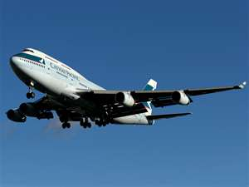
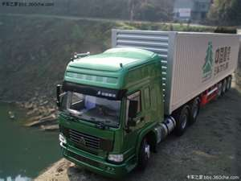
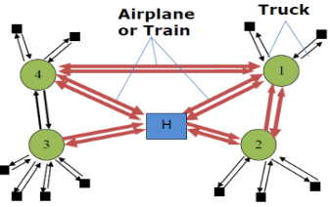

Service network design – Deterministic Modeling
Service network design
  Bi-directional commodity flow
  Transfer/consolidation
  Multi-modal
  Mixed Integer Problem
  Vehicle route, commodity flow path separate rep
  Tactical planning
Vehicle Routing Problem
  Single directional commodity flow
  No transfers/consolidation
  Integer Programming Problem
  Vehicle route/commodity flow integrated solution rep.
  Operational planning
D

Slide 7
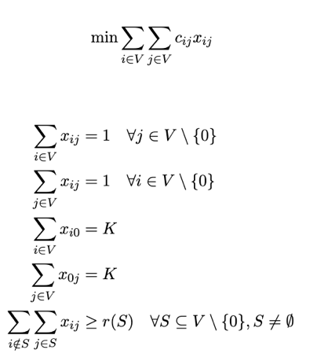
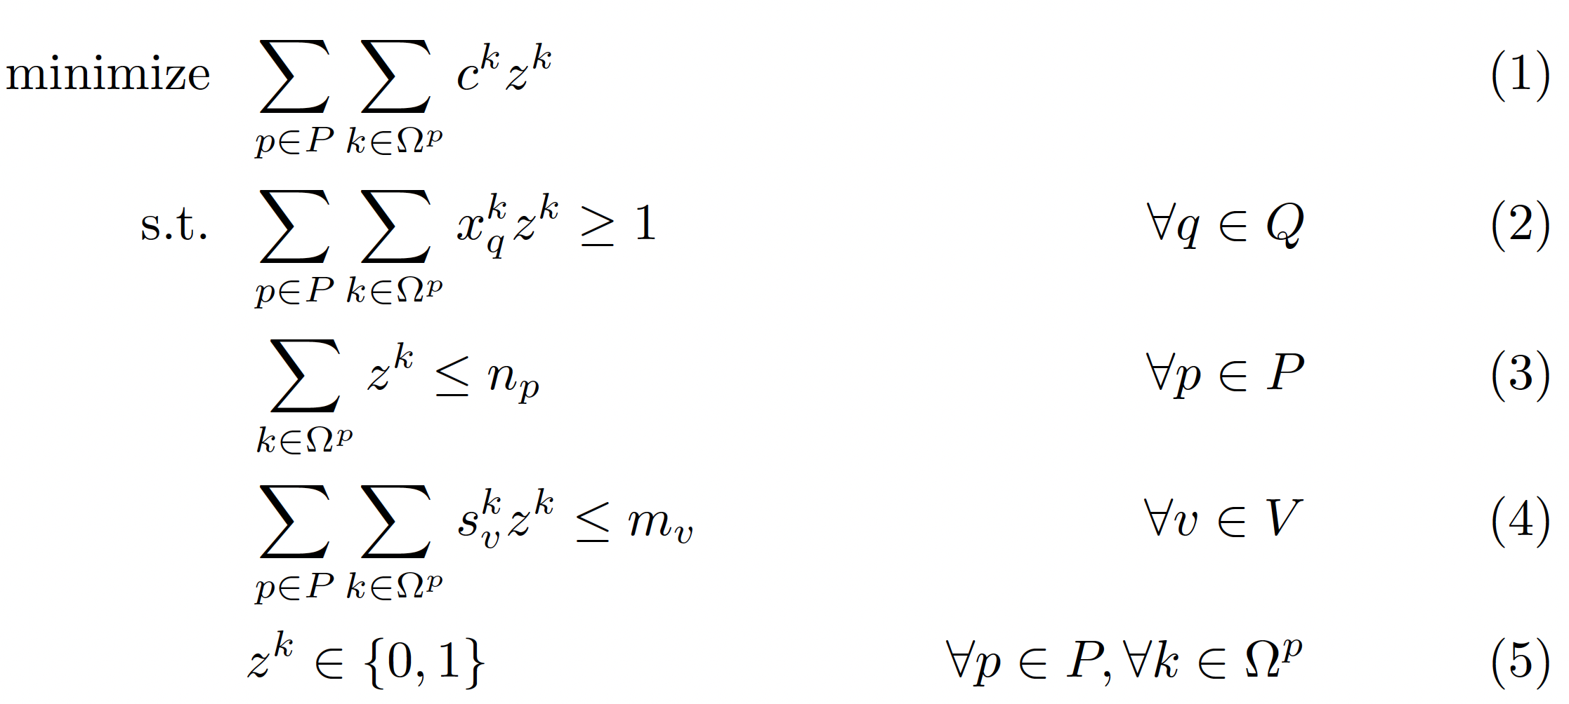



Capacitated Vehicle Routing Problem (CVRP) -Modelling
Model 1
Model 2: SCP
Each customer is serviced exactly once.
Total of K vehicles available.
$$Ω^{p}$$
Set of feasible routes for vehicle type p
$$z^{k}$$
Whether route k is used in the solution or not.
Sufficient vehicle capacity for any subset customers.
$$x_{q}^{k}$$
Indicate whether item q can be delivered by route k.

Slide 8
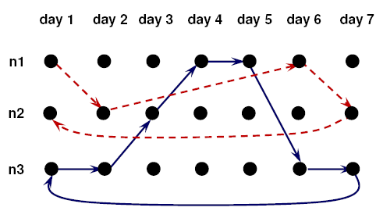
SNDP Modeling – An Arc-Node Model
Capacity
Flow conservation
Asset balancing
Design variables
Flow variables
A space-time network with 3 nodes over 5 days.

Slide 9
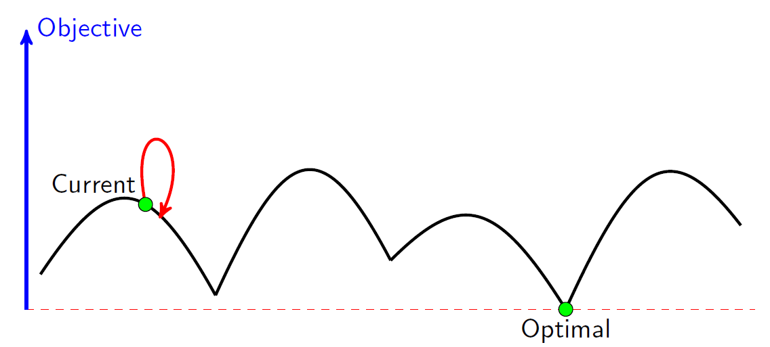
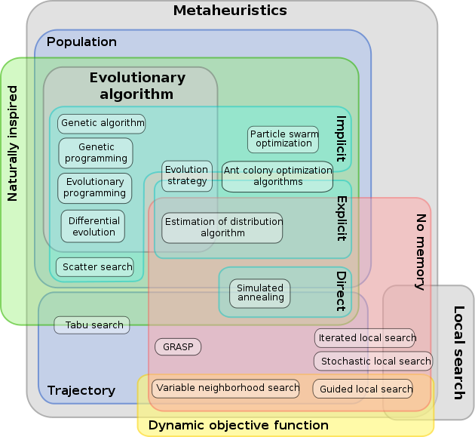
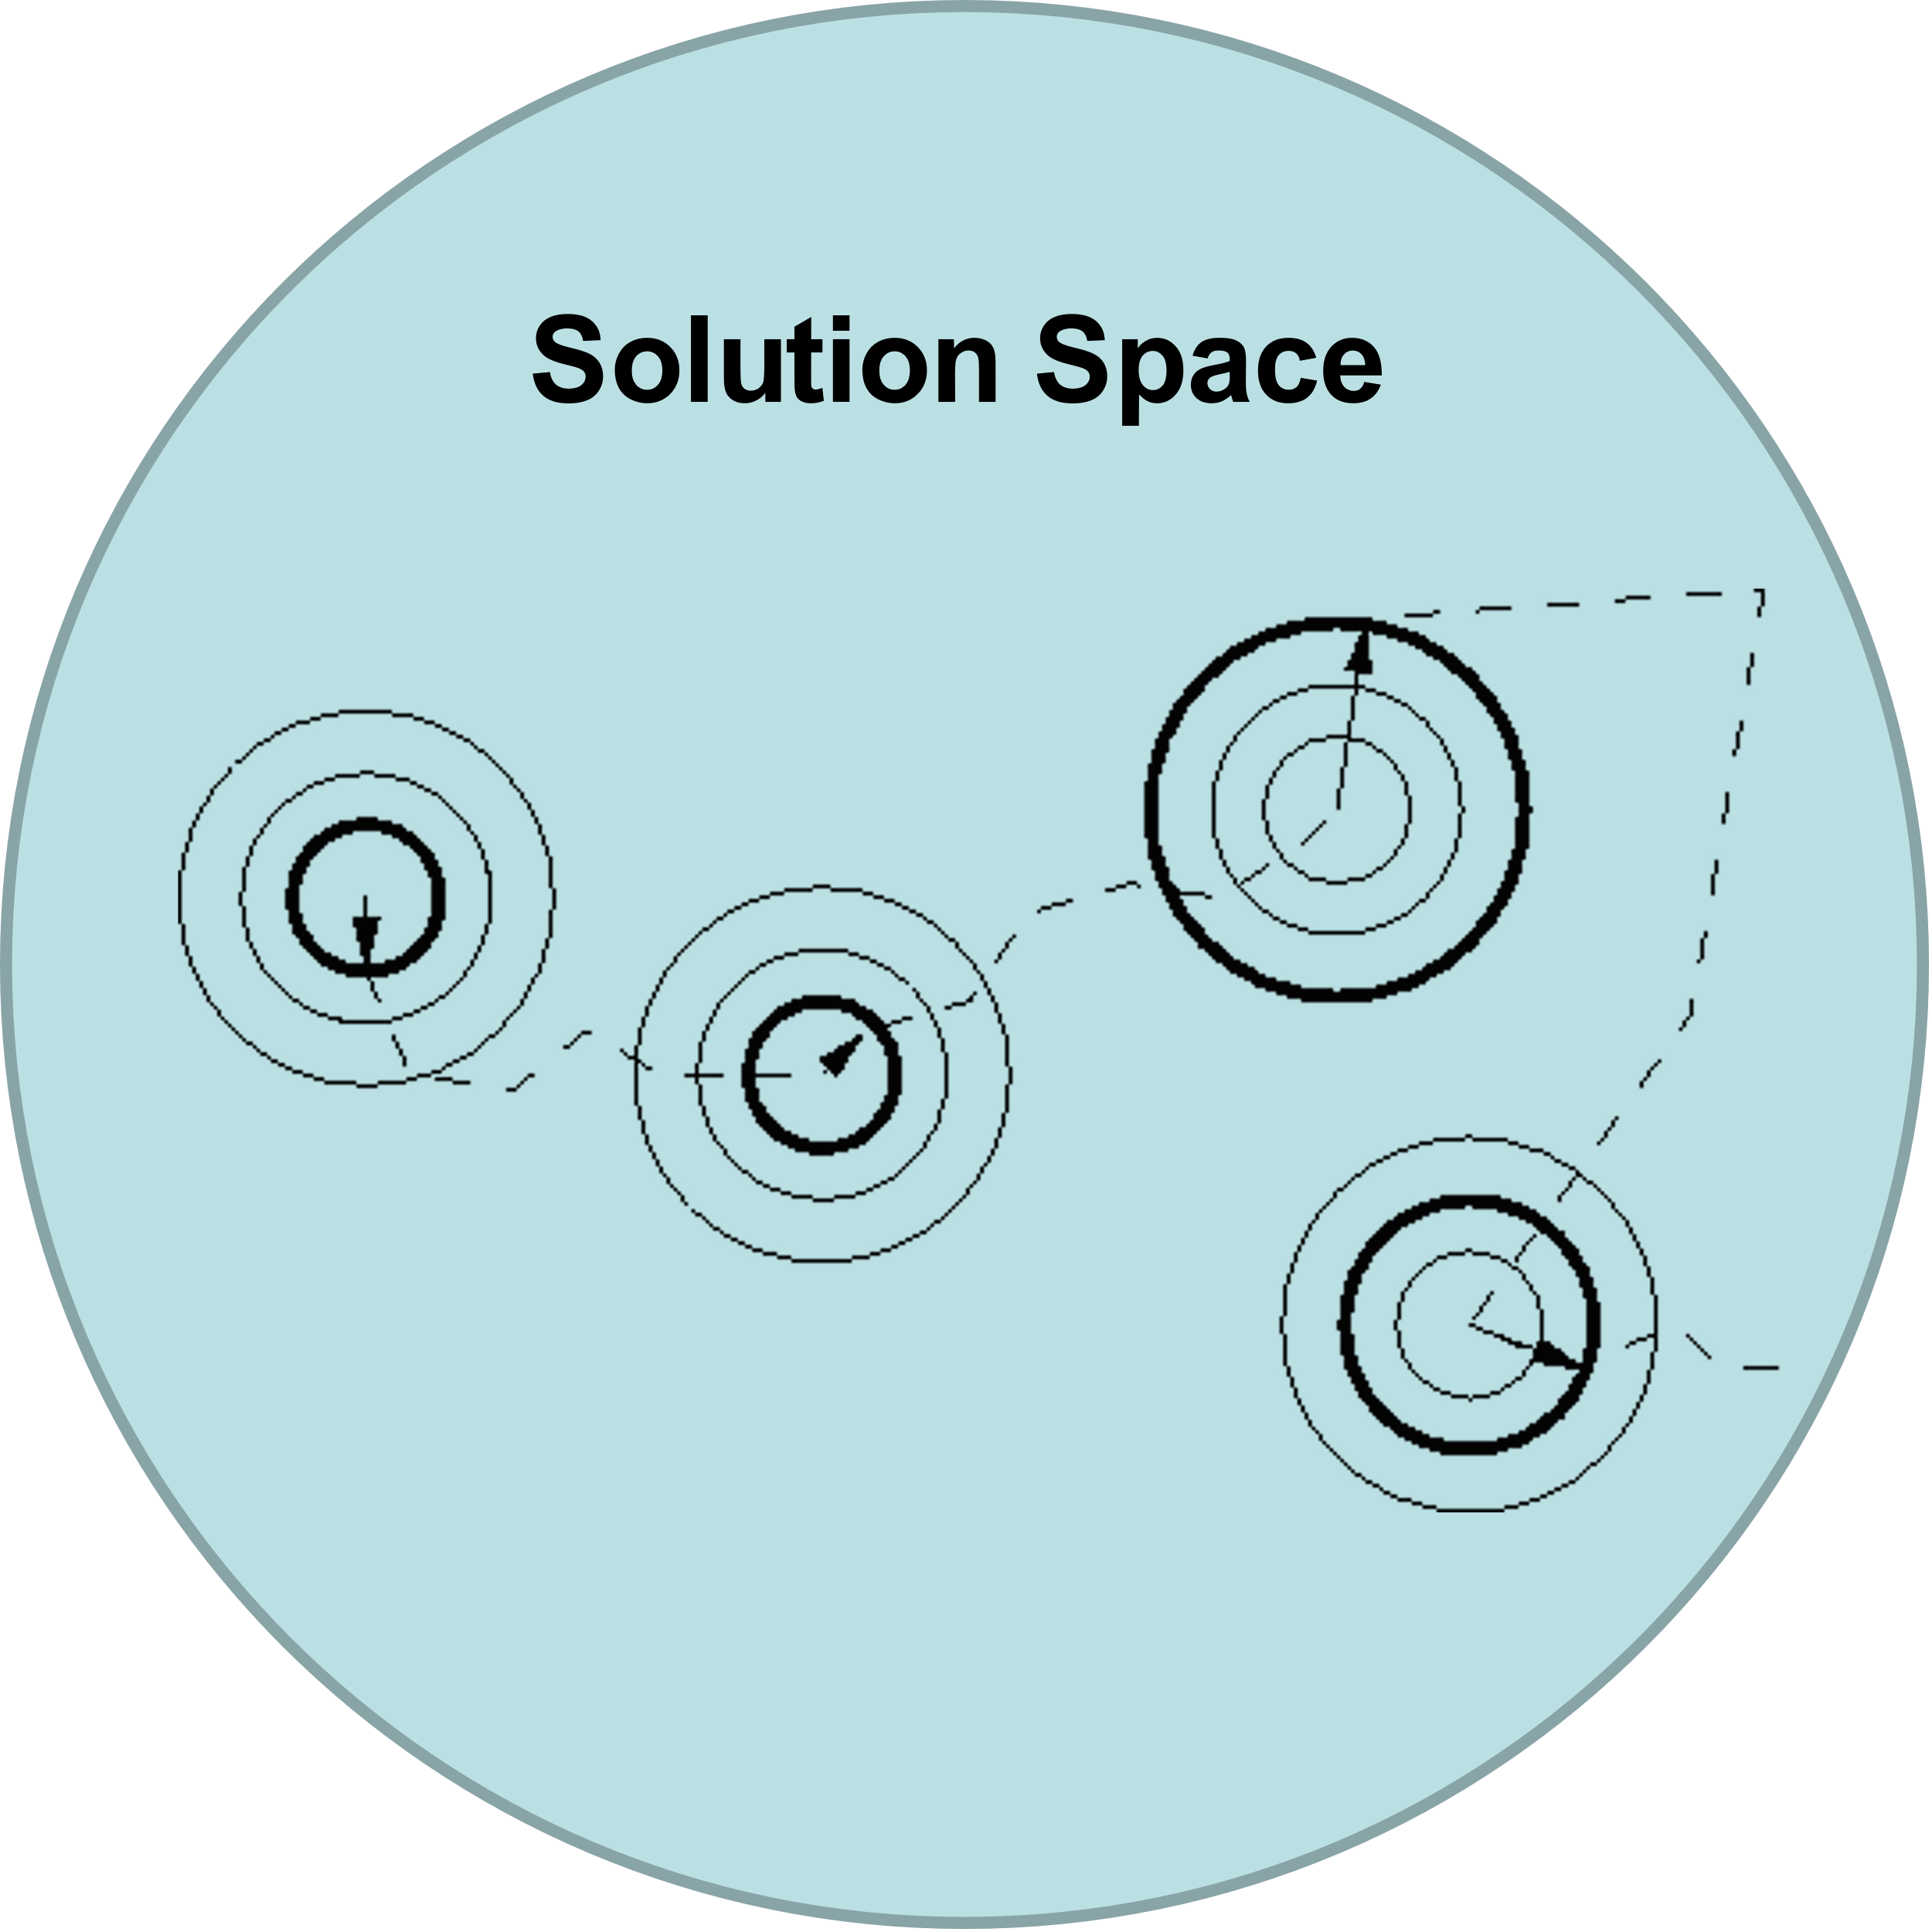
Metaheuristics for Combinatorial Optimisation
exploitation
exploration

Slide 10
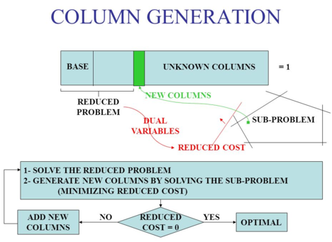
Integer Programming for VRP – Column Generation (or B&P)
Source: https://optimization.cbe.cornell.edu/index.php?title=Column_generation_algorithms

Slide 11
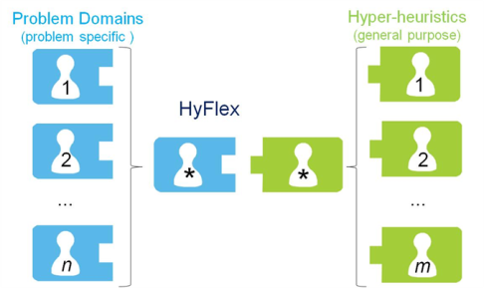
Hyper-heuristics
Hyper-heuristic is a search method or learning mechanism for selecting or generating heuristics to solve computationally difficult problems (Burke et al. 2013).
A class of methodologies with the common goal of automating the design and tuning of heuristic methods
Heuristic Space
Domain Barrier / Interface
Solution Space
E. K. Burke, M. Gendreau, M. Hyde, G. Kendall, G. Ochoa, E. Özcan, R. Qu, Hyper-heuristics: A Survey of the State of the Art, Journal of the Operational Research Society, 64 (12) , pp. 1695-1724, 2013. [PDF]

Slide 12
E. K. Burke, M. Hyde, G. Kendall, G. Ochoa, E. Özcan, and J. Woodward (2010). A Classification of Hyper-heuristic Approaches. In Gendreau, Michel and Potvin, Jean-Yves (eds.), Handbook of Metaheuristics, International Series in Operations Research & Management Science, Volume 146, pp. 449-468. Springer.
Heuristic Space
Nature of the heuristic search space
Solution Space
Heuristic selection
constructive heuristics
Hyper-heuristics
Methodologies to select
Fixed heuristics (mostly human designed)
perturbative heuristics
Heuristic generation
constructive heuristics
Automatically generated heuristics from components
Methodologies to generate
perturbative heuristics

Slide 13
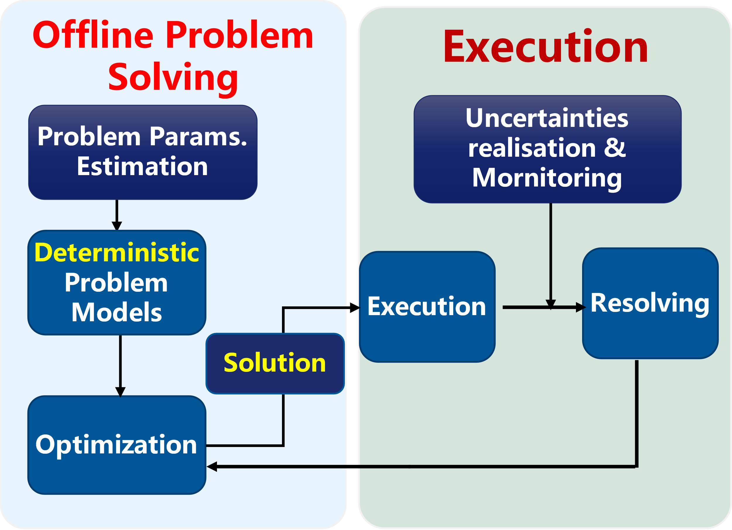
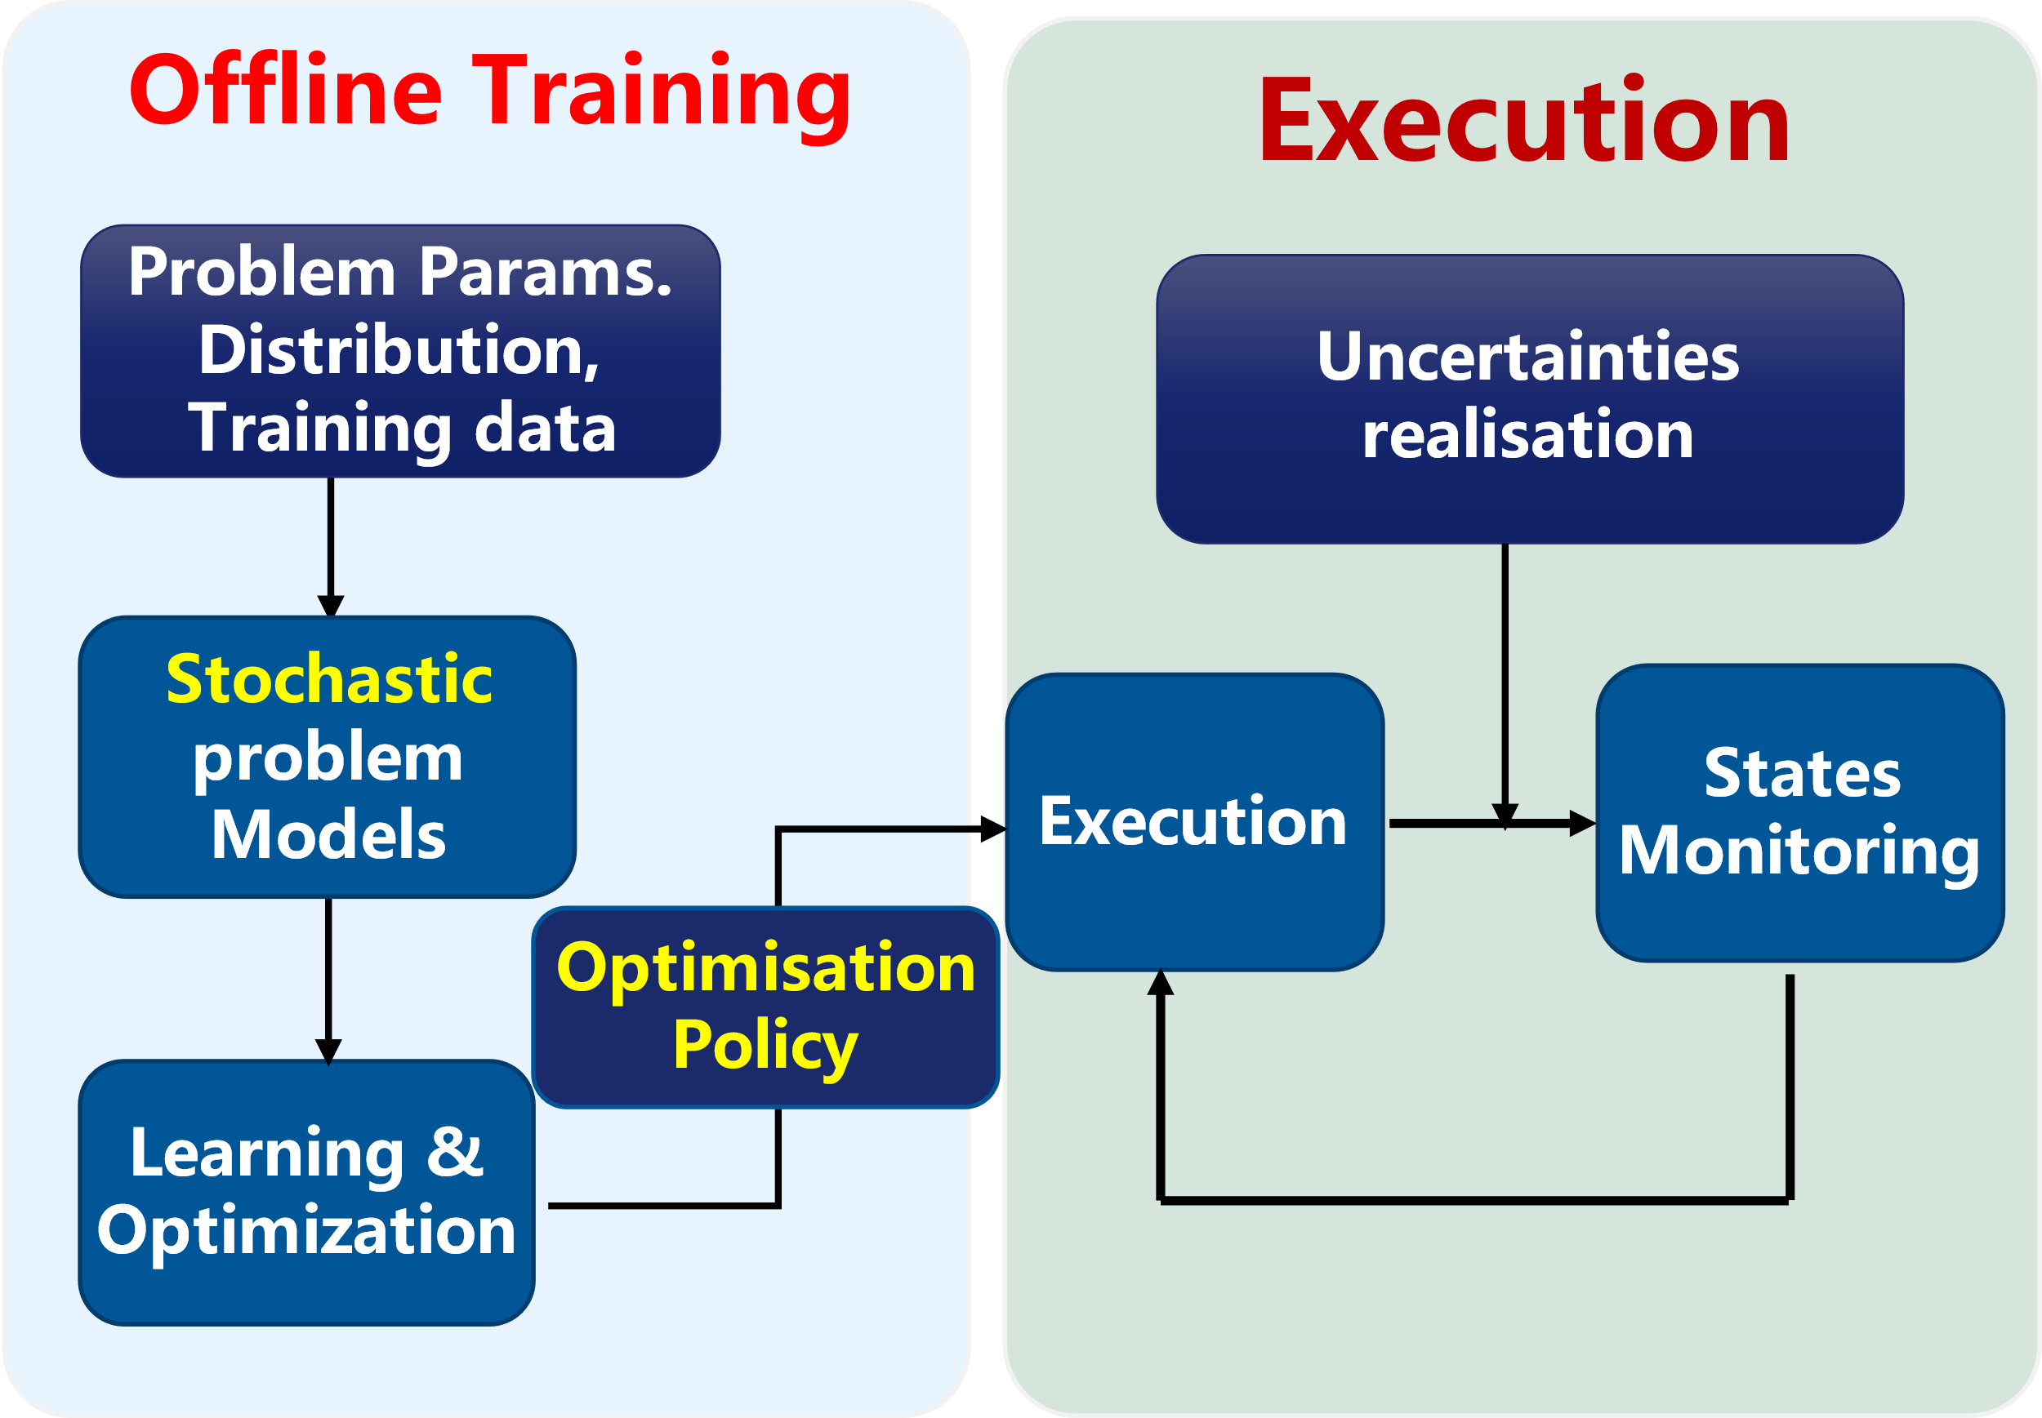
ML Guided VRP Research – A Classification
Ruibin Bai, Xinan Chen, Zhi-long Chen, et al. 2021. Analytics and Machine Learning in Vehicle Routing Research. International Journal of Production Research. https://arxiv.org/abs/2102.10012v1

Slide 14
Contents
Combinatorial Optimization and Hyper-heuristics
Container Port Truck Online Dispatching Optimization
A Double-layer Genetic Programming Hyper-heuristics
Deep Reinforcement Learning Hyper-heuristic

Slide 15

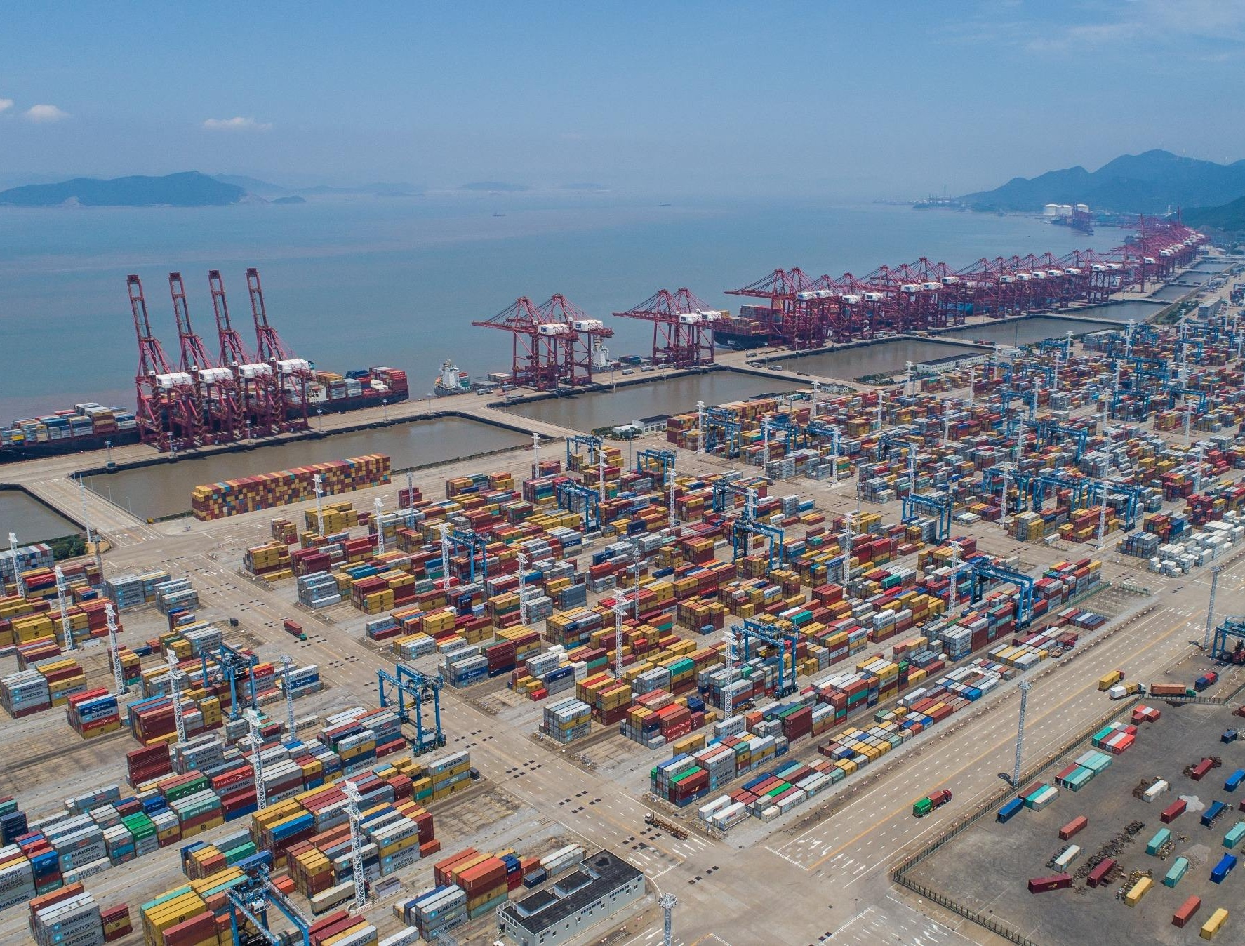





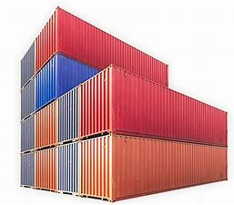

Optimization Problems in a Container Terminal
Berth & Crane
泊位及桥吊分配
Ship Arrivals
船期计划
Export Yard
出口箱派位
桥吊crane
班轮
ship
泊位berth
引桥
bridge
Load Balancing
船舶配载
Yard Plan
堆场计划
龙门吊
Yard crane
堆场
yard
Truck Routing
全场车辆调度
Import Yard
卸船（进口箱）派位
Yard Crane
堆场吊调度
集卡
truck

Slide 16

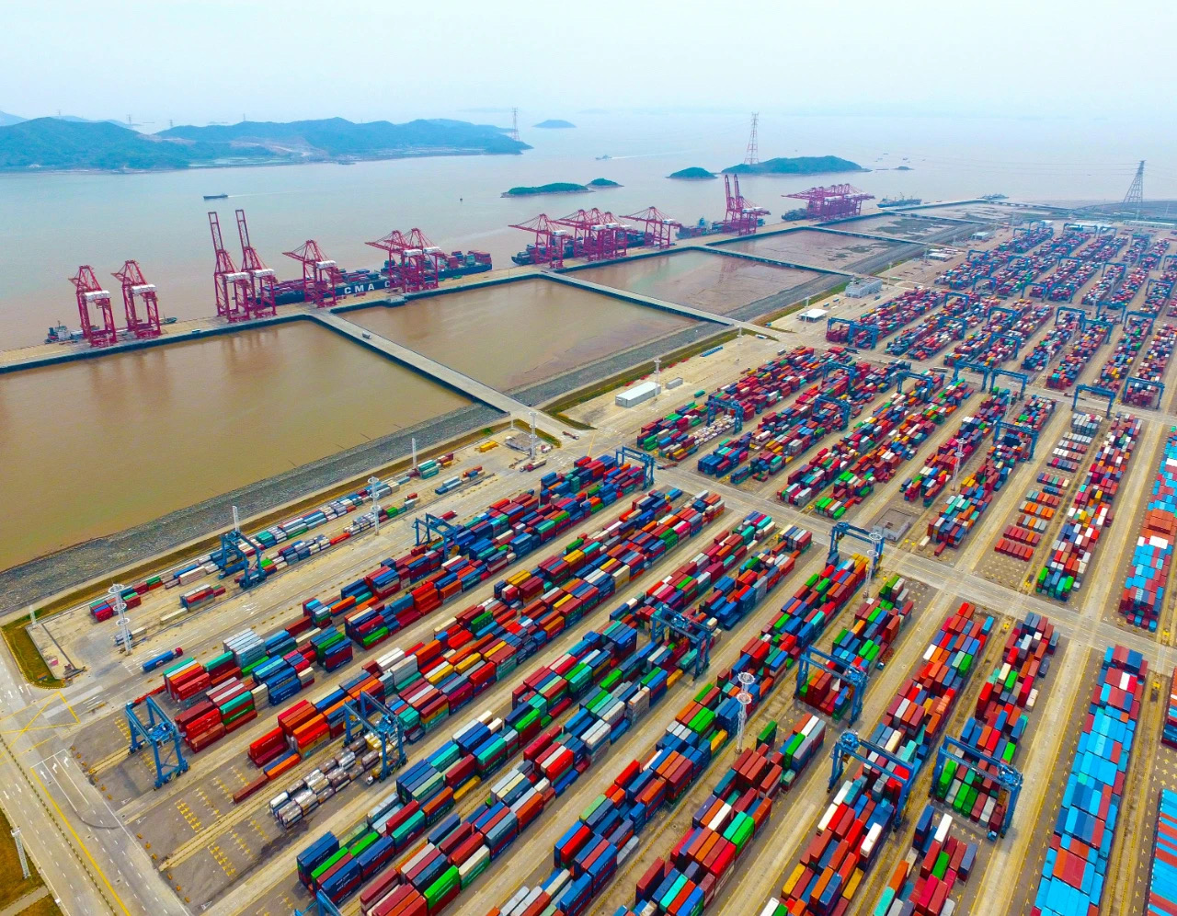

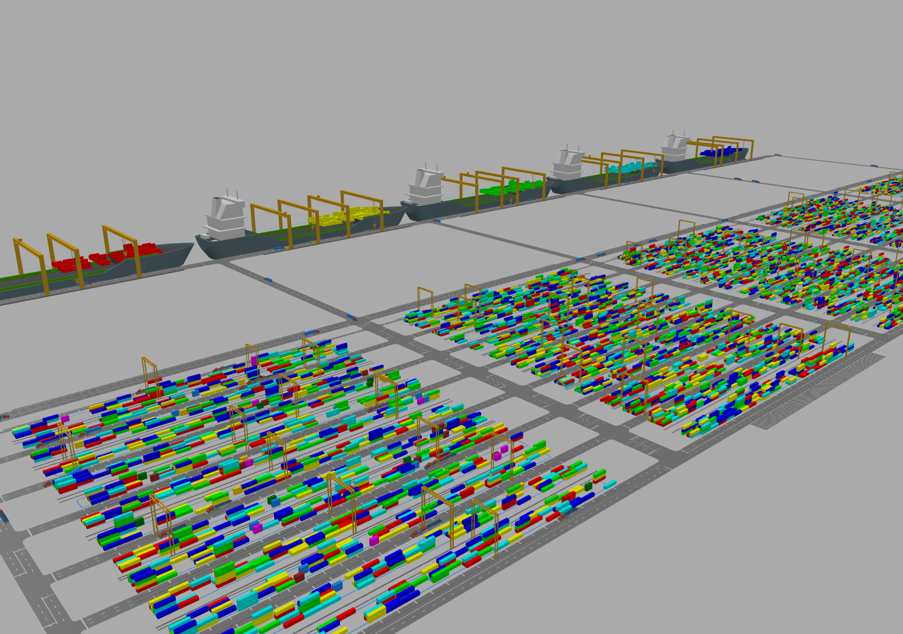
Port Terminal Simulation for Optimization Purposes
Data
数据
Business process业务流程
Algorithm
算法
Math. Model
数理模型
Robust and top performance algorithm requires a good training environment.

Slide 17
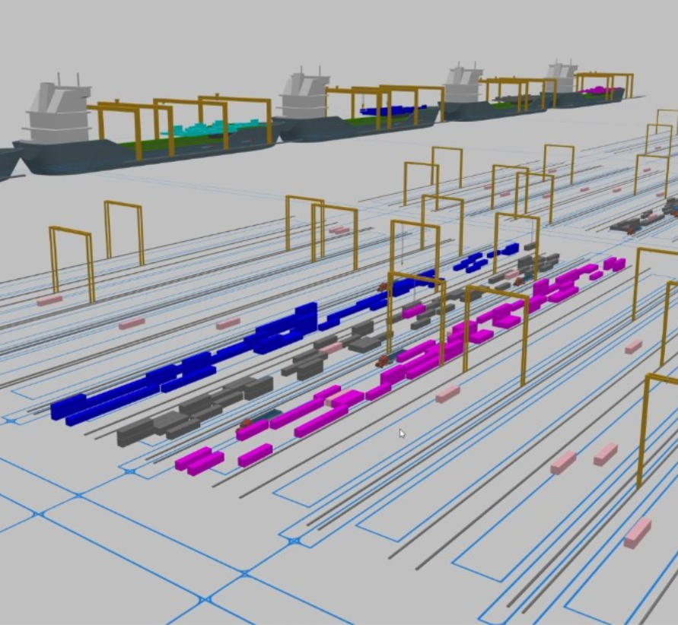
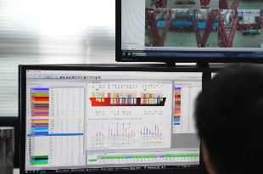
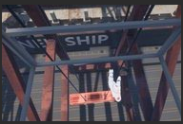
Digital Twin Based Port Operation System
数字孪生人工智能交互技术
港口业务系统（EDI/PORTNET）
港口作业系统
（TOS System）
数据转换
Dataset Generation数据生成
Scenario prediction场景推演
Algorithm Training 算法训练
Testing and Verfication 测试验证
HCI 中间件
Prediction and Warning 预测预警
Scen. Data
场景数据库
数字孪生
港口智能调度
Algorithms
算法知识库
数字孪生港口
非线性
超启发算法框架
动态
VR等交互
鲁棒
港口场景推演
基于VR人机交互

Slide 18
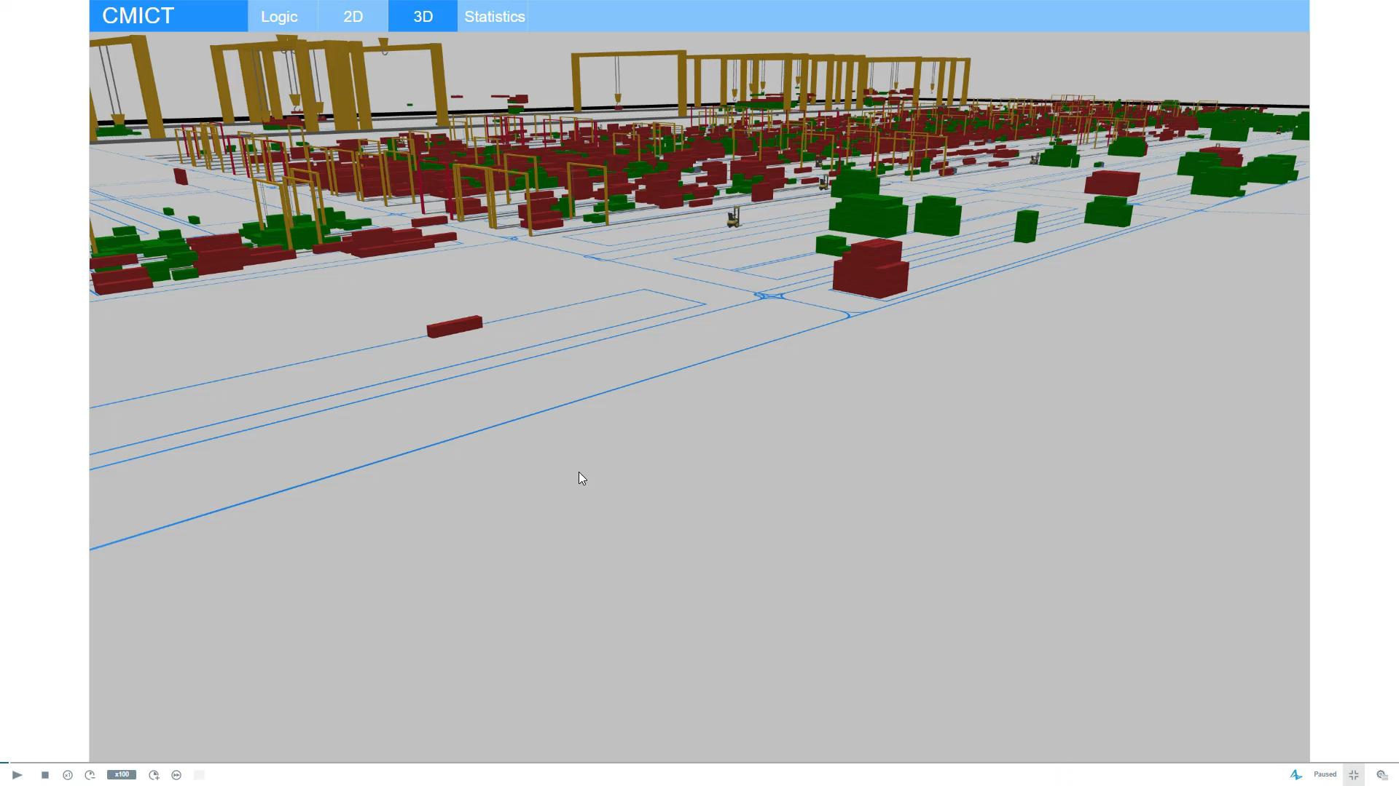
Port Simulation for Algorithm Training and Testing

Slide 19
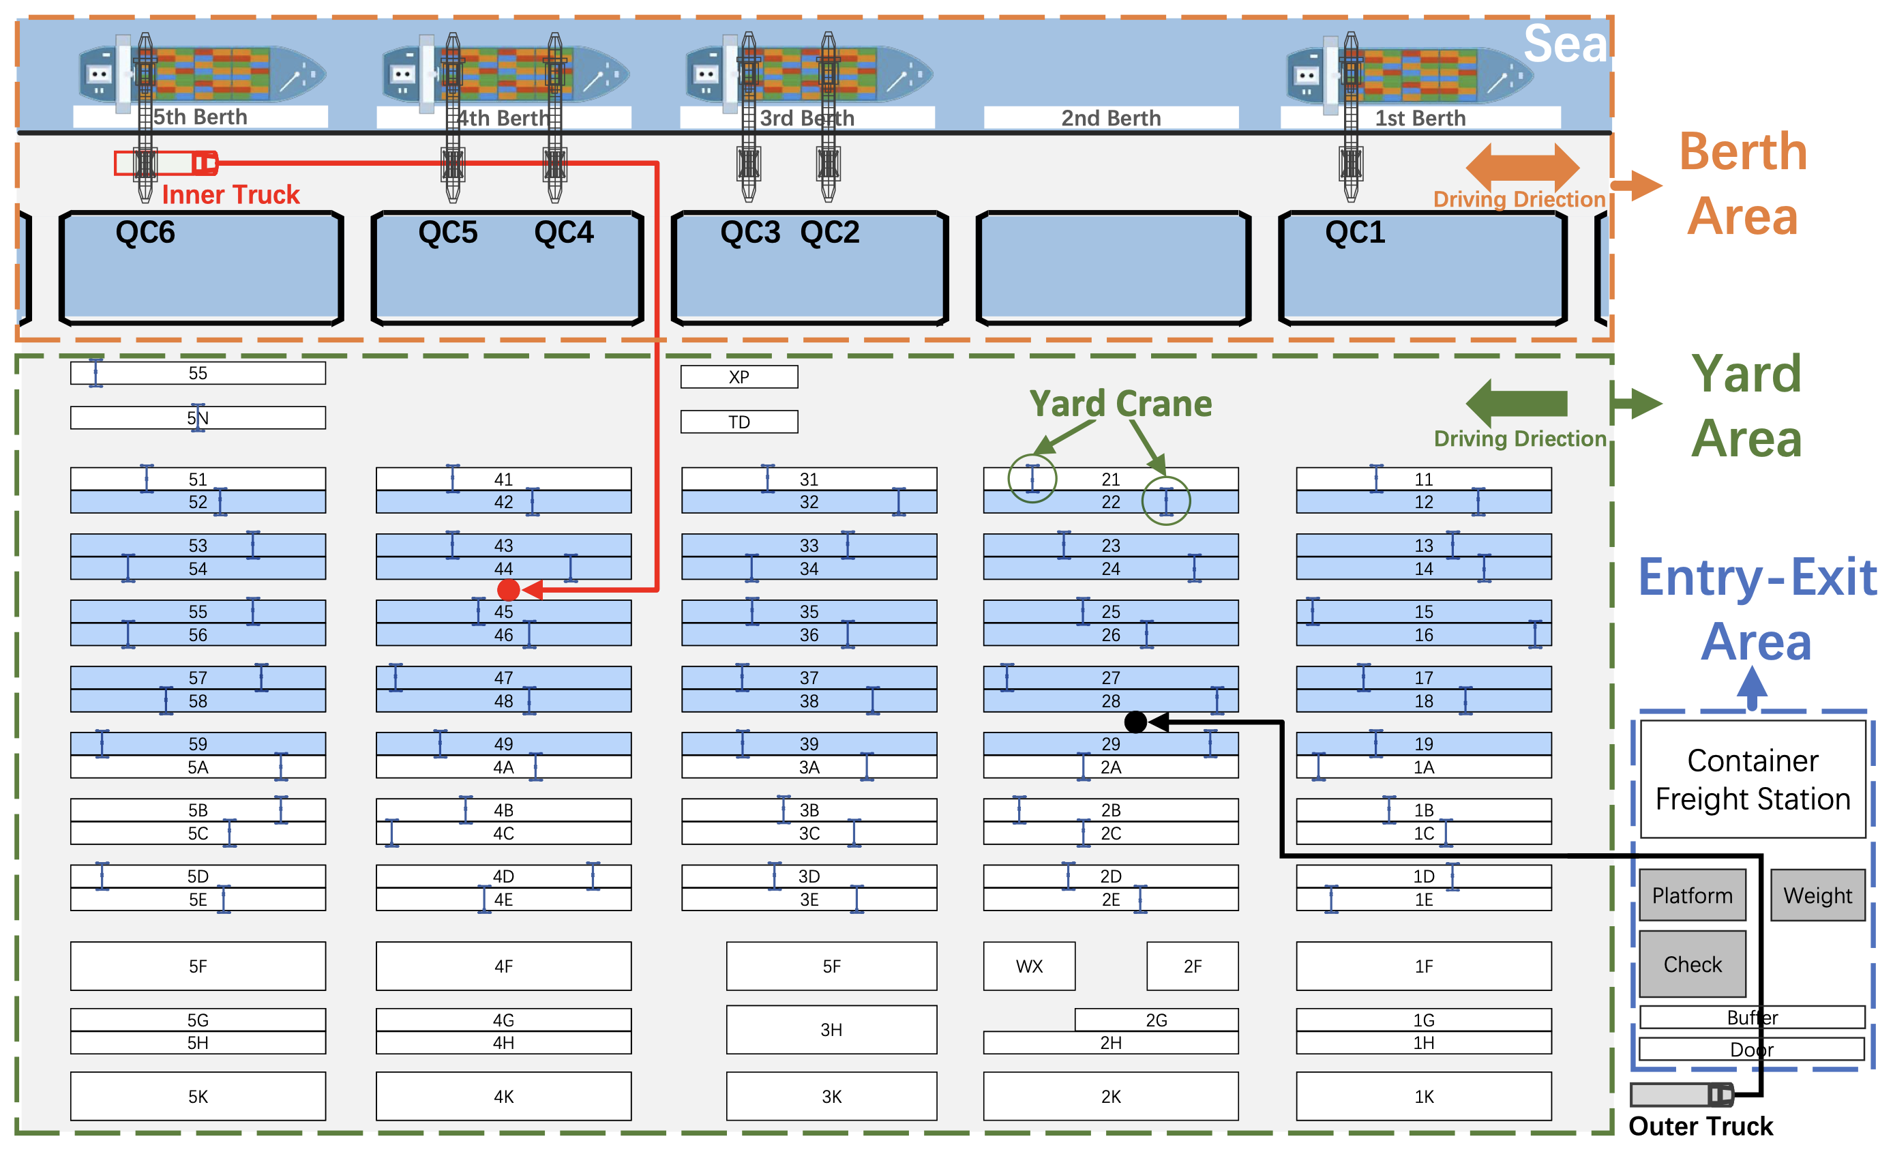
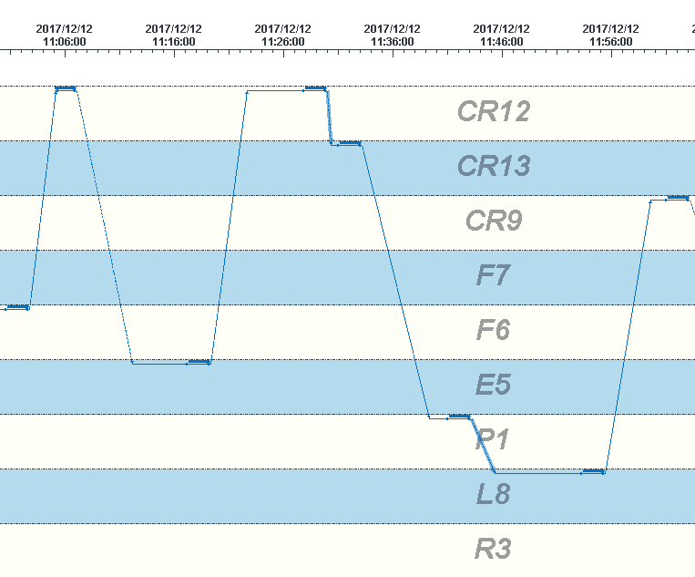
Dynamic Truck Dispatching in a Container Port
集装箱码头车辆动态派发优化
Empty mileage
Quay Crane (QC)
load op. to shop followed by another unload
PoW
QC waiting
Truck waiting
Unload op. followed by another loading op. to ship
Main challenges:
High correlation/interdependency Uncertainties (external, internal)
Large Scale (20K containers per day) Nonlinear: queues

Slide 20
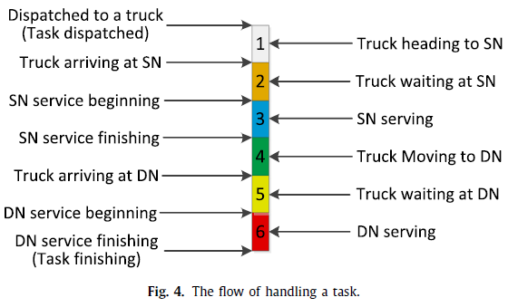

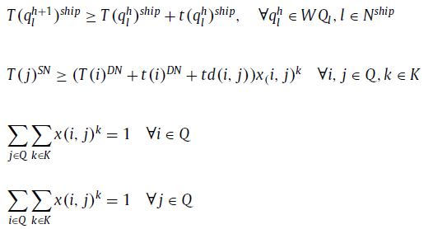


Problem Modelling
Minimize the total ship crane avoidable waiting
All tasks are serviced exactly in predefined order
Feasible operation start times
Each task serviced by exactly one truck
Yard crane scheduling policy π
$F\left({T\left(i\right)}^{yard},{T\left(j\right)}^{yard}\right)∈Π ∀i,j∈Q$
Crane operation times ( t(i)^{ship} , t(i )^{yard} ) are subject to uncertainties and are assumed to be revealed in an online fashion.
$${x(i,j)}^{k}$$
Truck assignment decisions variables:
takes value 1 if task jis immediately serviced after task i by truck k , and 0 otherwise.

Slide 21
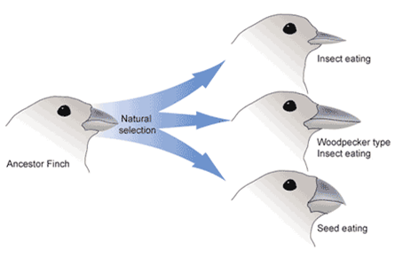
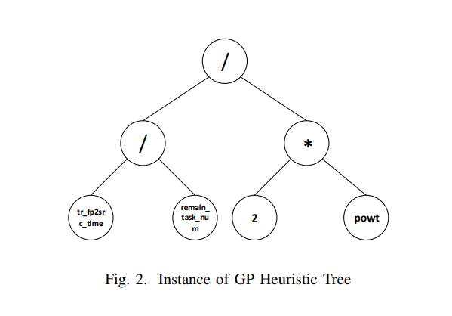


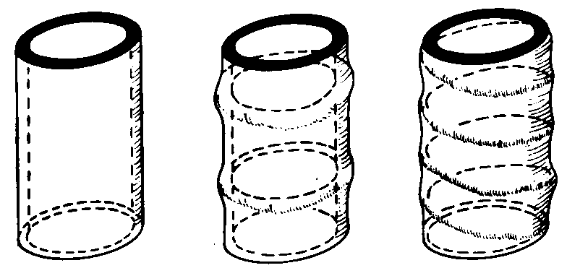
Genetic Programming
Natural Evolution
Advantages：
Robust in the long term – 4.5 billion years
Balancing complexity, reliability and efficiency.
GP Tree
Human Chromosomes
Crossover
交叉
mutation
变异
Replicate复制
Env.
环境
Stem
Insect Trachea
Bamboo
Adapted from Stated Clearly®

Slide 22
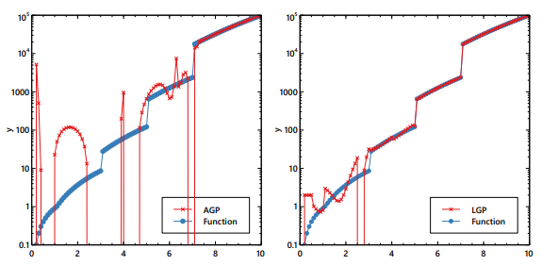
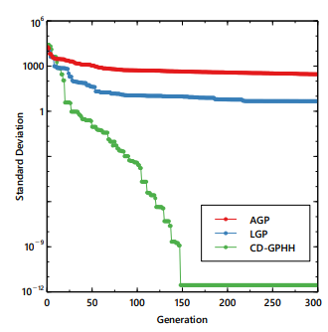
A Double-layer Genetic Programming Hyper-heuristics
Motivation
  Traditional GP methods struggles to fit multi-scenario functions
Fitting results
Training process

Slide 23
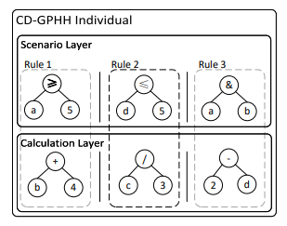
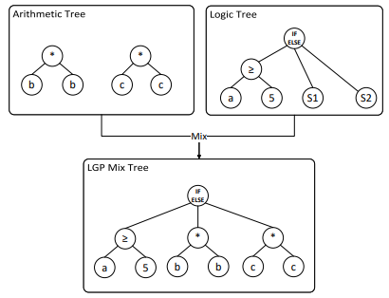
Non-stationary distributions - multi-scenarios
Single layer GP Tree
Double-layer GP Tree

Slide 24
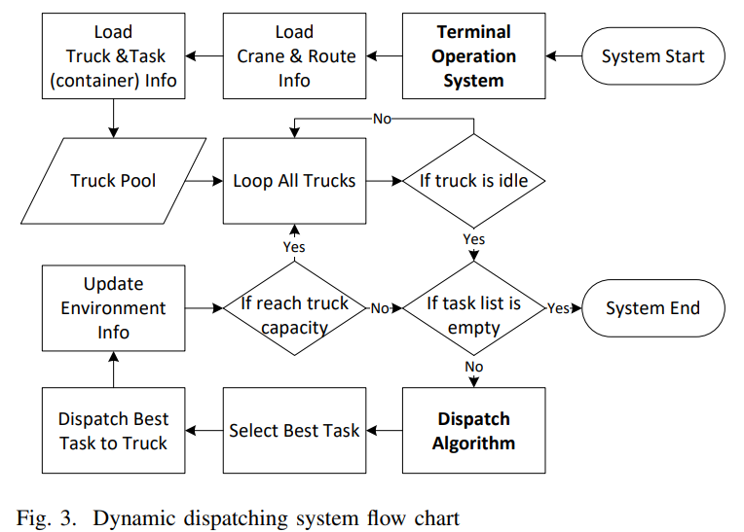
Dynamic Dispatch Process

Slide 25
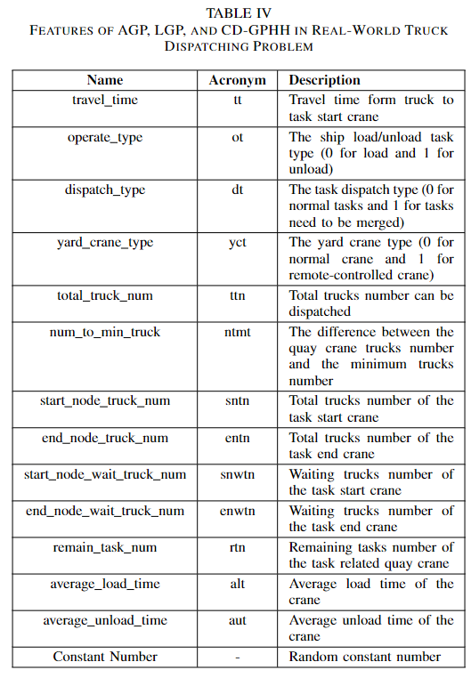
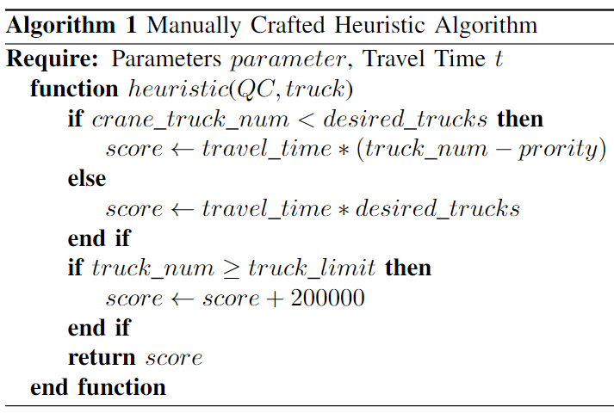
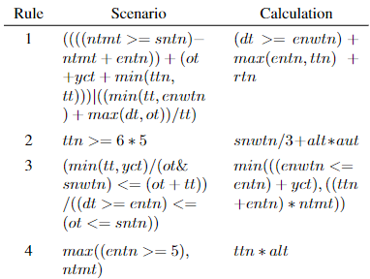
集装箱码头车辆调度方法对比
Experience based rules
基于经验的规则化调度
GP evolved multi-scenario rules
基于遗传编程的超启发调度
State features
状态列表
5%-8% improvement in efficiency wrt. practice！
13%-15% overall efficiency improvement
X. Chen, R. Bai *, R. Qu, and H. Dong. 2022. Cooperative Double-Layer Genetic Programming Hyper-Heuristic for Online Container Terminal Truck Dispatching, IEEE Transactions on Evolutionary Computation, in press..

Slide 26
Deep Reinforcement Learning Hyper-heuristics
DRL Hyper-heuristics

Slide 27
Deep Reinforcement Learning Hyper-heuristics (2)
Different equipment ratios
最佳设备配比曲线
The spectrogram of states over action
Y. Zhang, R. Bai*, R. Qu, C. Tu, and J. Jin, 2022. A deep reinforcement learning based hyper-heuristic for combinatorial optimisation with uncertainties, European Journal of Operational Research, vol. 300, no. 2, pp. 418-427.

Slide 28
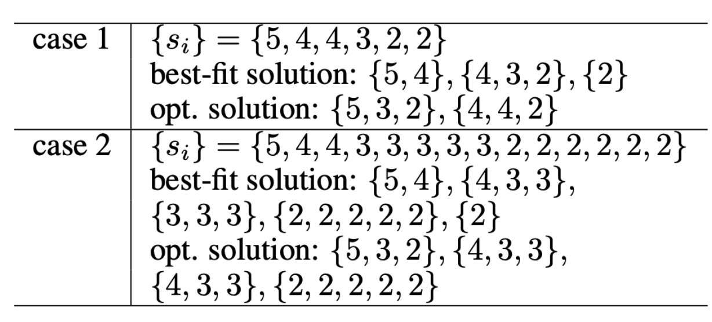
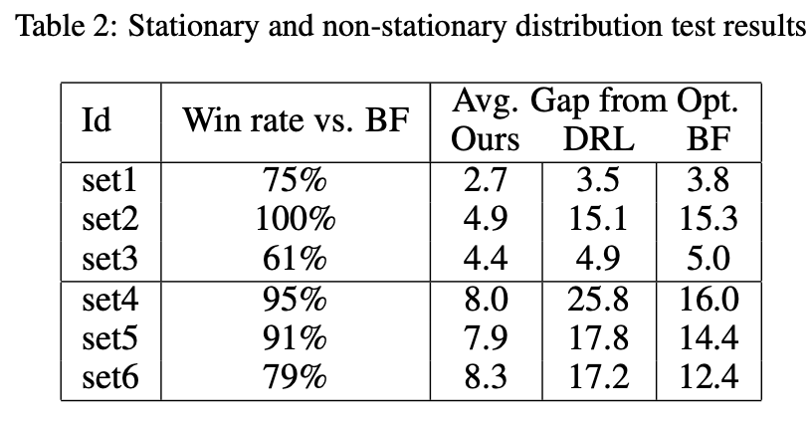
A more recent research efforts
Pattern based learning through dualism and pricing
  Can consider both objective and constraints simultaneously.
  1D bin packing
Case 1
Case 2

Slide 29
Conclusions
Many COPs have nice structures.
  OR focuses on the exploitation of these structures (obj., constraints).
  The resulting solution may not be robust.
  Computationally expensive if using robust optimization or stochastic programming
ML assisted model-driven methods for COPs can potentially balance the performance and robustness better.
Hyper-heuristics can improve the reusability of existing methods and also provides better interpretability.

Slide 30

谢谢！

