Slide 1




AI-assisted
Programming
Applications,
User Experiences,
Neuro-symbolic techniques
LOW-CODE USERS
DATA SCIENTISTS
DEVELOPERS
STUDENTS
Sumit Gulwani
PROSE team @ Microsoft
Marktoberdorf Summer School
Aug 2024

Slide 2
AI-Assisted Programming
Lectures organized by
Lecture 1:
Lecture 2:
Lecture 3:
Lecture 4:
Forms of intent expression
Logical Specifications
Input-Output Examples
Static or Temporal Context
Broken Programs
Natural Language
Program
Repair
Last-mile repair (low-code users)
EDU application (students)
Advanced Debugging (developers)

Slide 3

Cryptic syntax
Last-mile Repair
Excel help forum
Faulty Formula
= SUMIFS(Table[Height], Table[Weight], >$D$2)
Compiler
Error
Missing argument for operator: >
Correct Formula
=SUMIFS(Table[Height], Table[Weight], “>” & $D$2)

Slide 4
(Incorrect) Assumption that prefix is correct!
Last-mile Repair
PowerFx help forum
Faulty Formula
= If(!IsBlank(Label1.Text, “Text: ” & Label1.Text, “No text”)
Compiler
Error
The formula contains ‘EOF’ when ‘ParenClose’ is expected.
Correct Formula
= If(!IsBlank(Label1.Text), “Text: ” & Label1.Text, “No text”)

Slide 5
No attempt to fix
Last-mile Repair
Excel help forum
PowerFx help forum
Faulty Formula
=SUM(A1:10)
=LENGTH(TxtInput.Value)
Compiler
Error
Types not related
Unknown or unsupported function
Correct Formula
=SUM(A1:A10)
=LEN(TxtInput.Value)

Slide 6


Last-mile-repair as Generate & Rank
Symbolic module generates repair candidates obeying syntactic/semantic constraints.
Well-Formed/Buggy Formula Pairs
Well-Formed
Formulas
Neural models rank locations (efficiency) and candidates (precision).
Fixed Formula
Set(
varUserMail,
User().Email
)
Neural
Localizer
Predicted Locations
Buggy Formula
Ranked
List
Set( varUserMail,.User
)Email)
Symbolic
Candidate
Enumeration
Repairs
Neural
Ranker
Set(varUserMail, User().Email)
Set(varUserMail, {User:Email})
Set(varUserMail, [User].Email)
LaMirage
[OOPSLA 2022: Neurosymbolic Repair for Low-Code Formula Languages]

Slide 7

LLM as Generate-&-Rank Engine for Repair
(using LLM probabilities for ranking)
LLM enumerates repair candidates and ranks them.
Symbolic module (language tooling) provides diagnostics + relevant-example selection.
function Driver(opts) {
Driver.__super__.constructor.apply(
…
this.messages = [];
}
function Driver(opts) {
Driver.__super__.constructor.apply(
…
this.messages = [];
}
Unused variable.
Error in line 1, span starts 47
LLM
Candidate Generator
LLM probabilities-based ranking
Buggy/Fixed Pairs
With Error Diagnostics
[[AAAI 2023: Repair Is Nearly Generation: Multilingual Program Repair with LLMs]

Slide 8
Can handle semantic errors (Javascript)
Last-mile repair using LLMs
function (number){
var result = 1 ;
for(i=number; i>1; i++){
result *= i;
}
return result;
}
function (number){
var result = 1 ;
for(i=number; i>1; i--){
result *= i;
}
return result;
}

Slide 9
Can handle large-span errors (Python)
Last-mile repair using LLMs
def build_python_file(self, pwd = None):
"""Build a simple Python "program" that ctags can use."""
path = ''
with tempfile.NamedTemporaryFile(
delete = False, suffix = '.py’,
dir = pwd) as temp:
try:
path = temp.name
temp.writelines([
b'def my_definition():\n',
b'\toutput = "Hello, world!"\n',
b'\tprint(output)\n'])
finally:
temp.close()
return path
def build_python_file(self, pwd = None):
"""Build a simple Python "program" that ctags can use."""
path = ''
with tempfile.NamedTemporaryFile(
delete = False, suffix = '.py’,
dir = pwd) as temp:
try:
path = temp.name
temp.writelines([
b'def my_definition():\n',
b'\toutput = "Hello, world!"\n',
b'\tprint(output)\n'])
finally:
temp.close()
return path

Slide 10
Can infer new constants (Excel)
Last-mile repair using LLMs
AVERAGEIFS(B4:M4,">0")
AVERAGEIFS(B4:M4,B4:M4,">0")
The user left off a required parameter indicating the criteria range.
TEXTJOIN(",", A3:D3)
TEXTJOIN(",", TRUE, A3:D3)
The user forgot a required boolean parameter to ignore (or not) empty text.
COUNTIF("dog",A1:A9)
COUNTIF(A1:A9,"dog")
The user incorrectly swapped the range and criteria parameters.

Slide 11
Program Repair
Last mile repair (low-code users)
EDU application (students)
Advanced Debugging (developers)

Slide 12
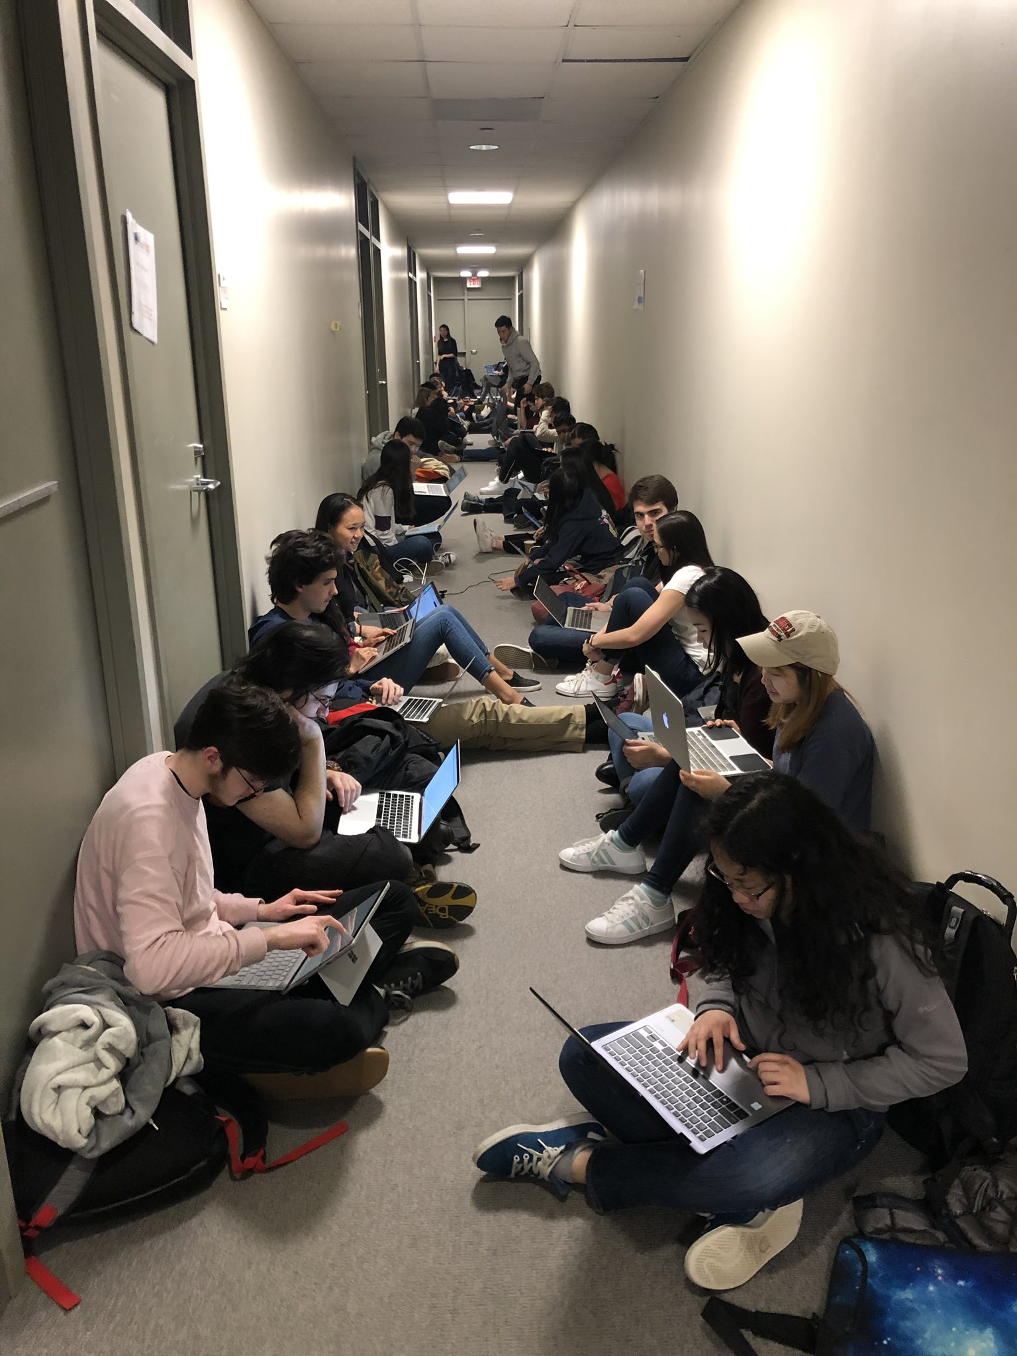
Challenges in Programming Education
5x demand for CS classes than available courses (Lack of TAs).
80% dropout amongst US minority students (Inadequate tech stack).
“I’ve seen people show up at office hours and wait for 2 hours to get the answer to 1 question.”

Slide 13
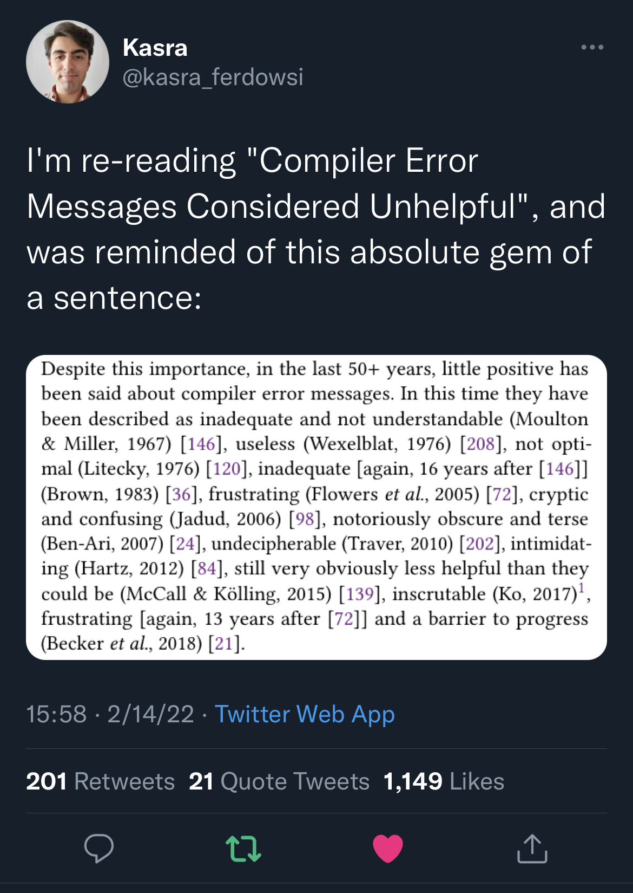
Syntax Errors
Syntax requirements are too unforgiving and sometimes unnatural!
Existing toolset assumes you are already a pro!
Student Code | Expected Code
C = (a+b) (a-b) | C = (a+b) * (a-b)
scanf(“%d”, a) | scanf(“%d”, &a)
Error Message
Called object type ‘int’ is not a function.
Format specifies type ‘int *’ but argument has type ‘int’.
[ICSE 2018: Compilation error repair: for the student programs, from the student programs]

Slide 14
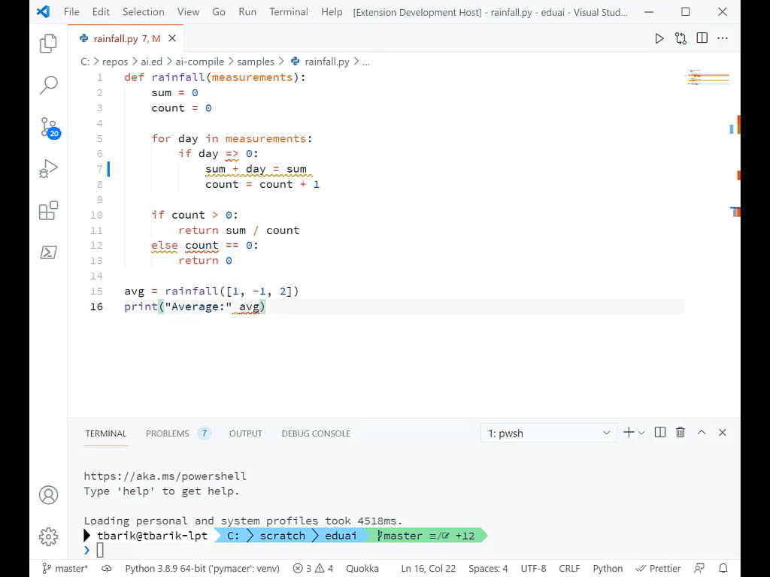

Slide 15
Functional Errors
Int[] ReverseArray(int [] a)
{
int b = new int[a.Length];
for (int i=0; i<a.Length; i++)
{
b[a.Length-i] = a[i-1];
}
return b;
}
i <= a.Length
i=1
Can search for repairs over:
A repair language
[PLDI 2013: Automated Feedback Generation for Introductory Programming Assignments]

Slide 16
Functional Errors
def computeDeriv(poly):
deriv = []
for i in range(len(poly)):
deriv[i]=float((i)*poly[i])
return deriv
1, len(poly)
deriv.append
deriv or [0.0]
Can search for repairs over:
A repair language
Expressions in other correct submissions
[PLDI 2018: Automated Clustering and Program Repair for Introductory Programming Assignments]

Slide 17
Functional Errors
def product (n,term):
total, k = 1, 1
while k <= n:
total = total * k
k = k + 1
return total
def product(n, term):
if (n==1):
return 1
return product(n-1, term) * n
term(k)
term(n)
Can search for repairs over:
A repair language
Expressions in other correct submissions
Past teacher corrections
[ICSE 2017: Learning Syntactic Program Transformations from Examples]

Slide 18
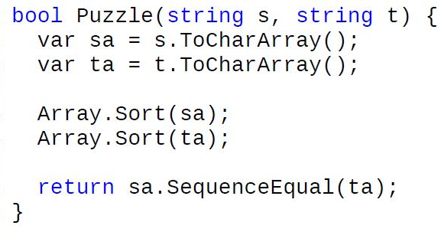
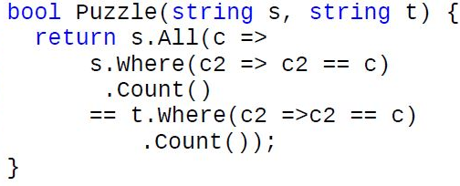
Performance Errors
Problem: Is a string t permutation of another string s?
Strategy B: For each character in one string, count & compare number of occurrences in another. O(n²)
Feedback: “Count number of characters in each string in a pre-processing phase to amortize cost.”
Strategy A: Sort & compare the two input strings. O(n log n)
Feedback: “Instead of sorting, compare number of occurrences of each character.”

Slide 19
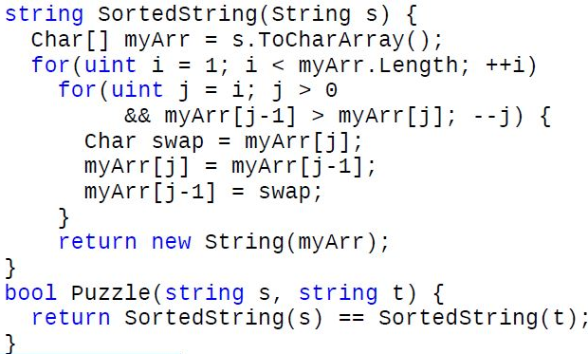
Sorting Strategy
Library routine
Explicit sorting

Slide 20
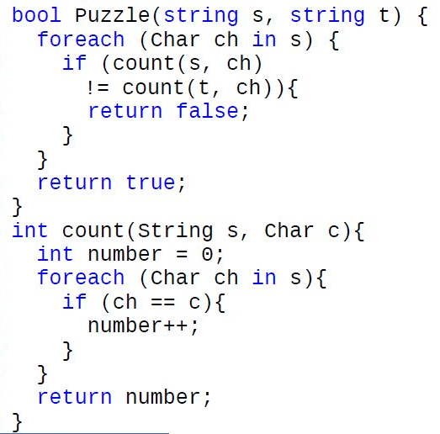
Counting Strategy
LINQ-style
Explicit Counting

Slide 21
Synthesizing strategy-level feedback
Methodology: Teacher documents various strategies + feedback.
Challenge: How to automatically identify student’s strategy?
Key Idea: Different implementations of the same strategy produce the same sequence of “key values”.
[[FSE 2014: Feedback generation for performance problems in introductory programming assignments]

Slide 22
Challenges in Programming Education
5x demand for CS classes than available courses (Lack of TAs).
80% dropout amongst US minority students (Inadequate tech stack).
Grand Challenge: Feedback generation AI-bot that provides feedback like a human TA (progressive reveal of hints)
Program analysis and verification
Large language models
Past student journeys
“I’ve seen people show up at office hours and wait for 2 hours to get the answer to 1 question.”

Slide 23


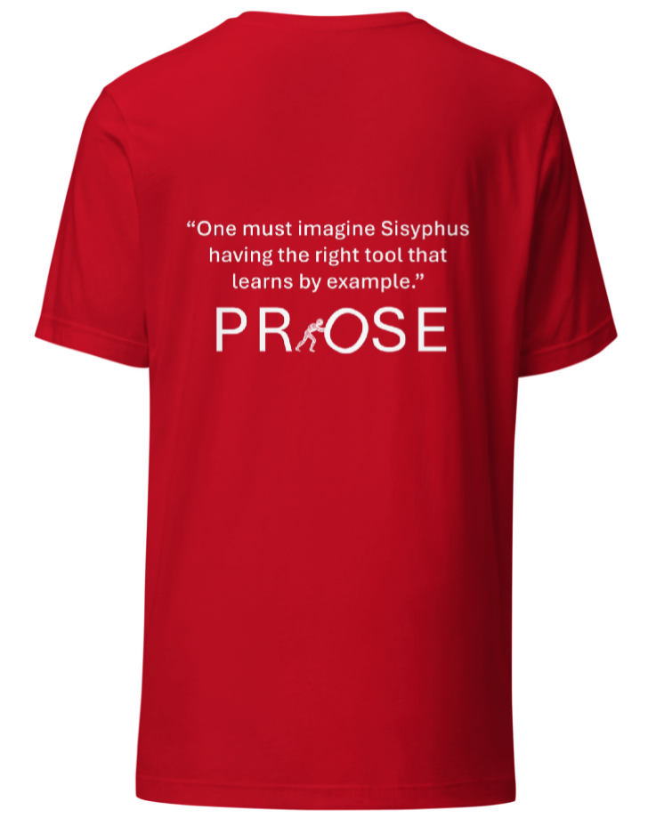
Students, year after year, across the globe, are struggling with a similar set of confusions that
TAs work hard to resolve!
“One must imagine Sisyphus
having the right tool that
learns by example”

Slide 24
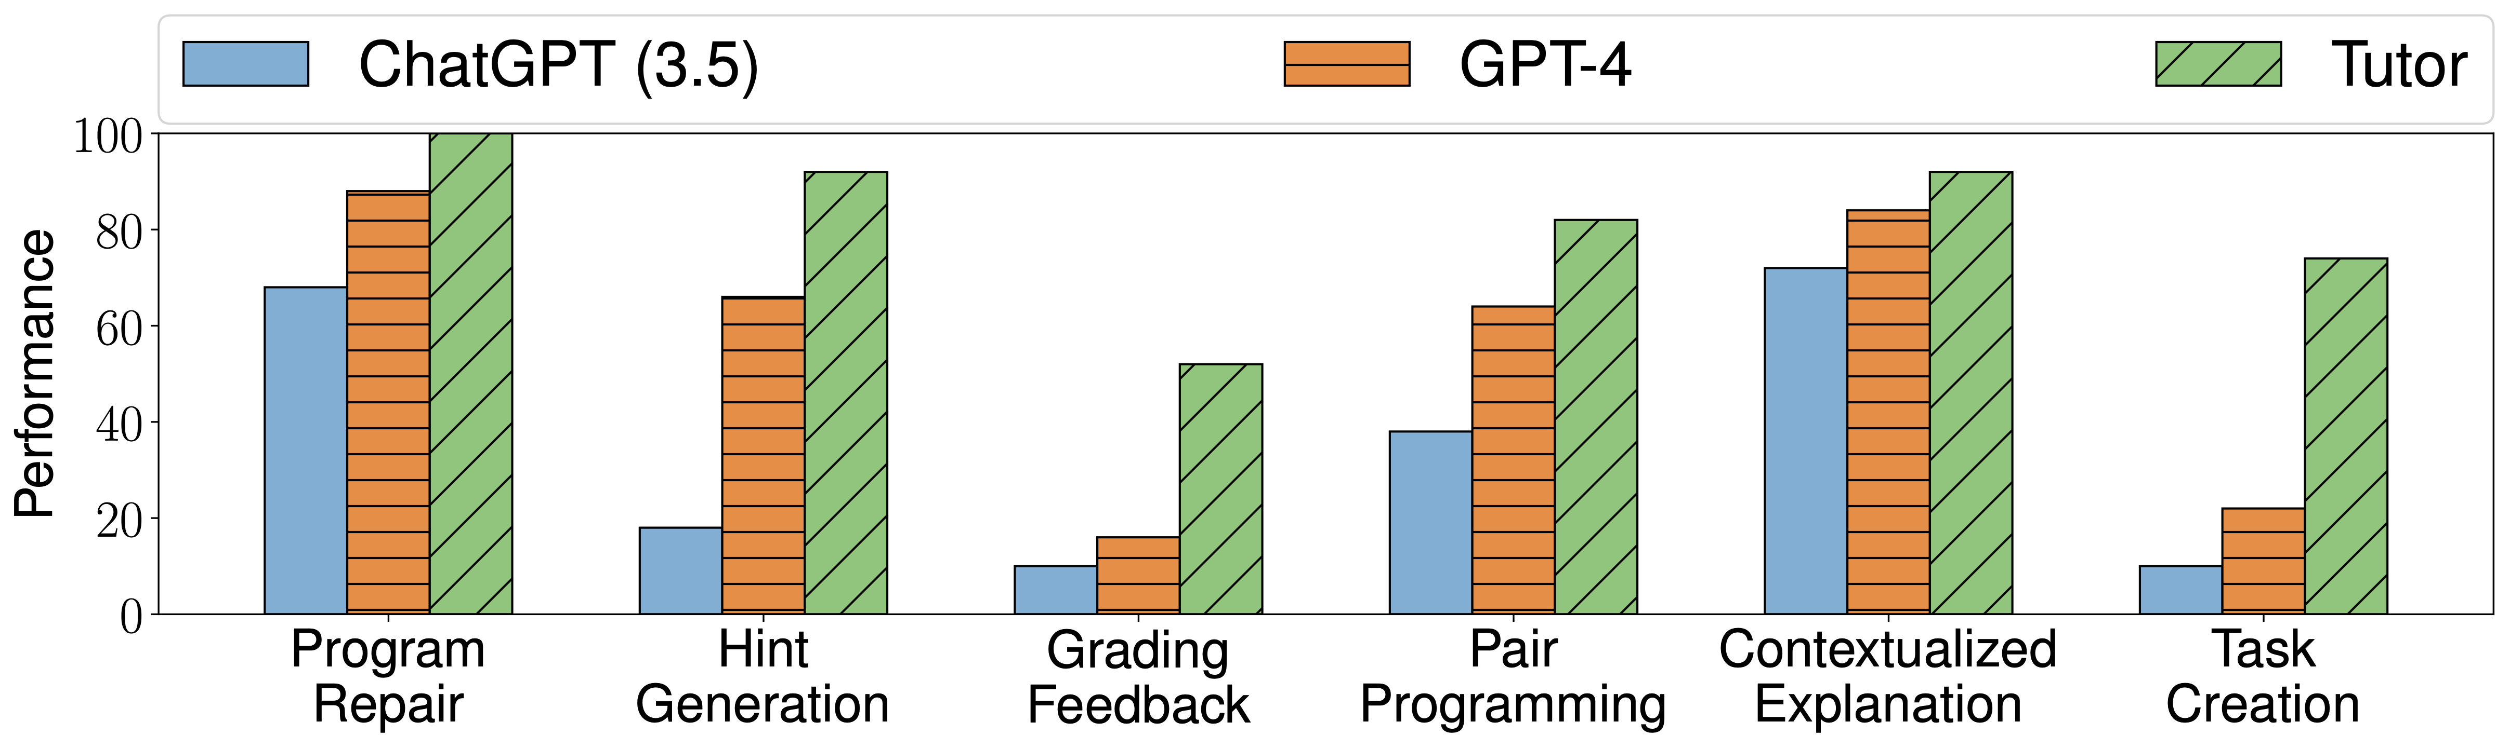
Generative AI for Programming Education:
Benchmarking ChatGPT, GPT-4, Human Tutors
Evaluation based on 5 introductory programming problems:
GCD, Fibonacci, DivisorsThatDivide3, Palindrome, MergeStrs
[ICER 2023: Generative AI for Programming Education: Benchmarking ChatGPT, GPT-4, and Human Tutors]

Slide 25
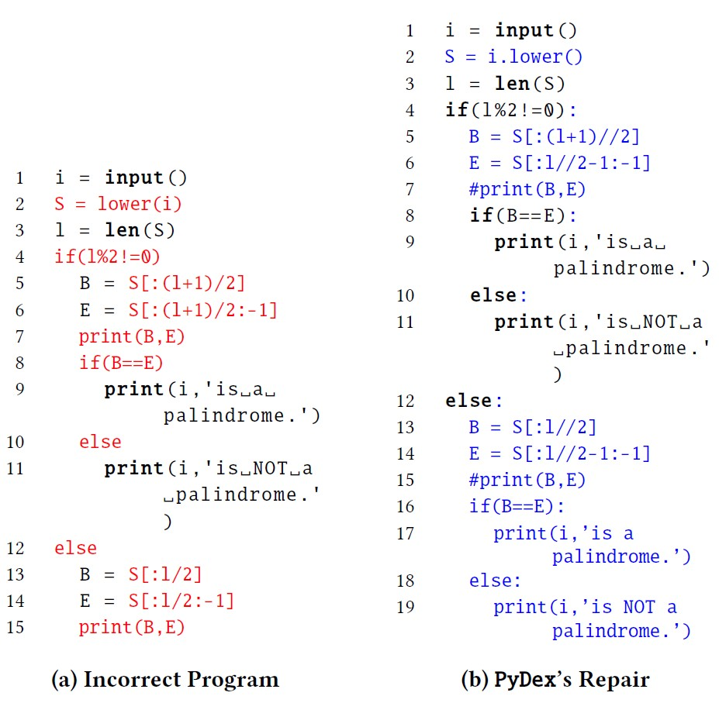
Fixing large errors in a student’s programming assignment.

Slide 26




Multi-turn workflow: step-by-step problem solving
Fix syntax errors one-by-one
& then semantic errors
Peer Buggy/Fixed Pairs
With Unit test Outcomes
LLM Fixer:
Syntax Phase
LLM Fixer:
Semantic Phase
Edit Distance Ranker
Generate Fixes
Rank
[OOPSLA 2024: PyDex: Repairing Bugs in introductory Python assignments using LLMs]

Slide 27
GPT4 Basic-Prompt for Hint Generation
I’m working on a Python programming problem. The current program below is not working well.
Problem description: …
Buggy program: …
Provide a concise single-sentence hint about one bug in this program. The hint should not be too detailed as I want to think about the fixes by myself. However, the hint should not be too abstract, as I need some help.
Generating hint
(as opposed to detailed explanation)
for showing to student.

Slide 28
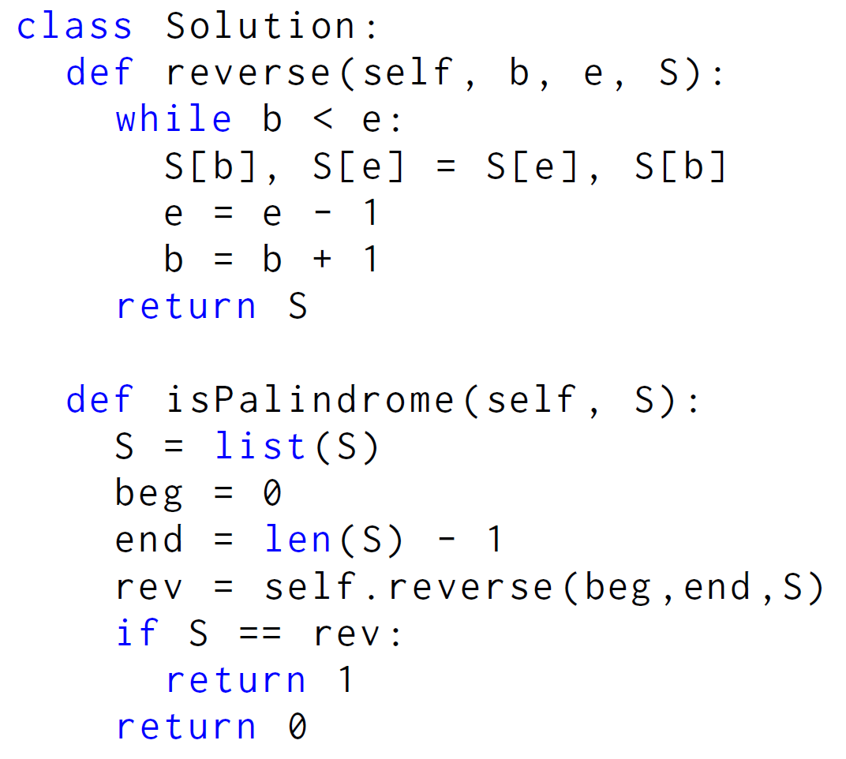




Generating Hint for Functional Errors
Hint generated by GPT4:
Consider how Python compares two lists using the '==' operator and how this might affect the result of 'S == rev'.
S.copy()
GPT-4 struggles to provide good hints by itself.

Slide 29
GPT4 Augmented-Prompt for Hint Generation
I’m working on a Python programming problem. The current program below is not working well.
Problem description: …
Buggy program: …
Failing test case: …
Fixed version of the buggy program: …
Describe the bug(s) and required fixes.
Provide a concise single-sentence hint about one bug in this program. The hint should not be too detailed as I want to think about the fixes by myself. However, the hint should not be too abstract, as I need some help.
Useful Information generated apriori by leveraging test cases.
Generating detailed explanation
before generating hint.
(Chain-of-thought reasoning)
Generating hint
(as opposed to detailed explanation)
for showing to student.

Slide 30
Generating Hint for Functional Errors
Hint generated by GPT4 basic-prompt:
Consider how Python compares two lists using the '==' operator and how this might affect the result of 'S == rev'.
Hint generated by GPT4 augmented-prompt:
Consider the effect of Python’s pass-by-reference behavior on mutable objects like lists when you’re reversing the string.
S.copy()

Slide 31
Effectiveness
Technique for Hint Generation | Precision | Recall
GPT4 basic-prompt | 66 | 100
Human Tutors | 92 | 100
GPT4 augmented-prompt | 82 | 100

Slide 32
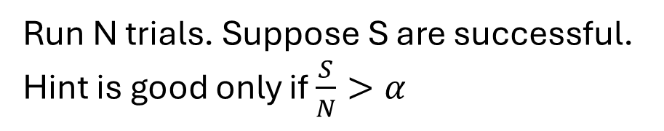
GPT 3.5 Prompt for Simulating Student with Explanation
GPT 3.5
I’m working on a Python programming problem. The current program below is not working well.
Problem description: …
Buggy program: …
Explanation of bugs in the buggy program: …
If anything in the explanation is incorrect or confusing, please say “Explanation is bad” and stop.
Else:
Please fix the buggy program as per explanation.
Explanation may not cover all bugs, so resolve the remaining bugs by yourself.
Provide an escape mechanism.
Needed to evaluate correctness of generated fix.
Run N trials. Suppose S are successful.
Hint is good only if $\frac{S}{N}>α$
Cater to stochastic nature of the process.

Slide 33
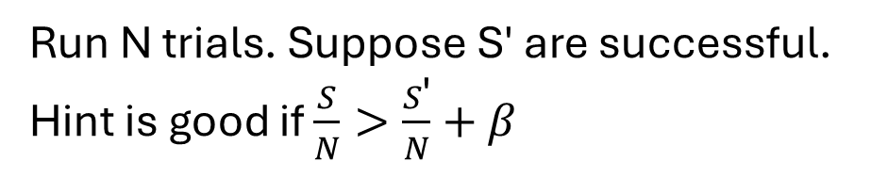
GPT 3.5 Prompt for Simulating Student without Explanation
I’m working on a Python programming problem. The current program below is not working well.
Problem description: …
Buggy program: …
Can you fix the buggy program?
Make sure that you make minimal possible changes needed to fix the program.
Run N trials. Suppose S' are successful.
Hint is good if $\frac{S}{N}>\frac{S\text{′}}{N}+β$
Comparison of effect with and without hint.

Slide 34
Effectiveness
Technique for Hint Generation | Precision | Recall
GPT4 basic-prompt | 66 | 100
Human Tutors | 92 | 100
GPT4 augmented-prompt | 82 | 100
GPT4 augmented-prompt with GPT3.5-Validation | 94.7 | 76
Variants of Validation Stage | Precision | Recall
N = 3 trials | 94.7 | 76
N = 1 trial | 91.7 | 48
GPT4 student model instead of GPT3.5 | 84.8 | 92
Using hint instead of detailed explanation | 89.3 | 56
Without comparison with S' | 86.8 | 76
[LAK 2024: Automating Human Tutor-Style Programming Feedback: Leveraging GPT-4 Tutor Model for Hint Generation
and GPT-3.5 Student Model for Hint Validation]

Slide 35
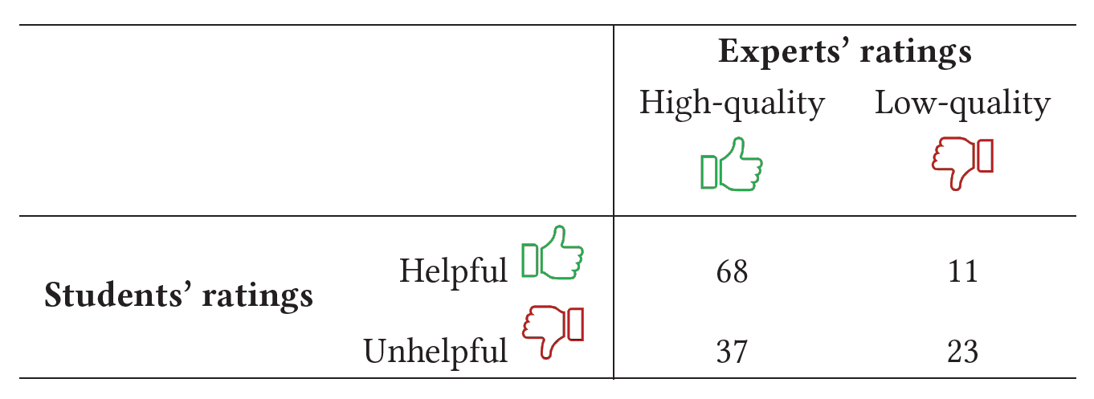
Student Perspectives on Hints
Only 65.5% agreement between experts and students!
Lessons learned from study
Account for student’s concern: which may be different than other potential hints.
Temporal context of past hints: provide new information not available in prior hints.
Problem-solving plan: When a student is far from solving, hints may provide refreshers or offer solving plans. When is student is close, hints may focus on bugs.
[Under Submission: Bridging Gaps Between Student vs. Expert Evaluations and Enhancing Quality of AI-Generated Programming Hints]

Slide 36
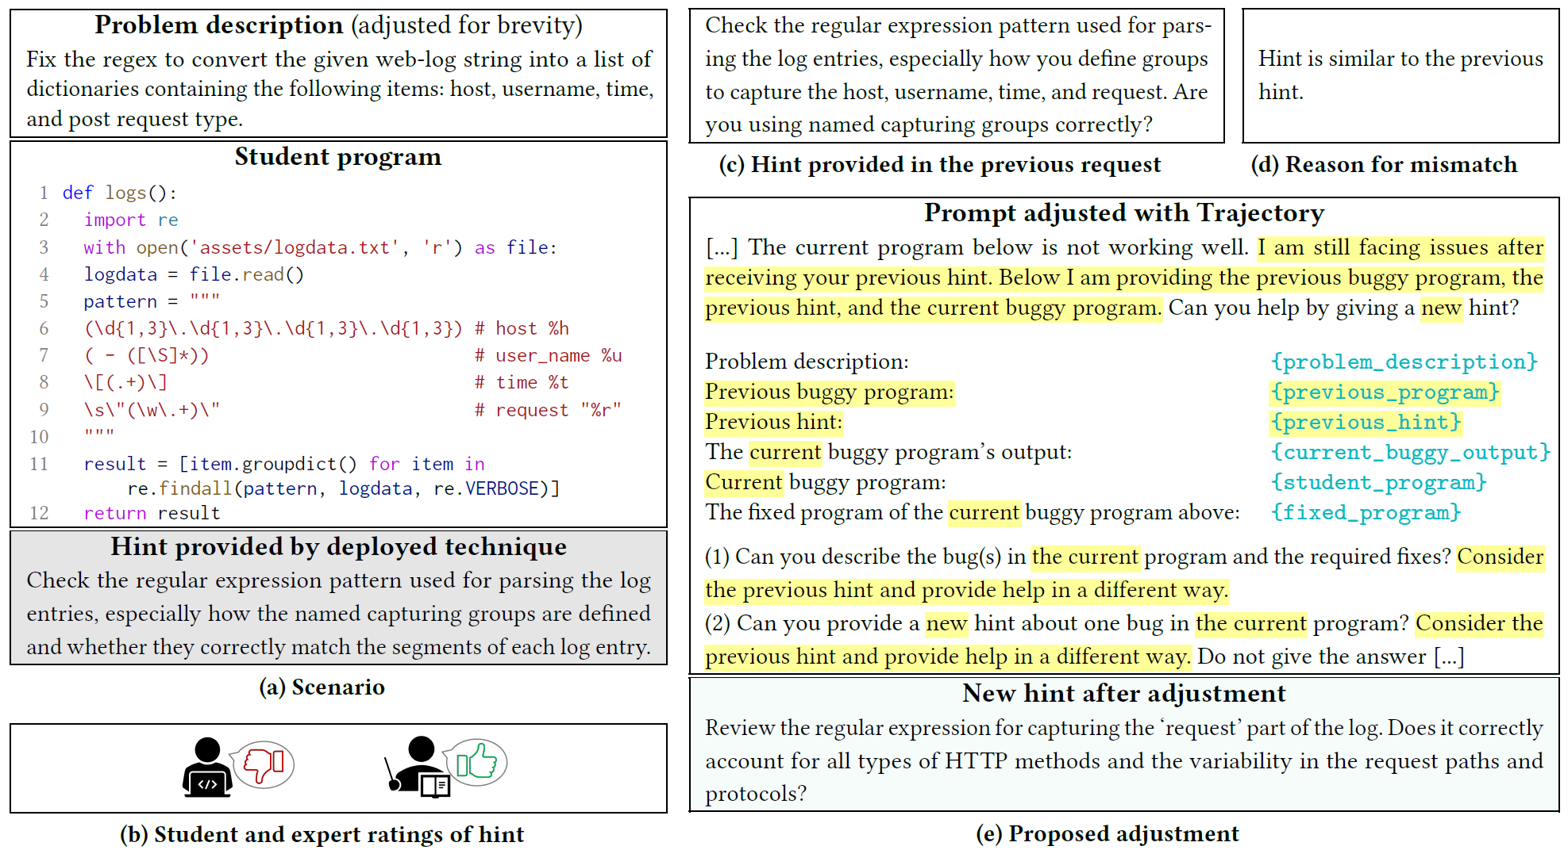

Slide 37
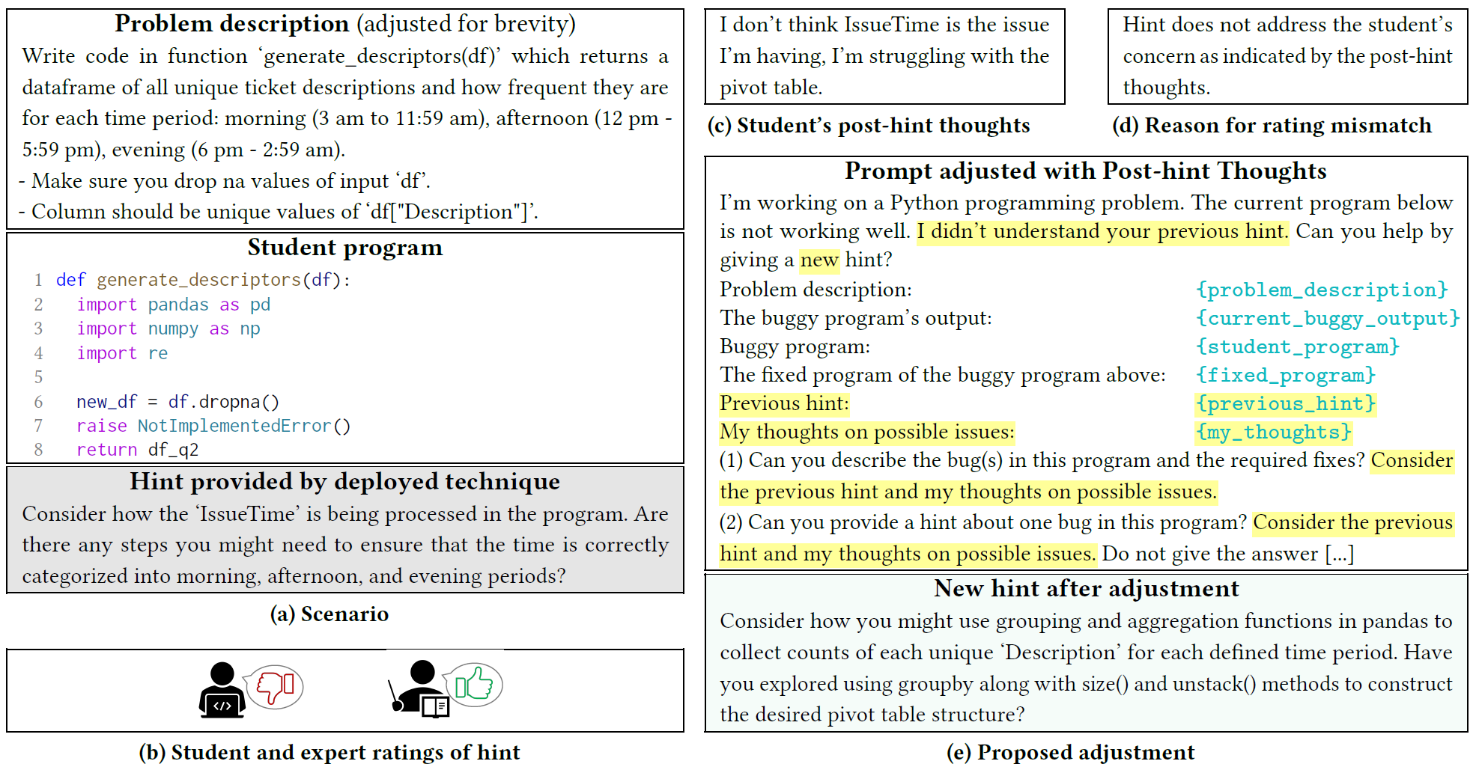

Slide 38






Datasets in Program Repair in Education and Low-code Platforms
PyMacer
2860 repair benchmarks
Collected by Prof. Amey Karkare at IIT Kanpur, India
AIED 2020, Chhatbar at al, MACER: A Modular Framework for Accelerated Compilation Error Repair.
TigerJython
Easy, single-line, low-edit-distance errors
746 repair benchmarks
SIGCSE 2019, Tobias Kohn, The Error Behind The Message: Finding the Cause of Error Messages in Python.
CSEDM 2019 Data Challenge
1100+ repair benchmarks
Python & Bash Programming Submissions
5 Courses, 666 students, 3+ academic years
490,829 Python programs
PowerFx and Excel formulas repair benchmark
400 real-user formulas collected from help forums and (anonymized) product telemetry
Each pair has the original buggy formula and a ground-truth repair
Contains syntax errors and some semantic mistakes, such as wrong arity in function calls

Slide 39
Program Repair
Last mile repair (low-code users)
EDU application (students)
Advanced Debugging (developers)

Slide 40
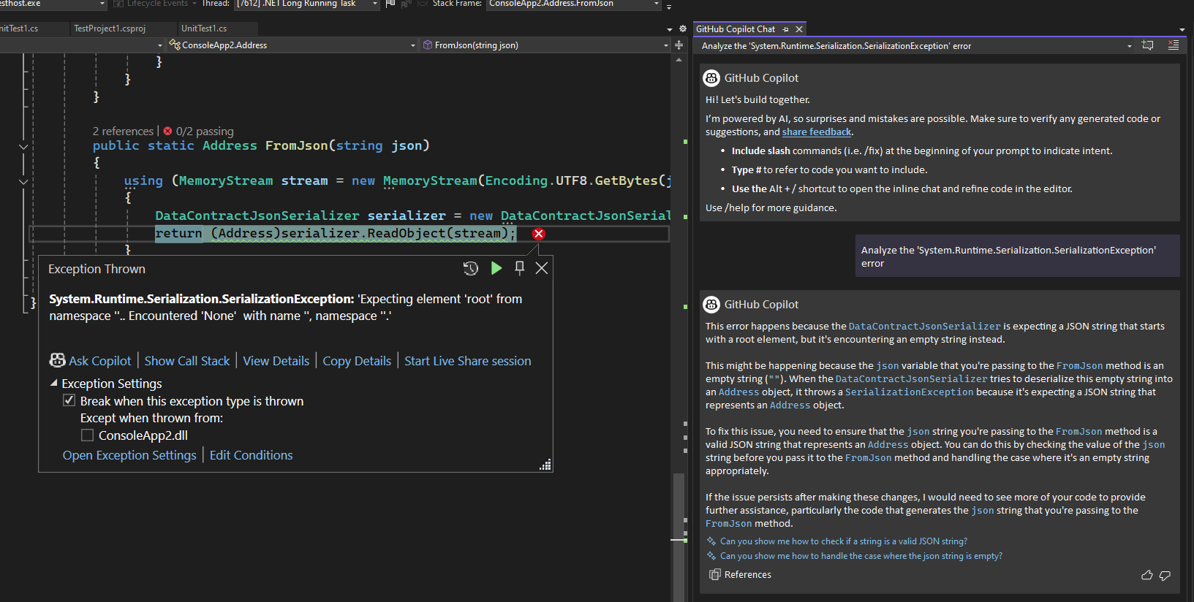
Debugging exceptions With GitHub Copilot Chat

Slide 41
Initial solution: prompt engineering
Visual Studio Debugger Functions
Context
25% success rate across the participants of our user study
Code
Stack Trace
Local values
  “I would probably not use this fix. I could throw a custom ArgumentException to handle this better, but I still want to find the deeper issue as to why the string is empty in the first place.”
Exception info
Instructions
Debugging instructions
Prompt template

Slide 42
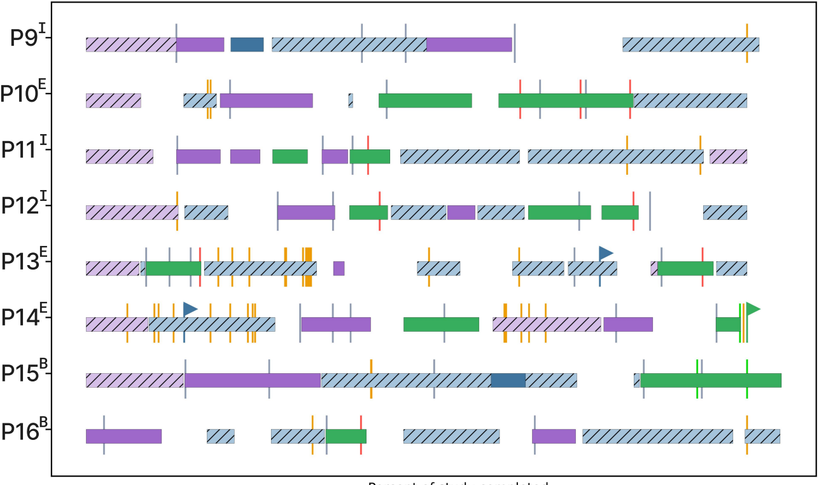
Developers did not engage with Copilot !

Slide 43
Copilot failed to follow the right debugging process and fails to effectively communicate with the developer, being eager to close the conversation.

Slide 44

Investigate-and-Respond Agentic Pattern
Utterance
Needs investigation?
No
Yes
Response
Responder Agent
User Input needed?
Yes
No
Collaborative Agent
Context Agent
Clarifying question,
Suggest action, …
[AIWare 2024: Let’s Fix this Together: Conversational Debugging with GitHub Copilot]

Slide 45
88% debugging tasks completed (vs. 25%)
“This is providing me thoughtful explanations and steps. The other version gave me the fix upfront, which confused me even more”
“feeling better equipped and knowing what to do the next time I see a similar bug”
“I often get stuck with the most pointless bugs while working, and you don’t feel like going to ask a senior SDE. This chat assistant would help a lot in these cases.”
“invaluable to new contributors”

Slide 46
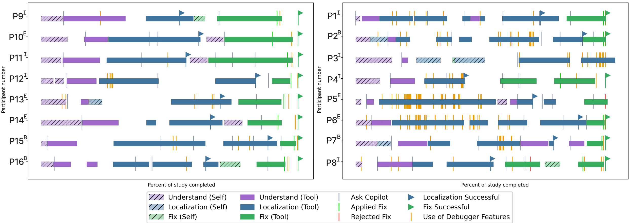
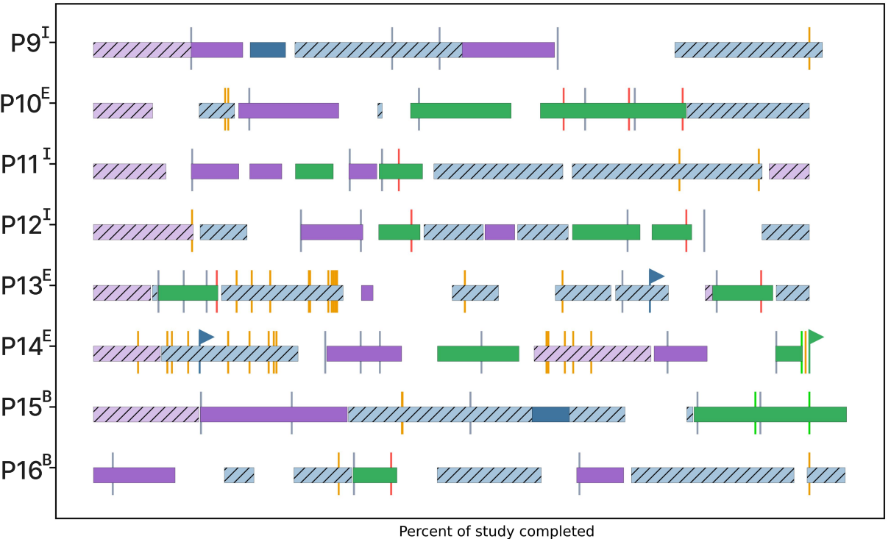
Participants used more debugging tools and followed a better debugging process
Baseline
Investigate-and-respond

Slide 47
Key Takeaways
Last mile repair (low-code users): Generate & Rank
EDU application (students): Validated Hints
Advanced Debugging (developers): Investigate-and-Respond agentic pattern

