Slide 1
Extensible Query Optimizers in Practice
Bailu Ding
Microsoft Research
4/11/2025, NWDS talk

Slide 2
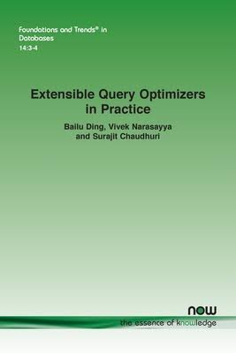
Book
Bailu Ding, Vivek Narasayya, and Surajit Chaudhuri. 2024. Extensible Query Optimizers in Practice. Foundations and Trends® in Databases, Volume 14, Issue 3-4, Pages 186 – 402
Outline
  Basics of query optimization
  Extensible optimizers, focusing on Volcano/Cascades
  Transformation rules
  Cost estimation
  Plan management
  Open challenges

Slide 3
This talk
Bailu Ding, Vivek Narasayya, and Surajit Chaudhuri. 2024. Extensible Query Optimizers in Practice. Foundations and Trends® in Databases, Volume 14, Issue 3-4, Pages 186 – 402
Outline
  Basics of query optimization
  Extensible optimizers, focusing on Volcano/Cascades
  Transformation rules
  Cost estimation
  Plan management
  Open challenges

Slide 4
Query processing
SELECT * FROM R, S, T
WHERE R.a = S.b AND S.c = T.d AND T.e = 10
SQL query
Parsing and validation
Query optimization
Query execution
Query results
Join
S.c=T.d
Nested Loop Join
S.b=R.a
Join
R.a=S.b
Select
T.e=10
Hash Join
S.c=T.d
Index Seek (R.Ia)
Select
Select
T
Table Scan (S)
Index Scan (T.Id)
R
S
Abstract syntax tree
Physical query plan

Slide 5
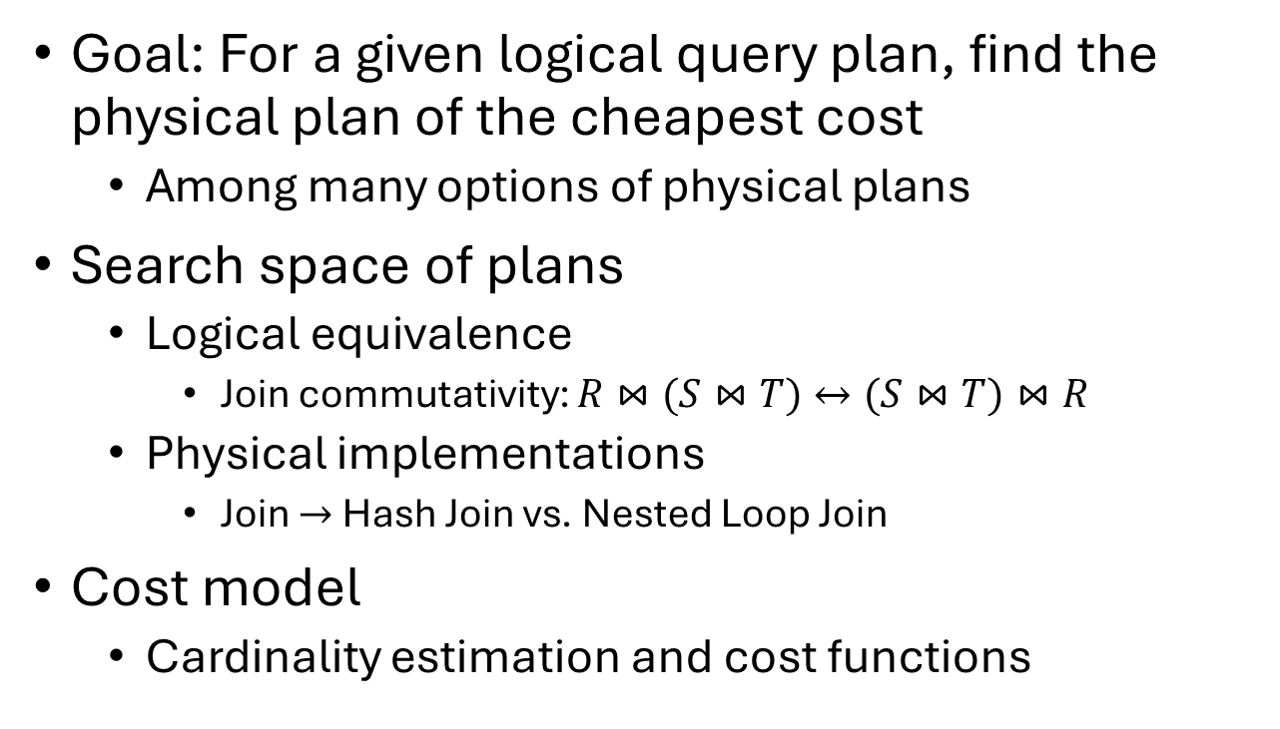
Query optimization
Join
S.c=T.d
Goal: For a given logical query plan, find the physical plan of the cheapest cost
  Among many options of physical plans
Search space of plans
  Logical equivalence
    Join commutativity: $R⋈(S⋈T)↔(S⋈T)⋈R$
  Physical implementations
    Join $→$ Hash Join vs. Nested Loop Join
Cost model
  Cardinality estimation and cost functions
Join
R.a=S.b
Select
T.e=10
Select
Select
T
R
S
Logical query plan
Nested Loop Join
S.b=R.a
Hash Join
S.c=T.d
Index Seek (R.Ia)
Table Scan (S)
Index Scan (T.Id)
Physical query plan

Slide 6
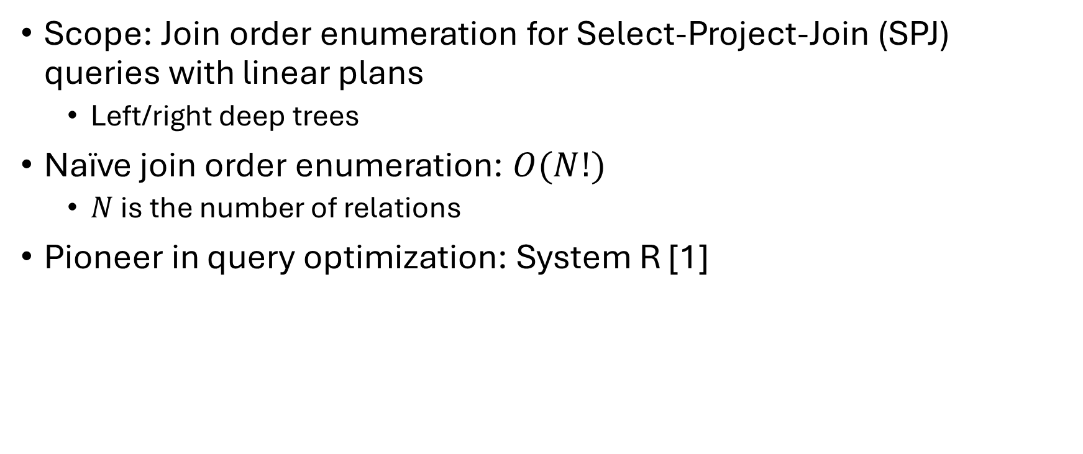
Warm up: Join order enumeration
Scope: Join order enumeration for Select-Project-Join (SPJ) queries with linear plans
  Left/right deep trees
Naïve join order enumeration: $O(N!)$
  $N$ is the number of relations
Pioneer in query optimization: System R [1]
Hash Join
A
Hash Join
B
Nested Loops Join
C
D
Linear plan
[1] P. G. Selinger et al., “Access Path Selection in a Relational Database Management System,” SIGMOD’79

Slide 7









Key insight: subproblem decomposition
The optimal plan of joining $N$ relations can be extended from the optimal subplan of joining $N−1$ relations for linear plans
  Including the choices of physical join operators
Bottom-up dynamic programming
  Complexity reduced from $O\left(N!\right)$ to $O(N∗2^{N})$
Hash Join
A
Hash Join
$$p(R,S,T)$$
Example: $R⋈S⋈T$
B
Nested Loops Join
$$p(R,T)$$
$$p(S,T)$$
$$p(R,S)$$
C
D
Linear plan
$$p(R)$$
$$p(S)$$
$$p(T)$$

Slide 8
Interesting orders
Example: Join R and S on R.a = S.a
The sort order of the relations makes a difference to the plan cost
Merge Join
Cost: 1000
Hash Join
Cost: 500
Merge Join
Cost: 100
Sort on R.a
Sort on S.a
Table Scan(R)
Table Scan(S)
Table Scan(R)
Table Scan(S)
Index Scan(R.a)
Index Scan(S.a)

Slide 9

Incorporate interesting orders into search
The optimal plan of joining $N$ relations $→$ the optimal plan of joining $N$ relations with specific interesting orders
  Find best plans for $p(R)$ and $p(R, sorted by R.a)$
Subproblem decomposition: Sort operators will be added to satisfy the interesting orders if needed
Merge Join
Cost: 1000
Hash Join
Cost: 500
Merge Join
Cost: 100
Sort on R.a
Sort on S.a
Table Scan(R)
Table Scan(S)
Table Scan(R)
Table Scan(S)
Index Scan(R.a)
Index Scan(S.a)

Slide 10
Need for extensible query optimizers
System R: Query optimization algorithm designed for SPJ queries
In 80s and 90s, analytical queries became popular
  New transformations: group-by push down below over joins
  New operators: outer joins do not commute in general
Group By
Group-by push down
Join
Outer Join
Outer Join
500
5
10
Join
R
Group By
R
S
S
R
5
1000
1000
R
S
S

Slide 11
Need for extensible query optimizers
Require manual efforts to modify the search algorithm in System R to support new transformations and operators
  Group-by push down: subproblem decomposition
  Outer joins: restricted join commutativity
Difficult to manage and maintain with new rules and operators!
Group By
Group-by push down
Join
Outer Join
Outer Join
500
5
10
Join
R
Group By
R
S
S
R
5
1000
1000
R
S
S

Slide 12
Extensible query optimizers
Goal: Incorporate new transformations and operators without requiring significant changes to the search algorithm itself
Abstract the query optimization to an extensible framework with rule-based transformations
  Volcano [1] / Cascades [2] framework
  Industrial adoption: Microsoft SQL Server, Orca, Calcite
Other examples: Starburst [3], Catalyst
[1] G. Graefe et al., “The Volcano Optimizer Generator: Extensibility and Efficient Search,” ICDE’93
[2] G. Graefe, “The Cascades Framework for Query Optimization,” IEEE Data Eng. Bull., vol. 18, no. 3, 1995
[3] G. M. Lohman, “Grammar-like Functional Rules for Representing Query Optimization Alternatives,” SIGMOD’88

Slide 13
Rules
Transform an expression to an equivalent expression
  Expression can be logical or physical
Transformation rules: logical equivalence
Join
Join commutativity
Join
R
S
S
R

Slide 14
Rules
Transform an expression to an equivalent expression
  Expression can be logical or physical
Transformation rules: logical equivalence
Implementation rules: logical operator(s) to physical operator(s)
Join
Join to Hash Join
Hash Join
R
S
R
S

Slide 15
Rules
Transform an expression to an equivalent expression
  Expression can be logical or physical
Transformation rules: logical equivalence
Implementation rules: logical operator(s) to physical operator(s)
Enforcer rules: change physical properties of an expression
  Interesting orders, degree of parallelism, etc
Sort
Select
Interesting order
Select
R
R

Slide 16
Rules to support new transformations
Add a new rule to detect the pattern of an expression and transform the expression
Example: group-by push down
  Details of group-by push down are described in the book
Group By
Group-by push down
Join
Join
T1
Group By
T1
T2
T2

Slide 17
Rules to explore equivalent expressions
Join commutativity
Join
Transformation rule
S
R
Join
R
R
S
Join to Hash Join
Hash Join
Subproblem decomposition
Implementation rule
R
S
S
Dynamic programming!
Enforcer rule

Slide 18
Search in Volcano
Top-down search based on dynamic programming
Cost: 180
Join
Hash Join
Join
Join
R
S
R
S
S
R
R
S
Best: 290
Best: 290
Cost: 360
Duplicate derivation!
R
S
Hash Join
S
R
Cost: 10
Cost: 100
Table Scan (R)
Table Scan (S)
Cost-based pruning!

Slide 19
Memo
Goal: Keep track of the expressions to reuse derived expressions to avoid duplicate work during the search
Memo: Compact representation to cache the derived expressions
19

Slide 20


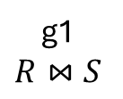
Memo
Group: Equivalent class of expressions
Join
R
S
g1
$$R⋈S$$
g2
$$R$$
g3
$$S$$
20

Slide 21
Memo
Expression: Logical or physical root operator with child groups
Join
g2 Join g3
Hash Join
g2 HJ g3
R
S
g1
$$R⋈S$$
R
S
g2
$$R$$
g3
$$S$$
21

Slide 22
Memo
Use memo to reuse derived expressions and detect duplicates
Join
g2 Join g3
Hash Join
Join
R
S
g1
$$R⋈S$$
g2 HJ g3
R
S
S
R
g3 Join g2
g3 HJ g2
g2
$$R$$
R
R
S
Hash Join
TS(R)
S
R
g3
$$S$$
S
TS(S)
Table Scan (R)
Table Scan (S)
22

Slide 23
Support a new transformation in Volcano
Example: Group-by push down
Cost: 500
Group By
Join
Group-by push down
Hash Agg
Join
R
Group By
Cost: 30
Join
Hash Join
R
S
S
R
S
R
Group By
Group By
R
S
Join
No significant change to the search algorithm!
S
R
S

Slide 24


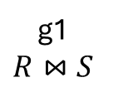
Implementation of Volcano
Generation phase
  Top-down search to generate all alternative logical expressions
Cost analysis phase
  Top-down search to find the best physical subplans
g2 Join g3
g1
$$R⋈S$$
g2 HJ g3
g3 Join g2
g3 HJ g2
g2
$$R$$
R
TS(R)
g3
$$S$$
S
TS(S)

Slide 25
Search strategy in Volcano
Two-phase derivation: explore then optimize
  Generate all logical expressions before deriving any physical subplans
Exhaustive in generating equivalent logical expressions
  Even if the search is non-exhaustive
g2 Join g3
g1
$$R⋈S$$
g2 HJ g3
g3 Join g2
g3 HJ g2
g2
$$R$$
R
TS(R)
g3
$$S$$
S
TS(S)

Slide 26
Search strategy in Volcano
Recursive depth-first search
  Derive all subplans of a child before deriving any subplan of the next child
Explore the search space region by region
  Can miss out other more promising regions if the search is not exhaustive
g2 Join g3
g1
$$R⋈S$$
g2 HJ g3
g3 Join g2
g3 HJ g2
g2
$$R$$
R
TS(R)
g3
$$S$$
S
TS(S)

Slide 27
Cascades
Similar to Volcano: Top-down search with memoization based on dynamic programming
  Rule-based transformations, memo, groups, expressions …
Goal: Explore the search space incrementally by interleaving the derivation of logical and physical expressions
Intuition: Break down the search into fine-grained tasks

Slide 28
Tasks in Cascades
Find best physical plans
Derive equivalent logical expressions
Volcano
Cost analysis phase
Generation phase
Recursive search
Optimize group
Explore group
Cascades
Iterative task scheduling using a stack
Optimize expression
Explore expression
Optimize Inputs
Apply Rule

Slide 29


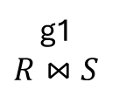
Tasks in Cascades
Optimize group
Explore group
Child
groups
ExplExpr: S
Optimize expression
Explore expression
ExplGrp: S
ExplGrp: R
Optimize Inputs
Apply Rule
ApplyRule: Join Commutativity
Memo
ExplExpr: R join S
g2 Join g3
g2
$$R$$
R
Join
ExplGrp: R join S
g1
$$R⋈S$$
R
S
S
OptGrp: R join S
g3
$$S$$
Stack of tasks

Slide 30
Tasks in Cascades
Optimize group
Explore group
Child
groups
Optimize expression
Explore expression
ExplExpr: R
ExplGrp: R
Optimize Inputs
Apply Rule
ApplyRule: Join Commutativity
Memo
ExplExpr: R join S
g2 Join g3
g2
$$R$$
R
Join
ExplGrp: R join S
g1
$$R⋈S$$
R
S
S
OptGrp: R join S
g3
$$S$$
Stack of tasks

Slide 31
Tasks in Cascades
Optimize group
Explore group
Child
groups
ExplGrp: S
Optimize expression
Explore expression
ExplGrp: R
ApplyRule: Join Commutativity
Optimize Inputs
Apply Rule
ExplExpr: S join R
Memo
ExplExpr: R join S
g2 Join g3
g2
$$R$$
R
Join
ExplGrp: R join S
g1
$$R⋈S$$
R
S
g3 Join g2
S
OptGrp: R join S
g3
$$S$$
Stack of tasks

Slide 32
Tasks in Cascades
Optimize group
Explore group
Child
groups
Optimize expression
Explore expression
Optimize Inputs
Apply Rule
ApplyRule: Join to HJ
Memo
g2 Join g3
g2
$$R$$
R
Join
OptExpr: S join R
g1
$$R⋈S$$
R
S
g3 Join g2
S
OptExpr: R join S
g3
$$S$$
Stack of tasks
g3 HJ g2

Slide 33
Tasks in Cascades
Optimize group
Explore group
Child
groups
Child
groups
Optimize expression
Explore expression
ApplyRule: S to Table Scan (S)
OptExpr: S
Optimize Inputs
Apply Rule
OptGrp: S
OptInputs: S in S HJ R
Memo
g2 Join g3
g2
$$R$$
R
Join
OptExpr: S join R
g1
$$R⋈S$$
R
S
g3 Join g2
S
OptExpr: R join S
g3
$$S$$
Stack of tasks
g3 HJ g2
TS(S)

Slide 34
Tasks in Cascades
Optimize group
Explore group
Child
groups
Child
groups
Optimize expression
Explore expression
ApplyRule: R to Table Scan (R)
OptExpr: R
Optimize Inputs
Apply Rule
OptGrp: R
OptInputs: R in S HJ R
Memo
g2 Join g3
g2
$$R$$
R
Join
TS(R)
OptExpr: S join R
g1
$$R⋈S$$
R
S
g3 Join g2
S
OptExpr: R join S
g3
$$S$$
Stack of tasks
g3 HJ g2
TS(S)

Slide 35
Why Cascades?
Optimize group
Explore group
Child
groups
Child
groups
Optimize expression
Explore expression
Optimize Inputs
Apply Rule
Interleaved derivation of logical and physical expressions!
// Unfortunately need a bigger example to demonstrate this (see the book)

Slide 36
Why Cascades?
Optimize group
Explore group
Child
groups
Parallel tasks!
Optimize expression
Explore expression
ExplGrp: S
ExplGrp: R
Optimize Inputs
Apply Rule
ApplyRule: Join Commutativity
Memo
ExplExpr: R join S
g2 Join g3
g2
$$R$$
R
Join
ExplGrp: R join S
g1
$$R⋈S$$
R
S
S
OptGrp: R join S
g3
$$S$$
Stack of tasks

Slide 37
Exercising extensibility
Add new transformation rules
  Already covered
Add new operators
  Example: outer join operator
Hash Join (outer)
Cost model
Cardinality estimation
Cost function
Outer Join
Outer Join to Hash Join
Outer Join
T1
T2
T1
T2
Other rules
Redundancy (in the book)
Merge join
Logical operator
Implementation rule

Slide 38
Exercising extensibility: Distributed query processing
Large scale data analytics need to scale to multiple nodes
Data needs to be distributed in a way to ensure the correctness of the join result
  Example: Both R and S are partitioned by the join column
Hash Join
Hash Join
Hash Join
R
S
R1
S1
R2
S2

Slide 39
Exercising extensibility: Distributed query processing
Extend the physical properties to include data distribution
Add a new enforcer
Add a new enforcer rule
New costing for enforcer
Hash Join
R, Hash(R.a)
S, Hash(S.a)
Shuffle by Hash(S.a)
New enforcer
Partitioned Table Scan(R), Hash(R.a)
Partitioned Table Scan(S), RoundRobin

Slide 40
Additional techniques to control on search
For database developers who want more control of the search
Customize search strategy
  Promise
  Guidance
Improve search efficiency
  Simplification rules
  Macro rules
  Multi-stage query optimization

Slide 41
Customize search: promise
For a given expression, some rules are more likely to lead to good plans than others
Promise: a score assigned to an expression and a rule for task prioritization to help the optimizer find good plans early in the search
Join
Hash Join
Join
Preferred if S is the smaller table!
R
S
R
S
S
R

Slide 42
Customize search: guidance
Goal: Scope the search space with heuristics
Reduce the overhead of duplicate derivation (sound)
  Join commutativity is disactivated after it is applied to an expression
Trim the search space (heuristic)
  No cross product
Join
Join
Join
R
S
S
R
R
S
Duplicate derivation!

Slide 43
Improve search efficiency: simplification rules
Some rules almost always lead to better plan
  Remove duplicate predicates
  Coalesce subqueries
Instead of deriving an alternative, replace the original expression

Slide 44
Improve search efficiency: macro rules
Join
Desirable
Intuition: Certain plan shapes are promising based on heuristics
Example: Star queries
  Join dimension tables from the most selective to the least selective
Challenge: It can take many transformations to derive the desirable plan shape
D1
Join
D2
Join
D3
F
Join
D2
Join
D3
Join
Original
D1
F

Slide 45
Improve search efficiency: macro rules
Join
Desirable
Macro rules: Dramatically change plan shape in one transformation
Ensure the optimizer to explore good plan shapes early in the search
  Cost-based pruning
  Non-exhaustive search
D1
Join
D2
Join
D3
F
Join
D2
Join
D3
Join
Original
D1
F

Slide 46
Improve search efficiency: multi-stage query optimization
Goal: Incrementally explore the search space with more complex transformations
  Quickly get a good plan for simple queries
  Progressively improve the plan quality if time permits
Multi-stage query optimization: Incrementally enable a larger set of rules in query optimization
  Implemented with guidance
  Memo is shared across the stages

Slide 47
Summary
Basics for query optimization
  System R: Dynamic programming and interesting orders
Extensible query optimization frameworks: Volcano and Cascades
  Top-down search with memoization
Examples to exercise the extensibility
Mechanisms to customize search strategy
Techniques to improve search efficiency
Check out our book for other important topics in query optimization!
Contact: Bailu Ding
bailuding@gmail.com

